Slide 1
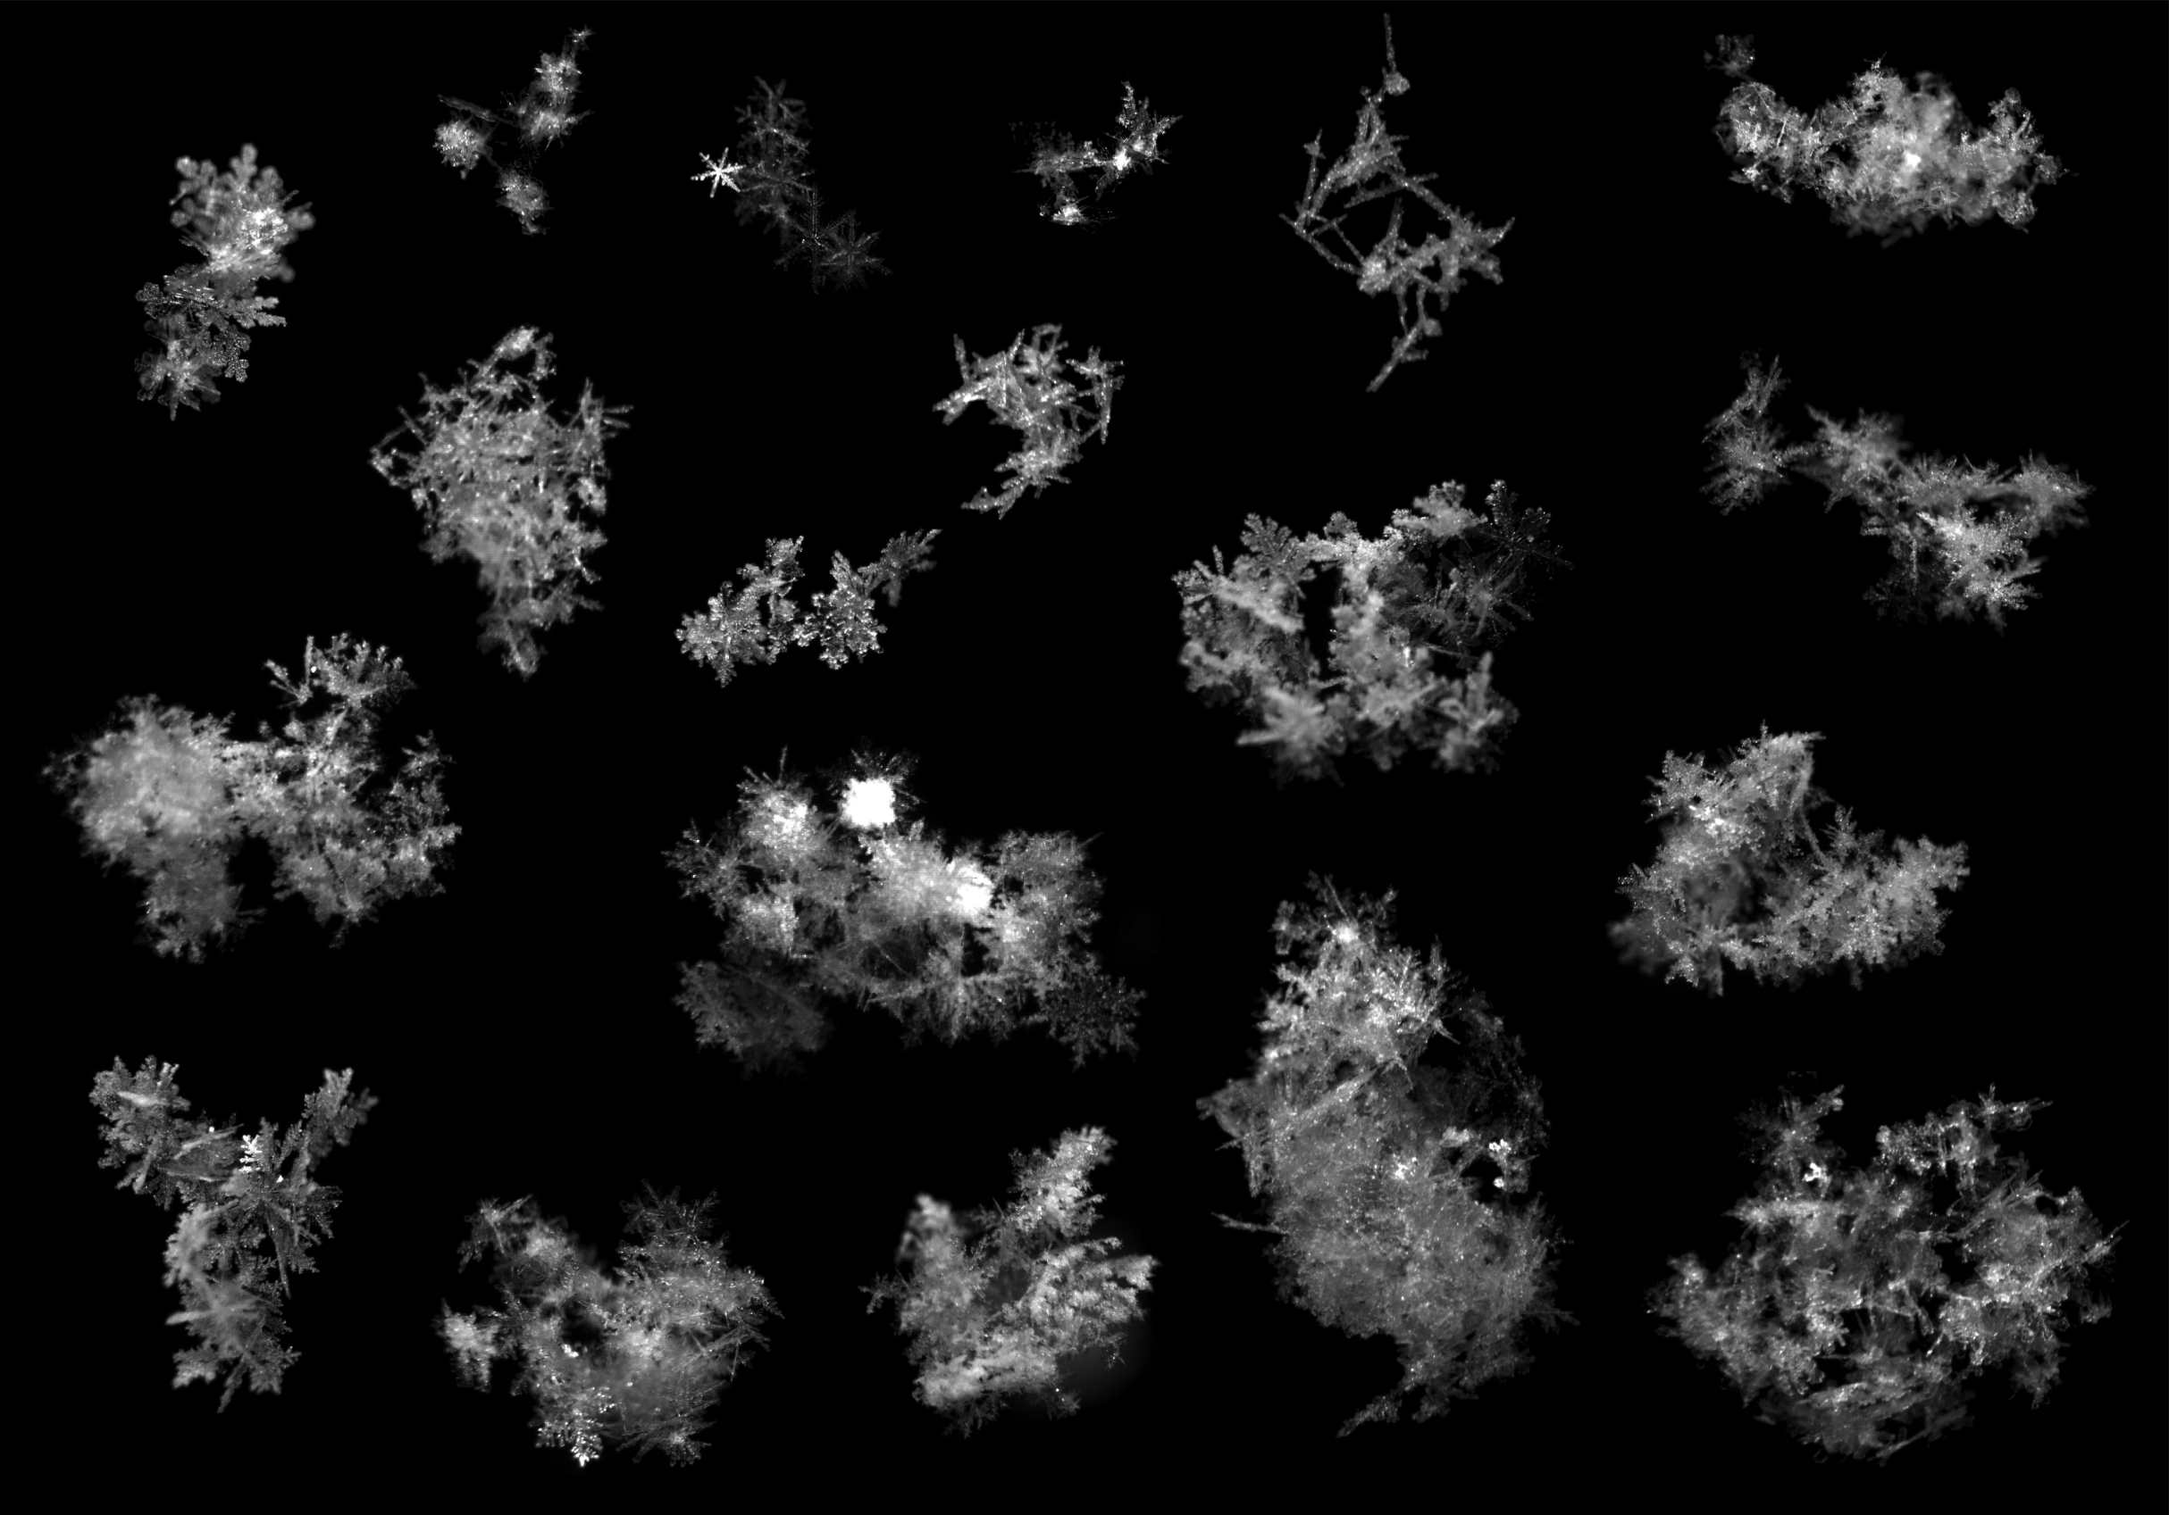
Equation for the microwave backscatter cross section of aggregate snowflakes using the Self-Similar Rayleigh-Gans Approximation
Robin Hogan
ECMWF and Department of Meteorology, University of Reading
Chris Westbrook
Department of Meteorology, University of Reading
Images from Tim Garrett, University of Utah

Slide 2
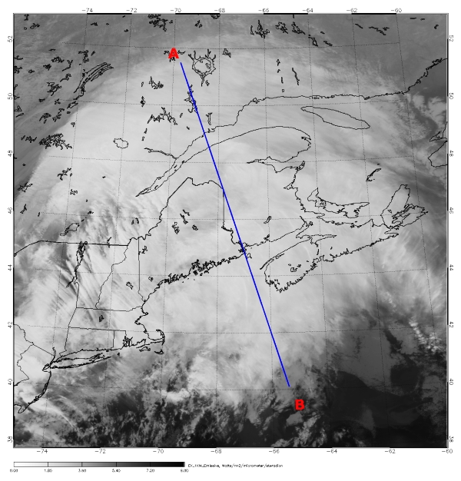
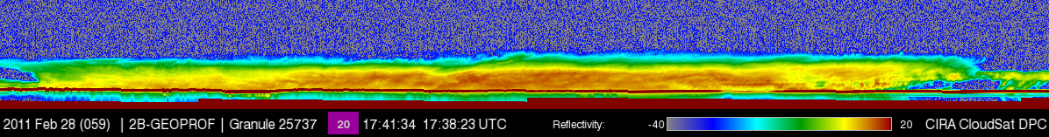
Motivation
Global snowfall rates very uncertain, both snow at the surface and above a melting layer
Space-borne 94-GHz radar potentially the best instrument we have
But backscatter cross-section of snowflakes very uncertain for D > λ
Global-mean IWP estimates dominated by deep clouds where retrievals are most uncertain
Snowstorm 28 Feb 2011: 20 cm of snow fell in New Brunswick

Slide 3
Overview
At cm wavelengths: D < λ
  Rayleigh theory applies: radar reflectivity proportional to mass squared
  Snowfall rates sensitive to mass-size and fallspeed-size assumptions
At mm wavelengths: D > λ
  Particle shape important in addition to mass
  Matrosov et al (2005), Hogan et al. (2012): large ice particles can be represented by homogeneous oblate (“soft”) spheroids with aspect ratio 0.6: characterize shape only by dimension in direction of propagation
  Petty & Huang (2010), Tyynelä et al. (2011): soft spheroids underestimate backscatter: need to represent exact shape
Who’s right?
  Is brute-force computation the only way (e.g. Discrete Dipole Approximation with thousands of snowflake shapes)?
This talk: an equation can be derived for cross-section because
  Snowflakes have fractal structure that can be described statistically
  The Rayleigh-Gans approximation is applicable

Slide 4
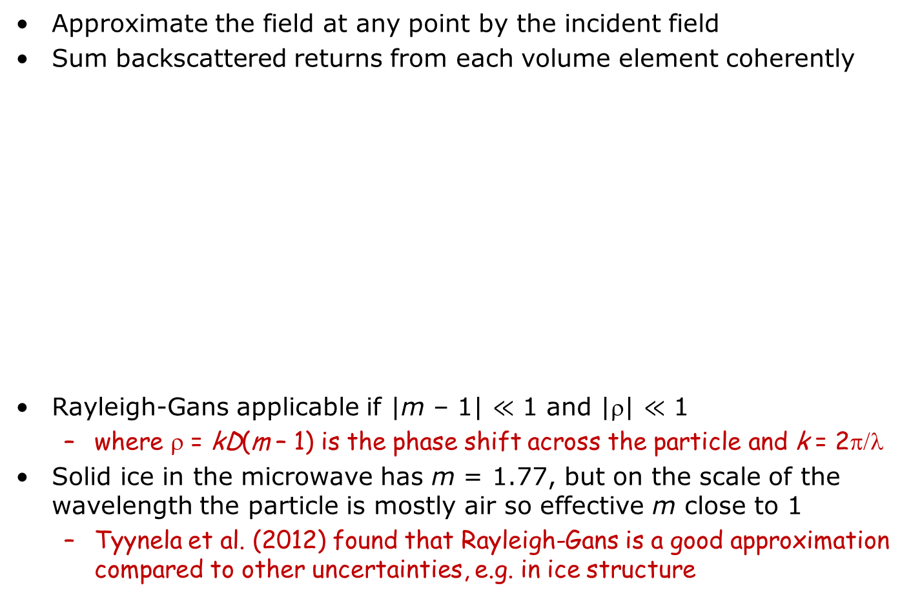
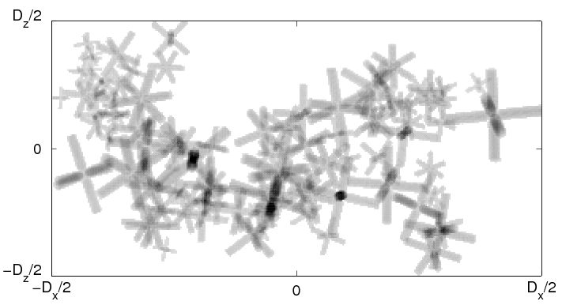
The Rayleigh-Gans approximation
Aggregate from Westbrook et al. (2004) model
Backscatter depends only on A(s) function and dielectric constant ε (or refractive index m = ε^{1/2})
Distance s
Area A(s)

Slide 5
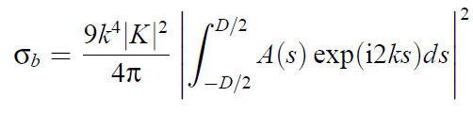
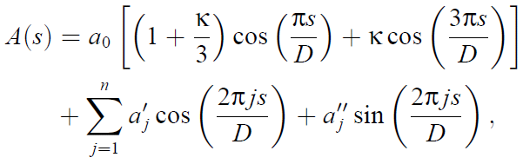

The Rayleigh-Gans approximation
Backscatter cross-section is proportional to the power in the Fourier component of A(s) at the scale of half the wavelength
Can we parameterize A(s) and its variation?
where and V is the volume of ice in the particle
Mean structure, κ = kurtosis parameter
Fluctuations from the mean

Slide 6
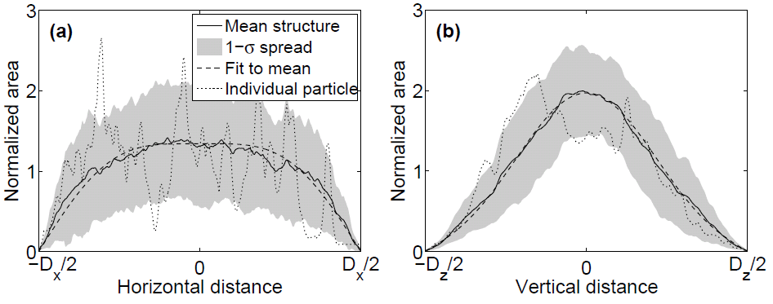
Mean structure of aggregate snowflake
Hydrodynamic forces cause ice particles to fall horizontally, so we need separate analysis for horizontally and vertically viewing radar
Mean structure of 50 simulated aggregates of bullet rosettes is very well captured by the two-cosine model with kurtosis parameters of
  κ = –0.11 for horizontal structure
  κ = 0.19 for vertical structure
Slightly different numbers for aggregates of other monomer crystals

Slide 7
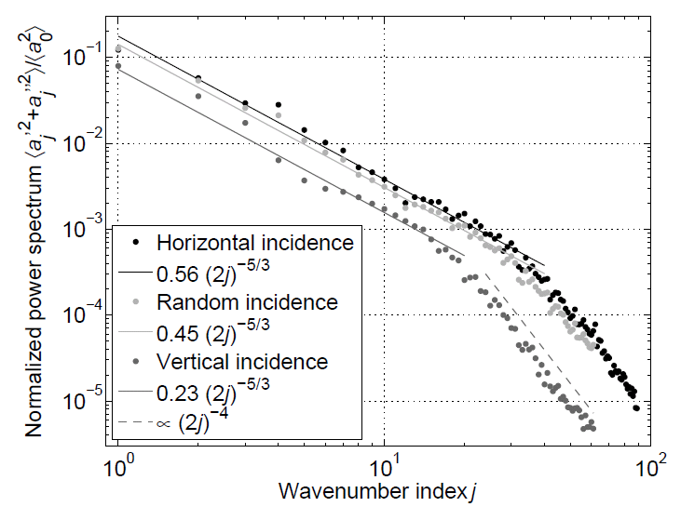
Aggregate self-similar structure
Power spectrum of fluctuations obeys a -5/3 power law
  Why the Kolmogorov value when no turbulence involved? Coincidence?
  Aggregates of columns and plates show the same slope
Aggregates of bullet rosettes
Aggregate structure: -5/3
Solid ice: -4
(Physical scale: D/j )

Slide 8
New equation for backscatter
Assumptions:
  Power-law:
  Fluctuations at different scales are uncorrelated:
  Sins and cosine terms at the same scale are uncorrelated:
Leads to the Self-Similar Rayleigh-Gans approximation for ensemble-mean backscatter cross-section:
  where
The {} term describes only the effect of the shape of the particle; the total volume of ice (i.e. the mass) is described only by V
  For small particles the {} term reduces to 4/π², yielding the Rayleigh approximation
Hogan and Westbrook (JAS 2014, in press)

Slide 9
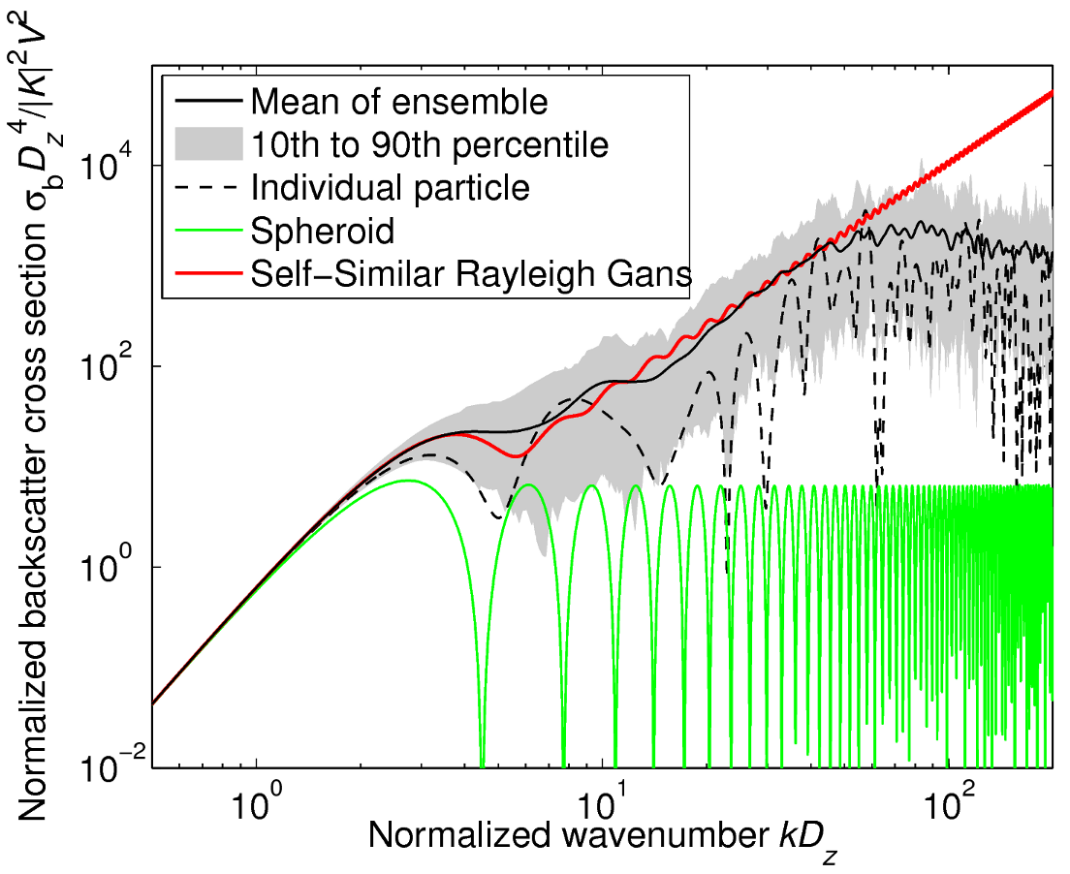
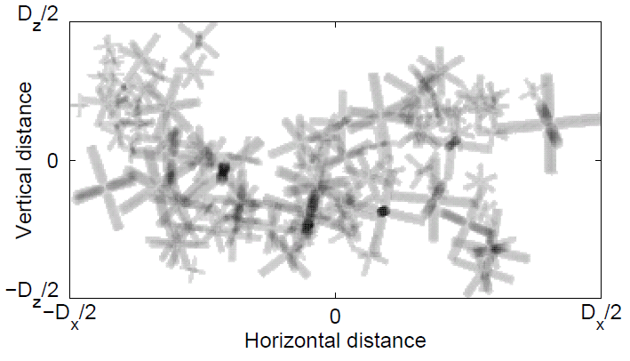
Radar scattering by ice
1 mm ice
1 cm snow
Realistic snowflakes
“Soft spheroids”
Internal structures on scale of wavelength lead to significantly higher backscatter than “soft spheroids” (proposed by Hogan et al. 2012)
The new SSRG equation matches the ensemble-mean well

Slide 10
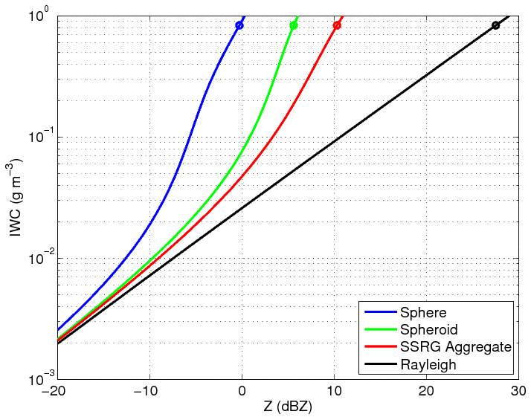
Impact of scattering model
4.5 dB
Factor of 5 error
Field et al. (2005) size distributions at 0°C
Circles indicate D₀ of 7 mm reported from aircraft (Heymsfield et al. 2008)
Lawson et al. (1998) reported D₀=37 mm: 17 dB difference
Ice water content (g m⁻³)
Radar reflectivity factor (dBZ)

Slide 11
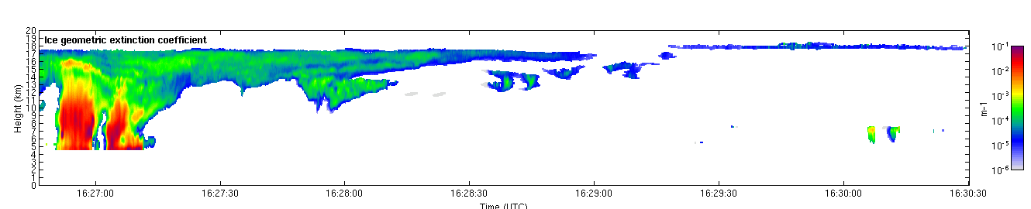
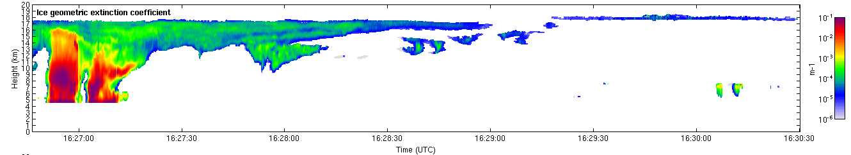
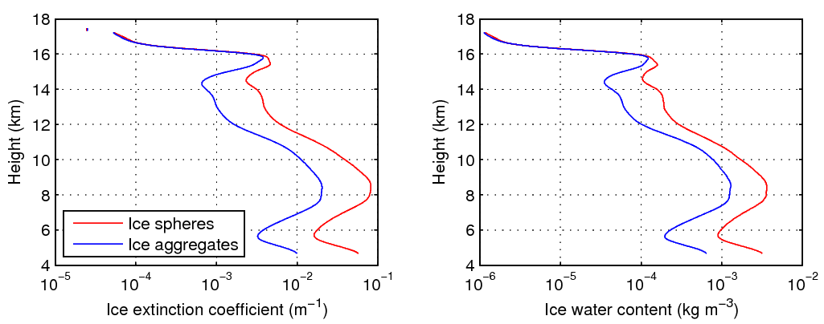
Example of impact on IWC retrievals
Ice aggregates
Ice spheres
Spheres can lead to overestimate of water content and extinction of factor of 3
All 94-GHz radar retrievals affected in same way

Slide 12
Summary
A new “Self-Similar Rayleigh Gans” equation has been proposed for backscatter cross-section of ice aggregates observed by radar
  Far less computationally costly than DDA
  The effects of shape and mass on backscattering are cleanly separated
  Could also be applied to light scattering by some aerosol aggregates
New equation predicts much higher 94-GHz backscatter for D > λ than the “soft spheroid” model, which only works for D < λ
  Use of soft spheroids in 94-GHz radar retrievals can lead to factor 3-5 error in IWC and snowfall rate in thick cloud and snow
Remaining uncertainties in ice/snow retrievals
  Mass-size relationship: riming increases density but EarthCARE’s Doppler will help
  Aspect ratio: difference between 0.6 and 0.45 around the same as difference between soft-spheroids and realistic particles
  Fallspeed relationship: improved with Heymsfield & Westbrook (2010)
Aggregate structure exhibits a power law with a slope of -5/3: why?
Hogan and Westbrook (JAS 2014, in press)

