Slide 1
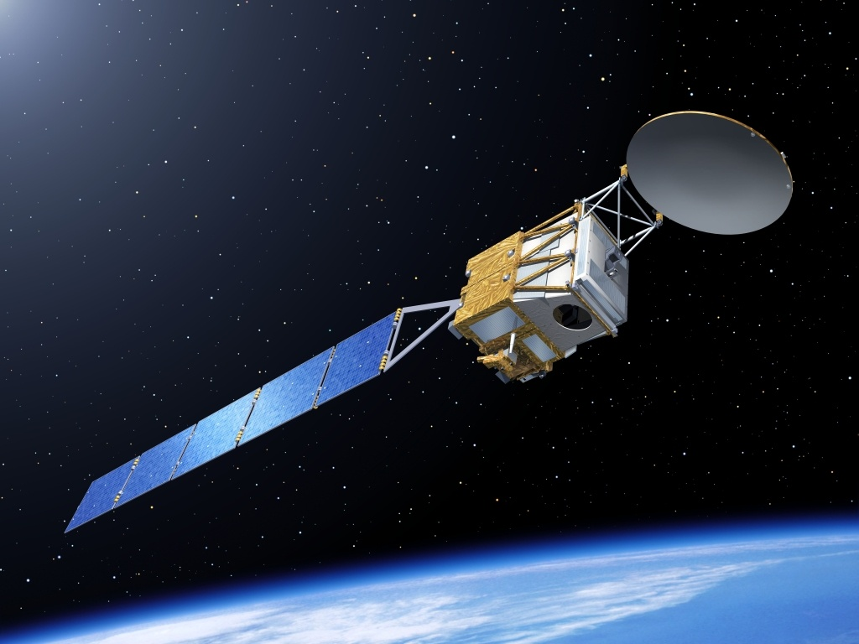
EarthCARE and snow
Robin Hogan, Chris Westbrook
University of Reading
Pavlos Kollias
McGill University
6 May 2013

Slide 2
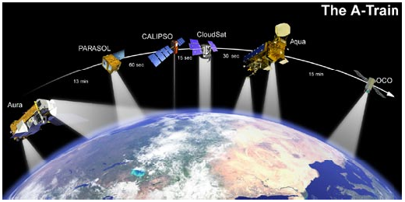
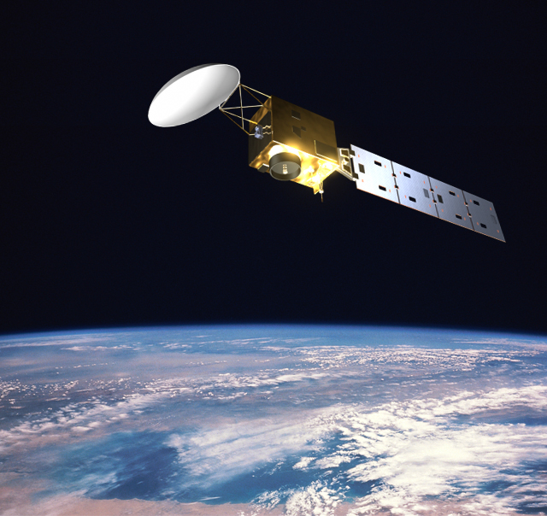
Spaceborne radar, lidar and radiometers
EarthCare
The A-Train (fully launched 2006)
  NASA
  700-km orbit
  CloudSat 94-GHz radar
  Calipso 532/1064-nm depol. lidar
  MODIS multi-wavelength radiometer
  CERES broad-band radiometer
  AMSR-E microwave radiometer
EarthCARE (launch 2016)
  ESA+JAXA
  400-km orbit: more sensitive
  94-GHz Doppler radar
  355-nm HSRL/depol. lidar
  Multispectral imager
  Broad-band radiometer
  Heart-warming name

Slide 3
Overview
Introduction to unified retrieval algorithm (in development!)
  What will EarthCARE data look like?
  Quantification and correction of Doppler errors
What are the issues in extending algorithm to riming/unriming snow?
  What’s the difference between ice cloud and snow?
  How do we validate particle scattering models using real data?
  Can we exploit EarthCARE’s Doppler to retrieve riming snow?
  Your advice would be much appreciated!
Preliminary simulation of a retrieval of riming snow
Outlook

Slide 4
Unified retrieval
1. Define state variables to be retrieved
Use classification to specify variables describing each species at each gate
Ice and snow: extinction coefficient, N₀’, lidar ratio, riming factor
Liquid: extinction coefficient and number concentration
Rain: rain rate, drop diameter and melting ice
Aerosol: extinction coefficient, particle size and lidar ratio
Ingredients developed
Not yet developed
2. Forward model
2a. Radar model
With surface return and multiple scattering
2b. Lidar model
Including HSRL channels and multiple scattering
2c. Radiance model
Solar & IR channels
4. Iteration method
Derive a new state vector: Gauss-Newton or quasi-Newton scheme
3. Compare to observations
Check for convergence
Not converged
Converged
5. Calculate retrieval error
Error covariances & averaging kernel
Proceed to next ray of data

Slide 5
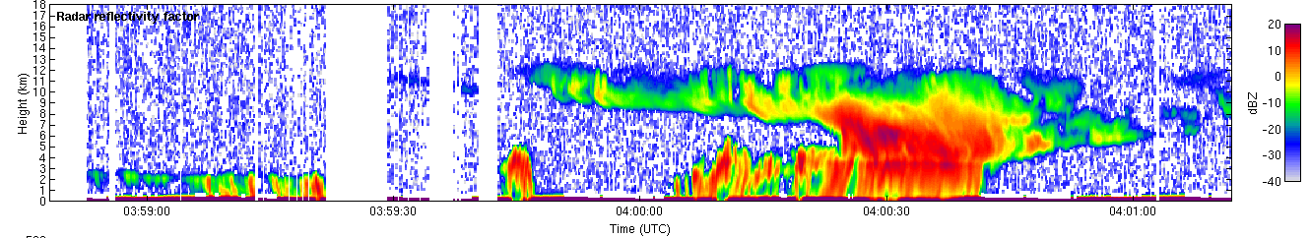
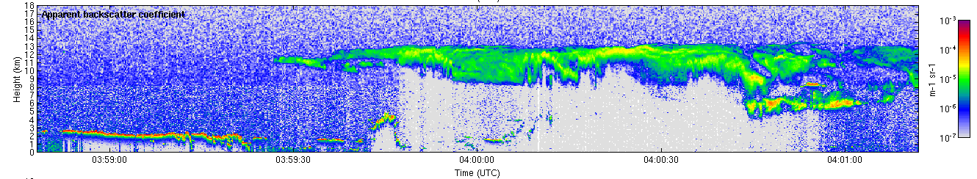
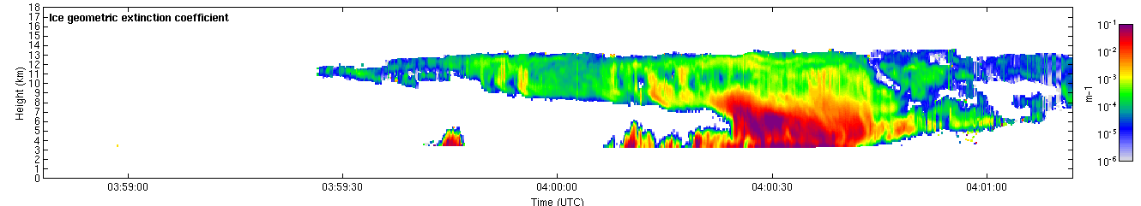
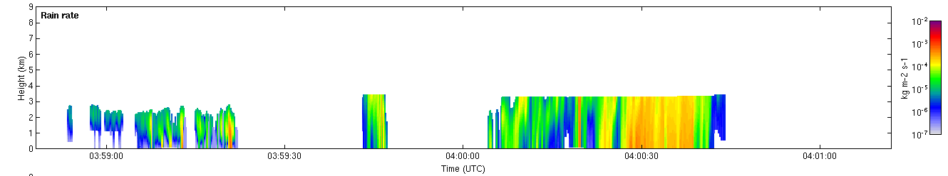
CloudSat
Calipso
Unified retrieval of cloud +precip …then simulate EarthCARE instruments
Unified retrieval algorithm
Ice extinction coefficient
Rain rate

Slide 6
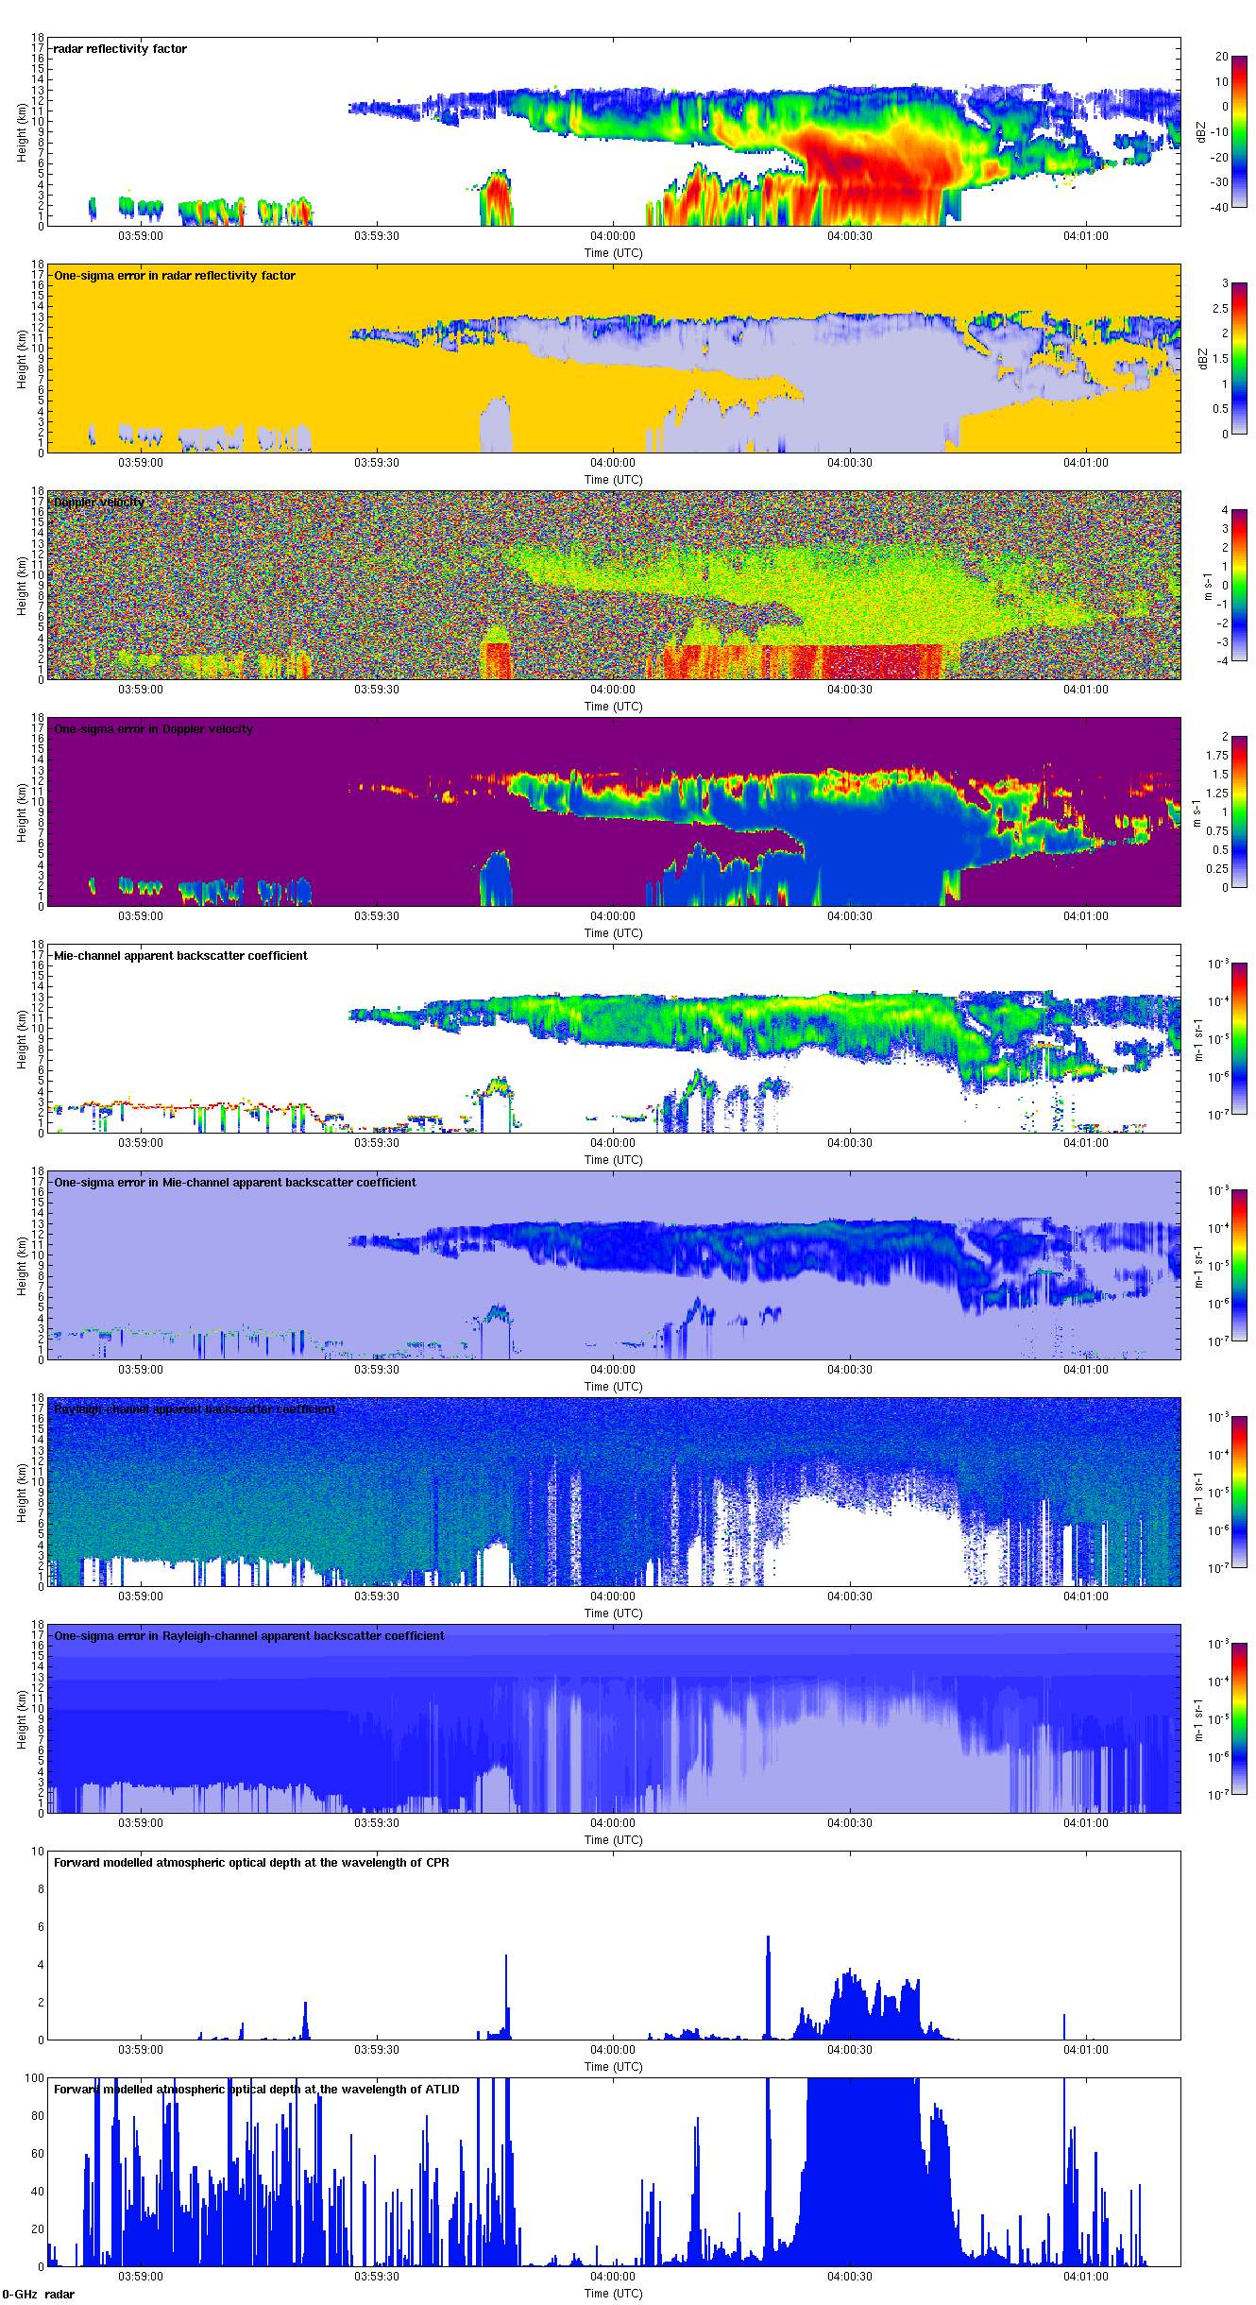
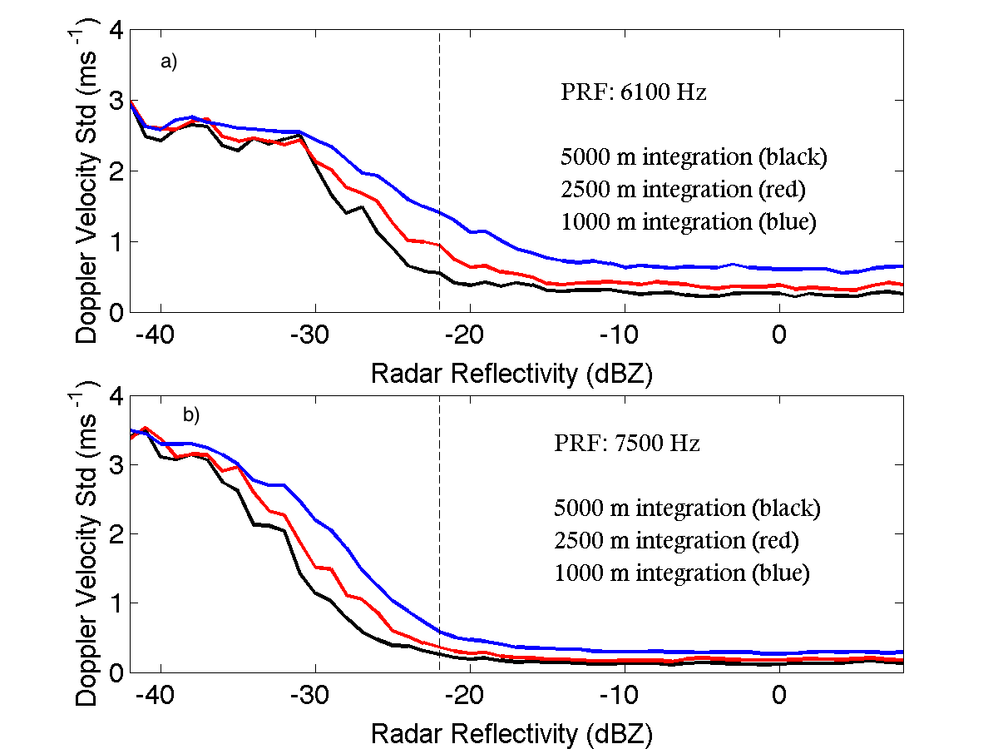
CloudSat
EarthCARE Z
Note higher radar sensitivity
EarthCARE Doppler
Pavlos Kollias
Worst case error in Tropics (lowest PRF) due to satellite motion, finite sampling, SNR conditions
But no riming, non-uniform beam-filling or vertical air motion!

Slide 7
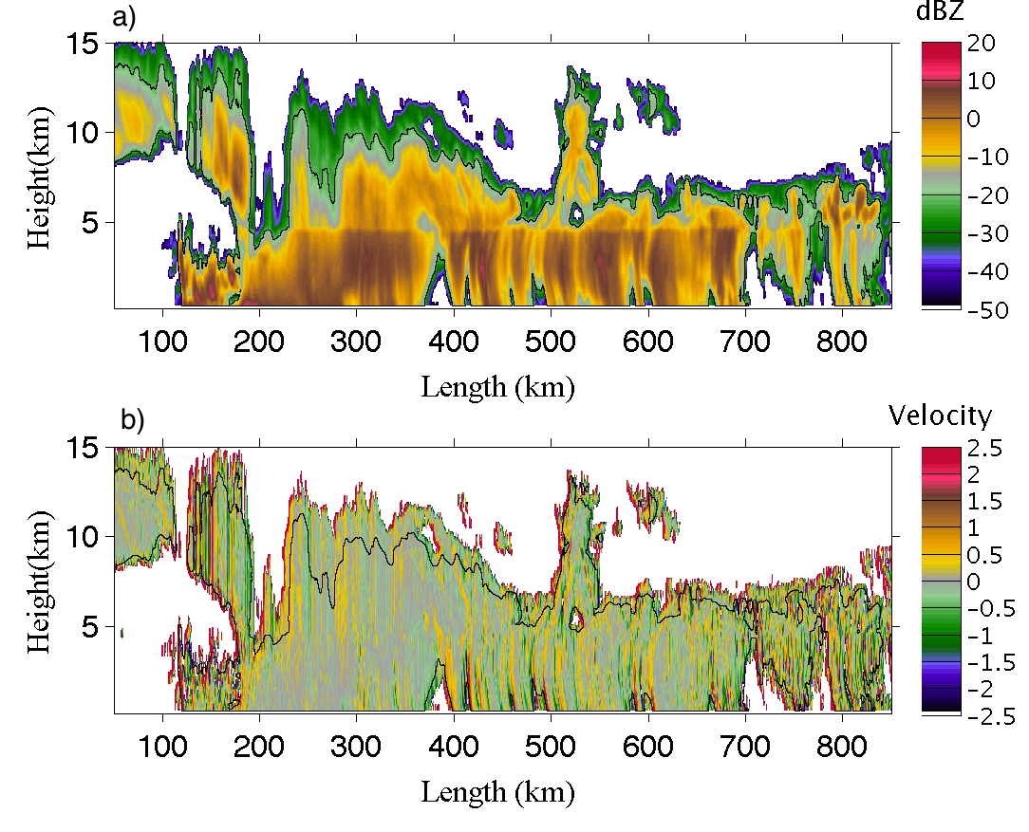
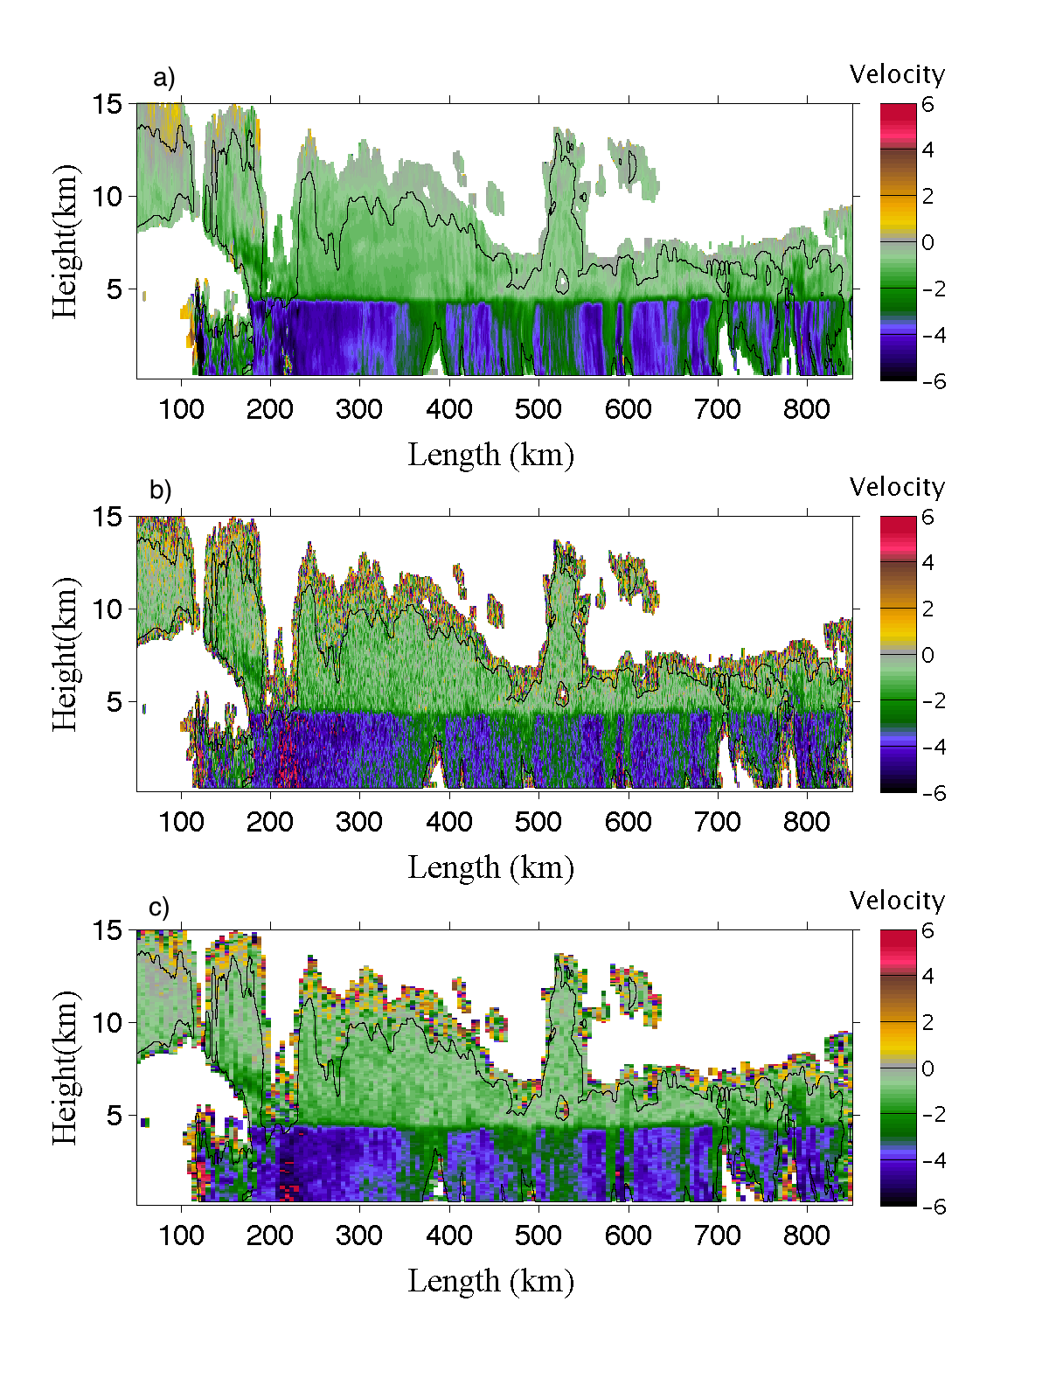
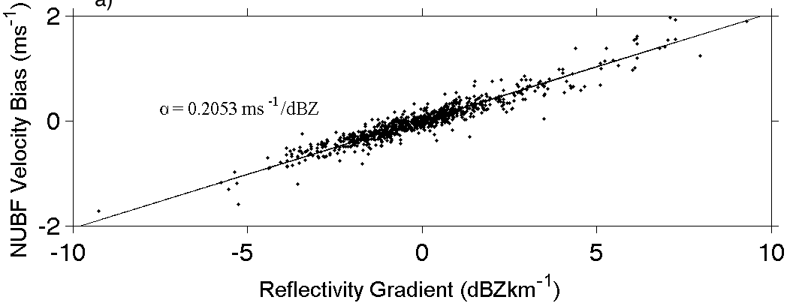
Correcting for non-uniform beam filling
Non-uniform beam filling error …with correction using gradient of Z
Pavlos Kollias

Slide 8
Calipso
Calipso backscatter
EarthCARE lidar: Mie channel
EarthCARE lidar: Rayleigh channel
Warning: zero cross-talk assumed!

Slide 9
What’s the difference between ice cloud & snow?
They’re separate variables in GCMs – should they be separate in retrievals?
Snow falls, ice doesn’t (as in many GCMs)?
  No! All ice clouds are precipitating
Aggregation versus pristine?
  Not really: even cold ice clouds dominated by aggregates (exception: top ~500 m of cloud and rapid deposition in presence of supercooled water)
  Stickiness may increase when warmer than -5°C, but very uncertain
Bigger particles?
  Sure, but we retrieve particle size so that’s covered
But I’ve seen bimodal spectra in ice clouds, e.g. Field (2000)!
  Delanoe et al. (2005) showed that the modes are strongly coupled, and could be fitted by a single two-parameter function
Riming?
  Some snow is rimed, so need to retrieve some kind of riming factor
Conclusion: we should be able to treat ice cloud and snow as a continuum in retrievals…

Slide 10
Prior information about size distribution
Radar+lidar enables us to retrieve two variables: extinction α and N₀* (a generalized intercept parameter of the size distribution)
When lidar completely attenuated, N₀* blends back to temperature-dependent a-priori and behaviour then similar to radar-only retrieval
  Aircraft obs show decrease of N₀* towards warmer temperatures T
  (Acually retrieve N₀*/α^{0.6} because varies with T independent of IWC)
  Trend could be because of aggregation, or reduced ice nuclei at warmer temperatures
  But what happens in snow where aggregation could be much more rapid?
Delanoe and Hogan (2008)

Slide 11
How complex must scattering models be?
“Soft sphere” described by appropriate mass-size relationship
  Good agreement between aircraft & 10-cm radar using Brown & Francis mass-size relationship (Hogan et al. 2006)
  Poorer for millimeter wavelengths (Petty & Huang 2010)
  In ice clouds, 94 GHz underestimated by around 4 dB (Matrosov and Heymsfield 2008, Hogan et al. 2012) -> poor IWC retrievals
Horizontally oriented “soft spheroid” of aspect ratio 0.6
  Aspect ratio supported for ice clouds by aggregation models (Westbrook et al. 2004) & aircraft (Korolev & Isaac 2003)
  Supported by dual-wavelength radar (Matrosov et al. 2005) and differential reflectivity (Hogan et al. 2012) for size <= wavelength
  Tyynela et al. (2011) calculations suggested this model significantly underestimated backscatter for sizes larger than the wavelength
  Leinonen et al. (2012) came to the same conclusions in half of their 3- wavelength radar data (soft spheroids were OK in the other half)
Realistic snow particles and DDA (or similar) scattering code
  Assumptions on morphology need verification using real measurements

Slide 12
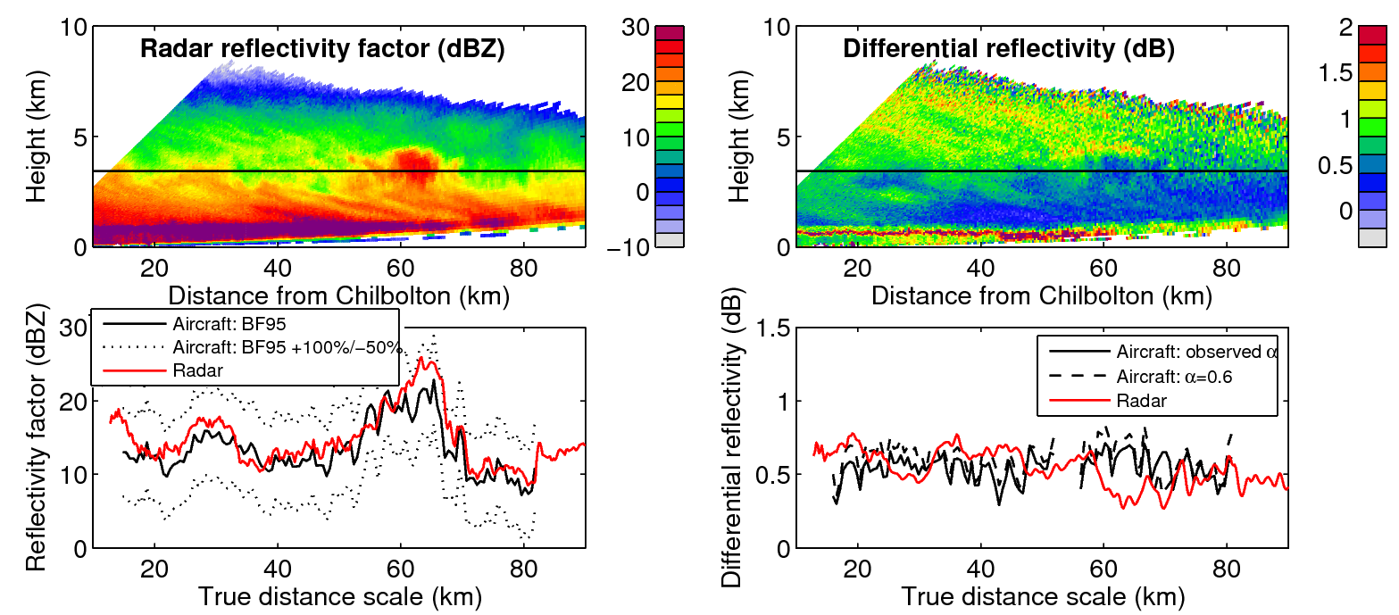
Chilbolton 10-cm radar + UK aircraft
21 Nov 2000
Z agrees, supporting Brown & Francis (1995) relationship (SI units)
  mass = 0.0185D_{mean}^{1.9} = 0.0121D_{max}^{1.9}
Differential reflectivity agrees reasonably well for oblate spheroids of aspect ratio α=0.6
Hogan et al. (2012)

Slide 13
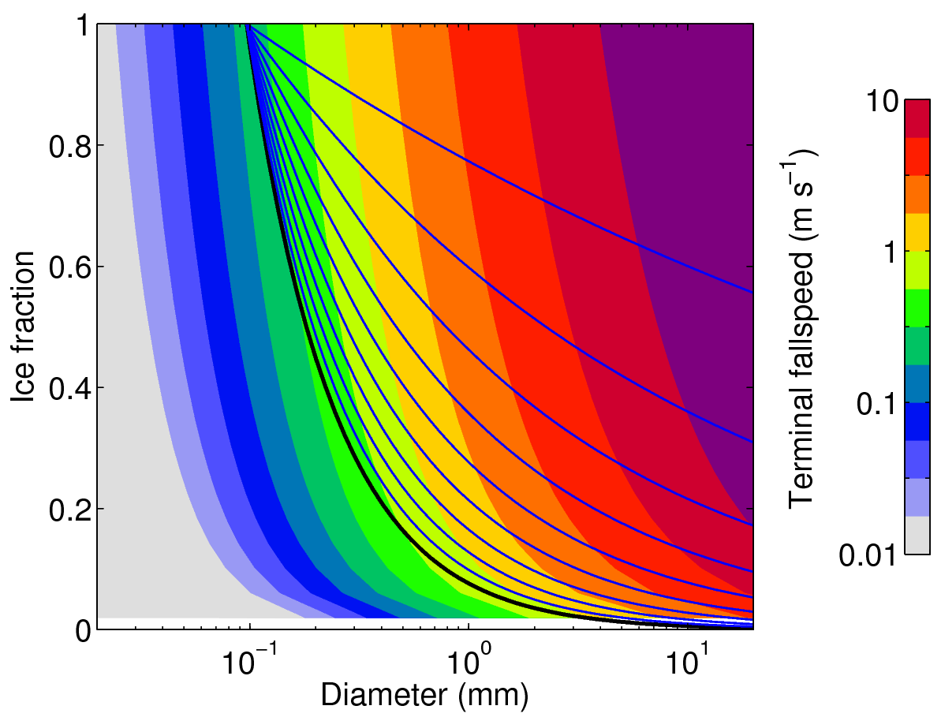
Extending ice retrievals to riming snow
Heymsfield & Westbrook (2010) fall speed vs. mass, size & area
Brown & Francis (1995) ice never falls faster than 1 m/s
Retrieve a riming factor (0-1) which scales b in mass=aD^{b} between 1.9 (Brown & Francis) and 3 (solid ice)
0.9
0.8
0.7
0.6
Brown & Francis (1995)

Slide 14
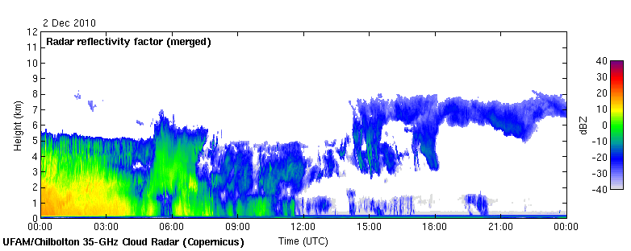
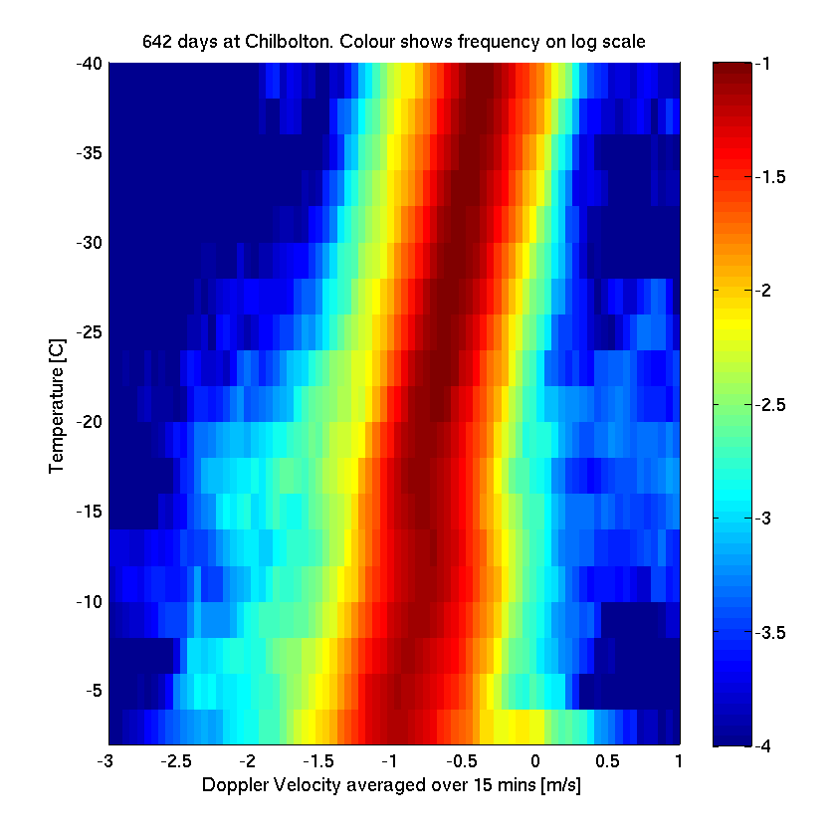
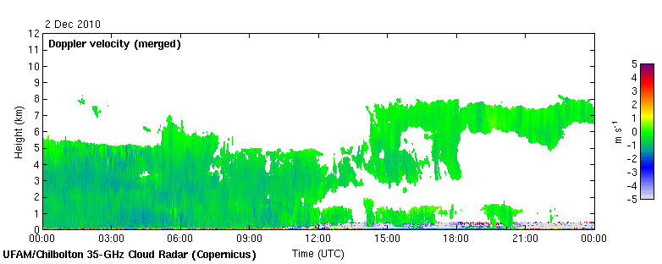
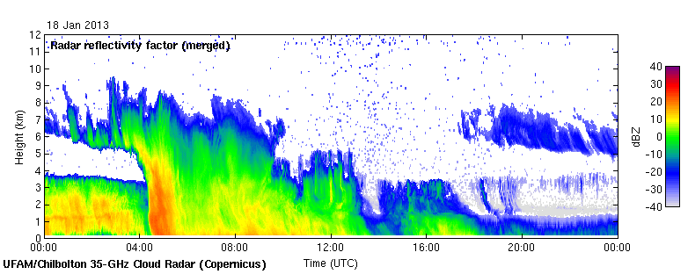
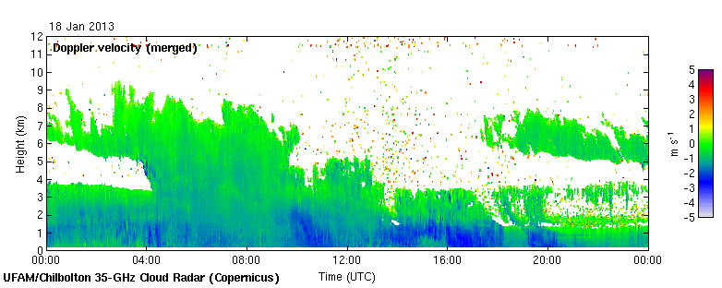
Examples of snow
35 GHz radar at Chilbolton
1 m/s: no riming or very weak
2-3 m/s: riming?
PDF of 15-min-averaged Doppler in snow and ice (usually above a melting layer)

Slide 15
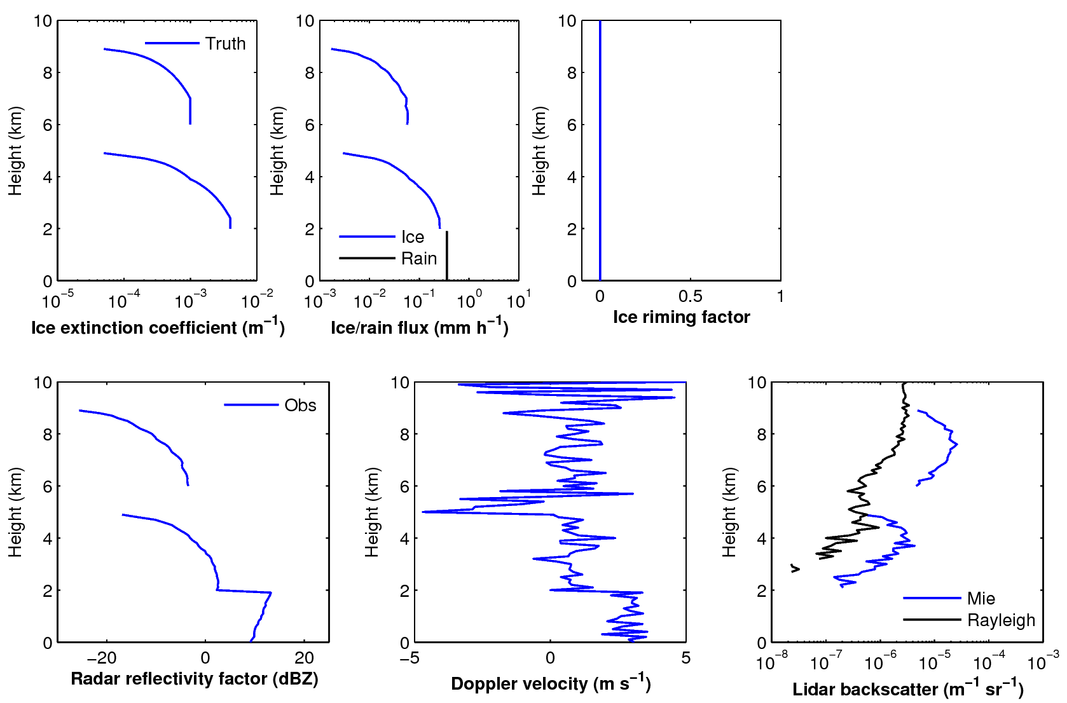
Simulated observations – no riming

Slide 16
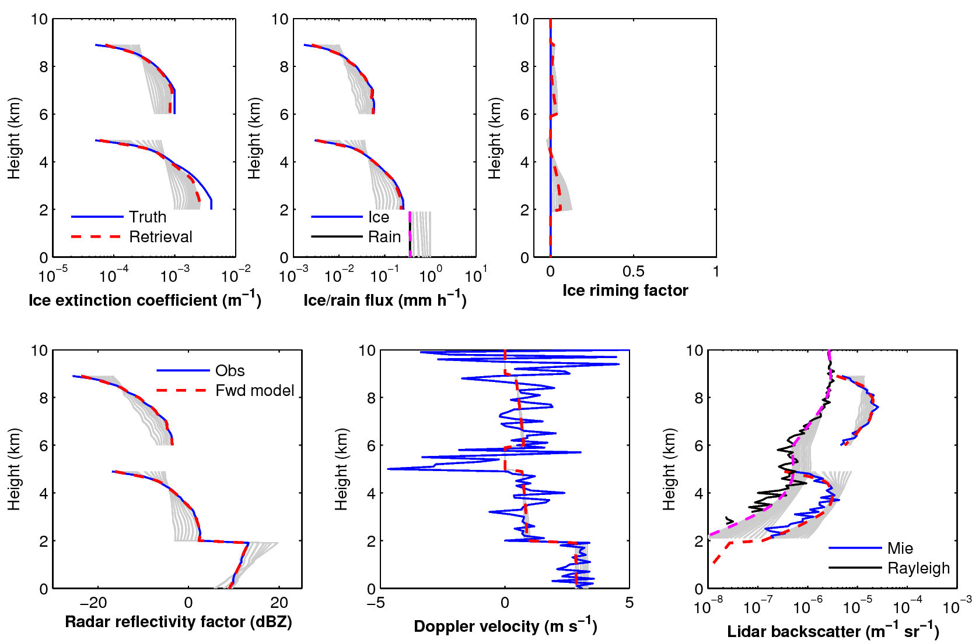
Simulated retrievals – no riming

Slide 17
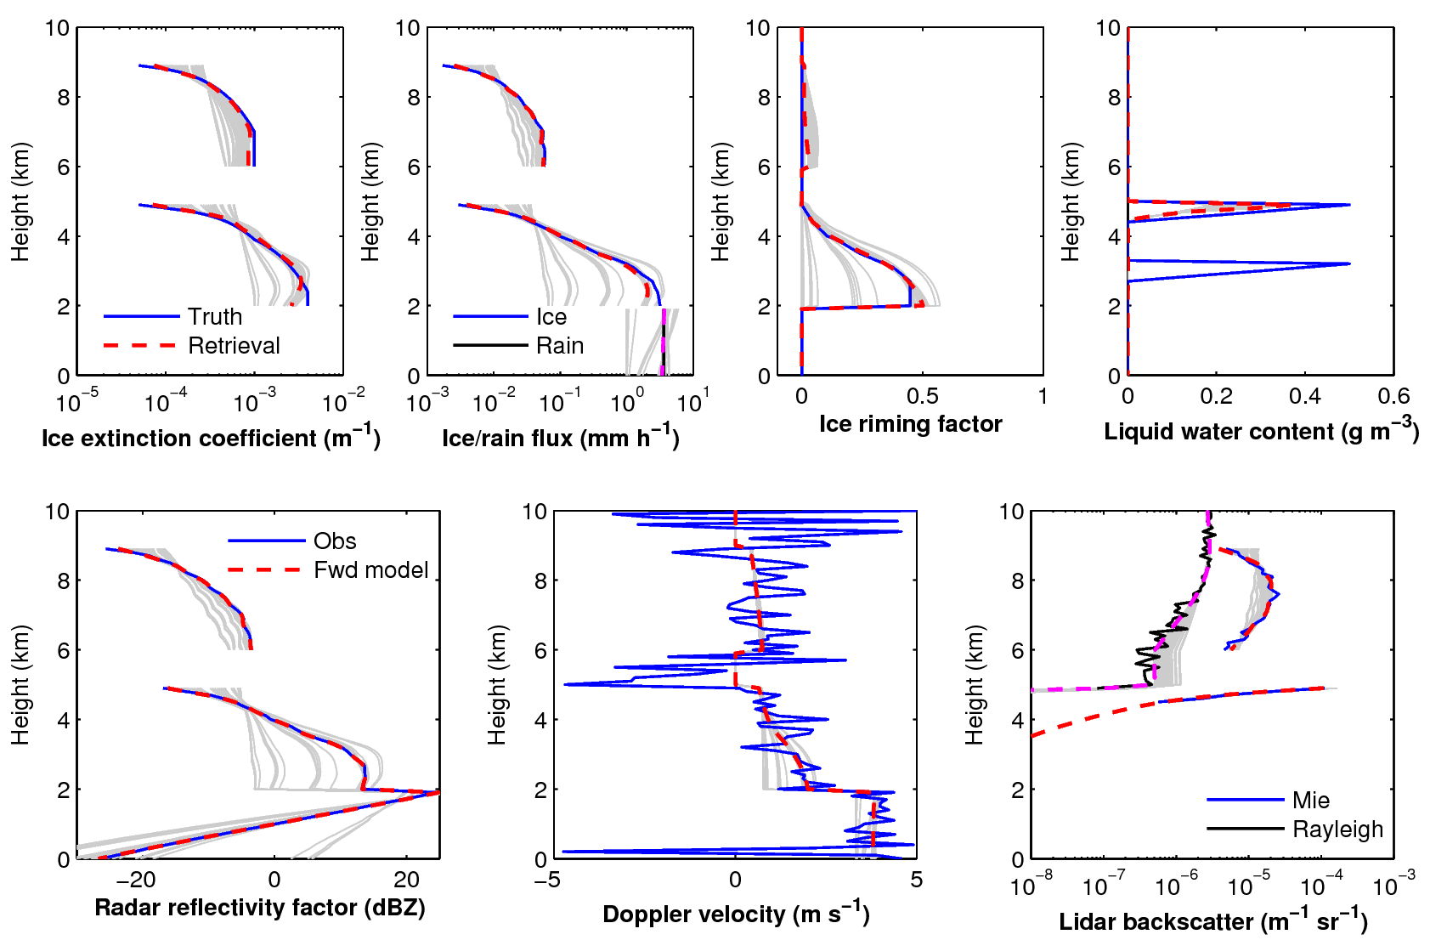
Simulated retrievals – riming

Slide 18
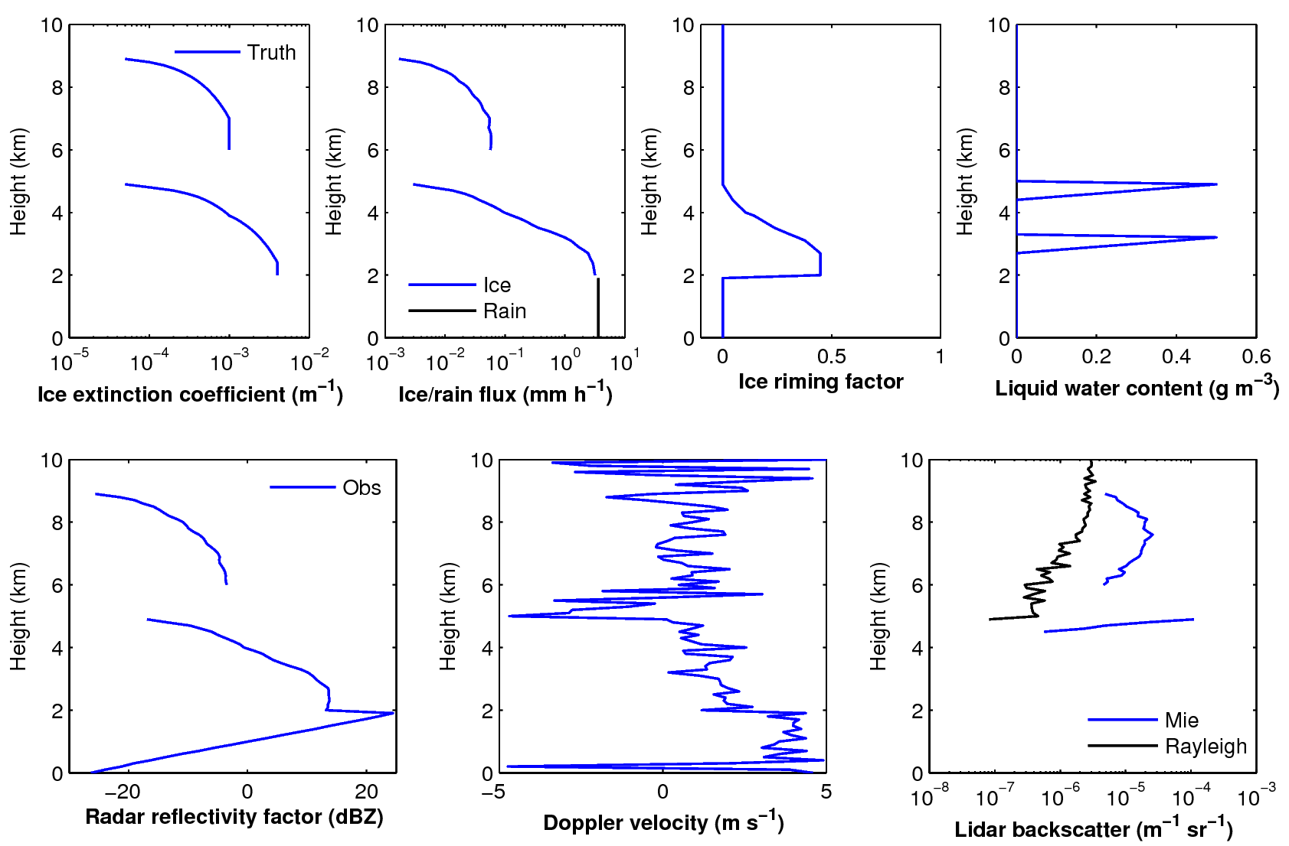
Simulated observations – riming

Slide 19
Outlook
EarthCARE Doppler radar offers interesting possibilities for retrieving rimed particles in cases without significant vertical motion
  Need to first have cleaned up non-uniform beam-filling effects
  Retrieval development at the stage of testing ideas; validation required!
As with all 94-GHz retrievals, potentially sensitive to scattering model
  In ice clouds at temperatures < –10°C, aircraft-radar comparisons of Z, DWR and ZDR support use of “soft spheroids” with Brown & Francis (1995) mass-size relationship and an aspect ratio of 0.6 (size <~ wavelength)
  No reason we can’t do the same experiments with larger snow particles, particularly for elevated snow above a melting layer (assuming it behaves the same…)
Numerous other unknowns
  In ice cloud we have good temperature-dependent prior for number concentration parameter “N₀*”: what should this be for snow?
  How can we get a handle on the supercooled liquid content in deep ice & snow clouds, even just a reasonable a-priori assumption?

Slide 21
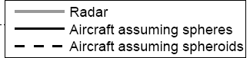
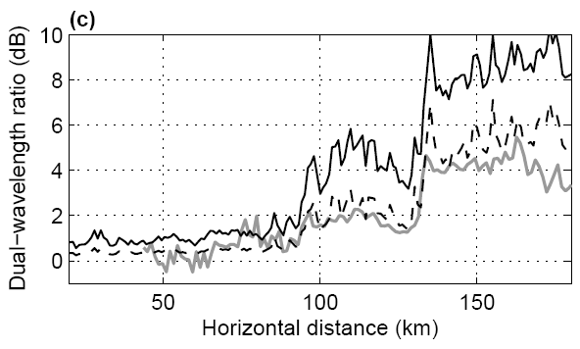
Test with dual-wavelength aircraft data
  Sphere produces ~5 dB error (factor of 3)
  Spheroid approximation matches Rayleigh reflectivity (mass is about right) and non-Rayleigh reflectivity (shape is about right)
Hogan et al. (2011)

Slide 22
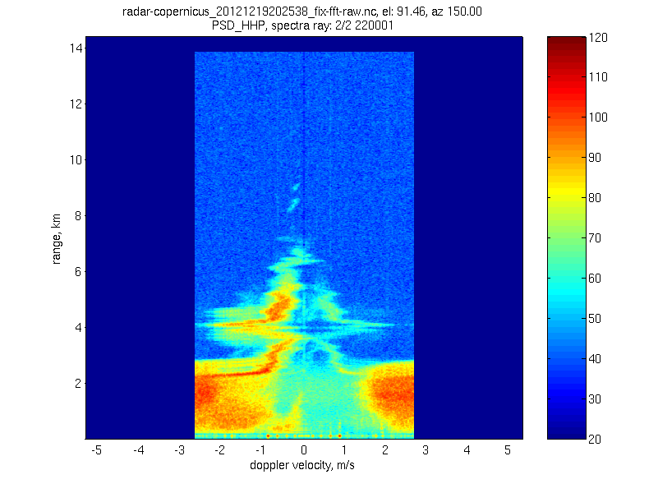
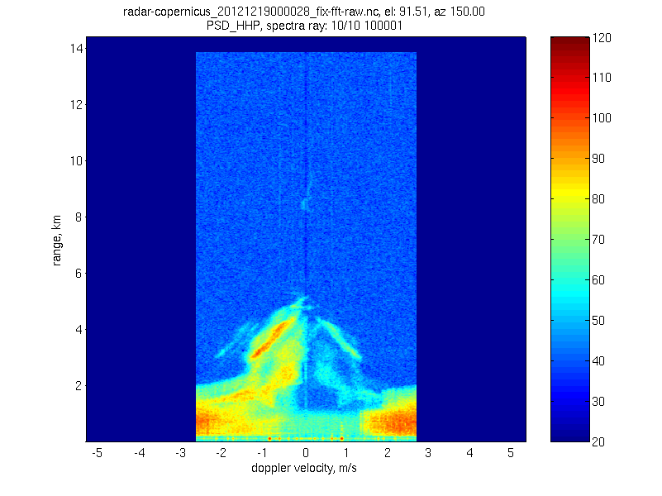
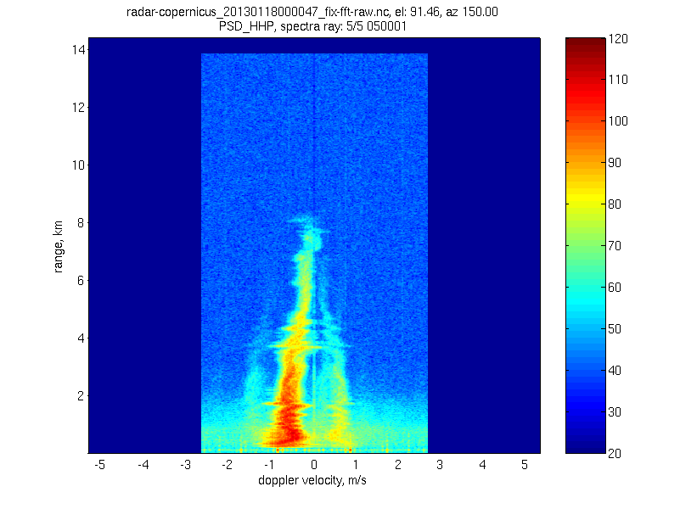
Doppler spectra

Slide 23
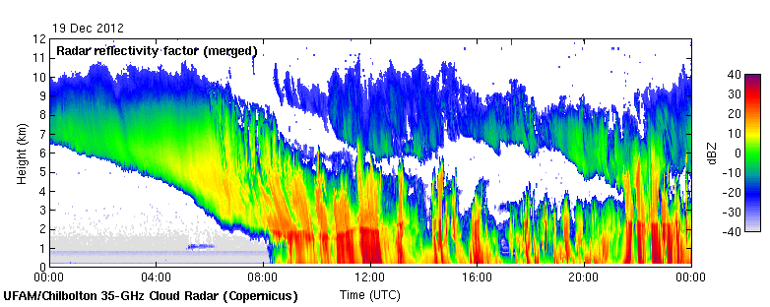
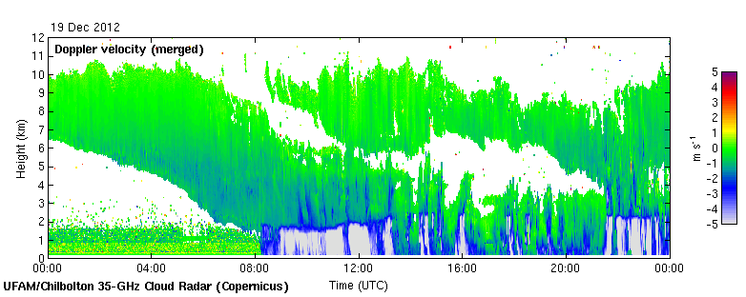
Examples of snow
35 GHz radar at Chilbolton
Snow falling at 1 m/s
  No riming or very weak
Snow falling at 2-3 m/s
  Riming present?

Slide 24
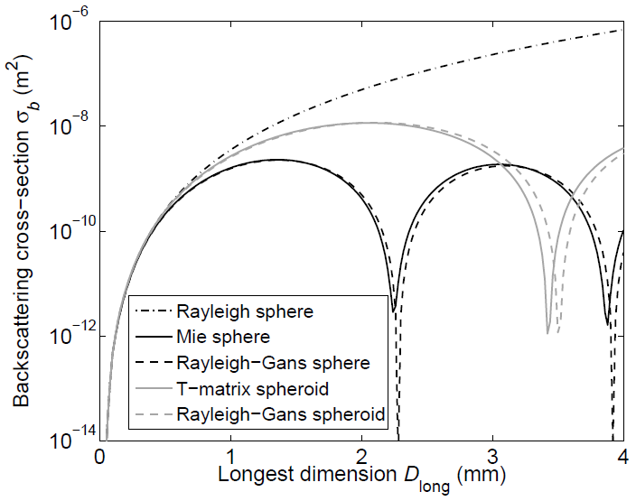
Spheres versus spheroids
Transmitted wave
Spheroid
Sphere
Sphere: returns from opposite sides of particle out of phase: cancellation
Spheroid: returns from opposite sides not out of phase: higher σ_{b}
Hogan et al. (2011)

Slide 25
Figure includes CPR Doppler velocity uncertainty ONLY due to satellite motion (Doppler fading), signal-to-noise conditions and number of integrated samples (~1 sample/m of along track displacement)
The higher PRF at high latitudes (above 60°) will result to better quality Doppler velocity measurements
Integration is needed to achieve acceptable uncertainty levels (5-10 km)
Integration is easier to perform in particle sedimentation areas.
Other sources of uncertainty in the Doppler velocity measurements are:
Non-Uniform Beam Filling
Antenna mis-pointing
Velocity Folding
Multiple Scattering
Tropics
High Latitudes
Standard deviation of the EC-CPR Doppler velocity estimates as a function of radar reflectivity and signal integration conditions.
Two PRF settings are considered: 6100 Hz (low end for tropics) (a) and 7500 (high end for high latitudes) Hz (b). Three different integration lengths are considered: 1000 m (blue), 2500 m (red) and 5000 m (black). Each point in figure corresponds to the standard deviation of the estimate from 10000 realizations using the same SNR and signal integration conditions. Radar reflectivities below -21.5 dBZ (vertical black line) correspond to negative SNR conditions.
Kollias et al., 2013, submitted

Slide 26
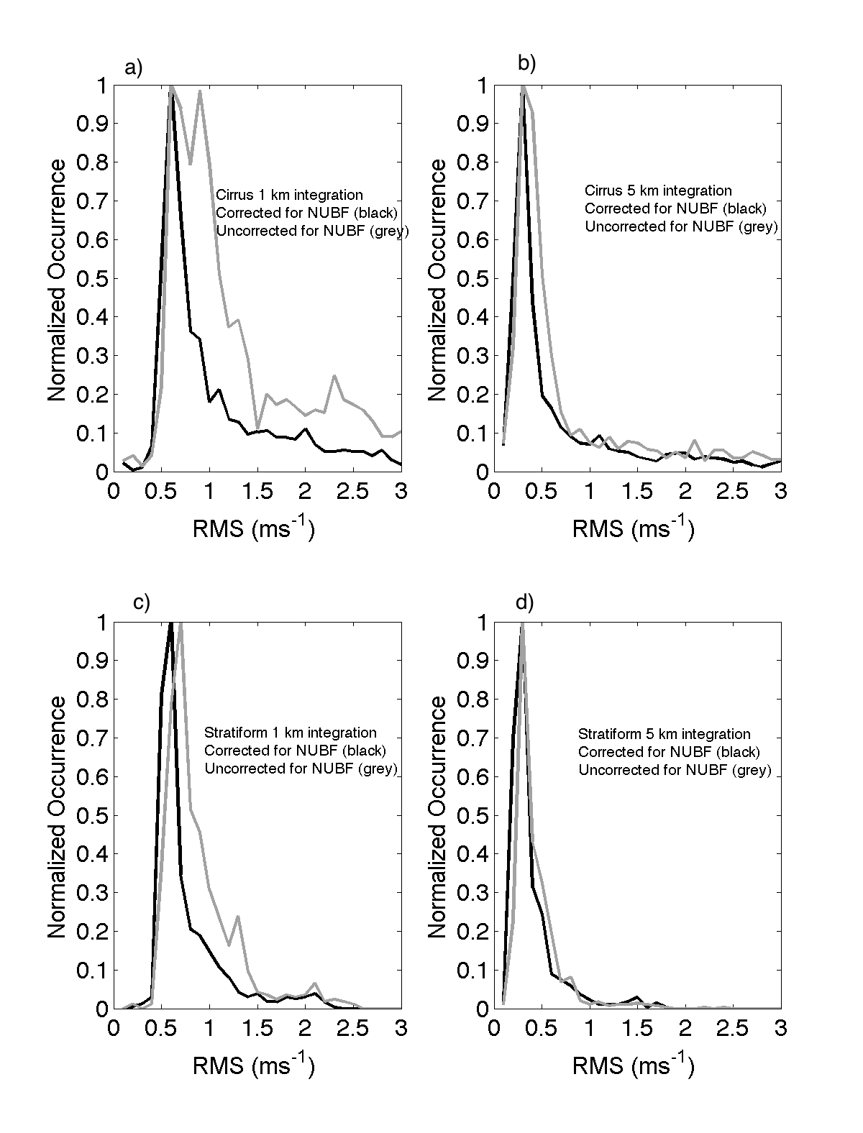
At low SNR conditions (dBZ < -15 ) the CPR Doppler velocity measurements have very large uncertainty
Away from cloud boundaries and areas with very high along track reflectivity gradients, the NUBF correction is possible with small error (~0.1 m/sec)
In particle sedimentation regimes, velocity unfolding is straightforward
Antenna mis-pointing will introduce a 0.3 m/s uncertainty
ARM
CPR Sim (1-km)
CPR Sim (5-km)
Distributions of root mean square deviation (RMSD) between ground-based (ARM) and simulated (CPR) for two integration length (1000 and 5000 m) for a large number of cirrus cases. The grey lines indicate the RMSD prior to NUBF corrections and the solid black lines indicate the RMSD after the NUBF correction.
1-km
5-km
Kollias et al., 2013, submitted

Slide 27
Principle of high spectral resolution lidar (HSRL)
If we can separate particle & molecular contributions, can use molecular signal to estimate extinction profile with no need assume anything about particle type or size

