Slide 1
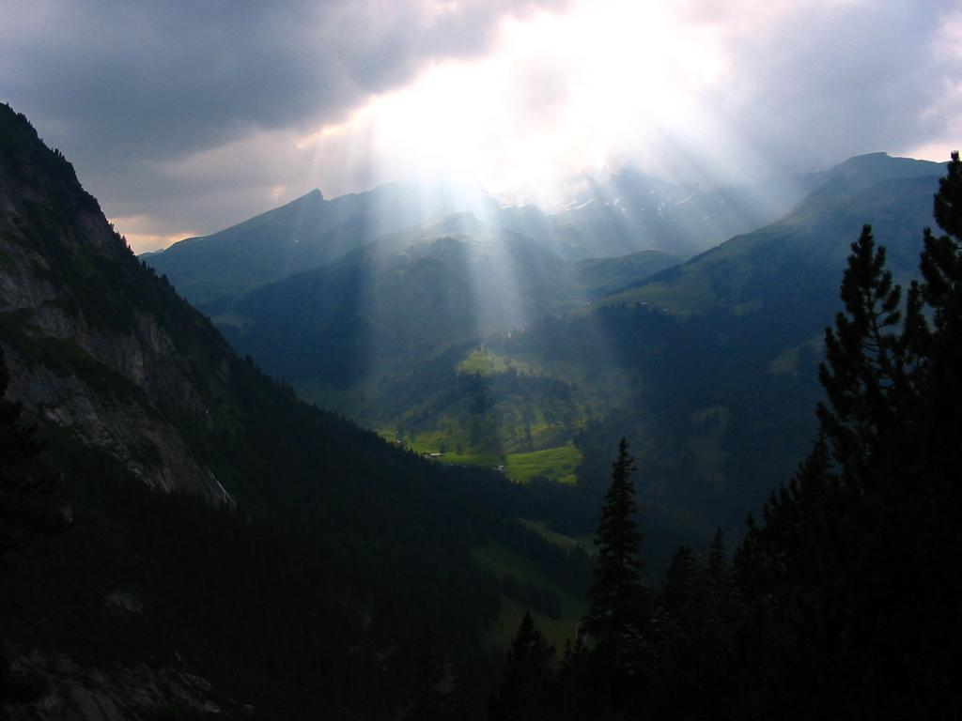
Radiative transfer in numerical models of the atmosphere
Robin Hogan
Slides contain contributions from Jean-Jacques Morcrette, Alessio Bozzo,Tony Slingo and Piers Forster

Slide 2

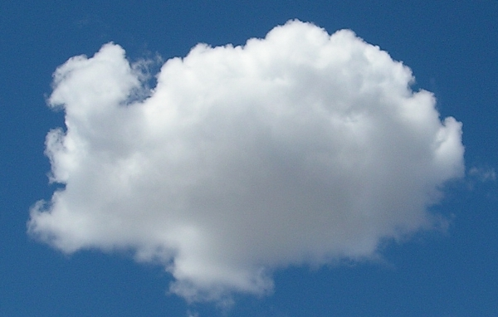
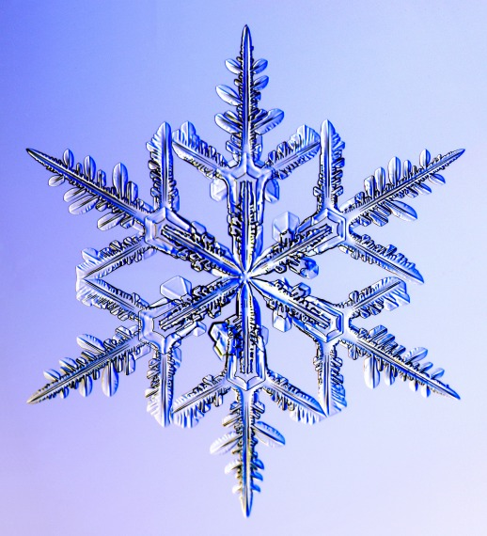
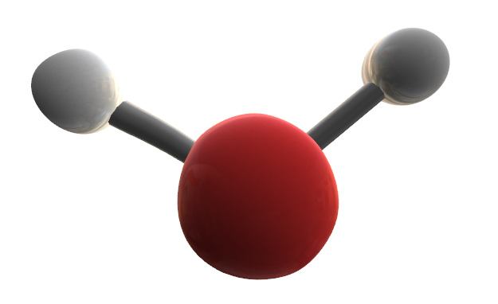
Outline
Lectures 1 & 2
  Global context
  From Maxwell to the two-stream equations
  Gaseous absorption and emission
Lecture 3 (Alessio Bozzo)
  The ECMWF radiation scheme
Lecture 4
  Representing cloud structure
  Some remaining challenges

Slide 3
Further reading
Petty, G., 2006: A first course on atmospheric radiation
Liou, K.-N., 1992: Radiation and Cloud Processes in the Atmosphere. Oxford University Press, 487 pp.
Morcrette, J-J., H. W. Barker, J. N. S. Cole, M. J. Iacono, R. Pincus, 2008: Impact of a New Radiation Package, McRad, in the ECMWF Integrated Forecasting System. Mon. Wea. Rev., 136, 4773–4798.
Randall, D. A., 2000: General circulation model development
Manabe, S., and R. F. Strickler, 1964: Thermal equilibrium of the atmosphere with a convective adjustment. J. Atmos. Sci., 21, 361-385
Hogan, R. J., and J. K. P. Shonk, 2009: Radiation parametrization and clouds. Proc. ECMWF Seminar 1-4 Sept 2008.
Scattering animations http://www.met.rdg.ac.uk/clouds/maxwell

Slide 4
Part 1: Global context
What does a radiation scheme do?
How does radiation determine global temperature?
What is the role of radiation in the global circulation?
How do we evaluate radiation schemes globally?

Slide 5
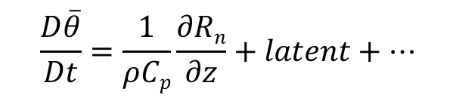
What does a radiation scheme do?
Prognostic variables: temperature, humidity, cloud fraction, liquid and ice mixing ratios, surface temperature
Diagnostic variables: sun angle, surface albedo, pressure, O₃, aerosol; well-mixed gases: CO₂, O₂, CH₄, N₂O, CFC-11 and CFC-12
MACC project can provide prognostic aerosols, CO₂ and CH₄
Radiation scheme
Fluxes / irradiances between model levels in W m⁻²
Net flux R_{n} = S – – S⁺ + L – – L⁺
S –, S⁺
L–, L⁺
Thermodynamic equation:
Radiation terms in surface energy balance: soil & sea temperatures

Slide 6
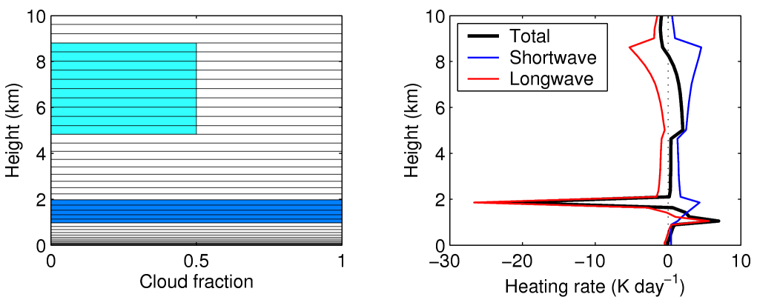
Heating rate profiles
Radiation scheme
  Radiation in the presence of clouds tends to destabilize the atmosphere
S_{n}
L_{n}

Slide 7
Radiation is unlike most other diabatic processes because
There exists a well known theory:
  Quantum Mechanics to Spectroscopy
  Maxwell’s equations to Radiative Transfer
Radiation exchanged with outside space: balance determines the climate
The sun providing the energy input so seasonal and diurnal forcings
Radiation at Top Of Atmosphere (TOA) has been globally measured since the 60’s (by operational satellites), with real flux measurements from ERB (1978), ERBE (1985), ScaRaB (1993), CERES (1998)
Surface radiation has been (roughly) measured at points over almost 40 years. Present programs like ARM, BSRN, SURFRAD measure it with high accuracy
Observations to evaluate the ability to predict spectral fluxes are also coming on line

Slide 9
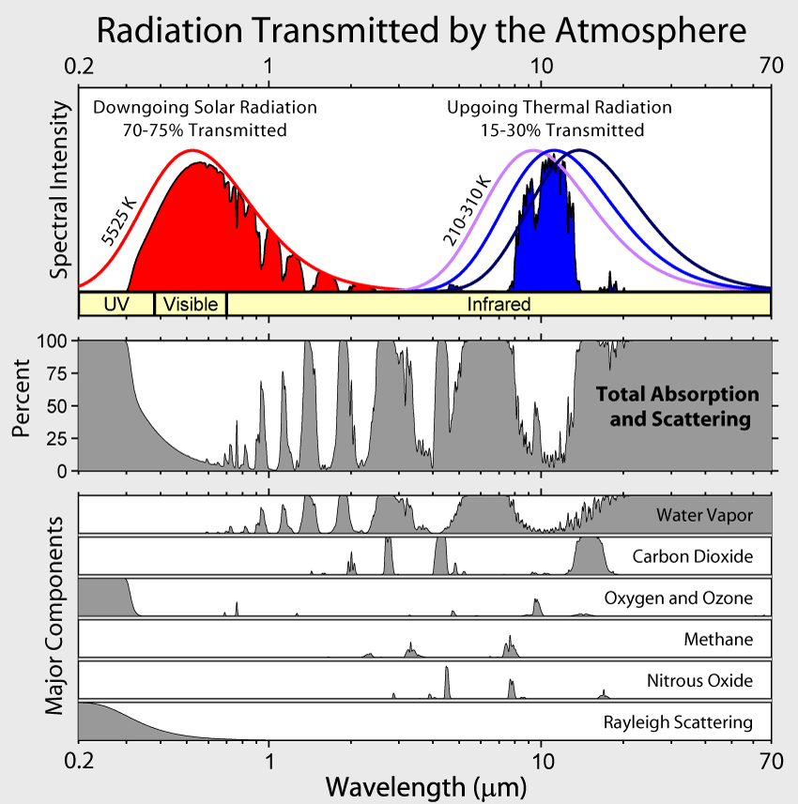
Spectral distribution of radiation
H₂O
CH₄
CO₂
CO₂
H₂O
O₃
Rayleigh scattering
H₂O
O₃
O₂
H₂O,
CO₂
Shortwave: atmosphere is mostly transparent
Longwave: atmosphere is mostly opaque

Slide 10
Composition of the Earth’s atmosphere
Gas | Parts by volume | Interaction
Nitrogen (N₂) | 780,840 ppmv (78.084%) | SW (Rayleigh)
Oxygen (O₂) | 209,460 ppmv (20.946%) | SW (Ray+abs)
Water vapour (H₂O) | ~0.40% full atmosphere, surface ~1%-4% | LW, SW (abs)
Argon (Ar) | 9,340 ppmv (0.9340%)
Carbon dioxide (CO₂) | 390 ppmv (0.039%) rising | LW, SW (abs)
Neon (Ne) | 18.18 ppmv (0.001818%)
Helium (He) | 5.24 ppmv (0.000524%)
Methane (CH₄) | 1.79 ppmv (0.000179%) rising | LW
Krypton (Kr) | 1.14 ppmv (0.000114%)
Hydrogen (H₂) | 0.55 ppmv (0.000055%)
Nitrous oxide (N₂O) | 0.319 ppmv (0.00003%) rising | LW
Carbon monoxide (CO) | 0.1 ppmv (0.00001%)
Xenon (Xe) | 0.09 ppmv (9×10⁻⁶%) (0.000009%)
Ozone (O₃) | 0.0 to 0.07 ppmv (0 to 7×10⁻⁶%) | LW, SW (abs)
SW “shortwave” solar radiation: Rayleigh scattering (blue sky) or absorption
LW “longwave” terrestrial infrared radiation: absorbing greenhouse gases

Slide 12
If the Earth was black (α=0), T_{eff} = 278 K, still lower than observed 288 K

Slide 15
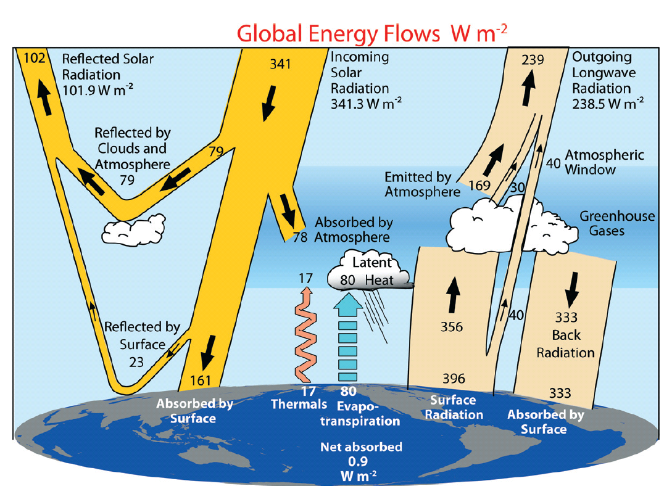
Global energy flows
Trenberth et al. (2009); modification of Kiehl & Trenberth (1997)

Slide 17
Global circulation
Warmer tropics means same pressure layers are thicker at equator
By thermal wind balance there must be westerlies
Excess heat transported polewards by
  Disturbances in these westerlies
  Oceanic transport

Slide 18
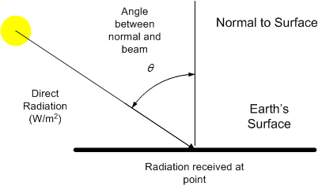
Solar zenith angle θ₀
θ₀ is a function of lat, lon, day of year, time of day
Often use μ₀ = cos (θ₀)
Irradiance through a plane parallel to the surface:
  S_{TOA} = S₀(d/d_{mean})⁻²μ₀
where S₀ is total solar irradiance, d is earth-sun distance
Surface flux for absorbing atmosphere:
  S_{surf} = S_{TOA}exp(-δ/μ₀)
where δ is the zenith optical depth

Slide 19
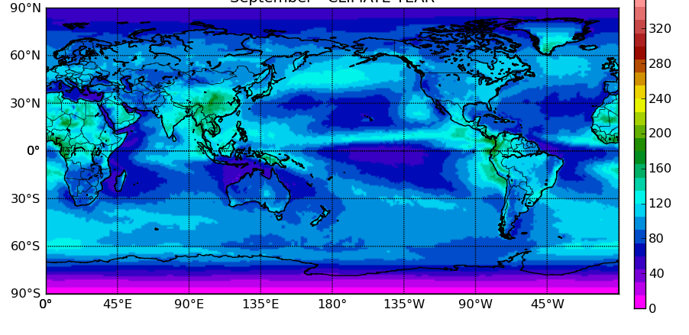
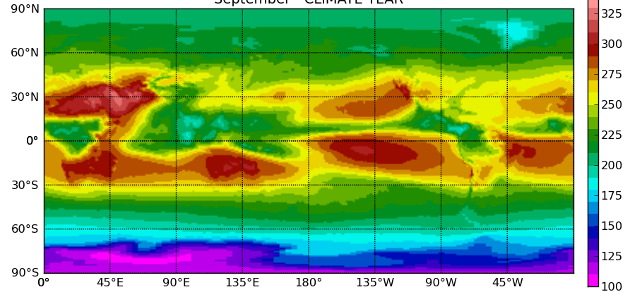
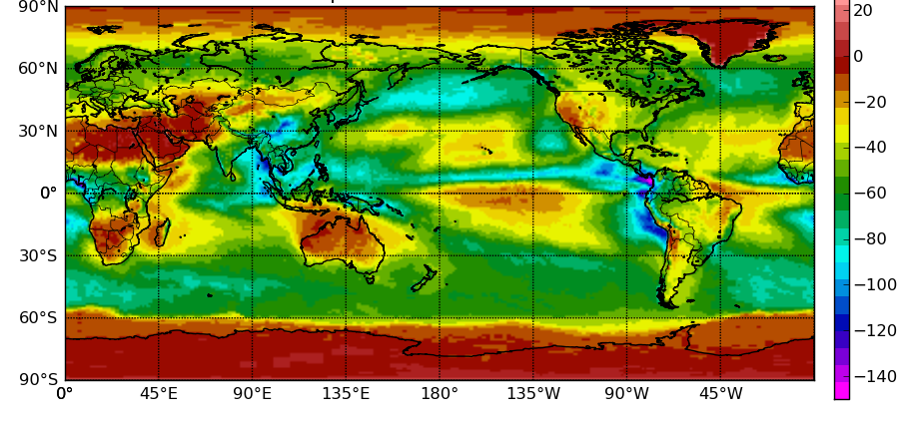
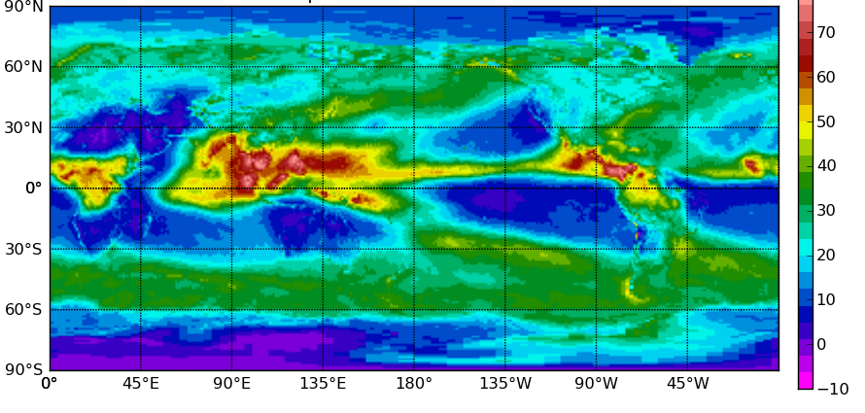
CERES radiometer (Sept)
TOA total upwelling irradiance
  Shortwave – Longwave
TOA cloud radiative effect (or “forcing”): F_{n}^{cloud} – F_{n}^{clear}
  Shortwave – Longwave

Slide 20
ECMWF model biases versus CERES
Before McRad (<2007)
  Shortwave – Longwave
After McRad (>2007)
  Shortwave – Longwave

Slide 21
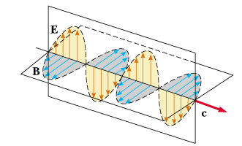
Part 2: Maxwell’s equations to the two-stream equations
How do Maxwell’s equations explain optical phenomena?
How do we describe scattering by cloud particles, aerosols and molecules?
How is radiative transfer implemented in models?

Slide 22
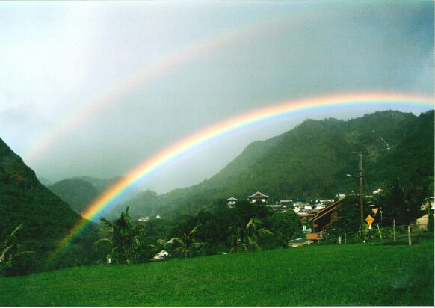
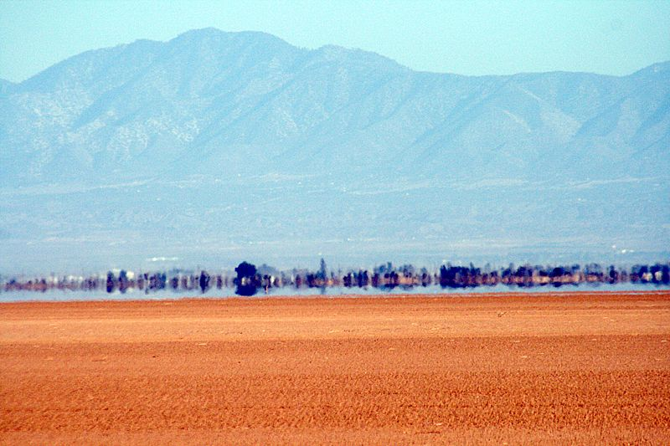

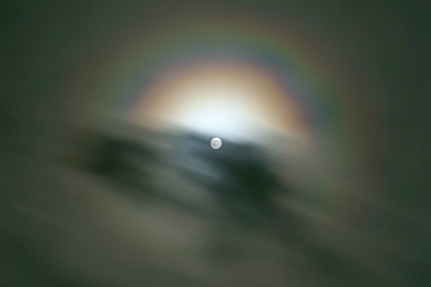

Slide 23
Building blocks of atmospheric radiation
Emission and absorption of quanta of radiative energy
  Governed by quantum mechanics: the Planck function and the internal energy levels of the material
  Responsible for complex gaseous absorption spectra
Electromagnetic waves interacting with a dielectric material
  An oscillating dipole is excited, which then re-radiates
  Governed by Maxwell’s equations + Newton’s 2nd law for bound charges
  Responsible for scattering, reflection and refraction
p
E
+
−
Oscillating dipole p is induced, which is typically in phase with the incident electric field E
Dipole radiates in all directions (except directly parallel to its axis)

Slide 24
Maxwell’s equations
Almost all atmospheric radiative phenomena are due to this effect, described by the Maxwell curl equations:
  where c is the speed of light in vacuum, n is the complex refractive index (which varies with position), and E and B are the electric and magnetic fields (both functions of time and position);
It is illuminating to discretize these equations directly
  This is known as the Finite-Difference Time-Domain (FDTD) method
  Use a staggered grid in time and space (Yee 1966)
  Consider two dimensions only for simplicity
  Need gridsize of ~0.02 μm and timestep of ~50 ps for atmospheric problems
B_{y}
E_{z}
E_{z}
B_{x}
B_{x}
B_{y}
E_{z}
E_{z}

Slide 25
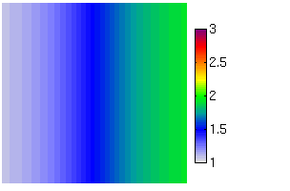

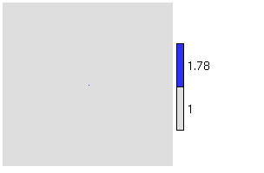

Simple examples
Refraction (a mirage)
Rayleigh scattering (blue sky)
n gradient
Single dipole
Refractive index Total E_{z} field
Scattered field
(total − incident)

Slide 26
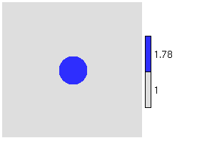

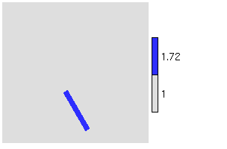

More complex examples
A sphere (or circle in 2D)
An ice column
Refractive index Total E_{z} field
Scattered field
(total − incident)

Slide 27
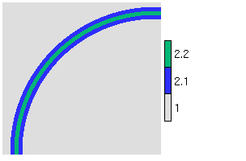

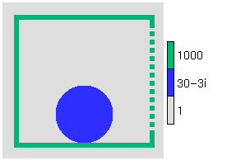
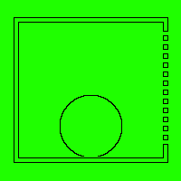
Non-atmospheric examples
Single-mode optic fibre
Potato in a microwave oven
Refractive index Total E_{z} field
Many more animations at www.met.rdg.ac.uk/clouds/maxwell
(interferometer, diffraction grating, dish antenna, clear-air radar, laser…)

Slide 28
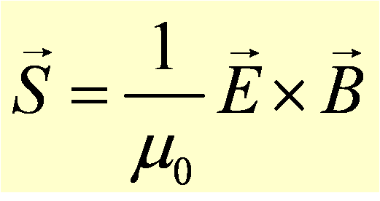
How are E & B fields related to fluxes?
Poynting vector given by
  Here μ₀ is the magnetic constant
It describes
  Direction of energy propagation
  Rate of energy flow in W m⁻² (more useful if time averaged)

Slide 29
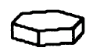
Particle scattering
Maxwell’s equations used to obtain scattering properties
Suppose we illuminate a single particle with monochromatic radiation of flux density P (in W/m²)
  Scattering cross-section σ_{s} (in m²) is defined such that the total scattered power (in W) is Pσ_{s}
  Absorption cross-section σ_{a} is the same but for absorbed power
  Extinction cross-section σ_{e} = σ_{s}+σ_{a} is the sum of the two
  Single scattering albedo ω₀ = σ_{s}/σ_{e}
Directional scattering described by the phase function p(Ω)
  Ω is the angle between incident and scattered directions
  Phase function normalized such that
P

Slide 30
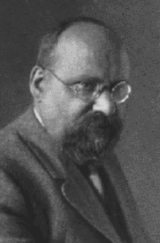
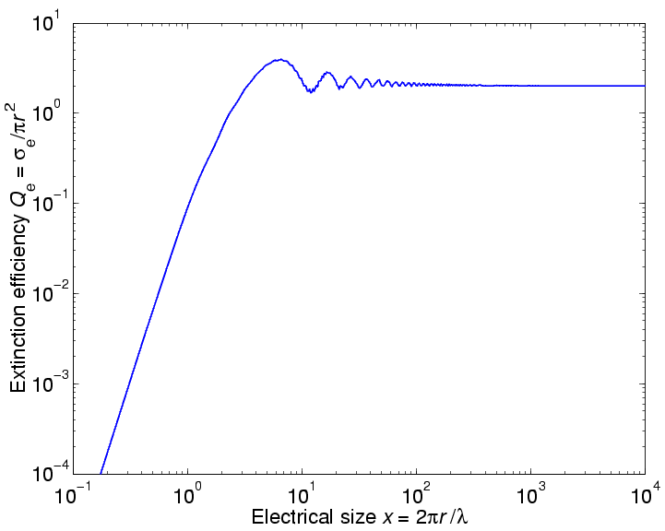
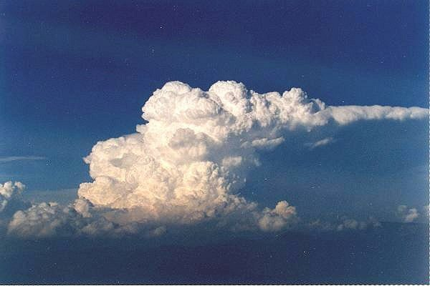
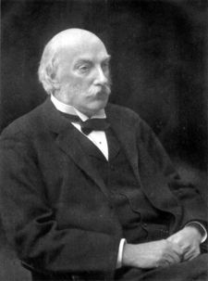
The limits of Mie theory
Gustav Mie
Geometric optics region (r>>λ):
Q_{e} = 2; σ_{e}= 2πr ²
…clouds are white
Rayleigh region (r<<λ):
Lord Rayleigh
…the sky is blue

Slide 31
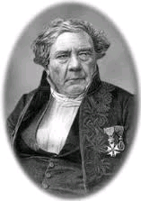



Jacques Babinet
The extinction paradox: σ_{e} is twice physical cross section
Babinet’s principle, valid due to superposition principle:
  E_{vacuum} = E_{hole} + E_{obstacle}
Diffraction scattering pattern around the obstacle is:
  E_{scat,obstacle}=E_{obstacle} – E_{vacuum}= –E_{hole}
Energy diffracted around particle equals energy intercepting particle so Q_{e} ≈ 2 for any particle shape
  E_{vacuum} E_{hole} E_{obstacle} E_{scat,obstacle}
= +

Slide 32
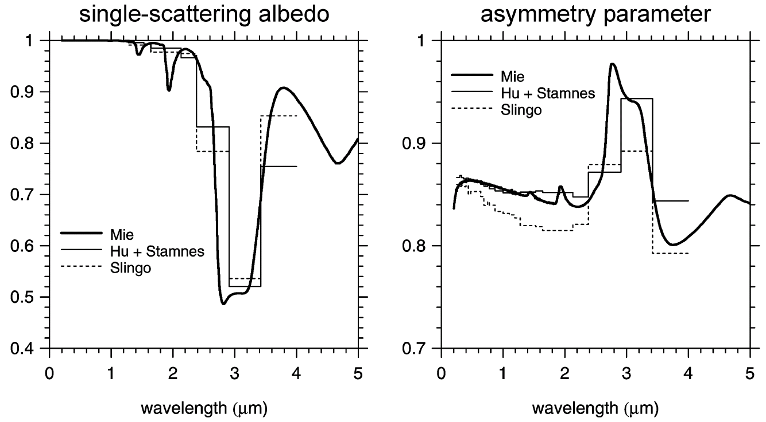
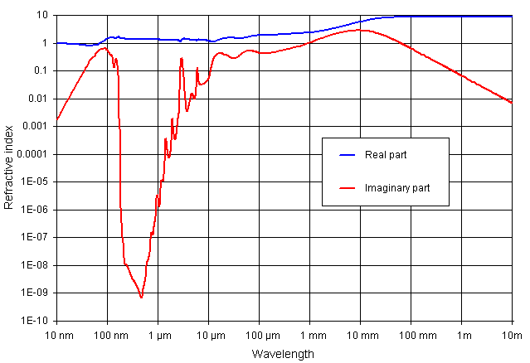
Single scattering albedo ω=σ_{s}/σ_{e}
Absorption related to imaginary part of refractive index m_{i}
For liquid and ice
  Visible: m_{i} is very small so ω is close to one (0.999…)
  Longwave: m_{i} higher so ω ∼ 0.5
Aerosols in the shortwave
  Water soluble: 0.9-0.95; Black carbon ~ 0.3
Refractive index of liquid water
Real part
Imaginary part

Slide 33
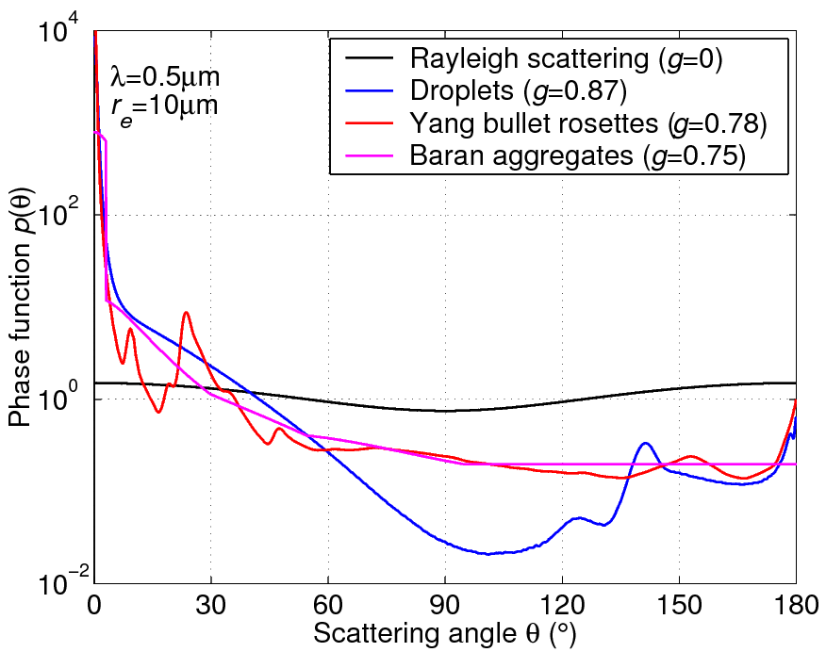
The scattering phase function
θ
The distribution of scattered energy is known as the “scattering phase function”
Different methods are suitable for different types of scatterer
  Spheres: Mie theory (Mie 1908) provides a solution to Maxwell’s equations as a series expansion
  Arbitrary ice particle shapes: depending on D/λ, use the Discrete Dipole Approximation, FDFT or ray tracing (Yang et al. 2000)
  But observations (Baran) suggest smoother phase functions implying that the surface of ice particles is “rough”

Slide 34
Asymmetry factor
Radiation schemes can’t use full phase function: approximate by asymmetry factor:
  Isotropic and Rayleigh scattering: g = 0
  Droplets larger than wavelength g ≈ 0.85
  Ice larger than wavelength g ≈ 0.7-0.8
Delta-Eddington scaling (Joseph et al. 1976)
  Treat some of forward scattered radiation as if it had not been scattered at all
  δ’ = δ(1 – ωg ²)
  ω’ = ω(1 – g ²)/(1 – ωg ²)
  g ’ = g/(1 + g)
Around half the scattered light diffracted by a small angle

Slide 35
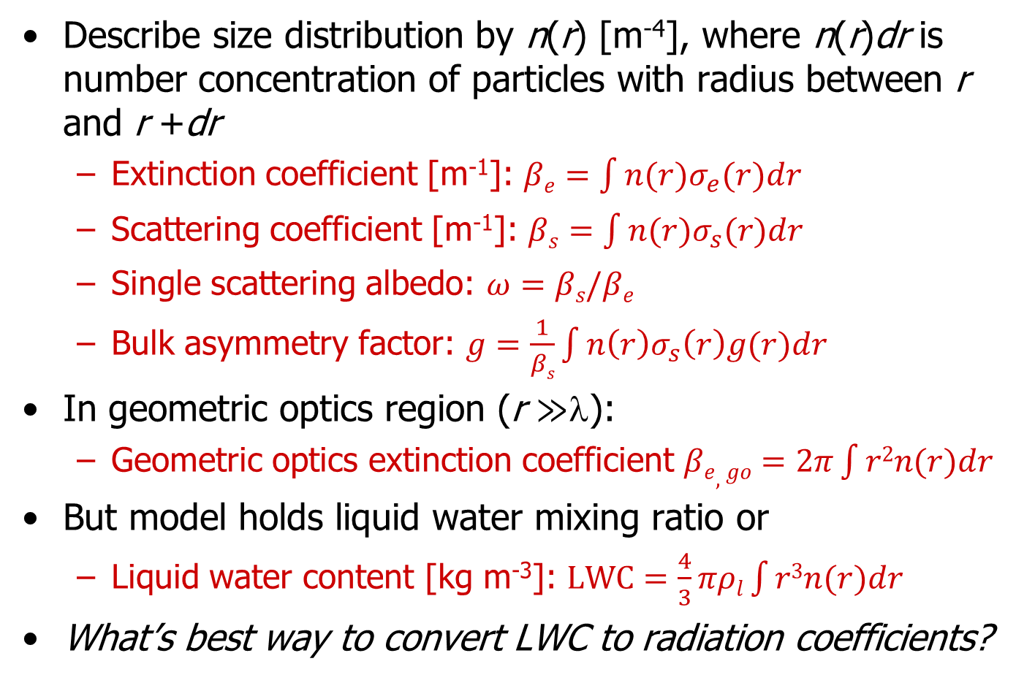
Size distributions
Describe size distribution by n(r) [m⁻⁴], where n(r)dr is number concentration of particles with radius between r and r +dr
  Extinction coefficient [m⁻¹]: $βe=\int{n(r)σ_{e}(r)dr}$
  Scattering coefficient [m⁻¹]: $βs=\int{n(r)σ_{s}(r)dr}$
  Single scattering albedo: $ω=βs/βe$
  Bulk asymmetry factor: $g=\frac{1}{βs}\int{n\left(r\right)σ_{s}\left(r\right)g(r)dr}$
In geometric optics region (r $≫$λ):
  Geometric optics extinction coefficient $βe,go=2π\int{r2n(r)dr}$
But model holds liquid water mixing ratio or
  Liquid water content [kg m⁻³]: $LWC=\frac{4}{3}πρl\int{r3n(r)dr}$
What’s best way to convert LWC to radiation coefficients?

Slide 36

Effective radius
Can convert liquid water mixing ratio to extinction with
  Liquid effective radius: $re=\frac{\int{r3n(r)dr}}{\int{r2n(r)dr}}=\frac{3LWC}{2ρlβe,go}$
For non-spherical ice, equivalent expression is:
  Ice effective radius: $re=\frac{3IWC}{2ρiβe,go}$
In each part of the spectrum, a radiation scheme parameterizes β_{e}/LWC, ω and g as a function of r_{e} (e.g. Slingo and Schrecker 1982)

Slide 37
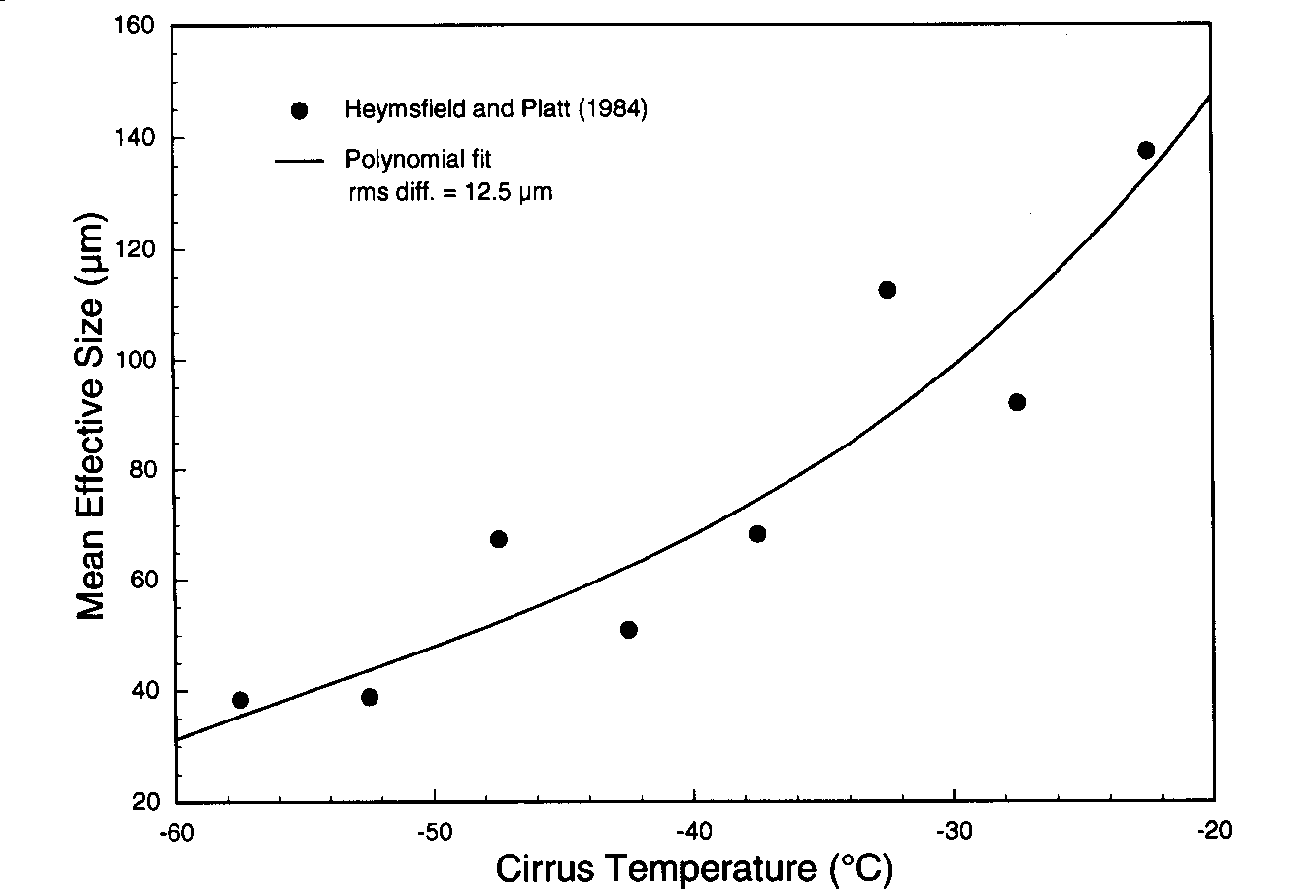
Parametrizing effective radius
Ice clouds
  ECMWF and most models parametrize vs temperature:
  Field et al. (2005) parametrized full ice size distribution, enabling r_{e}(T, IWC)
Liquid water clouds
  ECMWF: varies with height from 10 to 40 microns
  Some models have different values over land and sea
  Met Office UK forecast model has prognostic aerosol which is used for droplet number conc.
Radiation schemes need to use more information from cloud schemes!
Ou & Liou (1995)

Slide 38
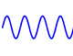
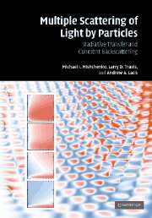
From Maxwell to radiative transfer
Maxwell’s equations in terms of fields E(x,t), B(x,t)
Mishchenko et al. (2007)
Reasonable assumptions:
Ignore polarization
Ignore time-dependence (sun is a continuous source)
Particles are randomly separated so intensities add incoherently and phase is ignored
Random orientation of particles so phase function doesn’t depend on absolute orientation
No diffraction around features larger than individual particles
3D radiative transfer in terms of monochromatic radiances I (x,Ω,ν) in W m⁻² sr⁻¹ Hz⁻¹

Slide 39

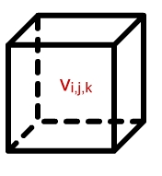


The 3D radiative transfer equation
Also known as the “Boltzmann transport equation”, this describes the radiance I in direction Ω (where the x and ν dependence of all variables is implicit):
Loss by absorption or scattering
Source
Such as thermal emission
Gain by scattering Radiation scattered from all other directions
Spatial derivative representing how much radiation is upstream
Direction Ω
Direction Ω’

Slide 40
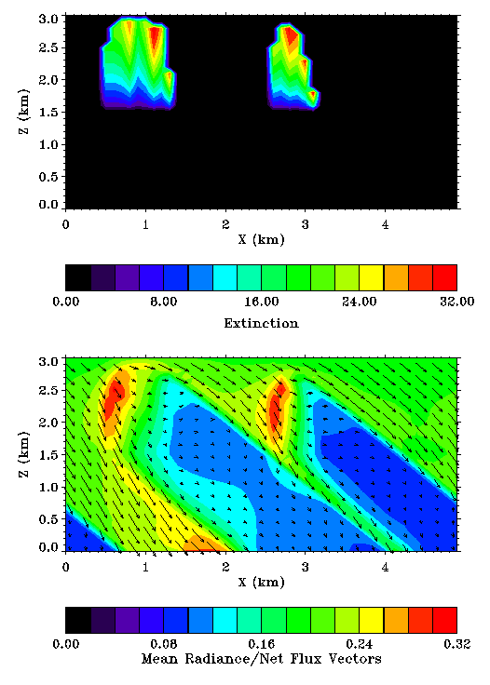
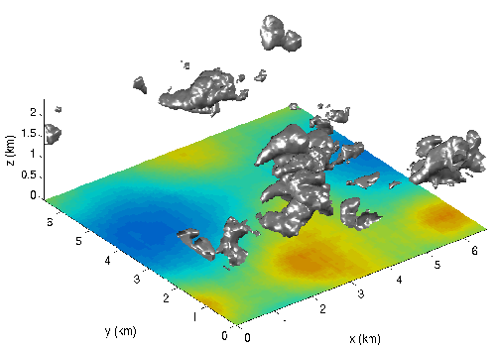
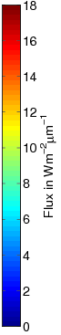
Explicit 3D radiation calculations
Freely available Monte Carlo and SHDOM codes can compute radiance fields everywhere
Very slow: 5D problem
Need to approximate for GCMs
SW: Franklin Evans, University of Colorado
LW: Sophia Schafer, University of Reading

Slide 41
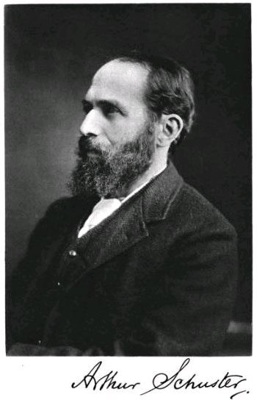
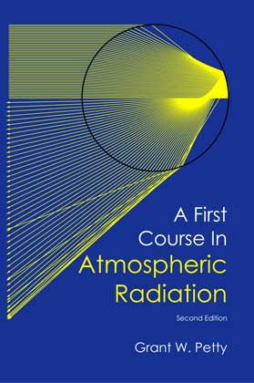
Two-stream approximation
3D radiative transfer in terms of monochromatic radiances I (x,Ω,ν)
Unreasonable assumptions:
Radiances in all directions represented by only 2 (or sometimes 4) discrete directions
Atmosphere within a model gridbox is horizontally infinite and homogeneous
Details of the phase functions represented by one number, the asymmetry factor
1D radiative transfer in terms of two monochromatic fluxes F ±(z,ν) in W m⁻² Hz⁻¹

Slide 42
Direct solar flux
θ₀
TOA flux:
  F_{0.5}^{d} = S₀cos(θ₀)
Zenith optical depth in layer i is δ_{i}, calculated simply as the vertical integral of extinction coefficient β_{e} across the layer
Fluxes at layer interfaces are
  F_{i+0.5}^{d} = F_{i-0.5}^{d}exp(-δ_{i}/cos θ₀)
F_{0.5}^{d}
Layer 1
δ₁
F_{1.5}^{d}
Layer 2
δ₂
F_{2.5}^{d}
For the moment we assume the model layers to be horizontally homogeneous and infinite: no representation of radiation transport between adjacent model columns

Slide 43
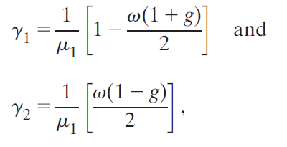
Two-stream equations
Gradient of flux with height
Loss of flux by scattering or absorption
Gain in flux by scattering from other direction
Source from scattering of the direct solar beam (shortwave) or emission (longwave)
Upwelling flux:
Downwelling flux:
Where coefficients given by (use delta-Eddington scaling):

Slide 44

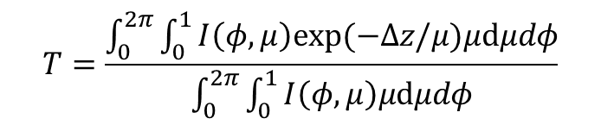
Two-stream angle / diffusivity factor
μ₁=cos(θ₁) is the effective zenith angle that diffuse radiation travels at to get the right transmittance T
Most schemes use Elsasser (1942) diffusivity factor of 1/μ₁=1.66, equivalent to θ₁=53°
Flux F_{i-1/2}⁺=TF_{i-1/2}⁺
θ₁
Radiances I(φ,μ)
Δz
Flux F_{i+1/2}⁺
Two stream approximation

Slide 45
Discretized two-stream scheme
Diffuse TOA source S₀⁻
F_{0.5}⁺
F_{0.5}⁻
Source terms S⁺, S⁻
Reflection R, Transmission T
Layer 1
F_{1.5}⁺
F_{1.5}⁻
Layer 2
F_{2.5}⁺
F_{2.5}⁻
Surface source S_{s}⁺, albedo α_{s}
Shortwave: scattering of direct solar beam
Longwave: thermal emission
Equations relating diffuse fluxes between levels take the form:
Terms T, R and S found by solving two-stream equations for single homogeneous layers: solutions given by Meador and Weaver (1980)

Slide 46
Solution for two-level atmosphere
Solve the following tri-diagonal system of equations
Efficient to solve and simple to extend to more layers
Typical schemes also include separate regions at each height for cloud and clear-sky

Slide 47
Physical interpretation of tri-diagonal solution
It is conceptually convenient to solve the system by
  Working up from the surface calculating the albedo α_{i} and upward emission G_{i} of the whole atmosphere below half-level i.
  Then working down from TOA, calculating the upwelling and downwelling fluxes from α_{i} and G_{i}.

Slide 48
Neglecting longwave scattering
Many (most?) GCMs neglect longwave scattering by clouds and aerosols, simplifying the algorithm
Layer monochromatic emissivity ε = 1 – exp(–δ_{a} /cosθ₁)
In practice this is usually done with a band transmission model
What is the error incurred by neglecting longwave scattering?
F_{0.5}– = 0
F_{0.5}–
Layer 1
Τ₁, ε₁
F_{1.5}–
F_{1.5}⁺
Layer 2
Τ₂, ε₂
F_{2.5}–
F_{2.5}⁺
Τ_{s}, ε_{s}

Slide 49
Effect of longwave scattering on OLR
High clouds
Mid-level clouds
Outgoing longwave radiation reduced by 3 W m⁻², changing cloud longwave radiative effect by 10% and net radiative effect by 20%
This is due to Kirchhoff’s law: scattering means cloud can reflect, so emissivity (= 1 – albedo) is reduced below black body value of 1
  If cloud albedo is 0.1, it will emit 10% less than a black body
Low clouds
All sky
Costa and Shine (QJ 2007)

Slide 50
Part 3: Gaseous absorption and emission
Part 2 considered monochromatic radiative transfer only
What causes complex emission/absorption spectra of gases?
How do we represent this efficiently in models?

Slide 51
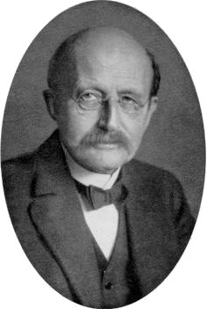
Planck’s law
Spectral radiance [W m⁻² sr⁻¹ Hz⁻¹] emitted by a black body at temperature T is
Can change to per-unit-wavelength via B_{ν}dν=B_{λ}dλ:
Max Planck
h = Planck’s constant 6.626x10⁻³⁴ J s
k = Boltzmann’s const 1.381x10⁻²³ J K⁻¹
c = speed of light in vacuum 299792458 m s⁻¹

Slide 52
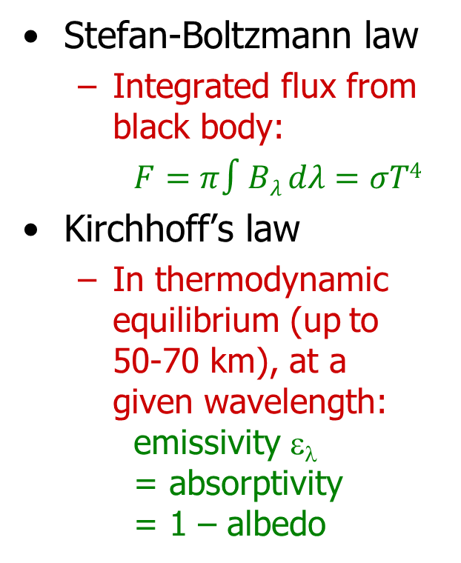
Related laws
Stefan-Boltzmann law
  Integrated flux from black body:
  $F=π∫Bλ dλ=σT4$
Kirchhoff’s law
  In thermodynamic equilibrium (up to 50-70 km), at a given wavelength: emissivity ε_{λ} = absorptivity = 1 – albedo

Slide 53
Emission by gases
Planck function has a continuous spectrum at all temperatures: maximum possible emission by medium in thermal equilibrium
Absorption by gases is an interaction between molecules and photons and obeys quantum mechanics
  Not quantized: kinetic energy ~ kT/2
  Quantized: changes in levels of energy occur by ΔE=h Δν steps
    rotational energy: lines in the far infrared λ > 20μm
    vibrational energy (+rotational): lines in the 1 - 20 μm
    electronic energy (+vibr.+rot.): lines in the visible and UV
Radiation schemes are benchmarked to spectroscopic databases from laboratory measurements
  For example, HITRAN database (Rothman et al. (JQSRT 2009)

Slide 54


Slide 55
Spectral lines
Spectral lines are of frequency ν=ΔE/h
Absorption cross-section per molecule: σ_{ν}=S f (ν−ν₀)
  S = line strength
  ν₀ = centre frequency
  f (ν−ν₀) = line shape (normalized to unit area)
Natural broadening
  Due to Heisenburg’s principle (negligible)
Pressure broadening
  Molecular collisions disrupt energy levels (troposphere and stratosphere)
Doppler broadening
  Due to random motion of molecules, absorption/emission is Doppler-shifted from natural line position (mesosphere)

Slide 56
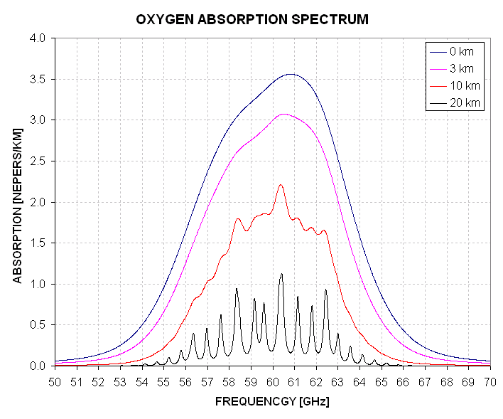
Pressure broadening
Theory is rather heuristic; usually described adequately but not perfectly by the Lorenz line shape:
With the half-width at half the maximum roughly proportional to the frequency of collisions, modelled by:

Slide 57

Doppler broadening
Molecular velocity distribution is Gaussian:
Doppler shift ν’= ν (1 – v/c) so line shape is Gaussian
where

Slide 58
Continuum absorption
In addition to spectral lines, some absorption does not exhibit line structure – this is due to:
Photoionization
  High energy photons (X/γ-rays) strip electrons from atoms
  Kinetic energy of resulting ion and electron not quantized, so will be continuum absorption above ionization energy
Photodissociation
  Ultraviolet light can break molecules (e.g. O_{2,} O₂) into constituent atoms: protects us from hard UV at surface
Water vapour continuum uncertain: mechanism either
  Far wings of lines (due to underestimate by Lorenz shape)
  Temporary water vapour clusters (dimers, trimers etc.)

Slide 59

Water vapour continuum
Shine et al. in CAVIAR project have found that current water vapour continuum models can significantly underestimate absorption in windows between bands, particularly in the near infrared
5 μm
1.25 μm

Slide 60

How do we integrate across the spectrum?
Consider first just one gas
Line-by-line model predicts spectrum (e.g. HITRAN)
Need ~10⁵ monochromatic radiation calculations
Water vapour spectrum Planck function

Slide 61

Divide into bands
Divide into the 16 longwave bands of well validated RRTM model (Mlawer et al. 1997)
Water vapour spectrum Planck function

Slide 62

The correlated k-distribution (CKD) method
In each band, sort absorption spectrum and average the Planck function
More conducive to numerical integration
Lacis & Oinas (1991)
Water vapour spectrum Planck function

Slide 63

The correlated k-distribution (CKD) method
Discretize sorted absorption coefficients into 2-16 intervals in each band
Numerical integration now needs ~120 monochromatic calculations for longwave when all gases considered
Water vapour spectrum Planck function

Slide 64

Why “correlated”?
Despite broadening, absorption spectra at different heights are very well correlated (in terms of rank correlation)
Method assumes perfect rank correlation, so imperfect correlation will cause small errors even for infinite resolution in g space
Mass absorption coefficient k (m² kg⁻¹)
Frequency ν
Normalized rank g

Slide 65



How best to choose intervals in g space?
Minimize errors in heating rate profile
Tiny parts of the spectrum where the absorption is strongest are responsible for upper-stratospheric heating rates
Mid-latitude summer standard atmosphere, water vapour only
Heating rate from monochromatic calculations at individual g points
Total

Slide 66


GRIPS intercomparison
Large discrepancies in ozone layer and mesosphere
Longwave
Shortwave

Slide 67


Shortwave comparison
Clear tropical profile Liquid cloud (plane parallel)
UV and visible
Barker et al. (JClim 2003)
Most models underestimate clear-sky near-IR absorption
  Poor continuum
Most models underestimate liquid cloud near-IR absorption
Full shortwave
Near infrared
LBL benchmark
Model range
Dusk
Overhead sun
Dusk
Overhead sun
Notes:
67

Slide 68
Summary so far
Radiation is the fundamental driver of the climate system
The radiative transfer aspects of a radiation scheme can be traced back to Maxwell’s equations, including
  Particle scattering
  The two-stream equations
Complex absorption spectra arise due to quantum mechanics
  The correlated-k-distribution is the state-of-the-art for representing gaseous absorption spectra in models
  Discrepancies remain between models, especially in representing the water vapour continuum and stratosphere/mesosphere infrared cooling rates

