Slide 1
Fast radiative transfer models and the representation of clouds
Robin Hogan, ECMWF
Contributions from:
Sophia Schäfer and Jon Shonk (University of Reading)
Howard Barker (Environment Canada)
Alessio Bozzo and Shoji Hirahara (ECMWF)
and numerous others

Slide 2
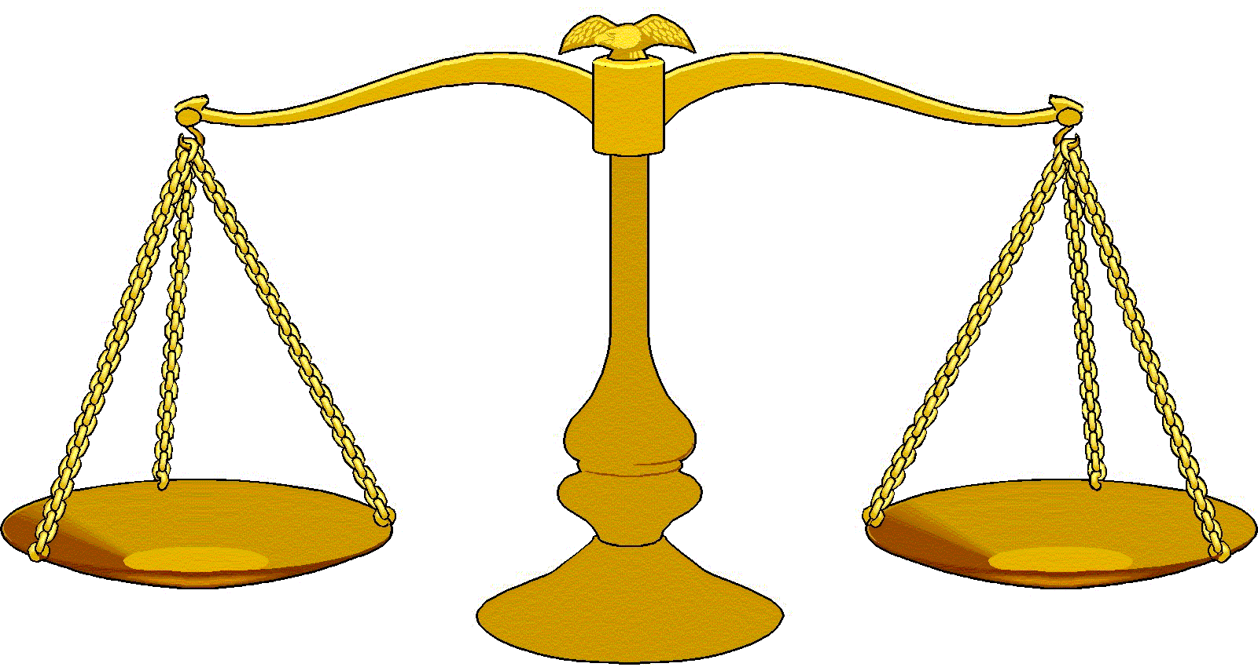
Overview
From Maxwell to the two-stream equations
The challenge of cloud structure
Representing 3D effects
Mitigating errors due to calling radiation infrequently in time and space
Reducing the number of spectral intervals
Outlook
Accuracy
Efficiency

Slide 3
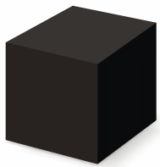
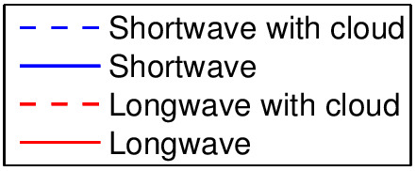
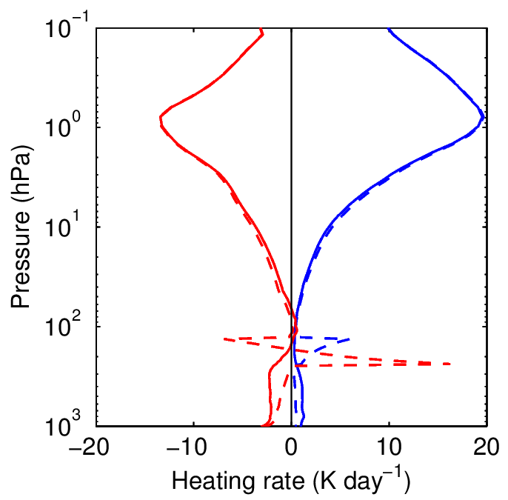
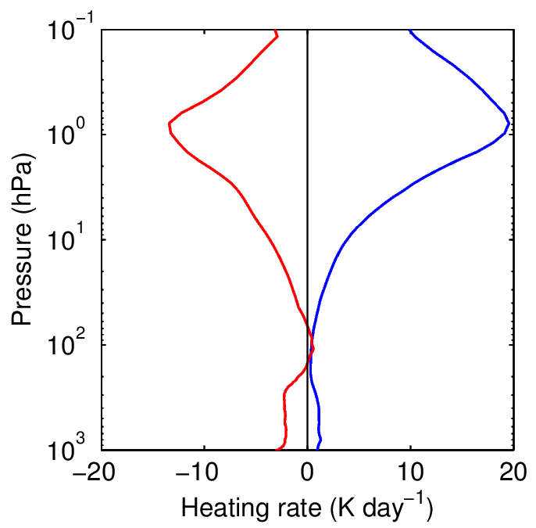

What does a radiation scheme do?
Input profile: temperature, pressure, gas concentrations, cloud properties…
Radiation scheme
A term in the model’s thermodynamic equation
Clouds tend to destabilize the atmosphere
Surface fluxes

Slide 4
Theories of light propagation and scattering
Particle theories
  Ibn al-Haytham (1021) – vision
  Newton (1710) – colour
  Planck (1901) – black-body radiation
  Einstein (1905) – photo-electric effect
Wave theories
  Huygens (1690) – refraction, reflection
  Young (1801) – double-slit experiment
  Fresnel (1821) – polarization, diffraction
  Maxwell (1873) – electricity & magnetism
Radiative transfer
  Lommel (1887) – radiative transfer equation
  Schuster (1905) – two-stream equations
  Chandrasekhar (1946) – full 3D radiative transfer equation with polarization
Mishchenko et al. (2002)
Quantum electrodynamics
  Fenyman, Schwinger, Tomonaga, Dyson (1946-1949)
    – Lamb shift, magnetic moment of electron
    – Describes all known properties of EM radiation exactly
?

Slide 5
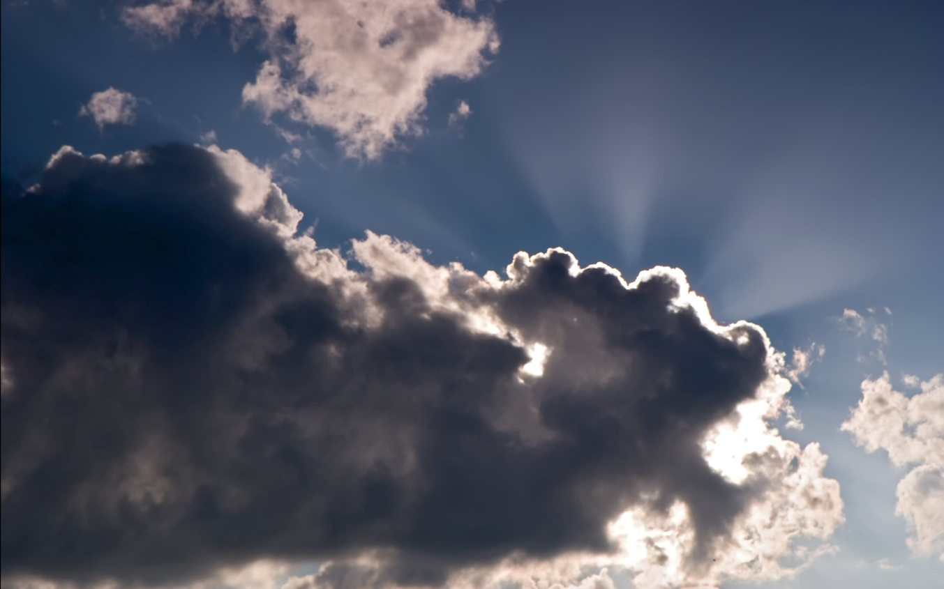
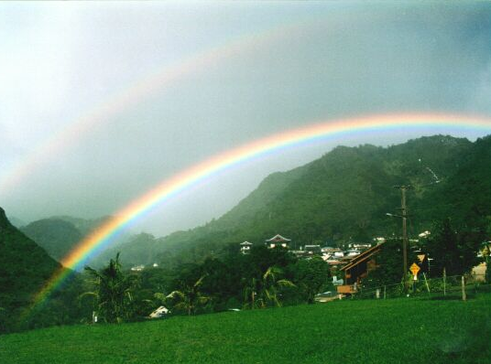
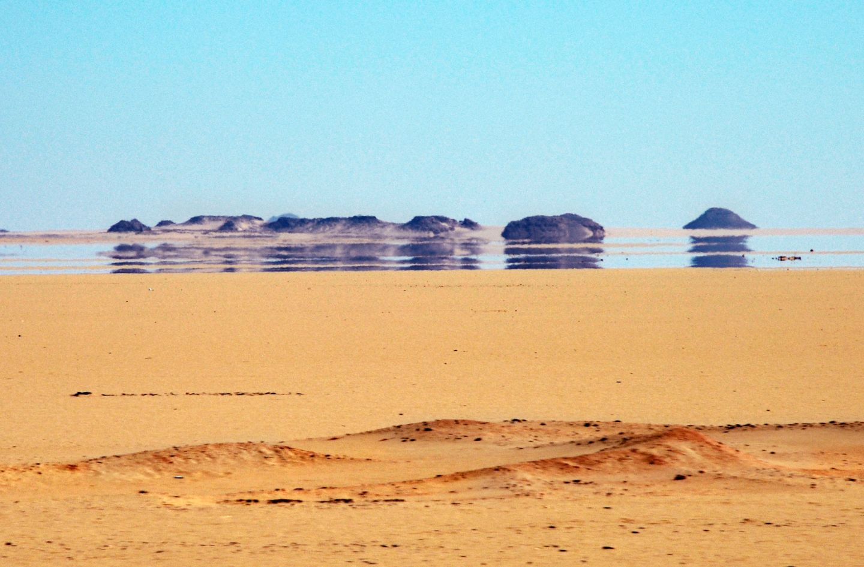
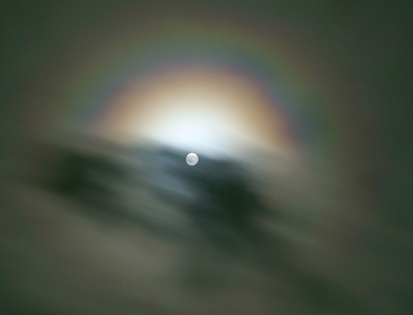
Optical phenomena explained by Maxwell’s equations
Need quantum mechanics to explain emission and absorption
All other atmospheric optics explained by electromagnetic radiation exciting a dipole in a dielectric material which then re-radiates
  Described by Maxwell’s curl equations + Newton’s 2nd law for bound charges
Illustrated with an “Electromagnetic Weather Forecast”
  Gridsize 0.02 μm and timestep 50 picoseconds
B_{y}
E_{z}
E_{z}
B_{x}
B_{x}
B_{y}
  Staggered grid in time and space (Yee 1966)
E_{z}
E_{z}

Slide 6
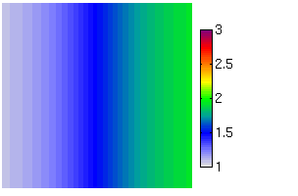

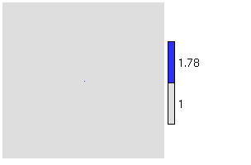

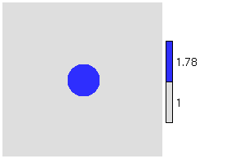

The Electromagnetic Weather Forecast
n gradient
Refraction
(a mirage)
Rayleigh scattering
(blue sky)
A sphere
(silver lining)
Refractive index Total E_{z} field
Single dipole
Refractive index Total E_{z} field
Scattered field

Slide 7
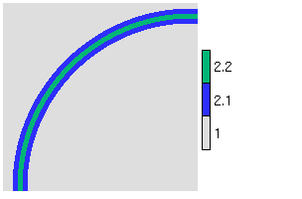
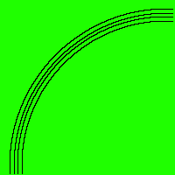
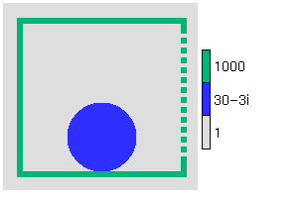
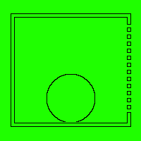
Non-atmospheric examples
Single-mode optic fibre
Potato in a microwave oven
Refractive index Total E_{z} field
Many more animations at www.met.rdg.ac.uk/clouds/maxwell
(interferometer, diffraction grating, dish antenna, clear-air radar, laser…)

Slide 8
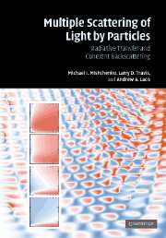
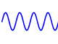
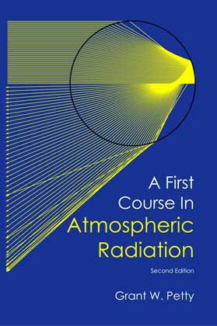
From Maxwell… …to the two-stream equations
Maxwell’s equations in terms of fields E(x,t), B(x,t)
Mishchenko et al. (2007)
Reasonable assumptions:
  Ignore polarization
  Ignore time-dependence (sun is a continuous source)
  Particles are randomly separated so intensities add incoherently and phase is ignored
  No diffraction around features larger than individual particles
Unreasonable assumptions:
  Diffuse radiances in all directions represented by only 2 discrete directions
  Atmosphere within a model gridbox is horizontally infinite and homogeneous
  Details of the phase functions represented by one number, the asymmetry factor
3D radiative transfer in terms of monochromatic radiances I (x,Ω,ν)
Petty (2006)
1D radiative transfer in terms of two monochromatic fluxes F ±(z,ν)

Slide 9






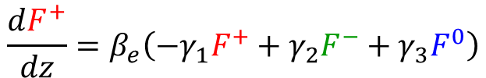
Two-stream equations (shortwave)
$$\frac{dF^{0}}{dz}={\frac{β_{e}}{μ_{0}}F}^{0}$$
Direct downwelling:
Diffuse upwelling:
Diffuse downwelling:
Or write in matrix form:
In the longwave, no F⁰ term and add Planck function on right-hand-side
$$z=z1$$
$$\frac{dF^{+}}{dz}=β_{e}\left({−γ}_{1}F^{+}+γ_{2}F^{−}+γ_{3}F^{0}\right)$$
$$\frac{dF^{−}}{dz}=β_{e}\left(γ_{1}F^{−}−γ_{2}F^{+}−γ_{4}F^{0}\right)$$
$$z=0$$
$$\frac{d}{dz}f=Γf$$
$$f=\left(\begin{matrix}F^{0} \\ F^{+} \\ F^{−}\end{matrix}\right)$$
where

Slide 10



Solving the two-stream equations in a single layer
For a homogeneous layer of thickness z₁ the general solution is:
where $e^{Γz1}$ is a matrix exponential (a 3x3 matrix)
In the 3x3 case, analytic formulas exist for each element, from which can get diffuse reflection R and transmission T of layer (Meador & Weaver 1980)
$$f(z1)=e^{Γz1}f(0)$$
F_{0.5}⁺
F_{0.5}⁻
Extension to multiple layers
Layer 1
S₁±
F_{1.5}⁺
F_{1.5}⁻
Layer 2
S₂±
$$F_{i−0.5}^{+}=T_{i}F_{i+0.5}^{+}+R_{i}F_{i−0.5}^{−}+S_{i}^{+}$$
F_{2.5}⁺
F_{2.5}⁻
Surface source S_{s}⁺, albedo α_{s}

Slide 11
Solution for two-level atmosphere
Solve the following tri-diagonal system of equations
Efficient to solve and simple to extend to more layers
  Can’t use Thomas’s algorithm due to possible zeros on the diagonal
Solution to this system is exactly equivalent to the adding method:
  Gaussian elimination ≡ moving up through atmosphere & computing total albedo below each level
  Backsubstitution ≡ moving down through atmosphere & computing fluxes from these total albedos
Top-of-atmosphere
Surface

Slide 12
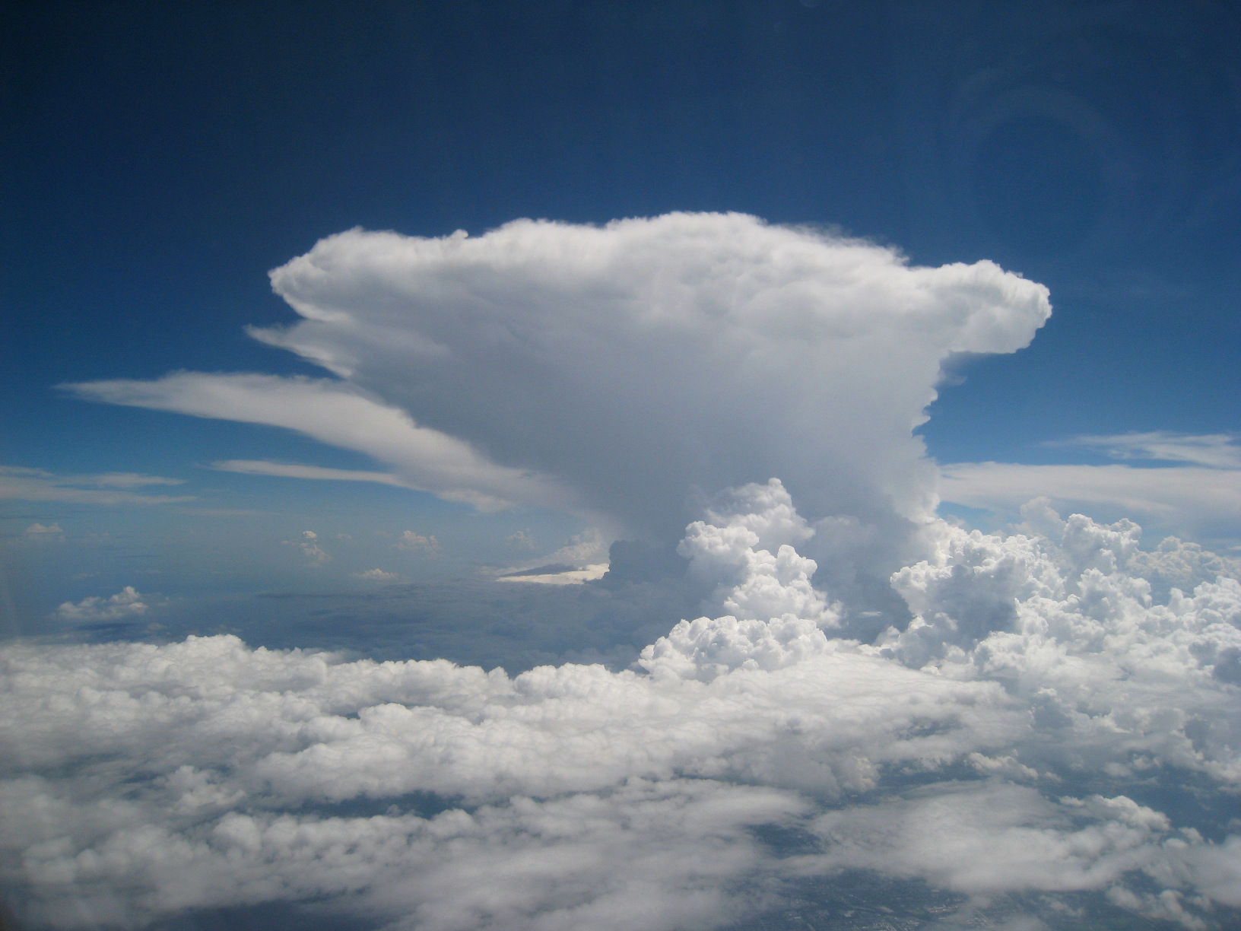
How do we compute how this interacts with radiation?

Slide 13
Plane-parallel, maximum-random overlap
Most models circa 2000
Model variables needed: cloud fraction, water content
Reflection & transmission computed for clear & cloudy regions separately
Fluxes merged at layer interfaces according to cloud fraction

Slide 14
Realistic overlap
Increases cloud cover and hence cloud radiative effect
Extra input: overlap decorrelation length from cloud radar ~2 km
  Ground-based (Hogan & Illingworth 2000, Mace & Benson-Troth 2002)
  CloudSat (Barker 2008, Shonk et al. 2010)

Slide 15
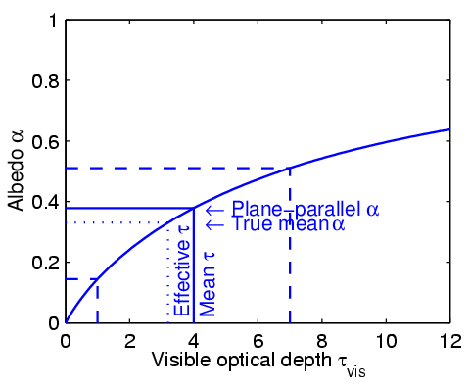
Tripleclouds (Shonk & Hogan 2008)
Cloud structure reduces cloud radiative effect
Cloud water fractional standard deviation ~0.75
  Satellite & cloud radar (Barker, Shonk, Cahalan, Oreopoulos, Rossow…)
Cloud water overlap decorrelation length ~1 km
  Ground-based cloud radar (e.g. Hogan & Illingworth 2003)

Slide 16
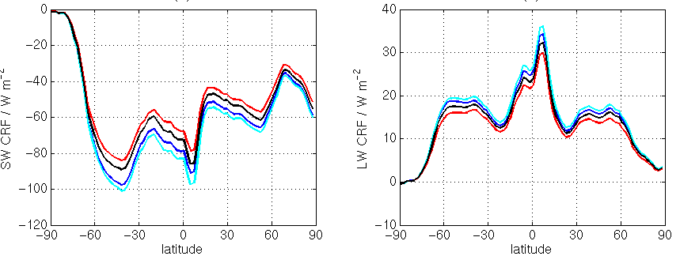
Global impact of cloud inhomogeneity and overlap
Plane-parallel, maximum-random
Top-of-atmosphere cloud radiative forcing
Shortwave
Longwave
Fix only overlap
Fix only inhomogeneity
Fixing just horizontal structure (blue to red) would overcompensate the error
Fixing just overlap (blue to cyan) would increase the error
Need to fix both overlap and horizontal structure
Fix overlap and inhomogeneity
Shonk & Hogan (2010)

Slide 17
Monte-Carlo Independent Column Approximation (McICA) – Pincus et al. (2005)
Info required similar to Tripleclouds but computationally a little faster
Use of stochastic cloud generator leads to some noise in fluxes
Now used in many (most?) global weather and climate models

Slide 18
Full Monte Carlo (being investigated by Barker et al.)
“It’s better to solve the right problem approximately than the wrong problem exactly,” or “random errors are better than biases.”
Use 3D cloud distribution generated by a stochastic model in each gridbox
How many light rays are needed for random errors to be tolerable? 500?
  NWP models can tolerate random errors less than climate models
Monte Carlo at least provides good benchmark for approximate schemes

Slide 19
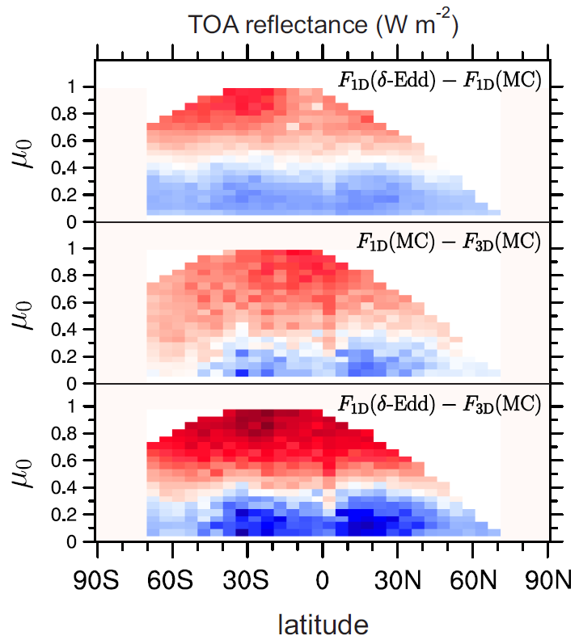
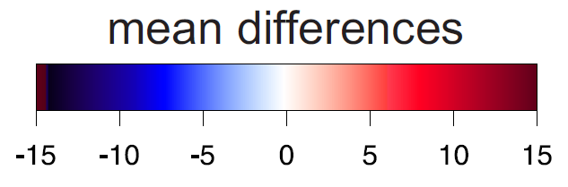
Shortwave errors due to 2-stream and 1D approximations
Barker et al. (in press 2015) using A-Train scenes
Overhead sun
Error due to only 2 streams
  2 streams minus infinite streams
  Up to around 10% of cloud radiative effect
Error due to neglecting 3D effects
  1D minus 3D
  Up to around 10% of cloud radiative effect
  Warning! Scenes are strictly only 2D
Error due to both assumptions
  Errors strongly correlated
Sun near horizon

Slide 20
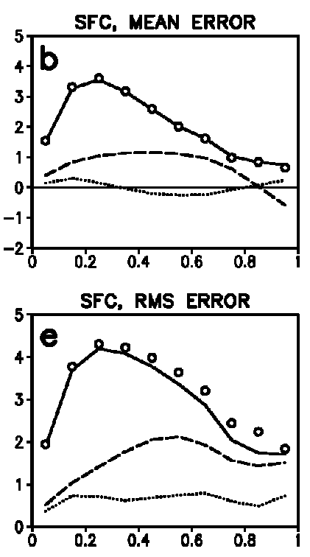

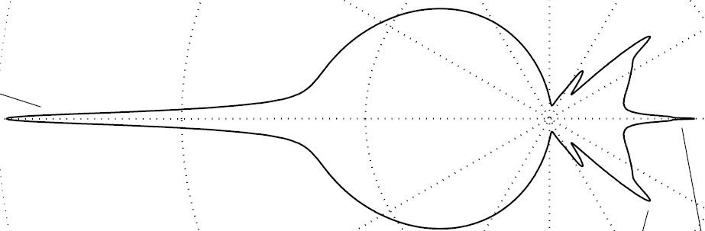
Reducing 2-stream errors
2-stream
Main problem is in optically thin clouds
  Single scattering dominates, so full details of phase function needed to predict reflection/transmission at all sun angles
  Almost all 2-stream models use the highly simplified δ-Eddington phase function (including the IFS)
4 streams much more accurate (twice the cost)
Räisänen (2002) significantly reduced error by tuning the 2-stream γ coefficients separately for droplets, ice crystals and aerosols
2-stream (tuned)
4-stream
*
Mie phase function
δ-Eddington phase function
Sun near horizon
Overhead sun

Slide 21
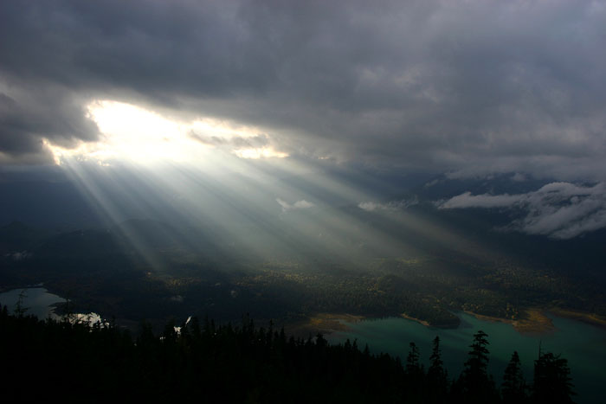
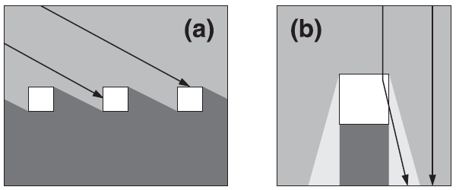
Errors due to neglecting 3D effects
Shortwave side illumination
  Strongest when sun near horizon
  Increases chance of sunlight intercepting cloud
Shortwave side escape
  Strongest when sun near zenith
  Forward scattering leads to more sunlight reaching the ground
Longwave effect
  Radiation can now be emitted from the side of a cloud
  3D effects can increase surface cloud forcing by a factor of 3 (for an isolated, optically thick, cubic cloud in vacuum!)

Slide 22
SPARTACUS (Hogan & Shonk 2014)
“Speedy algorithm for radiative transfer through cloud sides”
Effective cloud diameter – need more observations!
  Stratocumulus from MODIS: ~10 km (Jensen et al. 2008)
  Cumulus in cloud-resolving models: ~500 m (Schaefer)
  Cumulonimbus: ~8 km (Stein et al. 2015)

Slide 23




Extending the two-stream equations
More diffuse streams, e.g. 4
Rates of exchange between streams can be calculated from the scattering phase function
In both cases we have the same equation and solution as before:
Transport through cloud sides
Exchange between regions calculated from effective cloud diameter (Hogan & Shonk 2014)
Use 3 regions (2 cloudy) to capture cloud inhomogeneity (Shonk & Hogan 2008)
$$f=\left(\begin{matrix}F^{0} \\ \begin{matrix}F^{1} \\ F^{2}\end{matrix} \\ \begin{matrix}F^{3} \\ F^{4}\end{matrix}\end{matrix}\right)$$
$$f=\left(\begin{matrix}\begin{matrix}F^{a0} \\ F^{b0}\end{matrix} \\ \begin{matrix}F^{a+} \\ F^{b+}\end{matrix} \\ \begin{matrix}F^{a−} \\ F^{b−}\end{matrix}\end{matrix}\right)$$
Region a (clear)
Region b (cloudy)
$$\frac{d}{dz}f=Γf$$
$$f(z1)=e^{Γz1}f(0)$$

Slide 24
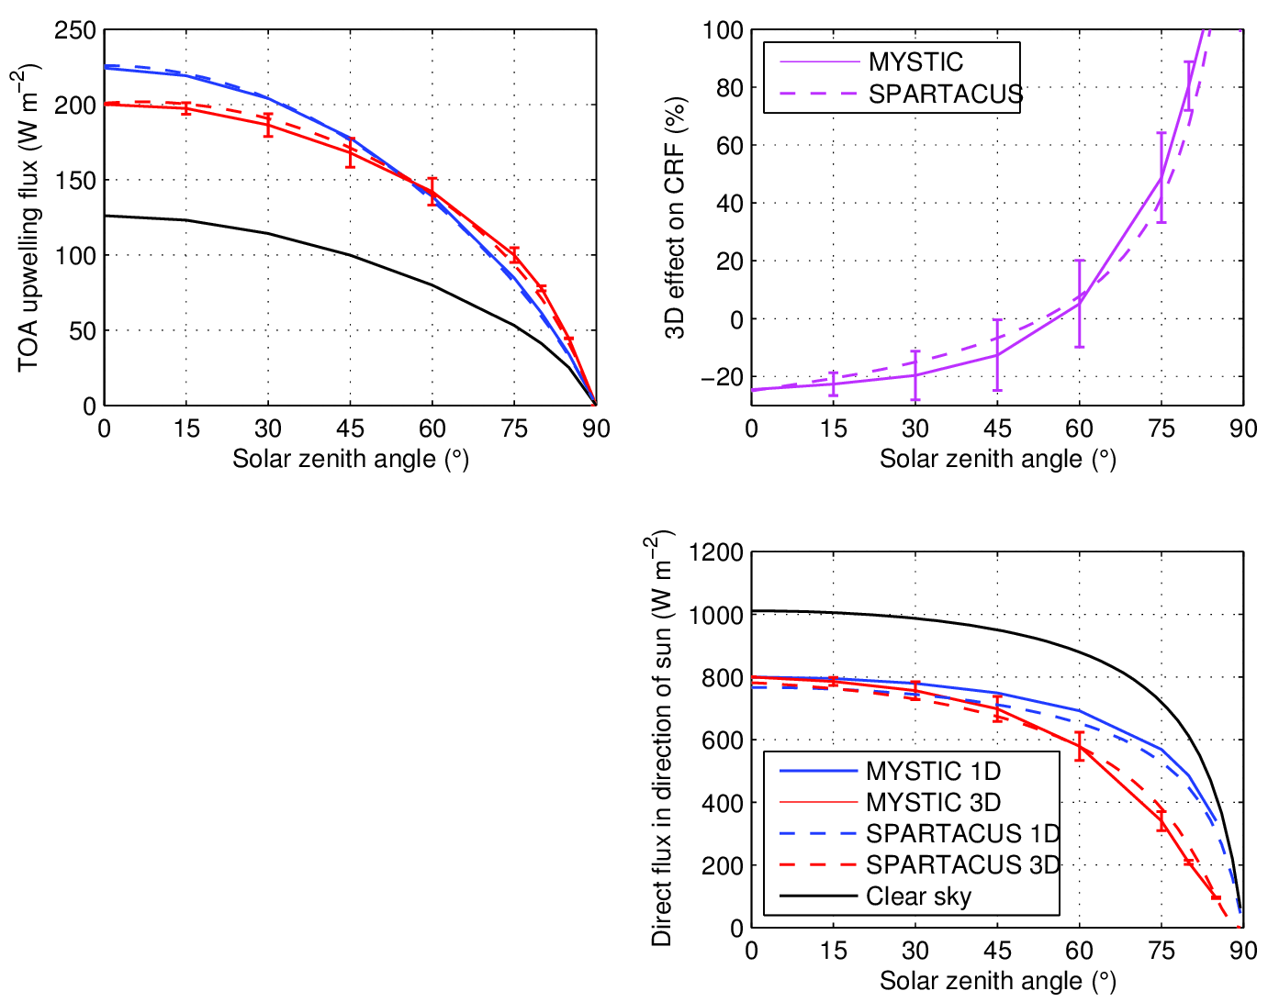
Broadband shortwave SPARTACUS vs Monte Carlo
SPARTACUS coded up in Fortran 90 with RRTM-G for gas absorption
Compare to full 3D Monte Carlo calculation from MYSTIC in cumulus
  Thanks to Carolin Klinger & Bernhard Mayer, LMU Munich
  Mean of 4 solar azimuths, error bar indicates standard deviation due to sun orientation
Good match!
3D effect up to 20 W m⁻², similar to inhomogeneity effect
Large difference in direct surface flux at large solar zenith angle
  SPARTACUS direct fluxes agree better with ARM observations

Slide 25
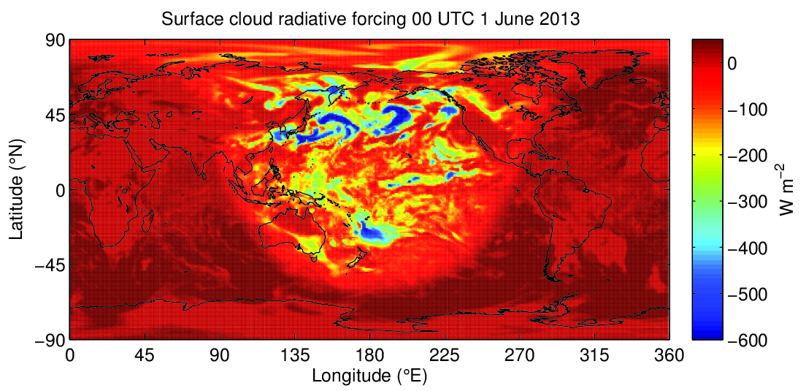
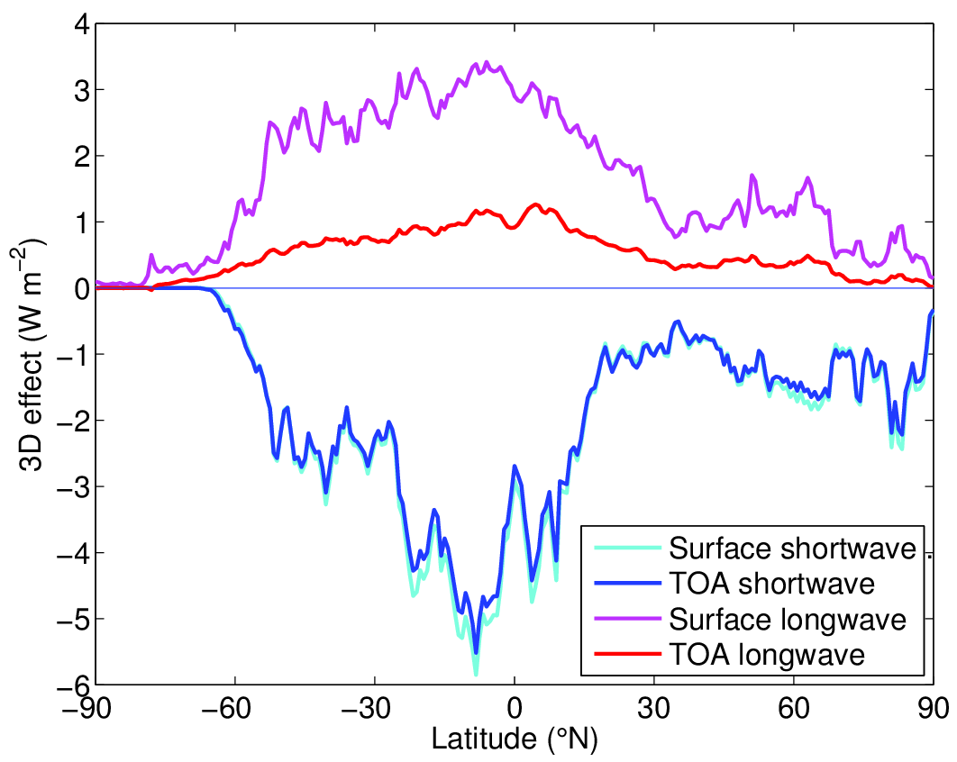
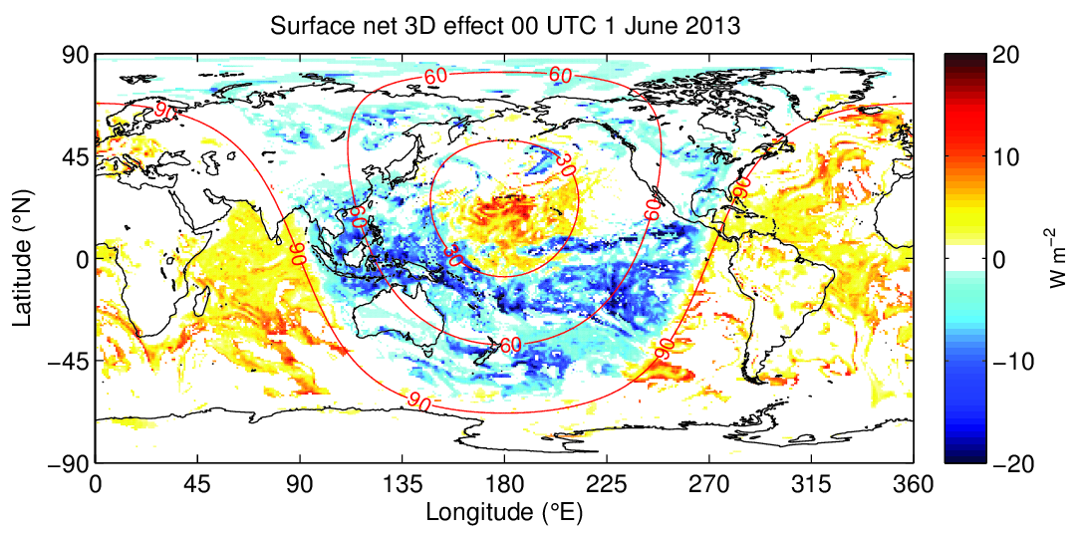
Towards a global estimate of the impact of 3D effects
Instantaneous cloud radiative forcing calculated by applying SPARTACUS to one ERA-Interim cloud field
3D effect is appreciable!
Next step: annual mean
Solar zenith angle
Night-time: positive LW effect
Low sun:
negative SW effect
High sun:
positive SW effect

Slide 26
Are we using computer time wisely?
Radiation is an integral:
Dimension | Typical number of quadrature points | How well is this dimension known? | Consequence of poor resolution
Time | 1 every 3 hours | At the timestep of the model | Changed climate sensitivity (Morcrette 2000); diurnal cycle (Yang & Slingo 2001)
Angle | 2 (sometimes 4) | Well (some uncertainty on ice phase functions) | ±6-8 W m⁻² (Stephens et al. 2001, Barker et al. 2015)
Space | 2 (clear+cloudy) McICA: equal to spectral intervals | Poorly (clouds!) | Up to a 20 W m⁻² long-term bias (Shonk and Hogan 2010)
Spectrum | 70-260 | Very well (HITRAN database) | Incorrect climate response to trace gases?
But only every 6th gridpoint!

Slide 27
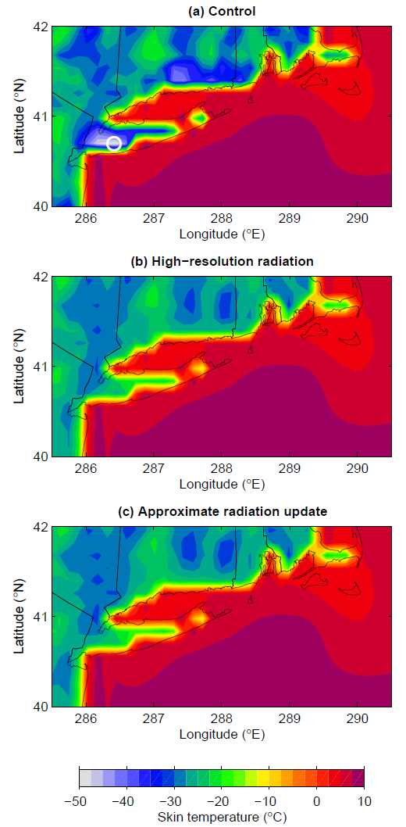
Approximate radiation updates
Hogan & Bozzo (JAMES 2015)
IFS can have large temperature errors at coasts due to running radiation at coarser resolution
New scheme updates longwave and shortwave fluxes every timestep and gridpoint in response to surface albedo and skin temperature
Fixes errors due to spatial interpolation at a cost of only around 2% that of the radiation scheme
T_{skin} 25 K colder
Long Island 0700 LT

Slide 28
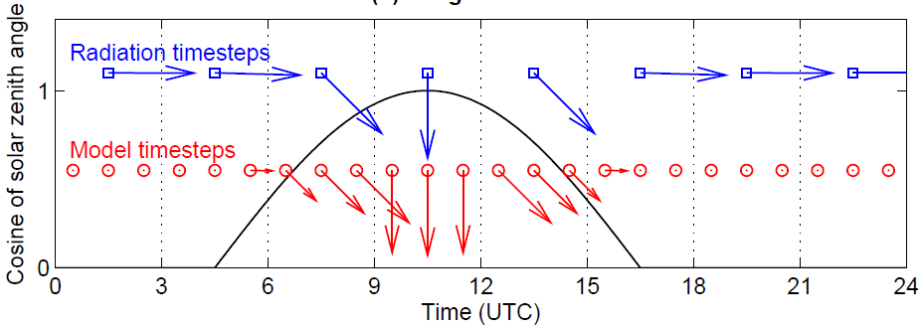
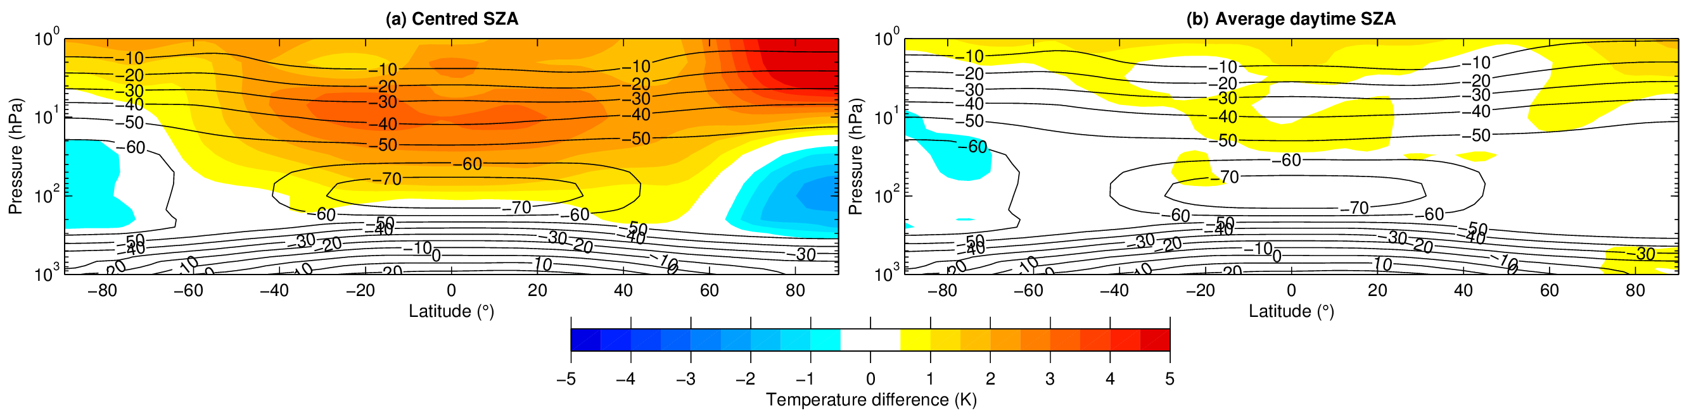
Climate errors due to infrequent calls to radiation scheme
All but one operational IFS configurations call radiation scheme only every 3 h
At dawn & dusk, sun angle at centre of 3-h period too shallow: absorption too high
Stratosphere too warm by 3-5 K (compared to running radiation scheme every timestep)
Fix by averaging cosine of solar zenith angle over sunlit part of radiation timestep
Hogan & Hirahara (ECMWF memo 2015)

Slide 29
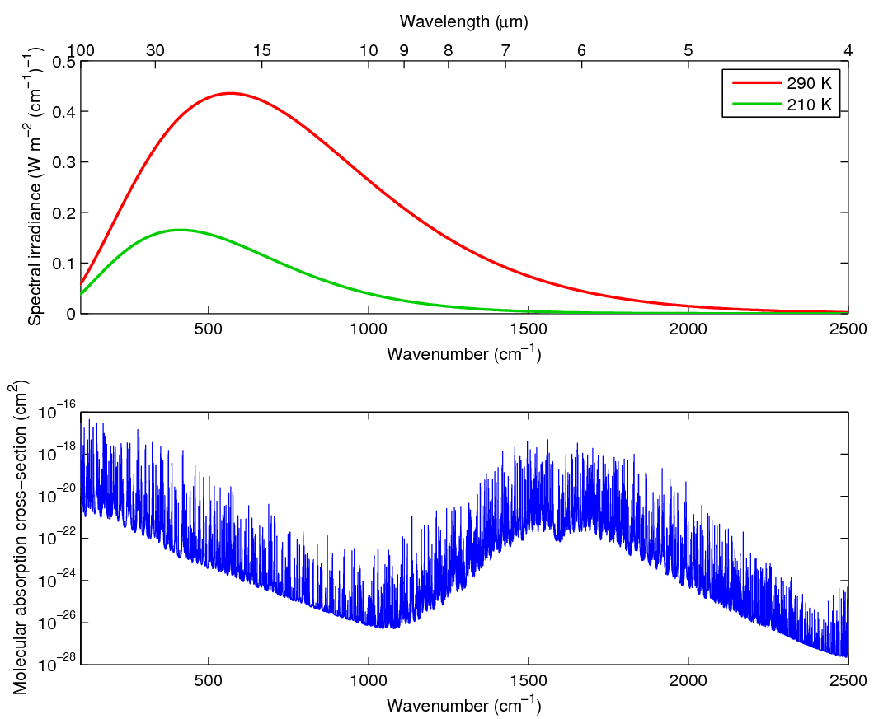
How do we integrate across the spectrum?
Consider one gas in longwave
Rapid spectral variation: need ~10⁵ monochromatic radiation calculations?
Water vapour spectrum Planck function

Slide 30
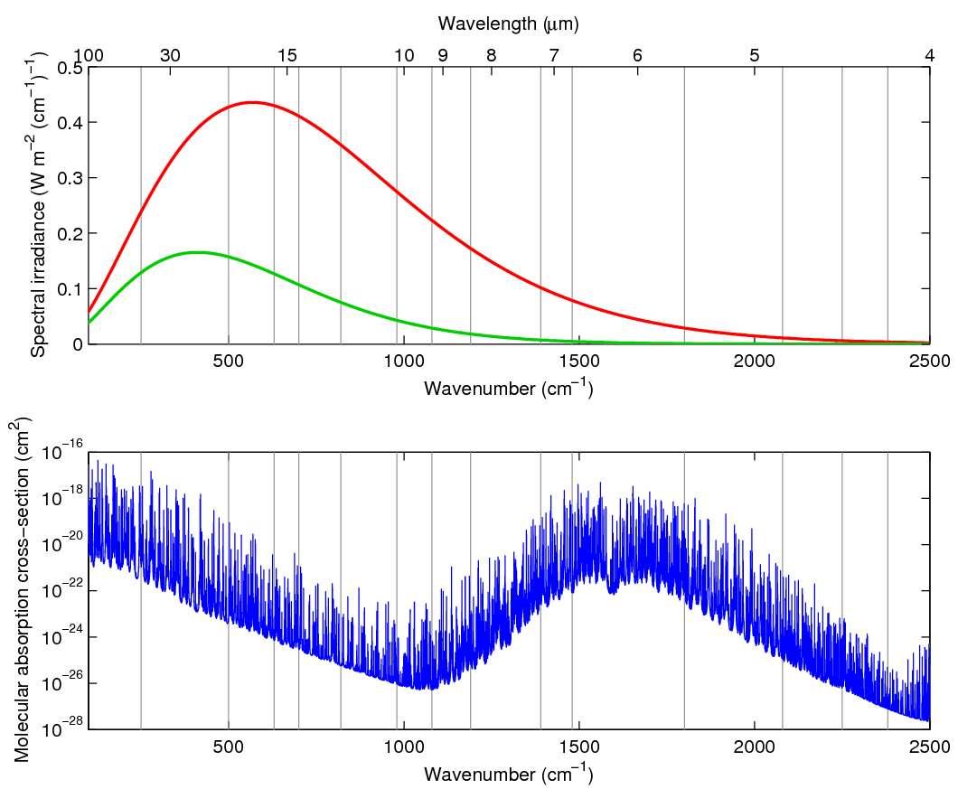
Divide into bands
Divide into the 16 bands of RRTM/RRTM-G model (Mlawer et al. 1997)
Water vapour spectrum Planck function

Slide 31
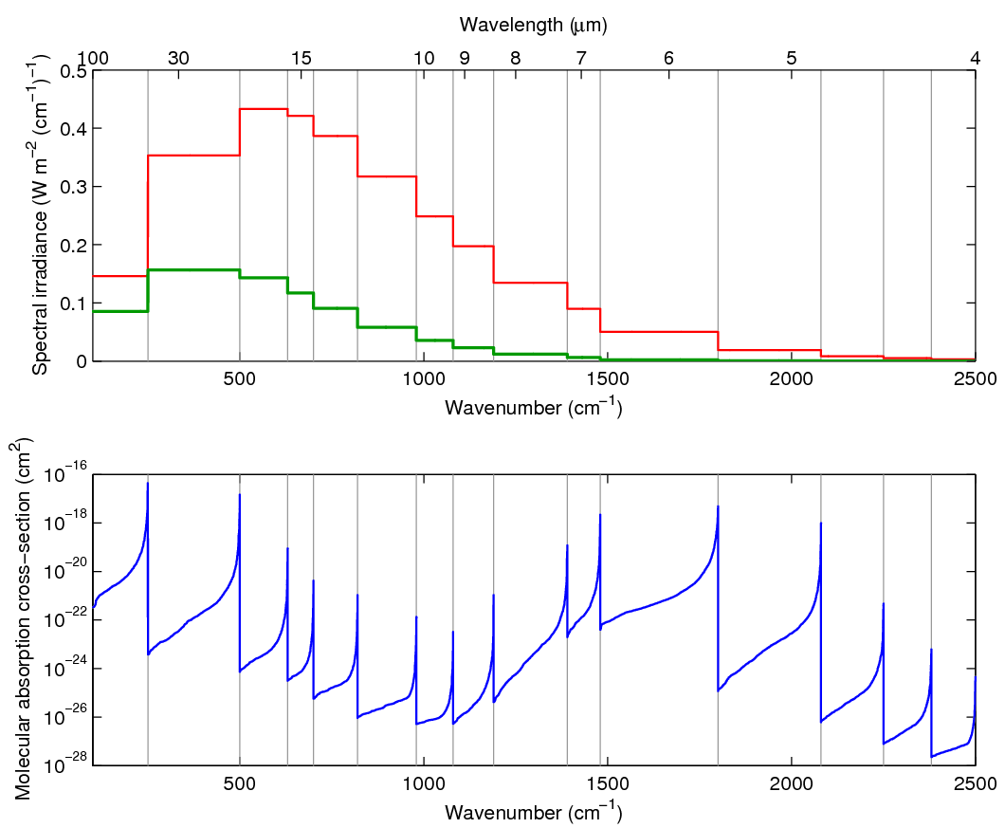
The correlated k-distribution method
In each band, sort absorption spectrum and average the Planck function
More conducive to numerical integration
Lacis & Oinas (1991)
Water vapour spectrum Planck function

Slide 32
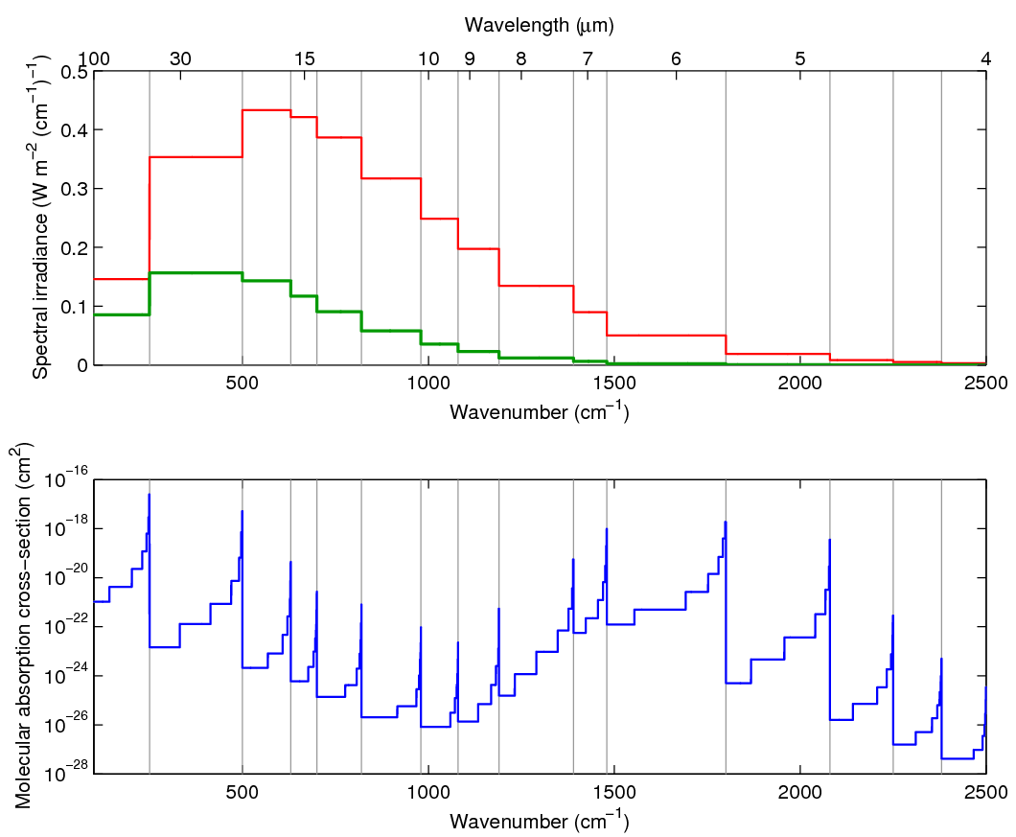
The correlated k-distribution method
Discretize sorted absorption coefficients into 2-16 intervals in each band
RRTM-G needs 140 “g-points” (monochromatic calculations) for longwave when all gases considered
Water vapour spectrum Planck function

Slide 33
Full-spectrum correlated-k (FSCK) method
Water vapour spectrum Planck function

Slide 34
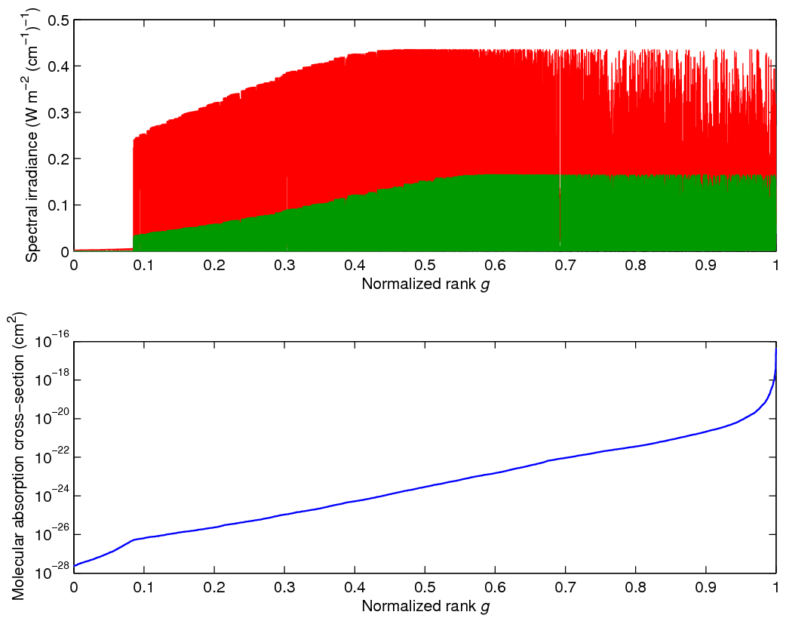
Full-spectrum correlated-k (FSCK) method
Water vapour spectrum Planck function
Reorder the entire longwave spectrum

Slide 35
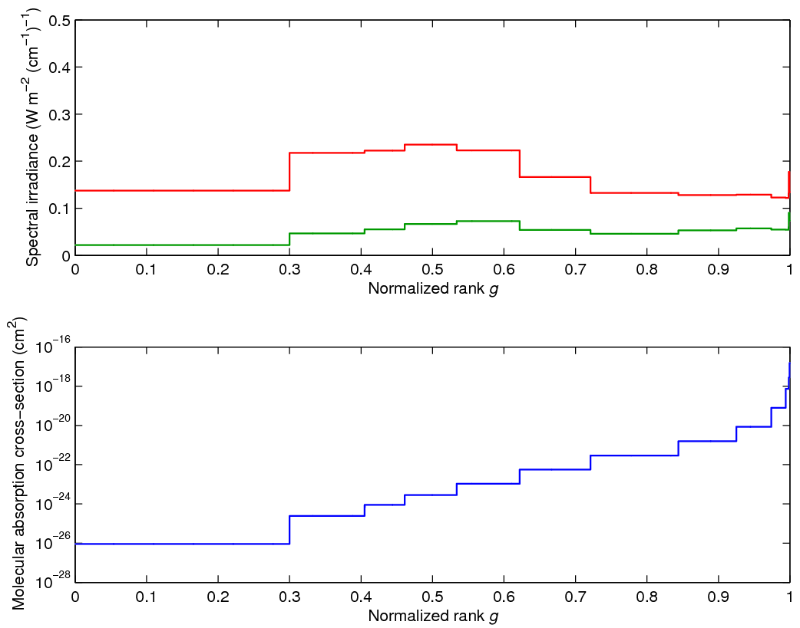
Full-spectrum correlated-k (FSCK) method
Discretize such that heating rate error in each interval is less than some tolerance
Integrate Planck function across interval
Far fewer g-points required
Water vapour spectrum Planck function

Slide 36
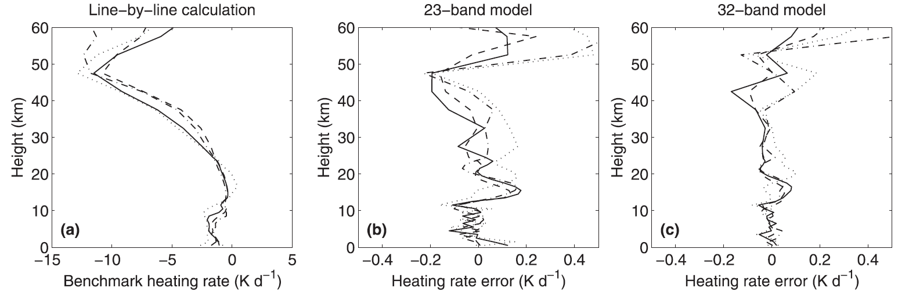

Performance of longwave FSCK on test profiles
Hogan (2010)
FSCK performance apparently similar to RRTM-G but with 25% the number of spectral intervals
FSCK possible in shortwave (Pawlak et al. 2004)
More work needed!
  Only considered longwave with H₂O, CO₂, O₃ so far
  Need to include clouds and aerosols
Good enough for NWP?
RRTM: 256 g-points
RRTM-G: 140 g-points
Mlawer et al. (1997)

Slide 37
Summary and outlook
Representation of cloud structure and overlap in radiation schemes is much improved compared to 15 years ago
  McICA is now the de facto standard for radiation schemes in weather and climate models
Look for opportunities to improve accuracy with no increase in cost
  “Tuned” 2-stream method; better continuum absorption models
  Approximate updates to fluxes to mitigate errors due to radiation calls infrequent in time and space
Opportunities to represent new physical processes with modest cost increase
  3D effects with SPARTACUS
Large number of spectral intervals limits what we can afford in other areas
  Faster implementation of RRTM-G, e.g. on GPUs
  Alternative approaches such as FSCK?
Plans for a new ECMWF radiation scheme
  Modular: solver and cloud, aerosol & gas optical models can be interchanged independently
  Open source off-line version to be released
Remember that radiative fluxes are only as good as the cloud and aerosol data coming from the host model!

Slide 39




The four components of a radiation scheme
Gas optical properties
Cloud optical properties
Aerosol optical properties
Determines spectral resolution
RRTM-G uses 252 spectral intervals
Determines how sophisticated interactions with clouds will be
Solver
Codes should be modular, allowing components to be changed independently

Slide 40
Building blocks of atmospheric radiation
Emission and absorption of quanta of radiative energy
  Governed by quantum mechanics: the Planck function and the internal energy levels of the material
  Responsible for complex gaseous absorption spectra
Electromagnetic waves interacting with a dielectric material
  An oscillating dipole is excited, which then re-radiates
  Governed by Maxwell’s equations + Newton’s 2nd law for bound charges
  Responsible for scattering, reflection and refraction
p
E
+
−
Oscillating dipole p is induced, typically in phase with incident electric field E
Dipole radiates in (almost) all directions

Slide 41




The 3D radiative transfer equation
This describes the radiance I in direction Ω (where the position and frequency dependence of all variables is implicit):
Loss by absorption or scattering
Source
Such as thermal emission
Gain by scattering Radiation scattered from all other directions
Spatial derivative representing how much radiation is upstream
$$I\left(Ω\right)+dI(Ω)$$
Direction Ω
Direction Ω’
$$I\left(Ω\right)$$
$$I\left(Ω′\right)$$

Slide 42



Extending the two-stream equations
Reflectance and transmittance of a layer are now matrices R and T:
Multi-layer problem is now block-tridiagonal, so still fairly efficient to solve
$$\left(\begin{matrix} & I & & & & \\ I & {−R}_{1} & {−T}_{1} & & & \\ & {−T}_{1} & {−R}_{1} & I & & \\ & & I & {−R}_{2} & {−T}_{2} & \\ & & & {−T}_{2} & {−R}_{2} & I \\ & & & & I & −α_{s}\end{matrix}\right)\left(\begin{matrix}f_{0.5}^{+} \\ f_{0.5}^{−} \\ f_{1.5}^{+} \\ f_{1.5}^{−} \\ f_{2.5}^{+} \\ f_{2.5}^{−}\end{matrix}\right)=\left(\begin{matrix}s_{0}^{−} \\ s_{1}^{+} \\ s_{1}^{−} \\ s_{2}^{+} \\ s_{2}^{−} \\ s_{s}^{+}\end{matrix}\right)$$

Slide 43

Forecast skill from temporal frequency of radiation calls
Forecast skill improves if radiation called every 1 h rather than every 3 h
  Half of this improvement is due to response of radiation fields to surface temperature; can be represented by keeping 3-h radiation but using approximate radiation updates in between (Hogan & Bozzo 2015)
  Half is due to interaction with clouds
Almost half spectral intervals important only in stratosphere and mesosphere
  Could run troposphere channels more frequently to capture response to fast changing surface and clouds (Manners et al. 2009)

