Slide 1

Exploiting multiple scattering in CALIPSO measurements to retrieve liquid cloud properties
Nicola Pounder, Robin Hogan,
Lee Hawkness-Smith, Andrew Barrett
University of Reading, Assimila Ltd., Met Office, ECMWF

Slide 2
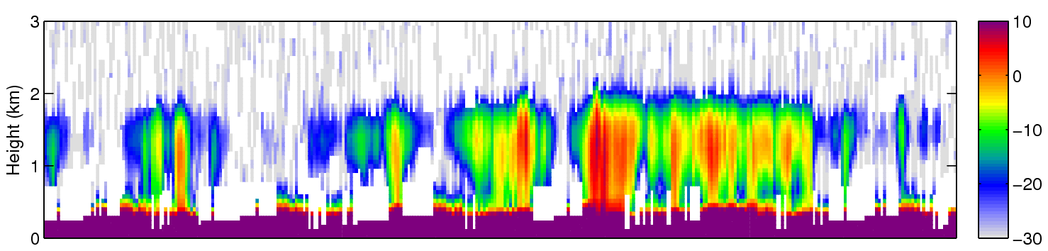
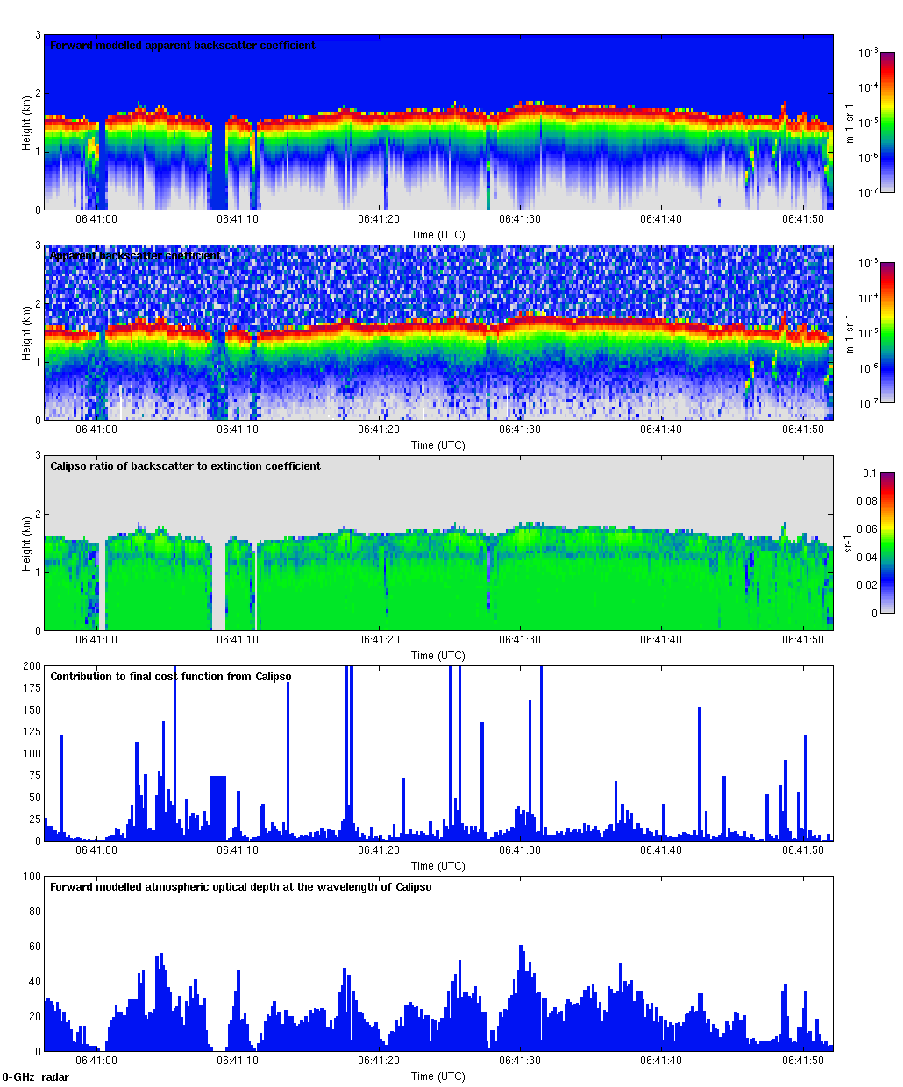
The problem with liquid clouds
90% of liquid clouds over the oceans; 90% of those contain drizzle
Lidar signal strongly attenuated & contaminated by multiple scattering
Can we use the lidar multiple scattering signal to estimate cloud properties (e.g. Polonsky & Davis 2004; Cahalan et al. 2005)?
CloudSat radar reflectivity factor (dBZ)
Where is cloud base?
Calipso lidar backscatter (m⁻¹ sr⁻¹)

Slide 3
Liquid cloud properties from space
High resolution (~1 km) integrated properties (LWP, τ) depend on:
CALIPSO multiple scattering can potentially fill a gap at night (in the day the solar background is usually too high)
 | Sea | Land
Day
Night
Shortwave radiances, e.g. MODIS (τ and LWP)
CloudSat path-integrated attenuation (LWP, Lebsock et al. 2011)
CALIPSO multiple scattering? (τ)

Slide 4
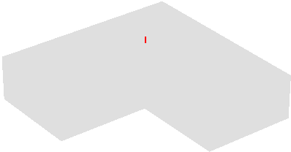
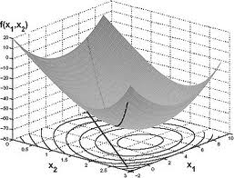
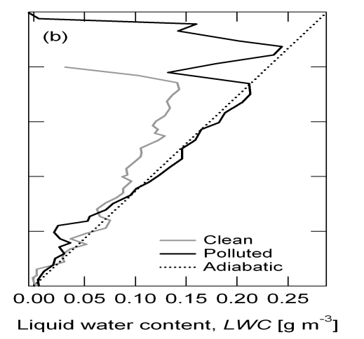
Retrieval ingredients
Fast forward model for lidar multiple scattering
  Hogan (2008) for small-angle scattering
  Hogan and Battaglia (2008) for wide-angle
  Several milliseconds to compute a profile
Variational retrieval framework
  “CAPTIVATE” (Clouds, Aerosol and Precipitation from mulTiple Instruments using a VAriational TEchnique)
  Will generate an official product for EarthCARE
One-sided gradient constraint
  Add a term to the cost function to penalize LWC gradients that are steeper than adiabatic
Earle et al. (2011)

Slide 5
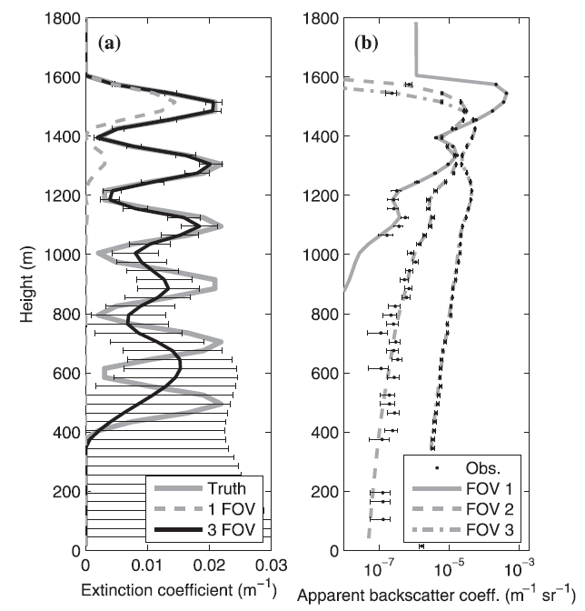
Multiple-FOV lidar
Pounder et al. (2012) showed that this approach with three fields of view could retrieve the vertical extinction profile down to around 6 optical depths
Good constraint on much higher optical depths
Applied to airborne THOR lidar

Slide 6
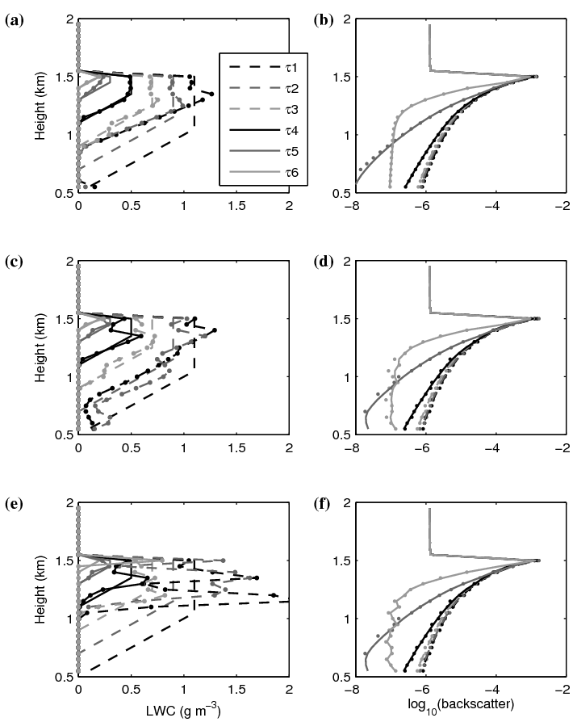
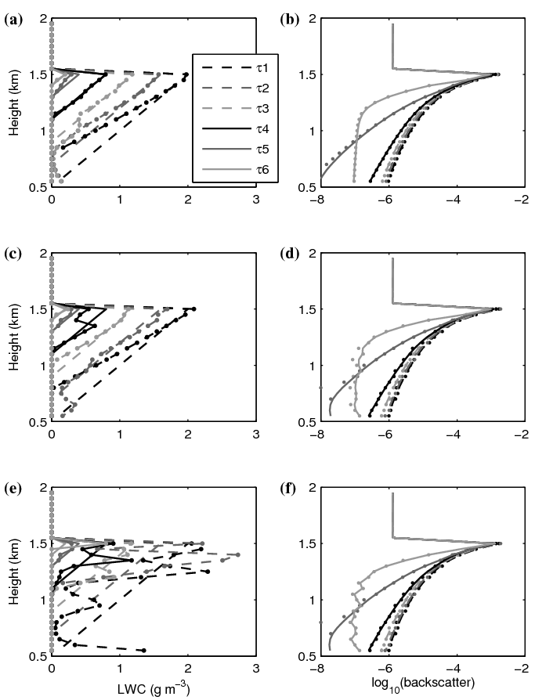
Single FOV lidar (e.g. CALIPSO)?
78
54
35
19
7
2.6
Simulated clipped triangular profile
  with gradient constraint
Triangular profile
  with gradient constraint
Triangular profile
  without gradient constraint
  Much poorer profile
Optical depth
90
62
39
21
7
2.6

Slide 7
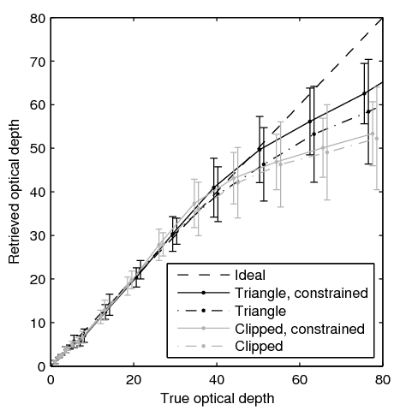
Optical depth
Retrieved optical is unbiased up to around 50
Larger values tend to be underestimated
  Not many photons get back from this deep in the cloud
If gradient constraint turned off:
  Much poorer extinction profile
  But retrieved optical depth only slightly poorer

Slide 8
Application to real CALIPSO data
CALIPSO attenuated backscatter observations:
At final iteration of retrieval, forward-modelled backscatter looks like:

Slide 9
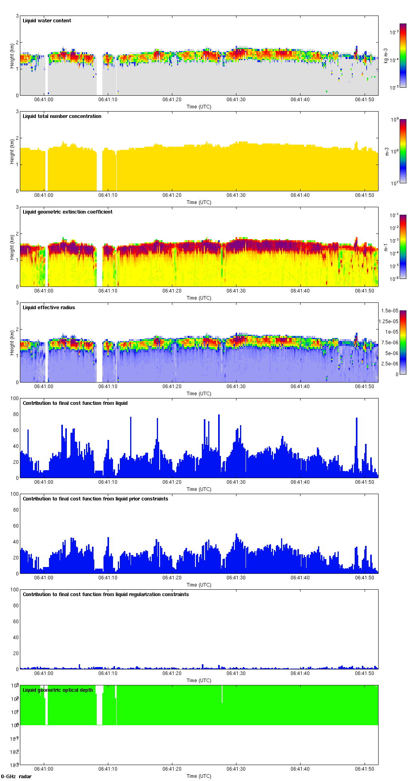
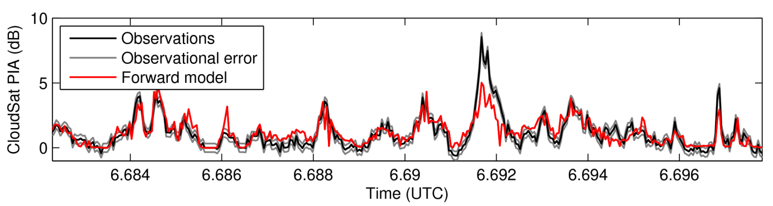
Calipso-only retrievals (assume fixed N_{d} )
LWC
Effective radius
Optical depth
CloudSat PIA

Slide 10
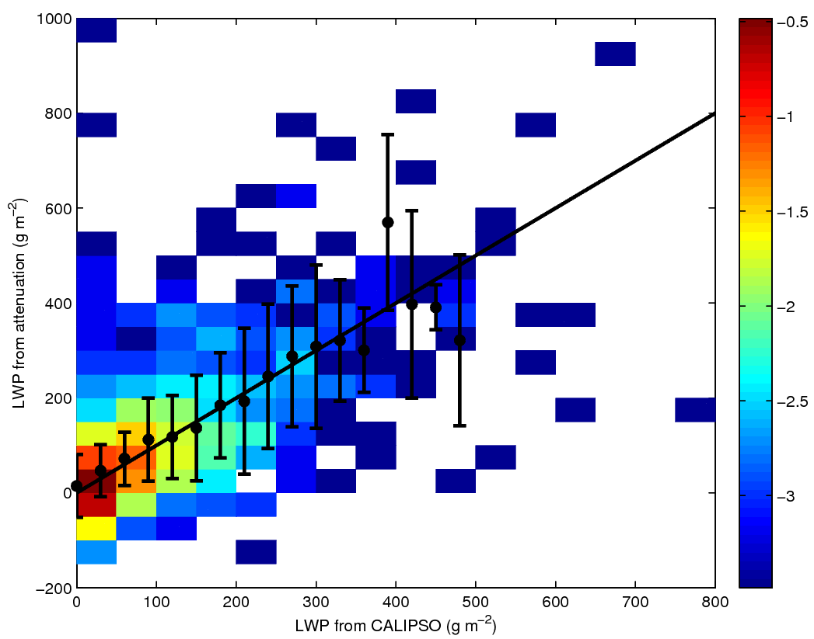
Comparison to CloudSat-estimated LWP
Hawkness-Smith (PhD, 2010) derived LWP from CloudSat path-integrated attenuation over oceans
  Similar to Lebsock et al. (2011)
Unbiased agreement with CALIPSO multiple scattering retrieval for assumed number concentration
  Some scatter!
Liquid water path from CloudSat PIA (g m⁻²)
Liquid water path from CALIPSO multiple scattering (g m⁻²)

Slide 11
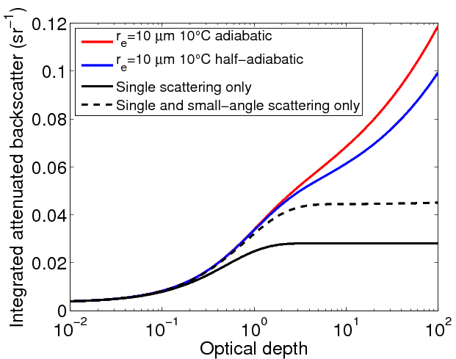
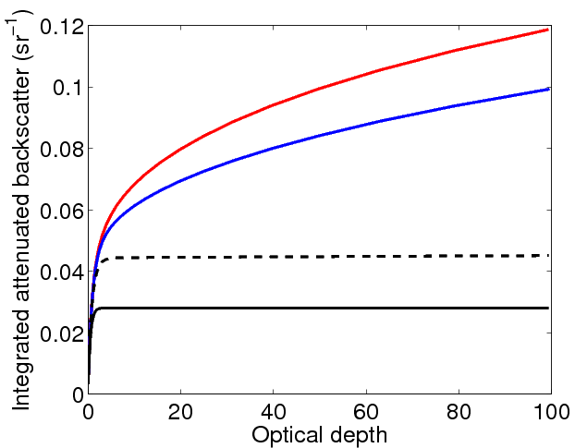
A simpler approach?
Optical depth can be estimated simply from integrated backscatter B!
  Some dependence on the shape of the extinction profile
  Ground-based lidar: weak wide-angle multiple scattering leads to constant B with optical depth so can use for calibration (O’Connor et al. 2004)

Slide 12
Summary and outlook
Via a fast multiple scattering model, we can interpret CALIPSO backscatter at night to retrieve optical depth and to some extent the vertical profile of extinction
This capability is part of “unified” CAPTIVATE retrieval scheme that will be applied to A-Train and EarthCARE data
Will be more difficult with EarthCARE due to narrower field of view
Recently developed a fast forward model for lidar depolarization due to multiple scattering, which could provide an additional constraint
The extinction coefficient profile would be retrieved much better from a future spaceborne lidar with multiple fields of view!

