Slide 1

Meteorology & Climate
Work Experience week 2015
Department of Meteorology
Welcome to the Department of Meteorology and Met Office Work Experience Week 2015!

Slide 2


Emergencies
On hearing the fire alarm make your way to the nearest available safe exit route and leave the building without delay.
The fire assembly point is located at the far side of the car park in front of the Department.
Notes:
Once you have left the building make your way to the fire assembly point which is located at the far side of the car park in front of the Department. Do not re-enter the building. Wait at the assembly point until you are informed by the Evacuation Officer or University Security that it is safe to return to the building.

Slide 3
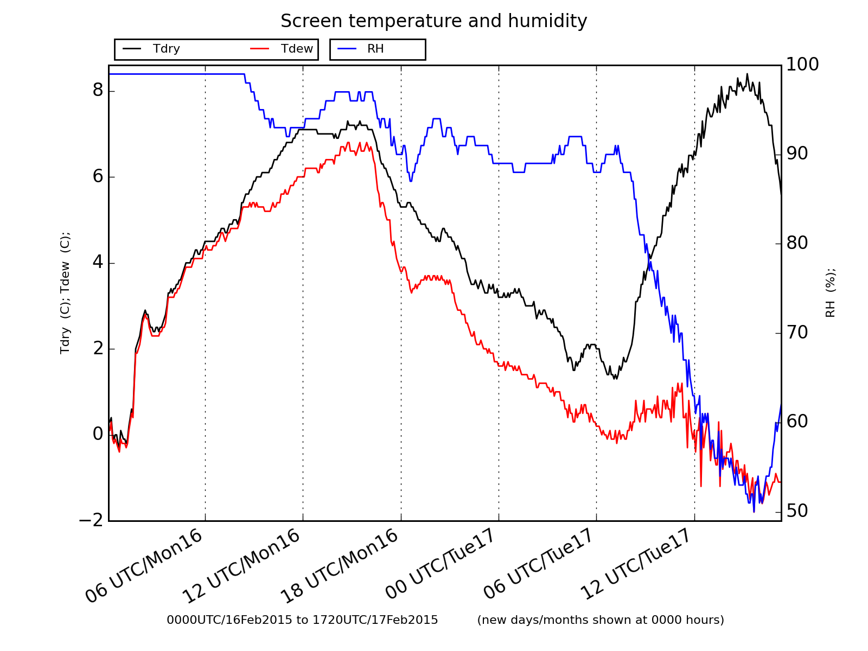
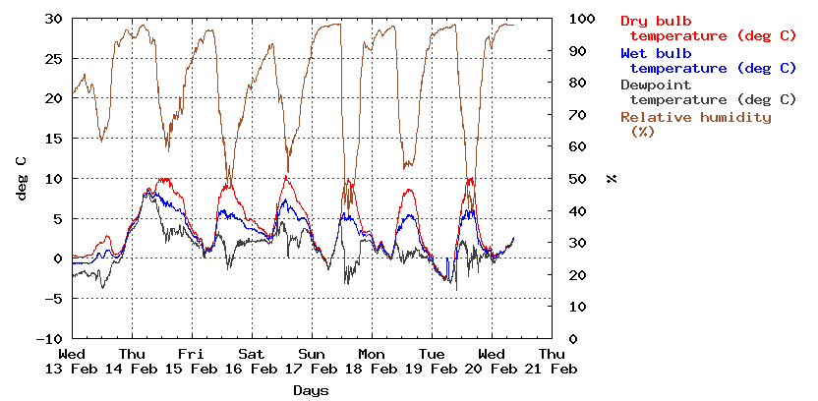
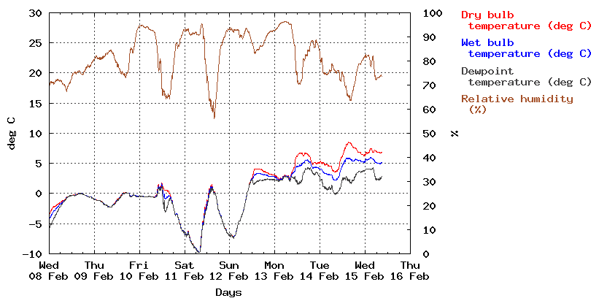
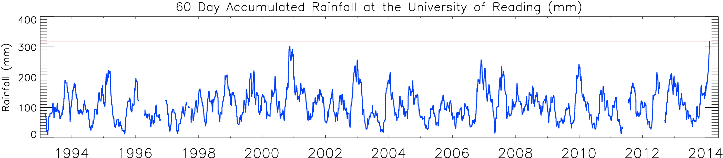
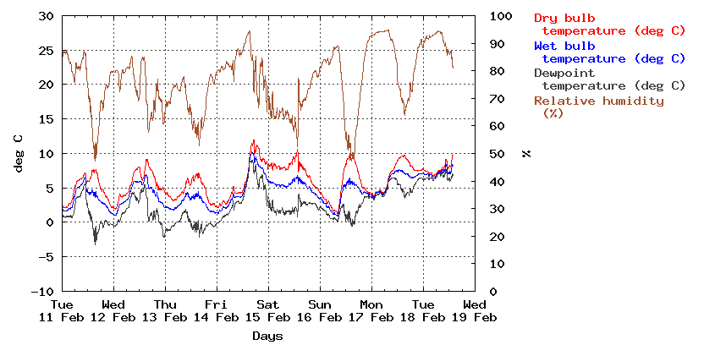
How do we observe the weather?
Notes:
Add in recent observations from field site

Slide 4
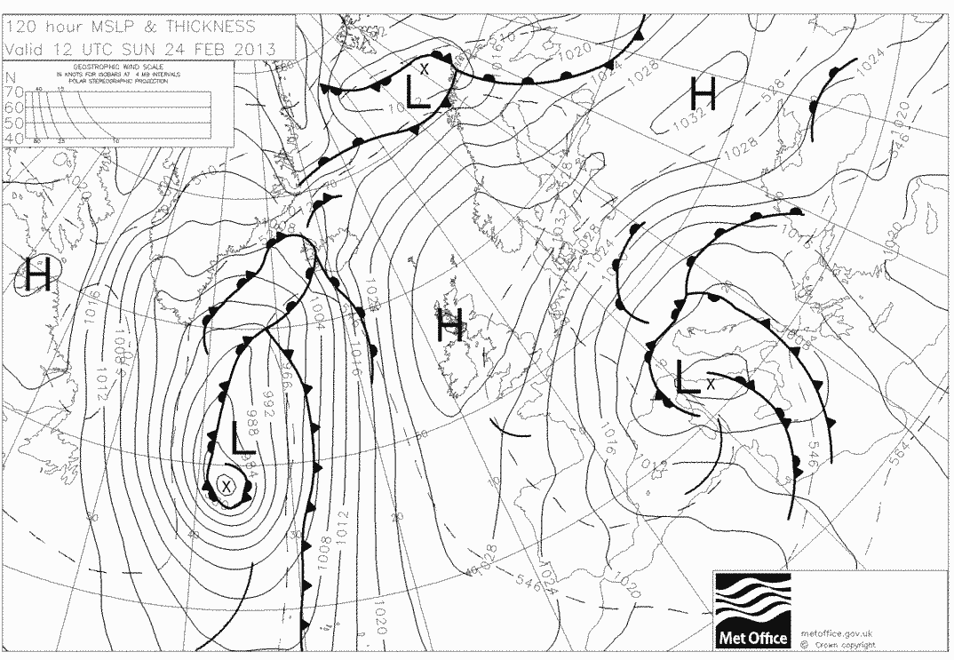
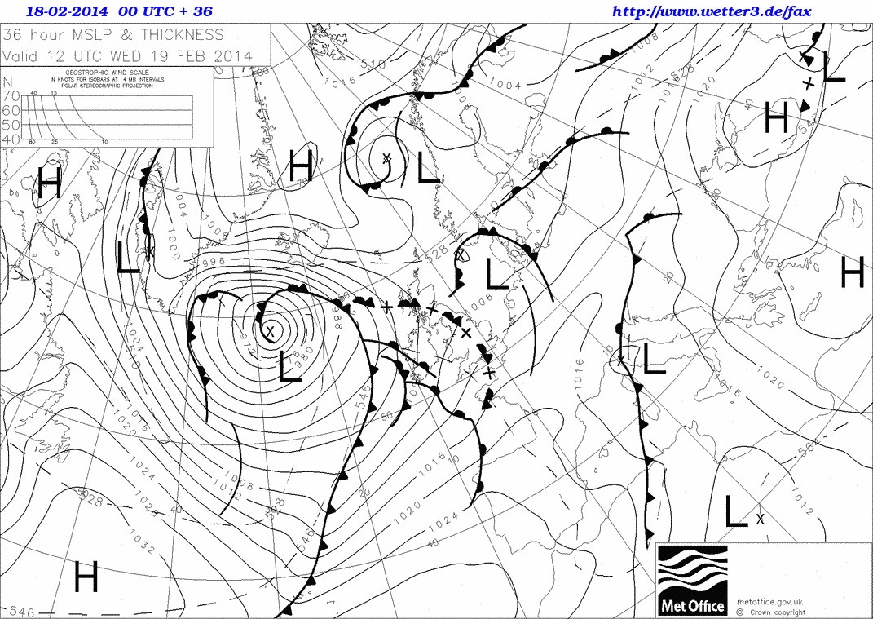
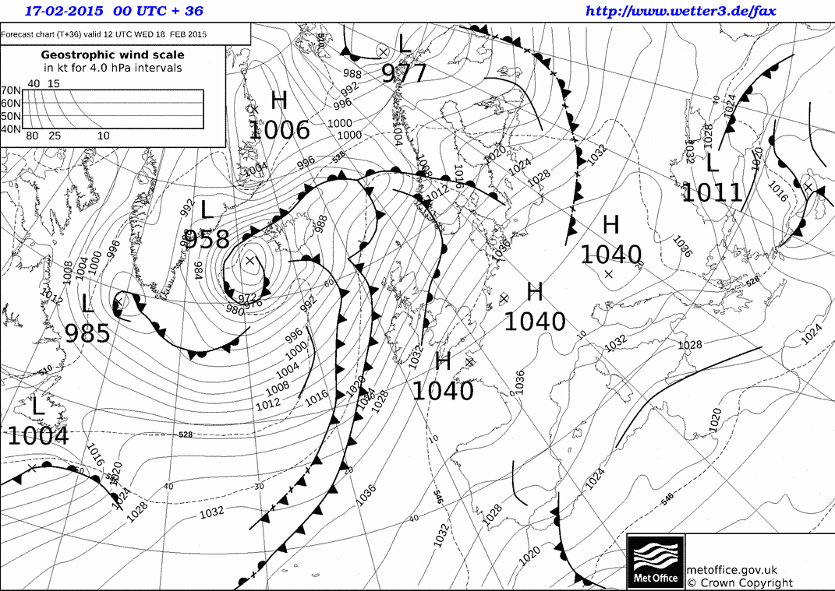
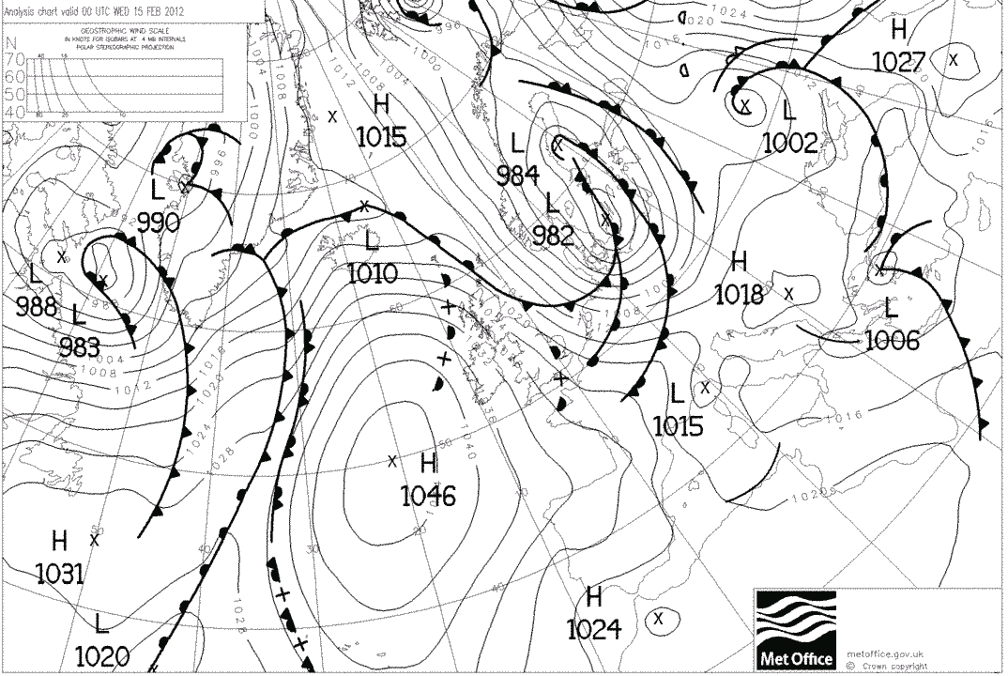
How do we interpret the weather?

Slide 5
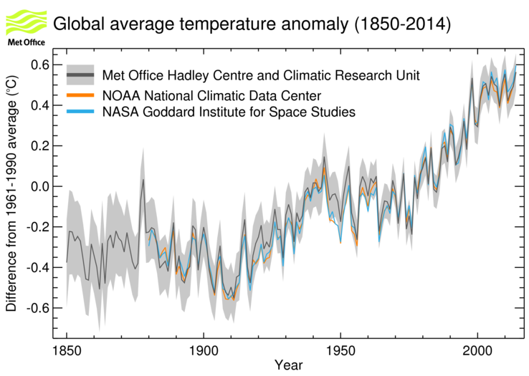
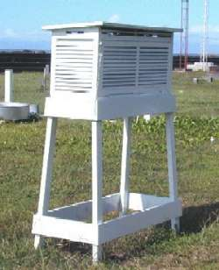
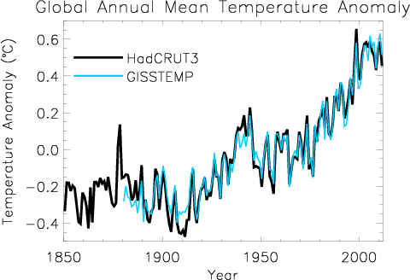
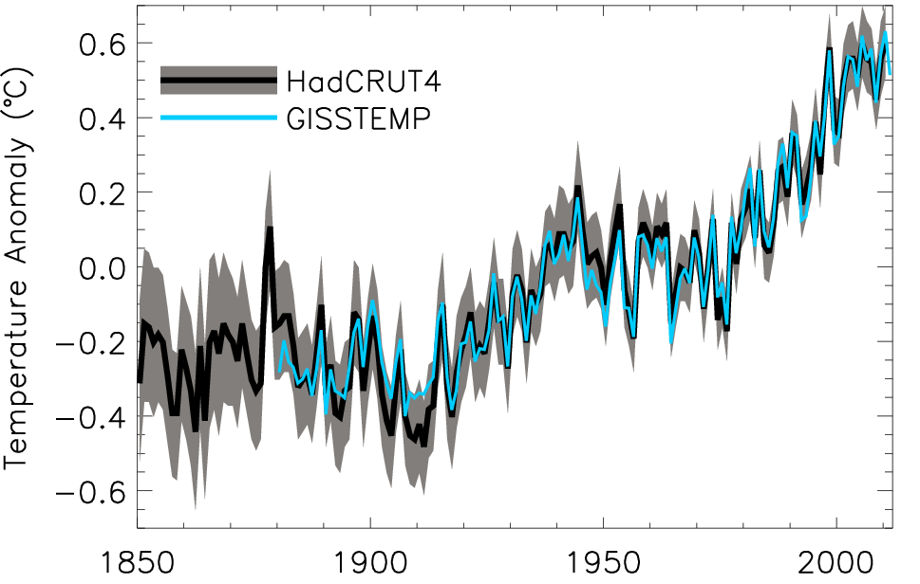
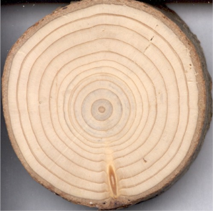
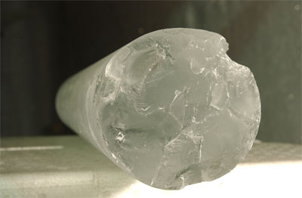
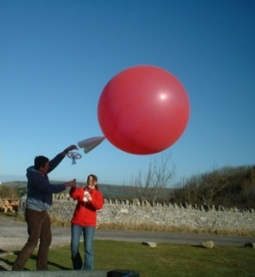
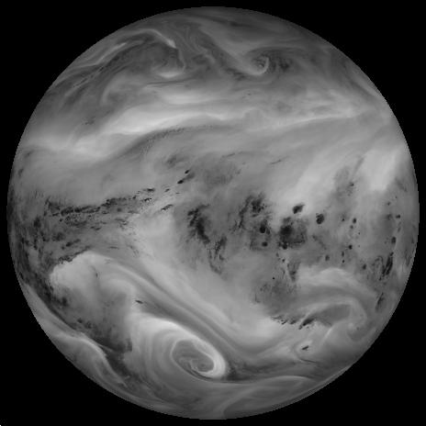
How do we measure climate?

Slide 6
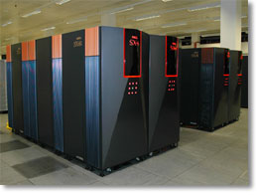

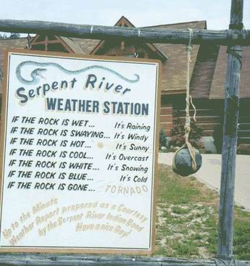
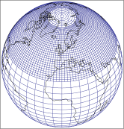


How do we predict the weather & climate?

Slide 7
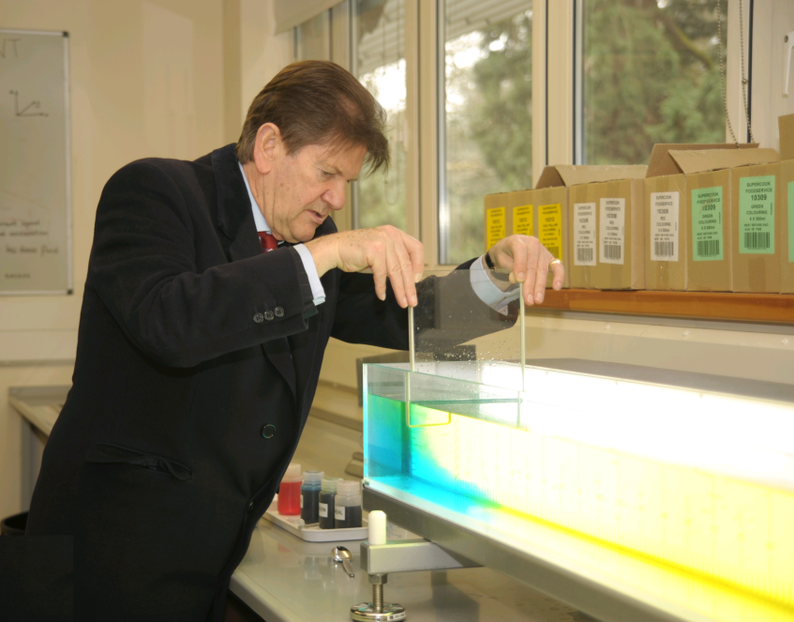
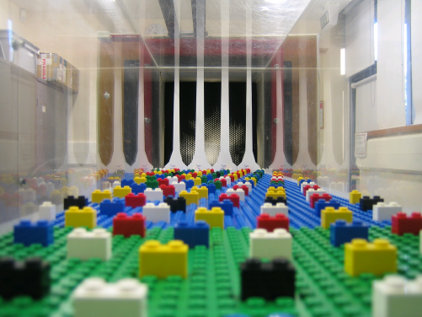

Experiments

Slide 8
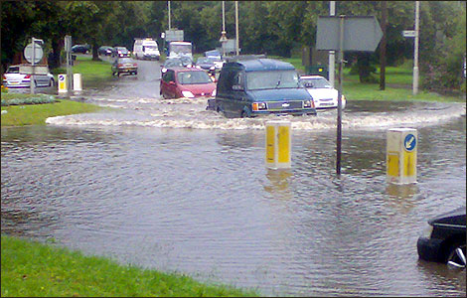
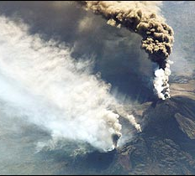
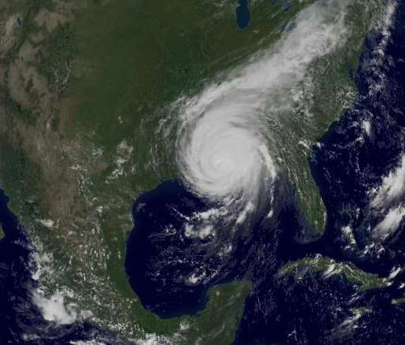
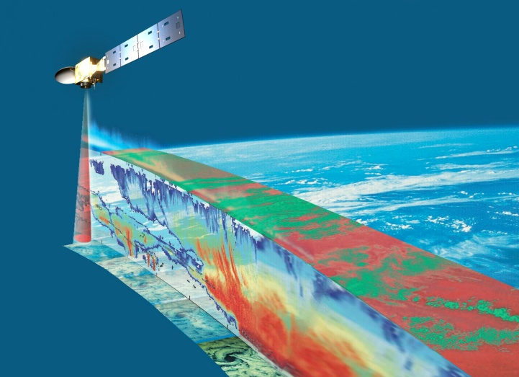
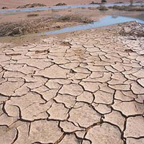
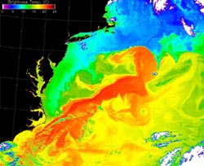
Research – Weather and Climate
Flooding (Reading)
Aerosols (Etna)
Tropical Cyclones
Satellite Observations
African Rainfall
Ocean circulation

Slide 9
Meteorology Courses
We offer the following undergraduate courses:
  BSc Meteorology and Climate (BB physics and maths)
  MMet Meteorology and Climate with a year in Oklahoma (AA physics and maths)
  BSc Mathematics and Meteorology
  MMath Mathematics and Meteorology
  NEW: Environmental Physics BSc (ABB from three A levels including Mathematics and Physics, one of which must be at a grade A)
More information at www.met.rdg.ac.uk/ug/ugcourses.html

Slide 10
Coming Up….
Day 1
Data gathering using hand held instruments
Shipping Forecast
Tour of observatory and radiosonde launch
Lab demonstrations ( including Fluids labs experiments, Lightening Detector and Urban meteorology activity)
Day 2
Visit to ECMWF
Analysis of weather data
Climate Debate - including researching of topics
Day 3
Met Office Forecasting activity
Weather and Climate discussion
Space Physics presentation
Notes:
Weather forecasts aren’t always accurate a few days ahead, so how can you possibly predict climate over the next 100 years?
Although they are made by the same sort of mathematical model, weather forecasts and climate predictions are really quite different. A weather forecast tells us what the weather (for example, temperature or rainfall) is going to be at a certain place and time over the next few days.
A climate prediction tells us about changes in the average climate, its variability and extremes. So, it might say that Berkshire, in 40–60 years time, will have, on average 25% more rain in winter with three times the current number of heavy rainfall events. It will not forecast that it will be raining in Berkshire on the morning of 15 October 2044.

Slide 11
Welcome to the
University of Reading
Meteorology/Climate Work Experience week 2015
Notes:
DAWN?? Introduce staff and student ambassadors
Fire alarm
Toilets

