Slide 1
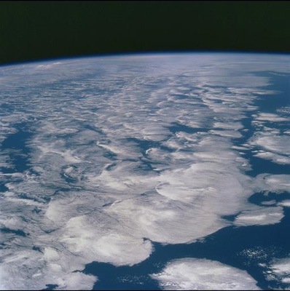

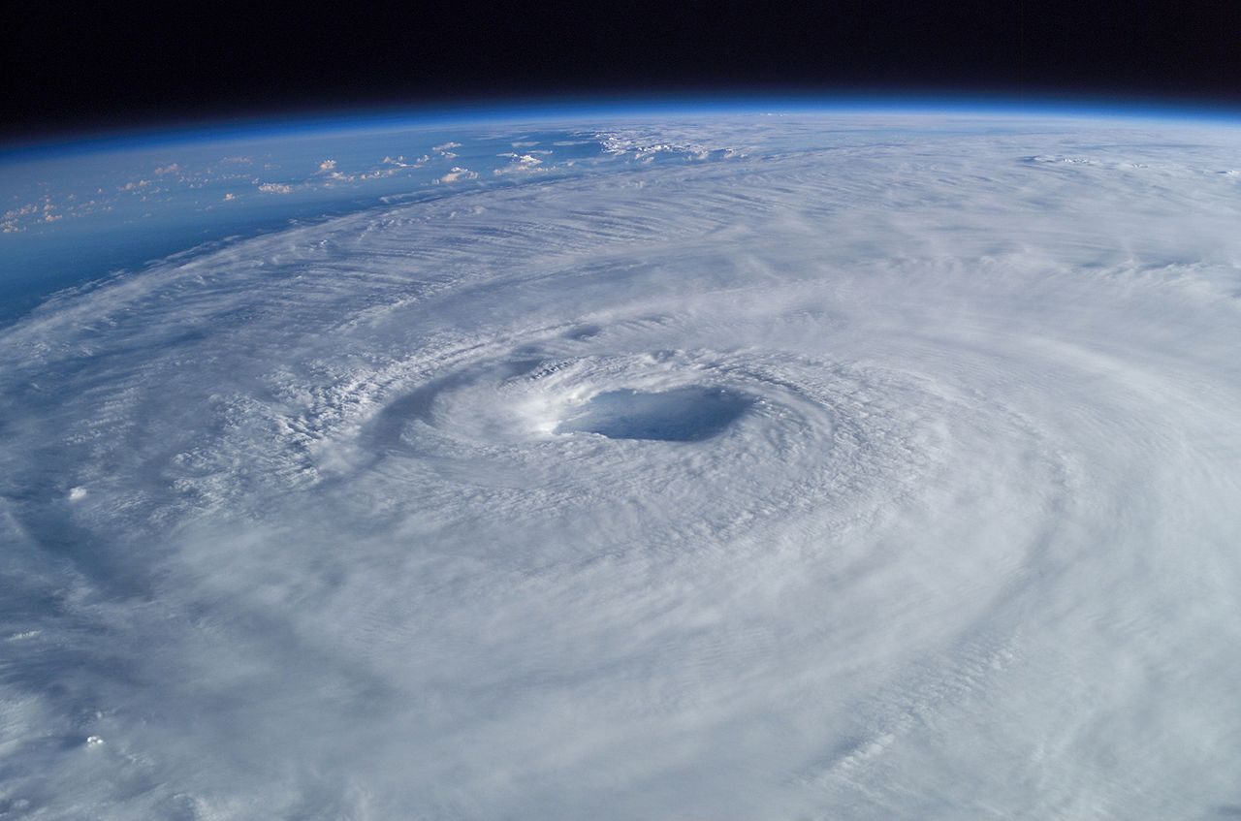




Weird weather – is this the new normal?
Dr Richard P. Allan r.p.allan@reading.ac.uk @rpallanuk
Department of Meteorology/National Centre for Atmospheric Sciences, University of Reading
Notes:
Also some extra slides on…
Add more on jet stream
Add more on warming hiatus
Add something on cloud feedback

Slide 2
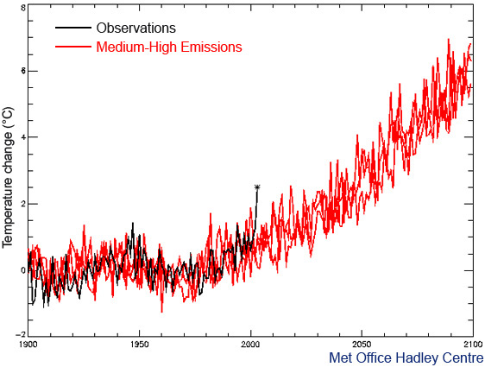

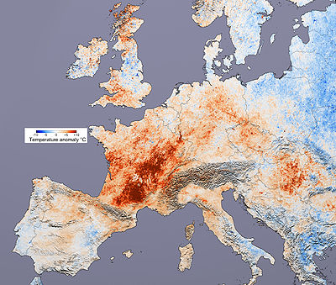
Europe 2003 extreme summer temperature:
normal by 2040s, cool by 2060s?
70
70
European summer temperature change (ºC) -2 0 2 4 6 8
Stott et al. (2004) Nature
1900 1950 2000 2050 2100
Notes:
A European heatwave in 2003 was an unusual weather event and lead to many deaths. Based upon climate model projections of the future these extreme temperatures will be normal by the 2040s (when I’m projected to be 70 years old!) and may be unusually cold by the 2080 (when my son will reach 70 years old). This heat is likely to be a different sort of heat however to 2003 which was caused by weather patterns that lead to a lack of cloud and rain and more absorbed sunlight. In the future, these excessive 2003 temperatures will be experienced also with cloudy and moist conditions.

Slide 3
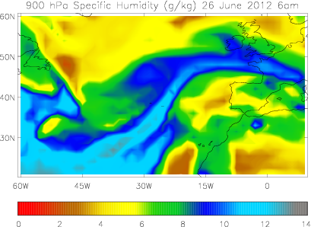
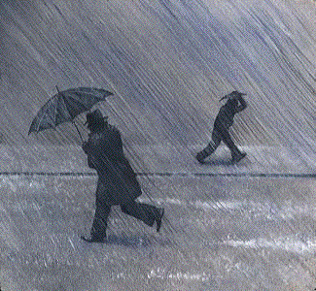
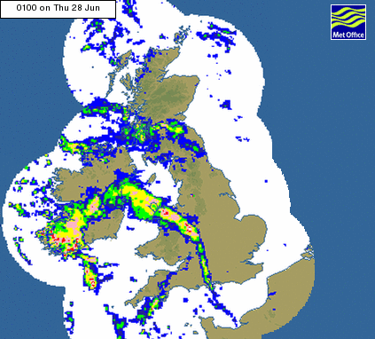
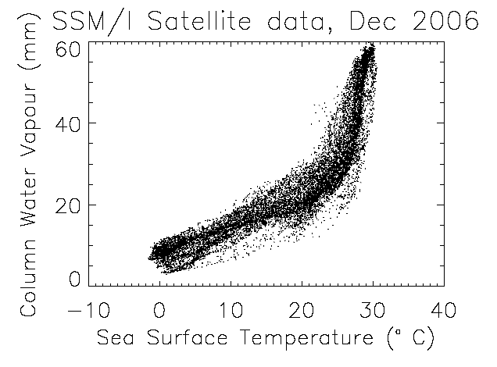
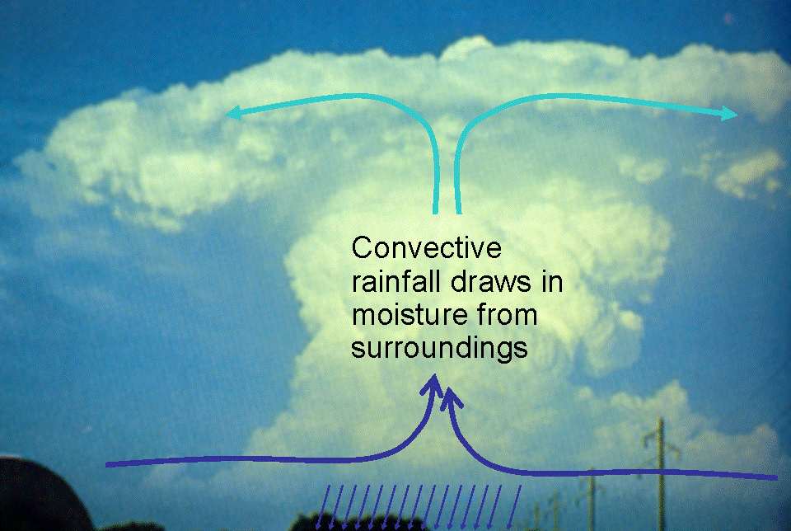
Intensification of rainfall
Atmospheric moisture increases with warming (observations/basic physics)
Moisture is the fuel for heavy rainfall e.g. Lavers et al. (2011)
Observations, physics and detailed simulations indicate intensification of rainfall with warming e.g. Allan & Soden (2008)

Slide 4
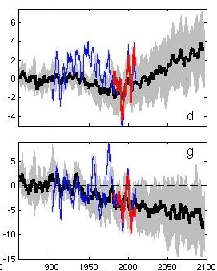


The rich get richer…
Warming enhances moisture flows from dry regions to wet regions
Physics, observations and simulations indicate wet regions will become wetter and dry regions increasingly drier
More flooding and more drought likely, especially across the tropics
Precipitation Change (%)
IPCC (2007)
Observations
Models
Wet region
Precipitation Change (%)
Dry region
Liu & Allan (2013) submitted

Slide 5
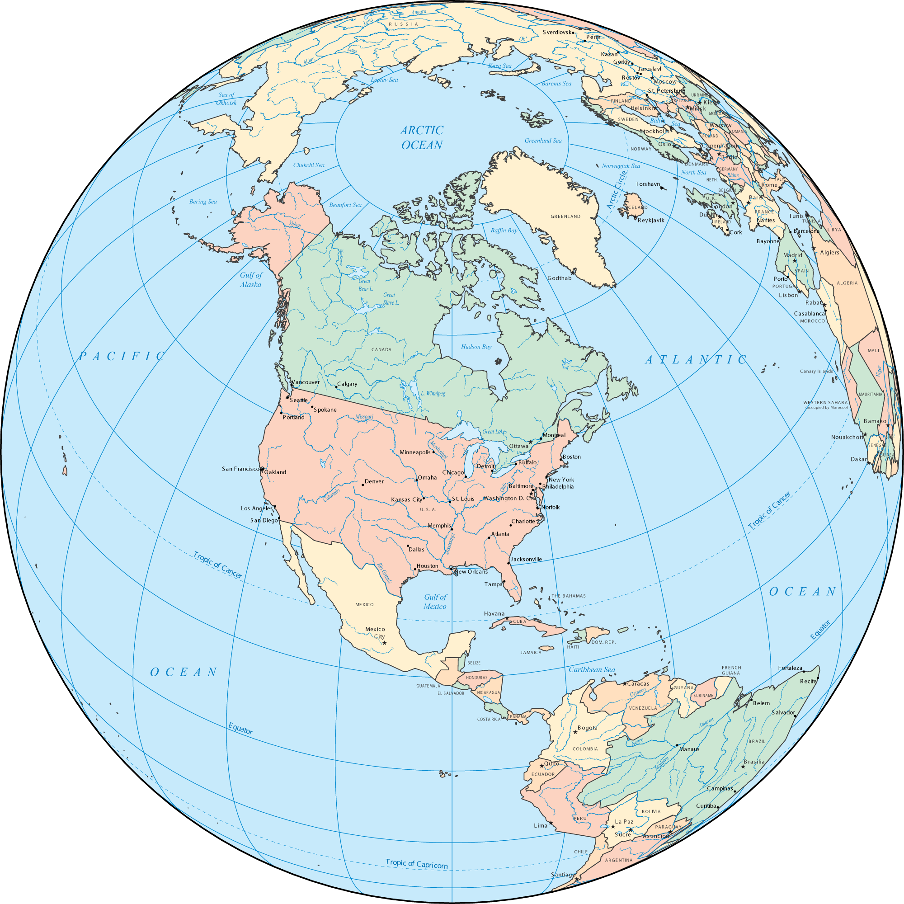
1. Air is warmer closer to the tropics (air expands) than at the poles (air contracts). This generates a poleward flow of air high up in the atmosphere
Weather patterns
2. The Earth spins: the surface moves quicker near the equator than at higher latitudes. So poleward-flowing air is deflected to the east (direction of spin)
COLD
WARM
3. This high altitude (5-7km) fast moving ribbon of air is called the jet stream. It steers weather systems over or away from the UK.

Slide 6
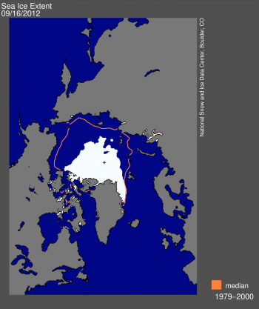
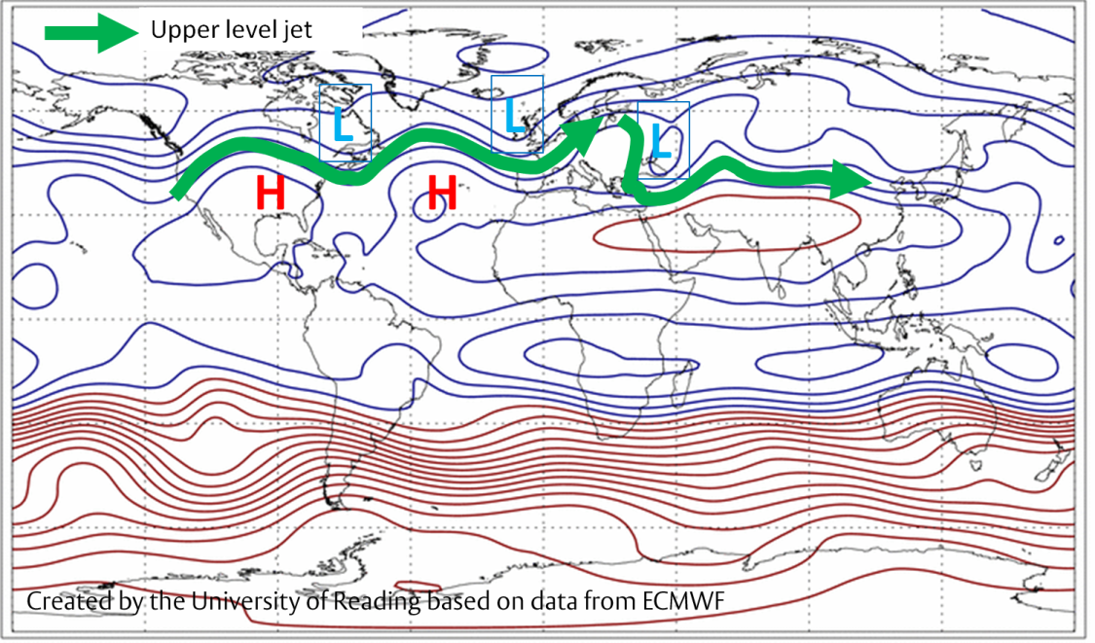
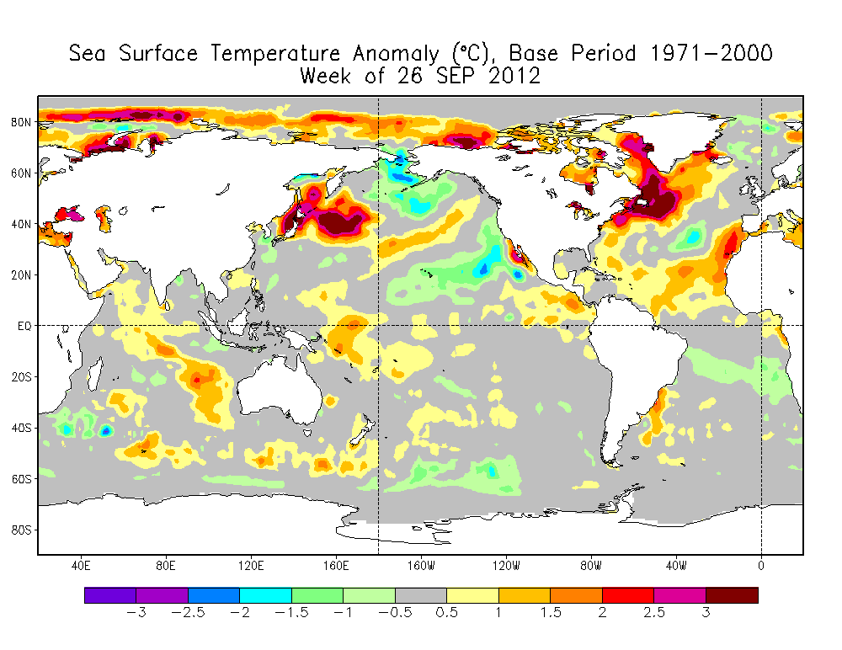
Arctic Ice, ocean temperature and the jet stream
4. Changes in this temperature difference between equator and pole can alter the position, strength and characteristics of the jet stream.
Both natural and human-caused effects influence our weather patterns

Slide 7
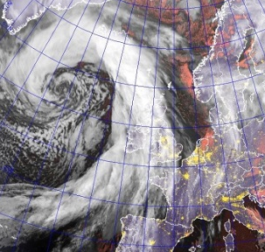
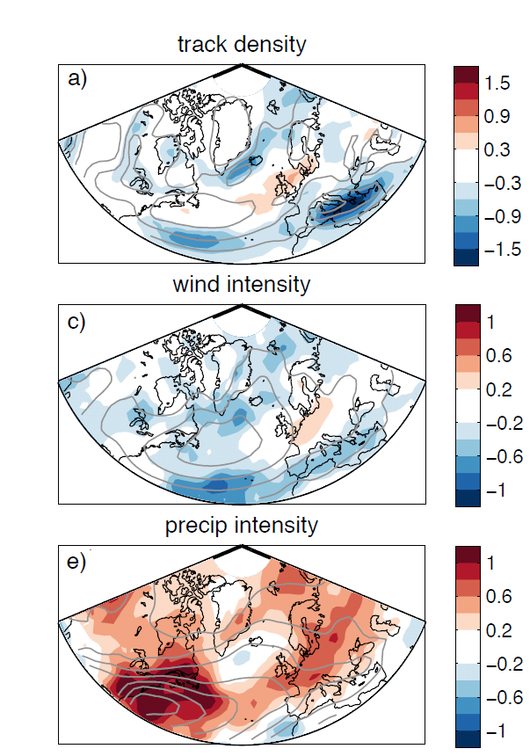
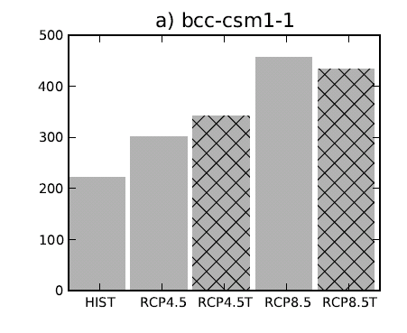
How will jet stream & winter storm characteristics alter in the future?
Shifts in the jet stream unclear (left)
Precipitation intensity (bottom left) & number of Atmospheric River events (below) likely to increase with warming
–
–
+
–
–
+
+
+
Zappa et al. (2013) J. Climate
Lavers et al. submitted

Slide 8
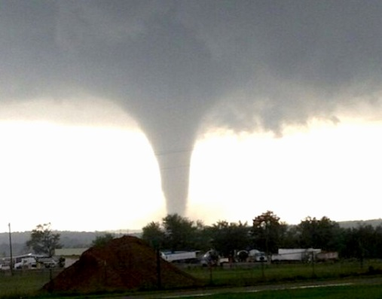
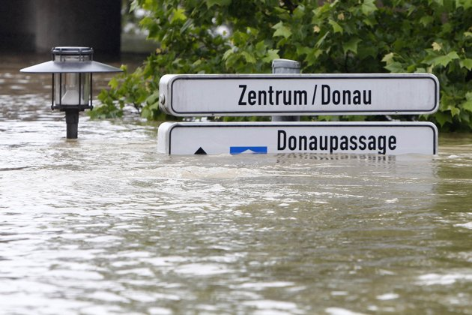
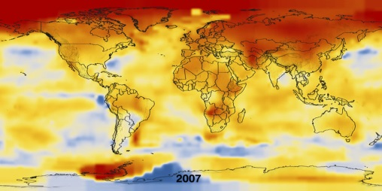
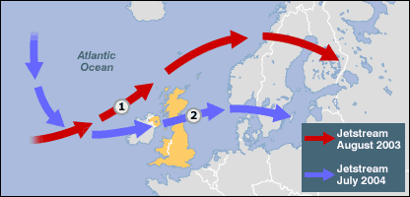
Weird weather – is this the new normal?
Attributing every extreme weather event to climate change is not useful
However, the environment, from which our weather takes shape, has changed significantly since the 1970s
Storms, jet streams, tropical cyclones and other weather phenomena are slightly different than they would have been without global warming
The “normal” is changing…
Notes:
How much will the Earth warm up?
How will tornadoes change?
Will there be more tropical cyclones?
How will the jet stream change?
Where and when will flooding and drought strike?

