Slide 1
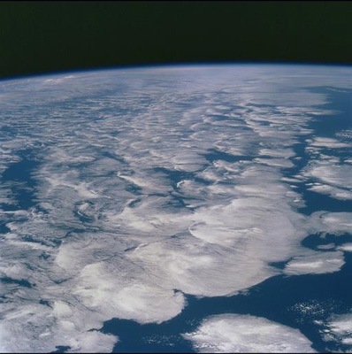

Changes in global net radiative
imbalance 1985-2012
Richard P. Allan, Chunlei Liu (University of Reading/NCAS Climate); Norman Loeb (NASA Langley); Matt Palmer (Met Office)
r.p.allan@reading.ac.uk @rpallanuk
GEWEX 7th International Conference, 16th July 2014

Slide 2
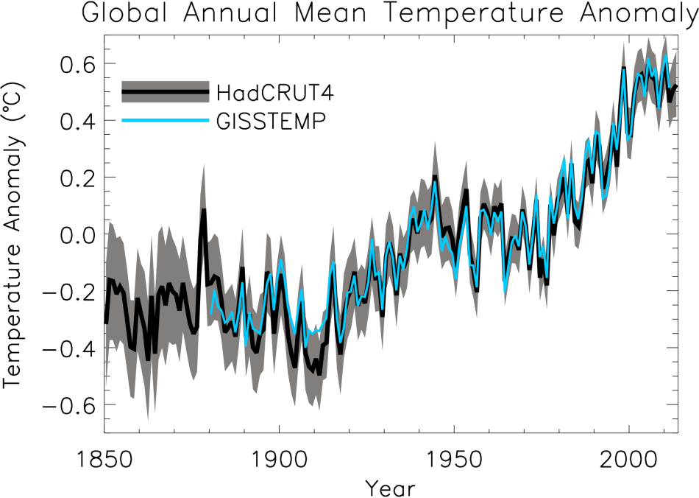
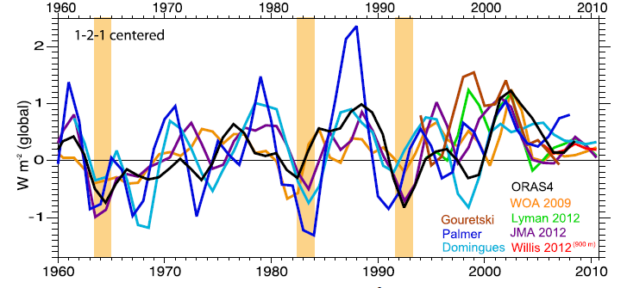
At what rate is Earth heating?
ºC Surface Temperature
Upper ocean (Wm⁻²)
Trenberth et al. (2014) J Clim

Slide 3
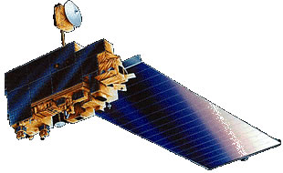
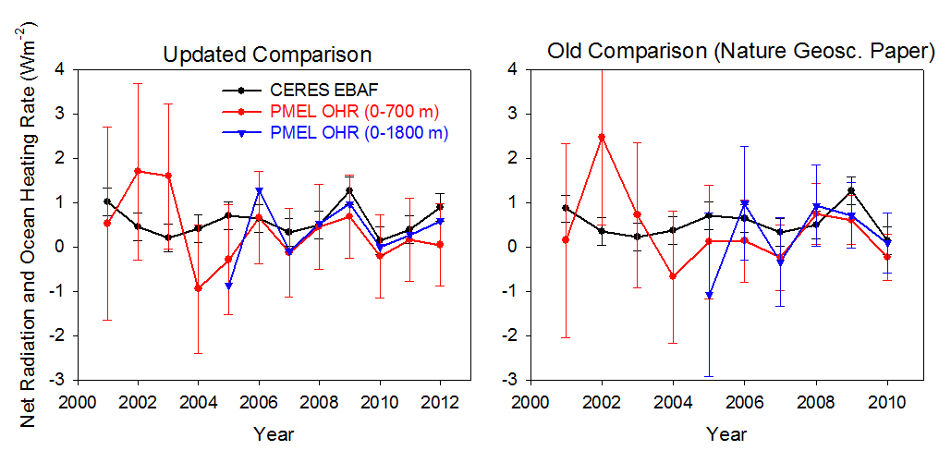
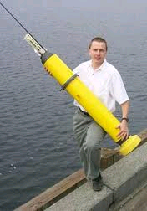
Combining Earth Radiation Budget data and Ocean Heat Content measurements
Tie 10-year CERES record with SORCE TSI and ARGO-estimated heating rate 2005-2010 + minor additional storage terms
Variability relating to ENSO reproduced by CERES and ERA Interim
Ocean heating rate sensitive to dataset and sampling
What about prior to 2000?
Loeb et al. (2012) Nat. Geosci.
unpublished
Loeb et al. (2012) Nat. Geosci. See also Hansen et al. (2011) ACP
Notes:
Fi gure 3 (a) Global annual average net TOA flux from CERES observations and (b) ERA Interim reanalysis are anchored to an estimate of Earth’s heating rate for 2005–2010 ⁵ The Pacific Marine Environmental Laboratory/Jet Propulsion Laboratory/Joint Institute for Marine and Atmospheric Research (PMEL/JPL/JIMAR) ocean heating rate estimates⁴ use data from Argo and World Ocean Database 2009; uncertainties for upper ocean heating rates are given at one-standard error derived from sampling uncertainties. The gray bar in (b) corresponds to one standard deviation about the 2001–2010 average net TOA flux of 15 CMIP3 models.

Slide 4
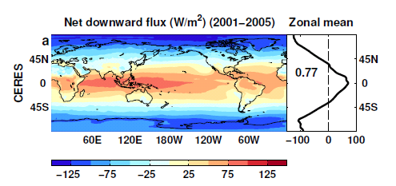
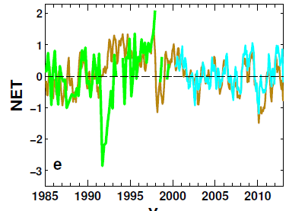
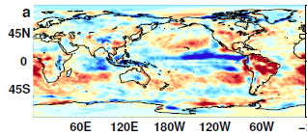
Reconstructing global radiative fluxes prior to 2000
ERBS/CERES variability
CERES monthly climatology
ERBS WFOV
CERES
ERA Interim
ERA Interim spatial anomalies
Combine CERES/ARGO accuracy, ERBS WFOV stability and reanalysis circulation patterns to reconstruct radiative fluxes

Slide 5
Use reanalyses or models to bridge gaps in record (1993 and 1999/2000)
Outgoing Longwave Radiation Anomalies (Wm⁻²)
ERA Interim trends suspect. Use model…
UPSCALE simulations (obs. SST, sea ice & realistic radiative forcings) “OBS”
Net less sensitive to method than OLR/ASR

Slide 6
Net Imbalance Anomaly (Wm⁻²)
Changes in imbalance in models & observations
Imbalance: 0.23 0.00 0.78 0.63 0.63 (Wm⁻²)
0.34±0.67 Wm⁻²
0.62±0.43 Wm⁻²
La Niña
El Niño
Volcano
Allan et al. (2014) in prep

Slide 7
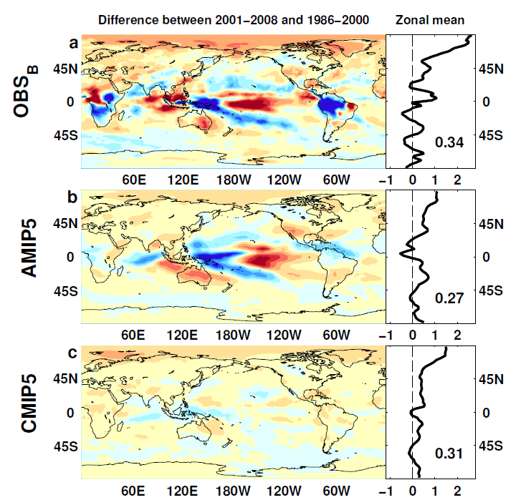

Outgoing Longwave Radiation
Wm⁻²

Slide 8
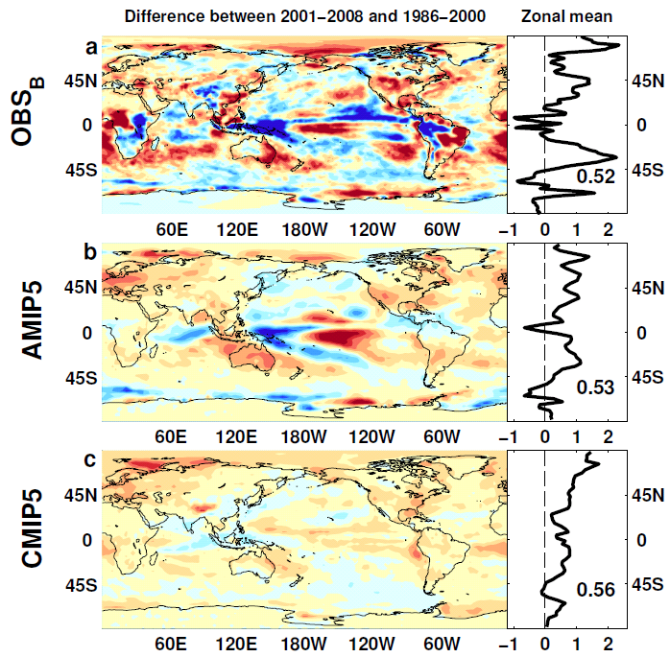
Absorbed Shortwave Radiation
Wm⁻²

Slide 9
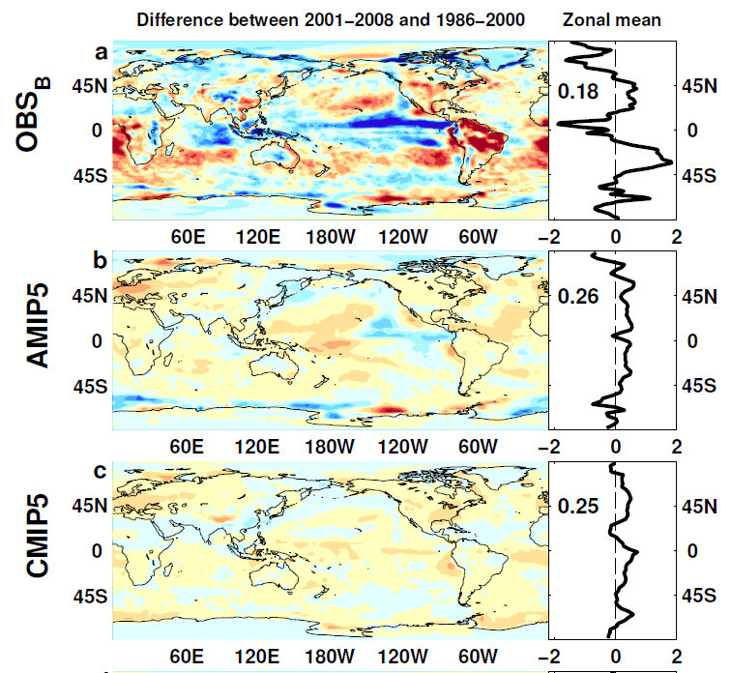

NET Radiation

Slide 10
Preliminary results
Heating of Earth continues at rate of ~0.6 Wm⁻²
Current variability in TOA radiation (1985-2013)
Net radiative flux imbalance fairly stable
  Requires anchoring to ARGO ocean heating rate + minor terms
  Influence of Pinatubo and ENSO
  ~0.3 Wm⁻² higher in 1995-1999 than 2000-2013 period
Distinct East Pacific signal in ΔT and ΔN
Radiative forcing alone can’t explain surface warming slowdown: internal variability important
Next steps: combining with reanalyses energy transports to estimate surface fluxes

Slide 11
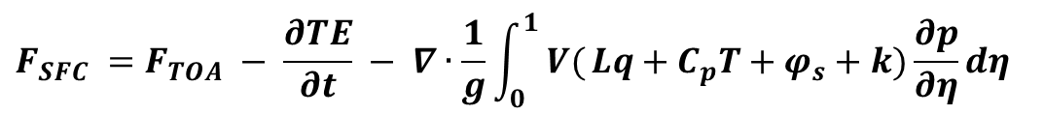
Estimates of Surface Flux
CERES/Argo Net Flux
Estimate horizontal energy flux
Surface Flux
$$F_{SFC} =F_{TOA} − \frac{∂TE}{∂t} − ∇∙\frac{1}{g}\int_{0}^{1}{ V(}Lq+C_{p}T+φ_{s}+k)\frac{∂p}{∂η}dη$$

Slide 13
Changes in Earth’s Energy balance
N=ΔF–ΔT/λ
Key variable linking radiative forcing/ feedbacks and ocean heat uptake
Global energy and water cycle coupling
  Fast and slow precipitation responses O’Gorman et al. (2012); Allan et al. (2014) Surv. Geophys
Diagnostic of changes in cloud, aerosol, etc
Diagnosing Earth’s Energy Pathways in the Climate system: DEEP-C project
ΔT
D

Slide 14
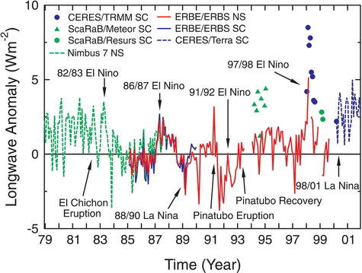
Earth Radiation Budget Satellite Data
20°N to 20°S
Wong et al. (2006) J Clim; Wielicki et al. (2002) Science

Slide 15
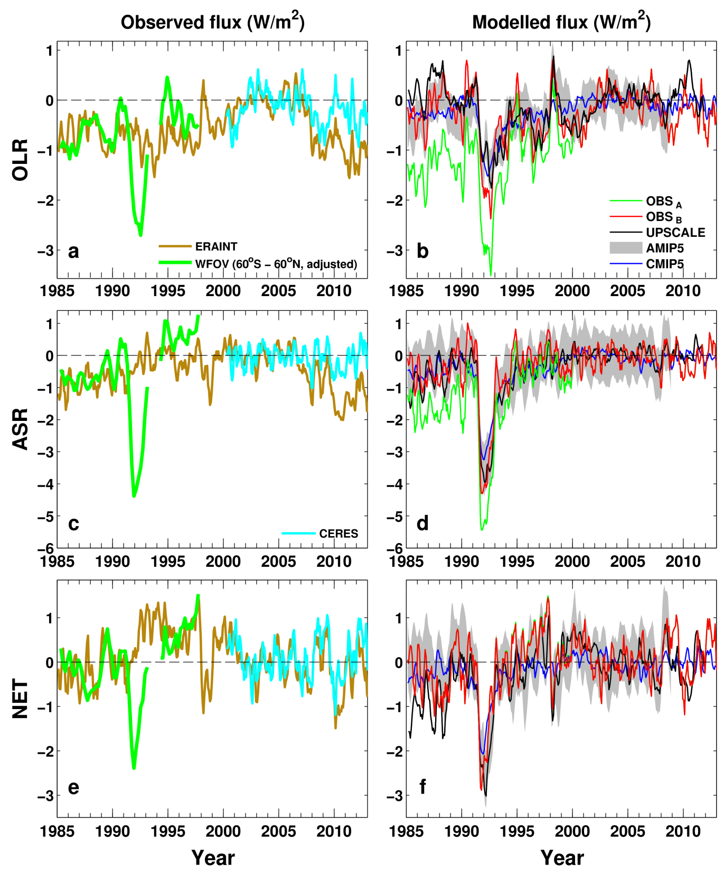
Net Imbalance Anomaly (Wm⁻²)
Reconstructed Net Flux (Wm⁻²)
0.23 0.00 0.78 0.63 0.63
0.62 Wm⁻²
See also: Wong et al. (2006) J Clim; Wielicki et al. (2002) Science

Slide 16
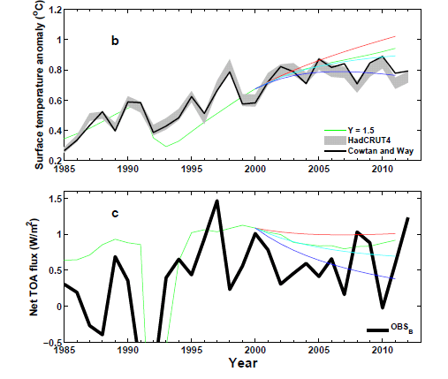
Analysis using simple energy balance model
+ve RF trend
0 RF trend
-ve RF trend
ΔT
N=ΔF–YΔT
Use AR5 RF
ΔT
D
N
ΔT_{d}

Slide 17
Combined CERES/Argo data
Incoming Solar: SORCE Level 3 V10
Reflected Shortwave/Outgoing Longwave from EBAF
  (v2.6r → v2.8 → V3…)
Added errors in quadrature to give ± 0.43 Wm⁻²
  Argo 0-2000m dOHCA/dt = 0.47 ± 0.38 Wm⁻² (2005-2010)
  >2000m ~ 0.07 ± 0.05 Wm⁻²
  Heating/melting ice, heating land/atmos ~ 0.04 ± 0.02 Wm⁻²
  CERES standard error ± 0.2 Wm⁻²
Jan 2001-Dec 2010: 0.50 ± 0.43 Wm⁻² (EBAF V2.6r)
March 2000 – February 2013: 0.60 ± 0.43 Wm⁻² (EBAF V2.8)
CERES scanner data: cloud mask → clear-sky fluxes; not possible for ERBS wide-field of view

Slide 18
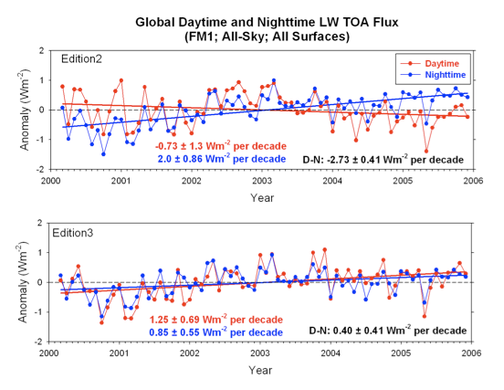
Updated CERES satellite data
Issues with sampling, radiance to flux conversion, calibration, etc
Correction for degradation of shortwave filter
Correction also improves physical consistency of trends in daytime longwave
We used version CERES_EBAF-TOA_Ed2.6r; currently v2.8

Slide 19
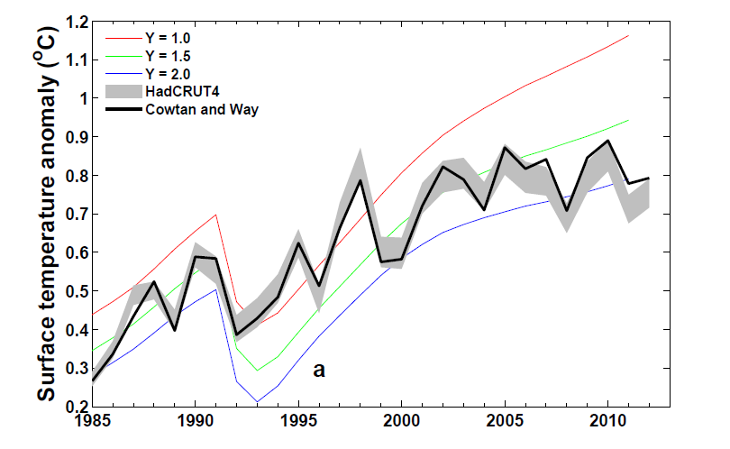
Is the temperature record wrong or are computer models inaccurate?
Can comparisons tell us about how sensitive climate is to radiative forcing? e.g. Otto et al. (2013) Nature Geosci
Spatial infilling of data gaps influences trends in surface temperature (Cowtan & Way, 2013 QJRMS) and ocean heat content (Lyman & Johnson 2014 J. Clim.)
Graph by Chunlei Liu

Slide 20
Changes in top of atmosphere radiative fluxes since 1985
Net Imbalance Anomaly (Wm⁻²)
Absorbed Solar (Wm⁻²) Outgoing Longwave
Chunlei Liu
Research in DEEP-C project at Reading…

Slide 21
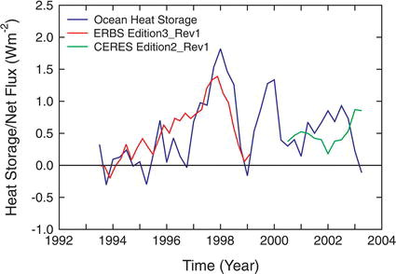
Wong et al. (2006) J Clim

