Slide 1
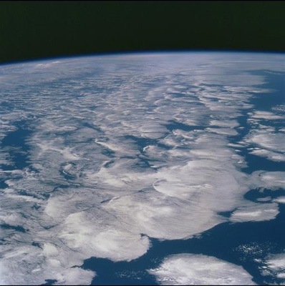



The Science Behind Climate Change
Richard P. Allan
Department of Meteorology
University of Reading, UK

Slide 2

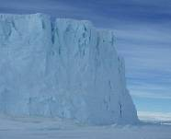

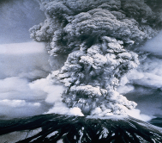
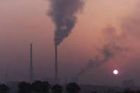
Climate Change: Past, Present and Future
Climate changes on all time-scales
  - the output of the sun varies on most of these time-scales (up to billions of years)
Millions of years: evolving atmosphere and plate tectonics
Thousands of years: Orbital variations leading to glacial cycles
Tens to hundreds of years: solar and volcanic effects, shifts in ocean circulation, effect of humans on the environment…

Slide 3
1) Is Earth currently warming?

Slide 4
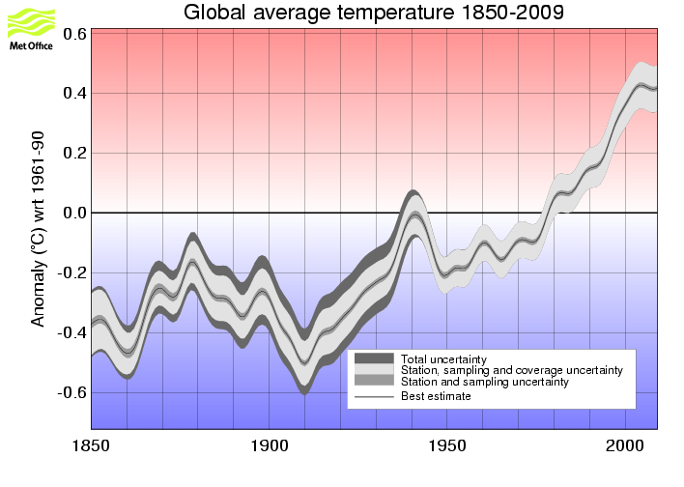
Notes:
Data available at www.metoffice.gov.uk
The relative warmth of years and decades and their uncertainty show just how unusual the last few decades have been in the instrumental record.

Slide 5
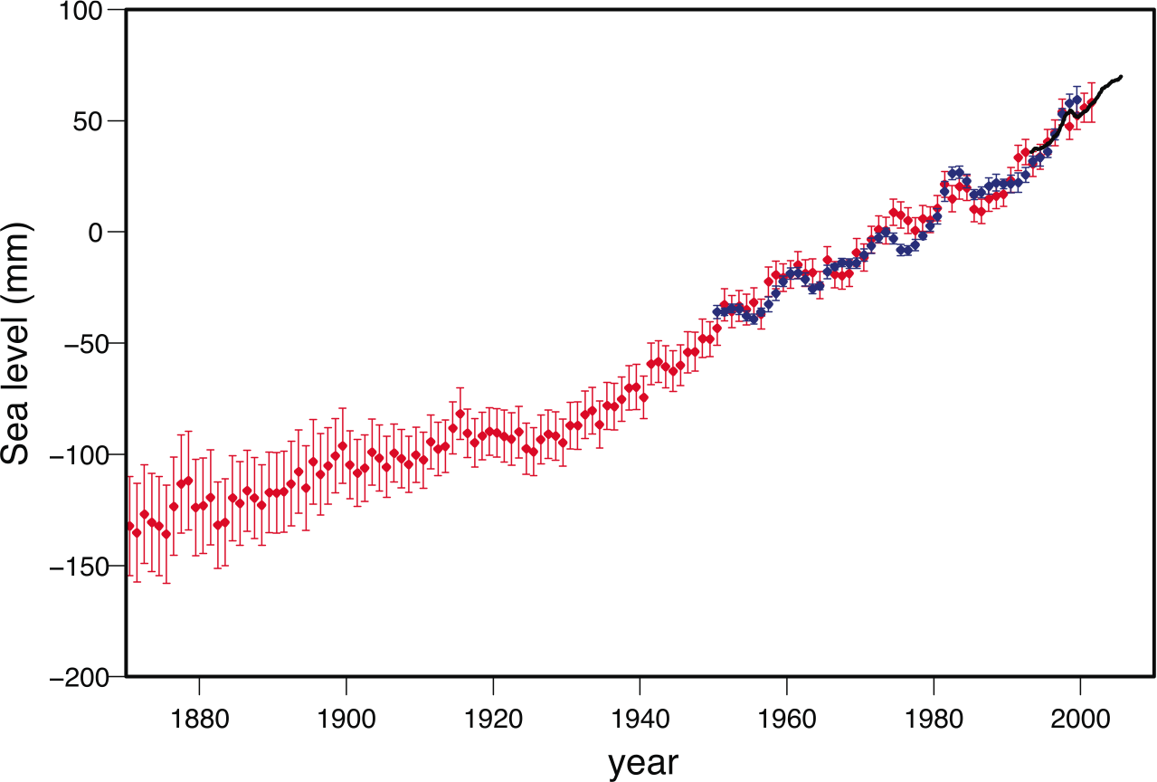
Sea level rising
IPCC 2007 Fig. 5.13 (p. 410)
Satellite altimetry
Recontructed (proxy)
Coastal tide gauges
Notes:
IPCC 2007 Figure 5.13. Annual averages of the global mean sea level (mm). The red curve shows reconstructed sea level fields since 1870 (updated from Church and White, 2006); the blue curve shows coastal tide gauge measurements since 1950 (from Holgate and Woodworth, 2004) and the black curve is based on satellite altimetry (Leuliette et al., 2004). The red and blue curves are deviations from their averages for 1961 to 1990, and the black curve is the deviation from the average of the red curve for the period 1993 to 2001. Error bars show 90% confidence intervals.

Slide 6
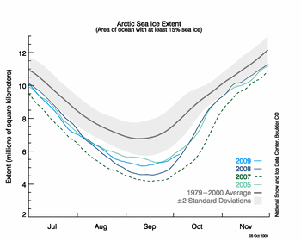
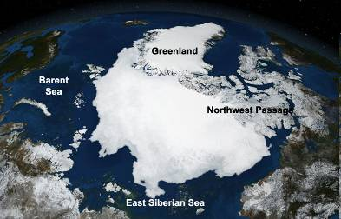
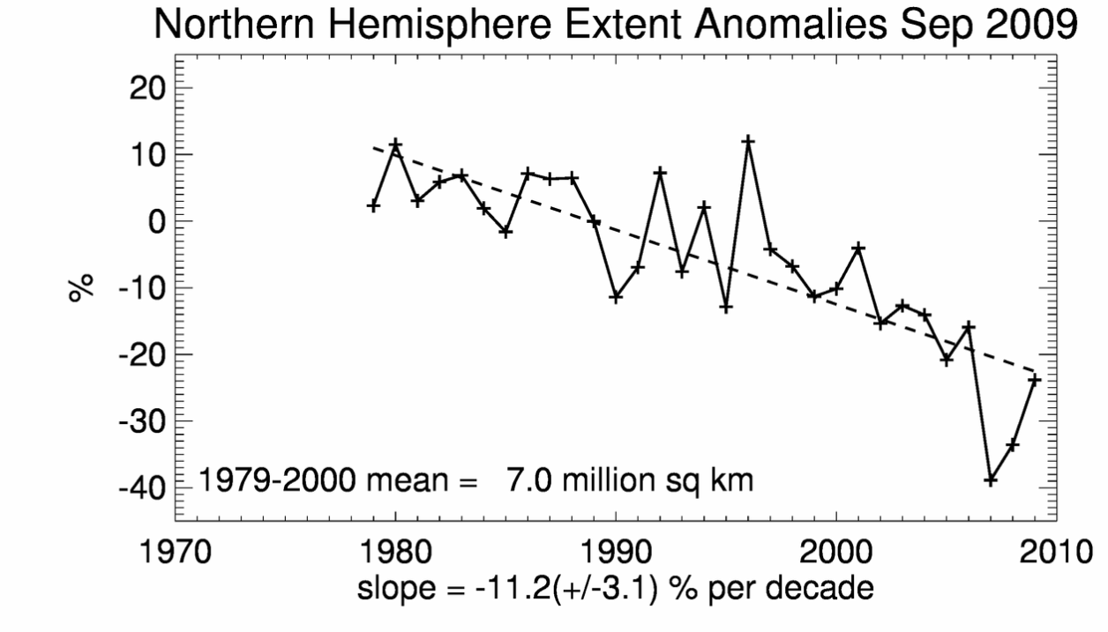
Arctic sea ice: declining extent and thickness
See NSIDC website: http://nsidc.org/news

Slide 7
2) Why is Earth warming?
Notes:
Rapid rises in GHG.
Primarily due to fossil fuel burning, cement making, changes in land use and agriculture.
We know it is anthropogenic because of its isotopic signature.
Satellite data detects the influence of greenhouse gases on the energy balance.

Slide 8

The Earth in space
Other changes we might significantly influence ourselves: for example, quite clearly we are influencing the amount of CO2 in the atmosphere, as well as CH4
A balance exists between sunlight absorbed by the planet…
…and infrared heat emitted back to space
Natural changes in climate have occurred throughout Earth’s history
If the absorbed sunlight is greater than the outgoing heat the Earth will warm
This is the climate system (physical + biological)
..until flux of energy/ second/square metre absorbed = emitted
Energy arriving gives rise to myriad of processes between high frequency energy in and low frequency energy out (entropy!)
Notes:
8

Slide 9
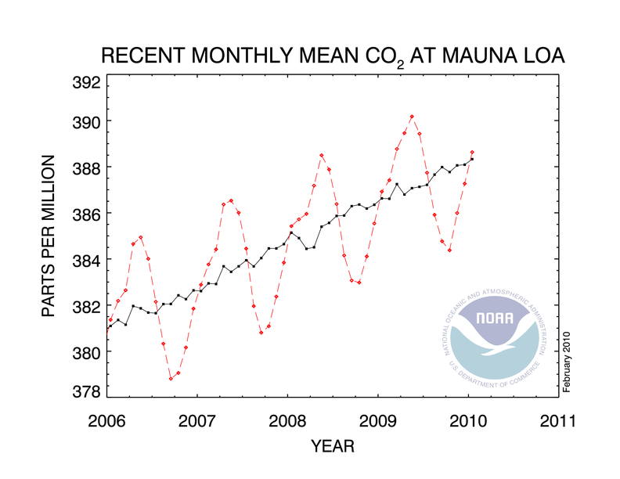
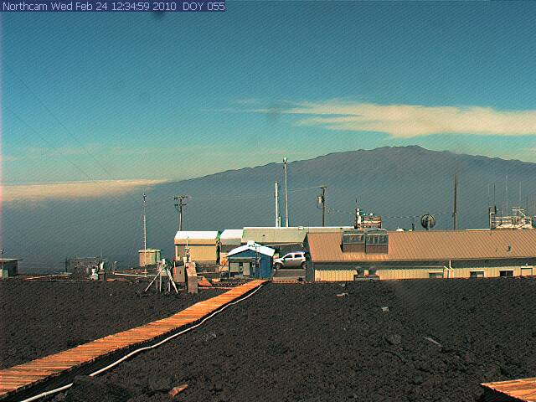
Notes:
Concentrations of CO2 are likely to surpass 400ppm by 2015

Slide 10
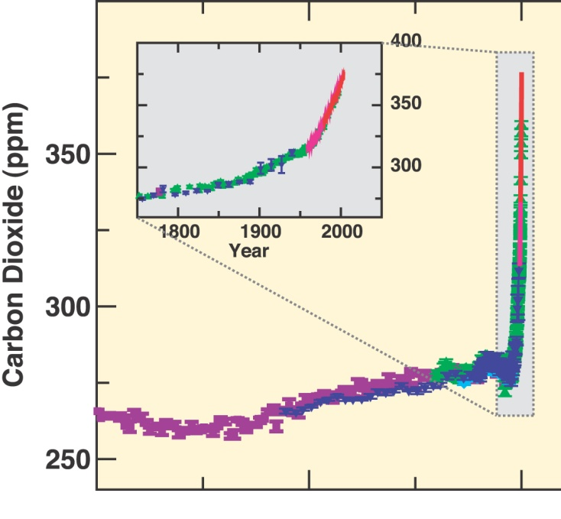
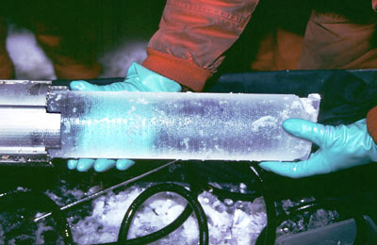
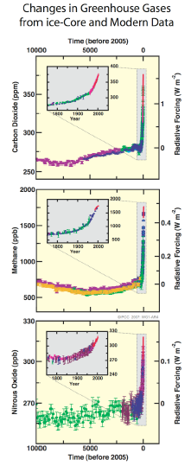
Rises in carbon dioxide concentration in the atmosphere unquestionably related to mankind
Notes:
Concentrations of CO2 are likely to surpass 400ppm by 2015

Slide 11
Courtesy of Prof. Richard Somerville http://richardsomerville.com

Slide 12
Earth’s global average energy balance: present day
Solar
Thermal
240 Wm⁻²
240 Wm⁻²
Efficiency ~61.5%
390 Wm⁻²
Surface Temperature = +15ºC
Radiating Efficiency, or the inverse of the Greenhouse Effect, is strongly determined by water vapour absorption across the electromagnetic spectrum
Notes:
As the planet warms up, it emits more thermal energy since warmer bodies emit more thermal (longwave) radiative energy. The Earth warms up until the outgoing thermal energy equals the absorbed solar energy, resulting in a global temperature of 15ºC, about 33ºC warmer than without a greenhouse effect.

Slide 13
Introduce a radiative forcing (e.g. 2xCO₂) note: could equally choose to change solar
Solar
Thermal: less cooling to space
240 Wm⁻²
236 Wm⁻²
Efficiency ~60.5%
390 Wm⁻²
Surface Temperature = +15ºC
Radiative cooling to space through longwave emission drops by about 4 Wm⁻² resulting in a radiative imbalance
Notes:
As the planet warms up, it emits more thermal energy since warmer bodies emit more thermal (longwave) radiative energy. The Earth warms up until the outgoing thermal energy equals the absorbed solar energy, resulting in a global temperature of 15ºC, about 33ºC warmer than without a greenhouse effect.

Slide 14
The climate system responds by warming
Solar >
Thermal
240 Wm⁻²
236 Wm⁻²
Efficiency ~60.5%
Heating
390 Wm⁻²
Surface Temperature = +15ºC
Notes:
As the planet warms up, it emits more thermal energy since warmer bodies emit more thermal (longwave) radiative energy. The Earth warms up until the outgoing thermal energy equals the absorbed solar energy, resulting in a global temperature of 15ºC, about 33ºC warmer than without a greenhouse effect.

Slide 15
New global temperature
Solar =
Thermal
240 Wm⁻²
240 Wm⁻²
Efficiency ~60.5%
397 Wm⁻²
Surface Temperature = +16ºC
The 2xCO₂ increased temperature by about 1ºC in this simple example. So what’s to worry about?
Notes:
As the planet warms up, it emits more thermal energy since warmer bodies emit more thermal (longwave) radiative energy. The Earth warms up until the outgoing thermal energy equals the absorbed solar energy, resulting in a global temperature of 15ºC, about 33ºC warmer than without a greenhouse effect.

Slide 16
But it’s not that simple…
IPCC (2007)

Slide 17
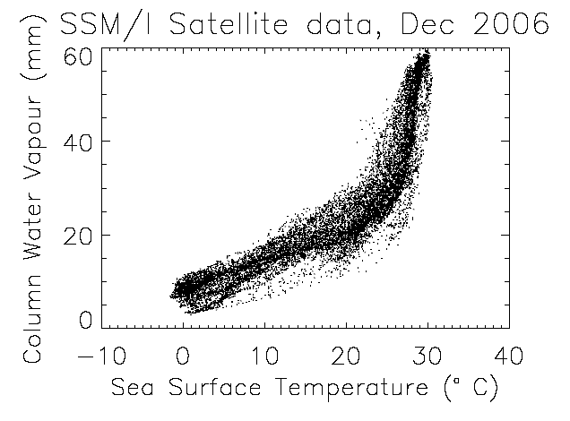
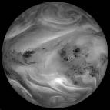
Feedback loops or “vicious circles” amplify or diminish initial heating or cooling tendencies e.g. Water Vapour Feedback
↑ CO₂
↑ Water vapour
↑Temperature
↑ Greenhouse effect
↑ Net Heating
Notes:
For example, as the atmosphere warms it will be able to ‘hold’ more water vapour. Water vapour itself is a very powerful greenhouse gas, so this will act as a positive feedback and roughly double the amount of warming. Similarly, when sea ice begins to melt, some of the solar radiation which would otherwise be reflected from the sea ice is absorbed by the ocean, and heats it further; another positive feedback. On the other hand, when carbon dioxide concentrations increase in the atmosphere then it acts to speed up the growth of plants and trees (the fertilisation effect) which in turn absorb more of the carbon dioxide; this acts as a negative feedback.

Slide 18
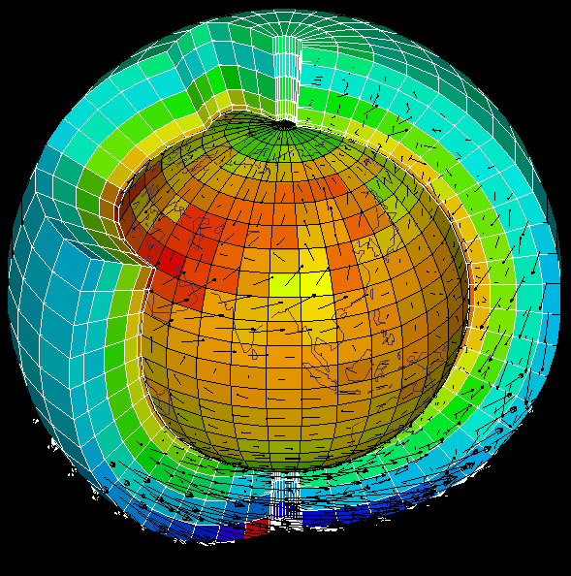
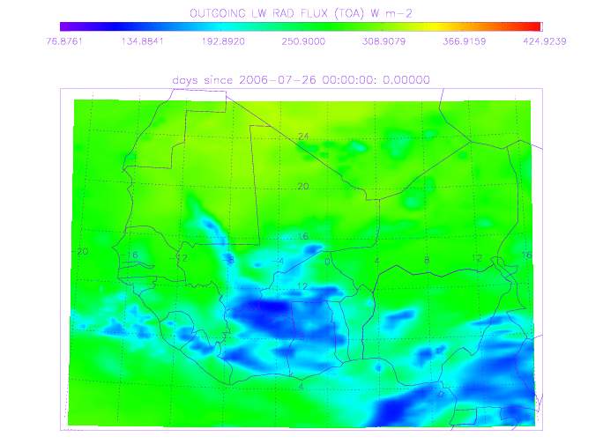
Climate Models
Million of lines of computer code
Apply laws of physics
  computer games also use physics!
Slices and dices the atmosphere into thousands of 3-D cuboids
  e.g., 100 km by 100 km, 500 m deep
Similar “grid” applied to oceans
Represents all the important physical climate processes
  e.g., clouds and storms, rivers and oceans, ice sheets and glaciers, vegetation and soil, chemistry and energy fluxes, etc

Slide 19

Experiments with climate models
How much of the recent warming can be explained by natural effects?
To answer such questions, experiments can be performed with climate models
Notes:
By prescribing changes in atmospheric constituents and changes in natural forcing agents such as the sun or volcanos, experiments can be run with climate models to see how well they reproduce the past climate and then what they project for future climate.

Slide 20
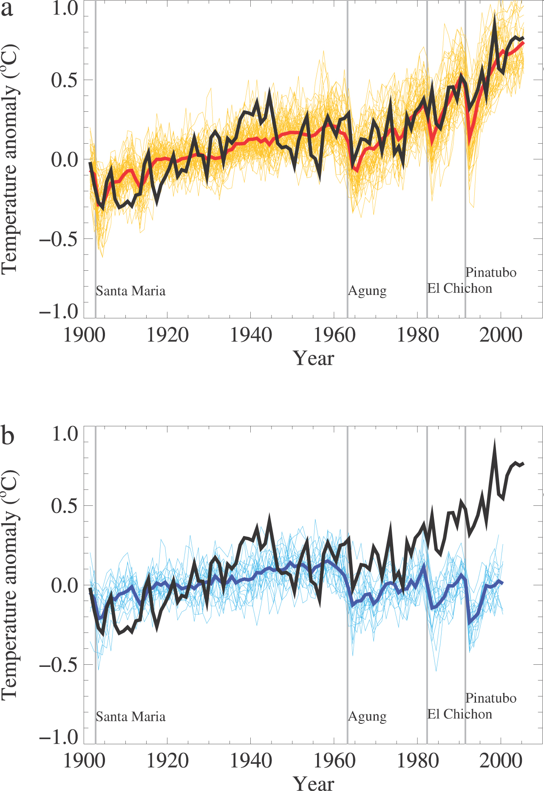
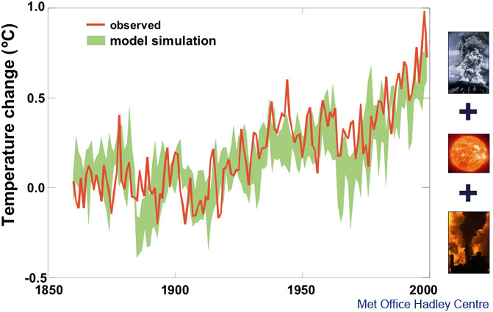
Natural factors cannot explain recent warming
Notes:
What are the causes of changes in global mean temperature observed since the early 1900s, shown in red on this slide? As we have already outlined, natural factors include a chaotic variability of climate due largely to interactions between atmosphere and ocean; changes in the output of the Sun and changes in the optical depth of the atmosphere from volcanic emissions. Climate models have been driven by changes in all these natural factors, and it simulates changes in global temperature shown by the green band in the slide above. This clearly does not agree with observations, particularly in the period since about 1970 when observed temperatures have risen by about 0.5 °C, but those simulated from natural factors have hardly changed at all.

Slide 21
Recent warming can be simulated when man-made factors are included
Notes:
If the climate model is now driven by changes in human-made factors — changes in greenhouse gas concentrations and sulphate particles — in addition to natural factors, observations (red) and model simulation (green) are in much better agreement. In particular, the warming since about 1970 is clearly simulated. Of course, this agreement may, to some extent, be fortuitous, for example, if the heating effect of man-made greenhouse gases and the cooling effect of man-made aerosols have been overestimated. Nevertheless, the ability to simulate recent warming only when human activities are taken into account is a powerful argument for the influence of man on climate.
In addition to simulating the global mean temperature, the model also simulates the pattern of changes in temperature, across the surface of the Earth and through the depth of the atmosphere. These ‘fingerprints of man-made warming’ have been compared to observations, providing even stronger evidence for the majority of the long-term trend over the last 50 years having been due to human activity.

Slide 22
4) How much will it warm?
Notes:
Rapid rises in GHG.
Primarily due to fossil fuel burning, cement making, changes in land use and agriculture.
We know it is anthropogenic because of its isotopic signature.
Satellite data detects the influence of greenhouse gases on the energy balance.

Slide 23
Predicting future climate change
EMISSIONS
Scenarios from
population, energy,
economics models
Carbon cycle and
chemistry models
Gas properties
Coupled climate
models
Impacts models
CONCENTRATIONS
CO₂, methane, etc.
Earth System Models
HEATING EFFECT
‘Climate Forcing’.
feedbacks
CLIMATE CHANGE
Temp, rain, sea level, etc.
IMPACTS
Flooding, food supply, etc.
Notes:
How quickly the climate will change in the future depends upon two factors: how much greenhouse gas emissions grow, and how sensitive the climate system is to these emissions. We predict future climate change in a number of stages, shown above. Projections of future emissions are deduced from separate models which take into account population growth, energy use, economics, technological developments, and so forth. Having obtained projections of how emissions will change, we then calculate how much remains in the atmosphere, i.e. what future concentrations will be. For CO2, this is done using a model of the carbon cycle, which simulates the transfer of carbon between sources (emissions) and sinks in the atmosphere, ocean and land (vegetation). Finally, the effect of the changed heating on climate has to be calculated. Following on from the climate change prediction, the impacts of climate change, on socio-economic sectors such as water resources, food supply and flooding, can be calculated.

Slide 24
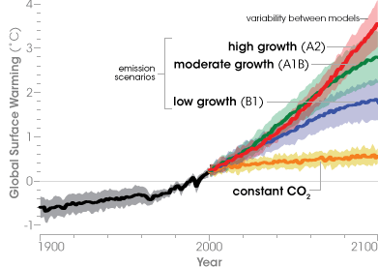
What is the uncertainty in future projections?
IPCC: www.ipcc.ch/ipccreports/ar4-wg1.htm
Notes:
24
IPCC 2007 {Figure 10.4}. Multi-model means of surface warming (compared to the 1980–1999 base period) for the SRES scenarios A2 (red), A1B (green) and B1 (blue), shown as continuations of the 20th-century simulation. The latter two scenarios are continued beyond the year 2100 with forcing kept constant (committed climate change as it is defined in Box TS.9). An additional experiment, in which the forcing is kept at the year 2000 level is also shown (orange). Linear trends from the corresponding control runs have been removed from these time series. Lines show the multi-model means, shading denotes the ±1 standard deviation range. Discontinuities between different periods have no physical meaning and are caused by the fact that the number of models that have run a given scenario is different for each period and scenario (numbers indicated in figure). For the same reason, uncertainty across scenarios should not be interpreted from this figure (see Section 10.5 for uncertainty estimates).

Slide 25
5) What consequences can we expect?
Notes:
Rapid rises in GHG.
Primarily due to fossil fuel burning, cement making, changes in land use and agriculture.
We know it is anthropogenic because of its isotopic signature.
Satellite data detects the influence of greenhouse gases on the energy balance.

Slide 26
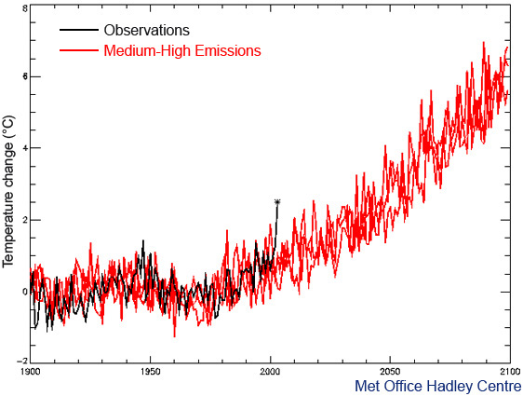
European 2003 summer temperatures could be
normal by 2040s, cool by 2060s
European summer temperature change (ºC) -2 0 2 4 6 8
1900 1950 2000 2050 2100

Slide 27

European 2003 summer temperatures could be
normal by 2040s, cool by 2060s
60
60
European summer temperature change (ºC) -2 0 2 4 6 8
1900 1950 2000 2050 2100

Slide 28

Projected Changes in Rainfall
Precipitation Intensity
Dry Days
Increased Precipitation
More Intense Rainfall
More droughts
Wet regions get wetter, dry regions get drier
Intergovernmental Panel on Climate Change: www.ipcc.ch

Slide 29
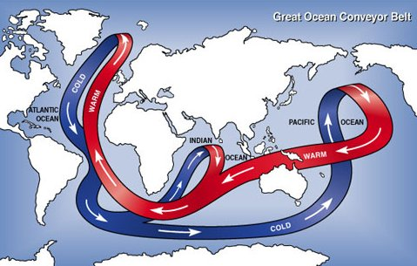
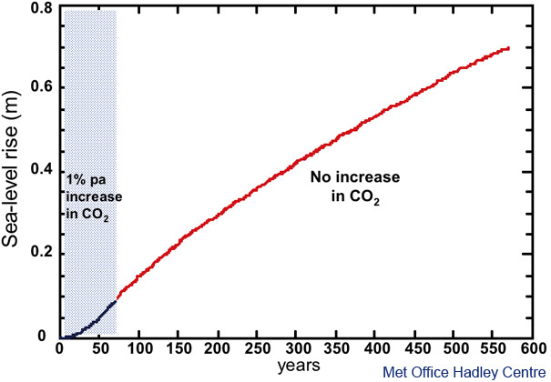
Long-term commitment to sea-level rise

Slide 30
CONCLUSIONS
Earth’s Climate has always changed
  Climate changes on a variety of time-scales from billions of years up to decades
Global warming over recent decades is
  Unequivocal & unusual in context of past change
  coincident with unprecedented rises in man-made greenhouse gas concentrations in the atmosphere
  The heating effect of rising greenhouse gas concentrations is well understood and detectable
Likely consequences include
  More heatwaves, droughts, intense rainfall; rising sea level, ocean acidification, …
Substantial uncertainty involving clouds and aerosol and future emissions by mankind
Notes:
John may be showing this…
Would be good to RECAP:
Climate has always changed
Changes are on time-scales ranging from billions of years (evolution of the sun), to millions (e.g. continental drift), to thousands (well-known changes in the Earth’s orbit around the sun influencing timing of ice ages) to tens-hundreds of years (changes in the sun, volcanic eruptions, chaotic variation of the ocean and atmosphere and increasingly, man)
Warming of climate over recent decades is unequivocal, unusual in the context of past changes, and may only be explained by the rapid rises in man-made greenhouse gases which have not been at high levels for the past million years based on ice core records.
To predict future climate we need to know not only how greenhouse gases will change in the future but how the planetary system responds to warming, initiating amplifying feedback loops or counteracting processes.

Slide 31
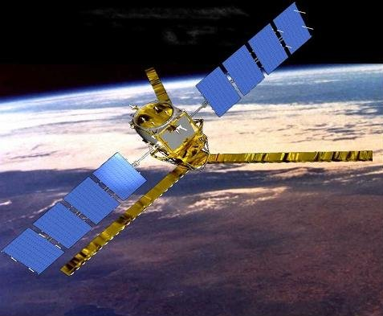
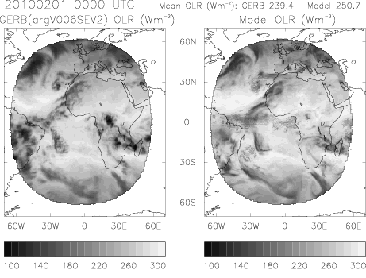
CONCLUSIONS
Earth’s Climate has always changed
  Climate changes on a variety of time-scales from billions of years up to decades
Global warming over recent decades is
  Unequivocal & unusual in context of past change
  coincident with unprecedented rises in man-made greenhouse gas concentrations in the atmosphere
  The heating effect of rising greenhouse gas concentrations is well understood and detectable
Likely consequences include
  More heatwaves, droughts, intense rainfall; rising sea level, ocean acidification, …
Observing and understanding climate is crucial in enabling prediction of the future
Notes:
31
John may be showing this…
Would be good to RECAP:
Climate has always changed
Changes are on time-scales ranging from billions of years (evolution of the sun), to millions (e.g. continental drift), to thousands (well-known changes in the Earth’s orbit around the sun influencing timing of ice ages) to tens-hundreds of years (changes in the sun, volcanic eruptions, chaotic variation of the ocean and atmosphere and increasingly, man)
Warming of climate over recent decades is unequivocal, unusual in the context of past changes, and may only be explained by the rapid rises in man-made greenhouse gases which have not been at high levels for the past million years based on ice core records.
To predict future climate we need to know not only how greenhouse gases will change in the future but how the planetary system responds to warming, initiating amplifying feedback loops or counteracting processes.

Slide 32
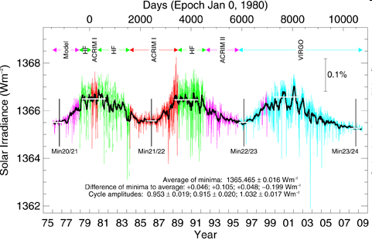
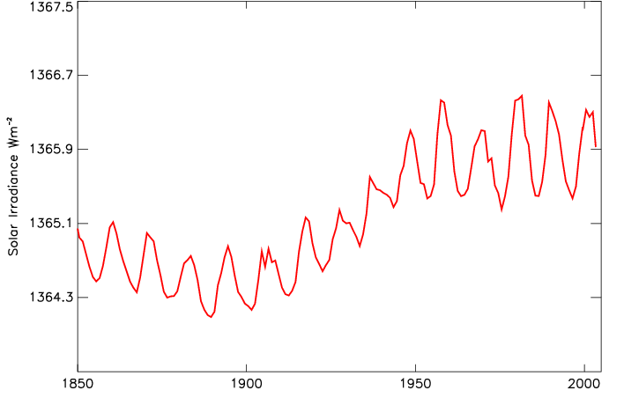
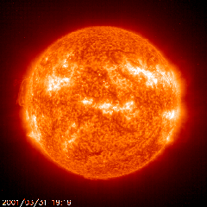
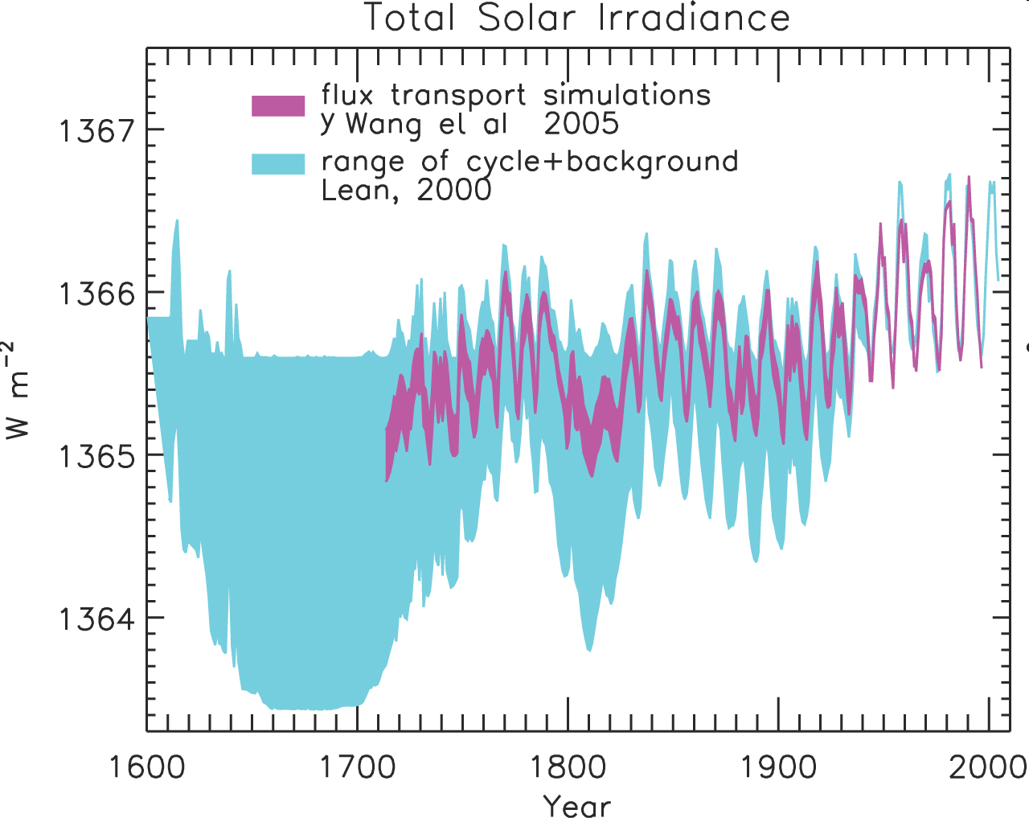
Energy from the Sun; stable over last 50 years
ACRIM/VIRGO
IPCC WG1 2.7.1 (p.188-193)
0.2
Implied changes in global temperature
0.1
0.0
Lean (2000) Y.Wang (2005)
See also: http://www.pmodwrc.ch/pmod.php?topic=tsi/composite/SolarConstant
Notes:
Solar irradiance before 1978 is estimated from proxy data (sunspots, etc) and is less reliable than that measured since then by satellites. However, proxy data combined with the satellite record shows clearly the 11-year solar cycle and a general rise from 1900-1950. This rise can only account for a 0.1 oC increase in temperature.
There are some theories that the solar influence on global climate could be amplified by an indirect route, for example involving stratospheric ozone or cosmic rays or clouds. A review of current understanding was prepared for the Hadley Centre by the University of Reading and Imperial College, London. This concluded that there is some empirical evidence for relationships between solar changes and climate, and several mechanisms, such as cosmic rays influencing cloudiness, have been proposed, which could explain such correlations. These mechanisms are not sufficiently well understood and developed to be included in climate models at present. However, current climate models do include changes in solar output, and attribution analyses that seek to understand the causes of past climate change by comparing model simulations with observed changes, do not find evidence for a large solar influence. Instead, these analyses show that recent global warming has been dominated by greenhouse gas-induced warming, even when such analyses take account of a possible underestimate of the climatic response to solar changes by models.

Slide 33

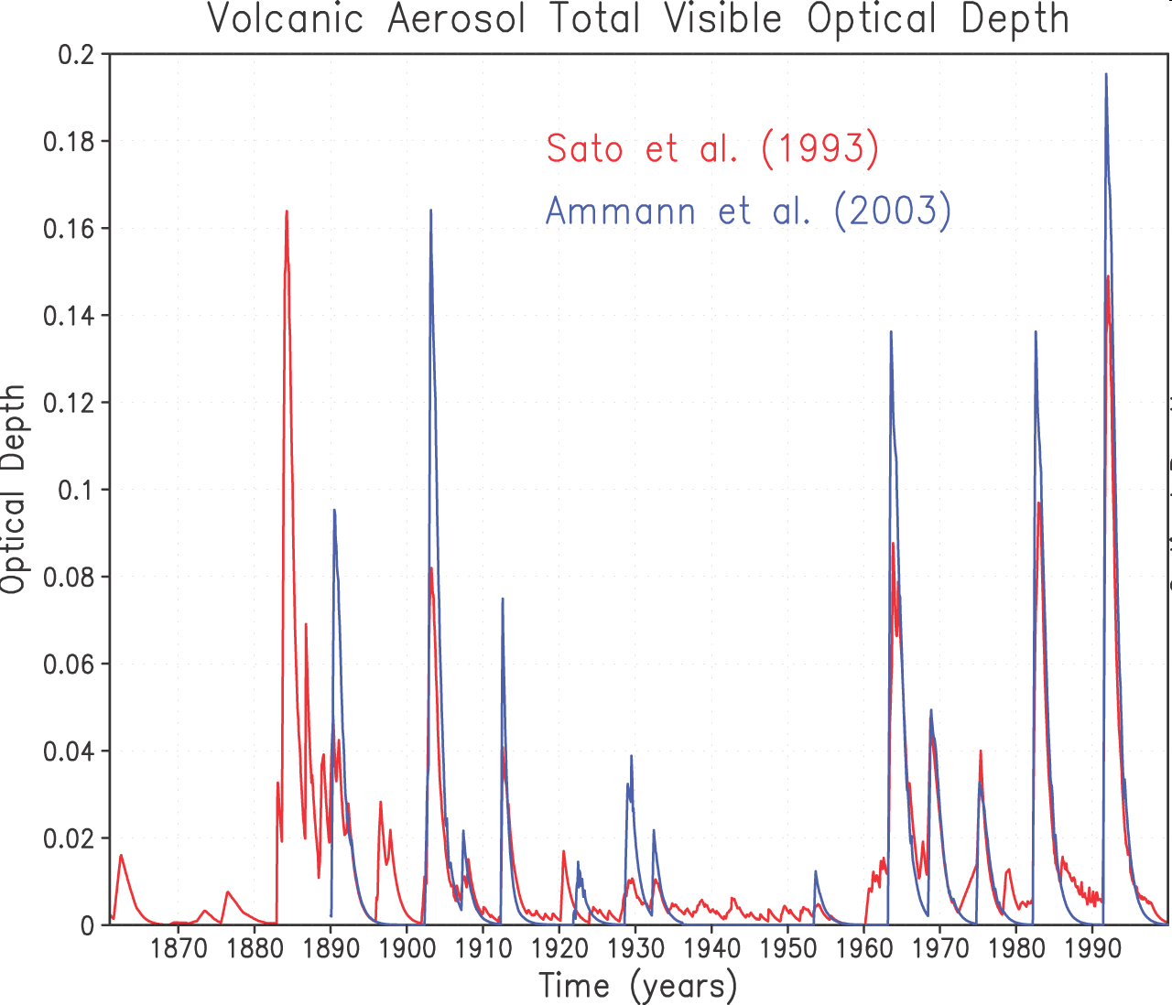
Change in volcanic aerosol
IPCC WG1 2.7.2 (p.193-195)
5
4
3
2
1
0
Estimated cooling effect, Wm⁻²
Notes:
Volcanoes inject gas into the atmosphere. If they are energetic enough, this gas will reach the stratosphere and form small sulphate aerosol particles which can persist for a few years. They reflect back some of the solar radiation which otherwise would have heated the surface of the Earth, and hence act to cool the planet. The amount of volcanic aerosol in the atmosphere is very variable as is the cooling effect that this would have. Although energetic volcanoes were relatively common in the late 19th century (for example, Krakatoa in 1883) and early 20th century, and there have been substantial numbers of energetic volcanoes since the 1960s (most recently, Pinatubo in 1991), there was a period in the 1940s and 1950s when the atmosphere was relatively clear of volcanic aerosol. The amount of climate cooling due to volcanic aerosols would have been quite small in that period. This unusually low amount of volcanic cooling (together with the increase in solar radiation shown in the last slide) may have contributed to temperatures in the 1940s being relatively high compared to earlier decades. As with solar energy, optical depth due to volcanic aerosols has been estimated indirectly before about 1983, and hence is less certain.

Slide 34



How much will cloud feedbacks amplify the warming? A large uncertainty.
Total range
Range of cloud feedback
Strength of Feedback (Wm⁻²/ºC)
Cloud
Surface reflection
Water vapour
ALL
See www.ipcc.ch reports. Each red dot is a different agencies climate model.
Notes:
34

Slide 35
Atmospheric moisture rises with warming in climate models and as detected by conventional and satellite observations
The enhanced greenhouse effect amplifies the initial warming
Notes:
35
Atmosphere-only and fully coupled climate models are able to reproduce the observed variations in column integrated water vapour and its dependence on surface temperature over the oceans.
Integrated water vapour is a key variable since it affects:
Precipitation over convective regions
Radiative cooling of the atmosphere to the surface
Global precipitation through a combination of the above
Strongly positive water vapour feedback
With regards to the last point, column integrated water vapour is sensitive to moisture in the lower troposphere while changes in moisture throughout the middle and upper troposphere are more important for water vapour feedback and it is important to ensure that models accurately capture changes in water vapour at these levels.

Slide 36
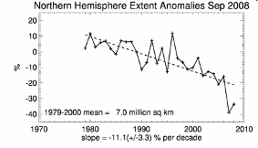
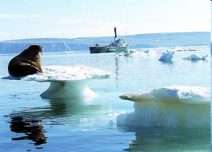
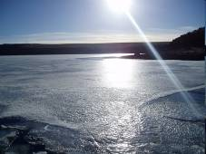
Another example: Ice-reflection feedback
↑ CO₂
Melting ice and snow
↑ CO₂
↑Temperature
↑Temperature
Reduced reflection of suns rays
Additional surface heating
Notes:
36
For example, as the atmosphere warms it will be able to ‘hold’ more water vapour. Water vapour itself is a very powerful greenhouse gas, so this will act as a positive feedback and roughly double the amount of warming. Similarly, when sea ice begins to melt, some of the solar radiation which would otherwise be reflected from the sea ice is absorbed by the ocean, and heats it further; another positive feedback. On the other hand, when carbon dioxide concentrations increase in the atmosphere then it acts to speed up the growth of plants and trees (the fertilisation effect) which in turn absorb more of the carbon dioxide; this acts as a negative feedback.

Slide 37
Some Conceptions and Misconceptions
  CO2 absorption is “saturated”, so adding CO2 will not cause extra warming........wrong, the wings of the absorption bands can go on absorbing as CO2 is added. This is all well understood and taken account of in the models.
  Past variations of greenhouse gases have been just as large as recent ones......wrong, at least for last 1M years, and they certainly – as far as our measurements can resolve – have not occurred anywhere near so fast.
Notes:
37

Slide 38
Continued:
  Feedbacks due to clouds, and to water vapour and aerosols, are hard to predict....right, there is considerable uncertainty surrounding how, for example, the cloud field responds to a warming climate: and, the direct cloud radiative effects are large – many tens of W/m2. Net cloud feedbacks 0 → 1 W/m2
By studying the variability in our observations, and the variability in our models, we are trying to put uncertainty limits on the predictions.
This is one of the most difficult and challenging problems. We need the brightest young people to solve this one.
Notes:
38

Slide 39
Continued:
  We are only in it for the research money.....yes, sure.........
it really is not because it is a fascinating, and important problem;
nor that our young people are drawn to study their Earth and how it works;
nor that some people really do make a connection between the number of people on this planet, the lifestyle of some of us, and the effect that we are having on the support systems.
  What can we do? In simple terms, we can observe the system, and we can simulate the system, and we can try to be as clever in doing both as we possibly can.......
Notes:
39

Slide 40
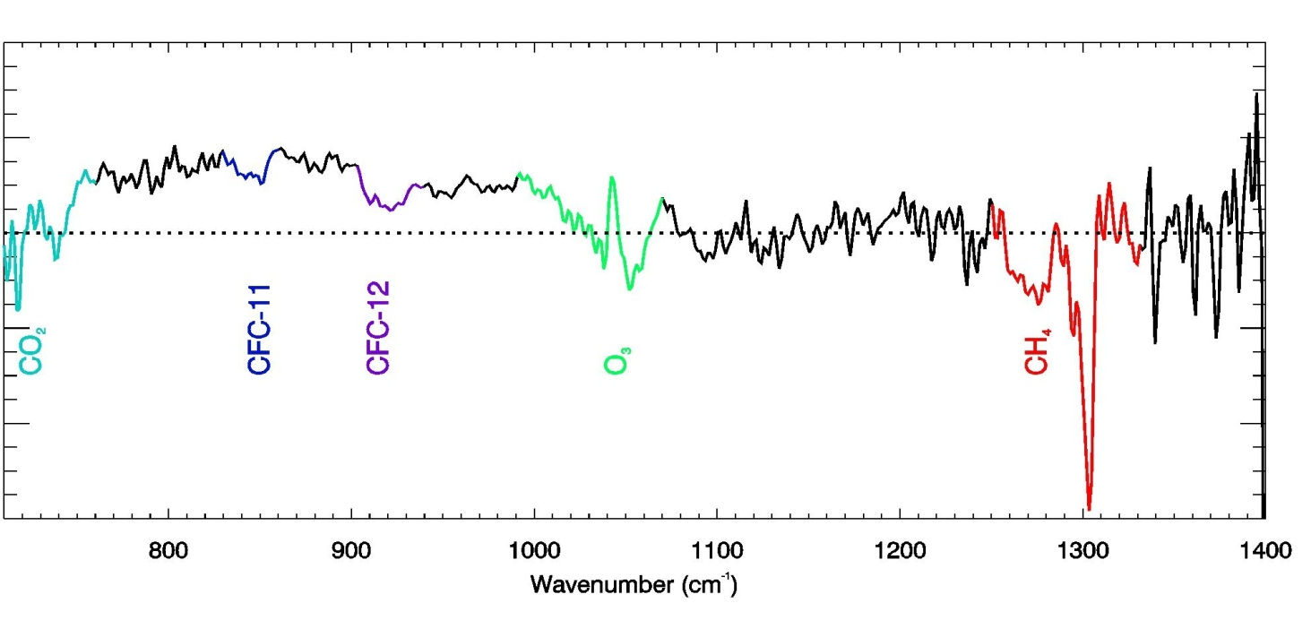
Satellite measurements (1970, 1997) confirm the effect of increasing greenhouse gases
These results showed for the first time experimental confirmation of the significant increase in the greenhouse effect from trace gases such as carbon dioxide and methane
Harries et al. 2001, Nature
Notes:
It is undoubtedly true that greenhouse gases act to warm the planet via the natural greenhouse effect.
Increases in these greenhouse gases have been shown, using satellite data, to have reduced the planets cooling from 1970 to 1997, in line with their predicted effects on the radiation budget.
Only by including the forcing of these greenhouse gas increases on the Earth’s radiative energy balance in sophisticated climate models, can the current warming trend be simulated…

Slide 41
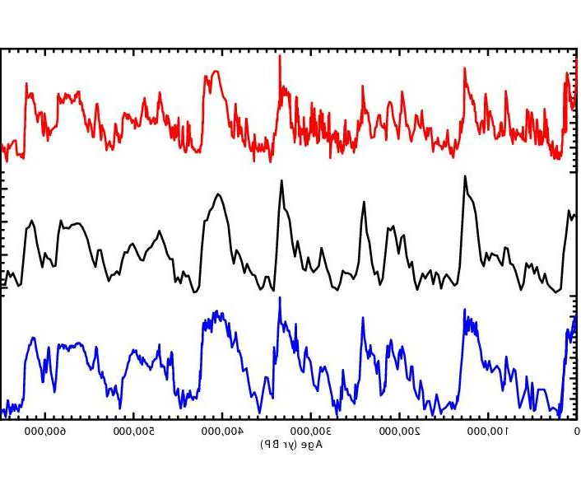
The last 650000 years…
800
700
600
500
400
300
CH_{4 (ppbv)}
≈10ºC
Temperature from δD_{ice} (‰)
300
280
260
240
220
200
180
CO_{2 (ppmv)}
Thousands of years ago: 500 400 300 200 100 Today
Data from Dome C Antarctic ice core (EPICA project) described in Siegenthaler et al. (2005) Science and Spahni et al. (2005) Science, supplied by Prof T. Stocker.
Notes:
Changes in temperature show glacial cycles which are related to predictable changes in the Earth’s orbit around the sun. There is an obvious correspondence between atmospheric carbon dioxide/methane and temperature. However, over these time scales the atmosphere responds to the temperature changes; for example a colder ocean can dissolve more CO2. But note the current levels of these gases (CH4 ~ 1800 ppbv; CO2 ~290 ppmv)
41

Slide 42
The last 650000 years…
800
700
600
500
400
300
CH_{4 (ppbv)}
≈10ºC
Temperature from δD_{ice} (‰)
300
280
260
240
220
200
180
CO_{2 (ppmv)}
Thousands of years ago: 500 400 300 200 100 Today
Data from Dome C Antarctic ice core (EPICA project) described in Siegenthaler et al. (2005) Science and Spahni et al. (2005) Science, supplied by Prof T. Stocker.
Notes:
Changes in temperature show glacial cycles which are related to predictable changes in the Earth’s orbit around the sun. There is an obvious correspondence between atmospheric carbon dioxide/methane and temperature. However, over these time scales the atmosphere responds to the temperature changes; for example a colder ocean can dissolve more CO2. But note the current levels of these gases (CH4 ~ 1800 ppbv; CO2 ~290 ppmv)
42

Slide 43
The last 650000 years…
800
700
600
500
400
300
CH_{4 (ppbv)}
≈10ºC
Temperature from δD_{ice} (‰)
300
280
260
240
220
200
180
CO_{2 (ppmv)}
Thousands of years ago: 500 400 300 200 100 Today
Data from Dome C Antarctic ice core (EPICA project) described in Siegenthaler et al. (2005) Science and Spahni et al. (2005) Science, supplied by Prof T. Stocker.
Notes:
Changes in temperature show glacial cycles which are related to predictable changes in the Earth’s orbit around the sun. There is an obvious correspondence between atmospheric carbon dioxide/methane and temperature. However, over these time scales the atmosphere responds to the temperature changes; for example a colder ocean can dissolve more CO2. But note the current levels of these gases (CH4 ~ 1800 ppbv; CO2 ~290 ppmv)
43

Slide 44
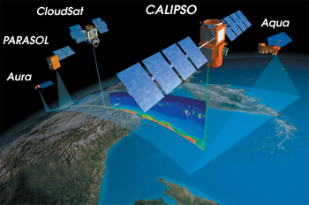
Observations and cloud feedback
Notes:
44
A constellation of satellites is currently active, measuring cloudiness in unprecedented detail. Meanwhile the search for a smoking gun on cloud feedback remains elusive…

Slide 45
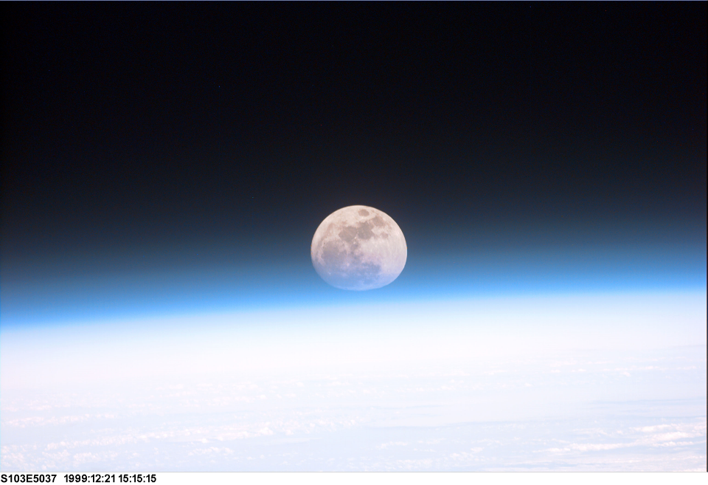

Slide 46
Earth’s global average energy balance: no atmosphere
Solar
Thermal
240 Wm⁻²
240 Wm⁻²
Efficiency = 100%
240 Wm⁻²
Surface Temperature = -18ºC
(1- α)S_{o}/4 = σT_{S}⁴
Notes:
The Earth without a Greenhouse Effect would be frigid since the Earth would cool more efficiently by emitting thermal radiation from the surface straight out into space.
F=σ(273-18)⁴=(5.67x10⁻⁸)x(255)⁴=…
[32 F = 0º C=273.15 K)

Slide 47
Earth’s global average energy balance: add atmosphere
Solar >
Thermal
240 Wm⁻²
Heating
240 Wm⁻²
Temperatures rise
(1- α)S_{o}/4 ≠ σT_{S}⁴
Notes:
Adding an atmosphere reduces the outgoing thermal radiation to space, and so the absorbed solar energy is greater than the outgoing thermal energy and the planet warms up. NOTE, WHAT WOULD THE WATER VAPOUR ONLY EFFECT BE?

Slide 48
Earth’s global average energy balance: present day
Solar
Thermal
240 Wm⁻²
240 Wm⁻²
Efficiency ~61.5%
390 Wm⁻²
Surface Temperature = +15ºC
(1- α)S_{o}/4 = σT_{E}⁴
Radiating Efficiency, or the inverse of the Greenhouse Effect, is strongly determined by water vapour absorption across the electromagnetic spectrum
Notes:
As the planet warms up, it emits more thermal energy since warmer bodies emit more thermal (longwave) radiative energy. The Earth warms up until the outgoing thermal energy equals the absorbed solar energy, resulting in a global temperature of 15ºC, about 33ºC warmer than without a greenhouse effect.

Slide 49
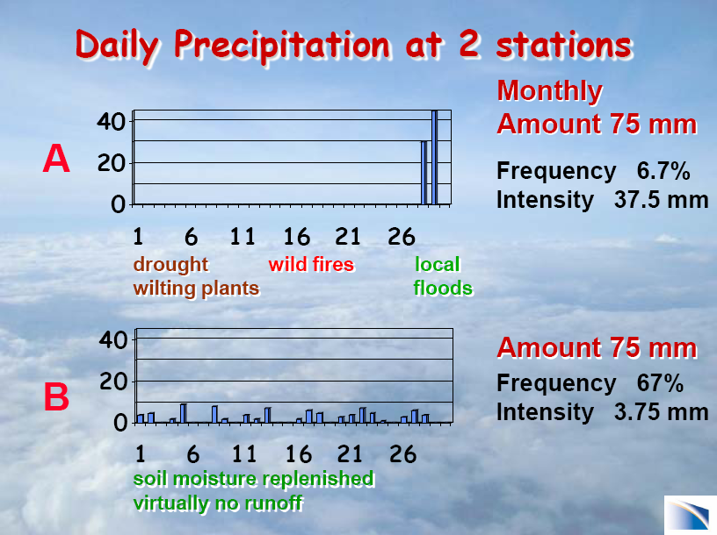
Courtesy of Dr Kevin Trenberth, Head of the Climate Analysis Section at the USA National Center for Atmospheric Research

Slide 50

What are the projections of future climate?
Climate change determined by forcings and feedbacks
Increase in man-made greenhouse gases alone will not determine amount of warming
Feedback loops or “vicious circles” amplify or diminish the warming from greenhouse gases
Understanding these processes and representing them within Earth system computer models is crucial for accurate prediction of future climate
Notes:
50
The additional heating of the climate system which would occur if the concentration of CO2 in the atmosphere was doubled, is about 3.8 Wm⁻². In a simple world this would ultimately warm the surface by about 1 °C. The prediction of climate change is complicated by the fact that, once climate change starts, there will be consequences (feedbacks) in the climate system which can act to either enhance or reduce the warming.

Slide 51
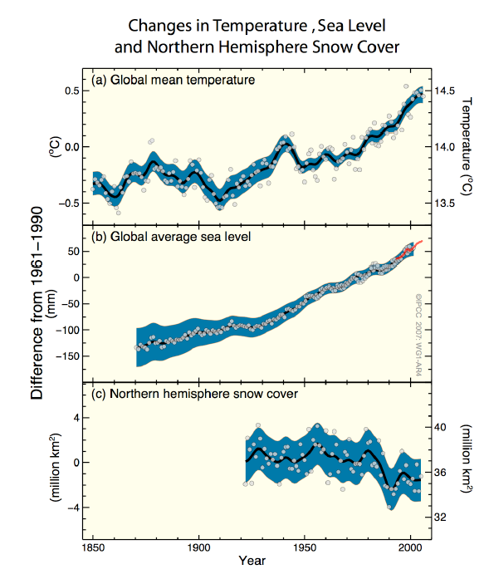
Is the planet warming?
“Warming of the climate system is unequivocal, as is now evident from observations of increases in global average air and ocean temperatures, widespread melting of snow and ice, and rising global mean sea level” [IPCC 2007]
Notes:
The total temperature increase from 1850 – 1899 to 2001 – 2005 is 0.76 [0.57 to 0.95]°C. Urban heat island effects are real but local, and have a negligible influence (less than 0.006°C per decade over land and zero over the oceans) on these values. [IPCC 2007]. More recently, the warming has been observed to heat the ocean to depths of at least 3km and to increase the average atmospheric water vapour (invisible, gaseous form of water) over land and ocean.
Global average sea level rose at an average rate of 1.8 mm per year over 1961 to 2003. The rate was faster over 1993 to 2003, about 3.1 mm per year. Whether the faster rate for 1993 to 2003 reflects decadal variability or an increase in the longer-term trend is unclear. There is high confidence that the rate of observed sea level rise increased from the 19th to the 20th century. The total 20th century rise is estimated to be 0.17 m.
Mountain glaciers and snow cover have declined on average in both hemispheres. Widespread decreases in glaciers and ice caps have contributed to sea level rise (ice caps do not include contributions from the
Greenland and Antarctic ice sheets) as has the thermal expansion of the oceans in line with the ocean warming.

Slide 52
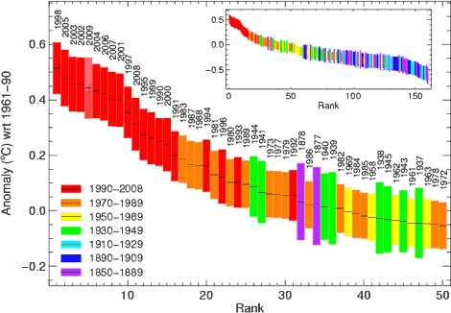
Global Annual Ranked Temperature
Data from www.metoffice.gov.uk Note 2009 is incomplete.
Notes:
Data available at www.metoffice.gov.uk
The relative warmth of years and decades and their uncertainty show just how unusual the last few decades have been in the instrumental record.

Slide 53
~20 slides
## MOSTLY PICTURES!
Intro (inc snow and ice)
Climate has always changed (1)
Why does climate change?
  Earth’s Energy Budget (2)
  Forcing and feedbacks (3/4)
  CO2 and climate (5)
Is the climate warming?
  Surface temperature (6)
  Sea level (7)
  Sea ice (8)
Is the warming unusual?
  Instrumental record (9)
  Ice cores (10)
Why is Earth warming?
  CO2 changes (11)
  Spectral signature (12)
  Natural effects (13)
  Climate models (14/15)
How much will Earth warm and what are the consequences?
  Heatwaves (16)
  Precipitation (17)
  Sea level rise (18)
  CONCLUSIONS
Notes:
Mass of Atmosphere = 5x10^18 kg
Total mass of CO2=3x10^15
Mol Mass of CO2=43
Mol mass of air=29
Co2 emissions ~8 GtC/yr = 8*43/12 GtCO2/yr = 28 GtCO2/yr = 28x10^12 kg CO2/yr
28x10^12/5x10^18=6x10^-6 yr-1 = 6 ppm/yr (by mass) = 6*29/43=4 ppmv/yr. Actual increase ~ 2 ppmv/yr so land and ocean take up about 50% of emissions.
V=mRT/p
VCO2/Vair=43.189.
383 ppmv = 582 ppm by mass
2 GtC/yr = 2 ppm/yr

Slide 54
Courtesy of Prof. Richard Somerville http://richardsomerville.com

Slide 55
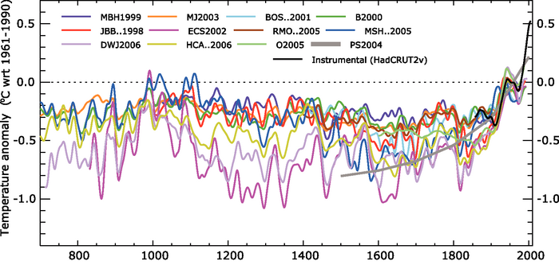
Northern hemisphere warming is unusual in context of at least the last 1000 years
The Arctic has probably not been as warm for 125 000 years
Notes:
Mann et al. (2008) PNAS “…results extend previous conclusions that recent Northern Hemisphere surface temperature increases are likely anomalous in a long-term context. Recent warmth appears anomalous for at least the past 1,300 years whether or not tree-ring data are used. If tree-ring data are used, the conclusion can be extended to at least the past 1,700 years, but with additional strong caveats. The reconstructed amplitude of change over past centuries is greater than hitherto reported, with somewhat greater Medieval warmth in the Northern Hemisphere, albeit still not reaching recent levels.” Mann et al. (2008) PNAS

