Slide 1
ST1.3 Atmospheric Precursors
Adrian Champion*, Richard Allan (UoR)
Hayley Fowler, Stephen Blenkinsop (UoN)

Slide 2
Deliverables & Milestones
M1.3.1 Identification of precursors and time/space scales of FFIR events (M12)
M1.3.2 Identification of clusters of events and links to catchment types (M24)
D1.3.1 Development of a case study set for WT2 intercomparison experiments (M33)
D1.3.2 Peer reviewed articles for J. Clim., JGR (M36)

Slide 3
M1.3.1 Identification of Precursors
Lavers et al. (2011, 2012) linked narrow bands of moisture convergence (Atmospheric Rivers) to winter flooding in the North-West of England.
Atmospheric River – defined using vertically integrated horizontal water vapour transport (IVT), present for 18 hours, extending over 2000km, using a threshold approach.

Slide 4
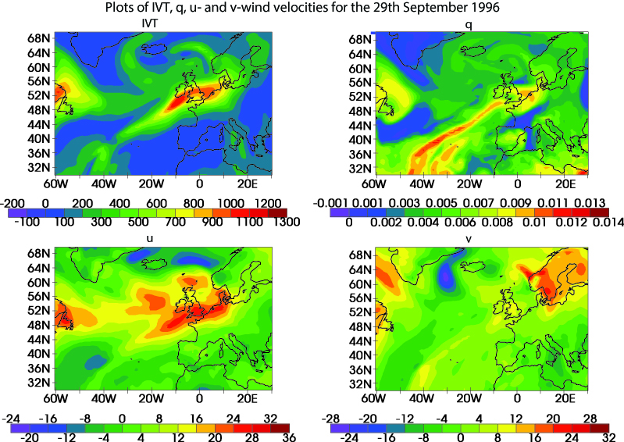
Atmospheric River
Champion et al., sub.

Slide 5
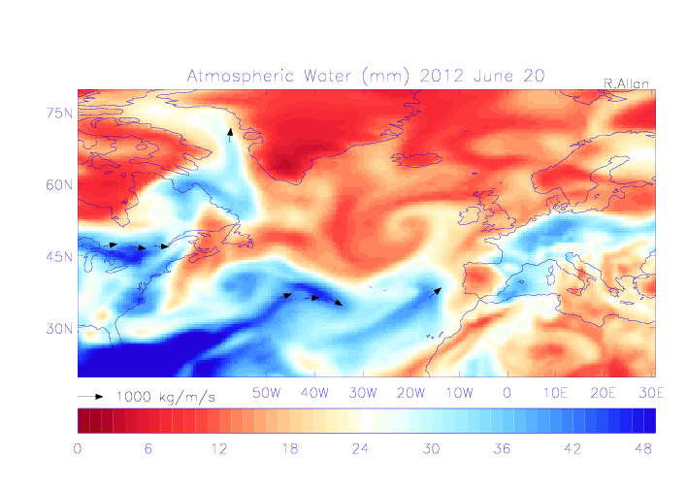
Atmospheric River

Slide 6
ARs & Summer Extreme Rain
Daily raingauge data from MIDAS
90% threshold of UK daily rain
ERA-Interim (1979 - 2013) & 20CR (1900 – 2012)
Summer results: <20% of extreme rain events identified had an associated AR. <10% of ARs produce an extreme rain event.
  Champion, A.J., Allan, R.P., Lavers, D.A., sub.: Atmospheric Rivers don’t explain UK Summer Extreme Rainfall, JGR.

Slide 7
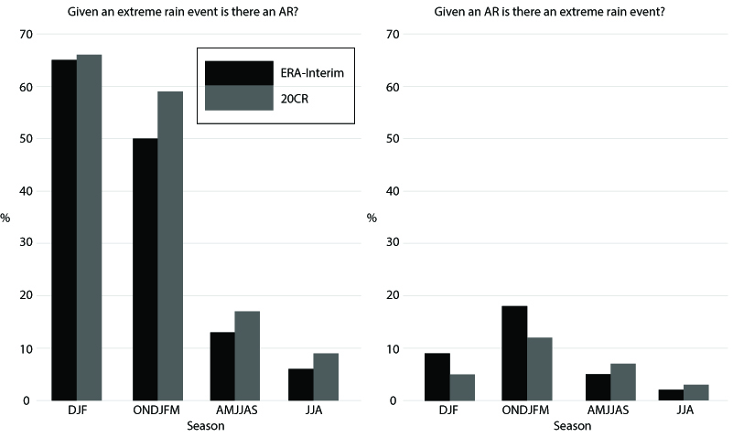
ARs and Summer Extreme Rain
Champion et al., sub.

Slide 8
MSc Dissertation Student
Maya Balasubramanyam
  “Extreme Rainfall and the Relationship to Summer Flooding Events in the UK”
  Sponsored by Catlin Group (re-insurance company)
Investigated different thresholds to define a rain event as an extreme rain event 1900 - 2013
  Comprehensive comparison to literature (newspapers, data sources)
  Use of extreme value theory to investigate trends
Looked at the atmospheric conditions prior to some of the identified events
  Highlight role of CAPE

Slide 9
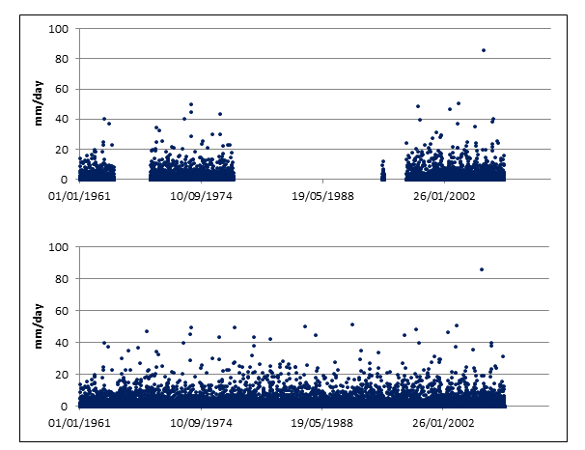
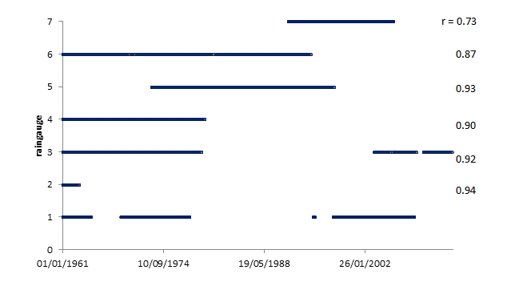
MSc Student Dissertation
Balasubramanyam, 2014. MSc Dissertation

Slide 10
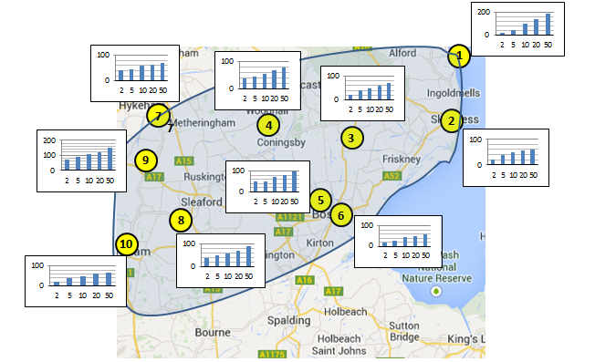
MSc Student Dissertation
Balasubramanyam, 2014. MSc Dissertation

Slide 11
New Identification Methods
Time-integrated variables:
  IVT
  Specific humidity
More localised processes:
  Vertical velocity
New tracking method:
  WCB within extra-tropical cyclones

Slide 12
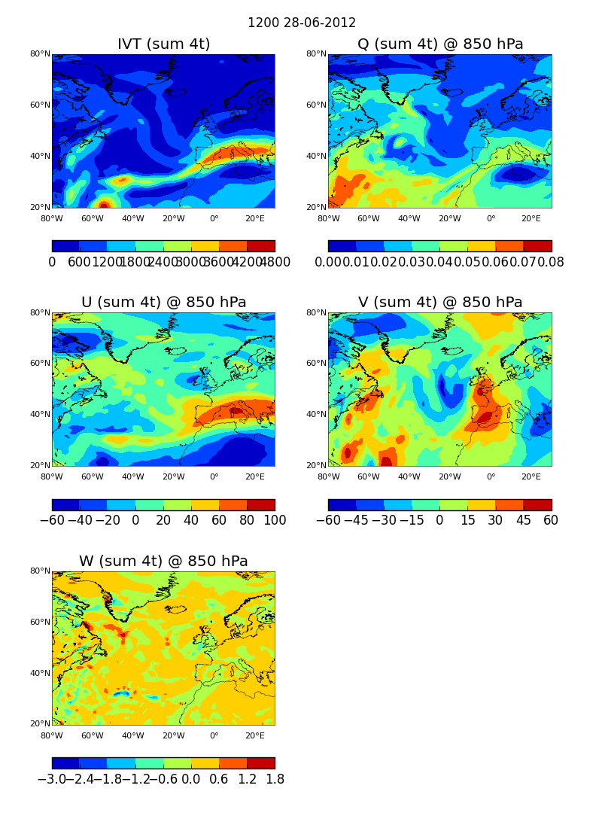
Early Investigations

Slide 13
M1.3.2 Identification of clusters of events and links to catchment types
Use hourly raingauge dataset being produced by Newcastle University (Stephen Blenkinsop)
Combine with results from precursor study to identify atmospheric events.

Slide 14
Summary
M1.3.1
  Extension of AR work by Lavers et al. showed very little correlation between ARs and summer FFIR events
  New metrics currently being tested with a view of looking at more localised processes
M1.3.2
  Will start middle of next year.
D1.3.1
  Collaboration with Newcastle University using hourly raingauge dataset
D.1.3.2
  Paper on linking ARs to summer FFIR events submitted to JGR.

Slide 15
Extra Slides

Slide 16
items from this subtask of interest for EA/SEPA/FFC/Met Office
Patterns associated with extreme events
  Moisture transports
  Moisture distribution
  SST patterns, CAPE
Physical processes associated with extreme events
…

Slide 17
criteria of 'measure of success' to work towards (e.g. impact)
Papers of broad interest
Media interviews
Identification of drivers

Slide 18
Atmospheric precursors in GPCP-1DD and model
Example column integrated or 850 hPa moisture and vapour transport precursors
Notes:
Just to make the point that 850 hPa moisture transport is comparable in structure to the integrated moisture transport field and that we can more easily compare the 850 hPa fields with models.

Slide 19
Number of heaviest 1% of rainfall events by month
Sum over all grid points around the British Isles
Distinct daily rainfall events only (no duplicates)
Less heavy daily rainfall observed in summer
Model simulates fewer distinct events in spring
Notes:
For each grid point, the heaviest 1% of daily events were calculated over the period 1997-2008 in the GPCP observations and HadGEM2-A simulation (AMIP observed SST forcing).

Slide 20
Example moisture and transport fields prior to daily event
GPCP/ERA Interim HadGEM2-A
Heaviest daily event
Composite moisture fields over top 1% of daily events
Notes:
The model and observations show AR-like structures prior to the heaviest rainfall events. Making a composite over the top 1% of daily events shows the region of high moisture and moisture transport (arrows).

Slide 21
Example moisture and transport fields prior to JJA daily event
GPCP/ERA Interim HadGEM2-A
Heaviest daily event
Composite moisture fields over top 1% of daily events
Notes:
When considering JJA, very few events are present apart from in the South and East of the UK. Here high moisture transport to the south and east and its transport appear important.

