Slide 1
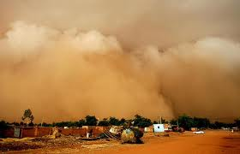
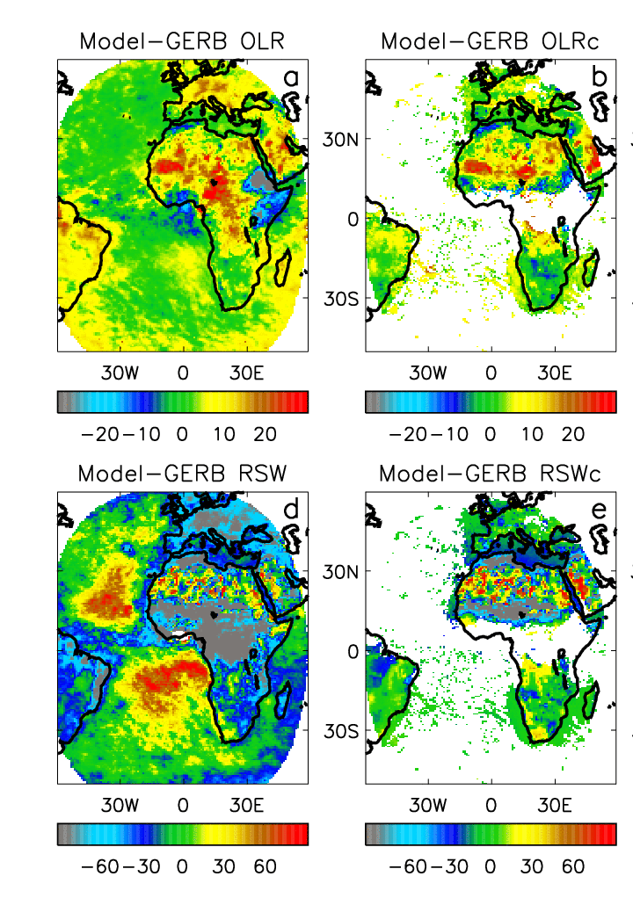
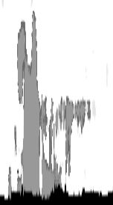
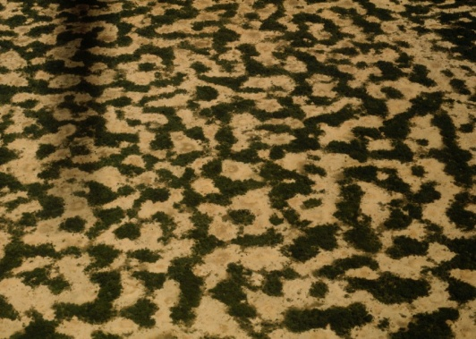

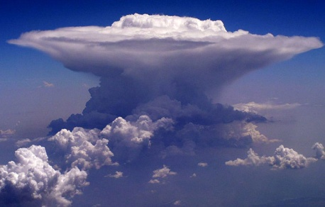
All-sky Clear-sky
Radiative biases in Met Office global NWP model
Convective outflow
Mineral dust
Shortwave Longwave
Improving model physics using GERB data
Surface albedo
Convective cloud
Marine stratocumulus

Slide 2
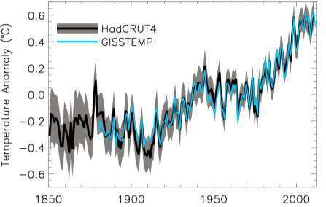
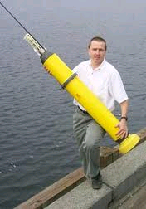
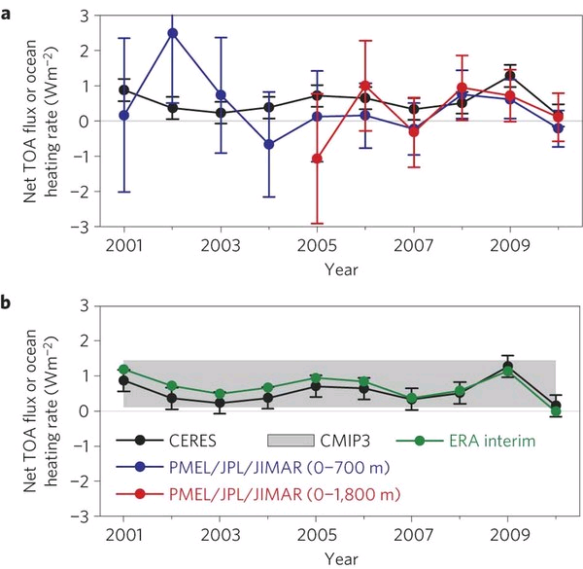
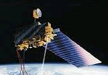
Is Earth still warming?
Combining satellite radiative energy balance observations with in situ ocean data…
Loeb et al. (2012) Nat. Geosci.
Despite a slowdown in the rate of surface warming heat is continuing to accumulate in the oceans
The rate of heating is 0.54 Watts per square metre
(this is equivalent to the heat of 250 billion 1 kilo-Watt electric heaters distributed over the planet)
Notes:
Fi gure 3 (a) Global annual average net TOA flux from CERES observations and (b) ERA Interim reanalysis are anchored to an estimate of Earth’s heating rate for 2006–2010 ⁵ The Pacific Marine Environmental Laboratory/Jet Propulsion Laboratory/Joint Institute for Marine and Atmospheric Research (PMEL/JPL/JIMAR) ocean heating rate estimates⁴ use data from Argo and World Ocean Database 2009; uncertainties for upper ocean heating rates are given at one-standard error derived from sampling uncertainties. The gray bar in (b) corresponds to one standard deviation about the 2001–2010 average net TOA flux of 15 CMIP3 models.

Slide 3
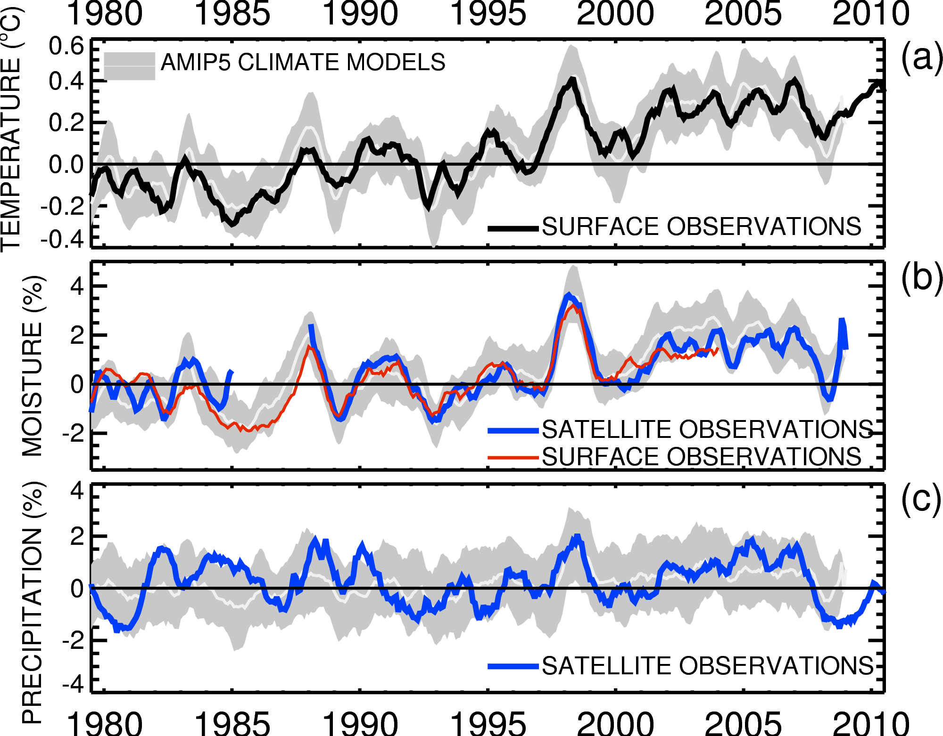



Monitoring changes in the global water cycle
Globally, in the present-day climate, temperature, moisture and precipitation are strongly coupled

Slide 4
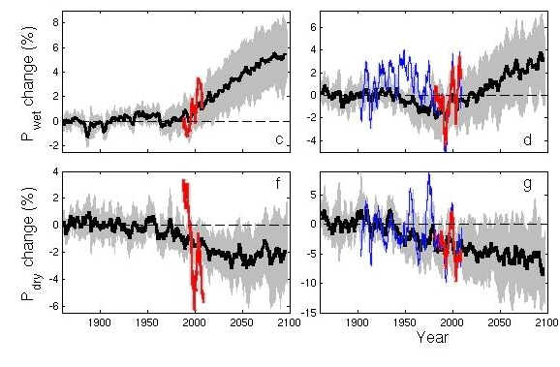
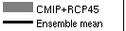
Simulations, observations & physics: wet get wetter, dry regions drier
Ocean Land
GPCC, GPCP
Pre 1988 GPCP ocean data does not contain microwave data
dry tropics wet
Precipitation Change (%)
Tropical dry Tropical wet
Robust drying of dry tropical land
30% wettest gridpoints vs 70% driest each month
Liu and Allan in prep; see also Allan et al. (2010) ERL.

Slide 5


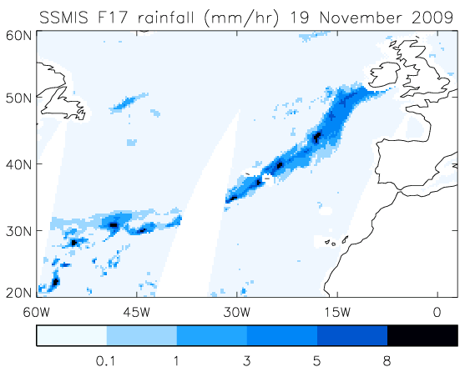
Precipitation extremes
NERC HydEF project: linking UK flooding to large-scale atmospheric precursors e.g. 2009 Cumbria floods
Lavers et al. (2011) Geophys. Res. Lett.

Slide 6
Extra slides

Slide 7
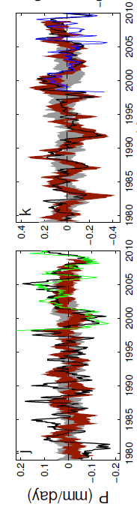
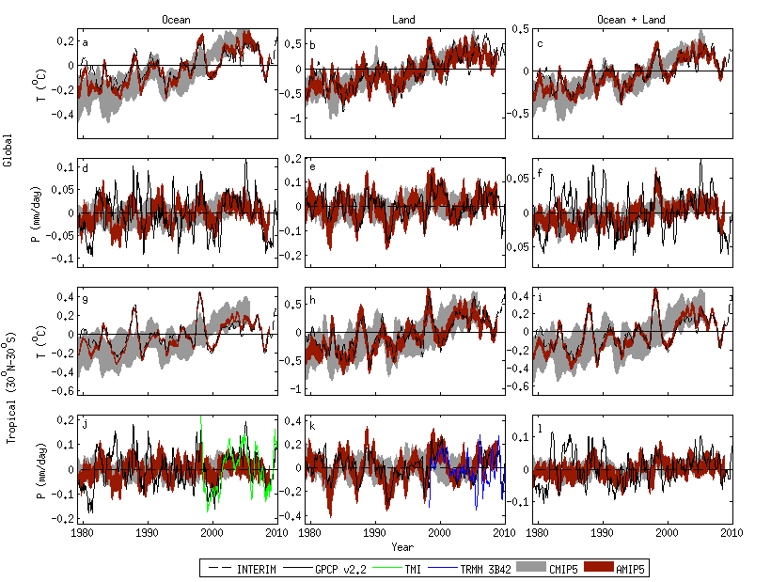
Challenge: Observing systems
Observed precipitation variability over the oceans is questionable. Over land, gauges provide a useful constraint.
Combining observational platforms is a powerful strategy e.g. microwave, gravity, ocean heat content, reanalysis transports
Oceans Land
Liu, Allan, Huffman (2012) GRL

Slide 8

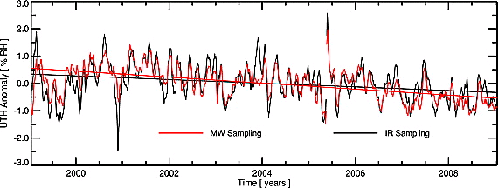
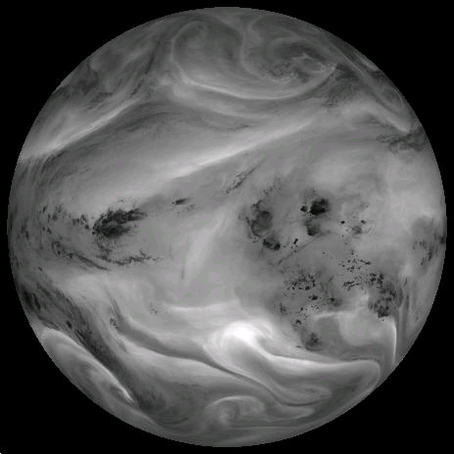
HadIR JWCRP project: developing a satellite infra-red/ microwave water vapour dataset
John et al. (2011) JGR
Carefully dealing with the effects of sampling and calibration
Plan to exploit data in the evaluation of models

Slide 9
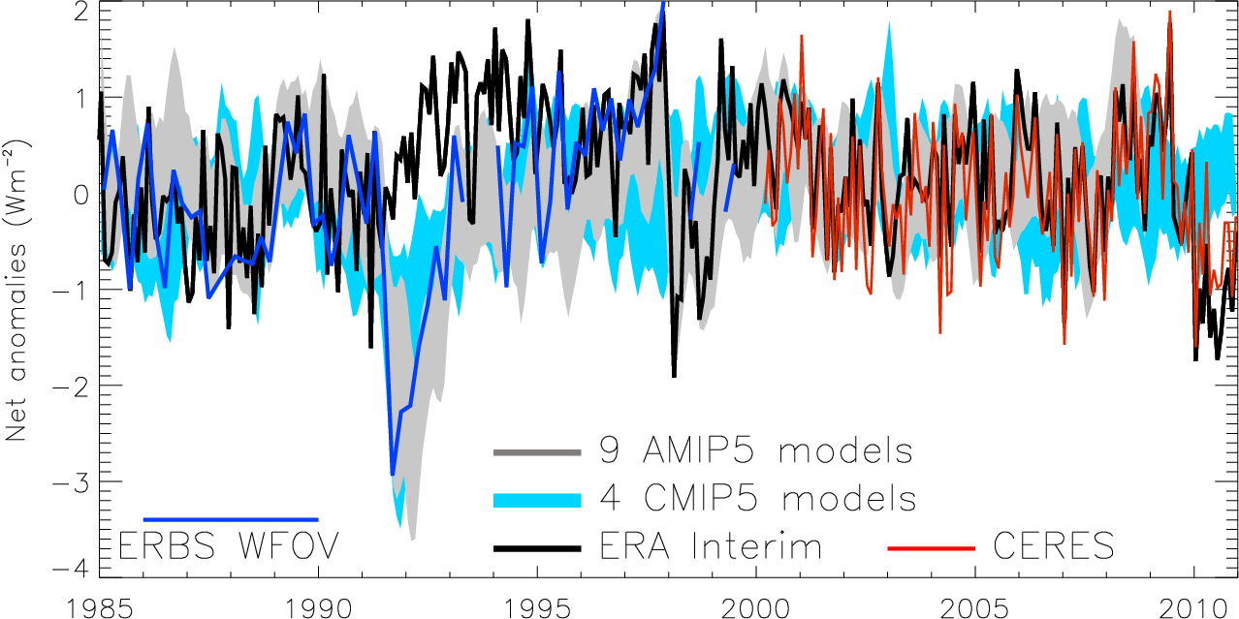
Variation in net radiation since 1985
60S-60N, after Allan (2011) Meteorol. Apps
Notes:
Deseasonalised monthly anomalies of net radiation (60ºS-60ºN) from satellite data (ERBS WFOV; CERES) and reanalysis simulations (ERA Interim) updated from ref 6 to include CMIP5 climate model simulations (AMIP 5 simulations from CNRM, NorESM1, HadGEM2 and INMCM4 in grey and combined historical and RCP4.5 scenario coupled simulations from CNRM, CanESM, HadGEM2-ES and INMCM4 in blue shading). CERES has been updated to EBAF2.6 and ERA Interim to 1985-2010.

Slide 10
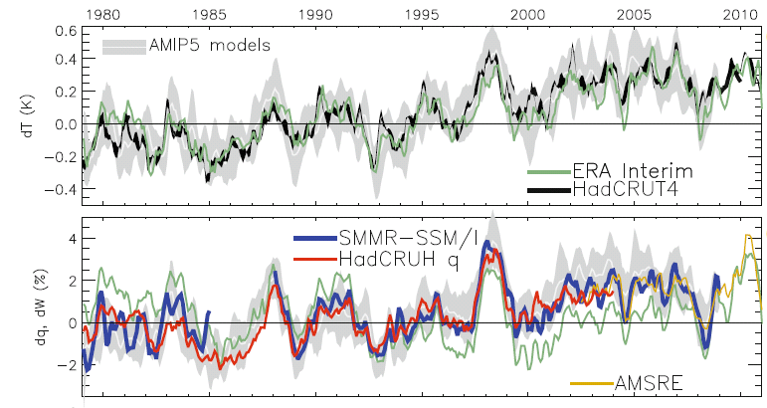
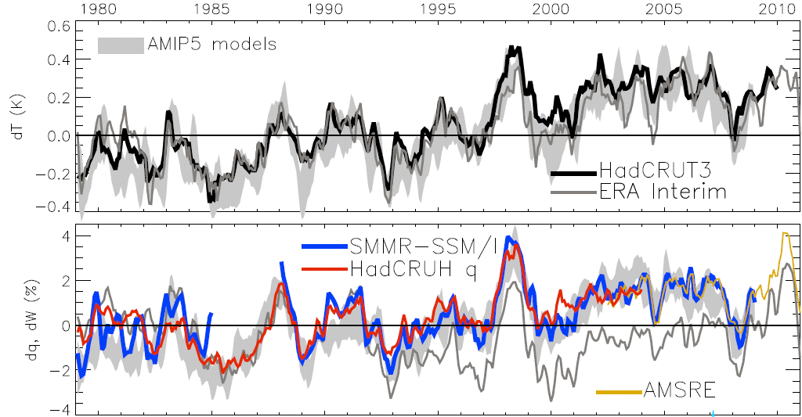
Global changes in water vapour
Water Vapour (%) Surface Tempertaure (K)
Notes:
The main point to note is that models and observations are consistent in showing increases in low level water vapour with warming. Reanalyses such as ERA Interim, which are widely used, are not constrained to balance their energy or water budgets.
For ocean-only satellite datasets I apply ERA Interim for poleward of 50 degrees latitude and for missing/land grid points.
Note that SSM/I F13 2003-2007 CWV = 24.7794 mm; AMSRE 2003-2007 CWV = 24.8850
10

