Slide 1
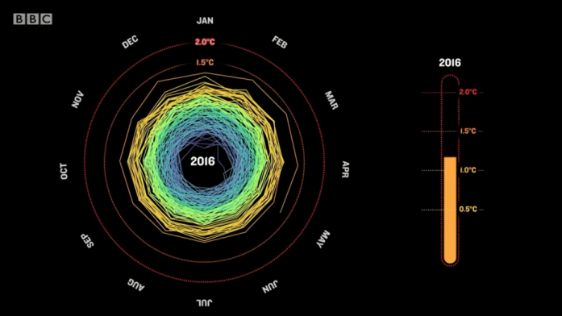
Media engagement, social networking – what’s the point?
Department of Meteorology
Richard Allan
Department of Meteorology, University of Reading
Notes:
> With apologies for troubling you, I was wondering if you may have some time
free in February to give a brief talk on media engagement and social network use
at this term's PDRA forum meeting.
>
> During our last meeting, most of the postdocs said that they do not advertise
their research to people outside of their specialised community (mainly because
they do not see the immediate advantage, in comparison to dedicating that time
to further research so as to maximise their number of publications). My
understanding is that some funding bodies do see wider public engagement as
important. However, it is a little unclear how widespread this view is, and what
is the most effective strategy for gathering media engagement ~Qbrownie
points~R.
>
> The PDRA forum meeting this term is therefore going to focus on media
involvement and the use of social networking at the early stages of an academic
career. Given that you have extensive experience of dealing with different kinds
of media as well as being Head of Department for External Affairs, I thought you
would have a very useful insight.

Slide 2
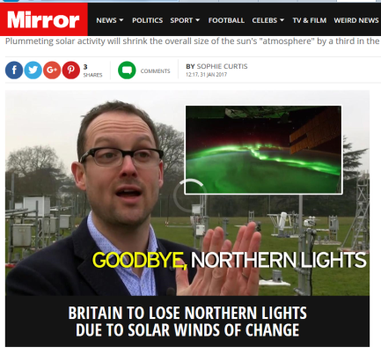
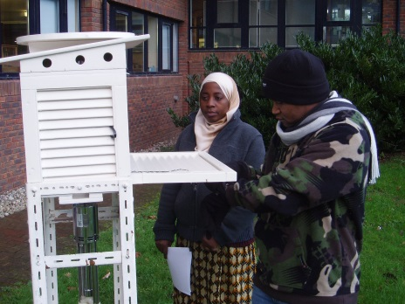
introduction
These are some personal thoughts on the use of social networking and public engagement to help your career and contribute to the department, University and wider societal wellbeing
Everyone is different and you can prioritise to suit your needs
I’ll cover twitter and media engagement as well as general public engagement from my perspective but also from the perspective of the department and the University.

Slide 3

What’s the point?
What’s the point of wasting time on media engagement or social networking when you should be publishing papers?
What’s the point of doing research?
Besides getting paid.
Why spend days, weeks and months researching, designing, implementing and publishing a journal paper…
…if only you, your co-author and a couple of reviewers ever read it?
If you’re not proud of your research who else is going to be?
If you don’t promote your research, who else will? (unless it’s so awesome you can just sit back and watch the citations pile up)

Slide 4
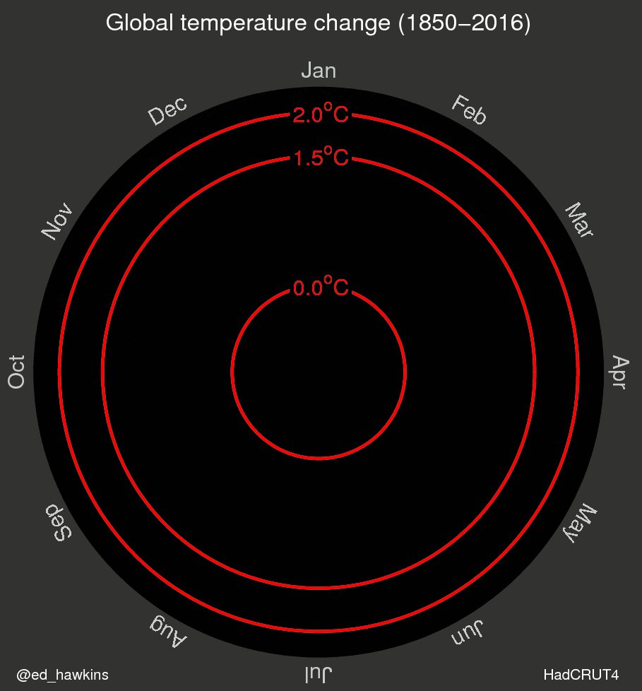
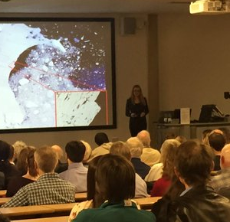
Engage [en-geyj]
verb (used with object), engaged, engaging.
to occupy the attention or efforts of (a person or persons): She engaged him in conversation.
to secure for aid, employment, use, etc.; hire: to engage a worker; to engage a room.
to attract and hold fast: The novel engaged her attention and interest.
to attract or please: His good nature engages everyone.

Slide 5
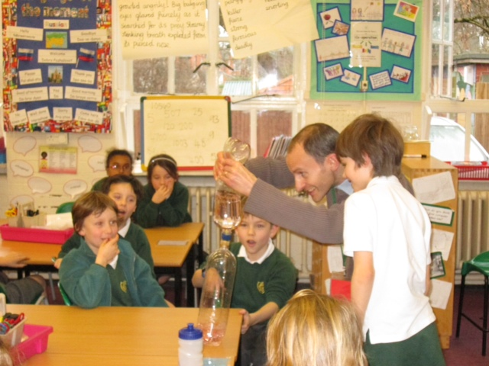
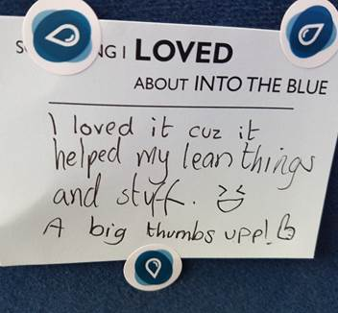
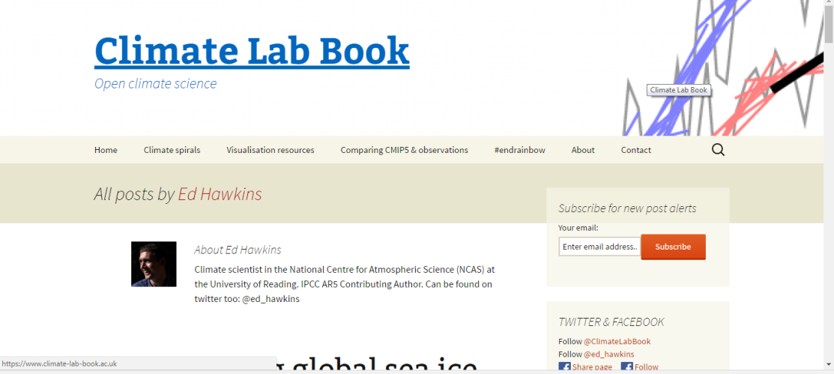
Public engagement
The public is everyone (including scientists, including you)
Public engagement benefits wider society but also you e.g. broader context, communication skills, fulfilment, public understanding of science...
Impact agenda & funding

Slide 6

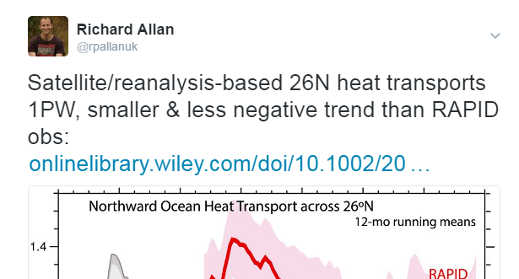
twitter
Follow people that are useful
Don’t follow people who just tell you about their kids/dinner/wonderful life (unless you’re interested in that)
Tweet useful information (not just about your kids/dinner/wonderful life)
Also promote yourself/department/University
Well, who else is going to?
I put my tweets on my homepage – that’s quite a good way to stop you from tweeting inappropriate rubbish (simple instructions on twitter)
You can engage with people using “reply” – ignore people who are annoying
Exemplar = @ed_hawkins (he’s not annoying… well apart from being so bloody good at social media)

Slide 7
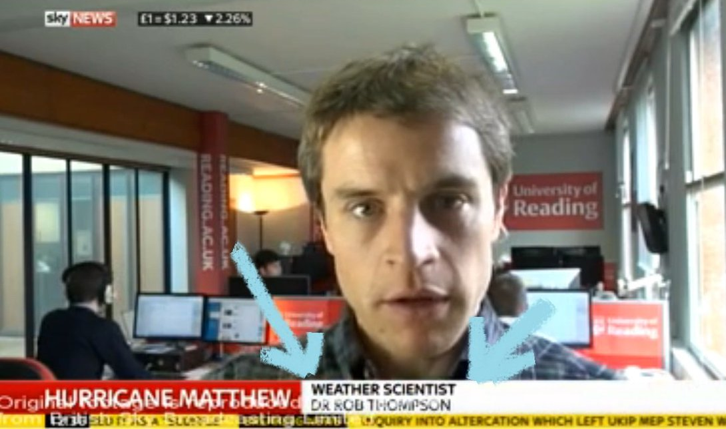
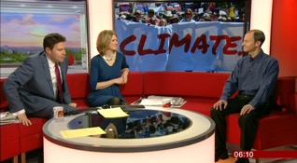
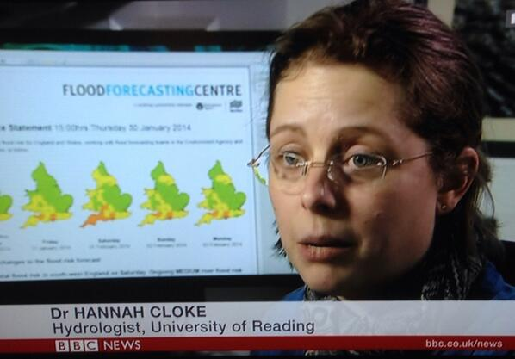
Media: some context
The University of Reading wants as much media coverage as possible
  This is to attract more students to Reading (££££)
The department wants to promote our reputation in research
  This is to increase impact of our research which helps funding and to attract more students (££££) but there is a risk of reputational damage
Individuals want to do their job (see above) but also contribute to the public understanding of science and promote own research
  There is a risk your peers will look down their nose at you and you can suffer reputational damage but also get wider recognition (e.g. useful in demonstrating impact/wider engagement for funding and doing your job as above is useful for promotion)
Proactive vs reactive . Live vs recorded. TV vs radio vs web vs print
Notes:
Grade 8 - Be available to provide expert commentary in a variety of media.

Slide 8
TO DO LIST
0) Keep up the good work. Publish and disseminate research.
Update webpage. All professional scientists should have their own webpage listing publications and their links as a bare minimum
Keep a log. Your contributions to outreach, media and wider engagement will be useful for your project but also your career
Training. Lifelong learning. Improving all forms of communication (written, oral, …) it’s a valuable transferable skill.
Engage. Don’t jump in at the deep end. Prioritise engagement to suit your needs and situation. There are many options (blogs, adult education, school events, local radio, expert comments) – ask advice from project PI or mentor.
Sometimes it might not taste nice but it’s good for you and can leave you with a warm glow inside (or is that the medicinal whisky?).

Slide 10
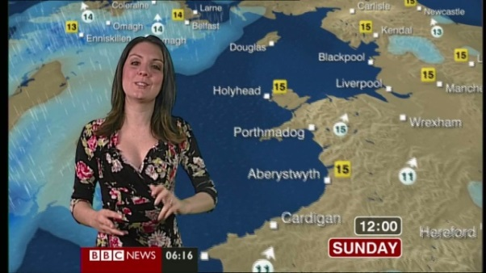
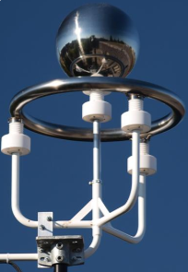
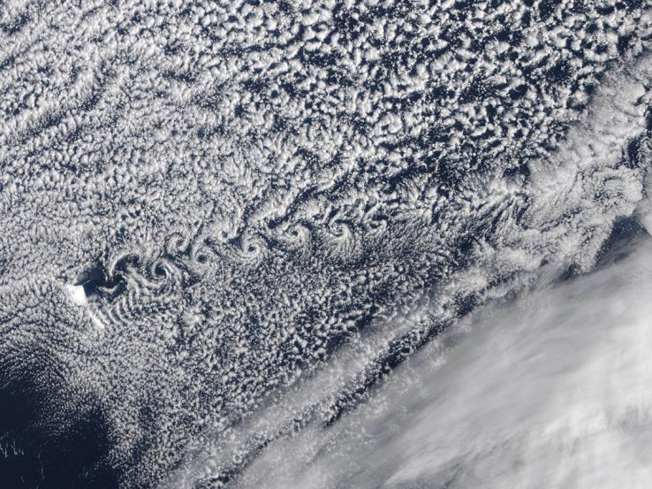
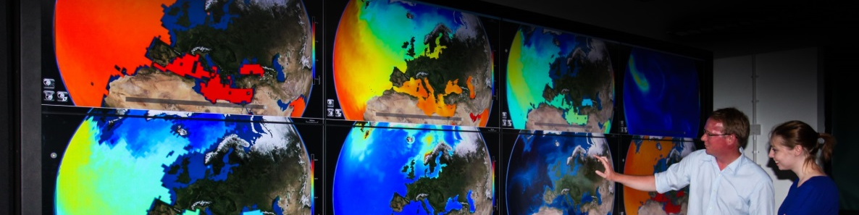
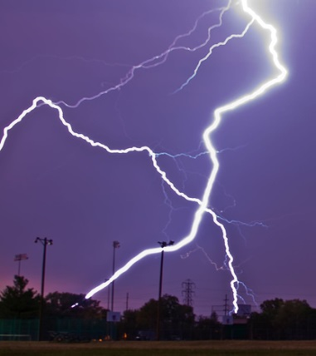
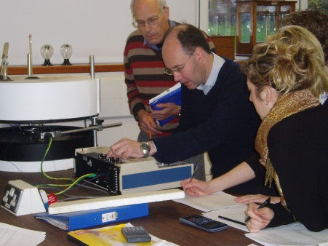
READING AS A CONDUIT FOR SEPNET
A major international science Department, with 50 years of global reach through its graduates

