Slide 1
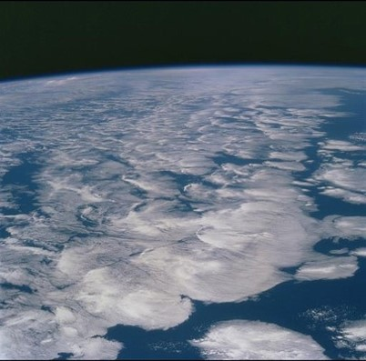



changes in Earth’s ENERGY imbalance & implications for water cycle
Department of Meteorology
Richard Allan r.p.allan@reading.ac.uk @rpallanuk
Thanks to Chunlei Liu, Norman Loeb and all co-authors

Slide 2
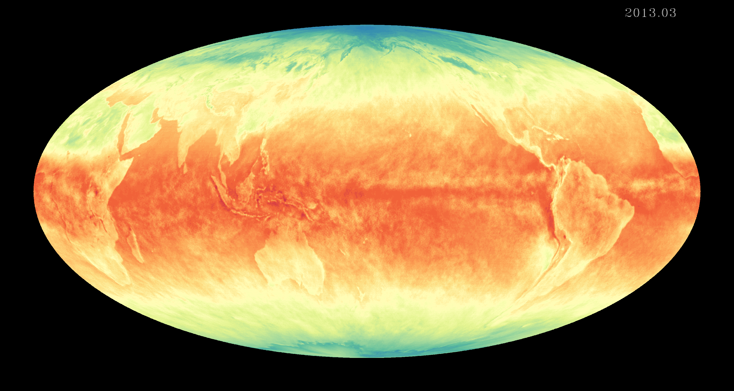
introduction
Earth's energy budget determines the trajectory and magnitude of climate change
Powerful constraint and also diagnostic of the water cycle globally and regionally
Flows of energy and moisture between land/ocean, northern/southern hemispheres and high/low latitudes fundamental for the climate that societies depend upon
How is Earth’s energy imbalance currently changing and what are the implications for the global water cycle?

Slide 3
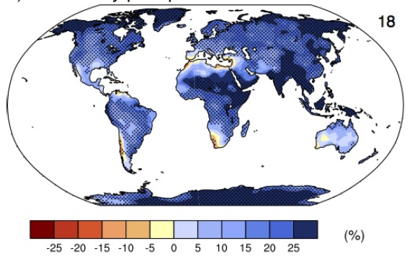
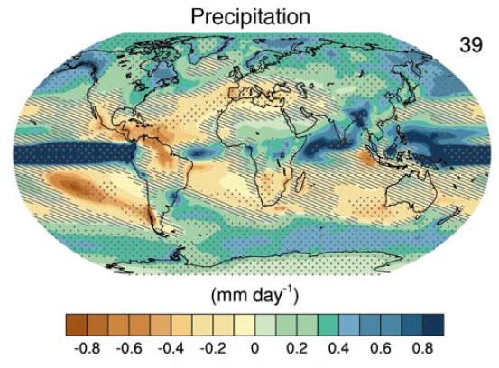
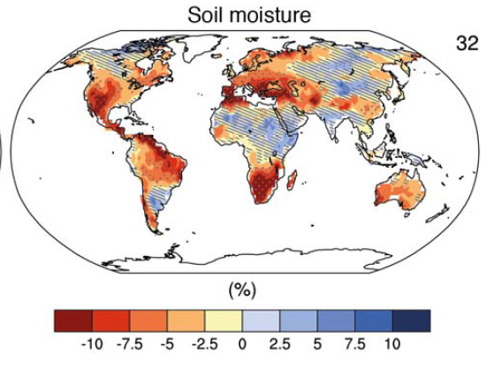
How will water cycle change?
Precipitation intensity
Increased Precipitation
More Intense Rainfall
More intense droughts
Intensification of wet and dry seasons?
Regional projections??
e.g. Liu & Allan (2013) ERL
IPCC (2013)
Notes:
PRECIPITATION: [Tech Summ Fig. 2]
RCP8.5 ANN: Multi-model CMIP5 average mm/day change.
Hatching: multi-model mean change is small (<1SD of internal variability)
Stippling: multi-model mean change is big (>2SD of internal variability and 90% of models agree on sign)
P INTENSITY:
Percent change in annual maximum 5-day precipitation 2081-2100 relative to 1981-2000 for RCP8.5 CMIP5 ensemble.
Fig. 12.26, Chapter 12.
Stippling → significant change
SOIL MOISTURE: [Tech Summ, Fig. 2]
RCP8.5 ANN change in %, Upper 10cm
Hatching: multi-model mean change is small (<1SD of internal variability)
Stippling: multi-model mean change is big (>2SD of internal variability and 90% of models agree on sign)

Slide 4
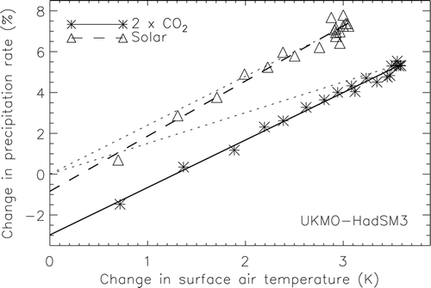
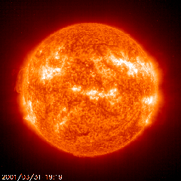
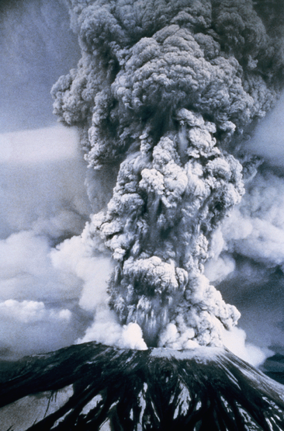
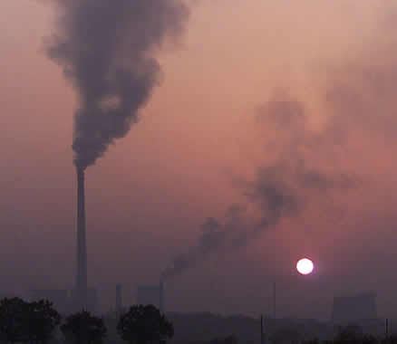
Earth’s Energy budget and precipitation response
LΔP ≈
kΔT – f_{F}ΔF
k
Andrews et al. (2009) J Clim
See also: Allen and Ingram (2002) Nature ; O’Gorman et al. (2012) Surv. Geophys ; Bony et al. 2014 Nature Geosci.
Notes:
4

Slide 5
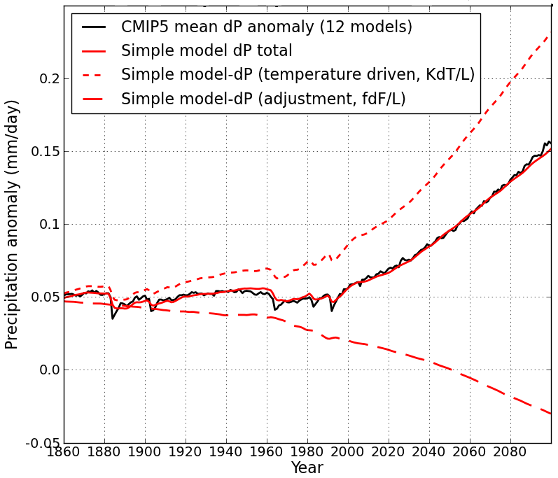
Simple model for global precipitation
Using simple model:
LΔP = kΔT – f_{F}ΔF
Precipitation change (mm/day)
N=ΔF – YΔT
CMIP5 historical/RCP8.5
ΔT
D
Zahra Mousavi (PhD project)
After Allan et al. (2014) Surv. Geophys and Thorpe and Andrews (2014) ERL
Notes:
5
There is huge uncertainty in global precipitation projections, relating both to climate sensitivity and mitigation pathways.
In PAGODA we are understanding the precipitation changes at the largest scales relating both to the warming (in response to radiative forcings) and and also the direct effect of the radiative forcings themselves on precipitation.

Slide 6
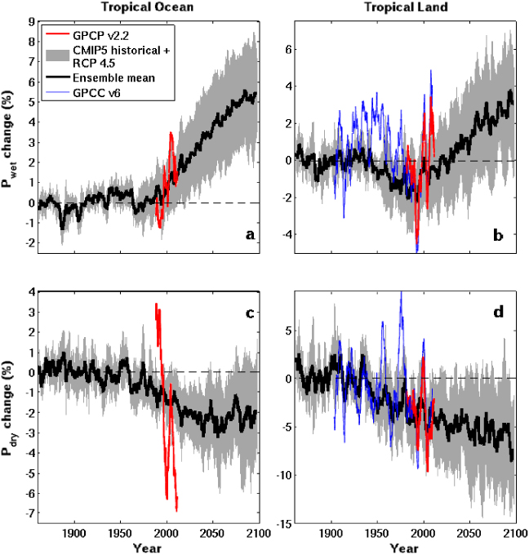
Moisture transport and intensification of wet/dry season
Tropical Land
Increased moisture with warming implies amplified P-E (e.g. Held & Soden 2006)
Multi-annual P-E > 0 over land implies increased P-E (e.g. Greve et al. 2014)
Changes in T/RH gradients also important (Byrne & O’Gorman 2015)
P-E < 0 in dry season over land: more intense wet/dry seasons? (Chou et al. 2013; Liu & Allan 2013; Kumar et al. 2014)
Aridity metrics more relevant (Scheff & Frierson 2015; Greve & Seneviratne 2015; Roderick et al. 2014)
Changes in circulation dominate locally (e.g. Scheff & Frierson 2012; Chadwick et al. 2013; Muller & O’Gorman 2011)
6
4
2
0
-2
-4
GPCC GPCP
WET
Precipitation Change (%)
1900 1950 2000 2050 2100
5
0
-5
-10
-15
DRY
CMIP5 Simulations
1900 1950 2000 2050 2100
Liu & Allan 2013

Slide 7
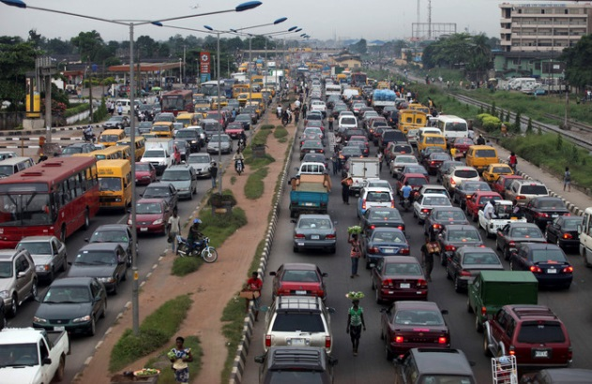
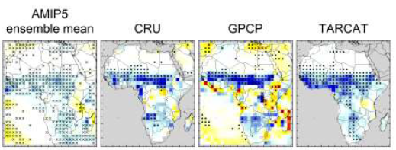

Recent trends in rainfall across Africa
Africa particularly susceptible to changes in water cycle
West Africa – particularly complex mix of pollution/cloud/dynamics
DACCIWA project - Knippertz et al. 2015 BAMS
Maidment et al. (2015) GRL

Slide 8
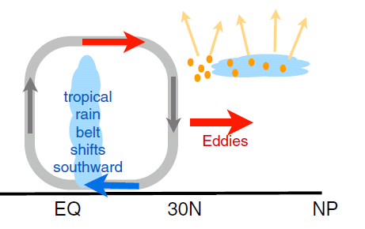
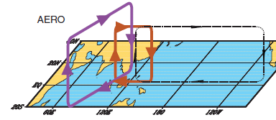
earth’s energy budget & regional changes in the water cycle
Regional precipitation changes sensitive to asymmetries in Earth’s energy budget
N. Hemisphere cooling: stronger heat transport into hemisphere
Reduced Sahel rainfall from:
Anthropogenic aerosol cooling 1950-1980s: Hwang et al. (2013) GRL →
Asymmetric volcanic forcing e.g. Haywood et al. (2013) Nature Climate
Enhanced energy transport
cooling
Sulphate aerosol effects on Asian monsoon e.g. Bollasina et al. 2011 Science (left)
Links to drought in Horn of Africa? Park et al. (2011) Clim Dyn
GHGs & Sahel rainfall recovery?
Dong & Sutton (2015) Nature Clim.

Slide 9
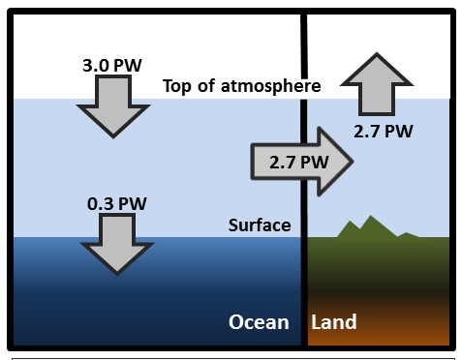
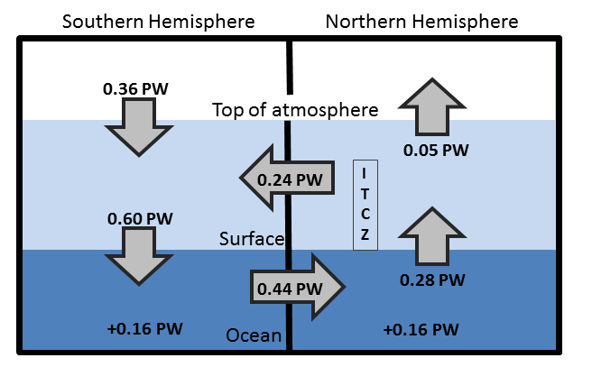
Observed Asymmetry in earth’s energy budget
Adapted from Liu et al. (2015) JGR (above) & Loeb et al. (2015) Clim. Dyn. (left)
Observed inter-hemispheric imbalance in Earth’s energy budget
Not explained by albedo: brighter NH surface but more clouds in SH (Stephens et al. 2015)
Inter-hemispheric heat transports determine and are influenced by position of ITCZ (e.g. Frierson et al. 2013) – more in next talk!!

Slide 10
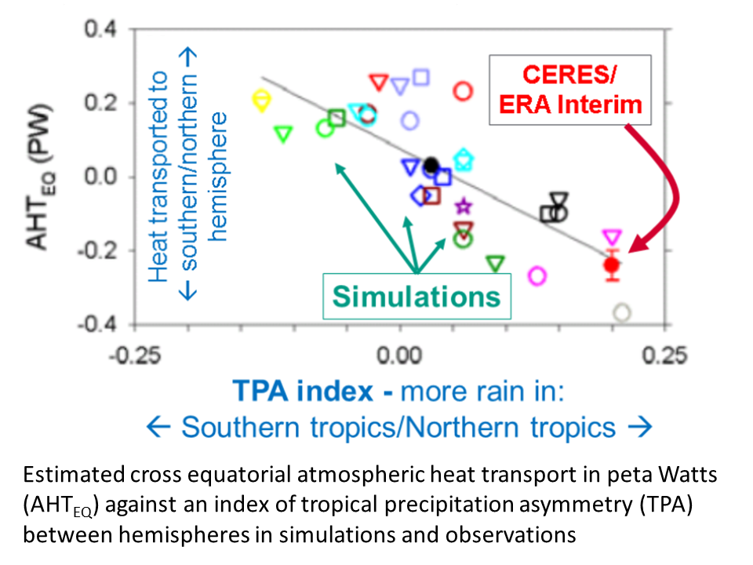
Cross-Equatorial heat transport linked to model precipitation bias
Clear link between bias in cross-equatorial heat transport by atmosphere and inter-hemispheric precipitation asymmetry Loeb et al. (2015) Clim. Dyn.
See talk in afternoon!

Slide 11
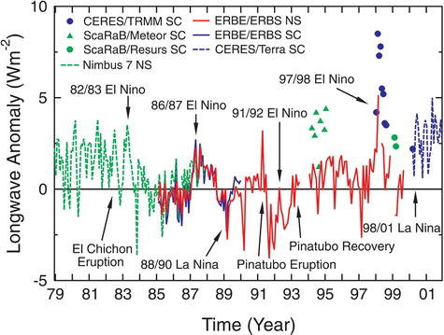
How is earth’s energy balance changing & what are implications?
20°N-20°S
Wong et al. (2006) J Clim; Wielicki et al. (2002) Science

Slide 12
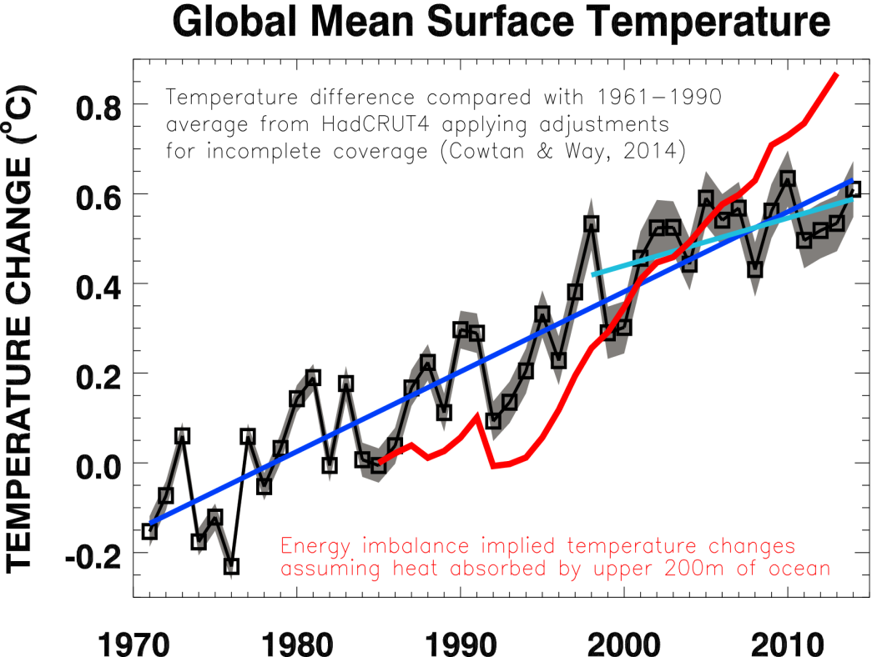
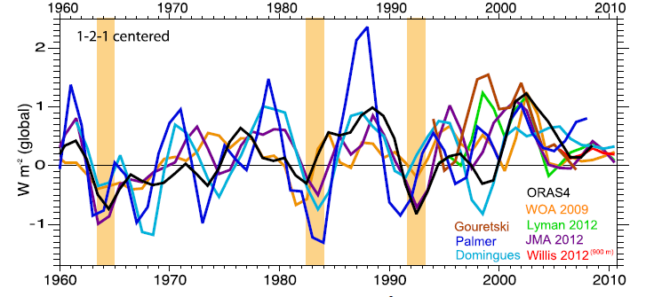
At what rate is Earth heating?
What are implications for climate sensitivity and the global water cycle?
Upper ocean heating rate (Wm⁻²)
Harries & Belotti (2010) J. Clim | Loeb et al. (2012) Nat. Geosci | Trenberth et al. (2014) J Clim

Slide 13
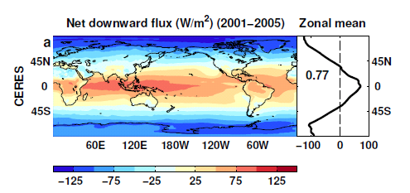
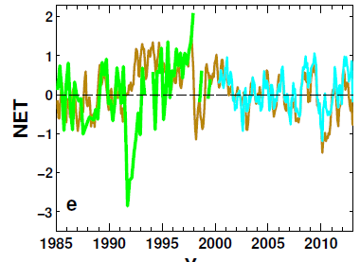
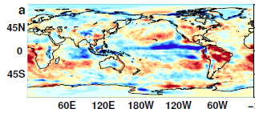
Reconstructing global radiative fluxes since 1985
ERBS/CERES variability
CERES monthly climatology
ERBS WFOV
CERES
ERA Interim
ERA Interim spatial anomalies
Combine CERES/ARGO accuracy, ERBS WFOV stability and reanalysis circulation patterns to reconstruct radiative fluxes

Slide 14
Net Imbalance Anomaly (Wm⁻²)
Changes in imbalance in models/obs
Imbalance: 0.23 0.00 0.78 0.63 0.63 (Wm⁻²)
0.34±0.67 Wm⁻²
0.62±0.43 Wm⁻²
La Niña
El Niño
Volcano
Allan et al. (2014) GRL

Slide 15
Discrepancy between radiation budget & ocean heating
Large ocean heating anomaly in 2002
Inconsistent with radiation budget observations and simulations
Changing observing system influence?
Slight drop in net flux 1999-2005?
Smith et al. (2015) GRL

Slide 16
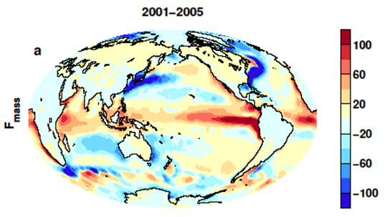
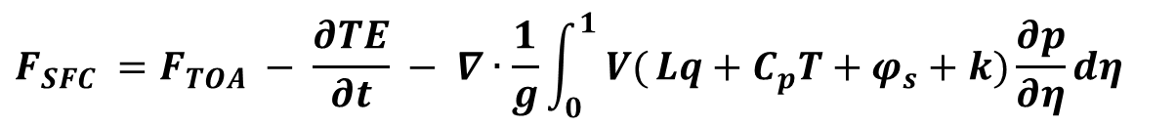
Indirect estimates of air-sea energy
fluxes from satellite/reanalysES
$$F_{SFC} =F_{TOA} − \frac{∂TE}{∂t} − ∇∙\frac{1}{g}\int_{0}^{1}{ V(}Lq+C_{p}T+φ_{s}+k)\frac{∂p}{∂η}dη$$
CERES/Argo Net Flux
Estimate horizontal energy flux
Surface Flux
Net surface downward energy flux (Wm⁻²)
Liu et al. (2015) JGR
see also: Loeb et al. (2015) Clim. Dyn , Trenberth et al. (2001) Clim. Dyn.

Slide 17
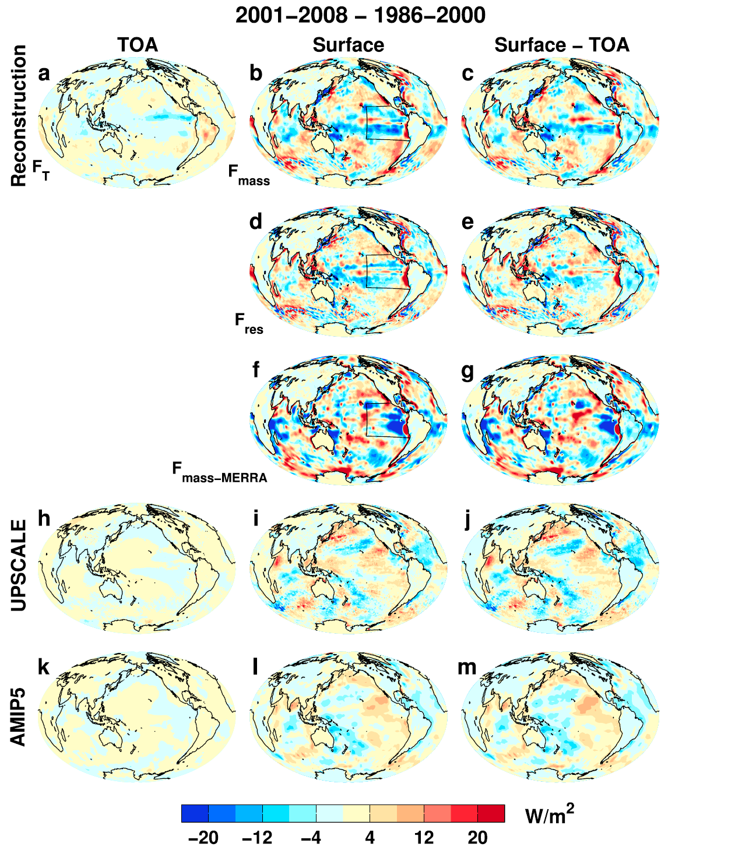
Where is the heat going? changes in surface energy flux
Changes in energy fluxes 1986-2000 to 2001-2008
Surface energy flux dominated by atmospheric transports
Contrasting model pattern of change
Are reanalysis transports reliable?
Liu et al. (2015) JGR

Slide 18
conclusions
Heating of Earth continues at rate of ~0.6 Wm⁻²
  Manifest as positive imbalance in Southern Hemisphere
  Variability from radiative forcings & ocean changes
Radiative transfer & Thermodynamics explain increased global precipitation with warming ≈ 2%/K
  Radiative forcings also directly affect water cycle responses
  Greenhouse gas & absorbing aerosol forcing supress global precipitation response to warming (“hydrological sensitivity”)
Inter-hemispheric heating, moisture budget & unforced variability dictate regional responses and determine climate model biases
  Decadal changes in ITCZ and global atmospheric/ocean circulation
  Has the “hiatus” affected water cycle?
  How do changes in cloud/circulation fit in?
  Where is energy going? NERC DEEP-C project…

Slide 20
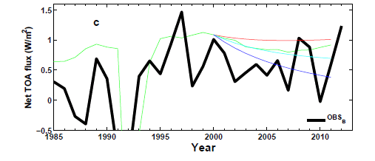
Understanding changes in net imbalance
+ve RF trend
AR5 RF
0 RF trend
-ve RF trend
N
N=ΔF–YΔT_{s}
Analysis using simple energy balance model Allan et al. (2014) GRL supplementary
ΔT_{s}
D
ΔT_{D}

Slide 21
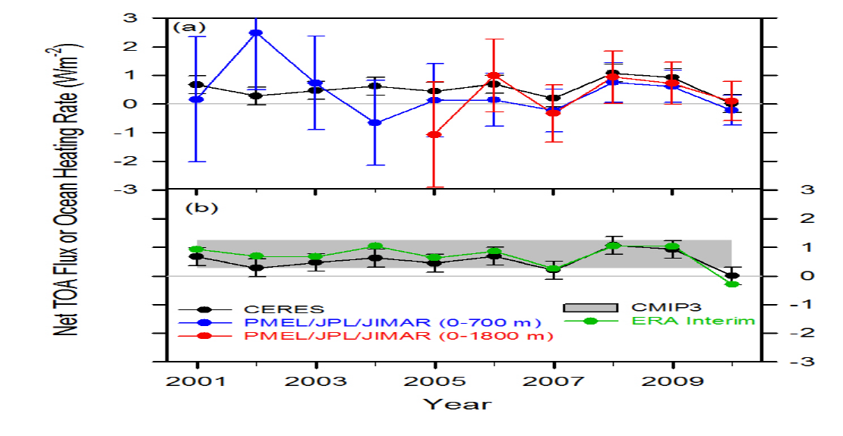
Combining Earth Radiation Budget and Ocean Heat Content data (2)
Replotted so that CERES and ERA Interim sample 6-months later than ARGO
Is there a lag in the system?
Where in ocean is energy accumulating?
Mechanism?
Notes:
Fi gure 3 (a) Global annual average net TOA flux from CERES observations and (b) ERA Interim reanalysis are anchored to an estimate of Earth’s heating rate for 2006–2010 ⁵ The Pacific Marine Environmental Laboratory/Jet Propulsion Laboratory/Joint Institute for Marine and Atmospheric Research (PMEL/JPL/JIMAR) ocean heating rate estimates⁴ use data from Argo and World Ocean Database 2009; uncertainties for upper ocean heating rates are given at one-standard error derived from sampling uncertainties. The gray bar in (b) corresponds to one standard deviation about the 2001–2010 average net TOA flux of 15 CMIP3 models.

Slide 22
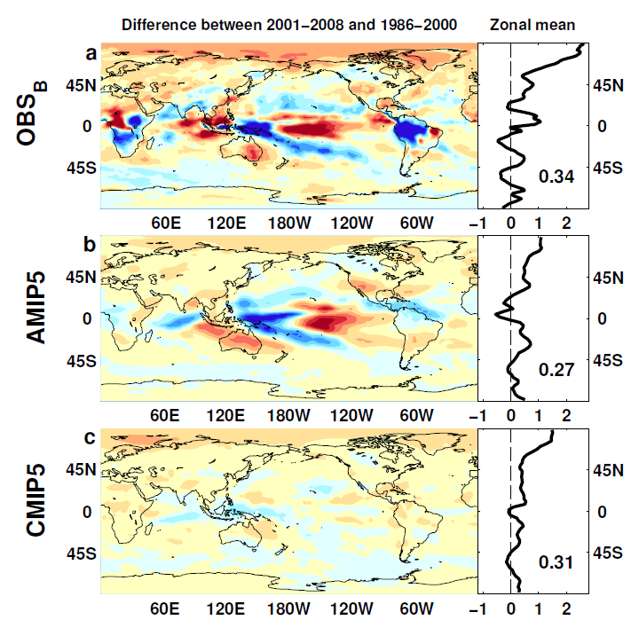

Outgoing Longwave Radiation
Wm⁻²

Slide 23
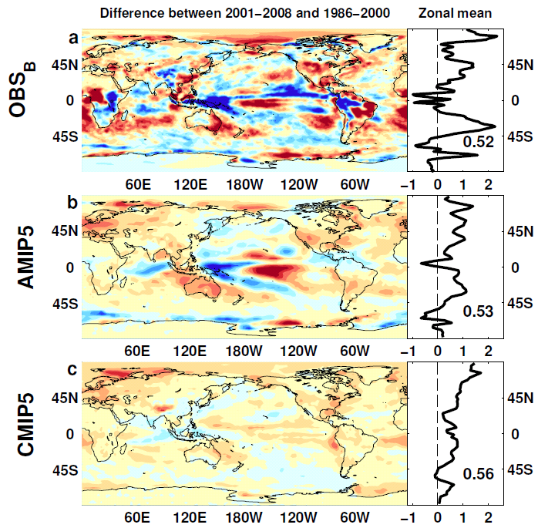
Absorbed Shortwave Radiation
Wm⁻²

Slide 24
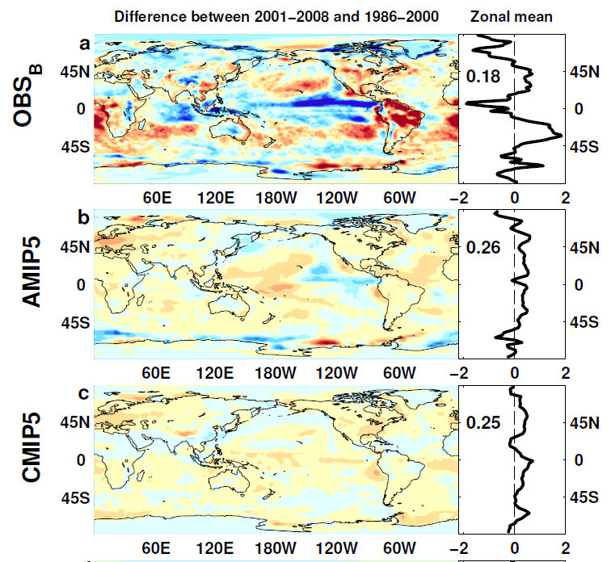

NET Radiation

Slide 25
lw & sw fluxes

