Slide 1
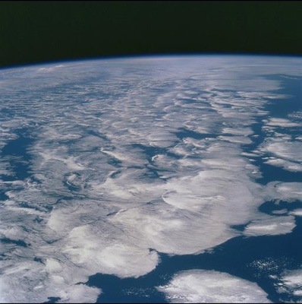

An update on the hiatus in
global warming at Earth’s surface
Richard Allan
WCD, Friday 13th March 2015
Notes:
Over the last decade the rate of global warming appears to have dwindled. Is this important and what are the implications?
What is the hiatus?
Surface temperature, DJF NH land
Oceans still heating, sea levels rising
What are the issues (slowing warming, less warming than models, implications for future warming)
What has caused the hiatus?
Coverage bias
Radiative Forcing
Internal ocean variability
Future
How long will it last
Current PDO
Climate Sensitivity

Slide 2
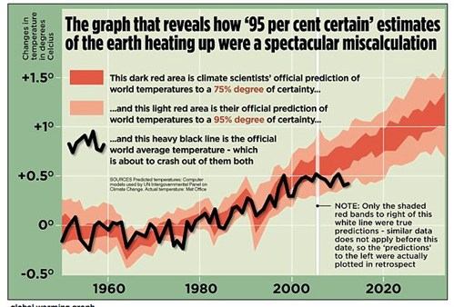
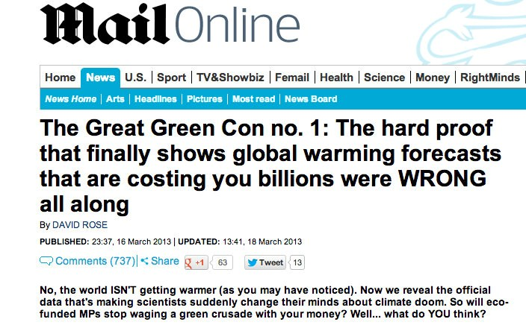
Has global warming stopped?
Mail on Sunday 16th March 2013

Slide 3
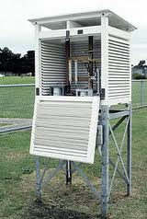
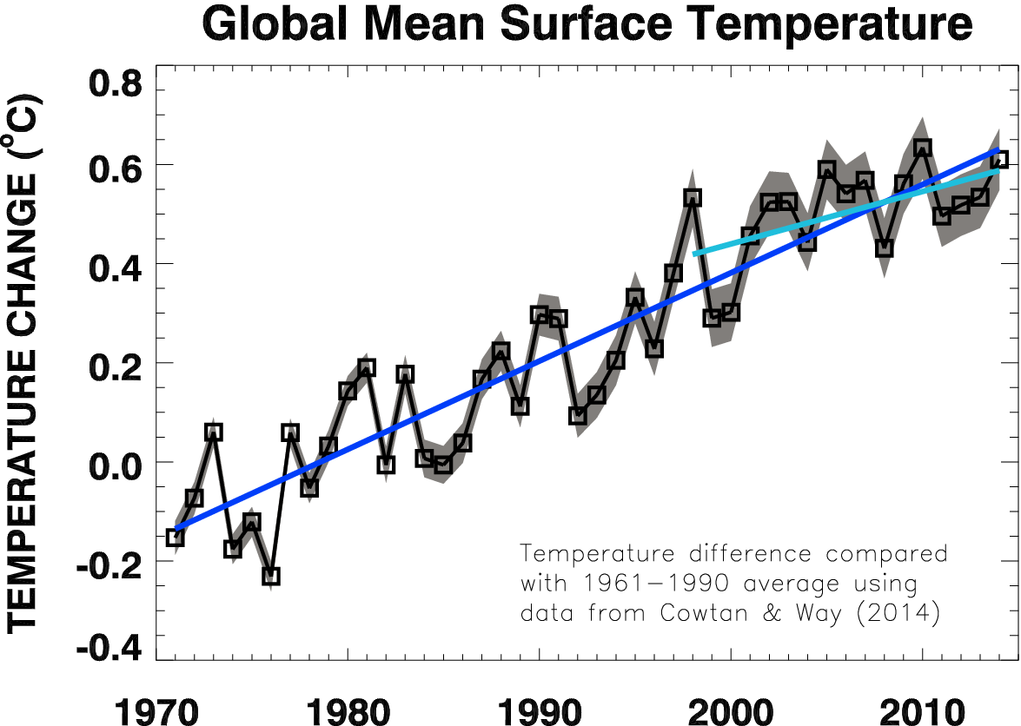
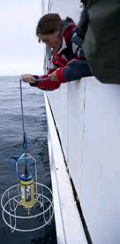
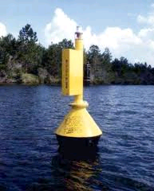
What hiatus?

Slide 4
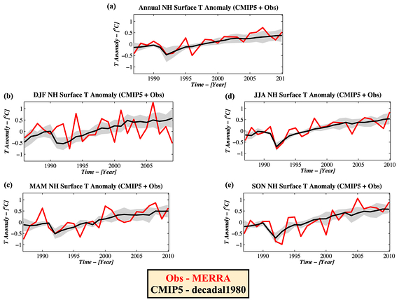
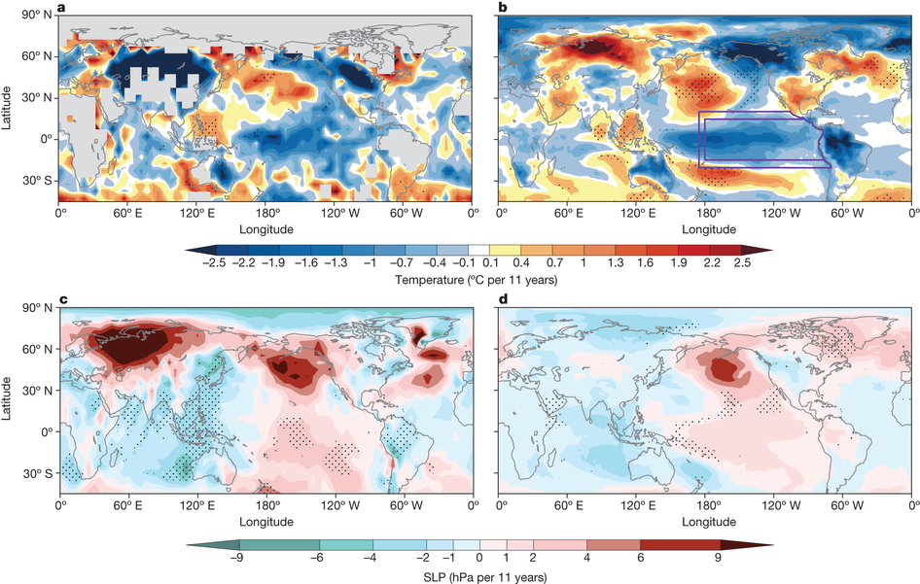
Morphology: The hiatus has a low latitude signal (Gleisner et al. 2015 GRL) but also in northern winter over land (Cohen et al. 2012 GRL) although data gaps are important (Cowtan and Way 2013 QJRMetS; Saffioti et al. 2015 GRL)
Cohen et al. 2012 GRL
Observed trends in DJF near surface temperature, 2002-2012: Kosaka and Xie (2013) Nature

Slide 5
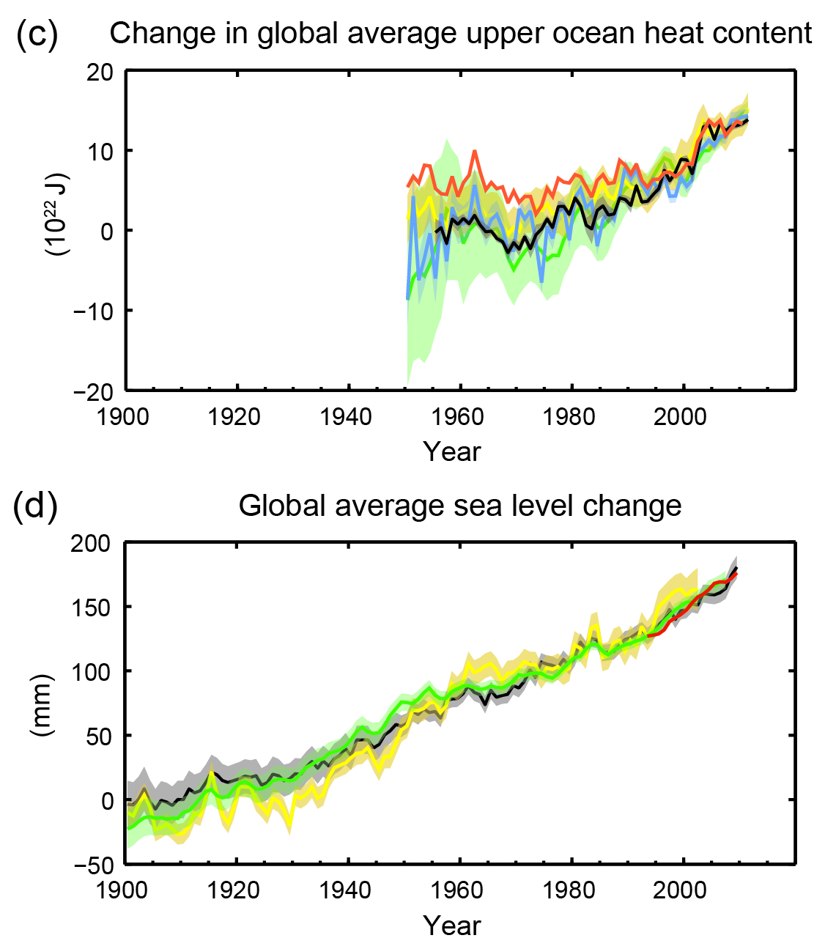
The oceans are continuing to heat up and sea-levels continue to rise
The Earth continues to gain heat (e.g. Loeb et al. (2012) Nat. Geosci.; Allan et al. (2014) GRL ; Roemmich et al. (2015) Nature Climate Change)
So why has rise in surface temperature slowed?
IPCC (2013) Figure SPM.3

Slide 6
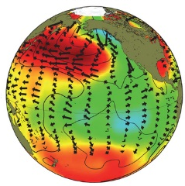
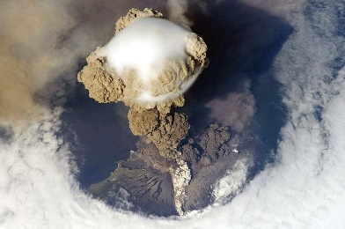
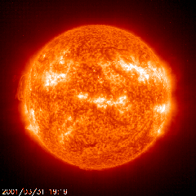
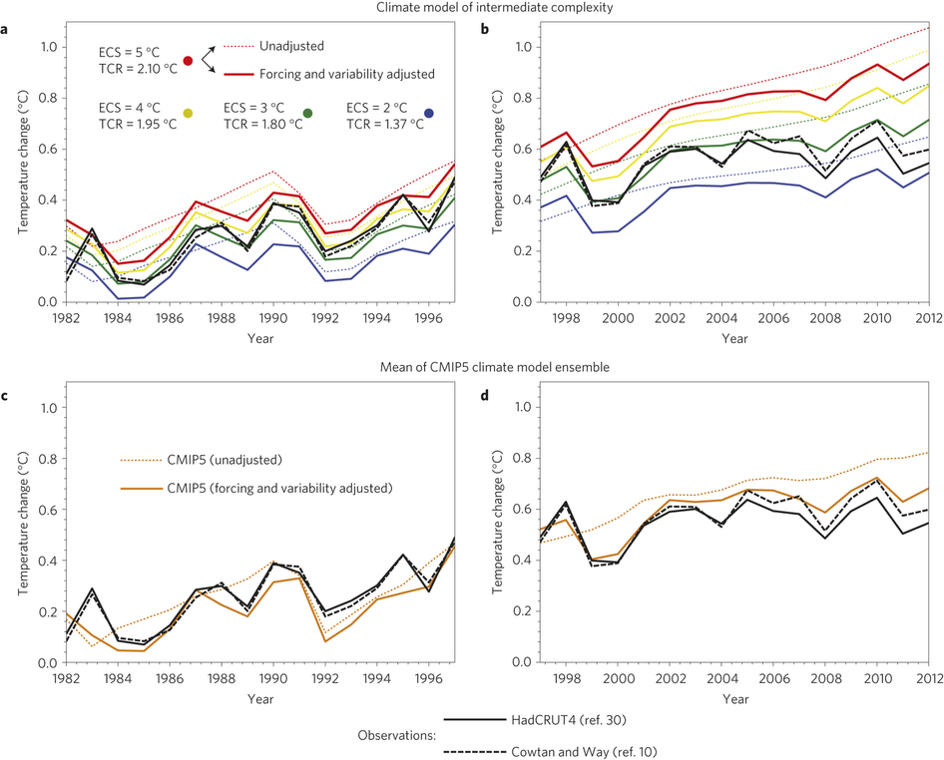
What explains the hiatus
Declining solar forcing (e.g. Hansen et al. 2013 PLOSONE) , more small volcanos (e.g. Ridley et al. 2014 GRL) & more La Niñas/cold NH land in winter vs late 1990s appear to explain:
  Slowing in surface warming (e.g. Foster & Rahmstorf 2012)
  Slower surface warming compared with coupled simulations (e.g. Risbey et al. 2014 ; Huber & Knutti 2014)
Simulations
Adjusted Simulations
Observations
Huber & Knutti 2014

Slide 7
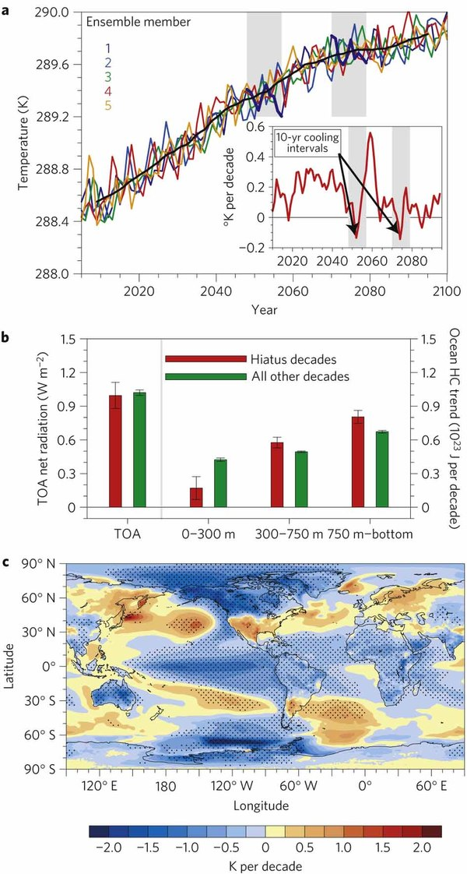
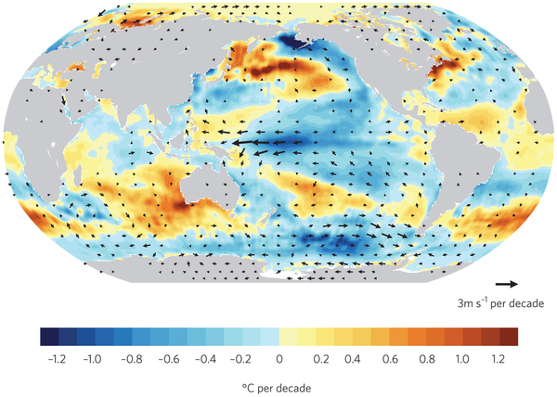
Climate models simulate decades with little surface warming despite CO₂ increases
Ocean variability causes heat to mix to deeper levels in some decades
Associated pattern of sea surface temperature trends match current observations
Heating rate
Temperature (K)
Temperature Trend (K/decade)
Model (Meehl et al. 2011, 2013) Observations 2001-2013 (Kosaka 2014)

Slide 8
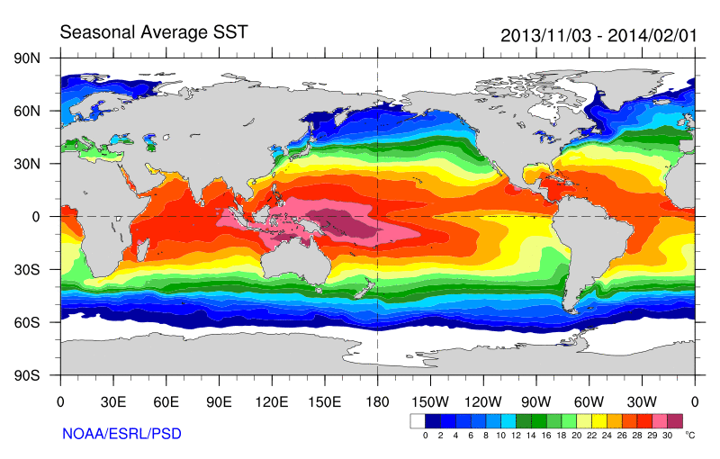
Role of Pacific Ocean Variability
Continued heating from rising greenhouse gas concentrations
Unusual weather patterns (Ding et al. 2014; Trenberth et al. 2014b)
Enhanced Walker Circulation
Ocean circulation strengthens atmospheric circulation
Increased sea height
Warm
Upwelling,
Cool water
Increased precipitation
Decreased salinity
Remote link to Atlantic?
McGregor et al. (2014)
Strengthening trade winds
Equatorial Undercurrent
Enhanced mixing of heat below 100 metres depth by accelerating shallow overturning cells and equatorial undercurrent
See: Merrifield (2010) J. Clim.; Sohn et al. (2013) Clim. Dyn.; L’Heureux et al. (2013) Nature Clim. Change; Kosaka and Xie (2013) Nature; England et al. (2014) Nature Clim. Change; Watanabe et al. 2014 Nature Clim. Change; Balmaseda et al. (2013) GRL; Trenberth et al. (2014) J. Clim.

Slide 9
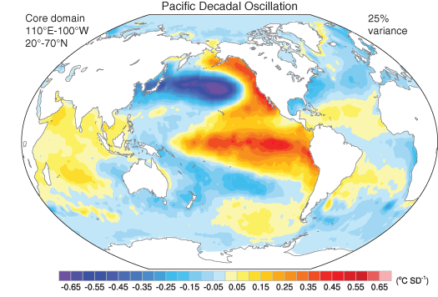
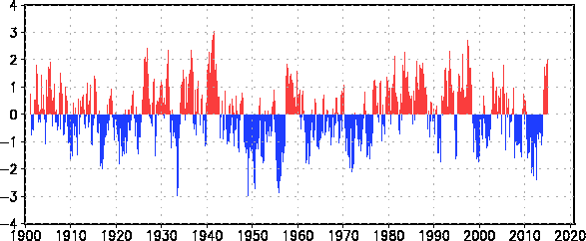
What next?
Trenberth and Fasullo (2013) Earth Futures
- Modelling: 1 in 6 chance of the current surface warming hiatus continuing for another 5 years - Roberts et al. (2015) Nature Climate Change
- Observations: Is Pacific Decadal Oscilation (PDO) shifting out of negative phase?
http://ds.data.jma.go.jp/tcc/tcc/products/elnino/decadal/pdo_month.html

Slide 10
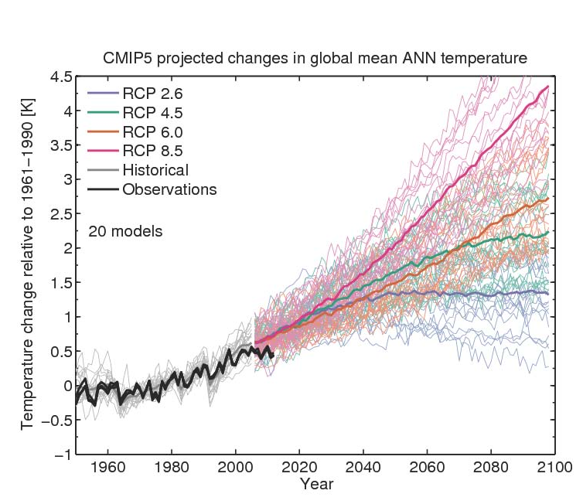
Implications for projections
Climate sensitivity and socioeconomic scenario
Climate sensitivity
From Ed Hawkins: see Climate Lab Book

Slide 11
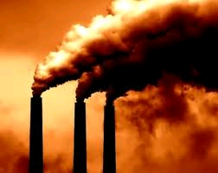
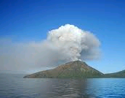
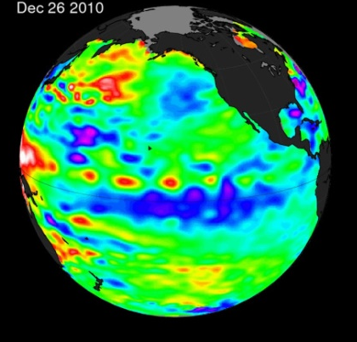
Conclusions
Heating of Earth continues mainly from rising greenhouse gas concentrations
A mixture of factors (mostly natural) have offset some of this heating since 2000 (weaker sun, small volcanoes, …)
More heat currently being mixed below surface ocean layers explaining lack of surface warming. Pacific appears key, but likely also Atlantic/Southern Ocean role.
The climate system is complex and will continue to surprise us but the implications of burning fossil fuels are clear… More links on DEEP-C website

Slide 12
Extra slides

Slide 13
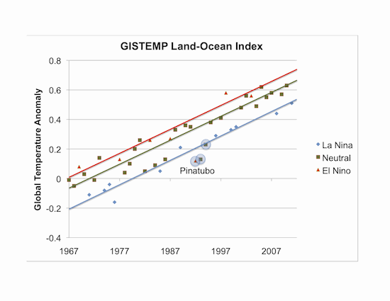
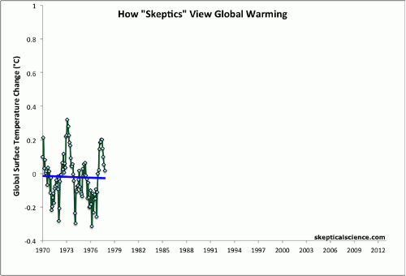
Influence of El Niño and Volcanoes on Surface Temperature Trends
But why have there been more La Niñas recently and hasn’t the slowdown in surface warming lasted a long time?
Click graph for animation…
John Nielsen-Gammon, Texas A&M University
see Foster & Rahmstorf (2012) Environ. Res. Lett.

Slide 14
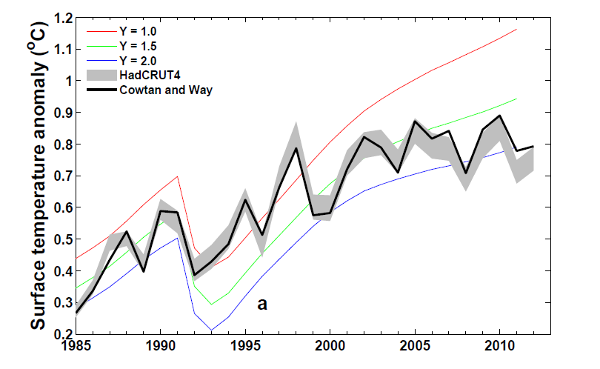
Is the temperature record wrong or are computer models inaccurate?
Can comparisons tell us about how sensitive climate is to radiative forcing? e.g. Otto et al. (2013) Nature Geosci
Spatial infilling of data gaps influences trends in surface temperature (Cowtan & Way, 2013 QJRMS) and ocean heat content (Lyman & Johnson 2014 J. Clim.)
Graph by Chunlei Liu
Research in DEEP-C project
(Reading, NOC-Southampton & Met Office)

Slide 15
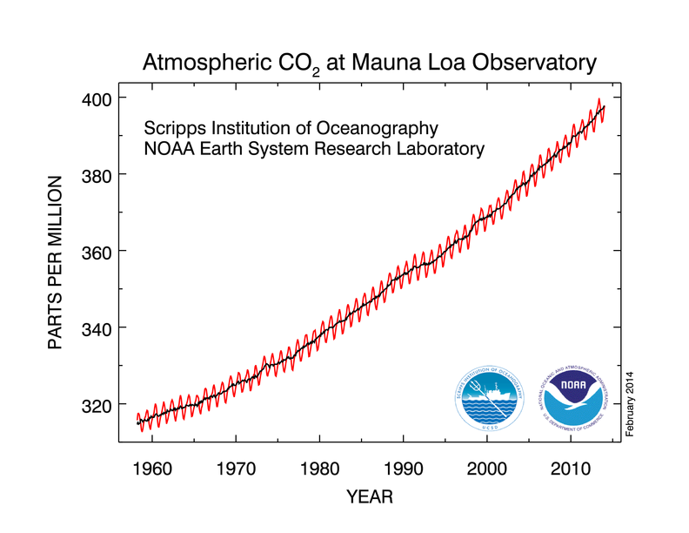
“Radiative forcing” of climate
Increased concentrations of greenhouse gases heat planet by reducing the efficiency at which Earth can cool to space
More small pollutant particles (aerosols) can cool the planet by reflecting sunlight
If more energy is arriving than is leaving the planet should heat up…

Slide 16
Have other factors offset warming from greenhouse gases?
The sun has weakened in the 2000s
There were a series of small volcanic eruptions causing reflection of sunlight
Particle pollution from Asia, changes in stratosphere water vapour, changes in Methane and sampling of temperature observations may also be important
Natural chaotic fluctuations in the ocean appear to play an important role

Slide 17
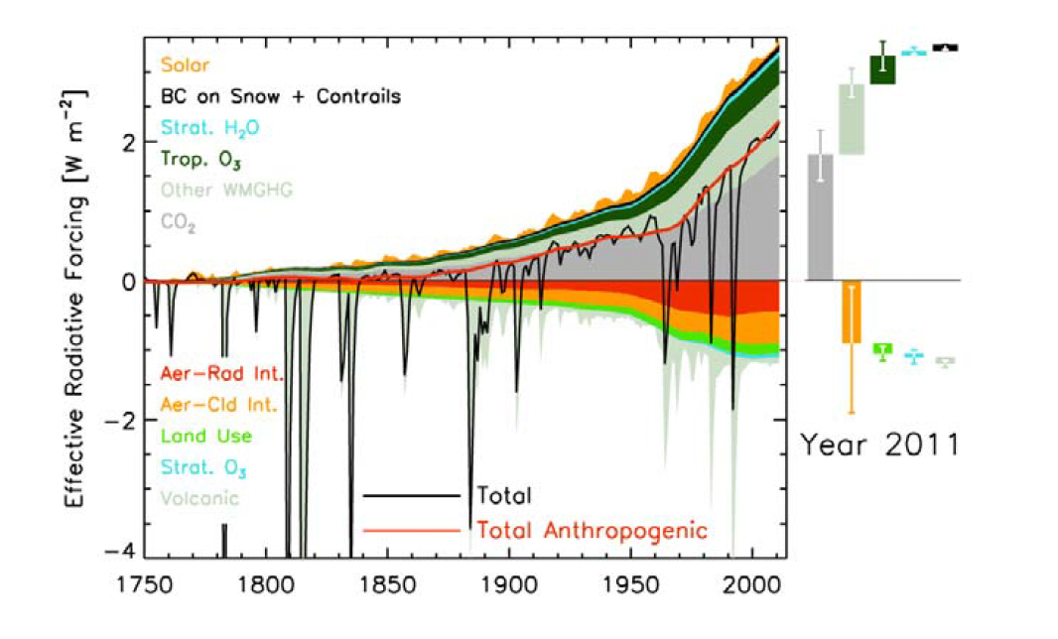
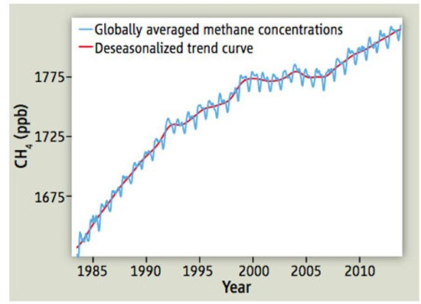
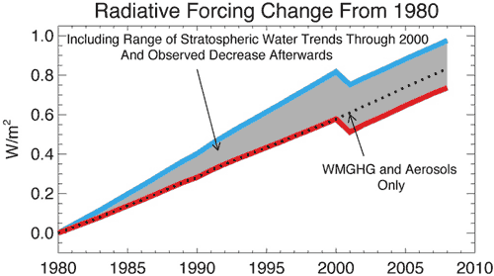
Changes in radiative forcing since 1750
IPCC (2013) Figure 8.18
Methane: Nisbet et al. (2014) Science
Strat. Water Vapour: Solomon et al. (2010) Science ; Hegglin et al. (2014) Nature Geosci.:

Slide 18
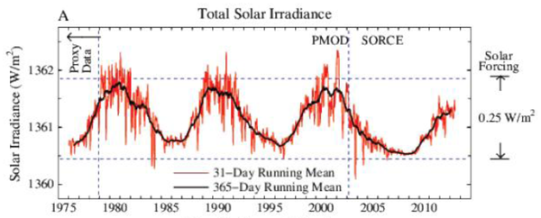
Weaker Solar Output?
IPCC: Solar Radiative Forcing change of –0.04 Wm⁻² from 1986 to 2008
Solar Radiative Forcing
~0.5 Wm⁻²
Hansen et al. (2013) PLOSONE; see also Kaufmann et al. (2011) PNAS

Slide 19

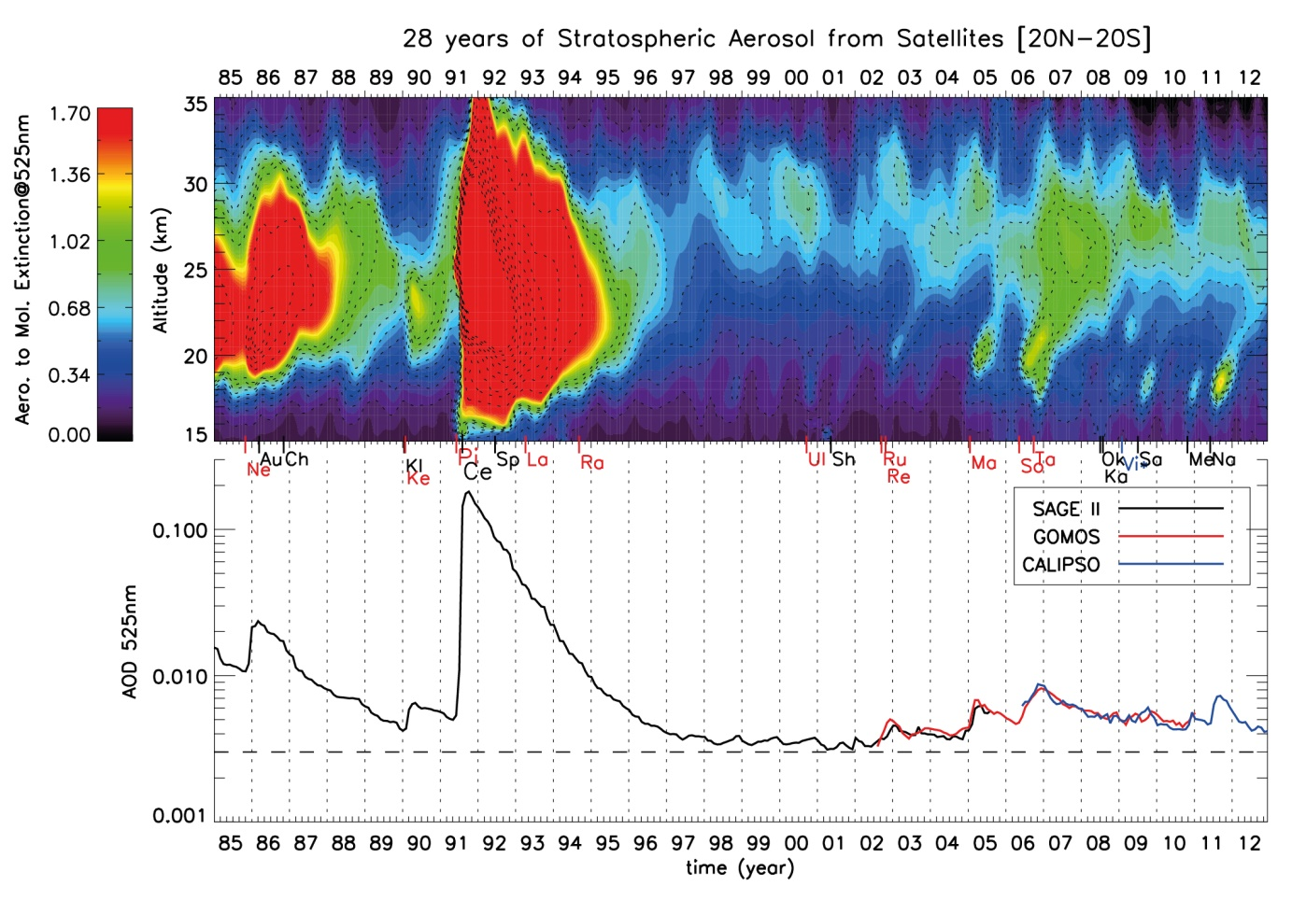
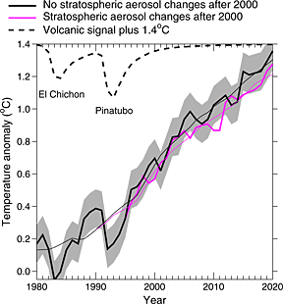
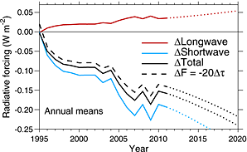
Cooling from small volcanos?
El Chichon Pinatubo
IPCC (2013) Fig. 8.13
Work by Solomon et al. (2011) Science; Vernier et al. (2011) GRL; Fyfe et al. (2013) GRL; Schmidt et al. (2014) Nature Geosci; Santer et al. (2014) Nature Geosci.; Ridley et al. (2014) GRL

Slide 20
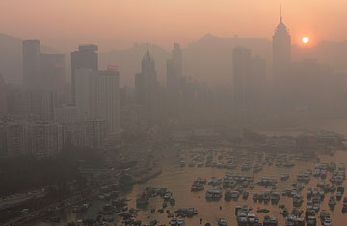
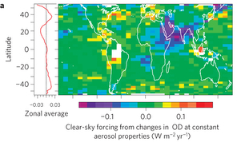
Has increased aerosol pollution refelected more sunlight back to space ?
Increased Asian aerosol offset by decreases elsewhere – little change in 2000s: Murphy (2013) Nature Geosci (below)
ALEX HOFFORD / EPA

Slide 21
What explains the hiatus?
The sun weakened in the 2000s
There were a series of small volcanic eruptions causing reflection of sunlight
Particle pollution from Asia, changes in stratosphere water vapour, changes in Methane and sampling of temperature observations may also contribute
Natural chaotic fluctuations in the ocean appear to play an important role

Slide 22
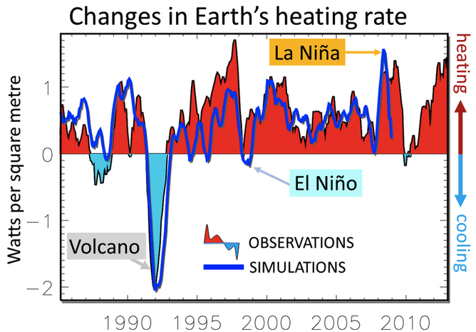
Heating of Earth continues…
0.34±0.67 Wm⁻²
0.62±0.43 Wm⁻²
Loeb et al. (2012) Nat. Geosci. ; Allan et al. (2014) GRL

Slide 23
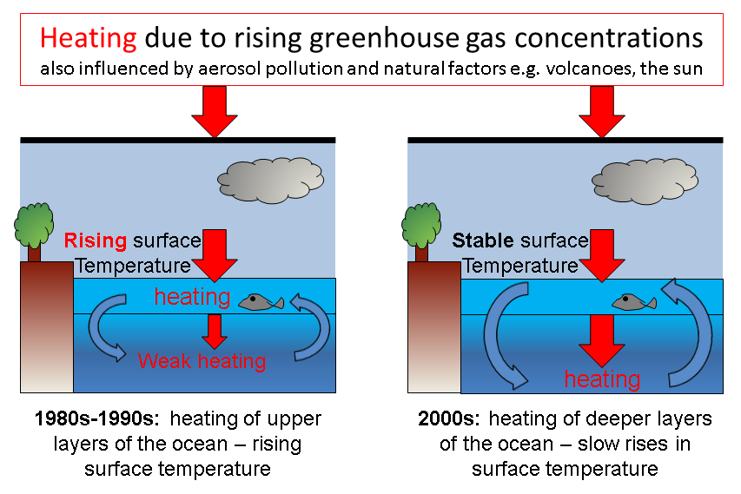
Chaotic ocean fluctuations have contributed to the hiatus
Increased heat flux to deeper layers of the ocean: Watanabe et al. (2013) GRL; Balmaseda et al. (2013) GRL; Trenberth et al. (2014) J. Climate ; Merrifield (2010) J. Climate; Sohn et al. (2013) Clim. Dyn.; L’Heureux et al. (2013) Nature Climate Change; Kosaka and Xie (2013) Nature; England et al. (2014) Nature Climate Change

Slide 24
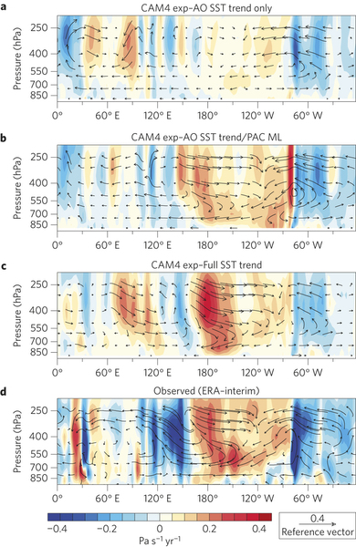
Mechanisms of ocean variability
Pacific Decadal Variability Pattern
Is Atlantic driving Pacific changes?
Atlantic circulation salinity feedback? (Chen & Tung 2014)
(Kosaka 2014)
Model simulates stronger Pacific trades when apply Atlantic SSTs + Pacific SST allowed to respond →
McGregor et al. (2014)

Slide 25
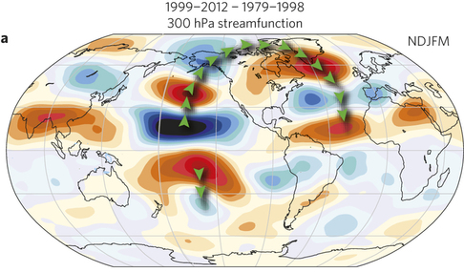
Remote influences on weather patterns
Hiatus dominated by northern winter (e.g. Cohen et al. 2012)
Cooling in east Pacific explains reduced heat export during northern winter (Kosaka & Xie 2013)
Rapid Arctic warming linked to tropical changes (Ding et al. 2014)
Atmospheric bridges link tropical anomalies & mid latitude weather patterns (e.g. Trenberth et al. 2014b)

Slide 26
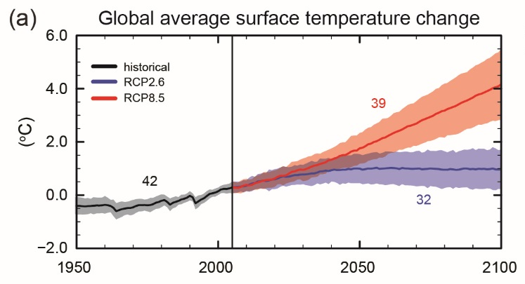
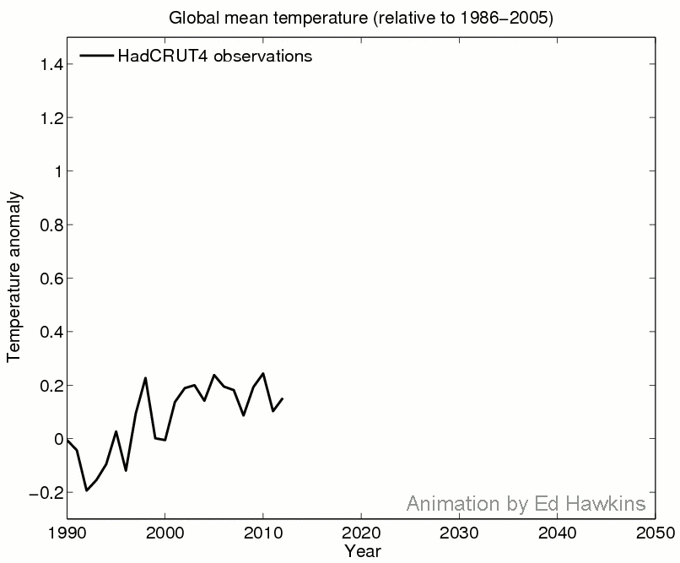
Implications for future
Click graph for animation…
From Climate Lab Book blog (Ed Hawkins)

Slide 27
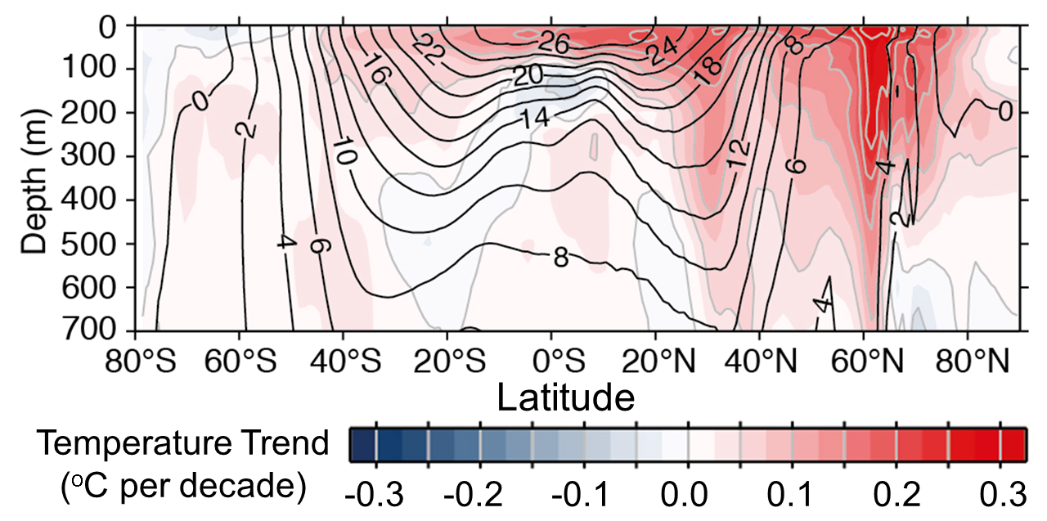
1) There has been a slowing
(rather than a pause) in the rate of surface warming
2) Heating from greenhouse gases
continue to warm upper oceans
3) Currently more heat is reaching
deeper ocean levels rather than warming the mixed layer which influences surface temperature

