Slide 1
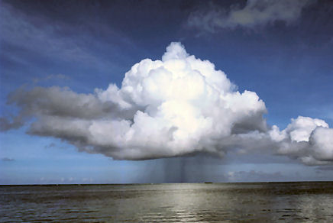
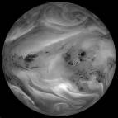
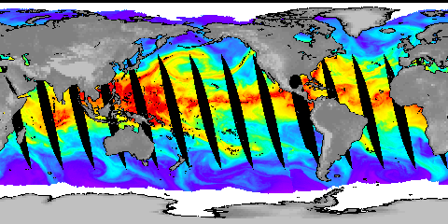




Current global and regional changes in atmospheric water vapour
Richard P. Allan
Department of Meteorology, University of Reading http://www.met.reading.ac.uk/~sgs02rpa
r.p.allan@reading.ac.uk

Slide 2
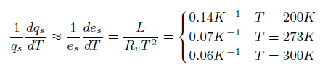
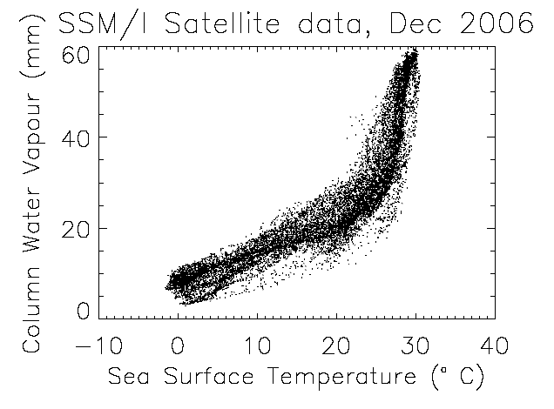
Clausius-Clapeyron
Strong constraint upon low-altitude water vapour over the oceans
Water vapour is a very forgiving climate variable!
Land regions?
Upper troposphere?
e.g. see Allan (2012) Surv Geophys
Notes:
Then radiation? SNLc vs CWV (could show ERA Int and CERES SRBAVG?) also show Prata curve.

Slide 3
Water Vapour amplifies climate change
↑ CO₂
↑ Water vapour
↑Temperature
↑ Greenhouse effect
↑ Net Heating
Notes:
3
For example, as the atmosphere warms it will be able to ‘hold’ more water vapour. Water vapour itself is a very powerful greenhouse gas, so this will act as a positive feedback and roughly double the amount of warming. Similarly, when sea ice begins to melt, some of the solar radiation which would otherwise be reflected from the sea ice is absorbed by the ocean, and heats it further; another positive feedback. On the other hand, when carbon dioxide concentrations increase in the atmosphere then it acts to speed up the growth of plants and trees (the fertilisation effect) which in turn absorb more of the carbon dioxide; this acts as a negative feedback.

Slide 4
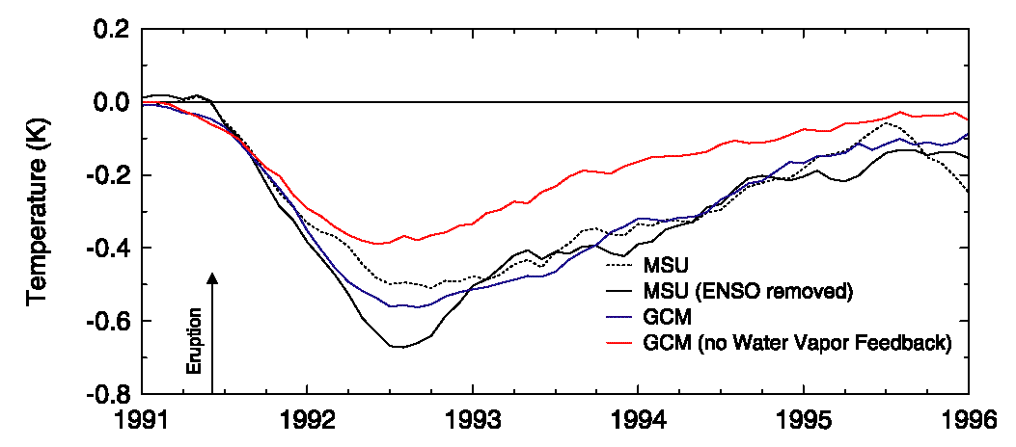

Water vapour feedback amplified climate response to Mt. Pinatubo
Soden et al. (2002) Science
The climate model cannot simulate the magnitude of cooling following the volcanic eruption without including water vapour feedback
Notes:
4
The eruption of Mt. Pinatubo provided a natural experiment for evaluation of feedbacks, in particular for upper tropospheric water vapour.
Analysing water vapour radiances, Brian Soden and colleagues demonstrated that a climate model could reproduce the drying in response to the cooling following the eruption. Furthermore, the satellite observations and model both conserved relative humidity to first order.
In a separate experiment where water vapour was held fixed in the radiation scheme, the model reduction in water vapour channel radiance was overestimated (reduced relative humidity). Note that the radiance channel is also sensitive to temperature as well as humidity; this explains the drop in brightness temperature for the constant relative humidity case.

Slide 5
Satellite data indicates increasing trends in upper tropospheric moisture
Trend in HIRS brightness temperature difference: 1983-2004
Observations
Model
Moistening
Constant RH model
Constant water vapour model
Soden et al. (2005) Science
Notes:
5
Trends in water vapour radiance channel differences, sensitive to upper tropospheric water vapour, also show consistency between models and satellite observations over the period 1983-2004. The constant water vapour model could not capture the observed changes over the tropics.
Water vapour feedback is likely to be the most important amplifier of warming in the current climate and observations suggest that models can capture the large-scale feedback well.

Slide 6
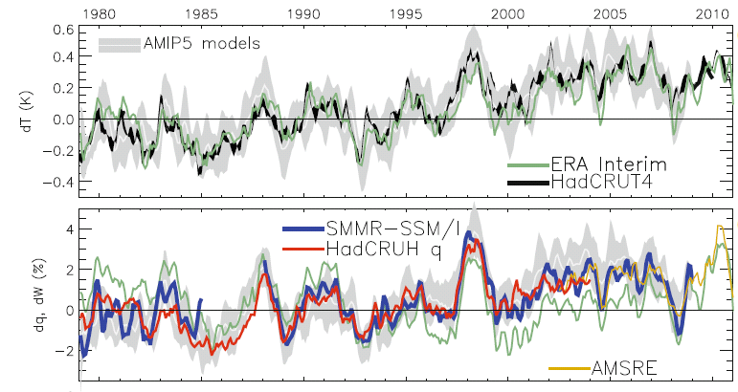
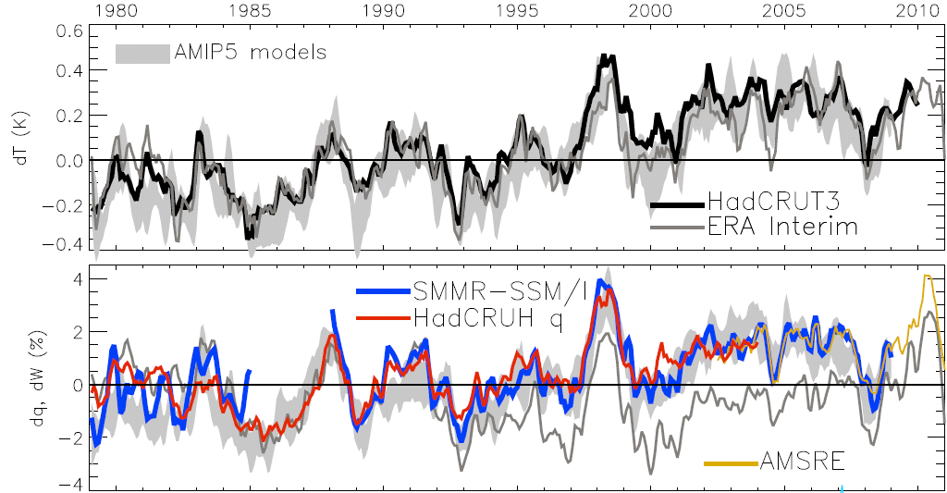
Current global changes in water vapour
Water Vapour (%) Surface Tempertaure (K)
Allan et al. (2013) Surv. Geophys
dW/dt ~ 1%/decade
Notes:
The main point to note is that models and observations are consistent in showing increases in low level water vapour with warming. Reanalyses such as ERA Interim, which are widely used, are not constrained to balance their energy or water budgets.
For ocean-only satellite datasets I apply ERA Interim for poleward of 50 degrees latitude and for missing/land grid points.
Note that SSM/I F13 2003-2007 CWV = 24.7794 mm; AMSRE 2003-2007 CWV = 24.8850
6

Slide 7
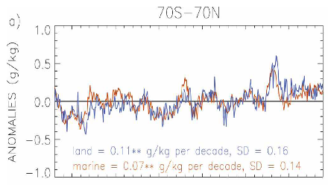
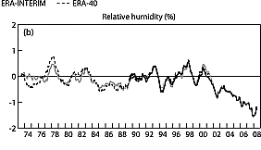
Regional changes in low-level moisture
Specific humidity trend correlation (left) and relative humidity over land (right)
Land Ocean
Willett et al. (2007) Nature
Evidence for recent reductions in RH over land (Simmons et al. 2009 JGR)?
Willett et al. (2008) J Clim
Robust relationships globally.
Less coherent relationships regionally/over land/at higher altitudes?

Slide 8


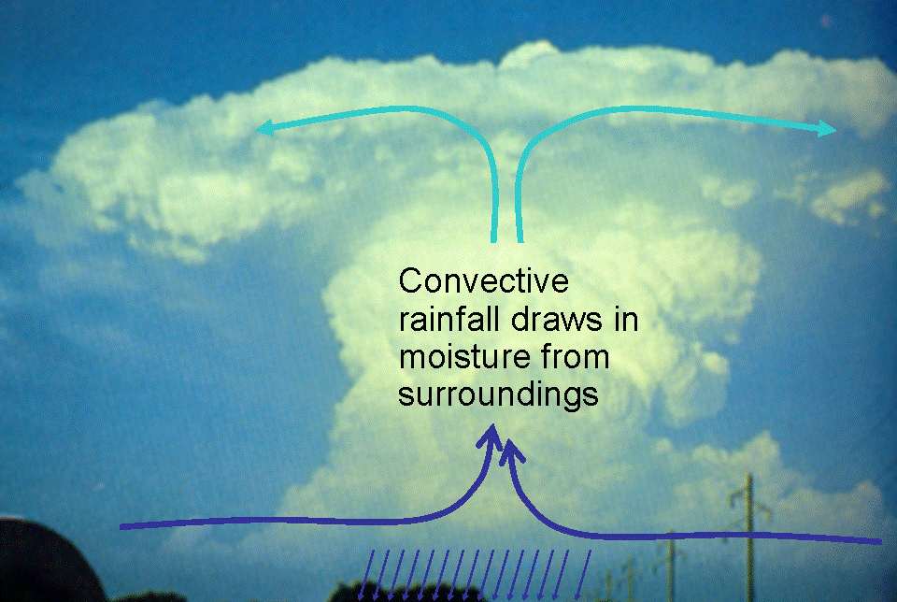
Precipitation extremes
Large-scale rainfall events fuelled by moisture convergence
  e.g. Trenberth et al. (2003) BAMS
Intensification of rainfall with global warming
  e.g. Allan and Soden (2008) Science
Notes:
e.g. June 28 2012 – 50mm rainfall in 2-3 hours. Water vapour ~ 45mm vapour.
Thorwald: 40 mm/hr storm, total water ~60mm (34mm vapour, 14mm rain/graupel, 12mm condensed)
As an example, above a single grid box with rain rate 40 mm/hr, the

Slide 9
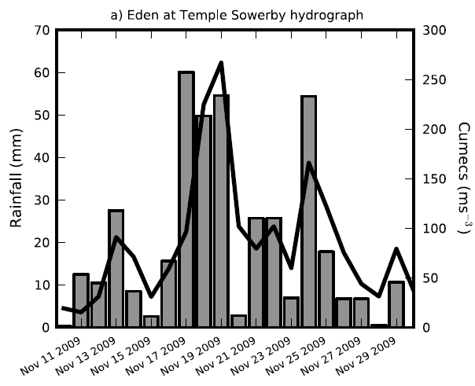
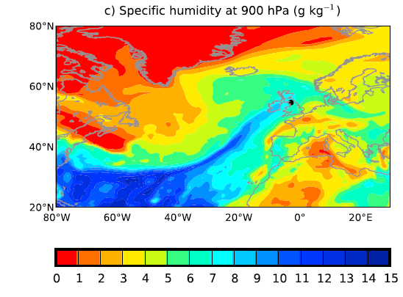
Precipitation extremes
Heavy rainfall requires substantial convergence of moisture
Clausius Clapeyron is a good starting point for anticipated changes in heavy rainfall
Lavers et al. (2011) Geophys. Res. Lett.
Notes:
1) 2000 x gauged flow of river Thames at Kingston (David Lavers)
2) 50mm in 3 hours in Newcastle June 28 2012

