Slide 1





World weather news 2011
1st March Worst drought in decades in N China
Warmest November Day since 2010!
Texas Drought
Drought in Horn of Africa
Thailand Flooding
Ongoing La Niña Cold Sea Surface Temperatures
Sri Lanka Flooding
1st March Landslides follow heavy rain in Bolivia
Australia: 2nd wettest summer
Perth – hottest summer on record
27th Nov Flooding in Sydney; West-coast wildfires

Slide 2
World weather news 2111??
More Flooding???
More Droughts???

Slide 3
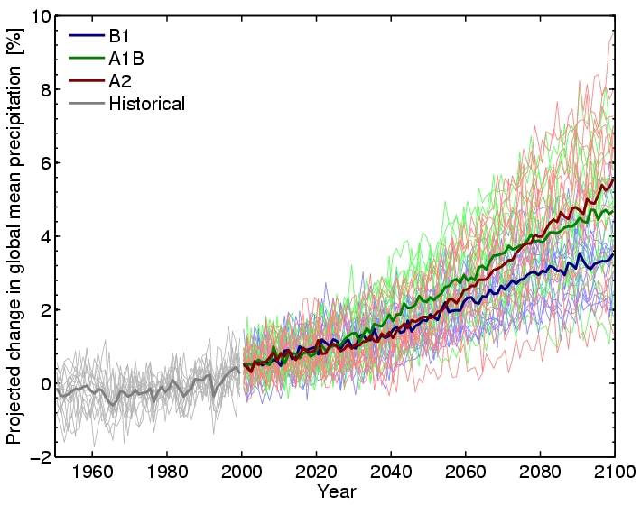
But how should global precipitation respond to climate change?
Hawkins and Sutton (2010) Clim. Dyn.
Notes:
3
There is huge uncertainty in global precipitation projections, relating both to climate sensitivity and mitigation pathways.

Slide 4
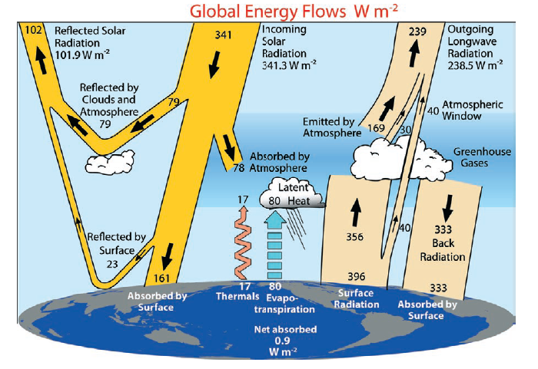
Physical basis: energy balance
Trenberth et al. (2009) BAMS
Notes:
Unpublished Kiehl and Trenberth (2008) BAMS

Slide 5
What rate of rainfall?
Net radiative cooling, R_{atm} ≈ 115 Wm⁻²
Sensible heating of atmosphere, SH ≈ 15 Wm⁻²
If this balances Latent Heating from precipitation, P:
P= R_{atm}–SH ≈ 100 Wm⁻² = 100 J s⁻¹ m⁻²
Assume density of water, ρ_{w}=1000 kgm⁻³ and latent heating all from condensation, L=2.5x10⁶ J kg⁻¹:
Rate of condensation: P/ρ_{w}L=100/2.5x10⁹ Js⁻¹m⁻²kg⁻¹m³J⁻¹ kg
=4x10⁻⁸ ms⁻¹
=3.4 mm/day
A warming atmosphere radiatively cools more effectively…

Slide 6
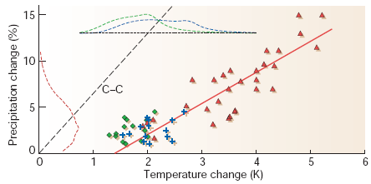
Global Precipitation is constrained by energy balance
Precipitation ~2-3%/K
Water vapour ~7%/K
Allen and Ingram (2002) Nature
Notes:
Climate models predict an increase in precipitation with warming. This is related to expected changes in the clear-sky atmosphere rather than clouds: as the atmosphere warms up with the surface due to greenhouse gas increases, its ability to cool to space and to the surface increases. This tendency to cool more than the surface causes the surface air to become buoyant relative to the atmosphere, leading to more rainfall, the latent heating from which compensates the extra atmospheric cooling tendency.
Notably, the climate models that warm the most tend to produce the biggest increases in precipitation. This is complicated by the even more rapid rise in atmospheric water vapour which leads to big increases in heavy rainfall events that are balanced by less light rainfall leading to the overall relatively modest rises in global precipitation. A complex picture!

Slide 7
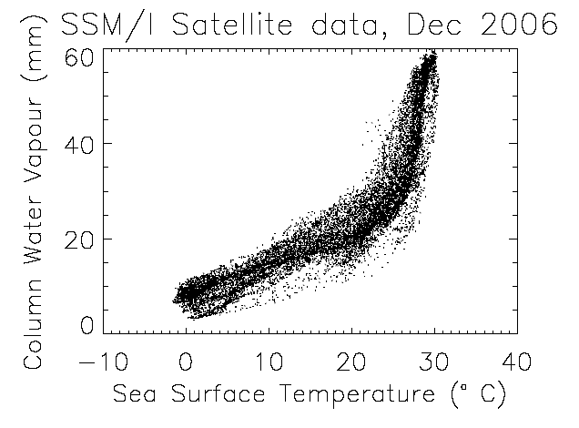
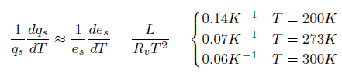
Physical basis: water vapour
Physics: Clausius-Clapeyron
Low-level water vapour concentrations increase with atmospheric warming at about 6-7%/K
  Wentz and Shabel (2000) Nature; Raval and Ramanathan (1989) Nature

Slide 8
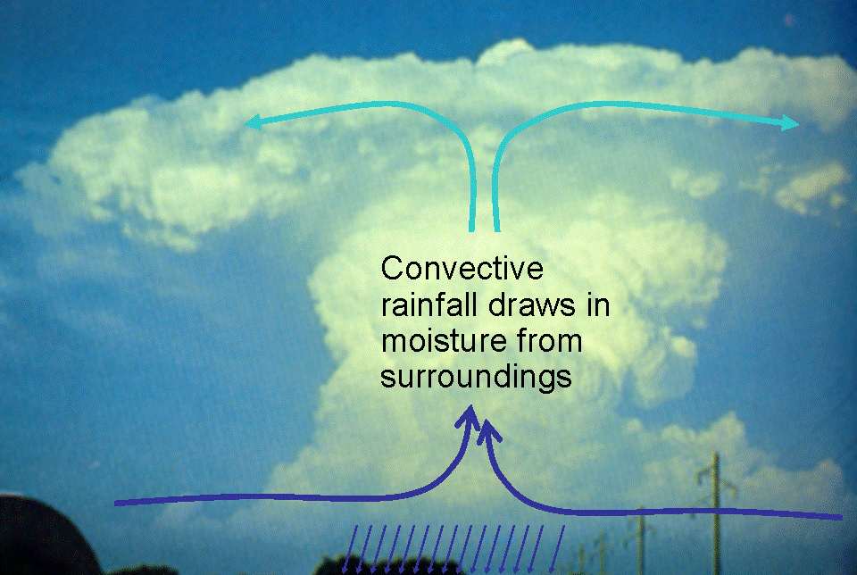
Extreme Precipitation
Large-scale rainfall events fuelled by moisture convergence
  e.g. Trenberth et al. (2003) BAMS
→ Intensification of rainfall (~7%/K?)

Slide 9
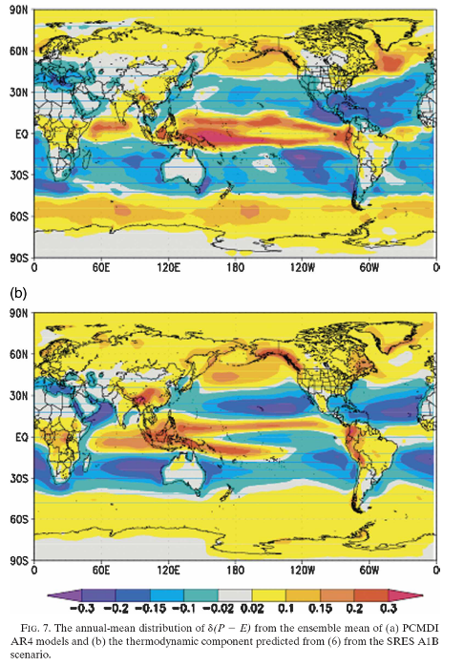

Implications for moisture transport and P-E patterns
Projected (top) and estimated (bottom) changes in Precipitation minus Evaporation d(P-E)
≈
Held and Soden (2006) J Climate

Slide 10

The Rich get Richer…
Heavy rain follows moisture (~7%/K)
Mean Precipitation linked to energy balance (~3%/K)
Precipitation →
Light Precipitation (-?%/K)
Temperature →

Slide 11
Climate model projections (see IPCC 2007)
Precipitation Intensity
Increased Precipitation
More Intense Rainfall
More droughts
Wet regions get wetter, dry regions get drier?
Regional projections??
Dry Days
Precipitation Change (%)

Slide 12
References
Allan (2011) Nature 470, 344-345
Available at: www.met.reading.ac.uk/~sgs02rpa
Allen and Ingram (2002) Nature 419, 224–232
Held and Soden (2006) J Clim 19, 5686–5699
Trenberth et al. (2003) BAMS 84, 1205–1217

Slide 13
Can we use observations to seek/confirm robust responses?
Precip. (%)
Allan and Soden (2008) Science
Notes:
13
In collaboration with the University of Miami, we are seeking to corroborate climate model projections of more intense rainfall events and an increased areal coverage of drought using monthly and daily satellite data over the ocean. Using natural fluctuations relating to El Nino we were able to identify an increased frequency of the heaviest rainfall in warmer months in both the climate models and satellite data (Allan and Soden, 2008, Science). A tendency for wet regions of the tropics to become wetter and dry regions drier is also exhibited by models and Earth Observation data (Allan and Soden, 2007, GRL) although considerable uncertainty remains in the observational estimates. [CWV is column integrated water vapour]

