Slide 1
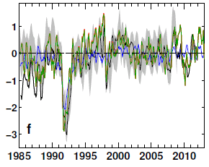
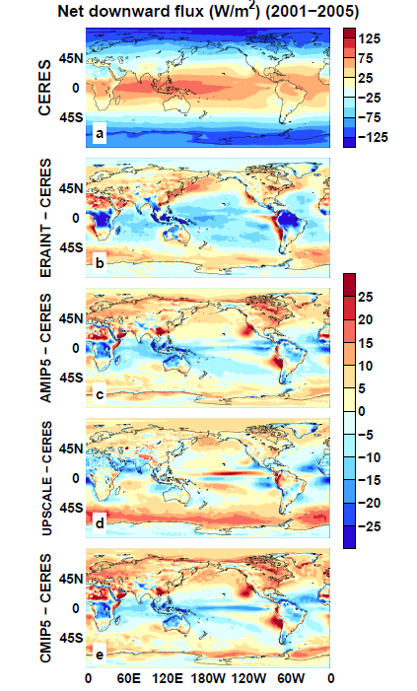

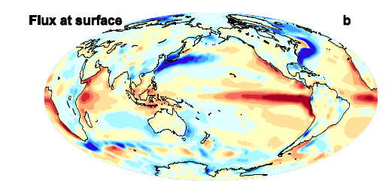
Earth’s Energy Imbalance
Richard Allan, Chunlei Liu
Changes in Net Imbalance (Wm⁻²)
Model biases in Net Imbalance (Wm⁻²)
Novel way to derive surface fluxes based upon TOA radiation and reanalysis energy transports →
Notes:
Top left: Ensemble mean biases in net top of atmosphere downward radiation
Top right: Changes in net downward top of atmosphere global mean radiation
Bottom: New product to derive surface fluxes based on satellite top of atmosphere radiation and reanalysis horizontal transports and atmospheric heating

Slide 2

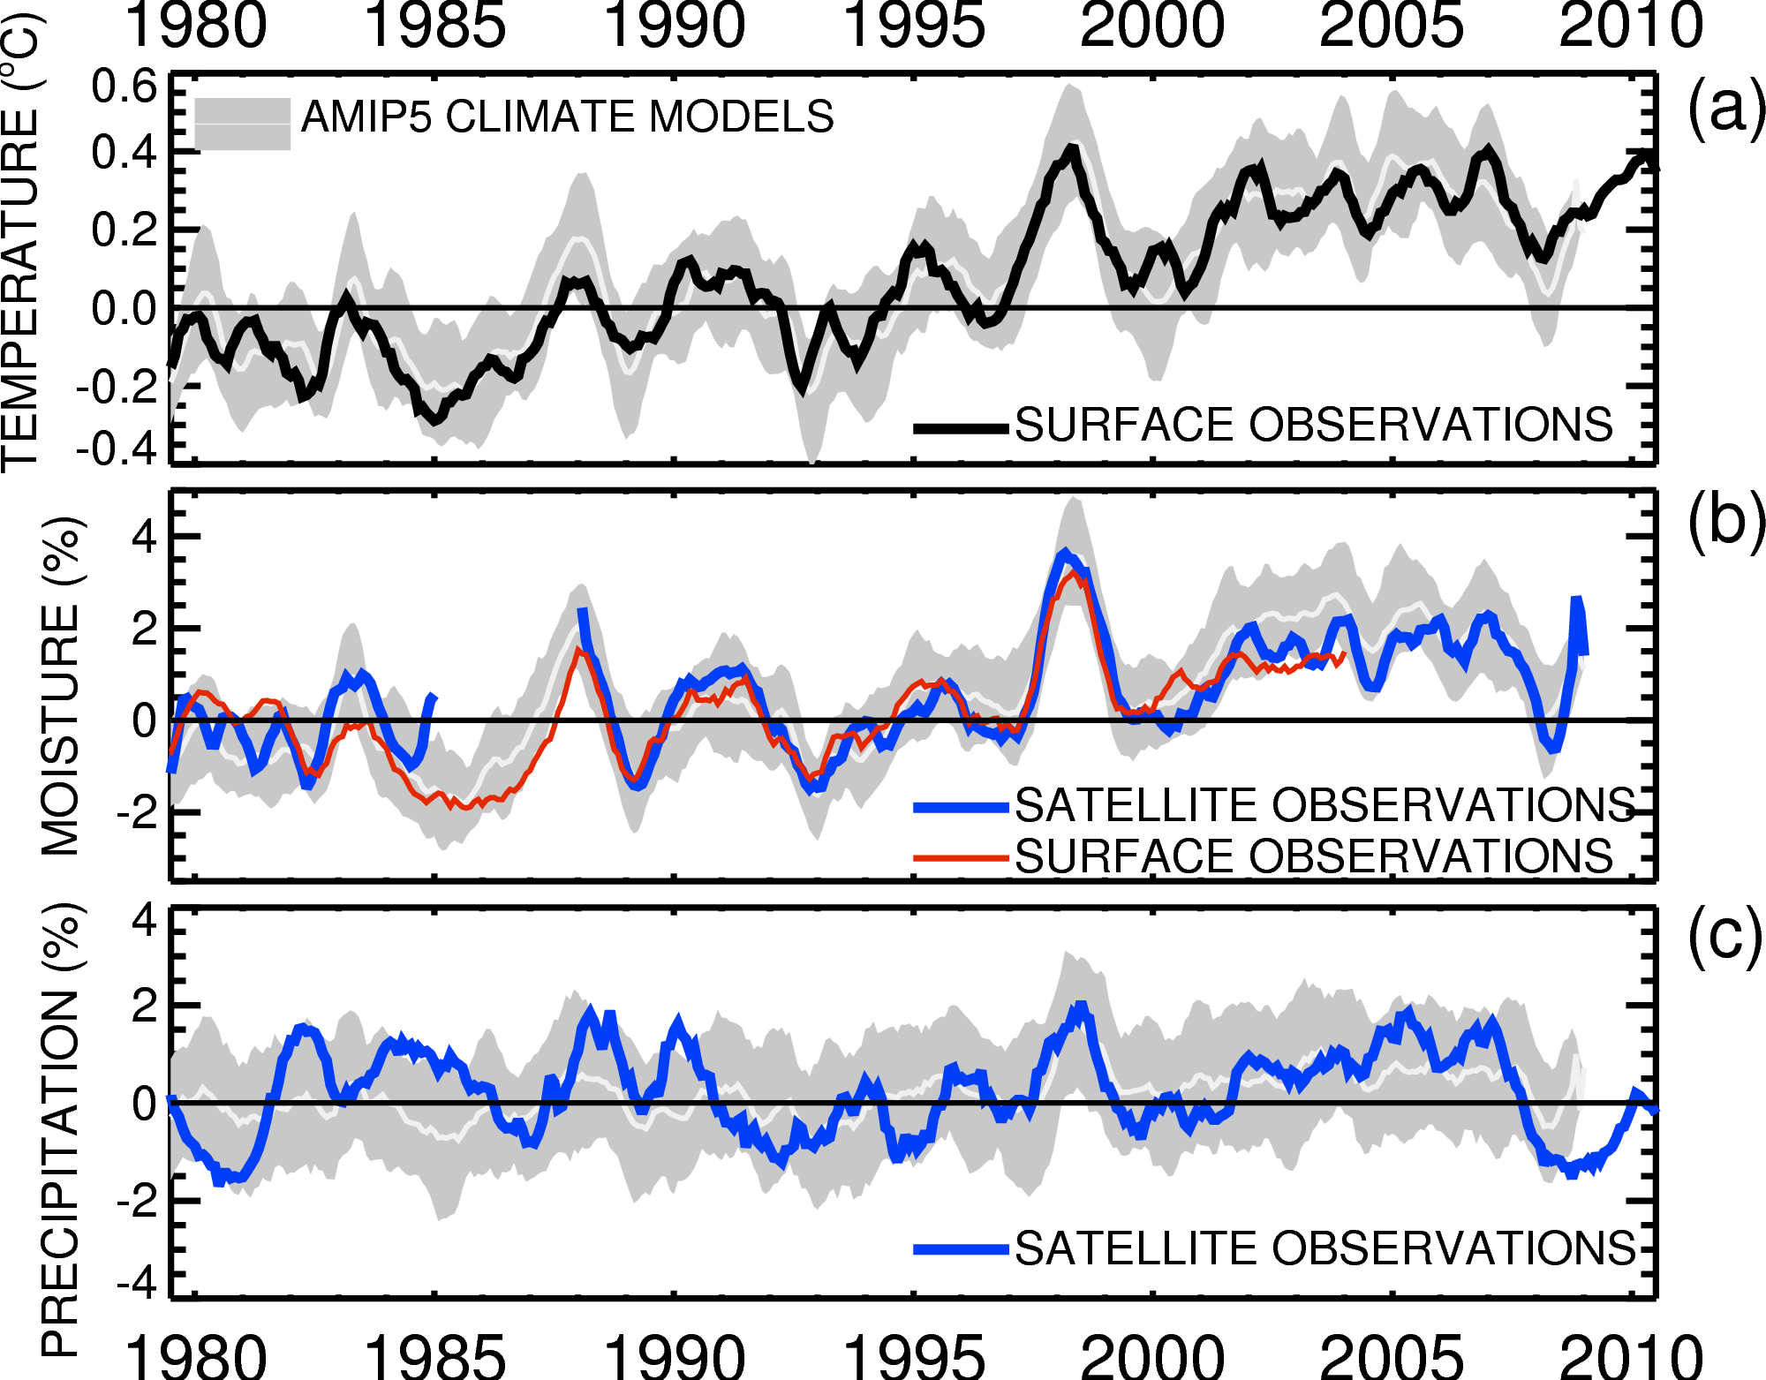

Diagnosing global responses/feedbacks
Co-variation: dW/dTs ~ 7%/ºC
~1%/decade trend
Adapted from: Allan et al. (2013) Surv. Geophys
Notes:
Combine AMIP5 simulations with blended satellite and surface observations to understand and evaluate global scale variability, responses and feedbacks in the current climate.

Slide 3
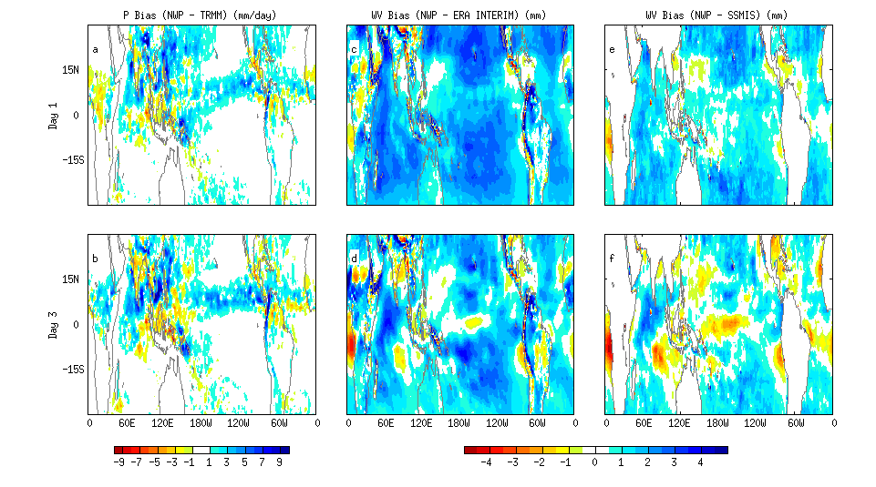
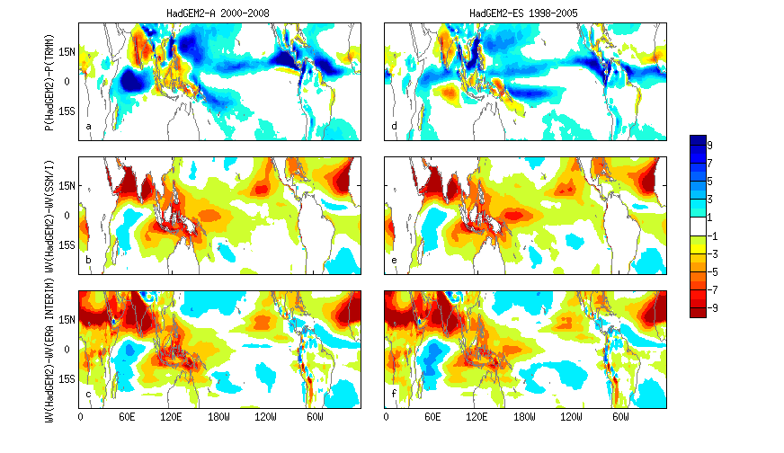
Linking systematic biases in water vapour & precipitation in NWP & climate models
PRECIPITATION (mm/day) Model – OBS WATER VAPOUR (mm) Model – OBS
HadGEM2-ES HadGEM2-A NWP-day 3
Liu, Allan, Brooks, Milton (2013) J Appl. Meteorol. Clim.
Notes:
Systematic biases in climate model simulations of precipitation are also evident in forecasts made by Weather Forecast models. This means that we may be able to exploit NWP models in exploring the reasons for systematic biases.

