Slide 1
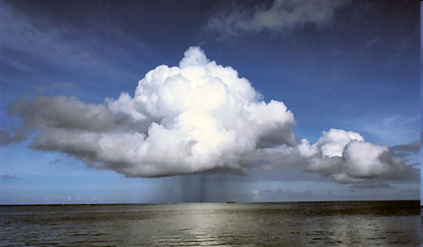
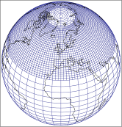
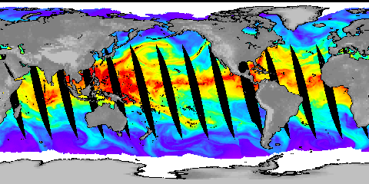






How and why is rainfall changing across the globe?
Richard Allan, David Lavers, Chunlei Liu, Matthias Zahn
Department of Meteorology, University of Reading
www.met.reading.ac.uk/~sgs02rpa r.p.allan@reading.ac.uk @rpallanuk
Notes:
Projected Responses in Extreme Precipitation and Atmospheric Radiative Energy
Energetics response
Wet/dry responses
Intense rainfall
Transient responses

Slide 2
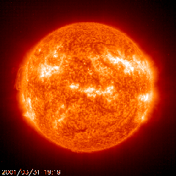
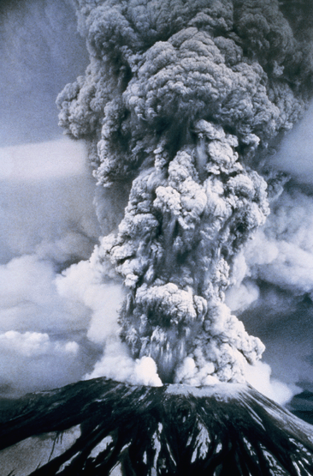
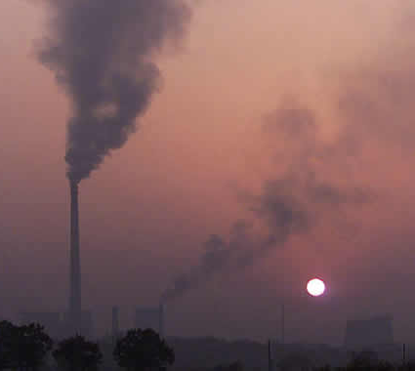
How will global precipitation respond to climate change?
Simulations:
RCP 8.5
Historical
RCP 4.5
Global Precipitation Change (%)
Observations
Allan et al. (2013) Surv. Geophys, see also Hawkins & Sutton (2010) Clim. Dyn
Notes:
2
There is huge uncertainty in global precipitation projections, relating both to climate sensitivity and mitigation pathways.

Slide 3
Climate model projections
Precipitation Intensity
Increased Precipitation
More Intense Rainfall
More droughts
Wet regions get wetter, dry regions get drier?
Regional projections??
Dry Days
Precipitation Change (%)
IPCC WGI (2007)

Slide 4
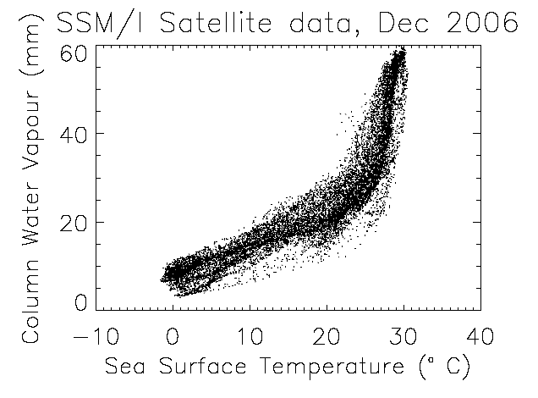
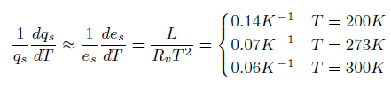
The role of water vapour
Physics: Clausius-Clapeyron
Low-level water vapour concentrations increase with atmospheric warming at about 6-7%/K
  Wentz and Shabel (2000) Nature; Raval and Ramanathan (1989) Nature

Slide 5
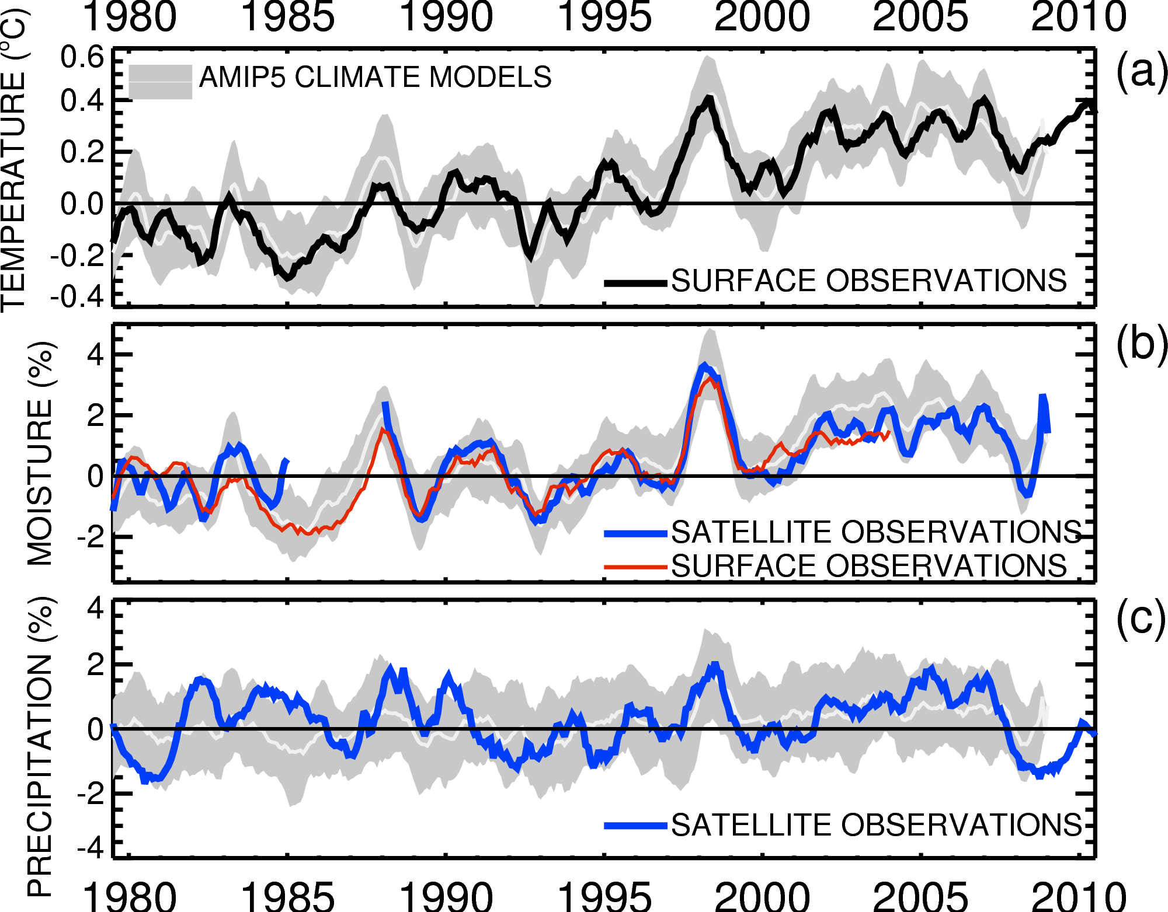

Globally, in the present-day climate, temperature, moisture and precipitation are strongly coupled
See poster by Chunlei Liu

Slide 6
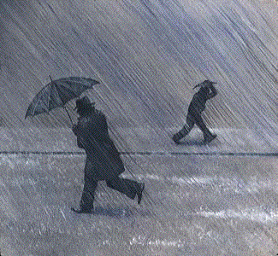
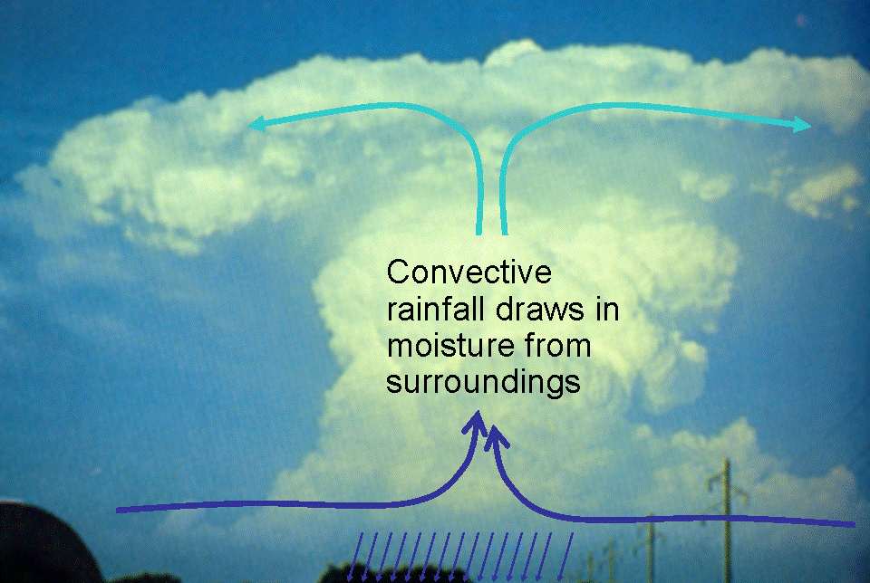
Extreme Precipitation
Large-scale rainfall events fuelled by moisture convergence
  e.g. Trenberth et al. (2003) BAMS
Intensification of rainfall with global warming
  e.g. Allan and Soden (2008) Science

Slide 7


Water vapour and mid-latitude flooding
Linking UK winter flooding to Atmospheric Rivers
  e.g. Nov 2009 Cumbria floods
  NERC HydEF project
  See poster by David Lavers
Lavers et al. (2011) Geophys. Res. Lett.

Slide 8

Contrasting precipitation response expected
Heavy rain follows moisture (~7%/K)
Mean Precipitation linked to energy balance (~2-3%/K)
Precipitation →
Light Precipitation (-?%/K)
Temperature →
e.g. Allen and Ingram (2002) Nature; Allan (2011) Nature

Slide 9
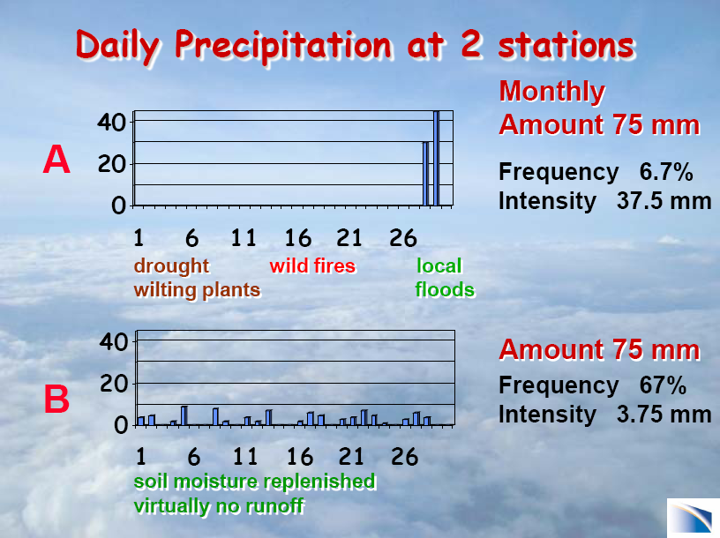
Courtesy of Dr Kevin Trenberth, Head of the Climate Analysis Section at the USA National Center for Atmospheric Research

Slide 10
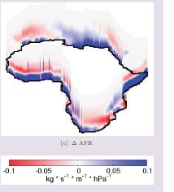
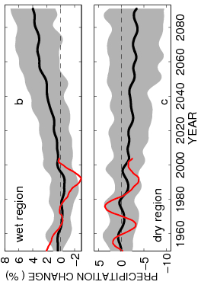
Contrasting precipitation response in wet and dry regions of the tropics
21C-20C
Tropical land
Simulations
Observations
NERC PREPARE project
See posters by Matthias Zahn and Chunlei Liu
Allan et al. (2010) Environ. Res. Lett., Zahn & Allan (2013) J Clim
Notes:
Note that the wet getting wetter and dry getting drier signal in the tropics is robust in models. The recently updated GPCP observations (black) show a slightly larger trend in the wet region. The dry region trend is probably spurious before 1988 since microwave data began in 1987.

Slide 11
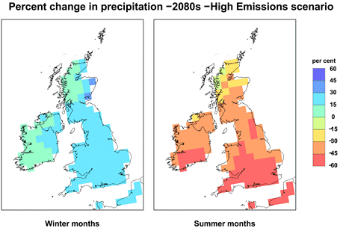
Robust predictions of regional changes in the water cycle: a great challenge
Shifts in circulation patterns are crucial to regional changes in water resources and risk yet predictability is often poor.
How will monsoons and jet stream positions respond to warming?
How will primary land-surface and ocean-atmosphere feedbacks affect the local response to global warming?

Slide 12
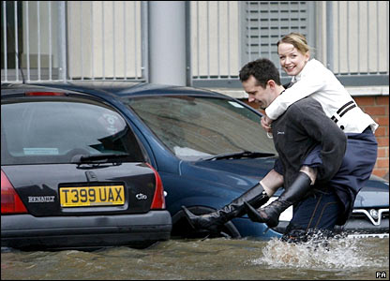
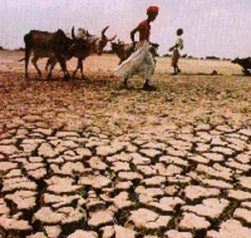
Conclusions
Global precipitation will rise with warming ~2%/K
  Constrained by energy budget of atmosphere
Heavy rainfall becomes more intense
  Fuelled by increased water vapour (~7%/K)
Wet get wetter, dry get drier
  More flooding, more drought ?
  But wet and dry regions don’t stay still…
Regional projections are a challenge
  Sensitive to small changes in atmospheric circulation
Notes:
12
Projected Responses in Extreme Precipitation and Atmospheric Radiative Energy

