Slide 1
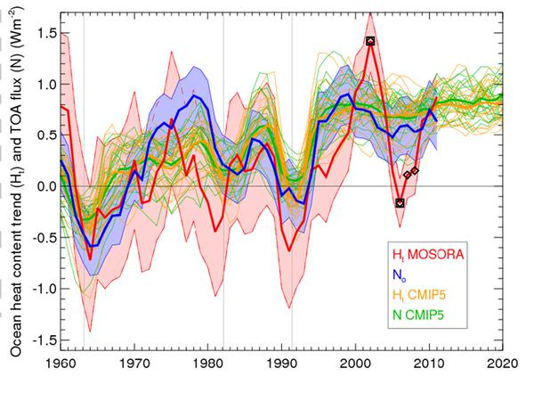
Reconciling net TOA flux/ocean heating in observations and models
Spurious ocean data?
5-yr running means (Smith et al. 2015)
Reanalysis/recon
ERBS/recon
CERES

Slide 2
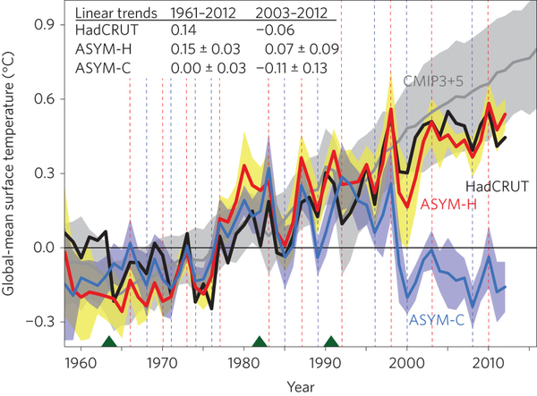
Mechanisms and metrics
Surface temperature hiatus despite continued upper ocean heating (Durack et al. 2014, Llovel et al., 2014)
Linked to observed strengthening of Pacific walker circulation e.g. Merrifield (2010) ; Sohn et al. (2013) ; L’Heureux et al. (2013) and greater heat uptake below mixed layer in Pacific e.g. Kosaka & Xie (2013) ; England et al. (2014)
Simulations suggest internal variability contributes +0.1ºC in 1980s/90s, ‒0.1ºC in 2000s:
Watanabe et al. 2014
Is there a better temperature metric to account for this?

Slide 3
Feedbacks on internal variability?
Above: observations, Loeb et al. (2012)
Left: simulations, Brown et al. (2014)

Slide 4
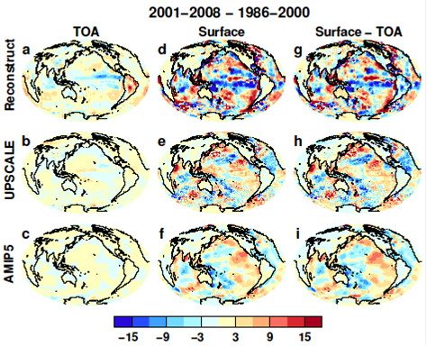
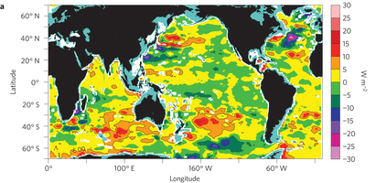
Spatial signature of ocean heating?
Liu et al. (2015) in prep
Roemmich et al. (2015), 2006-2013 heating rate

Slide 5
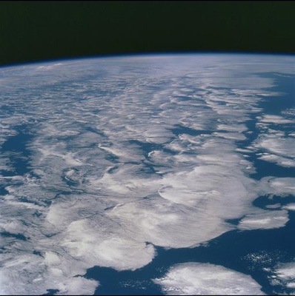

DEEP-C:
Introduction & WP1 update
Richard Allan, Chunlei Liu - University of Reading
Thanks to: Norman Loeb, Matt Palmer, Doug Smith
DEEP-C Meeting, Met Office, 20th September 2014

Slide 6
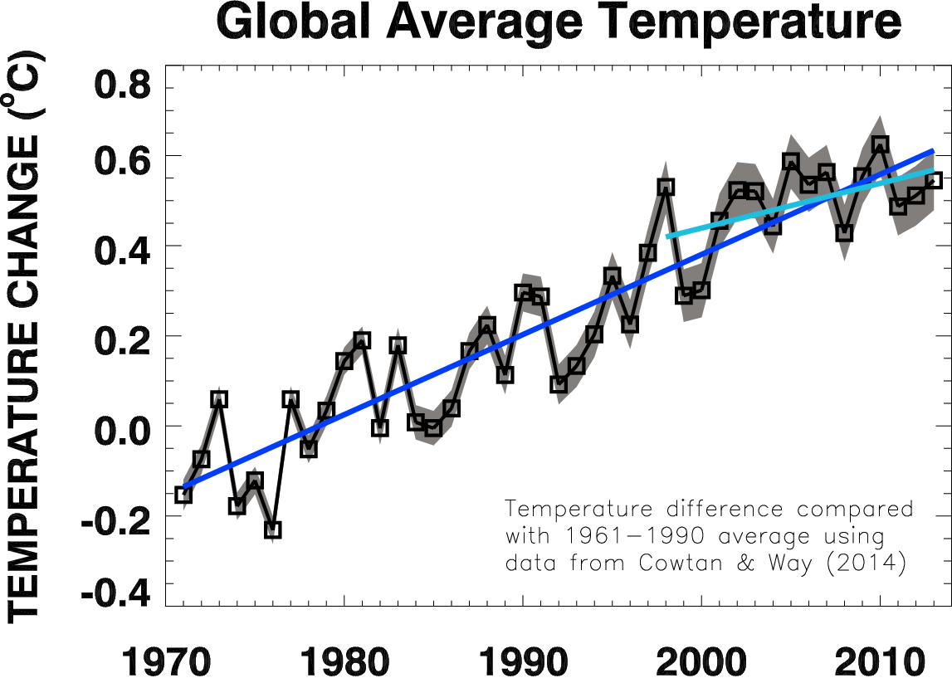
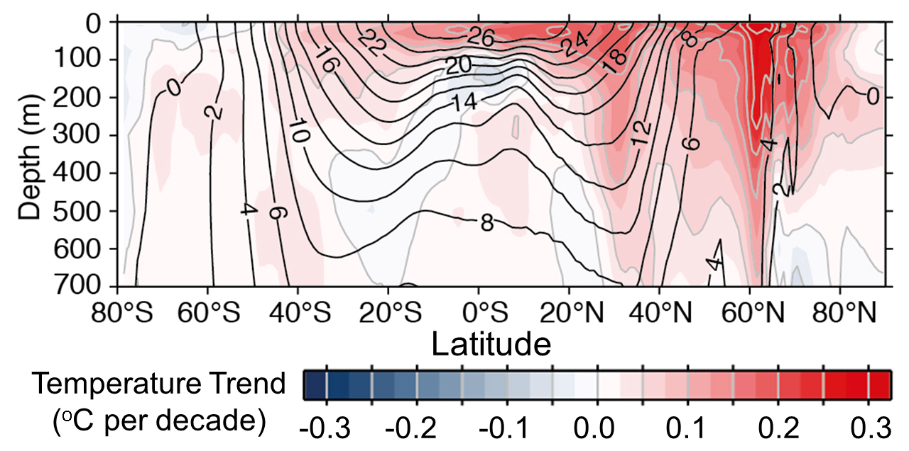
1) There has been a slowing
(rather than a pause) in the rate of surface warming
2) Heating from greenhouse gases
continue to warm upper oceans
3) Currently more heat is reaching
deeper ocean levels rather than warming the mixed layer which influences surface temperature

Slide 7
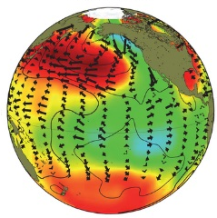
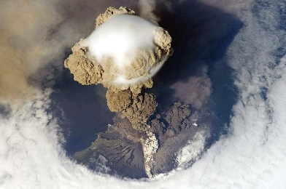
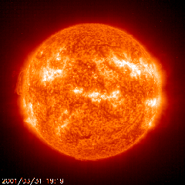
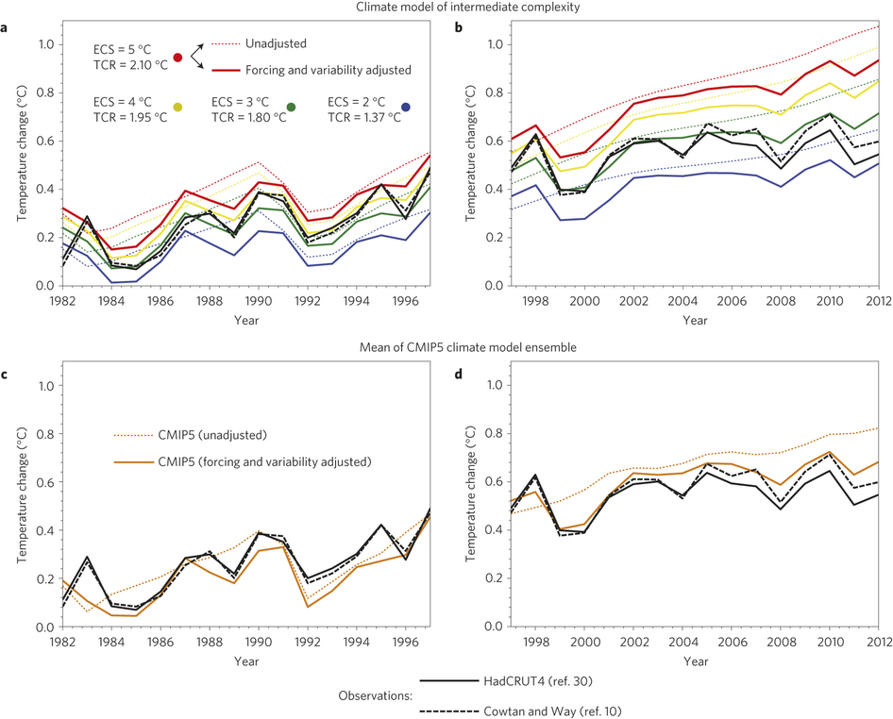
Factors explaining the hiatus
Declining solar forcing, more small volcanos & more La Niñas compared to late 1990s can explain:
  Slowing in surface warming (e.g. Foster & Rahmstorf 2012)
  Slow surface warming compared with coupled simulations (e.g. Risbey et al. 2014 ; Huber & Knutti 2014)
Simulations
Adjusted Simulations
Observations
Huber & Knutti 2014

Slide 8
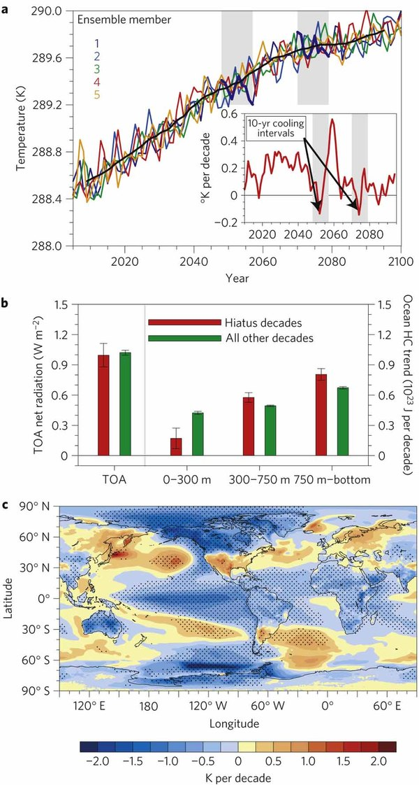
Heating of Earth continues
The oceans have continued to heat up in the 2000s as expected from rising atmospheric concentrations of greenhouse gas (e.g. Hansen et al. 2011 ; Trenberth et al. 2014)
  Ocean measurements and satellite observations show ocean heating rate has not declined (e.g. Loeb et al. 2012)
  Heat is mixing to deeper levels (e.g. Balmaseda et al. 2013; Watanabe et al. 2013)
  Hiatus decades are simulated by coupled models which mix more heat below 300m →
  Meehl et al. 2011

Slide 9
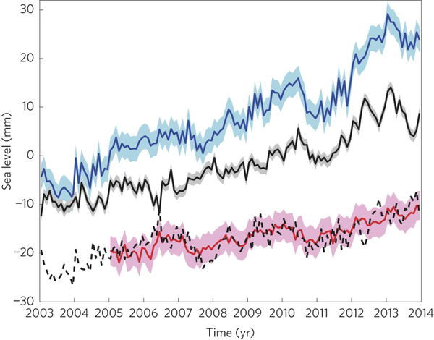
Heating accounted for in “upper” ocean
0-700m ocean heating underestimated? (Durack et al. 2014)
Continued sea level rise; almost all of heating and sea level rise due to heating accounted for in upper 2000m
Llovel et al. (2014)
Altimeter (total)
GRACE (mass contribution)
Sea level change (mm)
--- Thermal expansion (total minus mass changes)
0-2000m Argo-based thermal expansion
See also Cazenave et al. (2014)

Slide 10
Roemmich et al. (2015) Nature Climate Change: ocean temperature anomaly with time & depth

Slide 11
Oceans mixing heat to deeper layers
Heating accounted for in “upper” ocean e.g. Durack et al. (2014), Llovel et al. (2014)
Observed strengthening of Pacific walker circulation
e.g. Merrifield (2010) ; Sohn et al. (2013) ; L’Heureux et al. (2013)
Simulations applying observed wind stress uptake more heat below mixed layer in Pacific e.g. Kosaka & Xie (2013) ; England et al. (2014)
Simulations suggest internal variability contributes +0.11-0.13ºC in 1980s/90s and ‒0.11ºC in 2000s:
Watanabe et al. 2014

Slide 12
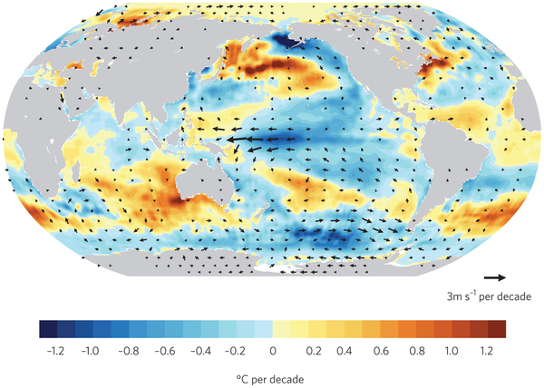
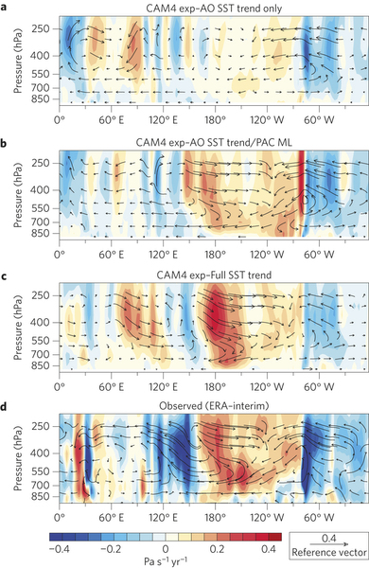
Mechanisms of ocean variability
Pacific Decadal Variability Pattern
Is Atlantic driving Pacific changes?
Atlantic circulation salinity feedback? (Chen & Tung 2014)
(Kosaka 2014)
Model simulates stronger Pacific trades when apply Atlantic SSTs + Pacific SST allowed to respond →
McGregor et al. (2014)

Slide 13
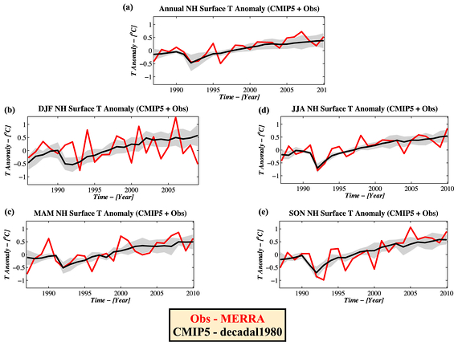
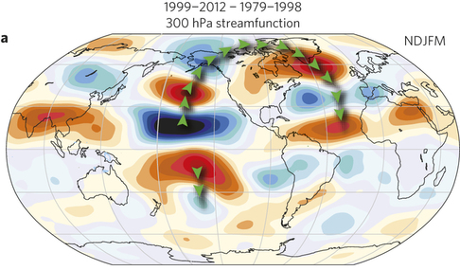
Remote influences on weather patterns
Hiatus dominated by northern winter (e.g. Cohen et al. 2012)
Cooling in east Pacific explains reduced heat export during northern winter (Kosaka & Xie 2013)
Rapid Arctic warming linked to tropical changes (Ding et al. 2014)
Atmospheric bridges link tropical anomalies & mid latitude weather patterns (e.g. Trenberth et al. 2014b)

Slide 14
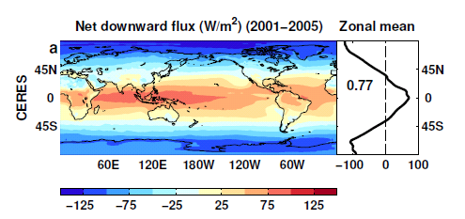
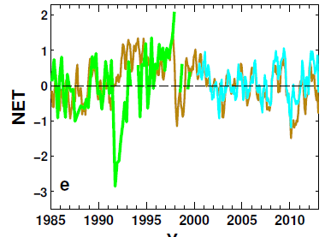
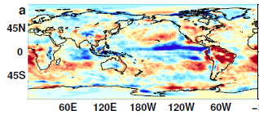
Reconstructing global radiative fluxes prior to 2000
ERBS/CERES variability
CERES monthly climatology
ERBS WFOV
CERES
ERA Interim
ERA Interim spatial anomalies
Combine CERES/ARGO accuracy, ERBS WFOV stability and reanalysis circulation patterns to reconstruct radiative fluxes

Slide 15
Net Imbalance Anomaly (Wm⁻²)
Changes in imbalance in models & observations
Imbalance: 0.23 0.00 0.78 0.63 0.63 (Wm⁻²)
0.34±0.67 Wm⁻²
0.62±0.43 Wm⁻²
La Niña
El Niño
Volcano
Allan et al. (2014) GRL

Slide 16
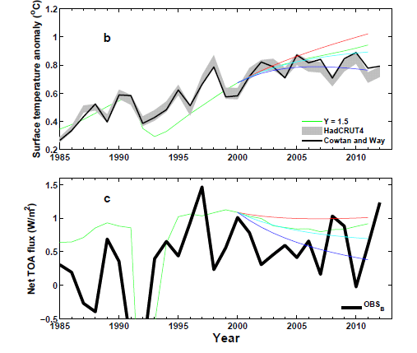
Analysis using simple energy balance model (Chunlei Liu)
+ve RF trend
0 RF trend
-ve RF trend
Use AR5 RF
Allan et al. (2014) GRL supplementary

Slide 17
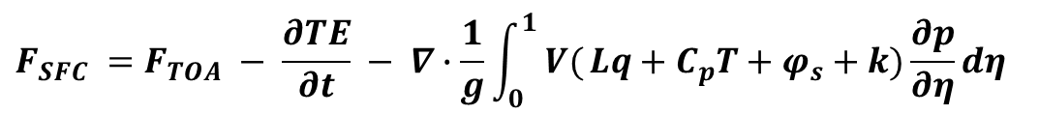
Current work: estimates of Surface Flux (Chunlei Liu)
CERES/Argo Net Flux
Estimate horizontal energy flux
Surface Flux
$$F_{SFC} =F_{TOA} − \frac{∂TE}{∂t} − ∇∙\frac{1}{g}\int_{0}^{1}{ V(}Lq+C_{p}T+φ_{s}+k)\frac{∂p}{∂η}dη$$

Slide 18
Conclusions
Heating of Earth continues at rate of ~0.6 Wm⁻²
Current variability in TOA radiation (1985-2013)
  Net flux higher in 1995-1999 than 2000-2012 period
  Pacific signal in ΔT and ΔN
  Radiative forcing alone can’t explain surface warming slowdown: internal variability important
Plans:
  Development of surface flux estimate (currently)
  Evaluate with other datasets; basin-scale flux changes
  Work with WP2 (surface fluxes) and WP3 (simulations) and comparison with surface fluxes products (Met Office)

