Slide 1
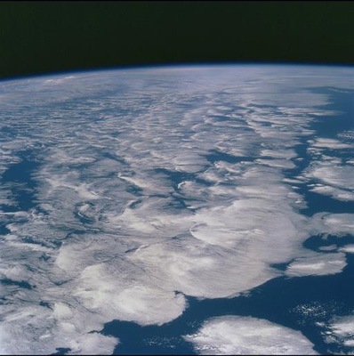

Current changes in Earth’s energy budget
Richard Allan, Chunlei Liu - University of Reading
SMURPHS meeting NOCS, May 3-4th 2017

Slide 2
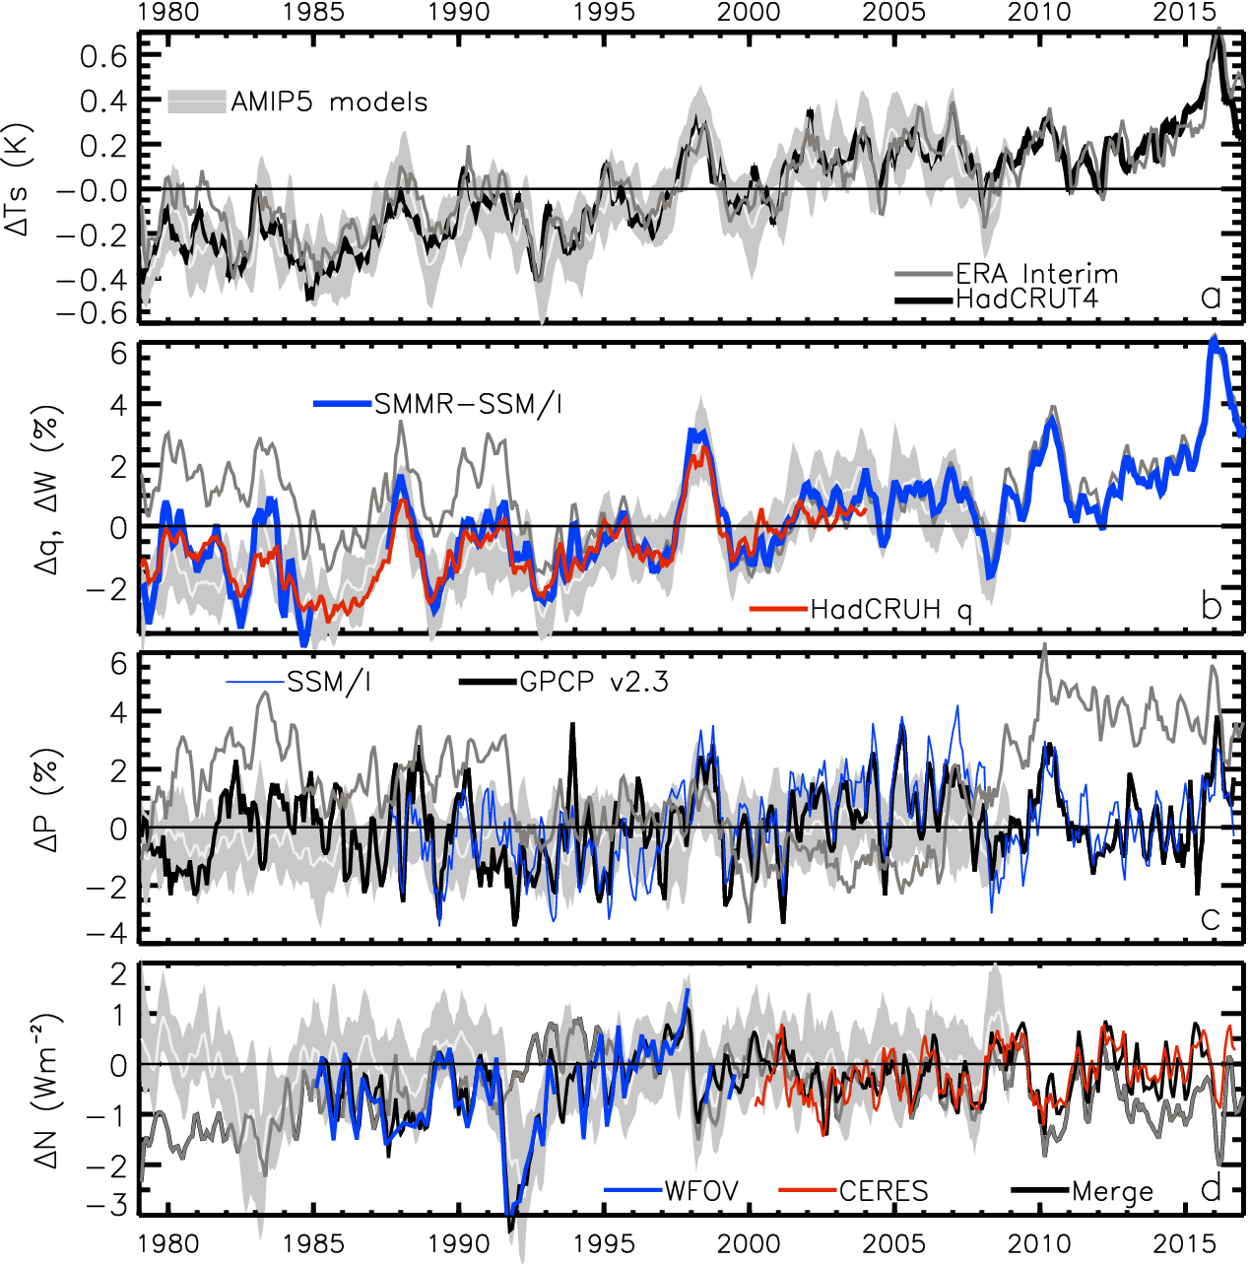
Earth’s global surface temperature & energy imbalance variability since the 1980s
TEMPERATURE anomaly (degC)
2.8
1.8
0.8
-0.2
-1.2
-2.2
ENERGY BUDGET anomaly (Wm⁻²)
Energy imbalance (Wm⁻²)

Slide 3
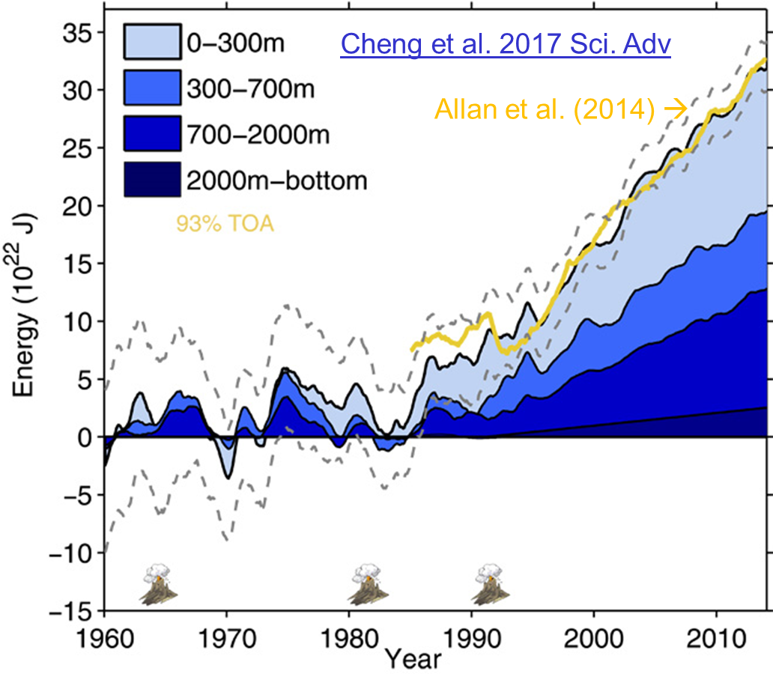
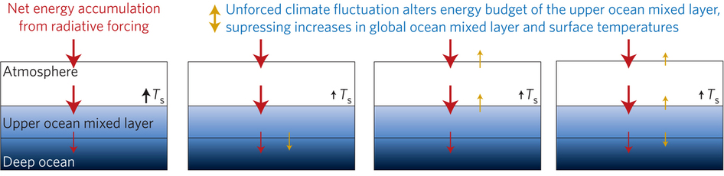
Improved global energy imbalance estimates
More accurate global imbalance from ocean and satellite observations: Cheng et al. 2017:
Steady decadal ocean heating since 2000: 0.6-0.8 Wm⁻² (Johnson et al. 2016)
Radiative forcing/internal variability influence TOA radiation (Palmer/ McNeall 2014; Allan et al. 2014; Huber/Knutti 2014; Xie/Kosaka 2017)
Upper ocean heat budget explains surface temperature: Hedemann et al. 2017 NatureCC
Allan (2017) Nature Climate Change
Notes:
Improved and longer records of ocean heating and top of atmosphere radiation measurements have improved estimates of Earth’s energy imbalance and its changes over recent decades.
Simulations with prescribed observed SST and radiative forcing are able to capture variations in energy budget
Greater appreciation for the role of internal variability in influencing global energy budget and the link between energy imbalance and surface temperature via heat budget of upper ocean

Slide 4
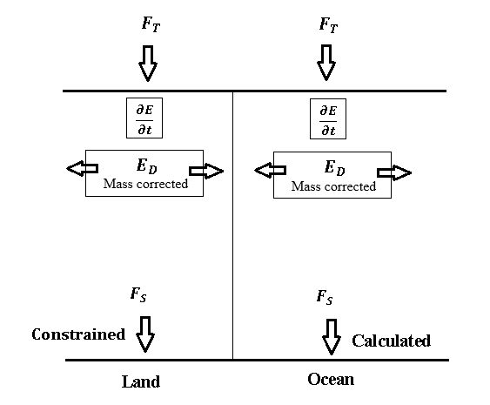
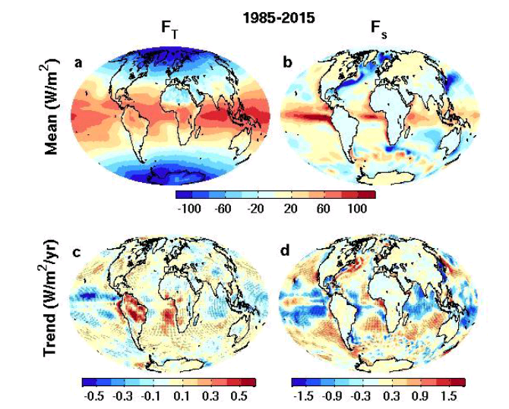

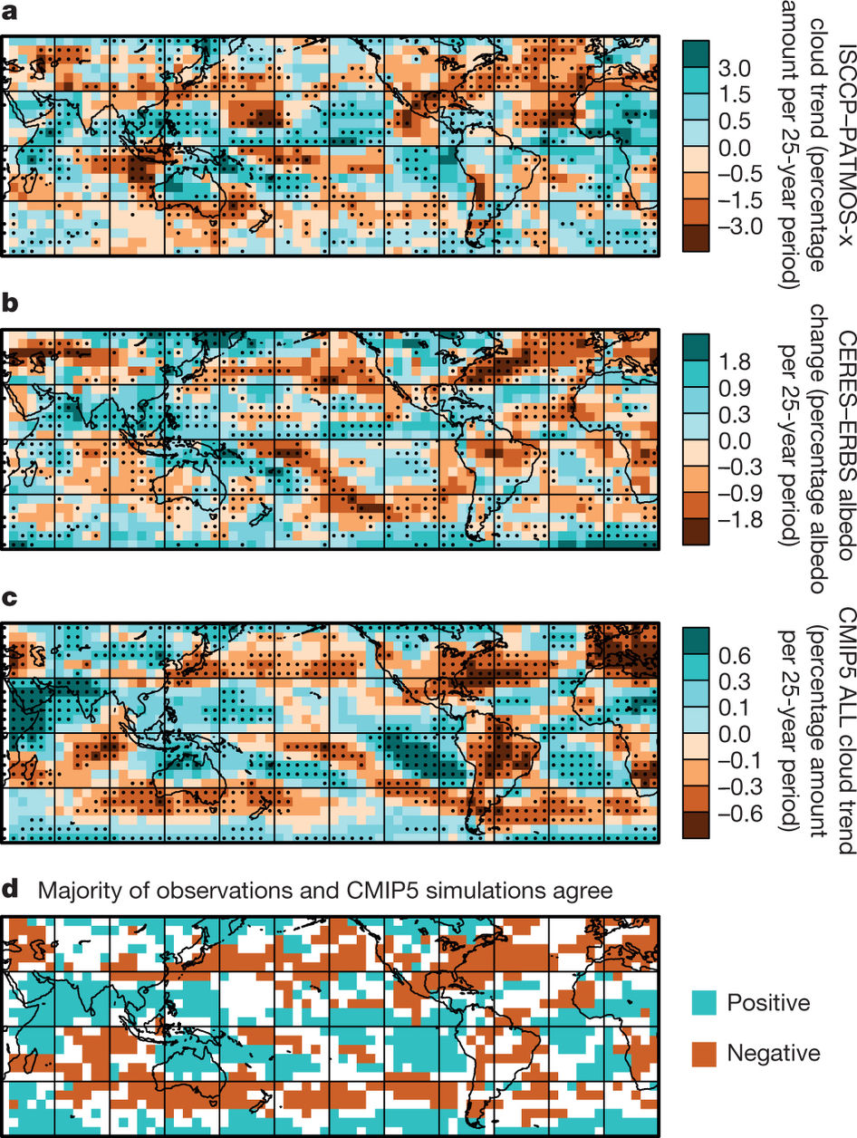
Surface/TOA energy fluxes & trends
ERBS CERES
reanalyses
top of atmosphere surface
Surface energy flux dataset combining TOA reconstruction with reanalysis energy transports: Liu et al. (2015) JGR
Liu et al. (2017) submitted to JGR
Data: http://dx.doi.org/10.17864/1947.111
Norris et al (2016) Nature
Changes in cloudiness

Slide 5
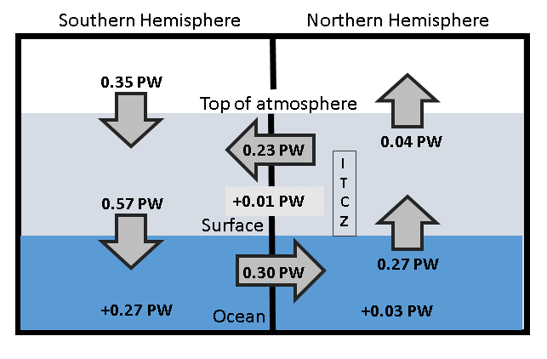
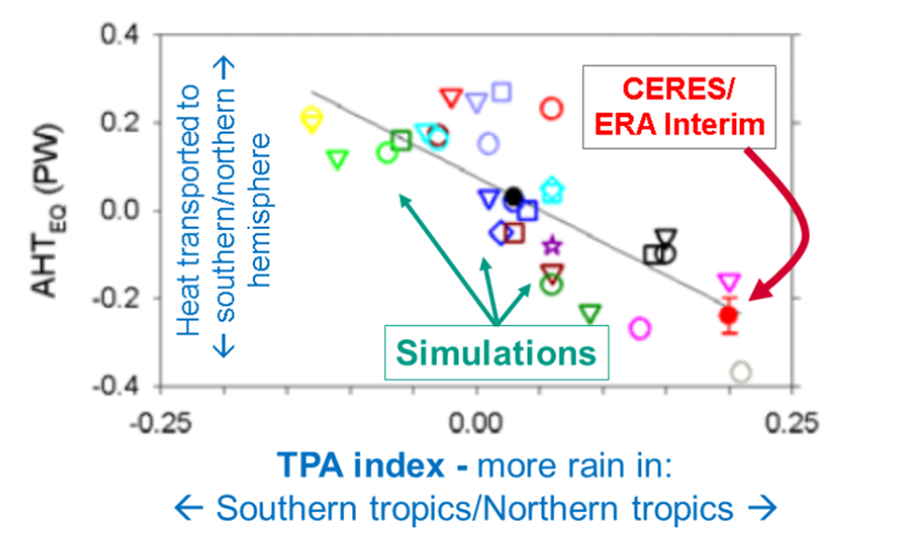
Inter-hemispheric energy imbalance/transport and precipitation biases in CMIP5 models
Observed inter-hemispheric imbalance in Earth’s energy budget 2000-15 (Liu et al. submitted update of Loeb et al. (2016) Clim. Dyn using Roemmich et al. (2015) Nature Climate ocean heating)
Implied ocean heat transport less than Loeb et al. (2016) & Frierson et al. 2013
Cross-equatorial heat transport by atmosphere & hemispheric precipitation asymmetry linked
Loeb et al. (2016) Clim. Dyn
See also: Haywood et al. (2016) GRL;
Hawcroft et al. (2016) Clim. Dyn.
Notes:
Combining top of atmosphere energy buget and reanalysis horizontal energy transports allows new estimates of global surface energy budget
This has enabled advances in observing/understanding inter-hemispheric energy imbalance/transports and precipitation and links to model biases
Many CMIP5 models contain gross errors in cross equatorial energy fluxes which coincide with incorrect depiction of hemispheric precipitation asymmetries offering a potential constraint on climate models

Slide 6
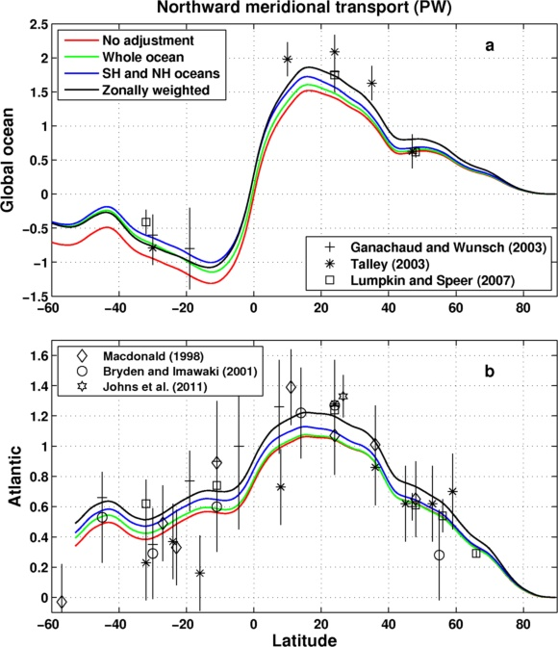
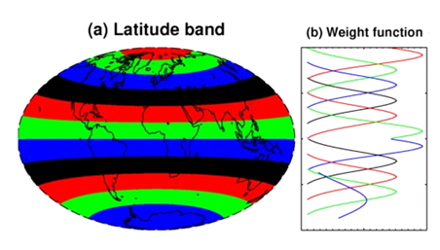
Comparison of Meridional Heat Transport
Inferred from F_{s} (Liu et al.) & ocean heating (Roemmich et al 2015) 2006-2013
Sensitivity of method to land flux correction
Zonal land correction
26ºN
Liu et al. (2017) submitted to JGR

Slide 7
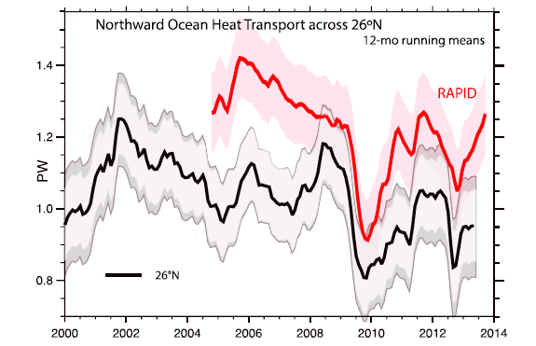
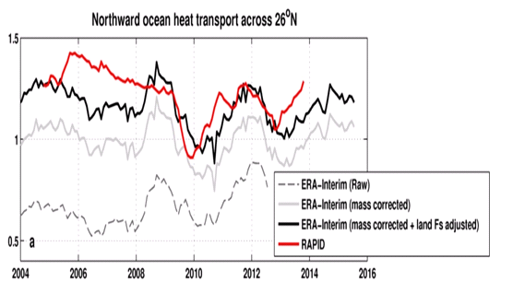
Inferred ocean heat transport@26ºN
Trenberth & Fasullo (2017) GRL
Compare indirect method with RAPID observations
Is TF2017 discrepancy due to lack of land F_{s} adjustment?
Ocean heating from ORAS4 (0-700m).
Better agreement after land Fs adjustment
2004-2013
RAPID 1.23 PW
TF2017 1.00 PW
Liu et al: 1.16 PW
large uncertainty
Liu et al. (2017) submitted to JGR

Slide 8
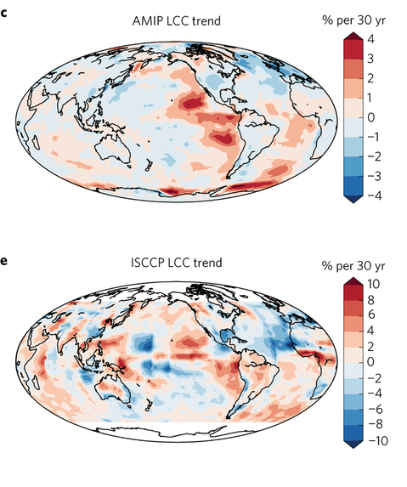
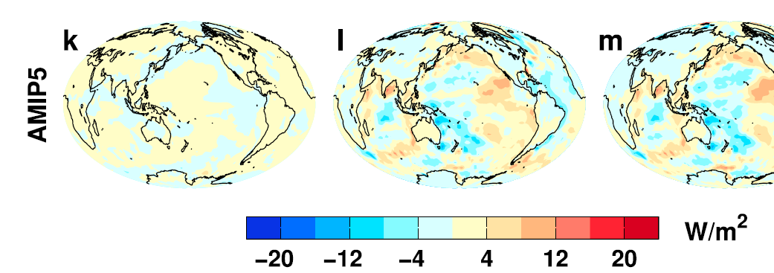
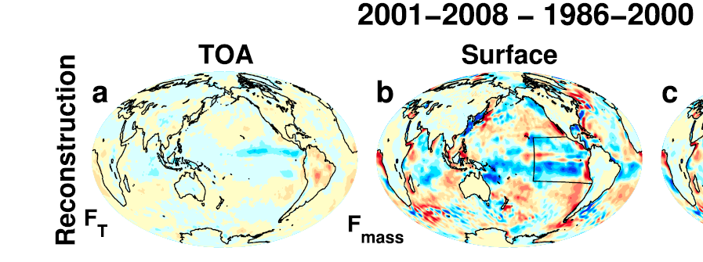
Feedbacks on internal and forced climate change involving regional energy budget
Low Cloud Cover trend 1980s-2000s Surface energy flux change
Distinct feedbacks on internal variability & forced change e.g. Brown et al. 2016 J. Clim; Xie et al. 2015 Nature Geosci; England et al. (2014) Nature Clim
Spatial patterns of warming crucial for feedbacks & climate sensitivity e.g. He & Soden (2016) J. Clim; Richardson et al. (2016) Nature Clim Change; Gregory & Andrews (2016) GRL
OBSERVATIONS AMIP MODELS
Zhou et al. (2016) Nature Geosci
Liu et al. (2015) JGR
What explains decreased heating of E Pacific; is it realistic?
Notes:
Combining decadal observations of cloud, radiation and energy transports is leading to advances in understanding regional to global feedbacks
There is emerging evidence of contrasting energy budget responses/feedbacks acting on internal and forced variability
The spatial pattern of warming is crucial in determining global feedback responses; accounting for this may help in determining climate sensitivity from observations

Slide 9
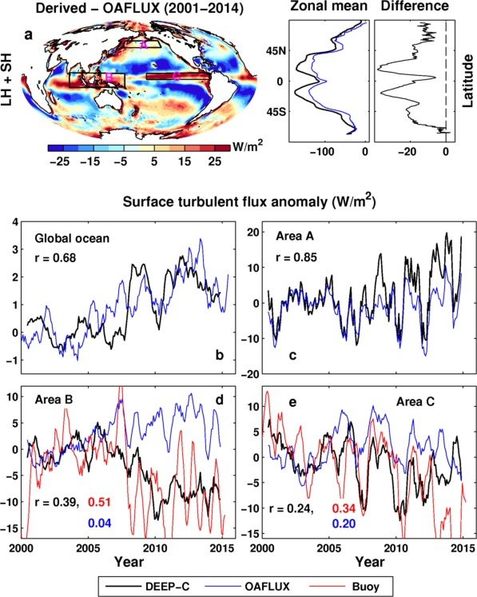
Evaluation of turbulent flux changes
Surface flux change 2000-2008 minus 1986-1999
Kato et al (2013) J Clim
CERES
Turbulent flux: F_{s} - F_{RAD}
OAFlux systematically lower (removed)
Good agreement in anomaly variability
Buoy data agree better with our product than with OAFlux
Are trends in reanalysis winds reliable?

Slide 10
Global energy budget: advances/questions
More accurate multi-decadal global estimates of Earth’s energy budget and its variability (e.g. Cheng et al. 2017 Sci. Adv.; Allan et al. 2014 GRL)
  Better indicator of global climate change than surface temperature but gaps in observing deep ocean (e.g. Palmer 2017 CCCR)
  Link to observed cloudiness? e.g. Norris et al (2016) Nature
Link between energy imbalance and surface warming depends on energy budget of upper mixed ocean layer (Roberts et al. 2015 JGR; Hedemann et al. 2017 Nature Climate Change; Xie & Kosaka 2017 CCCR)
  Better appreciation of mechanisms of decadal global climate variability
Distinct feedbacks on internal variability/forced change (Brown et al. 2016 J. Clim; Xie et al. 2015 Nature Geosci; Zhou et al. (2016) Nature Geosci
  Obs. estimates of climate sensitivity (Richardson et al. (2016) Nature Climate)
  Spatial patterns of warming crucial (Gregory and Andrews (2016) GRL)
  What explains decreased heating of E Pacific and is it realistic?
Advances in observing/understanding inter-hemispheric energy imbalance/transport and links to CMIP5 precipitation biases (Frierson et al. 2013; Loeb et al. 2016 Clim. Dyn; Stephens et al. 2016 CCCR)
  Possible constraint on realism of climate models (Haywood et al. (2016) GRL)

Slide 12
Changes in global water cycle
WATER VAPOUR anomaly (%)
PRECIPITATION anomaly (%)

Slide 13
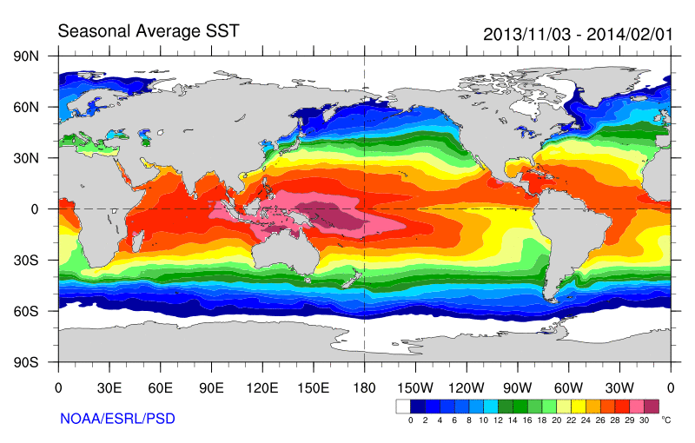
Role of Atlantic/Pacific Variability?
Radiative Forcing/Imbalance Johnson et al. (2016) ; Checa-Garcia et al. (2016) ; Huber & Knutti (2014) ;Santer et al. (2015) :
Continued heating from greenhouse gases
Aerosol forcing of circulation (Smith et al. 2016)
Unusual weather patterns (Ding et al. 2014; Trenberth et al. 2014b)
Pacific SST strengthens atmospheric circulation
Enhanced Walker Circulation
? Heat flux to Indian ocean Lee etal 2015
Increased sea height
Warm
Upwelling,
Cool water
Remote forcing from Atlantic:
Li et al. (2016) ;
McGregor et al. (2014)
Increased precipitation
Decreased salinity
Strengthening trade winds
Equatorial Undercurrent
Pacific dominates?
Mann et al. (2016) Kosaka & Xie (2013) England et al. (2014)
Enhanced mixing of heat below 100 metres depth by accelerating shallow overturning cells and equatorial undercurrent
See also: Merrifield (2010).; Sohn et al. (2013) .; L’Heureux et al. (2013) . Change; Watanabe et al. (2014) ; Balmaseda et al. (2013) ; Trenberth et al. (2014) .; Llovel et al. (2014) ;Durack et al. (2014) ; Nieves et al. (2015) ; Brown et al. (2015) JGR ; Somavilla et al. (2016) ; Liu et al. (2016)
Notes:
There is lots of new results focussing on the slower rates of surface warming and associated unusual climatic conditions at the beginning of the 21st century (see DEEP-C website: http://www.met.reading.ac.uk/~sgs02rpa/research/DEEP-C.html#PAPERS).

