Slide 1
Energy accumulation and surface warming
Heating due to rising greenhouse gas concentrations
Also influenced by aerosol pollution and natural factors, e.g. volcanoes, the sun
Rising surface Temperature
heating
Weak heating
Notes:
Piers to show this one.

Slide 2
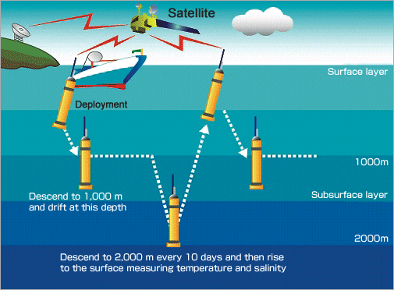
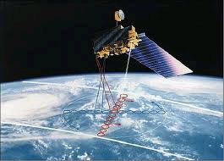
Measuring Earth’s energy flows
ARGO
Automated floats measure the heating of the ocean
  Down to 1800m depth
  Since around 2005
Satellite instruments accurately measure small changes in the energy arriving at and leaving our planet
  Sunlight & thermal radiation
  Best data since 2000
CERES
Notes:
Rich: Slide 1 - If more heat is arriving than leaving the planet the climate will warm.
Briefly mention observations that can measure this heating since 2000.

Slide 3
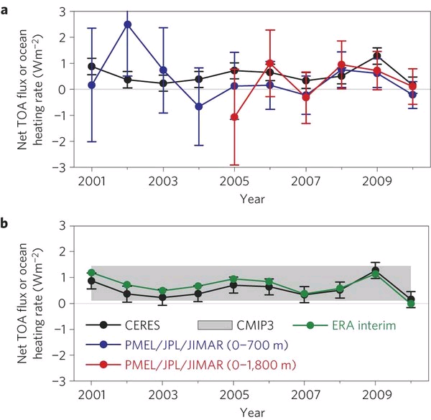

Combining satellite measurements with ocean observations…
Observations
simulations
Loeb et al. (2012) Nature Geosciences
Heat is continuing to accumulate at a rate of 0.6 Watts per square metre
this is equivalent to the continuous heating from more than 250 billion 1 kilo-Watt electric heaters distributed over the planet
Notes:
Rich: Slide 2 - Bottom line is the these observations show that more energy is arriving the climate system than leaving. Equivalent to more than 250 billion etc…
Note 0.6 Wm-2 refers to 2000-2013 period, updated from Loeb et al. (2012)
Figure 3 (a) Global annual average net TOA flux from CERES observations and (b) ERA Interim reanalysis are anchored to an estimate of Earth’s heating rate for 2006–2010 ⁵ The Pacific Marine Environmental Laboratory/Jet Propulsion Laboratory/Joint Institute for Marine and Atmospheric Research (PMEL/JPL/JIMAR) ocean heating rate estimates⁴ use data from Argo and World Ocean Database 2009; uncertainties for upper ocean heating rates are given at one-standard error derived from sampling uncertainties. The gray bar in (b) corresponds to one standard deviation about the 2001–2010 average net TOA flux of 15 CMIP3 models.

Slide 4
Energy accumulation and surface warming
Heating due to rising greenhouse gas concentrations
Rising surface Temperature
heating
Weak heating
1980s-1990s: heating of upper layers of the ocean – rising surface temperature
Notes:
Prior to 2000s, build up of energy was heating upper layers of the ocean leading to rising surface temperatures

Slide 5
Energy accumulation and surface warming
Heating due to rising greenhouse gas concentrations
Stable surface Temperature
heating
2000s: heating of deeper layers of the ocean – slow rises in surface temperature
Notes:
In the most recent decade it appears that this heat is still accumulating but much of this is heating lower layers of the ocean leading to relatively stable surface temperatures.
It is likely that slow changes in the ocean influence this rearrangement of energy.
Models do simulate this duering decades of slow temperature rises. However, they are not designed to predict the timings of this natural variability. They produce their own variability so combining lots of model simulations has the effect of smoothing out this natural variability.

Slide 6
Energy accumulation and surface warming
Heating due to rising greenhouse gas concentrations
Rising surface Temperature
Stable surface Temperature
heating
Weak heating
heating
1980s-1990s: heating of upper layers of the ocean – rising surface temperature
2000s: heating of deeper layers of the ocean – slow rises in surface temperature

