Slide 1
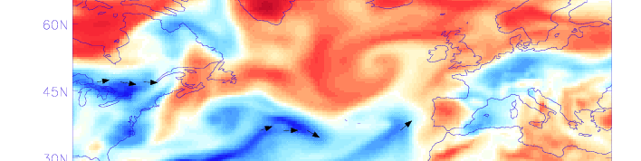
St1.3 Atmospheric Precursors
Department of Meteorology
Richard Allan, Adrian Champion (University of Reading)
Hayley Fowler, Stephen Blenkinsop (Newcastle University)

Slide 2
St1.3 objectives atmospheric precursors
Assess the influence of moisture transport in FFIR summer events using reanalysis data
Evaluate the time/space scales associated with FFIR events using daily and hourly rain gauge data
Characterise atmospheric conditions preceding FFIR impacts using historical and rain gauge data
Contribute toward case study inter-comparisons and write up publications

Slide 3
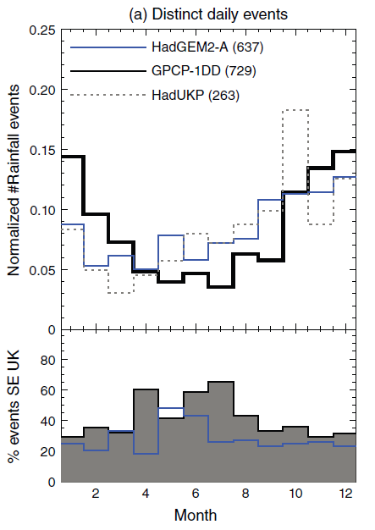
frequency of heavy rainfall by month (1997-2008)
Frequency of top 1% daily rainfall by month across UK
Fewer summer daily extreme events
But up to 60% of summer events for South East region
Highly sensitive to time/space scales
What are moisture characteristics associated with heavy rainfall?
Use satellite or gauge-based rainfall observations and simulations
Is intense moisture transport (e.g. Atmospheric Rivers) associated with intense summer rainfall
Allan et al. (2015)

Slide 4
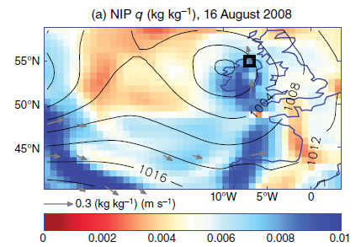
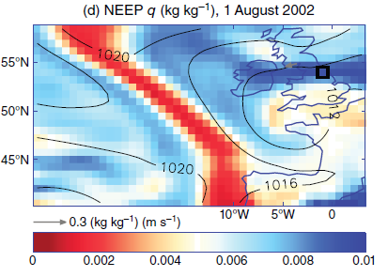
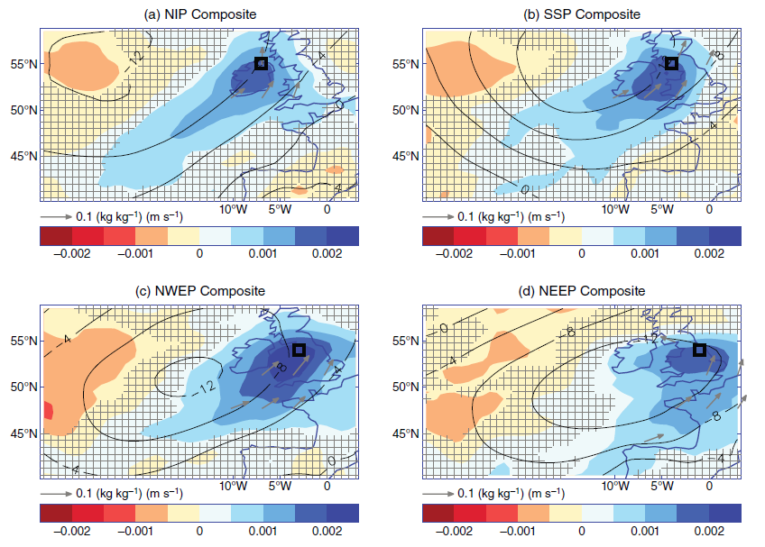
Annual Composites Summer Events
HadUKP gauge record
Allan et al. (2015) IJOC

Slide 5
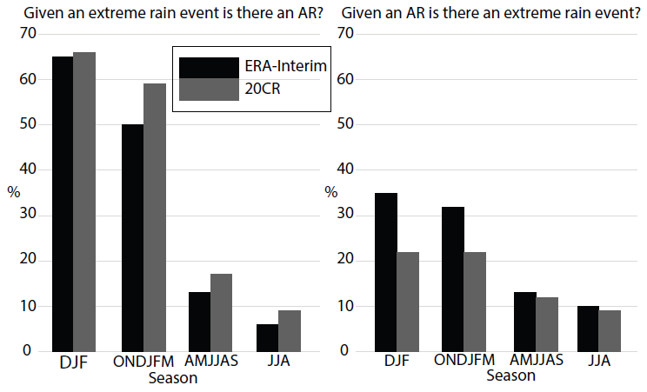
Role of Atmospheric rivers?
Daily raingauge data from MIDAS
90% threshold of UK daily rain
ERA-Interim (1979 - 2013) & 20CR (1900 – 2012) reanalyses
Summer results:
  <20% of extreme rain events identified had an associated AR.
  <10% of ARs produce extreme rain event.
Champion et al. (2015) JGR

Slide 6
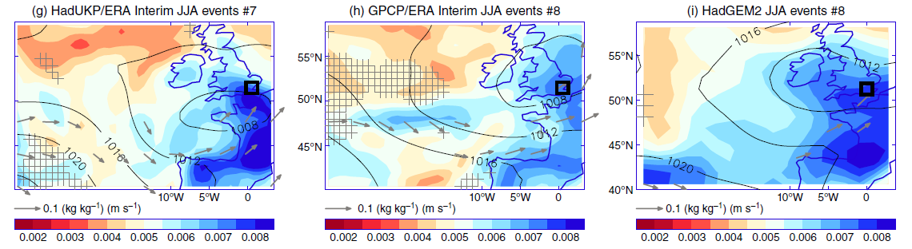
Moisture characteristics
What moisture characteristics are associated with heavy summer rainfall?
Gauge/satellite-based rainfall + reanalysis vs simulation
Composites for SE: Cyclonic flow, high continental moisture
Allan et al. (2015) IJOC see also Lavers et al. 2014 Nature Comm

Slide 7
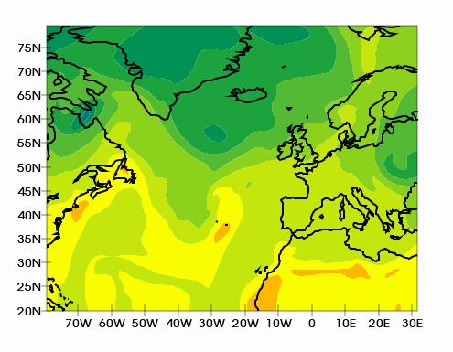
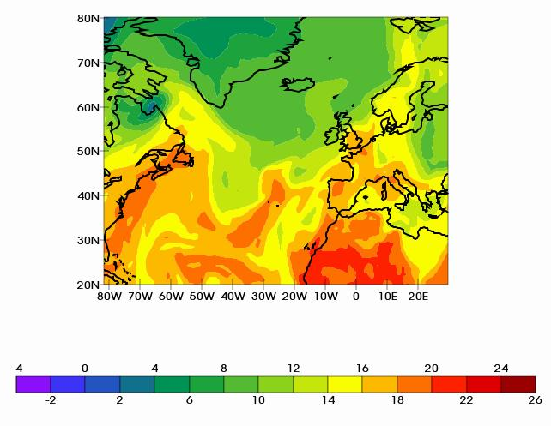
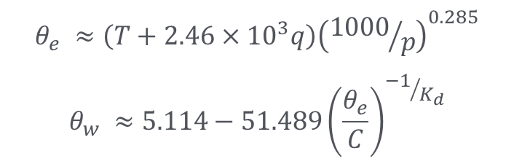

ST1.3 Ongoing work
Progressing to 3-hourly gauge data
Considering range of additional precursor diagnostics including stability-based metrics (e.g. wet bulb potential temperature)
What is the dependence on region/season/catchment type?
Can we use historical events data?
500 hPa
$$θ_{e} ≈\left(T+2.46×{10}^{3}q\right){\left({1000}/p\right)}^{0.285}$$
$$θ_{w} ≈5.114−51.489{\left(\frac{θ_{e}}{C}\right)}^{{−1}/{K_{d}}}$$
700 hPa
$$θw surrogate$$

Slide 8
Diagnostics under investigation
Integrated Water Vapour (IWV) - when the maximum exceeds the 85% threshold over the UK
Integrated Vapour Transport (IVT) - when the maximum exceeds the 85% threshold over the UK, no other relevance to ARs
Theta-e, Theta-w surrogates - the difference between 700hPa and 500hPa as a stability proxy
Warm moist ascents with a horizontal wind shear at upper levels (500hPa) - exactly how this will be defined is being worked out.
Reanalysis convective rainfall diagnostic as proxy of large-scale instability?
Extreme event?
Atmospheric precursor?

Slide 9
plans
Complications with AR study and in acquiring 3-hourly rain-gauge data have delayed work – sorry!
Progressing to 3-hourly rain gauge data & additional precursor diagnostics (e.g. dew point & wet bulb potential temperature)
Finalise and apply set of precursor diagnostics and case studies for initial analysis of atmospheric precursors to extreme rainfall/flooding events using reanalysis datasets and hourly/3-hourly rain gauge data in collaboration with Newcastle → paper
Plan for further study assessing regional/temporal /catchment characteristic dependence of atmospheric precursors
Continue to work with Newcastle & partners to collaborate on datasets (hourly rain-gauge data and potentially flooding impacts information), precursor diagnostics and assessing spatiotemporal clustering of events

Slide 10
Outputs/Deliverables
Dissemination: Various talks on SINATRA work (e.g. EMS conference)
Outreach: schools events, talks to general public, development of online courses, twitter, media interviews
Additional Activities:
- Meetings with FFC, Nigel Roberts and Newcastle to discuss diagnostics
- 2 MSc projects: daily/hourly rain gauge datasets (inc. link to XL Catlin)
Publications/Reports:
Champion, A.J., R.P. Allan and D.A. Lavers, (2015) Atmospheric Rivers don't explain UK Summer Extreme Rainfall, Journal of Geophysical Research, 120, 6731-6741, doi: 10.1002/2014JD022863
Allan, R. P., D. A. Lavers and A. J. Champion (2015), Diagnosing links between atmospheric moisture and extreme daily precipitation over the UK, Int. J. Climatol., in press, doi: 10.1002/joc.4547.
Allan R.P. (2015) Scientific Knowledge of Meteorological Drivers of Widespread Flooding, report to JBA/Environment Agency

