Slide 1
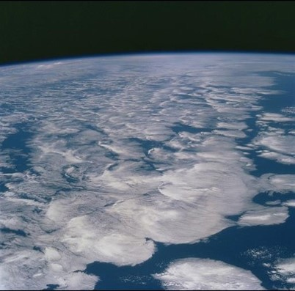



Earth’s radiation budget
Department of Meteorology
Richard Allan r.p.allan@reading.ac.uk @rpallanuk

Slide 2
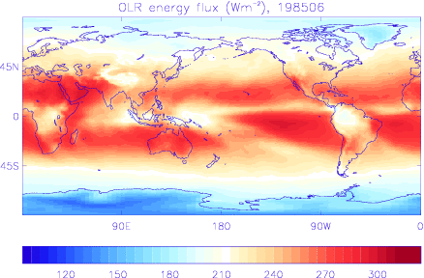
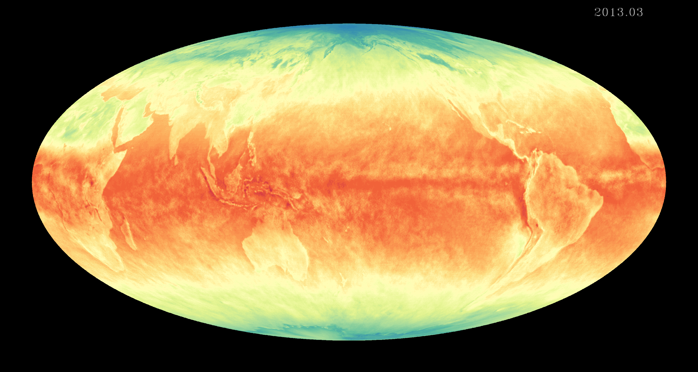
introduction
Earth's energy budget determines trajectory and magnitude of climate change
Both a powerful constraint on and diagnostic of the water cycle globally and regionally
Flows of energy and moisture between land and ocean, northern and southern hemispheres and high/low latitudes are fundamental for determining the climate characteristics societies depend upon
How is Earth’s energy imbalance currently changing and what are the implications for the global water cycle?

Slide 3
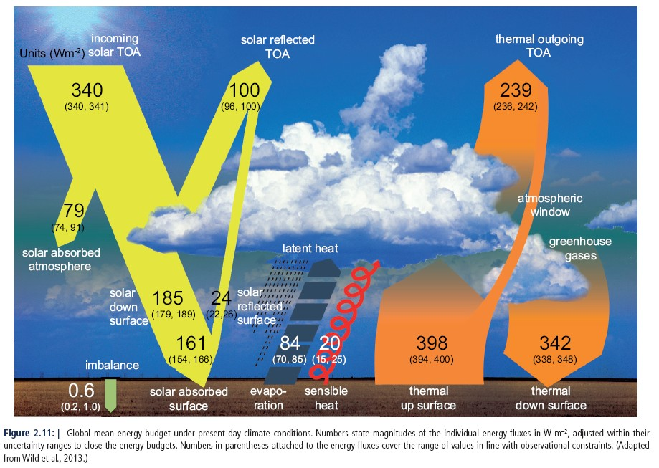
Earth’s Global annual average energy budget
IPCC AR5 WG1 Fig. 2.11

Slide 4
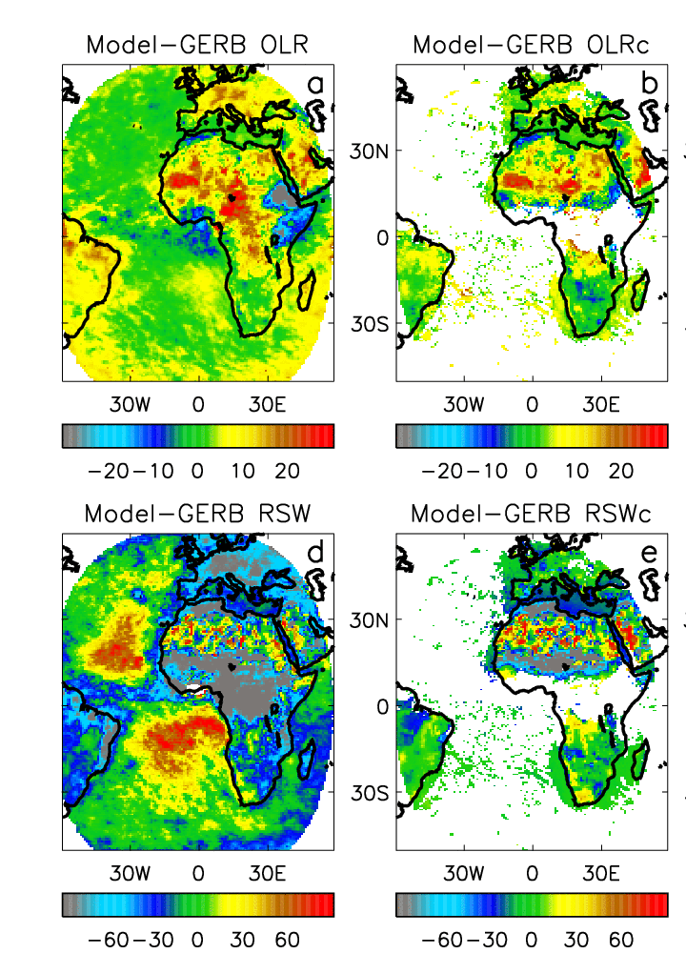
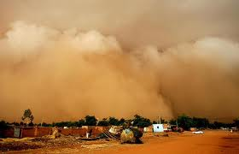
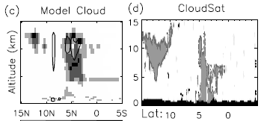


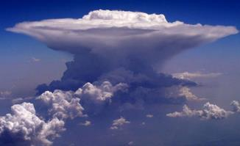
All-sky Clear-sky
Convective outflow
Mineral dust
Shortwave Longwave
Using GERB data to identify systematic model biases
Surface albedo
Convective cloud
Marine stratocumulus
Allan et al. (2007) QJRMS

Slide 5
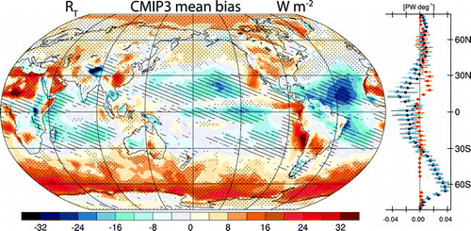
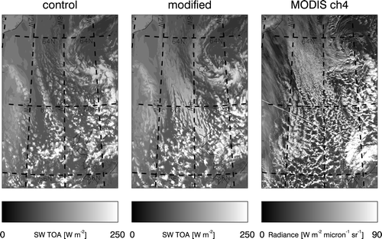
What causes
Systematic model bias in southern ocean?
Assessing cloud properties and radiative forcing relating to cold air outbreaks (e.g. Trenberth & Fasullo, 2010; Karlsson & Svensson, 2011 ; Bodas-Salcedo et al., 2012;
← Field et al. 2014)

Slide 6
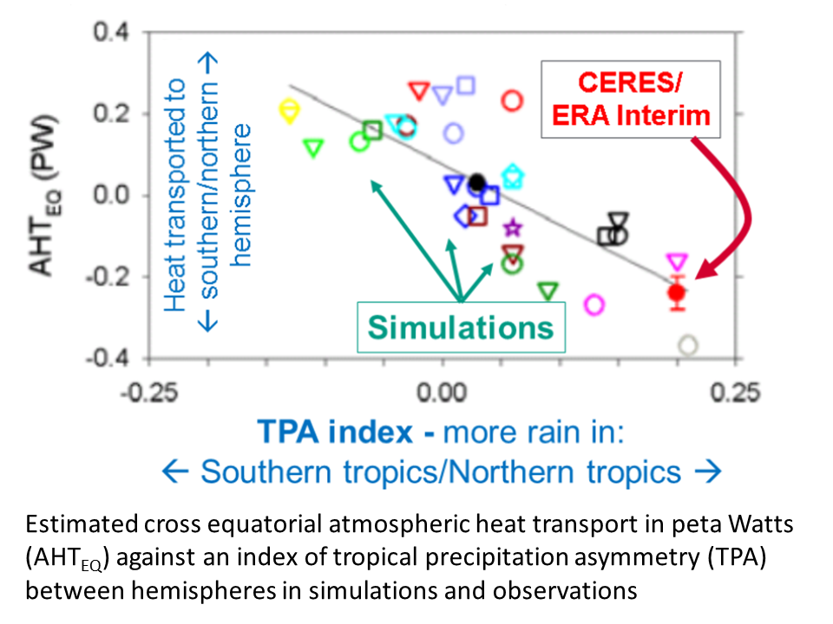
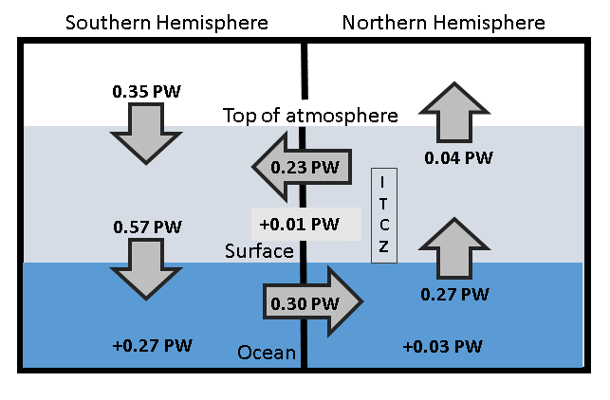
What are causes/consequences of hemispheric asymmetry in energy budget?
Link between bias in cross-equatorial heat transport by atmosphere and inter-hemispheric precipitation asymmetry; Frierson et al. (2013) Nature Geosci ; Haywood et al. (2016) GRL; Stephens et al. (2015) Rev Geophys
Above: Loeb et al. (2016) Clim. Dyn
Right: hemispheric energy budget based
upon Liu et al. (2015) JGR →

Slide 7
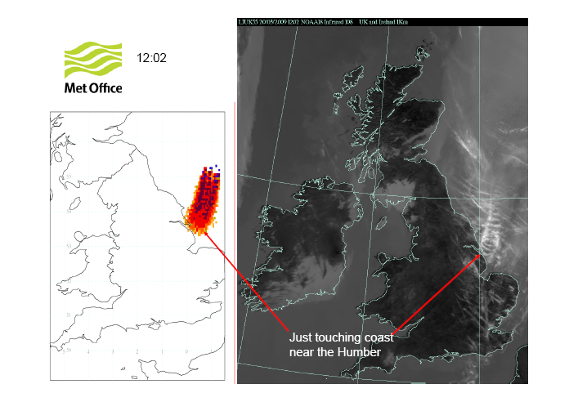
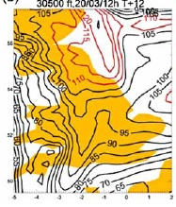
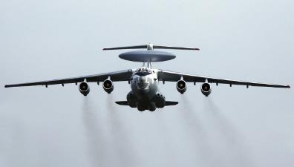
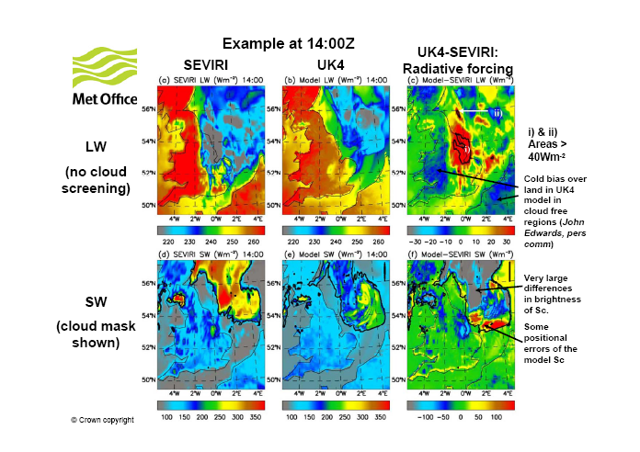
What is Radiative forcing of contrail cirrus?
ECMWF predicted Super-saturation
Haywood et al. (2009) JGR

Slide 8
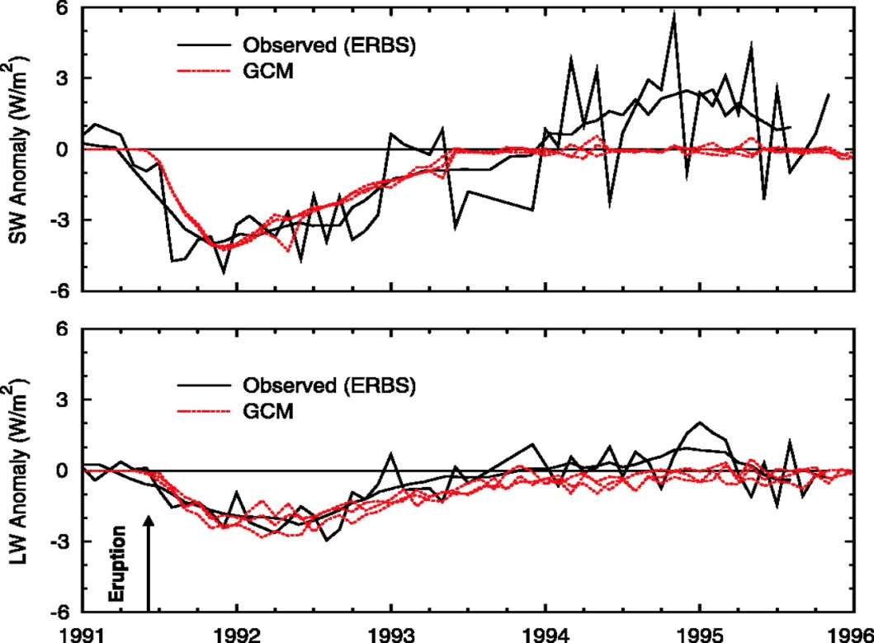
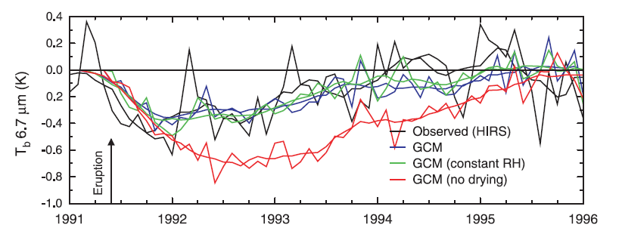
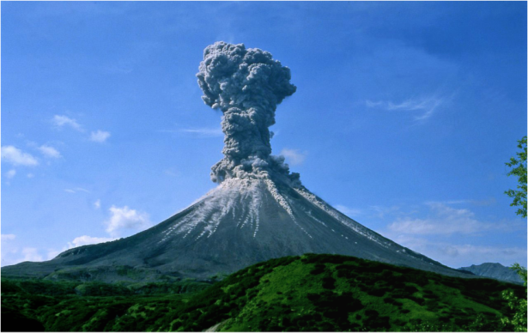
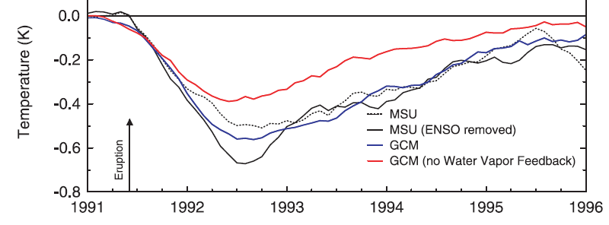
are simulated forcings/feedbacks realistic?
Radiative forcing by 1991 eruption of Mt. Pinatubo
Resulting cooling drives decreased water vapour in upper troposphere
Diminished greenhouse effect amplifies cooling
Climate model simulates cooling realistically due to realistic water vapour feedback
Soden et al. (2002) Science

Slide 9
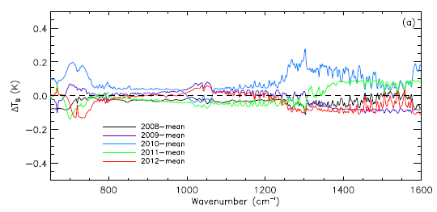
What is Spectral signature of climate change?
Harries et al. 2001, Nature
Left: Increased greenhouse gas forcing 1970-97
Below: inter-annual spectral variability from IASI (Brindley et al. 2015 J. Clim)
Far infra-red <500 cm⁻¹?
← infra-red spectrum (cm⁻¹) →
?

Slide 10
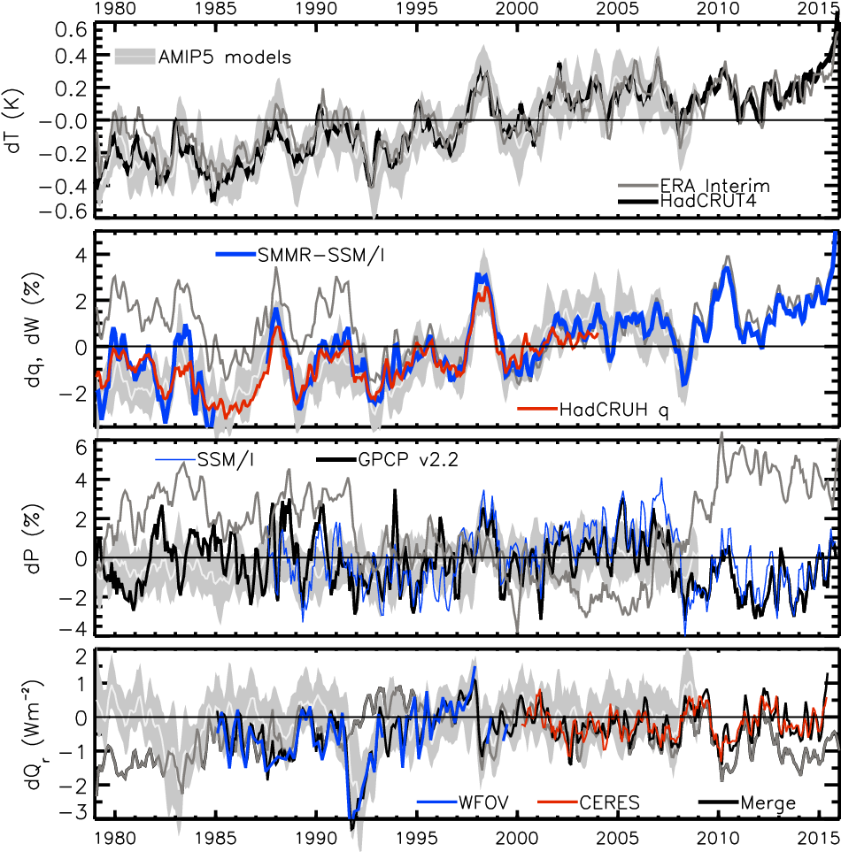
How is earth’s radiation budget & climate changing?
SURACE TEMPERATURE (K)
Wm⁻²
2.3
1.8
1.3
0.8
0.3
-0.2
-0.7
-1.2
-1.7
NET RADIATION ANOMALY (Wm⁻²)
Update from Loeb et al. (2012) Nature Geoscience & Allan et al. (2014) GRL

Slide 12
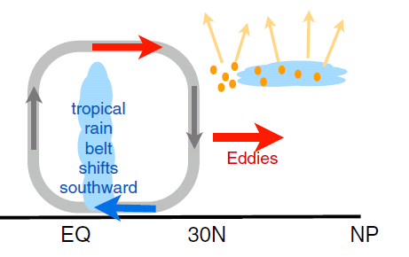
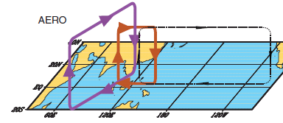
earth’s energy budget & regional changes in the water cycle
Regional precipitation changes sensitive to asymmetries in Earth’s energy budget
N. Hemisphere cooling: less heat transport out of hemisphere
Reduced Sahel rainfall from:
Anthropogenic aerosol cooling 1950s-1980s: Hwang et al. (2013) GRL →
Asymmetric volcanic forcing e.g. Haywood et al. (2013) Nature Climate
Enhanced energy transport
cooling
Anomalous heat fluxes
Sulphate aerosol effects on Asian monsoon e.g. Bollasina et al. 2011 Science (left)
Links to drought in Horn of Africa? Park et al. (2011) Clim Dyn
GHGs & Sahel rainfall recovery?
Dong & Sutton (2015) Nature Clim.

Slide 13
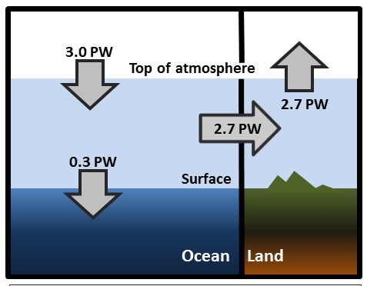
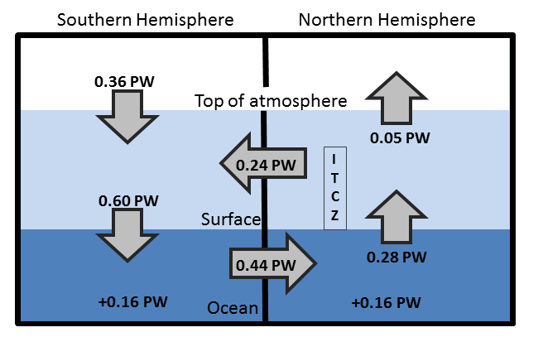
Observed Asymmetry in earth’s energy budget
Adapted from Liu et al. (2015) JGR (above) & Loeb et al. (2015) Clim. Dyn. (left)
Observed inter-hemispheric imbalance in Earth’s energy budget
Not explained by albedo: brighter NH surface but more clouds in SH (Stephens et al. 2015)
Inter-hemispheric heat transports determine and are influenced by position of ITCZ (e.g. Frierson et al. 2013)

Slide 14
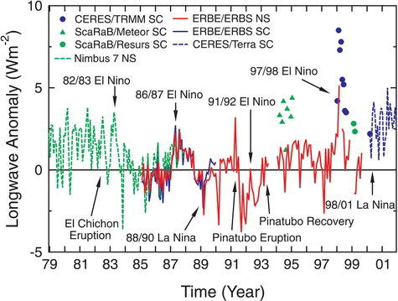
How is earth’s energy balance changing & what are implications?
20°N-20°S
Wong et al. (2006) J Clim; Wielicki et al. (2002) Science

Slide 15
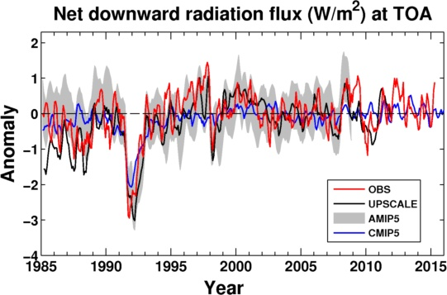
Net Imbalance Anomaly (Wm⁻²)
How is EARTH’s ENERGY BALANCE CHANGING?
Imbalance: 0.21 0.02 0.82 0.67 0.67 0.61 (Wm⁻²)
0.35±0.67 Wm⁻²
0.65±0.43 Wm⁻²
La Niña
El Niño
Volcano
Allan et al. (2014) GRL
See also: Wielicki et al. (2002) Science; Wong et al. (2006) J Climate; Harries & Belotti (2010) J. Climate ; Loeb et al. (2012) Nature Geosci

Slide 16
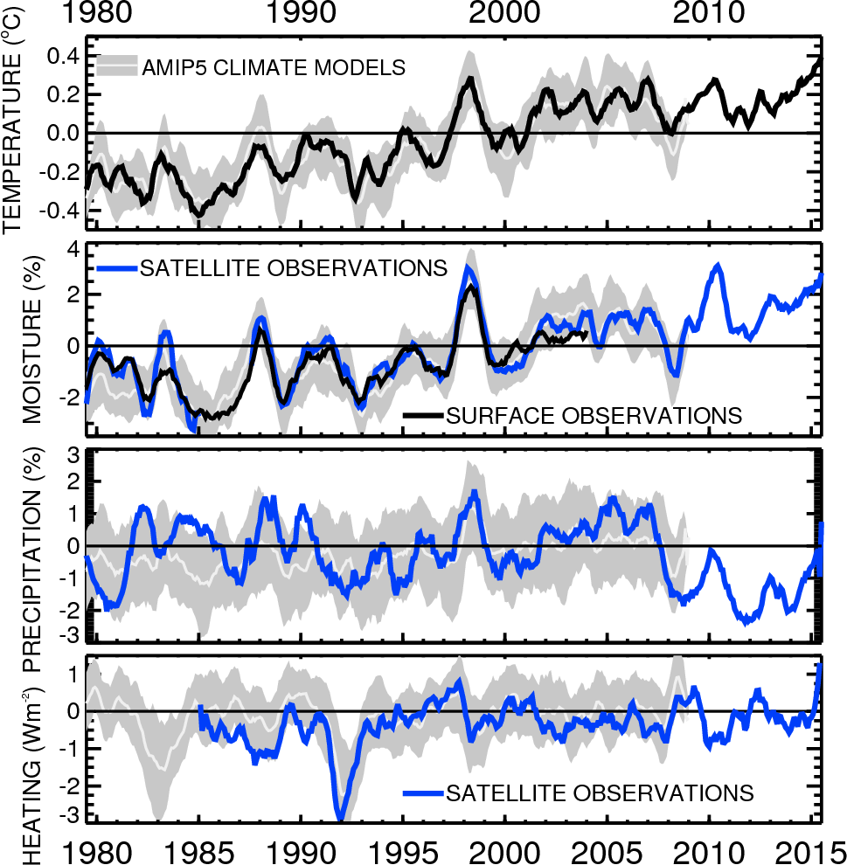

Slide 17
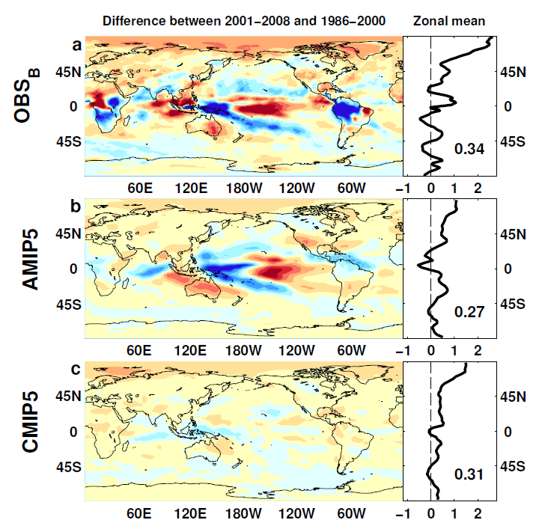

Outgoing Longwave Radiation
Wm⁻²

Slide 18
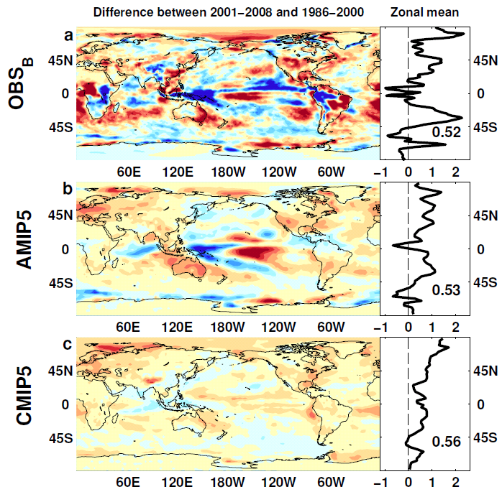
Absorbed Shortwave Radiation
Wm⁻²

Slide 19
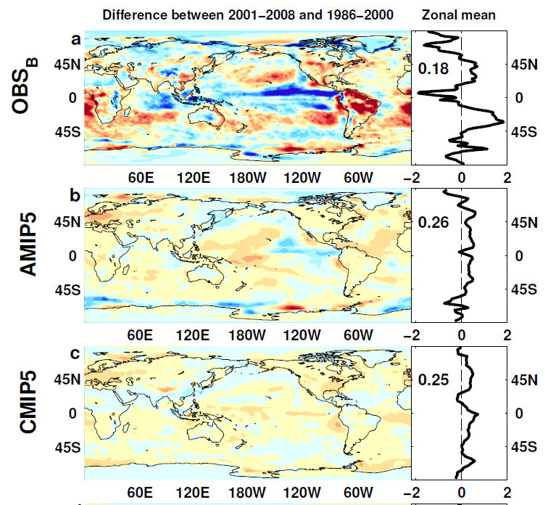

NET Radiation

