Slide 1
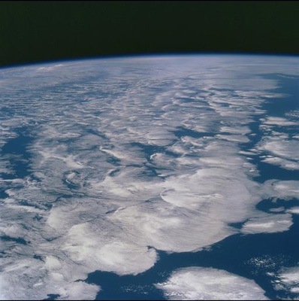





How confident are we in the response of the global water cycle to climate change?
Richard P. Allan r.p.allan@reading.ac.uk @rpallanuk
Department of Meteorology, University of Reading, UK
Thanks to: Chunlei Liu, Matthias Zahn, David Lavers, Brian Soden, Viju John
Notes:
ROYAL SOCIETY TALK:
~20 slides.
How confident are we that:
Precipitation is going to increase globally? – radiation, fast/slow
Heavy rainfall will become more intense? – thermodynamics, rivers, feedback?
Wet regions/seasons will get wetter, dry drier – thermodynamics and fast/slow
Regional changes in runoff/soil moisture? – evaporation, catchment specific?, circulation
Local changes (e.g. UK, river catchments) – role of aerosol and feedbacks, circulation, Sahel example
Scott Power, Nigel Arnell (plus Kevin Trenberth, Dennis Hartmann)
GRC talk:
30 mins + 10 minutes (20-25 slides?)
Energy balance (briefly)
Global precipitation
EBM – fast/slow responses
Andrews, etc
include Moyet study, Wu as well
Implications for global circulation
Inc Chadwick, Bony, …
Intense rainfall, wet dry regions…
Links to regional energy budgets (Muller & O’Gorman, Levermann)
Observational evidence?
Links to hiatus?

Slide 2
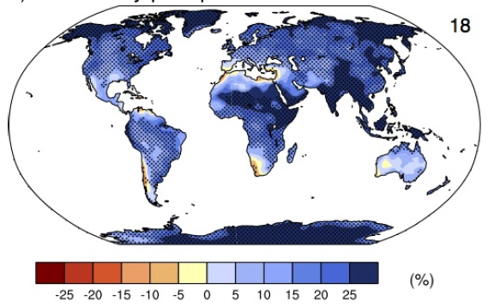
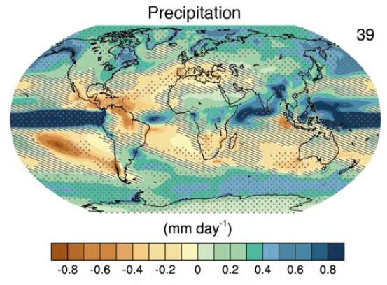
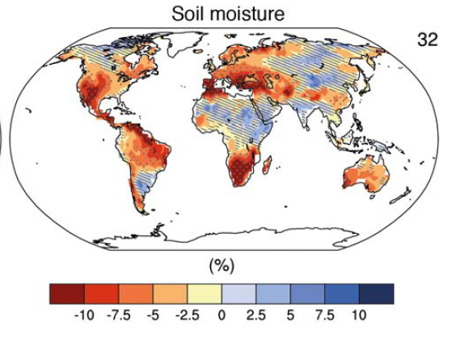
Climate model projections
Precipitation intensity
Increased Precipitation
More Intense Rainfall
More droughts
Wet regions get wetter, dry regions get drier?
Regional projections??
IPCC WGI (2013)
Notes:
PRECIPITATION: [Tech Summ Fig. 2]
RCP8.5 ANN: Multi-model CMIP5 average mm/day change.
Hatching: multi-model mean change is small (<1SD of internal variability)
Stippling: multi-model mean change is big (>2SD of internal variability and 90% of models agree on sign)
P INTENSITY:
Percent change in annual maximum 5-day precipitation 2081-2100 relative to 1981-2000 for RCP8.5 CMIP5 ensemble.
Fig. 12.26, Chapter 12.
Stippling → significant change
SOIL MOISTURE: [Tech Summ, Fig. 2]
RCP8.5 ANN change in %, Upper 10cm
Hatching: multi-model mean change is small (<1SD of internal variability)
Stippling: multi-model mean change is big (>2SD of internal variability and 90% of models agree on sign)

Slide 3
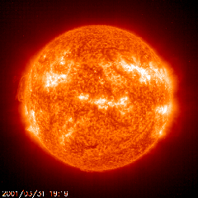

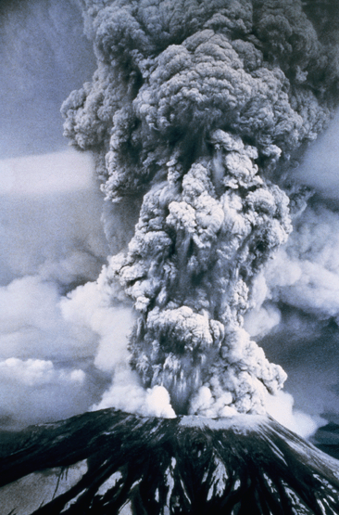
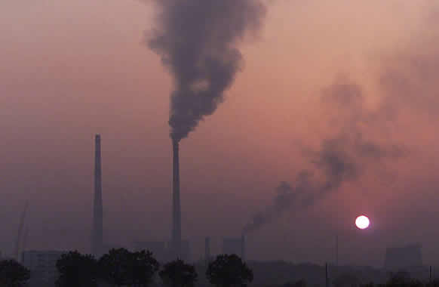
How will global precipitation respond to climate change?
Observations
Simulations:
Simulations:
RCP 8.5
Historical
RCP 4.5
Allan et al. (2013) Surv. Geophys
See also Hawkins & Sutton (2010) Clim. Dyn
Notes:
3
There is huge uncertainty in global precipitation projections, relating both to climate sensitivity and mitigation pathways.

Slide 4

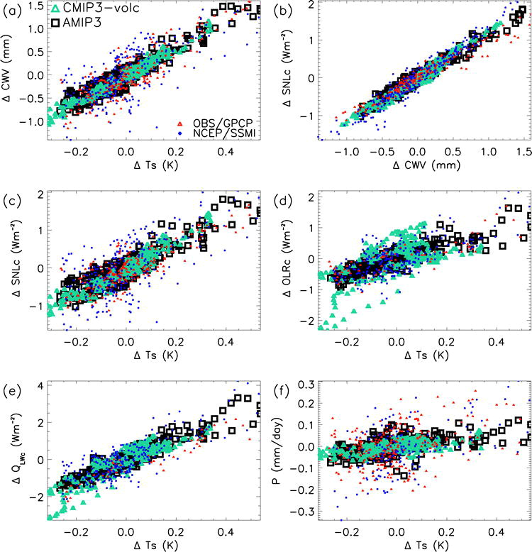
Confident global precipitation increases with warming
Enhanced atmospheric radiative cooling with warming
  Clear-sky dominates
  Model agreement
  Radiative transfer and thermodynamics
  Lambert & Webb (2008) GRL ; Previdi (2010) ERL ; Huang et al. (2013) J Clim
Energy balance constrains increase in precipitation
Δ clear-sky LW radiative cooling (Wm⁻²)
Allan (2009) J. Clim
  e.g. Allen and Ingram (2002) Nature ; Stephens & Ellis (2008) J. Clim ; O’Gorman et al. (2012) Surv. Geophys

Slide 5
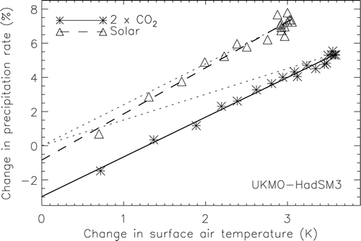
Improved understanding: radiative forcing & precipitation response
Andrews et al. (2009) J Climate
See also: Allen and Ingram (2002) Nature ; O’Gorman et al. (2012) Surv. Geophys ; Pendergrass & Hartmann (2012) GRL
Notes:
5

Slide 6
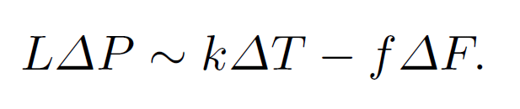
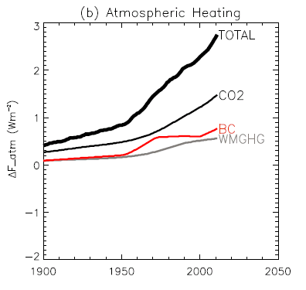
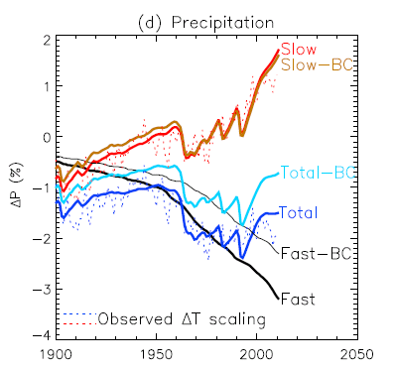
A simple model of precipitation change
direct radiative heating of troposphere
Allan et al. (2013) Surv. Geophys, using f calculated by Andrews et al. (2010) GRL ; see also Kvalevåg et al. (2010) GRL
Notes:
PLACEHOLDER: GET ZAHRA TO PRODUCE NEW PLOT.

Slide 7
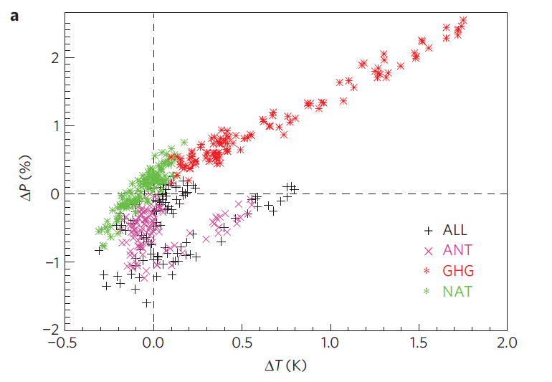
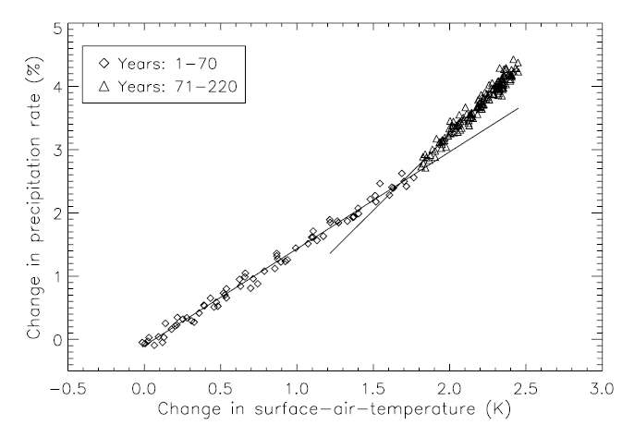
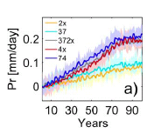
Implications for transient responses
GHG
NAT
ΔP →
ALL ANT
ΔT →
Wu et al. (2013) Nature-Climate
Above: GHG-aerosol influence on precipitation
Left: precipitation ramp-up on CO₂ ramp-down
CMIP3 coupled model ensemble mean: Andrews et al. (2010) Environ. Res. Lett.
Degree of hysteresis determined by forcing related fast responses and linked to ocean heat uptake
Work also by: McInerney & Moyer ; Schaller et al. (2013) ESDD

Slide 8
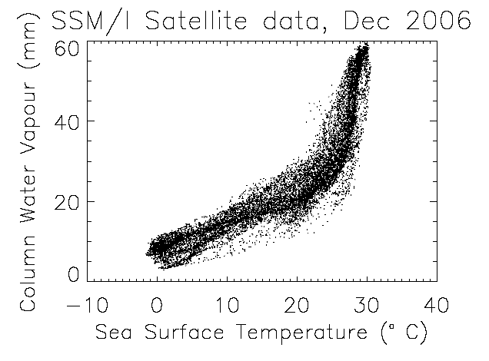
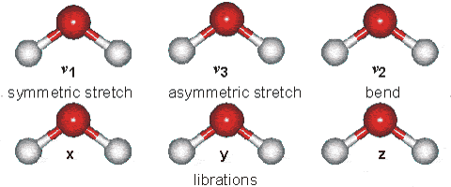
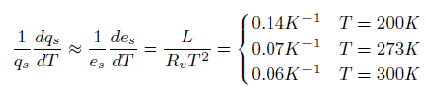
The role of water vapour
Physics: Clausius-Clapeyron
Low-level water vapour concentrations increase with atmospheric warming at about 6-7%/K
  Wentz & Shabel (2000) Nature; Raval & Ramanathan (1989) Nature

Slide 9

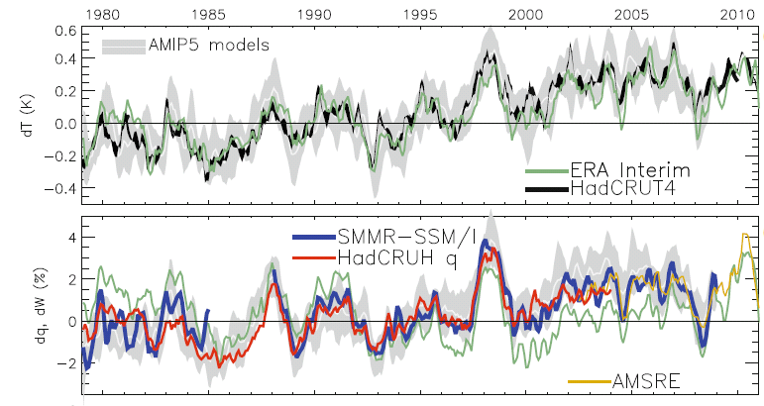
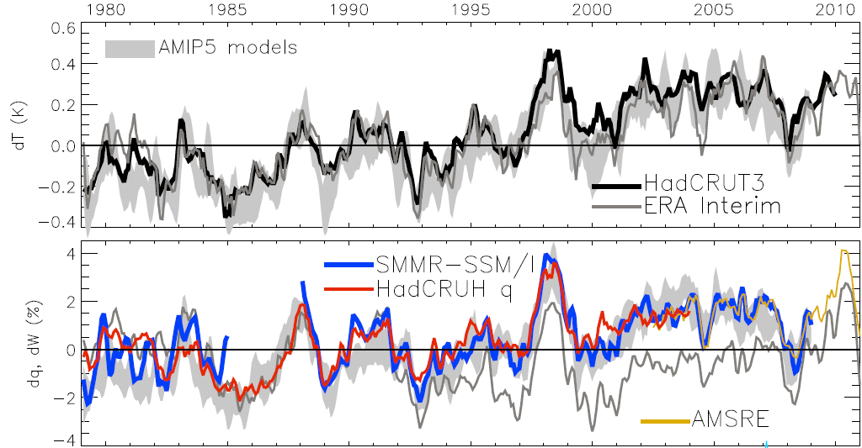
Global changes in water vapour
Water Vapour (%) Surface Tempertaure (K)
dW/dT ≈ 7%/K
≈ 1%/decade
Allan et al. (2013) Surv. Geophys
Global mean estimates (use SMMR-SSM/I, AMSRE and ERA Interim over land and high latitudes)
Notes:
The main point to note is that models and observations are consistent in showing increases in low level water vapour with warming. Reanalyses such as ERA Interim, which are widely used, are not constrained to balance their energy or water budgets.
For ocean-only satellite datasets I apply ERA Interim for poleward of 50 degrees latitude and for missing/land grid points.
Note that SSM/I F13 2003-2007 CWV = 24.7794 mm; AMSRE 2003-2007 CWV = 24.8850
9

Slide 10
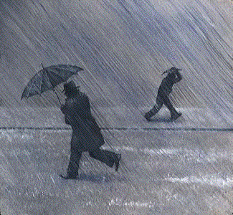
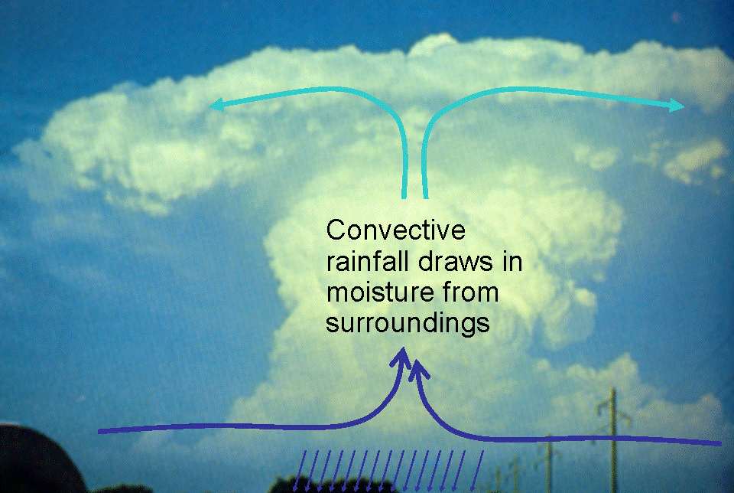
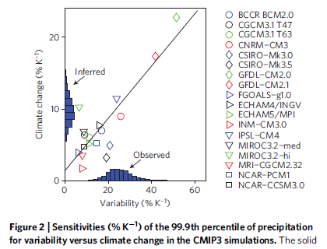
Extreme Precipitation
Moisture convergence fuels large-scale rainfall events
e.g. Trenberth et al. (2003) BAMS
Intensification of rainfall with warming
e.g. Allan & Soden (2008) Science
Amplifying latent heat feedbacks?
e.g. Berg et al. (2013) Nature Geo
Time/space scale important
Observational constraints? →
e.g. O’Gorman (2012) Nature Geosci; Liu & Allan (2012) JGR

Slide 11
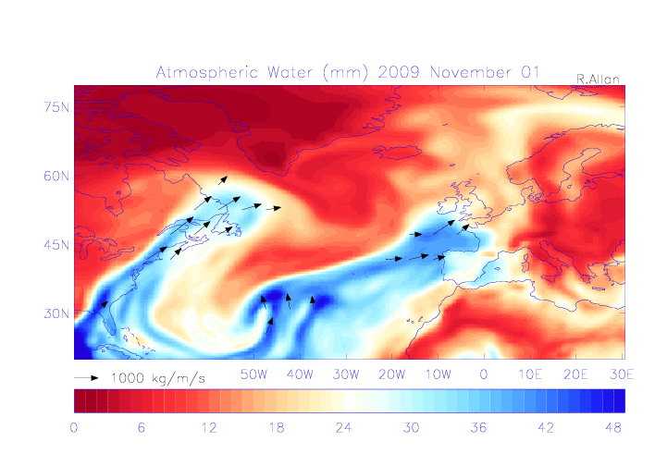
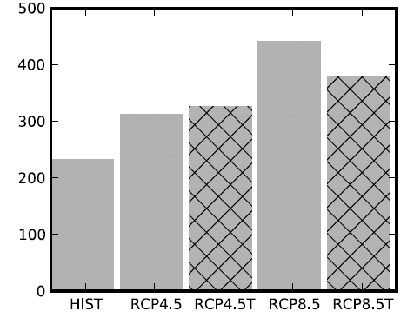
Linking flooding impacts to atmospheric precursors
UK winter flooding linked to strong moisture transport events
  Cumbria November 2009 (Lavers et al. 2011 GRL)
  “Atmospheric Rivers” (ARs) in warm conveyor
  Lavers et al. (2013) ERL
Future increase in moisture explains most (but not all) of intensification of AR events
  Confident in the mechanisms and physics involved
Number of ARs
NorESM1-M

Slide 12

Contrasting precipitation response expected
Heavy rain follows moisture (~7%/K)
Mean Precipitation linked to energy balance (~2-3%/K)
Precipitation →
Light Precipitation (-?%/K)
Temperature →
e.g. Allen and Ingram (2002) Nature ; Held & Soden (2006) J Climate

Slide 13
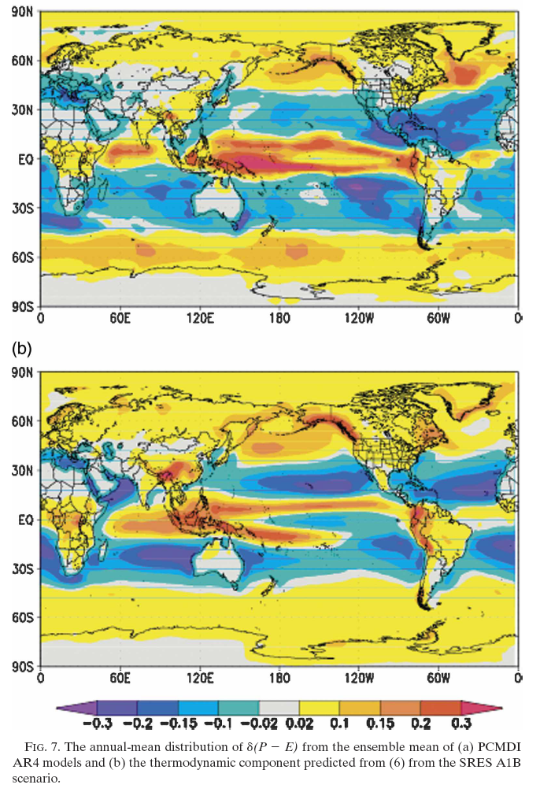

Moisture Balance
Enhanced moisture transport F leads to amplification of
(1) P–E patterns (left)
Held & Soden (2006) J Climate
(2) ocean salinity patterns
Durack et al. (2012) Science
≈
See also Mitchell et al. (1987) QJRMS

Slide 14
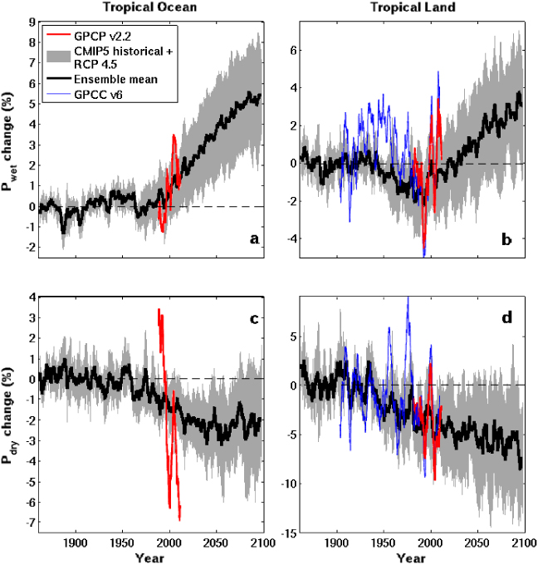

CMIP5 simulations: Wettest tropical grid-points get wetter, driest drier
Ocean Land
Wet land: strong ENSO influence
GPCC GPCP
Pre 1988 GPCP observations over ocean don’t use microwave data
dry tropical region wet
Precipitation Change (%)
Tropical dry Tropical wet
Robust drying of dry tropical land
30% wettest gridpoints vs 70% driest each month
Liu and Allan (2013) ERL; see also: Chou et al. (2013) Nature Geosci; Chadwick et al. (2013) J Clim ; Allan (2012) Clim. Dyn.
Notes:
HERE! TIMES TIME BY 1.86

Slide 15
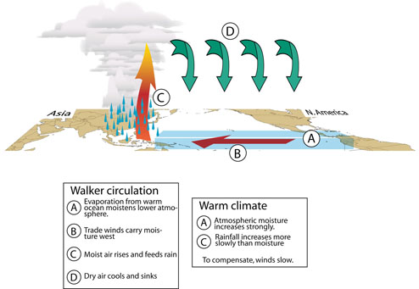
Circulation response
First argument:
P ~ Mq
So if P constrained to rise more slowly than q, this implies reduced M:
Bony et al. (2013) Nat Geosci Chadwick et al. (2012) J Clim
Second argument:
ω = Q/σ
Subsidence (ω) induced by radiative cooling (Q) but the magnitude of ω depends on static stability (σ = Г_{d} - Г).
If Г follows MALR → increased σ. This offsets Q effect on ω.
See Held & Soden (2006) and Zelinka & Hartmann (2010) JGR
ω = Q/σ
P ~ Mq
Q
ω
P
M
q
Schematic from Gabriel Vecchi
Notes:
15

Slide 16
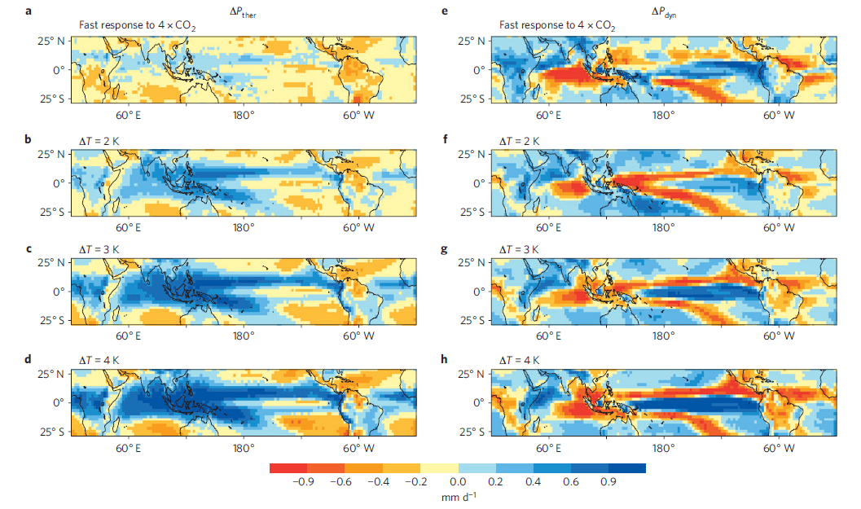
Walker circulation response to fast and slow precipitation effects
Thermodynamic response to warming Fast response to CO₂
Bony et al. (2013) Nature Geosciences Both fast and slow responses to CO₂ forcings induce reduced Walker circulation in response to P = Mq constraint
Reduced Walker circulation: Vecchi et al. (2006) Nature Recent strengthening of circulation? Merrifield (2011) J Clim; Sohn et al. (2011) Clim Dyn; L’Heureux et al. (2013) Nature Climate

Slide 17
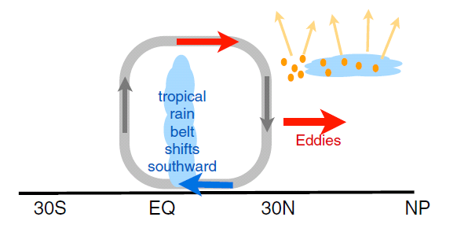
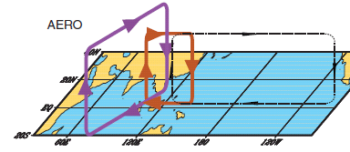
Aerosol & regional circulation response
N Hemisphere Aerosol cooling 1950-1980s
Induces southward movement of ITCZ
Reduced Sahel rainfall →
Recovery after 1980s e.g. Wild 2012 BAMS
+Asymmetric volcanic forcing e.g. Haywood et al. (2013) Nature Climate
Enhanced energy transport
cooling
Hwang et al. (2013) GRL
Sulphate aerosol effects on Asian monsoon e.g. Bollasina et al. 2011 Science
Links to Horn of Africa drought ? Williams et al. (2011) Clim Dyn

Slide 18


Challenge: Regional projections
Shifts in circulation systems are crucial to regional changes in water resources and risk yet predictability is often poor (but see Power et al. (2012) J Clim )
JJA DJF
How will jet stream positions and monsoons respond to warming? e.g. Levermann et al. (2009) PNAS
How will primary land-surface and ocean-atmosphere feedbacks affect the local response to global warming?

Slide 19

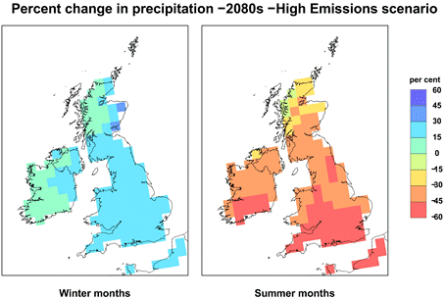

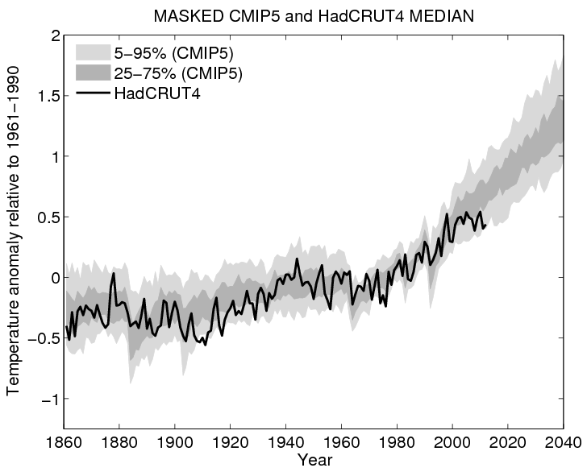
Outstanding Issues
Observing systems can’t monitor changes in precipitation & radiation adequately
Are regional responses predictable?
Will extreme precipitation outpace Clausius Clapeyron constraint?
What are changes in radiative forcings and their associated fast adjustments?
Implications for climate geoengineering
What is the effect of the global surface temperature hiatus on the water cycle?

Slide 20
Conclusions
Radiative energy balance is fundamental to climate response
Energy and moisture balance powerful constraints on global water cycle
Global precipitation rises with surface warming (~2-3%/K)
Direct effects of radiative forcing from greenhouse gases/ absorbing aerosol cause rapid adjustments in E and P (+cloud)
Current & future increases in wet and dry extremes
  Linked to rises in low-level moisture of about 7%/K
  Combined energy and moisture balance constraints via circulation
Aerosol radiative forcing appears key in determining global and circulation-driven precipitation responses
How SST patterns and the land surface respond to rising CO₂ is crucial for improving regional predictions

