Slide 1
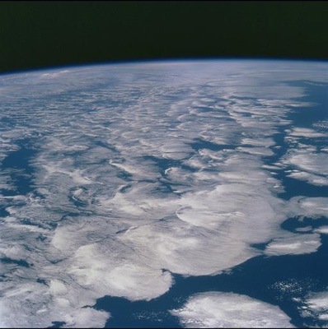




Current Changes in Earth’s Energy Imbalance and the Global Water Cycle
Richard P. Allan
University of Reading, Department of Meteorology NCAS-Climate/NCEO
Thanks to Chunlei Liu, David Lavers, Matthias Zahn, Norman Loeb, John Lyman, Greg Johnson, Brian Soden, Viju John
Notes:
This is the title slide, PowerPoint will automatically format the first slide with the title master, although this can be changed in the design palette.

Slide 2
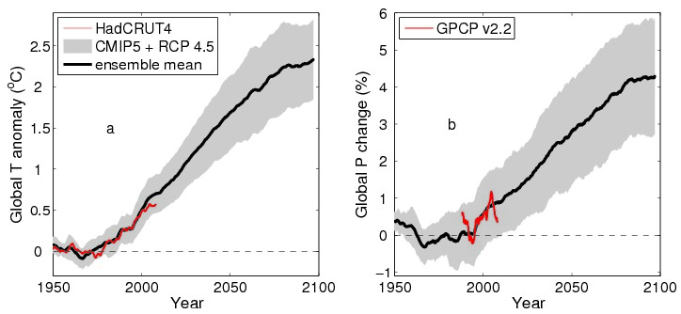
How is global climate change doing?
Part 1: Global Heating
Part 2: Global Water Cycle

Slide 3
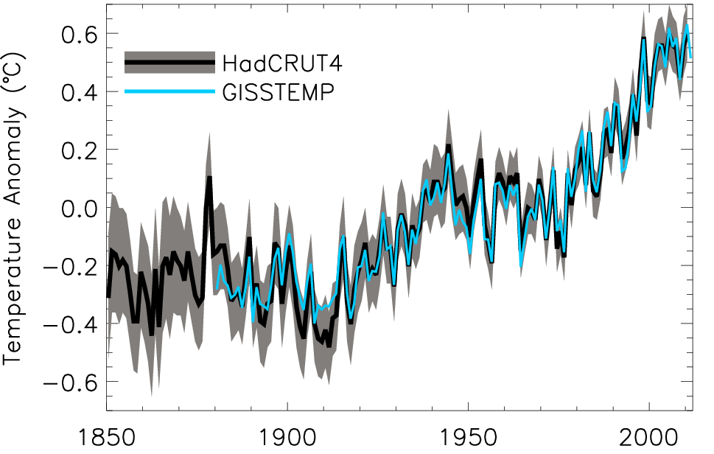
Decline in rate of surface warming?
Global annual average temperature anomalies relative to 1951–1980 mean (shading denotes lower and upper 95% uncertainty range for HadCRUT4)

Slide 4
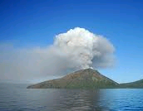
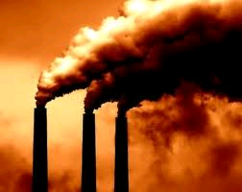
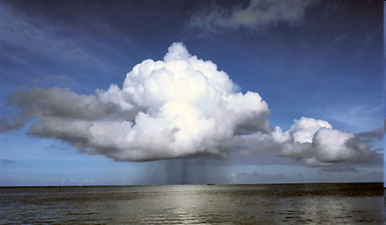
Radiative forcing or energy redistribution?
Small, persistent volcanic forcing?
  e.g. Solomon et al. (2011) Science
Sulphur emissions?
  e.g. Kaufmann et al. (2011) PNAS
Stratospheric water vapour?
  e.g. Solomon et al. (2010) Science
Solar output?
Cloud forcing/feedbacks & El Nino?
Ocean circulation e.g. Modelling studies:
  Meehl et al. (2011) Nature Climate Change , Palmer et al. (2010) GRL , Katsman and van Oldenborgh (2011) GRL

Slide 5
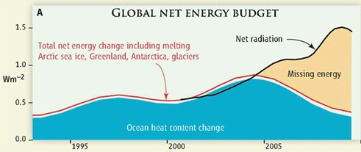
Missing energy?
Trenberth and Fasullo (2010, Science) highlighted an apparent large discrepancy between net radiation and ocean heat content changes
We undertook a reanalysis of the satellite and ocean record over the period 2000-2010…

Slide 6
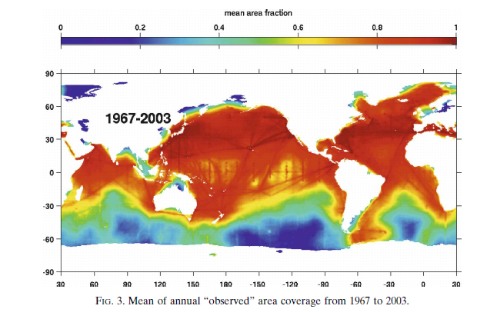
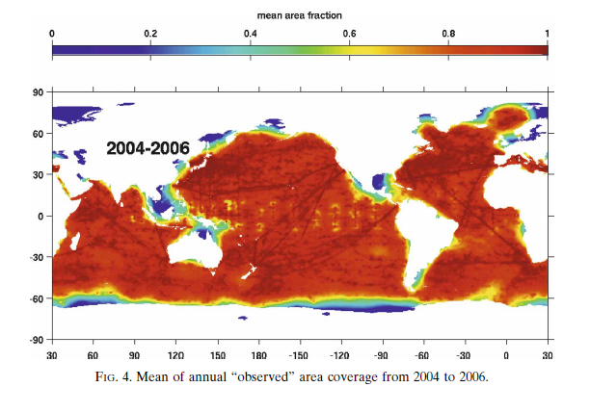
Ocean Heat Content data
Use weighted integral to account for changes in data coverage
Ensures transition to ARGO era does not introduce spurious variability
Integrate ocean heat content trend over time and divide by Earth’s surface area → Wm⁻²
Lyman & Johnson (2008) J Clim

Slide 7
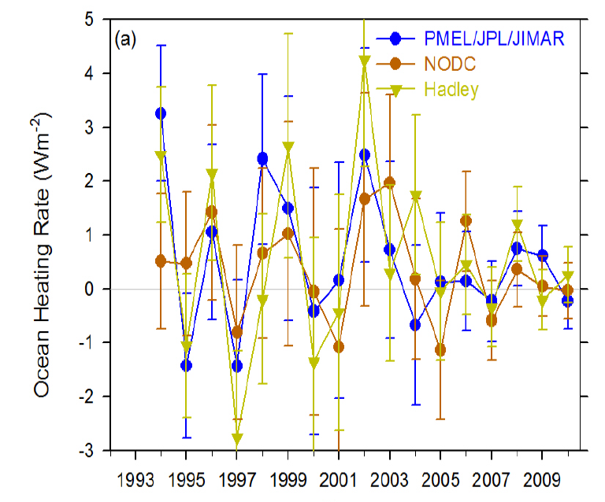
Ocean heat content data uncertainty
Accounting for considerable sampling/structural uncertainty we find no evidence for a robust decline in ocean heating rate since 2005
Loeb et al. (2012) Nat. Geosci

Slide 8
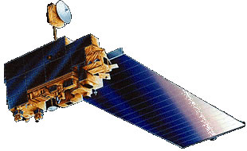
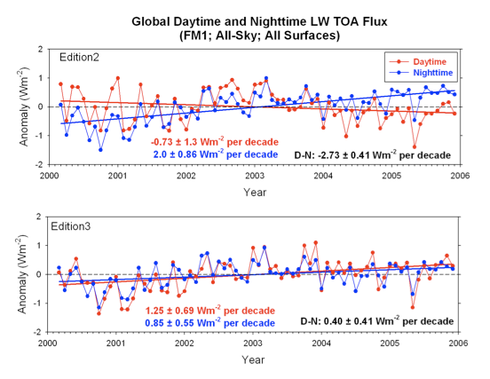
Updated CERES satellite data
Global Earth Radiation Balance
Correction for degradation of shortwave filter
Correction also improves physical consistency of trends in daytime longwave
We use version CERES_EBAF-TOA_Ed2.6r

Slide 9
Trends in net radiation
Errors in satellite sensors and inappropriate use of satellite products explain much of large rise in net radiative flux shown by Trenberth and Fasullo (2010)
global net radiation anomalies

Slide 10
Combining Earth Radiation Budget and Ocean Heat Content data
Tie 10-year CERES record with SORCE TSI and ARGO-estimated heating rate 2005-2010
Best estimates for additional storage terms
Variability relating to ENSO reproduced by CERES and ERA Interim
Estimate of decade long net energy imbalance of 0.50±0.43 Wm^{–2}
Loeb et al. (2012) Nat. Geosci. See also Hansen et al. (2011) ACP
Notes:
Fi gure 3 (a) Global annual average net TOA flux from CERES observations and (b) ERA Interim reanalysis are anchored to an estimate of Earth’s heating rate for 2006–2010 ⁵ The Pacific Marine Environmental Laboratory/Jet Propulsion Laboratory/Joint Institute for Marine and Atmospheric Research (PMEL/JPL/JIMAR) ocean heating rate estimates⁴ use data from Argo and World Ocean Database 2009; uncertainties for upper ocean heating rates are given at one-standard error derived from sampling uncertainties. The gray bar in (b) corresponds to one standard deviation about the 2001–2010 average net TOA flux of 15 CMIP3 models.

Slide 11
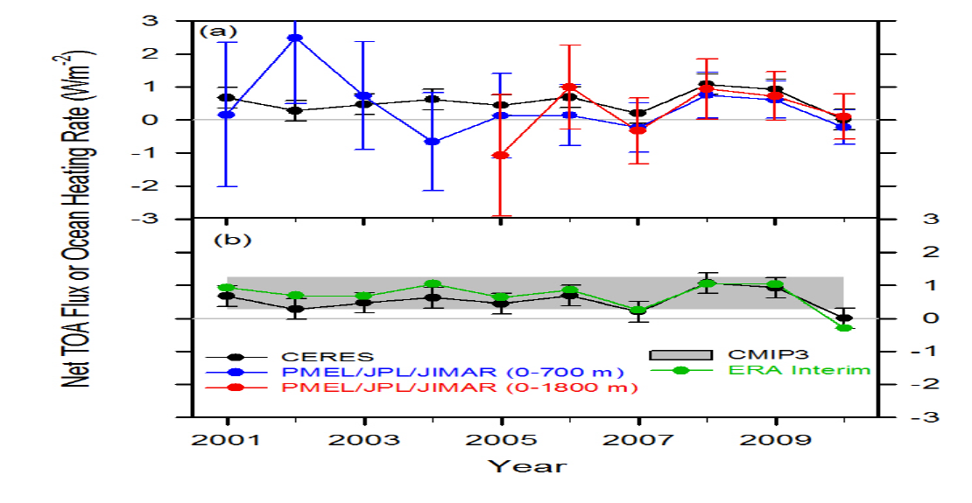
Combining Earth Radiation Budget and Ocean Heat Content data (2)
Replotted so that CERES and ERA Interim sample 6-months later than ARGO
Is there a lag in the system?
Where in ocean is energy accumulating?
Mechanism?
Notes:
Fi gure 3 (a) Global annual average net TOA flux from CERES observations and (b) ERA Interim reanalysis are anchored to an estimate of Earth’s heating rate for 2006–2010 ⁵ The Pacific Marine Environmental Laboratory/Jet Propulsion Laboratory/Joint Institute for Marine and Atmospheric Research (PMEL/JPL/JIMAR) ocean heating rate estimates⁴ use data from Argo and World Ocean Database 2009; uncertainties for upper ocean heating rates are given at one-standard error derived from sampling uncertainties. The gray bar in (b) corresponds to one standard deviation about the 2001–2010 average net TOA flux of 15 CMIP3 models.

Slide 12
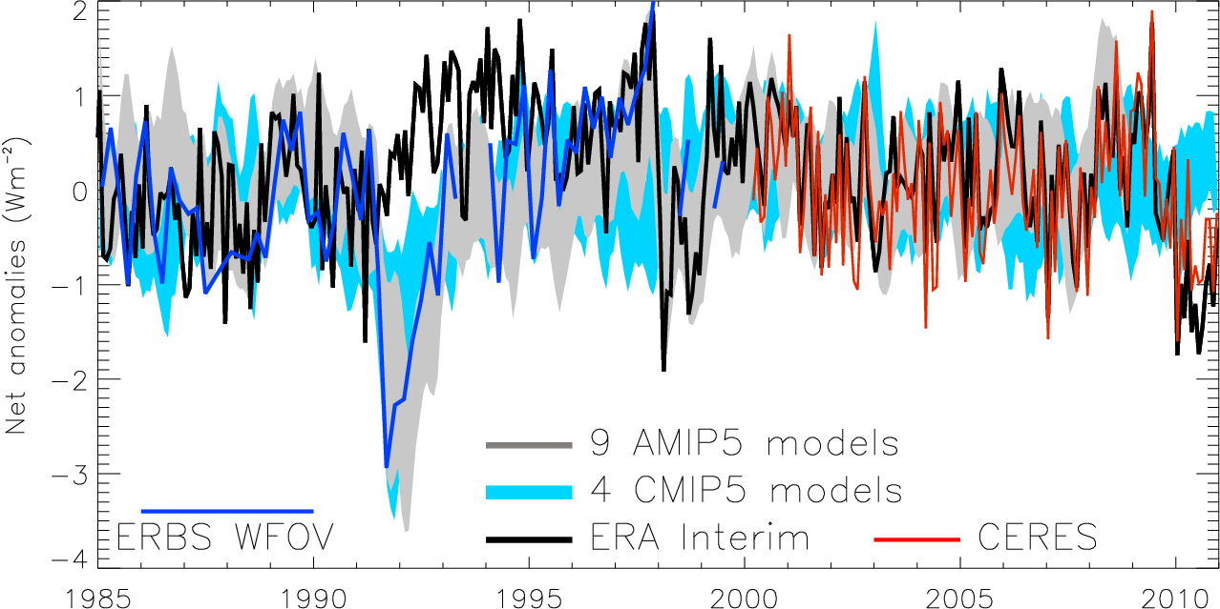
Variation in net radiation since 1985
60S-60N, after Allan (2011) Meteorol. Apps
Notes:
Deseasonalised monthly anomalies of net radiation (60ºS-60ºN) from satellite data (ERBS WFOV; CERES) and reanalysis simulations (ERA Interim) updated from ref 6 to include CMIP5 climate model simulations (AMIP 5 simulations from CNRM, NorESM1, HadGEM2 and INMCM4 in grey and combined historical and RCP4.5 scenario coupled simulations from CNRM, CanESM, HadGEM2-ES and INMCM4 in blue shading). CERES has been updated to EBAF2.6 and ERA Interim to 1985-2010.

Slide 13
Conclusions (1)
Previously highlighted “missing energy” explained by ocean heat content uncertainty combined with inappropriate net radiation satellite products
Heating of Earth continues at rate of ~0.5 Wm⁻²
  Negative radiative forcing does not appear to contribute strongly
Implications/mechanisms?
  Energy continues to accumulate below the ocean surface
  Strengthening of Walker circulation, e.g. Merrifield (2011) J Clim?
  Implications for hydrological cycle, e.g. Simmons et al. (2010) JGR?
New NERC project: Diagnosing Earth’s Energy Pathways in the Climate System (DEEP-C)
  + NOC Southampton/Met Office/Jonathan Gregory/Till Kuhlbrodt)

Slide 14
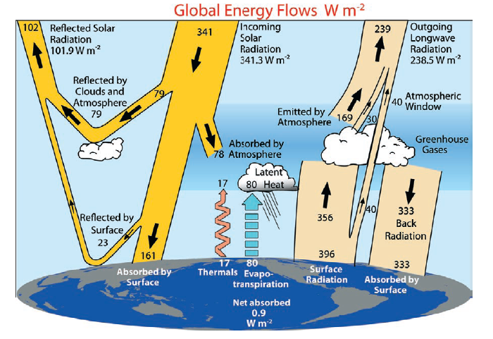
What has Earth’s Energy Budget got to do with current changes in the Global Water Cycle?
338-348
0.6
LH ~ 80-90
Trenberth et al. (2009) BAMS, but see update by Wild et al. (2012) Clim. Dynamics

Slide 15
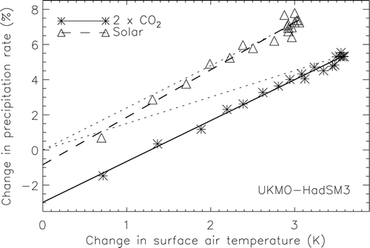
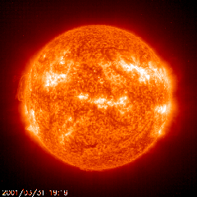
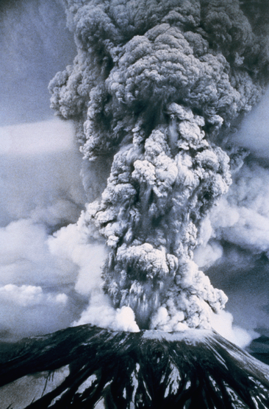
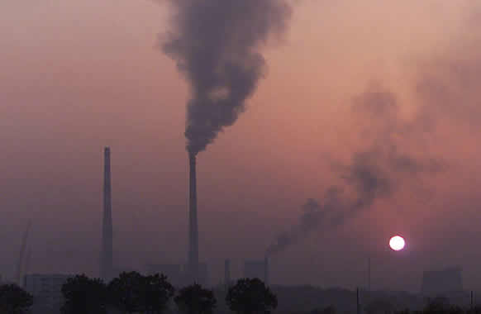
Direct influence of radiative forcing and climate response on precipitation changes
Andrews et al. (2009) J Climate
Notes:
15
CO2 heats the atmosphere increasing stability and reducing precipitation while solar changes have a smaller effect. While the model response to temperature increases in consistent, based upon the enhanced net radiative cooling of a warmer atmosphere, the response of the water cycle to a complex pattern of forcing is less clear. Observations of surface and top of atmosphere radiation from CERES and GERB will address this question.

Slide 16
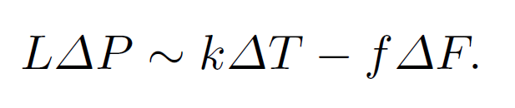
Energetic constraint upon global precipitation
(i) k ~ 2 Wm⁻²K⁻¹
(ii) f dependent upon type of radiative forcing ΔF
Precipitation change ΔP determined by:
“slow” response to warming ΔT (enhanced radiative cooling of warmer troposphere)
“fast” direct influence of radiative forcing on tropospheric energy budget (rapid adjustment)
See Allen and Ingram (2002) Nature for detailed discussion

Slide 17
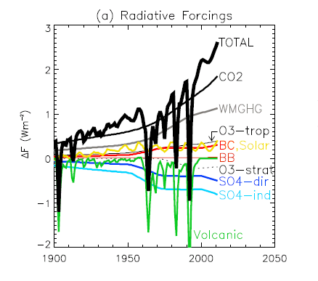
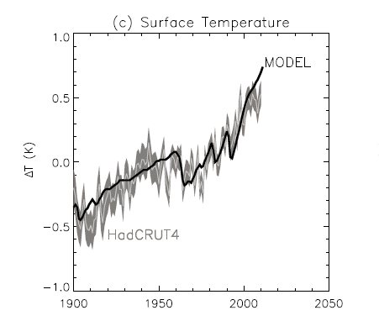
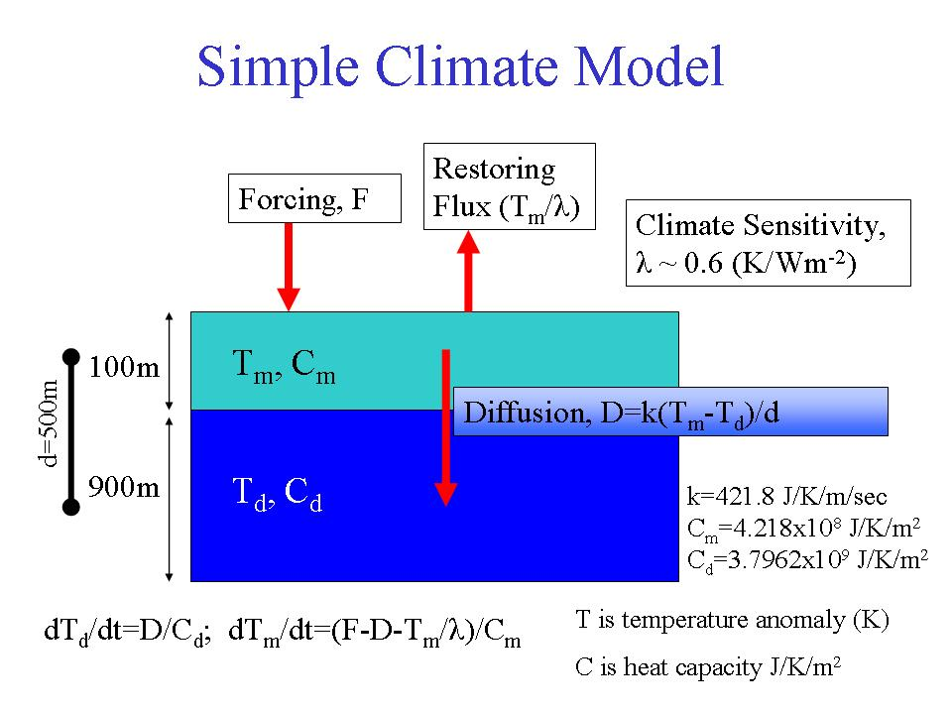
A simple model of precipitation change
Thanks to Keith Shine and Evgenios Koukouvagias

Slide 18
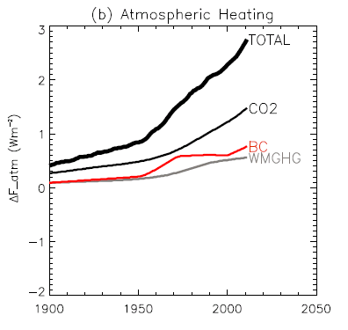
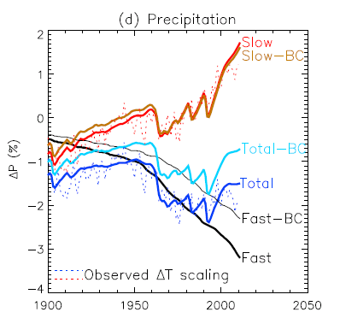
A simple model of precipitation change
direct radiative heating of troposphere
Allan et al. (2013) Surv. Geophys, using calculations from Andrews et al. (2010) GRL
Thanks to Keith Shine and Evgenios Koukouvagias

Slide 19

How will global precipitation respond to climate change?
Observations
Simulations:
Simulations:
RCP 8.5
Historical
RCP 4.5
See also Hawkins & Sutton (2010) Clim. Dyn
Notes:
19
There is huge uncertainty in global precipitation projections, relating both to climate sensitivity and mitigation pathways.

Slide 20

Climate model projections
Precipitation Intensity
Increased Precipitation
More Intense Rainfall
More droughts
Wet regions get wetter, dry regions get drier?
Regional projections??
Dry Days
Precipitation Change (%)
IPCC WGI (2007)

Slide 21
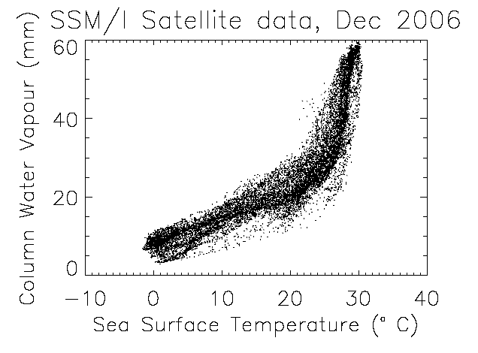
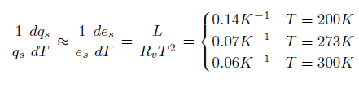
The role of water vapour
Physics: Clausius-Clapeyron
Low-level water vapour concentrations increase with atmospheric warming at about 6-7%/K
  Wentz and Shabel (2000) Nature; Raval and Ramanathan (1989) Nature

Slide 22
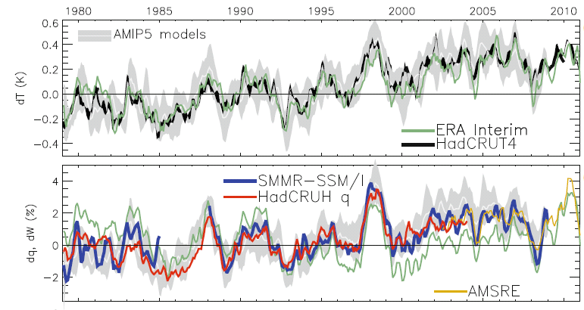
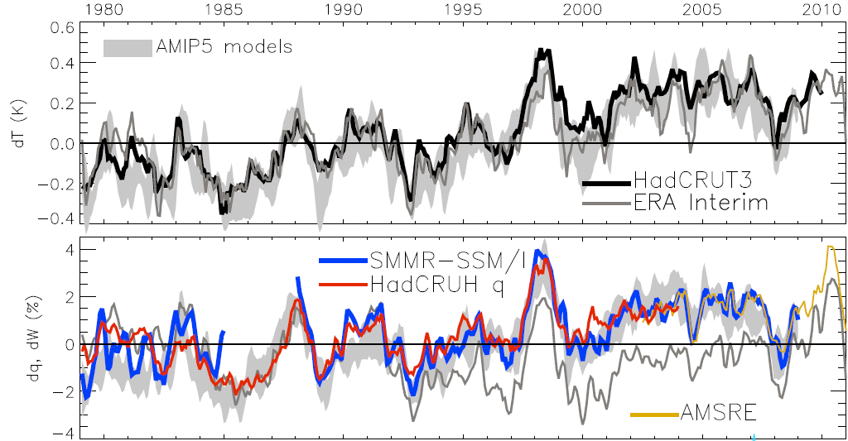
Global changes in water vapour
Water Vapour (%) Surface Tempertaure (K)
Allan et al. (2013) Surv. Geophys
Notes:
The main point to note is that models and observations are consistent in showing increases in low level water vapour with warming. Reanalyses such as ERA Interim, which are widely used, are not constrained to balance their energy or water budgets.
For ocean-only satellite datasets I apply ERA Interim for poleward of 50 degrees latitude and for missing/land grid points.
Note that SSM/I F13 2003-2007 CWV = 24.7794 mm; AMSRE 2003-2007 CWV = 24.8850
22

Slide 23

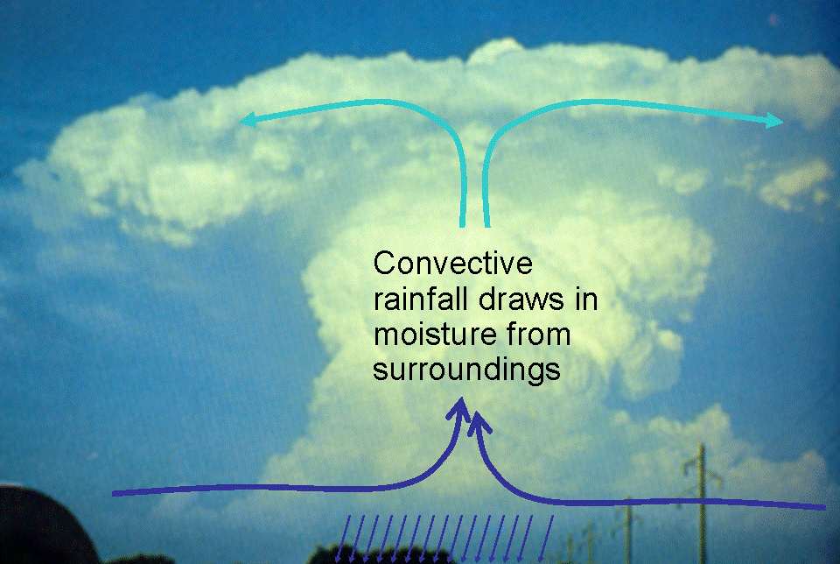
Extreme Precipitation
Large-scale rainfall events fuelled by moisture convergence
  e.g. Trenberth et al. (2003) BAMS
Intensification of rainfall with global warming
  e.g. Allan and Soden (2008) Science

Slide 24


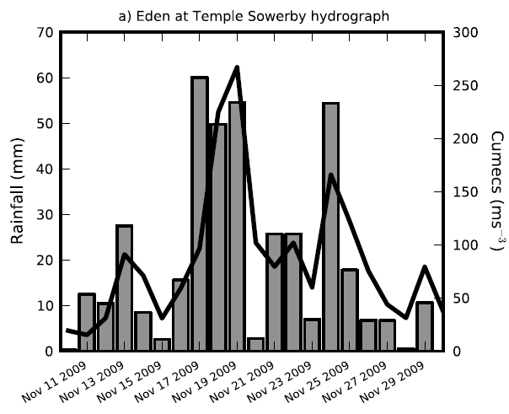
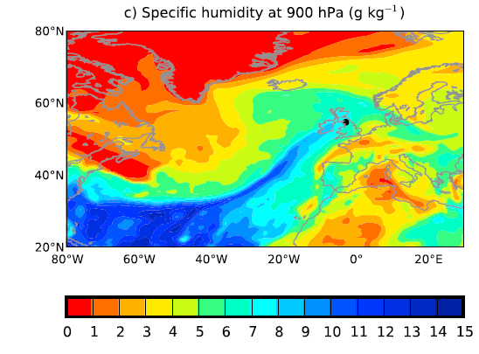
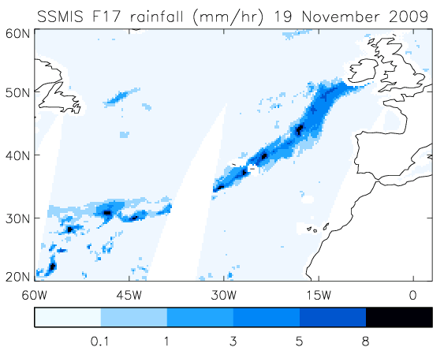

Precipitation extremes
NERC HydEF project
Linking UK flooding to large-scale precursors e.g. 2009 Cumbria floods
Lavers et al. (2011) GRL, Lavers et al. (2012) JGR

Slide 25
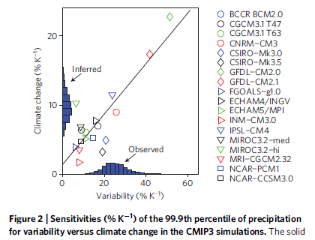
Using observed interannual variability to evaluate climate model simulations of precipitation extremes
Can observations be used to constrain the projected responses in extreme precipitation?
O’Gorman (2012) Nature Geosciences
See also Allan & Soden (2008) Science; Liu & Allan (2012) JGR

Slide 26

Contrasting precipitation response expected
Heavy rain follows moisture (~7%/K)
Mean Precipitation linked to energy balance (~2-3%/K)
Precipitation →
Light Precipitation (-?%/K)
Temperature →
e.g. Allen and Ingram (2002) Nature; Allan (2011) Nature

Slide 27
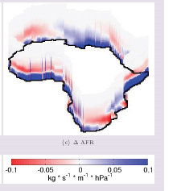
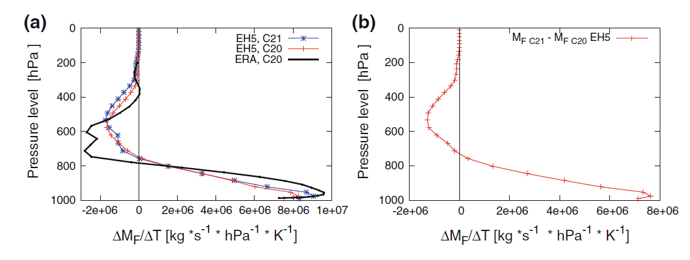
Enhanced moisture transports into the “wet” tropics, high latitudes and continents
PREPARE project
Zahn & Allan, submitted to WRR
See also Demory et al. (2013)
Enhanced outflow
Enhanced inflow
(dominates)
see also: Zahn and Allan (2013) J Clim

Slide 28
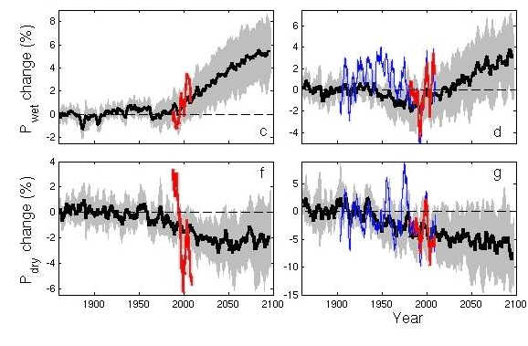
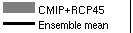

CMIP5 simulations: Wettest tropical grid-points get wetter, driest drier
Ocean Land
GPCC, GPCP
Pre 1988 GPCP observations over ocean don’t use microwave data
dry tropical region wet
Precipitation Change (%)
Tropical dry Tropical wet
Robust drying of dry tropical land
30% wettest gridpoints vs 70% driest each month
Liu and Allan in prep; Allan et al. (2010) ERL. See also Chadwick et al. (2013) J Clim, Allan (2012) Clim. Dyn., Balan Sarojin et al. (2013) GRL

Slide 29
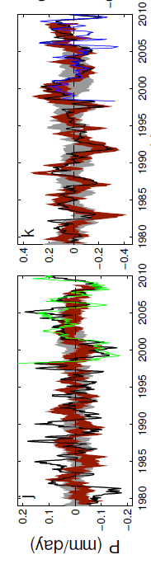
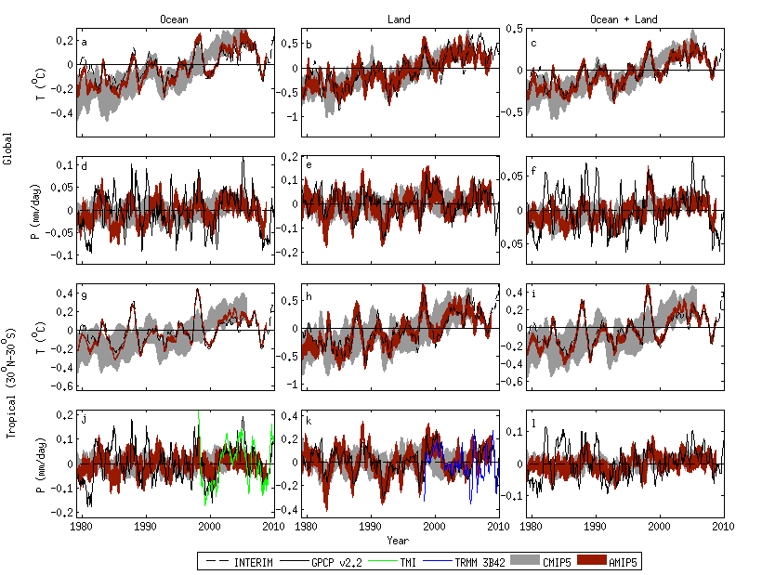
Challenge: Observing systems
Observed precipitation variability over the oceans is questionable. Over land, gauges provide a useful constraint.
Combining observational platforms is a powerful strategy e.g. microwave, gravity, ocean heat content, reanalysis transports
Oceans Land
Liu, Allan, Huffman (2012) GRL

Slide 30
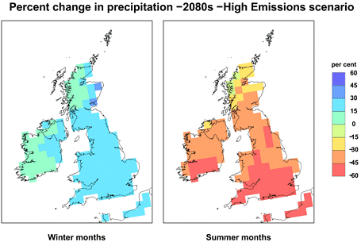
Challenge: Regional projections
Shifts in circulation systems are crucial to regional changes in water resources and risk yet predictability is often poor.
How will monsoons and jet stream positions respond to warming?
How will primary land-surface and ocean-atmosphere feedbacks affect the local response to global warming?

Slide 31
Conclusions
Energy balance is fundamental to climate response
Energy and moisture balance powerful constraints on global water cycle
Heating of Earth continues at rate of ~0.5 Wm⁻² over the last decade despite stable Surface Temperature
Global precipitation rises due to surface warming (~2%/K) offset slightly by direct effect of GHG forcing on troposphere
Current increases in wet and dry extremes
  Linked to rises in low-level moisture of about 7%/K
Aerosol radiative forcing appear key in determining global and circulation-driven precipitation responses
  Interesting regional trends e.g. Africa: see Ross Maidment’s seminar
Further details available from www.met.reading.ac.uk/~sgs02rpa:
Loeb et al. (2012) Nature Geosci and Allan et al. (2013) Surv. Geophys

Slide 33
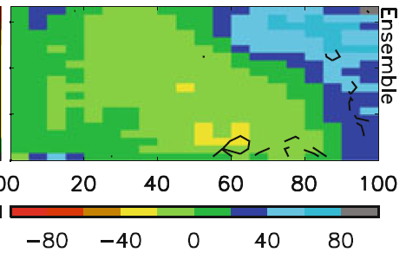
Fingerprints of precipitation response by dynamical regime
PREPARE project
Warmer surface temperature →
Model biases in warm, dry regime
Strong wet/dry fingerprint in model projections (below)
Stronger ascent →
Allan (2012) Clim. Dyn.
Stronger ascent →

Slide 34
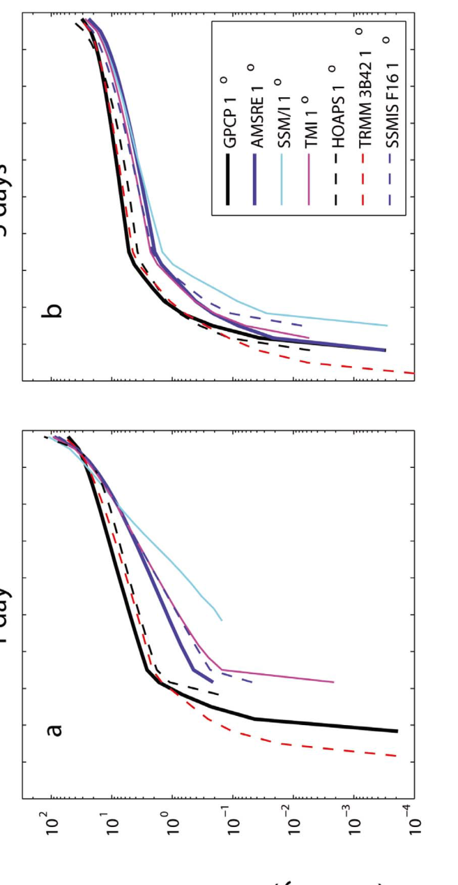
1 day 5 day
Precipitation intensity (mm/day)
Uncertainty in observed P intensity & response (tropical oceans)
Precipitation intensity change with mean surface temperature (%/day)
Liu & Allan (2012) JGR
Precipitation intensity percentile (%)

Slide 35
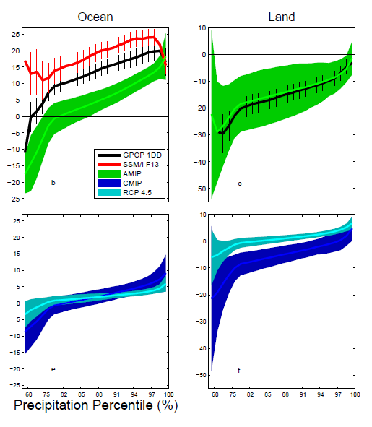
Response of Precipitation intensity distribution to warming:
Observations and CMIP5, 5-day mean
Is present day variability a good proxy for climate response?
dP_{i}/dT (%/K)
CMIP5 AMIP/OBS
Allan et al. (2013) Surv. Geophys

Slide 36
Identifying “Atmospheric Rivers” simulated by climate models
AMIP CMIP
← Coarse-scale climate models able to capture flood-generating mid-latitude systems
Will thermodynamics dominate over changes in dynamics under climate change? →
…Lavers et al. in progress (HydEF)

Slide 37
