Slide 1
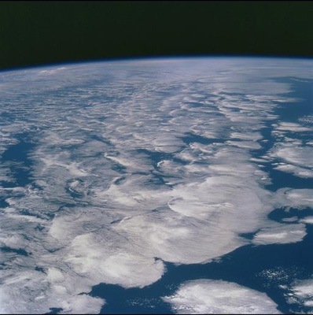

Climate Change:
Where has the warming gone?
Richard Allan - University of Reading/NCAS climate
Thanks to: Norman Loeb, Matt Palmer, Chunlei Liu, Ed Hawkins, Piers Forster, Science Media Centre…
RMetS South East Centre Meeting, Wednesday 5th March 2014
Notes:
Over the last decade the rate of global warming appears to have dwindled. Is this important and what are the implications?

Slide 2
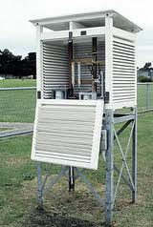
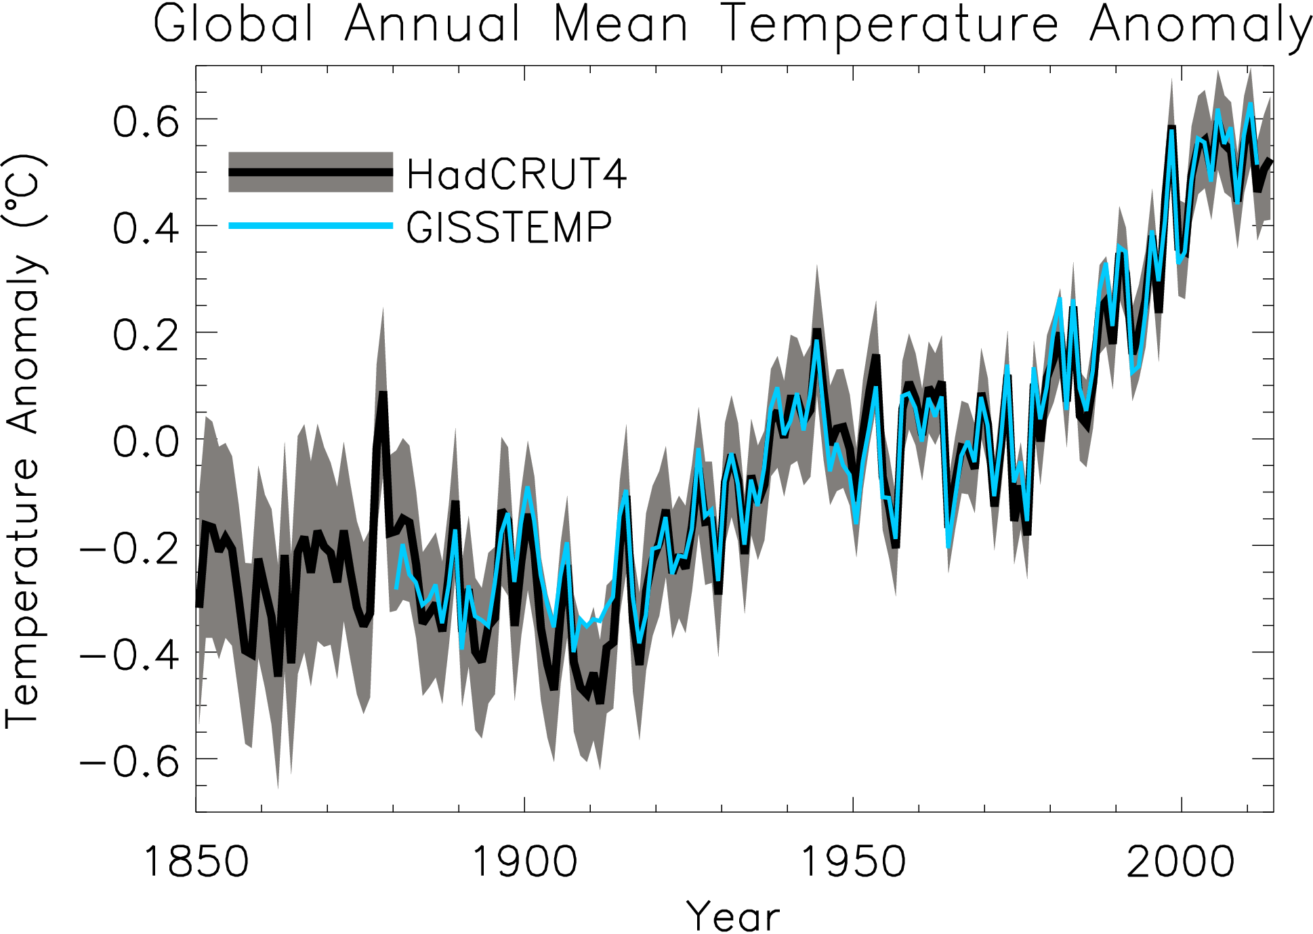
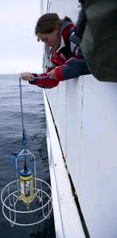
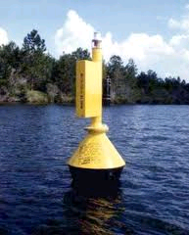
Global Warming……

Slide 3
Global Warming……
slowdown
pause
hiatus
has stalled?

Slide 4
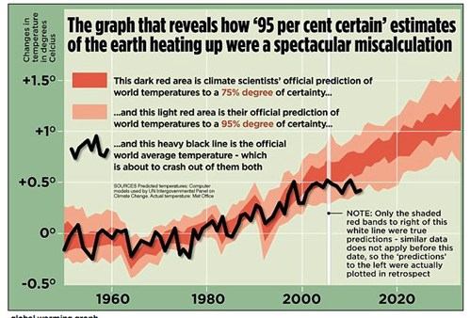
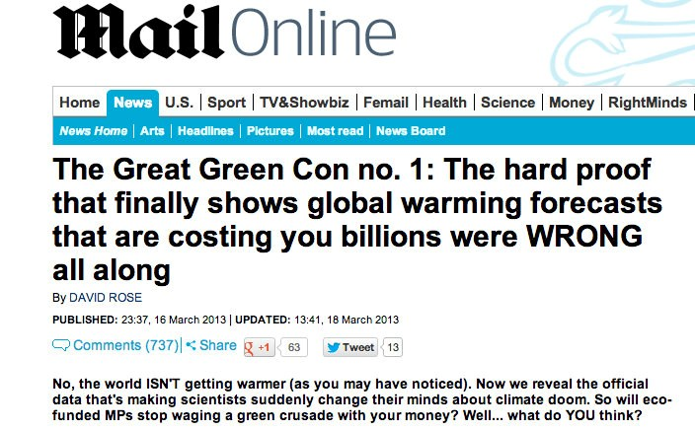
Has global warming stopped?
Mail on Sunday 16th March 2013

Slide 5
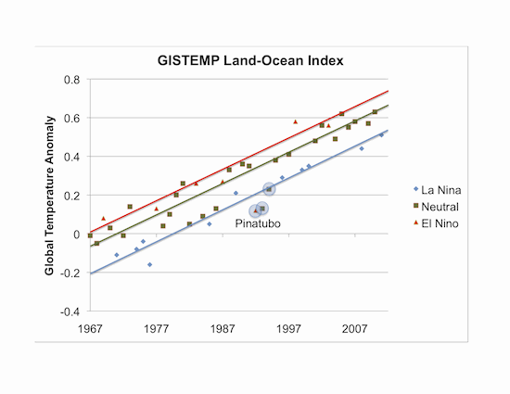
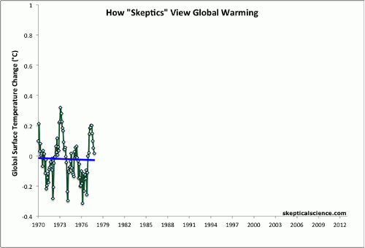
Influence of El Niño and Volcanoes on Surface Temperature Trends
But why have there been more La Niñas recently and hasn’t the slowdown in surface warming lasted a long time?
John Nielsen-Gammon, Texas A&M University
see Foster & Rahmstorf (2012) Environ. Res. Lett.

Slide 6
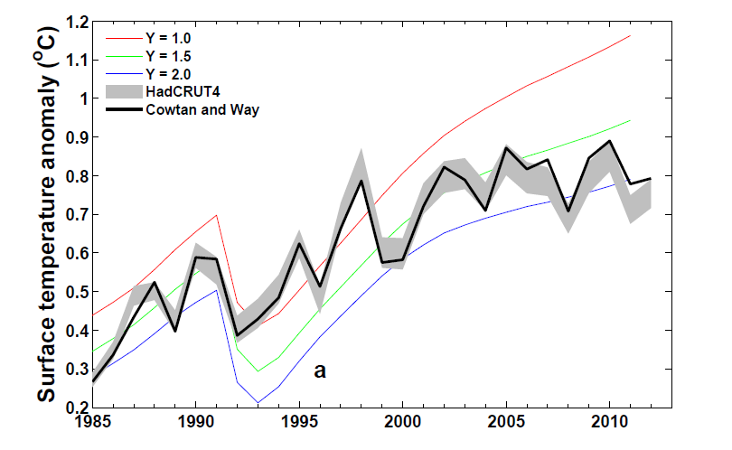
Is the temperature record wrong or are computer models inaccurate?
Can comparisons tell us about how sensitive climate is to radiative forcing? e.g. Otto et al. (2013) Nature Geosci
Spatial infilling of data gaps influences trends in surface temperature (Cowtan & Way, 2013 QJRMS) and ocean heat content (Lyman & Johnson 2014 J. Clim.)
Graph by Chunlei Liu
Research in DEEP-C project
(Reading, NOC-Southampton & Met Office)

Slide 7
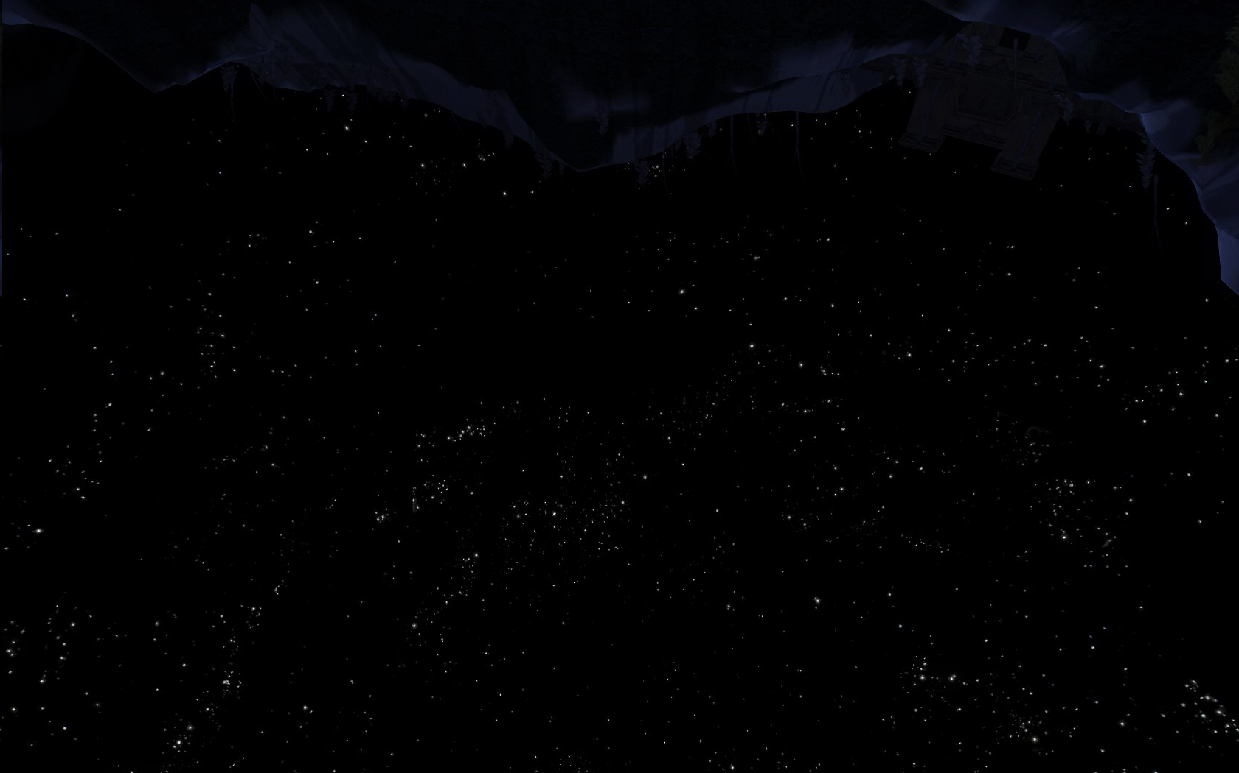
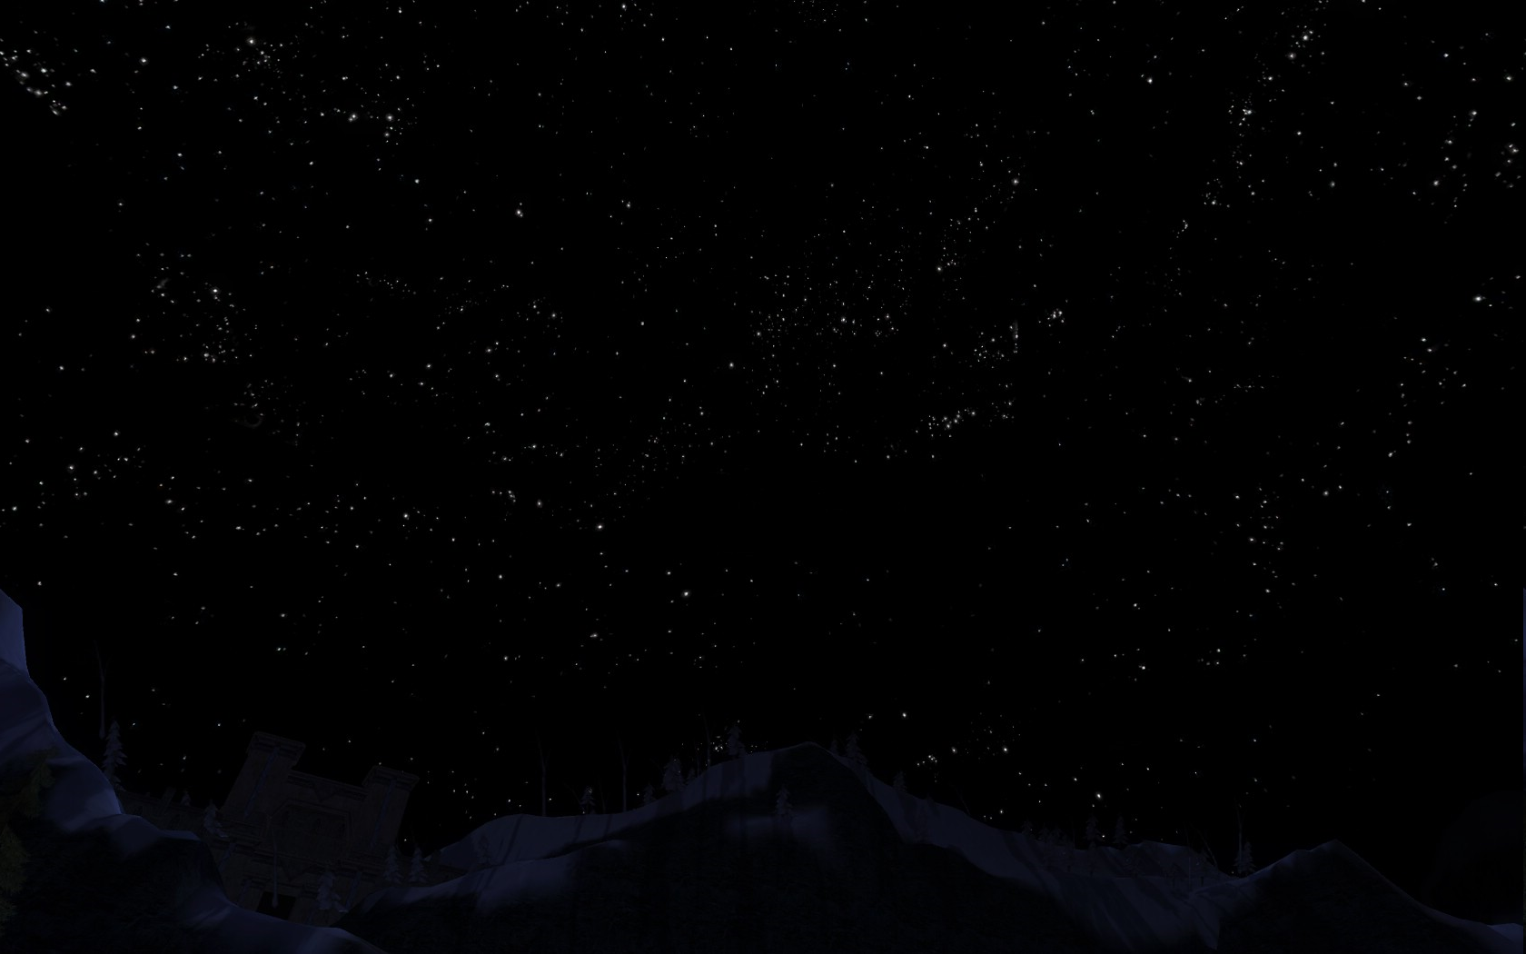
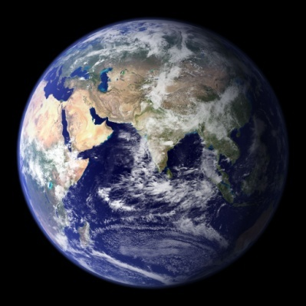
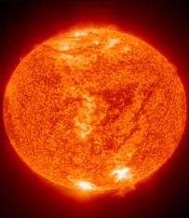
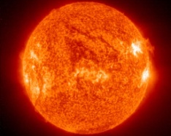
Earth’s energy balance in space
4πr²
Thermal/Infra-red or Outgoing Longwave Radiation (OLR)=σT_{e}⁴
S
πr²
Absorbed Solar or Shortwave Radiation (S/4)(1-α)
There is a balance between the absorbed sunlight and the thermal radiative cooling of the planet
Notes:
7

Slide 8
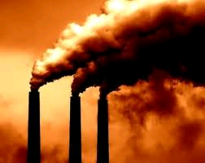
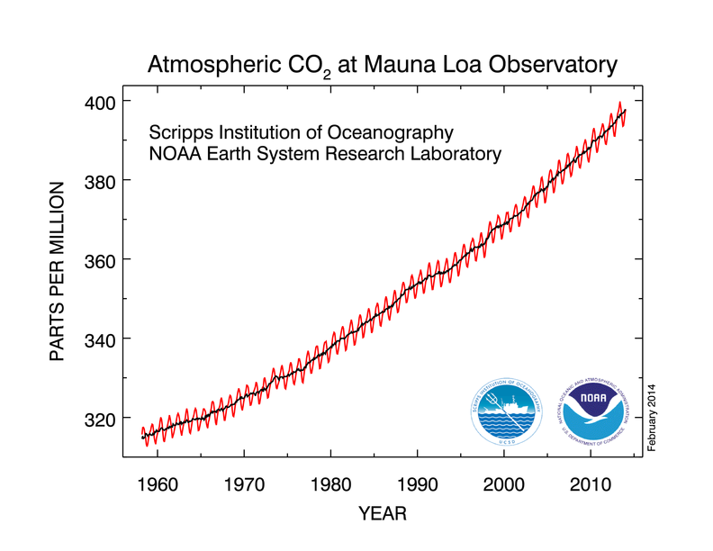
“Radiative forcing” of climate
Increased concentrations of greenhouse gases heat planet by reducing the efficiency at which Earth can cool to space
More small pollutant particles (aerosols) can cool the planet by reflecting sunlight
If more energy is arriving than is leaving the planet should heat up…

Slide 9
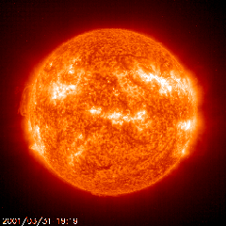
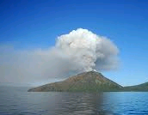
Have other factors offset warming from greenhouse gases?
The sun has weakened in the 2000s
There were a series of small volcanic eruptions causing reflection of sunlight
Particle pollution from Asia, changes in stratosphere water vapour, changes in Methane and sampling of temperature observations may also be important
Natural chaotic fluctuations in the ocean appear to play an important role

Slide 10
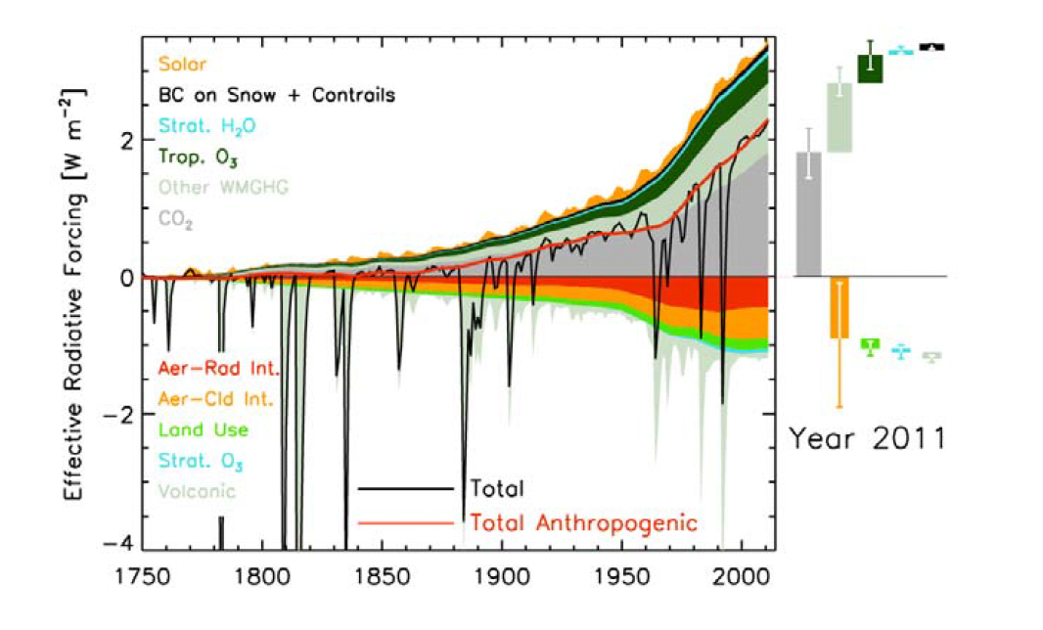
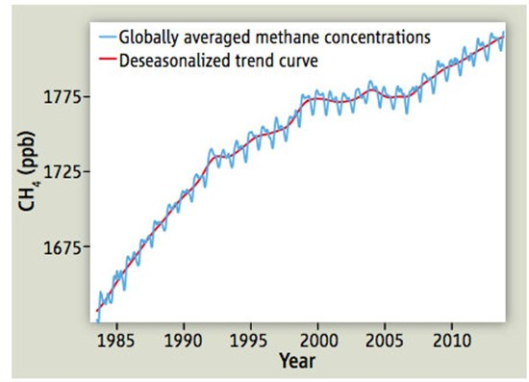
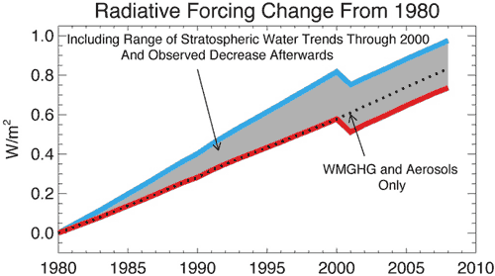
Changes in radiative forcing since 1750
IPCC (2013) Figure 8.18
Nisbet et al. (2014) Science on Methane
Solomon et al. (2010) Science on Stratospheric Water Vapour

Slide 11
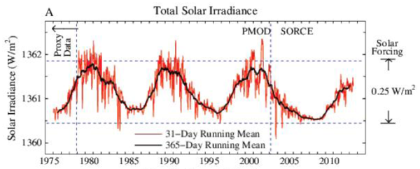
Weaker Solar Output?
IPCC: Solar Radiative Forcing change of –0.04 Wm⁻² from 1986 to 2008
Solar Radiative Forcing
~0.5 Wm⁻²
Hansen et al. (2013) PLOSONE; see also Kaufmann et al. (2011) PNAS

Slide 12
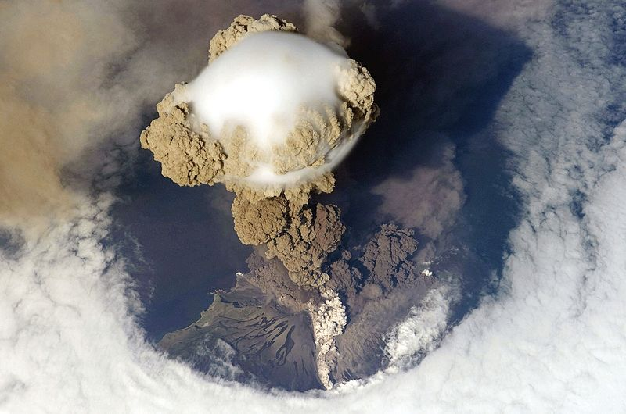
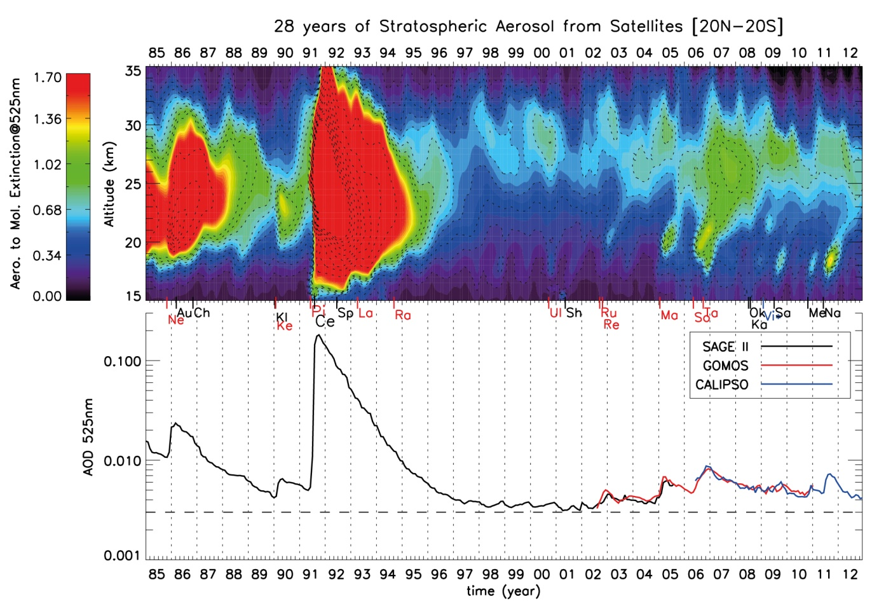
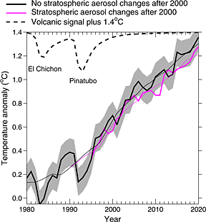
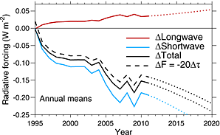
Cooling from small volcanos?
El Chichon Pinatubo
IPCC (2013) Fig. 8.13
Work by Solomon et al. (2011) Science; Vernier et al. (2011) GRL; Fyfe et al. (2013) GRL; Schmidt et al. (2014) Nature Geosci; Santer et al. (2014) Nature Geosci.

Slide 13
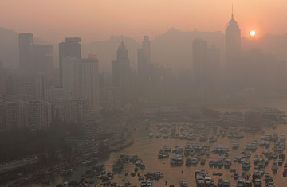
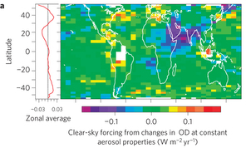
Has increased aerosol pollution refelected more sunlight back to space ?
Increased Asian aerosol offset by decreases elsewhere – little change in 2000s: Murphy (2013) Nature Geosci (below)
ALEX HOFFORD / EPA

Slide 14
Causes of Climate Change 1998-2012
Cause | Estimated Change in Radiative Forcing (W per sq.m)¹
Greenhouse gases | + 0.48
Solar | – 0.16
Volcanoes | ‒ 0.06
Other (e.g. aerosols) | ± ?
TOTAL | + 0.26 ± ?
Since 1998 natural factors have masked some of the greenhouse gas warming influence
In the 1990s natural factors (especially recovery from Mt. Pinatubo) added to the greenhouse warming influence
Little overall influence of natural factors since the 1950s
¹ Quantifying other forcings and
uncertainties is ongoing research
Piers Forster, University of Leeds

Slide 15
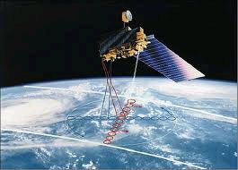
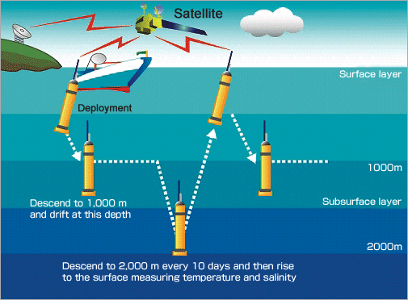
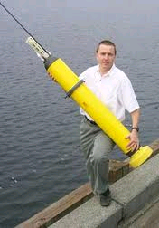
Measuring Earth’s energy flows
CERES
Satellite instruments measure energy arriving and leaving our planet
  Sunlight & thermal radiation
Automated floats measure heating of the ocean
ARGO floats →

Slide 16
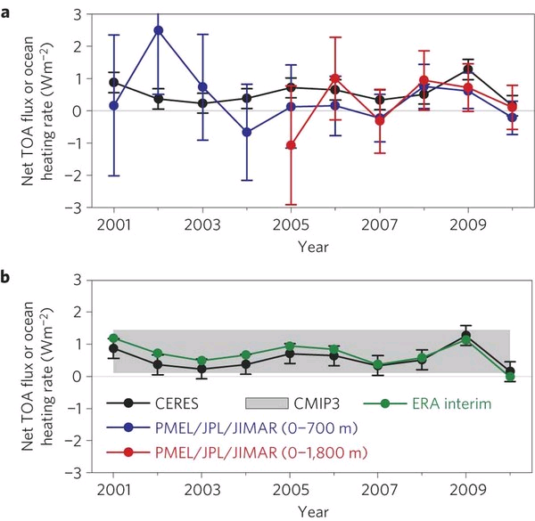
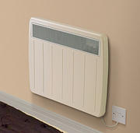
Combining satellite measurements with ocean observations…
simulation
Reanalysis simulation
Loeb et al. (2012) Nature Geosci
We found that heat is continuing to accumulate at 0.5 Watts per square metre
(this is equivalent to the heat of 250 billion 1 kilo-Watt electric heaters distributed over the planet)
…updated estimate 2000-2012: 0.6 Wm⁻²
Notes:
Fi gure 3 (a) Global annual average net TOA flux from CERES observations and (b) ERA Interim reanalysis are anchored to an estimate of Earth’s heating rate for 2006–2010 ⁵ The Pacific Marine Environmental Laboratory/Jet Propulsion Laboratory/Joint Institute for Marine and Atmospheric Research (PMEL/JPL/JIMAR) ocean heating rate estimates⁴ use data from Argo and World Ocean Database 2009; uncertainties for upper ocean heating rates are given at one-standard error derived from sampling uncertainties. The gray bar in (b) corresponds to one standard deviation about the 2001–2010 average net TOA flux of 15 CMIP3 models.

Slide 17
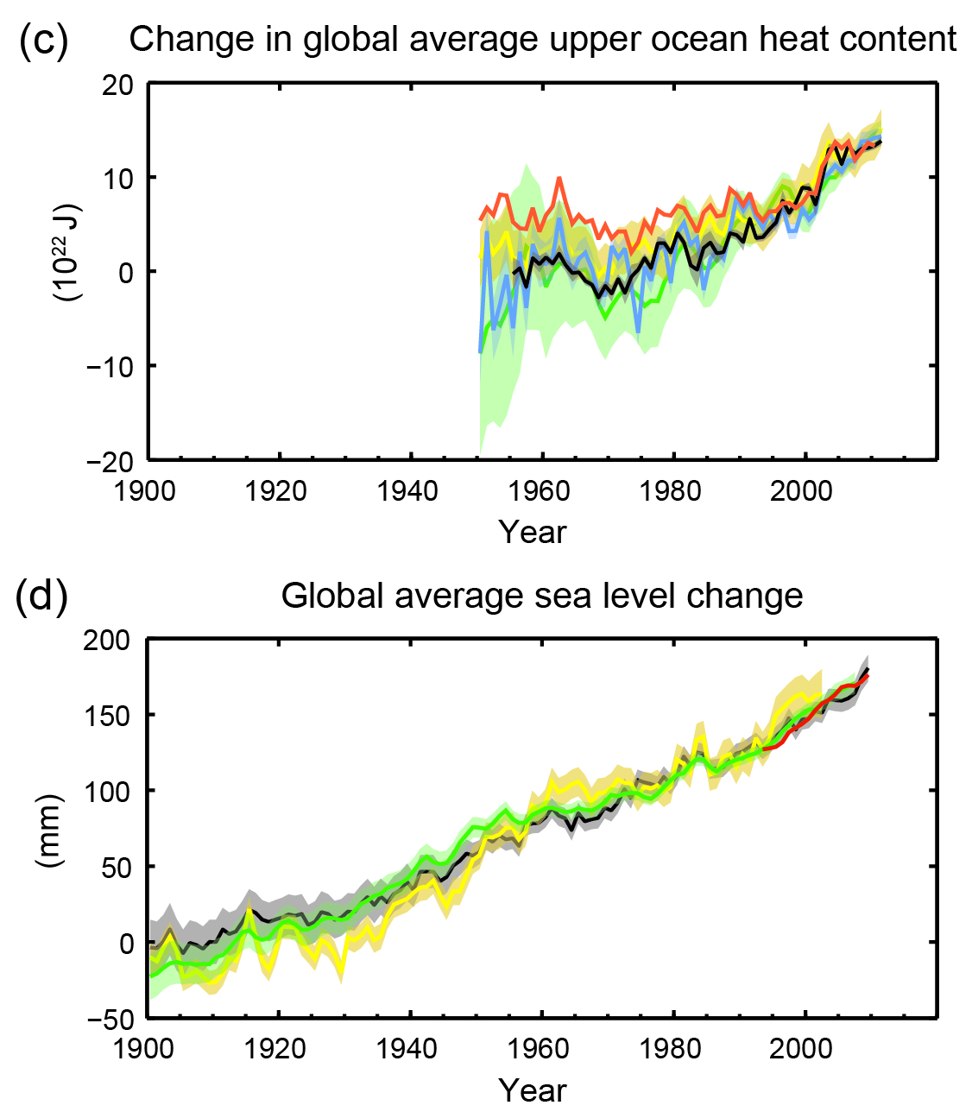
Continued heating of the oceans and sea-level rise
How can the oceans be heating up without warming surface temperatures?
IPCC (2013) Figure SPM.3

Slide 18
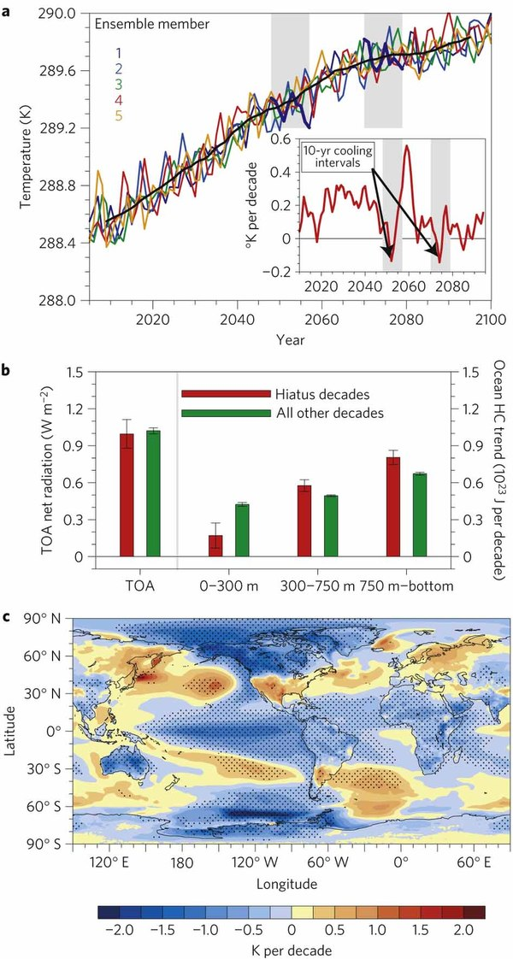
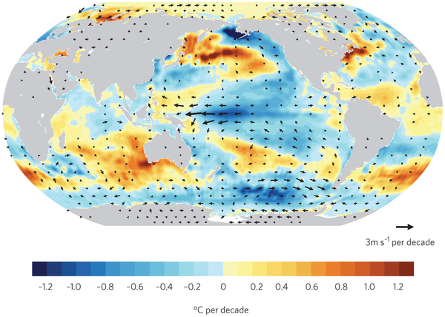
Climate models simulate decades with little surface warming despite CO₂ increases
Ocean variability causes heat to mix to deeper levels in some decades
Associated pattern of sea surface temperature trends match current observations
Heating rate
Temperature (K)
Temperature Trend (K/decade)
Model (Meehl et al. 2011, 2013) Observations 2001-2013 (Kosaka 2014)

Slide 19
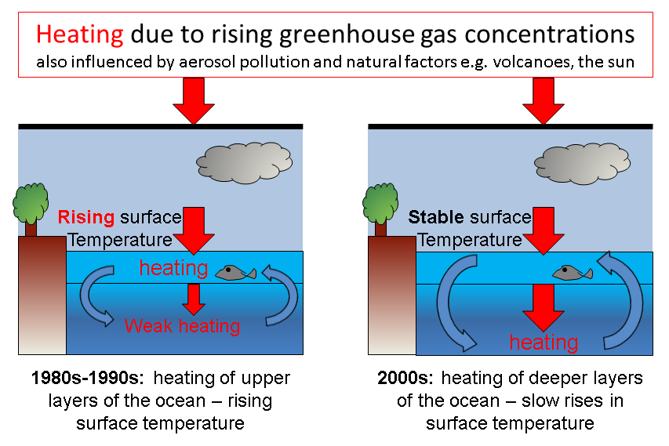
The role of ocean circulation…
Increased heat flux to deeper layers of the ocean: Watanabe et al. (2013) GRL; Balmaseda et al. (2013) GRL; Trenberth et al. (2014) J. Climate

Slide 20
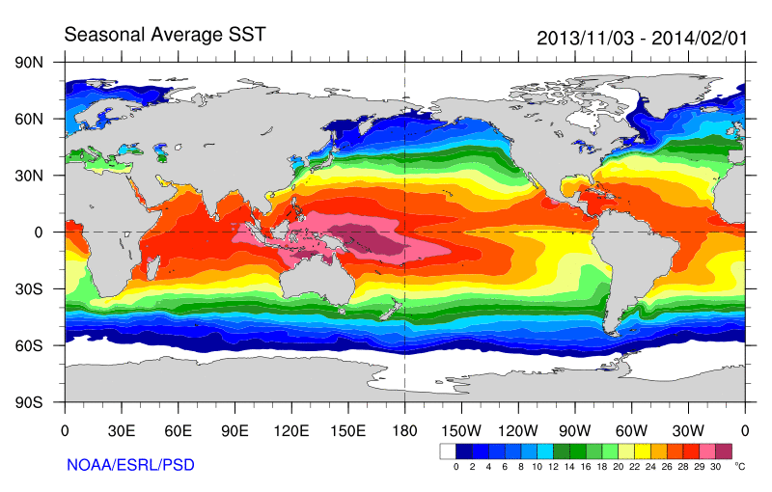
Role of Pacific ocean variability
Continued heating from rising greenhouse gas concentrations
Unusual weather patterns
Enhanced Walker Circulation
Ocean circulation strengthens atmospheric circulation
Increased sea height
Warm
Upwelling,
Cool water
Increased precipitation
Decreased salinity
Strengthening trade winds
Equatorial Undercurrent
Enhanced mixing of heat below 100 metres depth by accelerating shallow overturning cells and equatorial undercurrent
Work by Merrifield (2010) J. Climate; Sohn et al. (2013) Clim. Dyn.; L’Heureux et al. (2013) Nature Climate Change; Kosaka and Xie (2013) Nature; England et al. (2014) Nature Climate Change

Slide 21
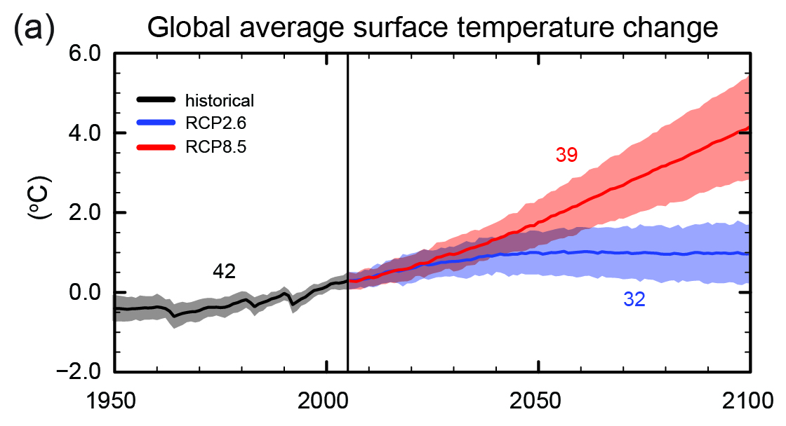
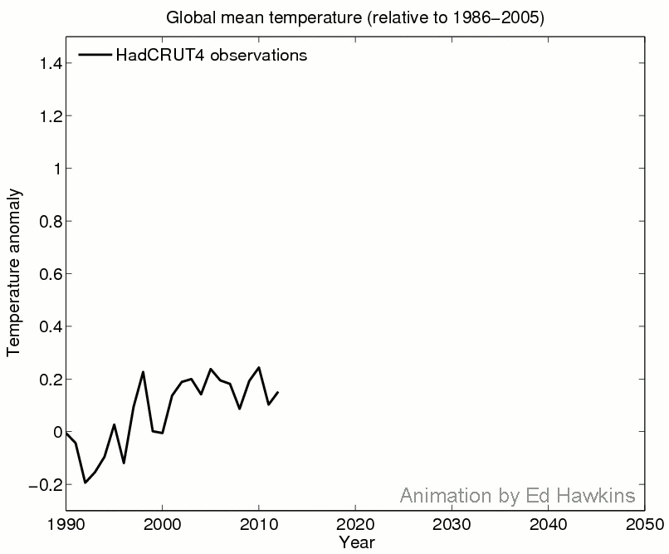
Implications for future
From Climate Lab Book blog (Ed Hawkins)

Slide 22
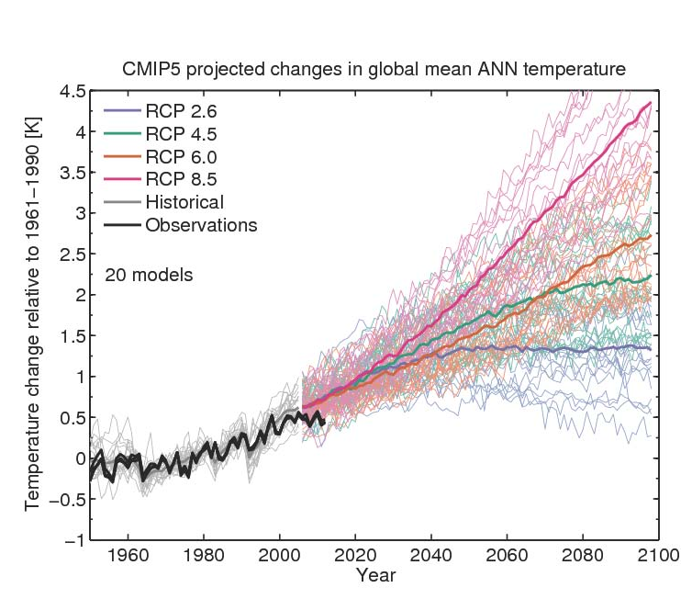
Implications for projections
Climate sensitivity and socioeconomic scenario
Climate sensitivity
From Ed Hawkins, University of Reading

Slide 23
Conclusions from recent Science Media Centre briefing
recent changes need to be put in longer term context & other climate indicators such as sea level, Arctic sea ice, snow cover, glacier melt, etc are also important;
explanation for recent slowdown is partly additional ocean heat uptake & partly negative trends in natural radiative forcing (due to solar changes and small volcanic eruptions) which slightly counteract the positive GHHG forcing trend;
the quantification of the relative magnitude of these causes is still work in progress;
climate models simulate similar pauses (due to fluctuations in ocean circulation) but are not designed to predict timing
As summarized on Ed Hawkins’ blog:
www.climate-lab-book.ac.uk/2013/recent-slowdown/

Slide 24
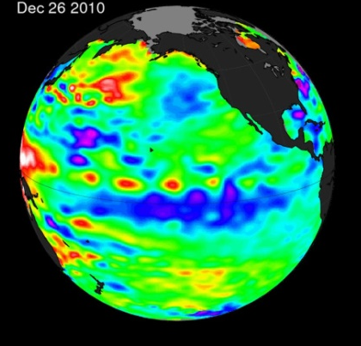
Conclusions
Heating of Earth continues mainly from rising greenhouse gas concentrations
A mixture of factors (mostly natural) have offset some of this heating since 2000 (weaker sun, small volcanoes, …)
Pacific ocean circulation currently mixing more heat below surface layers explaining lack of surface warming
Fascinating science: the climate system is complex and will continue to surprise us but the implications of burning fossil fuels are clear
More links on DEEP-C website

Slide 26
Extra slides
Sun (done)
Volcano (done)
Stratospheric water vapour (done)
Aerosol pollution/Asian Brown Cloud? (done)
Other RF (Methane) (done)
Measurement error (Cowton and Way, ish)
Ocean heat content (done)
Pacific changes (done)

Slide 27
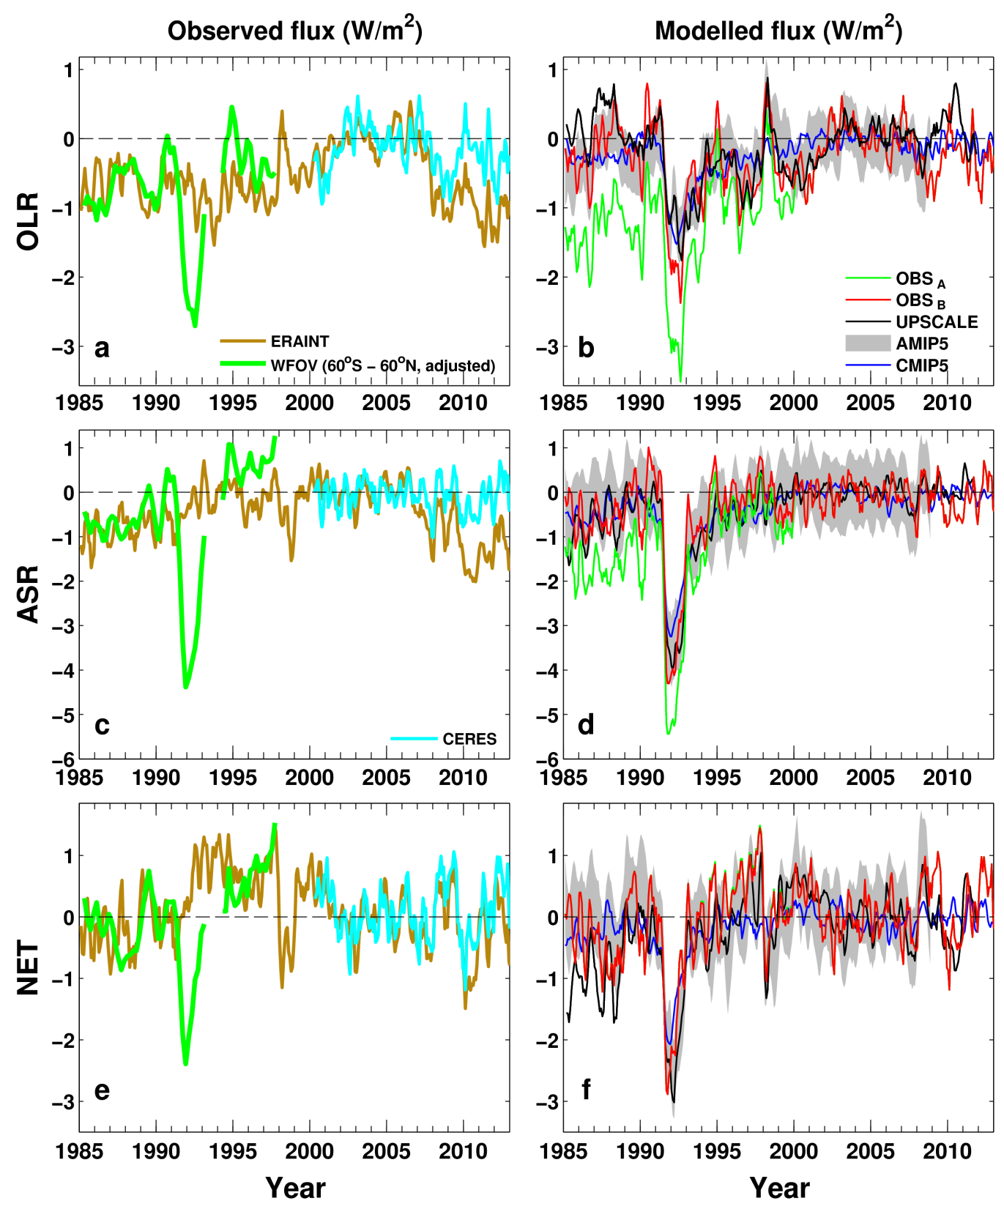
Changes in top of atmosphere radiative fluxes since 1985
Net Imbalance Anomaly (Wm⁻²)
Absorbed Solar (Wm⁻²) Outgoing Longwave
Chunlei Liu
Research in DEEP-C project at Reading…

Slide 29
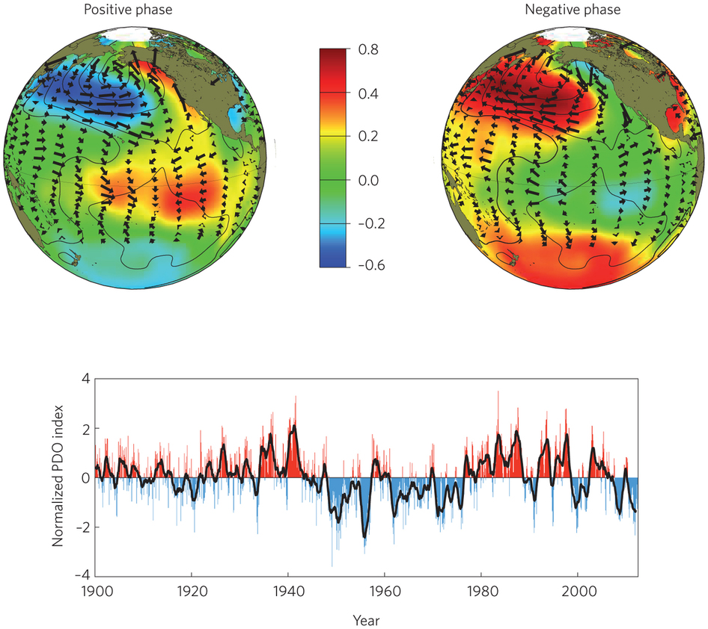
Goddard (2014) Nature Climate Change

Slide 30
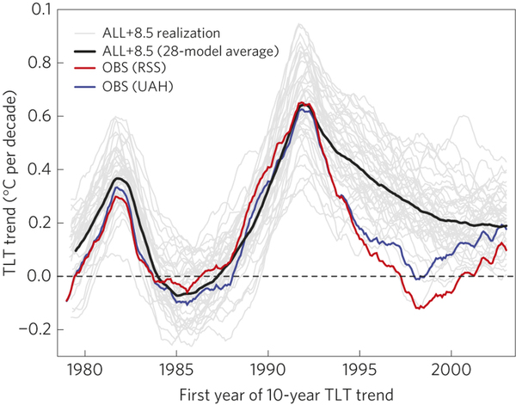
Santer et al. (2014) Nature Geosci
Figure 4: Behaviour of overlapping 10-year trends in the ‘ENSO removed’ near-global (82.5° N–70° S) TLT data.
Least-squares linear trends were calculated over 120 months, with overlap by all but one month; that is, the first trend is over January 1979–December 1988, the second trend over February 1979–January 1989, and so on. The last trend is over January 2003–December 2012.

Slide 31
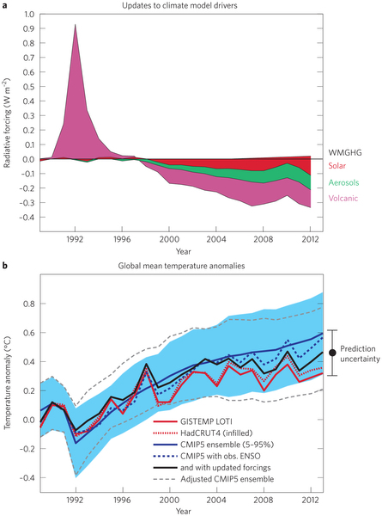
Schmidt et al. (2014) Nature Geoscience
Notes:
a, The latest reconstructions of optical depth for volcanic aerosols9, 10 from the Mount Pinatubo eruption in 1991 suggest that the cooling effect of the eruption (1991–1993) was overestimated in the CMIP5 runs, making the simulated temperatures too cool. From about 1998 onwards, however, the cooling effects of solar activity (red), human-made tropospheric aerosols (green) and volcanic eruptions (pink) were all underestimated. WMGHG, well-mixed greenhouse gases. b, Global mean surface temperature anomalies, with respect to 1980–1999, in the CMIP5 ensemble (mean: solid blue line; pale blue shading: 5–95% spread of simulations) on average exceeded two independent reconstructions from observations (GISTEMP Land–Ocean Temperature Index (LOTI)6, solid red; HadCRUT4 with spatial infilling7, dashed red) from about 1998. Adjusting for the phase of ENSO by regressing the observed temperature against the ENSO index11 adds interannual variability to the CMIP5 ensemble mean (dashed blue), and adjusting for updated external influences as in a further reduces the discrepancy between model and data from 1998 (black). The adjusted ensemble spread (dashed grey) clearly shows the decadal impact of the updated drivers. As an aside, we note that although it is convenient to use the CMIP5 ensemble to assess expected spreads in possible trends, the ensemble is not a true probabilistic sample.

Slide 32
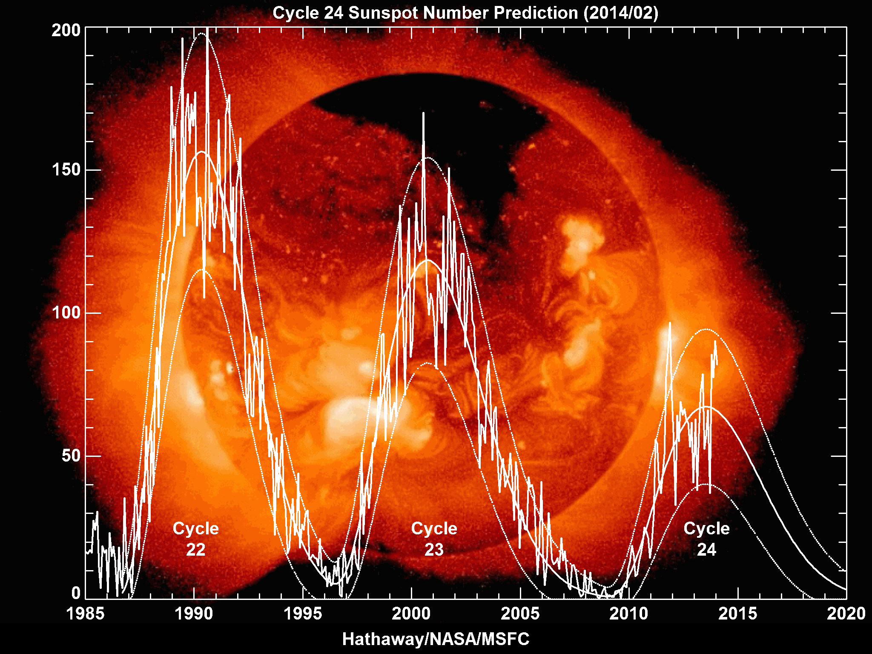
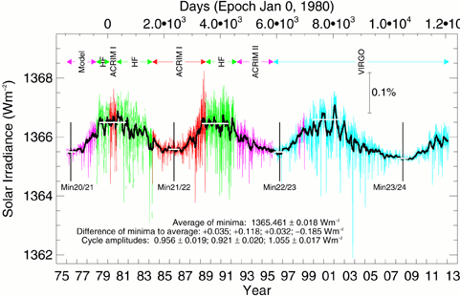
http://solarscience.msfc.nasa.gov/predict.shtml

Slide 33
Weaker Solar Output?
IPCC: Solar Radiative Forcing decrease of –0.04 Wm⁻² 1986 to 2008
Radiative Forcing
~0.5 Wm⁻²
http://www.pmodwrc.ch/pmod.php?topic=tsi/composite/SolarConstant

Slide 34
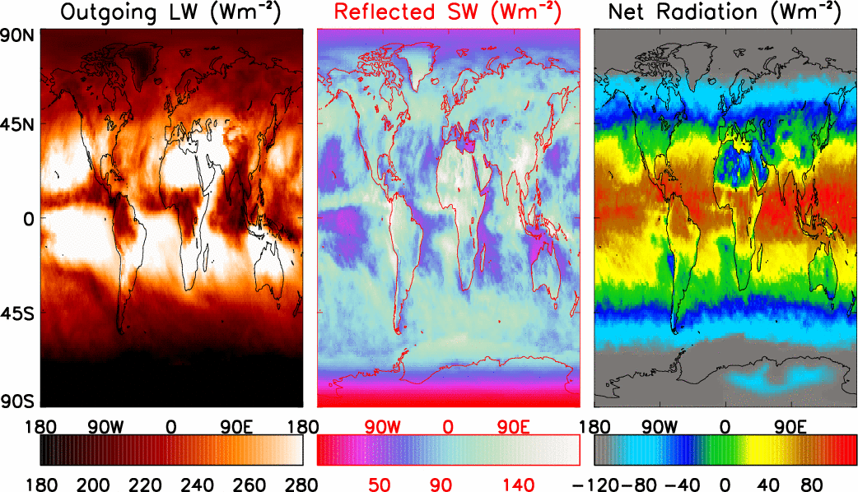
Top of Atmosphere Radiative Energy Fluxes CERES/TERRA, September 2004

Slide 35
Top of Atmosphere Radiative Energy Fluxes CERES/TERRA, September 2004

Slide 36
Top of Atmosphere Radiative Energy Fluxes CERES/TERRA, September 2004

Slide 37

Role of Pacific ocean variability
Increased precipitation
Decreased salinity
Work by Merrifield (2010) J. Climate; Sohn et al. (2013) Clim. Dyn.; L’Heureux et al. (2013) Nature Climate Change; Kosaka and Xie (2013) Nature; England et al. (2014) Nature Climate Change

