Slide 1
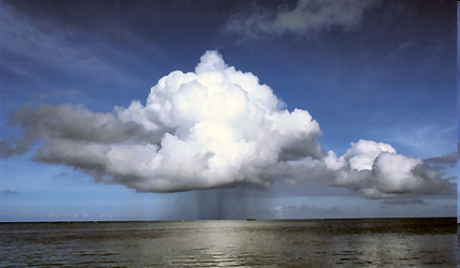
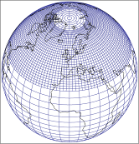
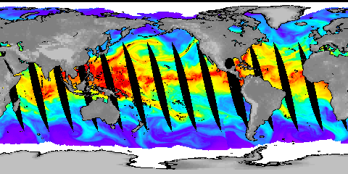
Understanding Current Observed Changes in the Global Water Cycle
Richard Allan, Chunlei Liu, Matthias Zahn
University of Reading

Slide 2
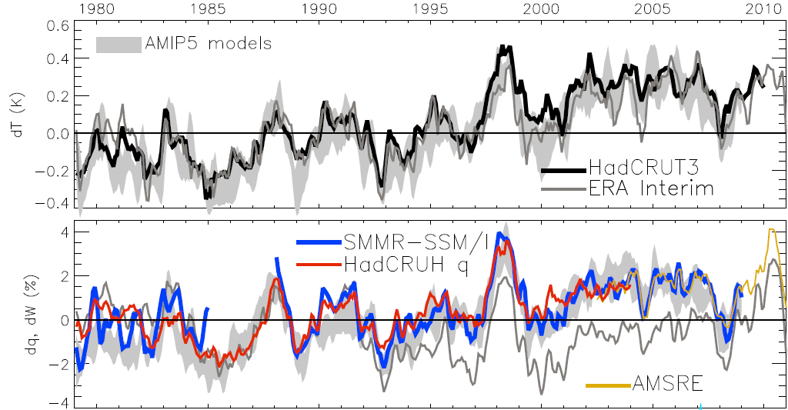
Global changes in water vapour
Updated from O’Gorman et al. (2012) submitted; see also John et al. (2009) GRL
Notes:
The main point to note is that models and observations are consistent in showing increases in low level water vapour with warming. Reanalyses such as ERA Interim, which are widely used, are not constrained to balance their energy or water budgets.
For ocean-only satellite datasets I apply ERA Interim for poleward of 50 degrees latitude and for missing/land grid points.
Note that SSM/I F13 2003-2007 CWV = 24.7794 mm; AMSRE 2003-2007 CWV = 24.8850

Slide 3
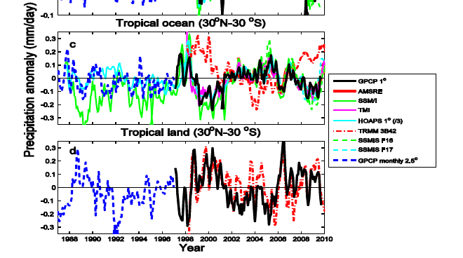
Exploiting satellite observations
We are currently assessing and exploiting satellite and gauge-based estimates of precipitation
Liu and Allan (2011) JGR in press
Notes:
We are analysing tropical and global variability and responses of PDFs of precipitation to present day temperature variability.
We have identified two outliers: HOAPS (divided by 3 on plot) data overestimates variability while TRMM 3B42 (widely used) displays spurious variability over the oceans.

Slide 4
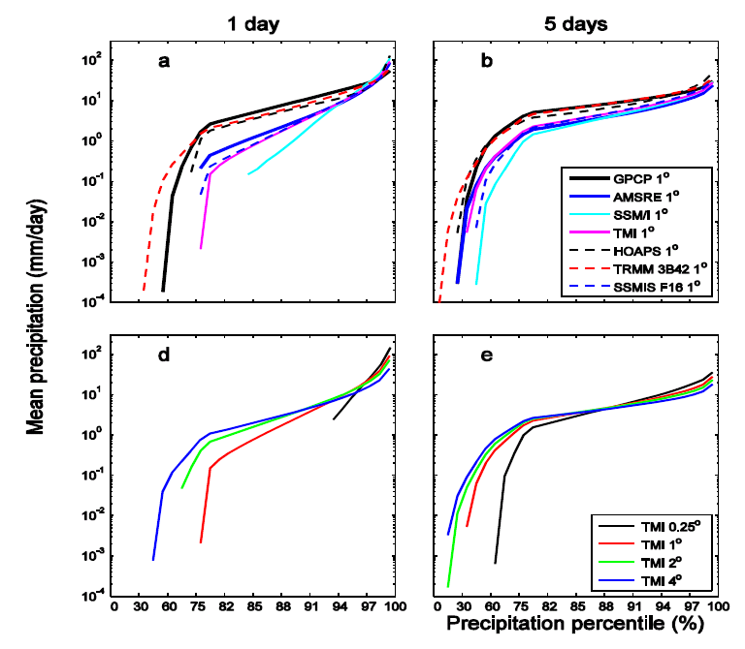
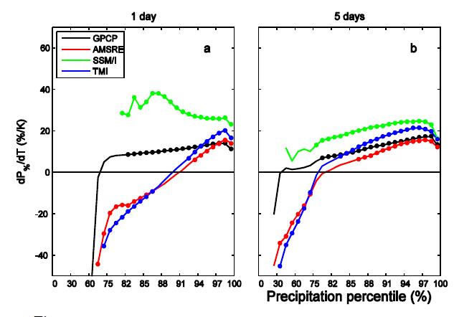
Extremes of precipitation
Sensitivity, dP%/dTs (%/K) Mean P (mm/day)

Slide 5
CMIP5 climatology/seasonal cycle

Slide 6
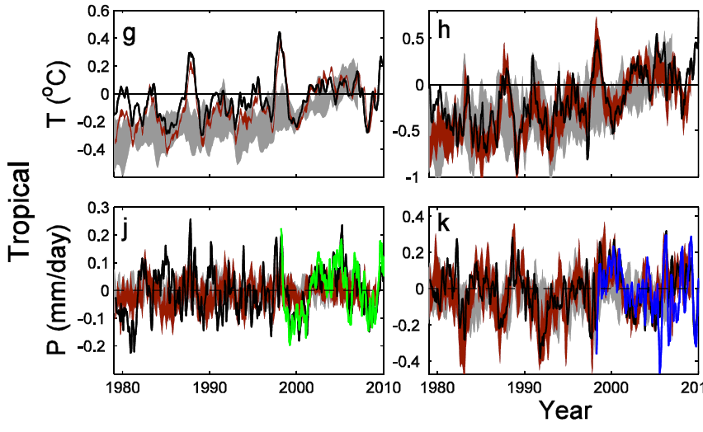
Current changes in tropical precipitation in CMIP5 models
Oceans Land
Liu and Allan in prep…

Slide 7
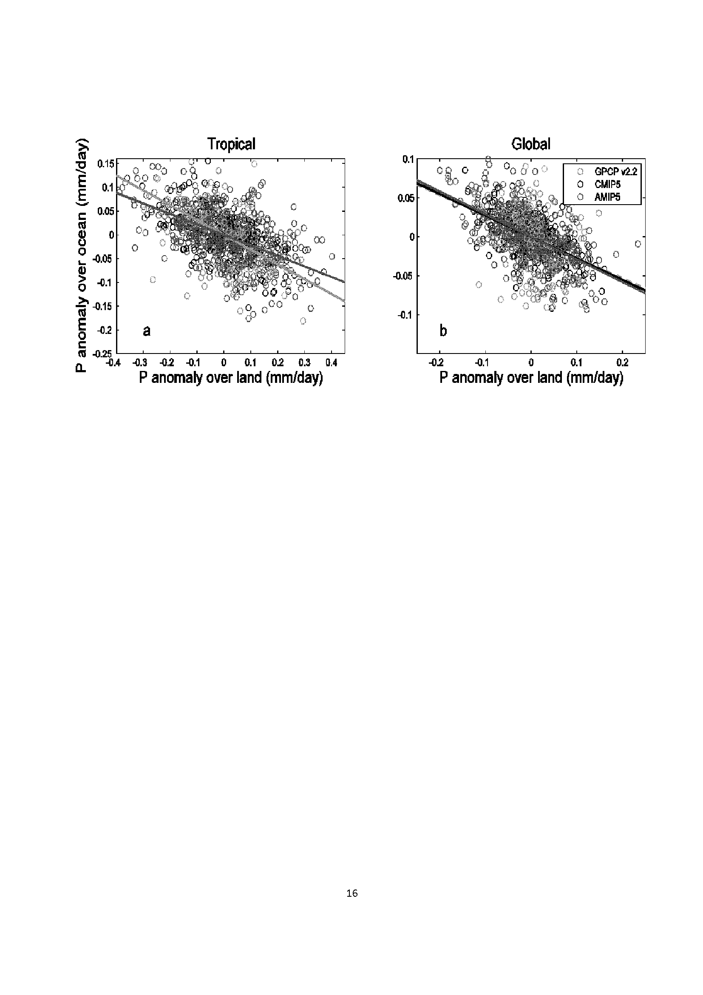
Contrasting land/ocean changes relate to ENSO
See also Gu et al. (2007) J Clim

Slide 8
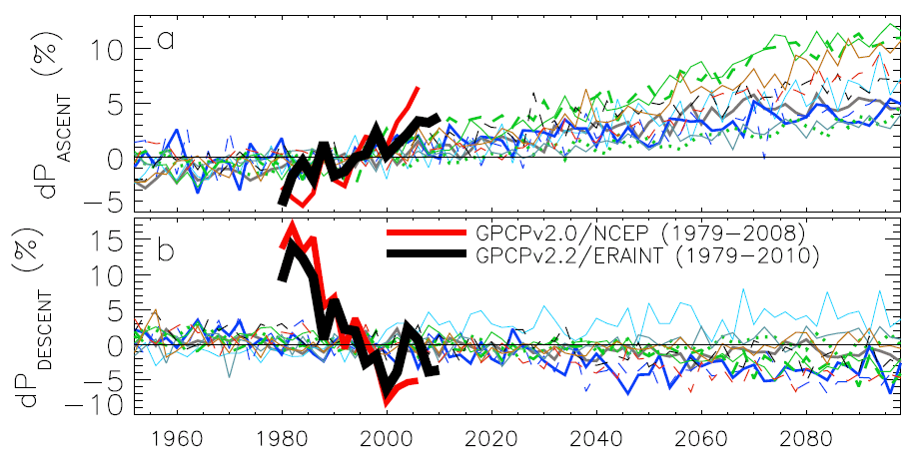
Contrasting precipitation response in wet and dry regions of the tropical circulation
ascent
Observations
Models
Precipitation change (%)
descent
Updated from Allan et al. (2010) Environ. Res. Lett.
Notes:
Note that the wet getting wetter and dry getting drier signal in the tropics is robust in models. The recently updated GPCP observations (black) show a slightly larger trend in the wet region. The dry region trend is probably spurious before 1988 since microwave data began in 1987.

Slide 9
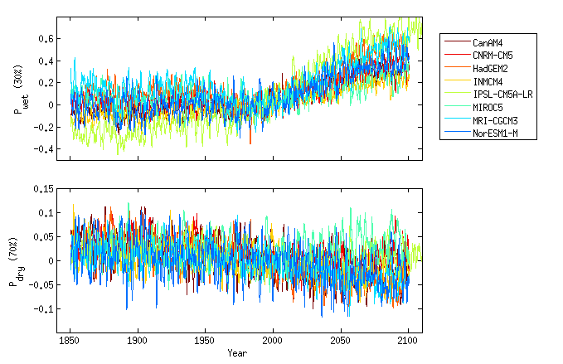
CMIP5: Changes in Wet and Dry region Precipitation

Slide 10
Links to ongoing NERC CWC projects
PREPARE, HYDEF

Slide 11
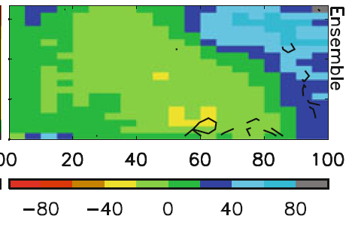
Simulated/observed precipitation fingerprints
Model biases in warm, dry regime
Strong wet/dry fingerprint in model projections (below)
Warmer surface temperature →
Stronger ascent →
PREPARE project
Allan (2012) Clim. Dyn. In press
Stronger ascent →

Slide 12
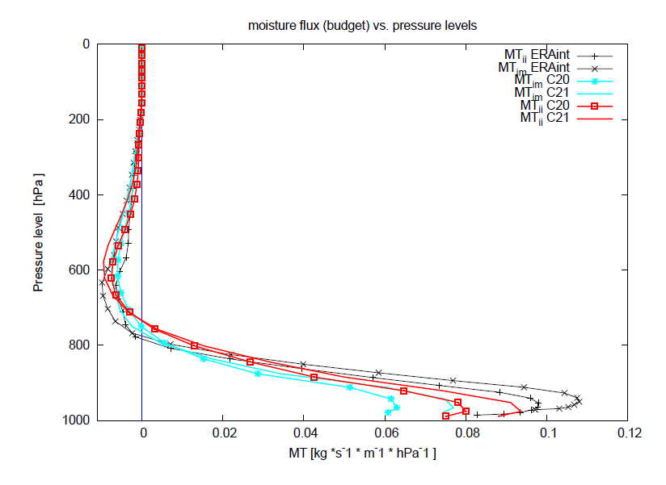
Moisture flux into ascending regime
ERA Interim (+)
ECHAM5 0.5x0.5º 20C (□) and 21C simulations
PREPARE project: Matthias Zahn

Slide 13
Extreme precipitation & mid-latitude Flooding
Atmospheric Rivers or moisture conveyors
Nov 2009 Cumbria floods
HYDEF project: Lavers et al. (2011) GRL

Slide 14
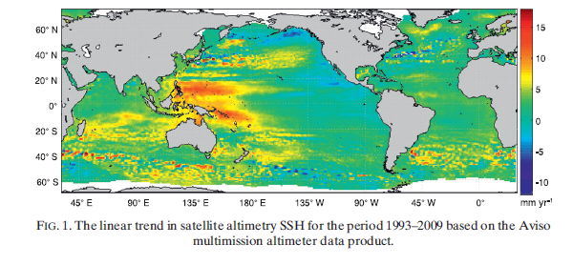
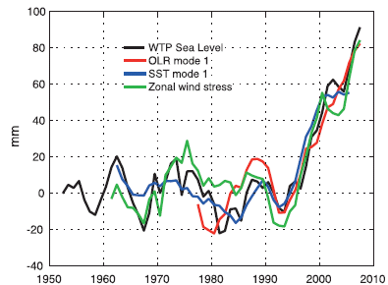
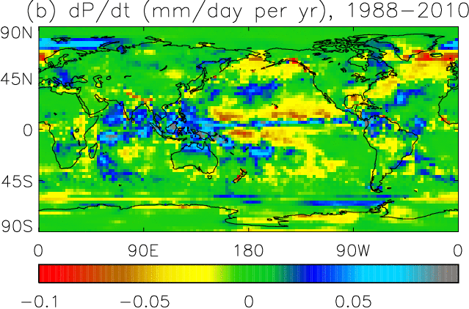
Precipitation & circulation trends
Wind-driven changes in sea surface height (Merrifield 2011)
http://journals.ametsoc.org/doi/abs/10.1175/2011JCLI3932.1
Influence on precipitation trends
Links to Ocean salinity (WP2/3)

Slide 15
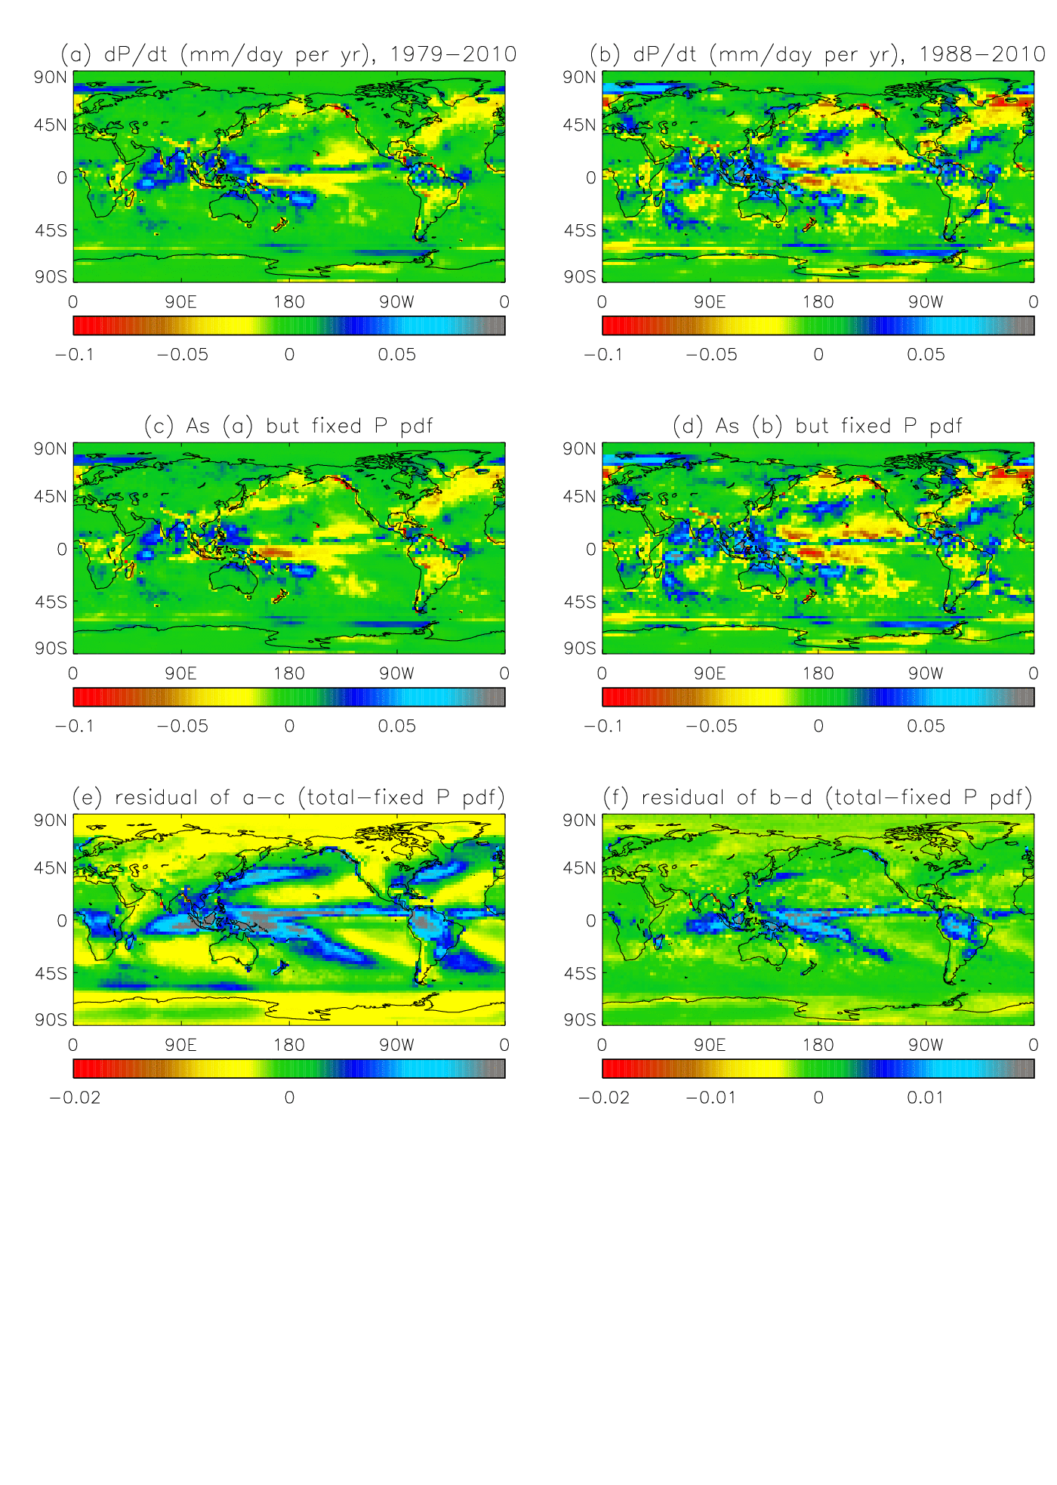
Separating dynamical thermodynamic trends
Top: fixed P intensity PDF
Bottom: residual (total trend minus fixed PDF)
We are currently applying this technique to CMIP5 models

Slide 16
Ongoing work and potential issues
Work assessing satellite record of precipitation is well advanced and evaluation of CMIP5 models is underway
Future plans:
Provide observational datasets/metrics to WPs
P-E and salinity → WP2
Potential issues:
Links to CEH sub-package?
longer term datasets?
Initial drifts in NWP model
Funding ends December 2012

