Slide 1
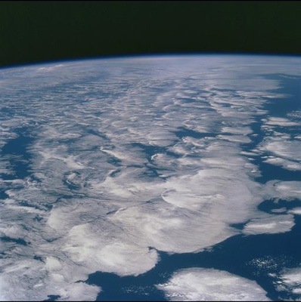





WP3 outcomes: Observed changes in the global water cycle and metrics
Richard P. Allan (r.p.allan@reading.ac.uk) ; Chunlei Liu
University of Reading, Department of Meteorology NCAS-Climate/NCEO
Notes:
This is the title slide, PowerPoint will automatically format the first slide with the title master, although this can be changed in the design palette.

Slide 2
WP3 - Primary Goals
characterise observed changes in the water cycle on global-to-regional space scales and decadal timescales
evaluate, at process level, consistency between observed and modelled changes
Focus here upon satellite era
WP3 - Objectives
1. Quantify observed changes in the water cycle on global-to-regional space scales and decadal time scales and evaluate consistency with processes anticipated by simple models and depicted by GCMs
2. Elucidate key regional processes and feedbacks relating to energy and water fluxes, ocean salinity, ocean surface heat flux tendencies and the partitioning between land interception, evaporation and transpiration
3. Monitor current observed changes in global water cycle variables, also employing global NWP forecasts to evaluate model drifts from analyses linking mean state errors to predicted hydrological response

Slide 3
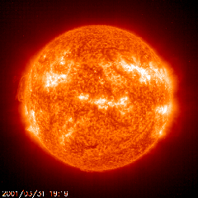

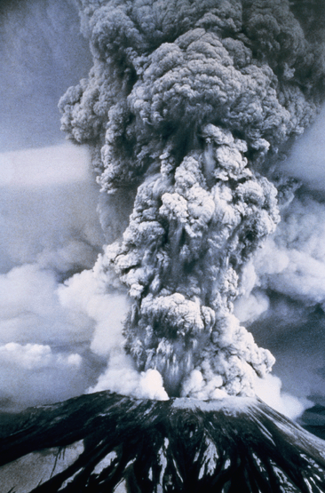
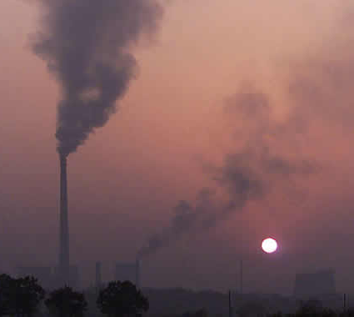
Global changes in the water cycle
Observations
Simulations:
Simulations:
RCP 8.5
Historical
RCP 4.5
Global mean Precipitation change (%)
Allan et al. (2013) Surv. Geophys
see Hawkins & Sutton (2010) Clim. Dyn; Arnell & Lloyd-Hughes (2013) Clim. Change
Notes:
3
There is huge uncertainty in global precipitation projections, relating both to climate sensitivity and mitigation pathways.
In PAGODA we are understanding the precipitation changes at the largest scales relating both to the warming (in response to radiative forcings) and and also the direct effect of the radiative forcings themselves on precipitation.

Slide 4
Global changes in the water cycle
Using simple model: ΔP = kΔT – fΔF
Observations
Simulations:
Simulations:
RCP 8.5
Historical
RCP 4.5
Global mean Precipitation change (%)
From Thorpe & Andrews. Also Zahra Mousavi (PhD student)
Allan et al. (2013) Surv. Geophys
see Hawkins & Sutton (2010) Clim. Dyn; Arnell & Lloyd-Hughes (2013) Clim. Change
Notes:
4
There is huge uncertainty in global precipitation projections, relating both to climate sensitivity and mitigation pathways.
In PAGODA we are understanding the precipitation changes at the largest scales relating both to the warming (in response to radiative forcings) and and also the direct effect of the radiative forcings themselves on precipitation.

Slide 5
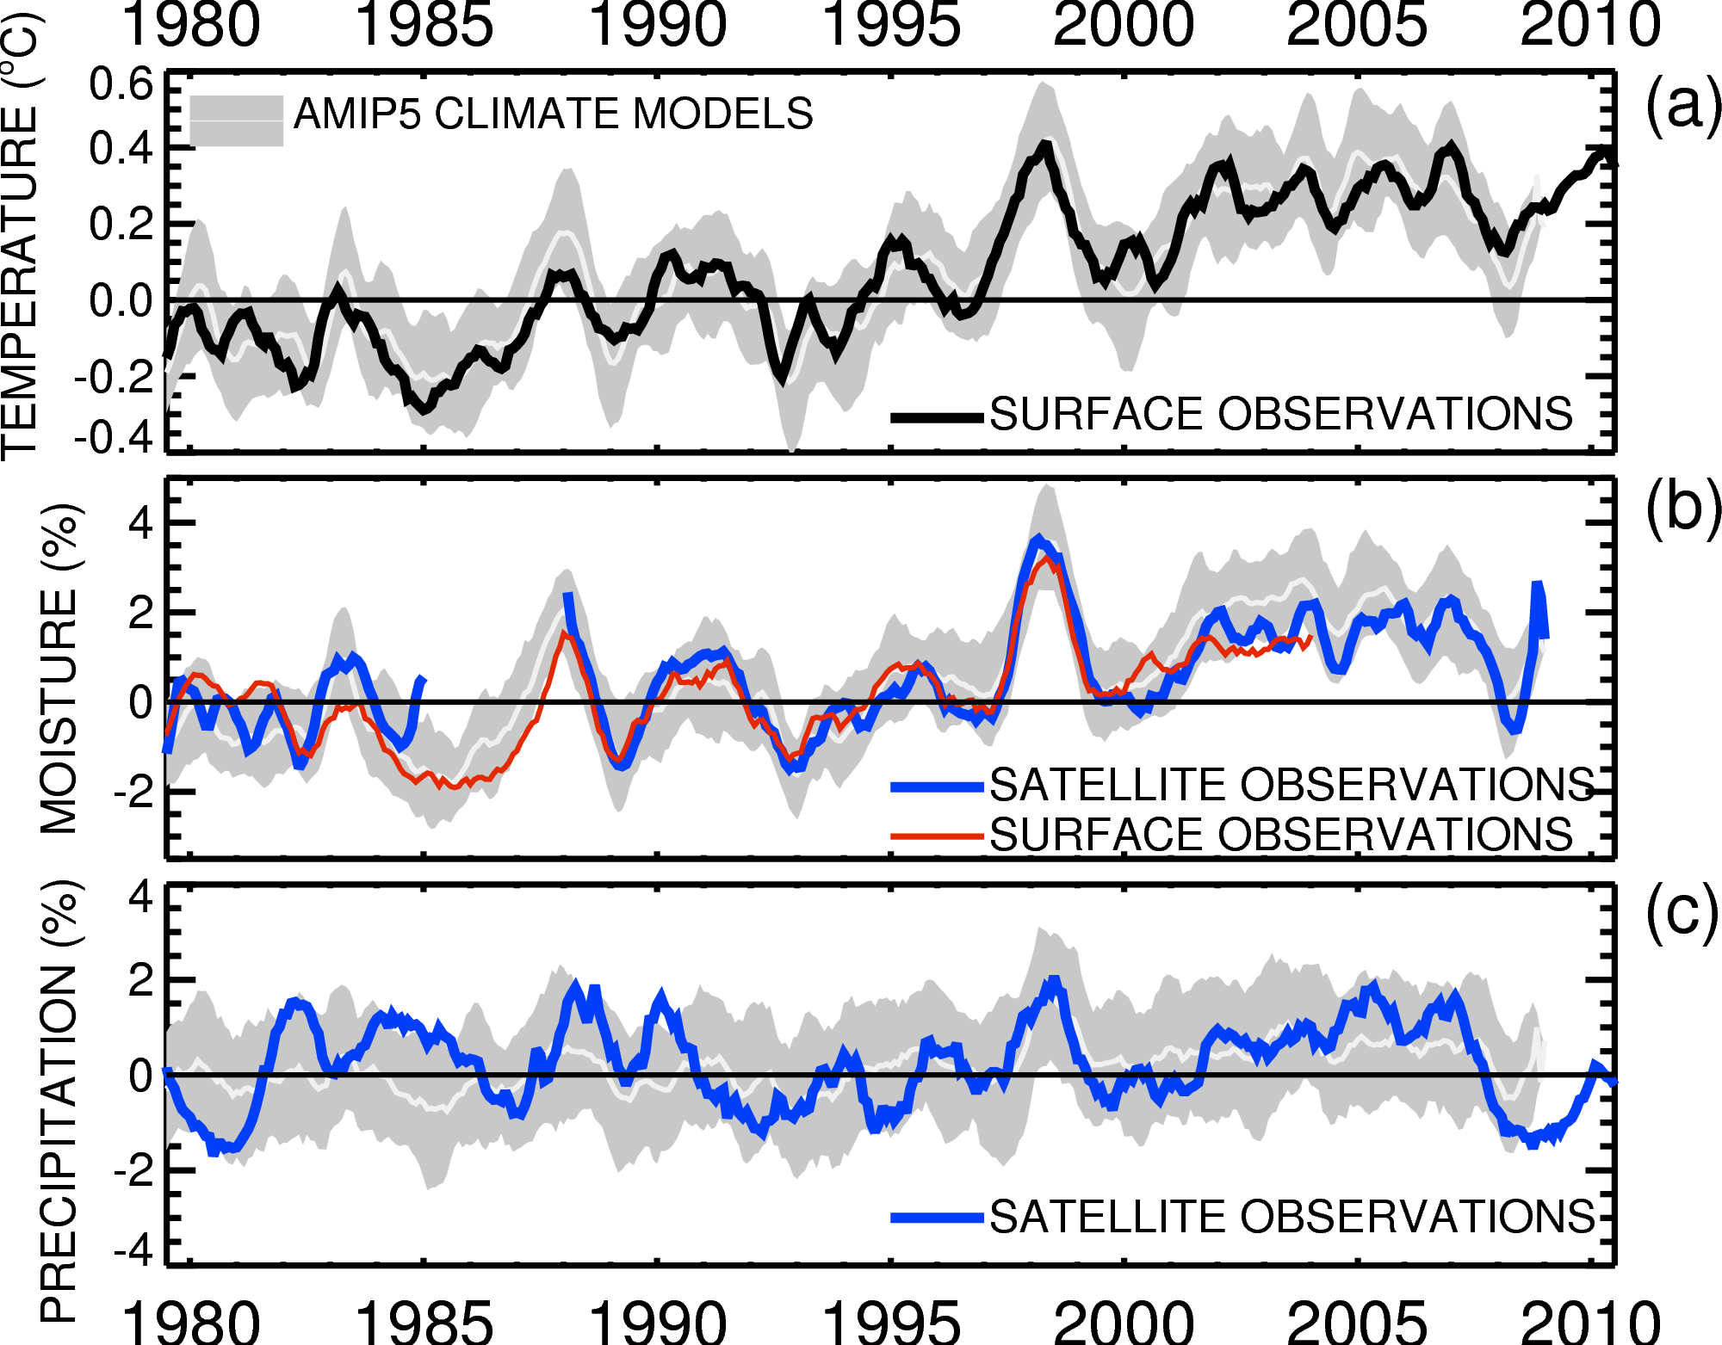
Current changes in global water cycle
Co-variation: dW/dTs ~ 7%/ºC
~1%/decade trend
Adapted from: Allan et al. (2013) Surv. Geophys

Slide 6
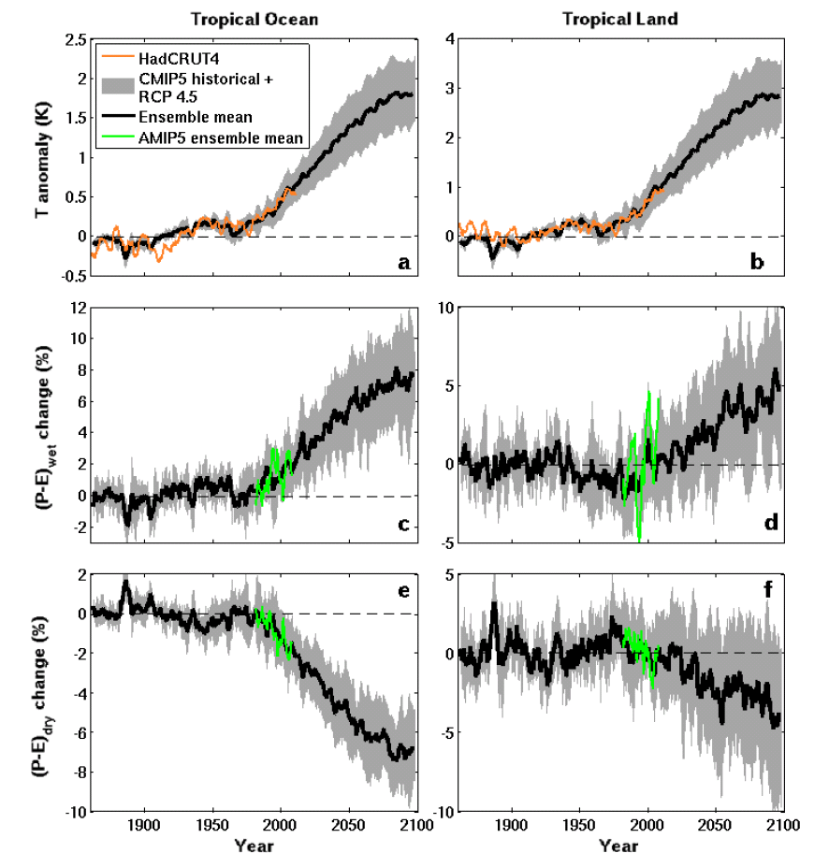
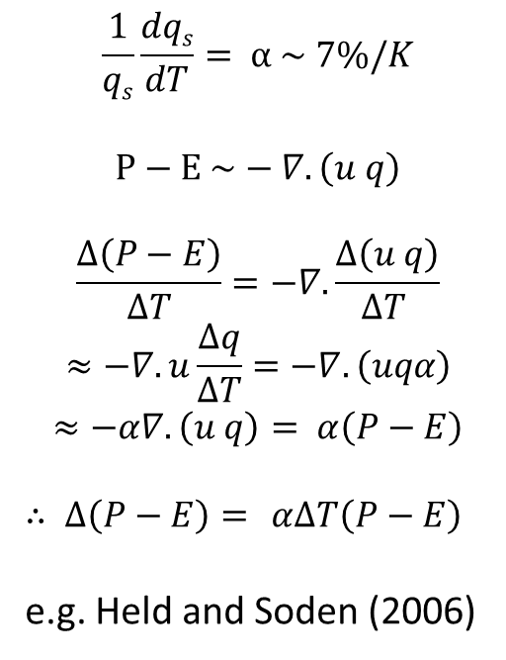
Tropical Ocean Tropical Land
Amplification of P–E with warming
$$\frac{1}{qs}\frac{dqs}{dT}= α \sim 7\%/K$$
$$P−E \sim −∇.\left(u q\right)$$
$$\frac{∆\left(P−E\right)}{∆T}=−∇.\frac{∆\left(u q\right)}{∆T }$$
$$≈−∇. u\frac{∆q}{∆T}=−∇.\left(uqα\right)$$
$$≈−α∇.\left(u q\right)= α\left(P−E\right)$$
$∴ ∆\left(P−E\right)=$ $α∆T\left(P−E\right)$
e.g. Held and Soden (2006)
CMIP
Δ(P–E) (%) WET
AMIP
Δ(P–E) (%) DRY
Liu and Allan (2013) ERL

Slide 7
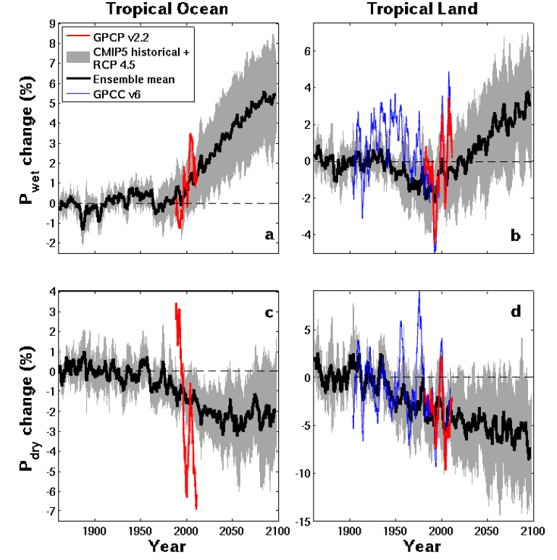


CMIP5 simulations: wettest tropical grid-points get wetter, driest drier
Discrepancy: wet tropical land
Ocean Land
GPCC, GPCP
Pre 1988 GPCP observations over ocean don’t use microwave data
dry tropical region wet
Precipitation Change (%)
Tropical dry Tropical wet
Robust drying of dry tropical land
30% wettest gridpoints vs 70% driest each month
Liu and Allan (2013) ERL Allan et al. (2010) ERL; Chadwick et al. (2013) J Clim, Allan (2012) Clim. Dyn., Balan Sarojin et al. (2013) GRL; Polson et al. (2013) J Clim

Slide 8
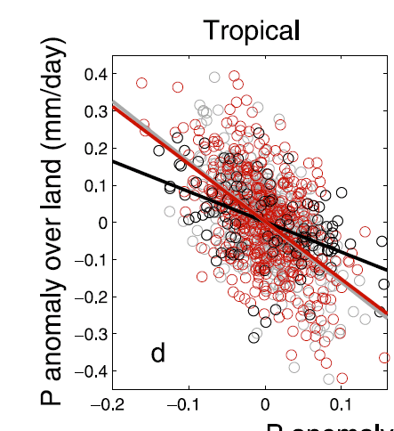
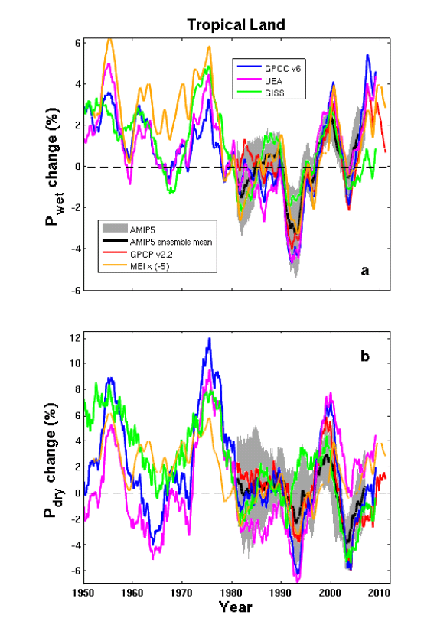
Interannual changes in precipitation over land
Interannual-decadal changes in continental rainfall dominated by: La Niña (more rain) & El Niño (less rain)
P anomaly over ocean (mm/day)
Land and ocean rainfall anti-correlated on interannual time-scale (above)
GISS AMIP
volcano
Liu, Allan, Huffman (2012) GRL
Liu & Allan (2013) ERL

Slide 9
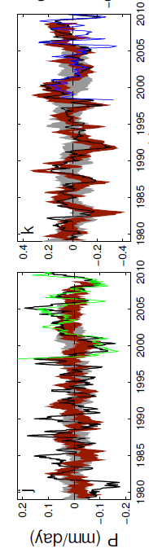
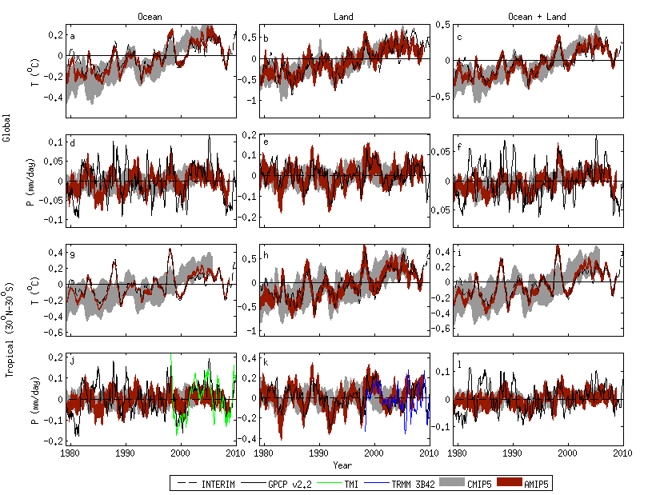
Tropical precipitation variability in satellite data and CMIP5 simulations
Note consistency between atmosphere-only AMIP model simulations over land and GPCP observations. This is not the case for the ocean, in particular before about 1996.
AMIP5 simulations with prescribed observed sea surface temperature can simulate GPCP observed rainfall variability over land.
Over oceans, the observing system appears questionable
Oceans Land
Tropical Ocean Tropical Land
La Niña
Volcano
El Niño
Liu, Allan, Huffman (2012) GRL

Slide 10
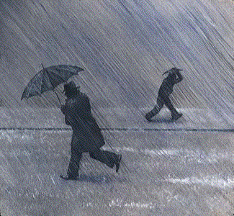
Precipitation Extremes
Observed surface temperature sensitivity
Averaging in time improves consistency amongst datasets
1 day average 5 day average
Change in Precipitation Intensity per ºC warming (%/day)
Increase of ~15% per ºC warming
10 mm/day
0 mm/day
20 mm/day
4 mm/day
Precipitation intensity percentile (%)
Liu & Allan (2012) JGR; see also O’Gorman (2012) Nature Geosci

Slide 11
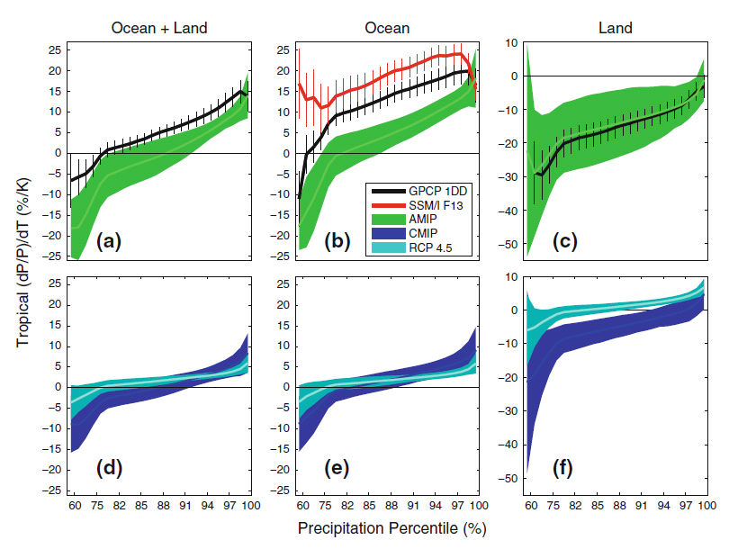
Changes in precipitation extremes
Allan et al. (2013) Surv. Geophys
②
dP/dT (%) Tropics
①
③
5-day means (observations and simulations)
① More positve dP/dT for heavier percentiles (observations & models)
② Observations have more positive sensitivity over the ocean
③ Mostly negative dP/dT for all percentiles over land due to less rainfall over land during El Niño when warmer tropical mean Temperatures
Notes:
5-day means.
More positve dP/dT for heavier percentiles (obs and models)
Higher observed sensitivity than models over ocean, good agreement over land.
Mostly negative dP/dT for all percentiles (apart from heaviest) over land. Partly due to less rainfall over land in El Nino when warmer tropical T
Coupled models: similar picture over ocean. Smaller sensitivity for highest percentiles under climate change since global increases in P with warming are muted by increasing CO2 levels.

Slide 12
Changes in precipitation extremes
Allan et al. (2013) Surv. Geophys
①
RCP4.5
2080-2099 minus 1985-2005
amip
amip
dP/dT (%) Tropics
③
Historical 1985-2005
②
① Smaller dP/dT sensitivity for coupled simulations (historical vs amip)
② Smaller dP/dT sensitivity under climate change (historical vs rcp4.5) as dP/dT supressed by direct atmospheric heating from rising greenhouse gases
③ More positive dP/dT over land under climate change (rcp4.5 vs historical) as Temperature rises un-related to ENSO for climate change response
CONCLUSIONS: a. Amplification of precipitation extremes with climate warming
b. Interannual variability is not a good proxy for climate change over land
Notes:
5-day means.
More positve dP/dT for heavier percentiles (obs and models)
Higher observed sensitivity than models over ocean, good agreement over land.
Mostly negative dP/dT for all percentiles (apart from heaviest) over land. Partly due to less rainfall over land in El Nino when warmer tropical T
Coupled models: similar picture over ocean. Smaller sensitivity for highest percentiles under climate change since global increases in P with warming are muted by increasing CO2 levels.

Slide 13

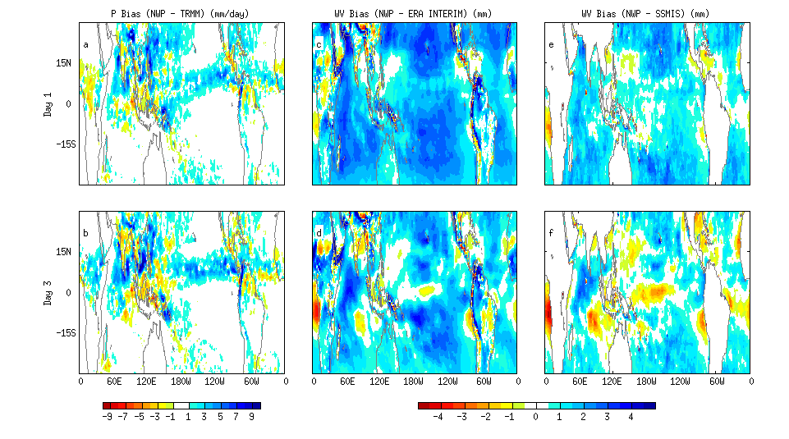
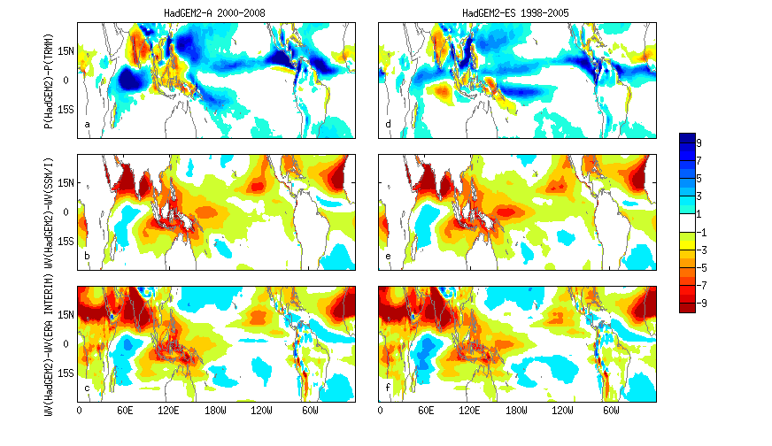
Linking systematic biases in water vapour & precipitation in NWP & climate models
PRECIPITATION Model – OBS WATER VAPOUR model – OBS
HadGEM2-ES HadGEM2-A NWP-day 3
Liu et al. (2013) JAMC
Notes:
Systematic biases in climate model simulations of precipitation are also evident in forecasts made by Weather Forecast models. This means that we may be able to exploit NWP models in exploring the reasons for systematic biases.

Slide 14
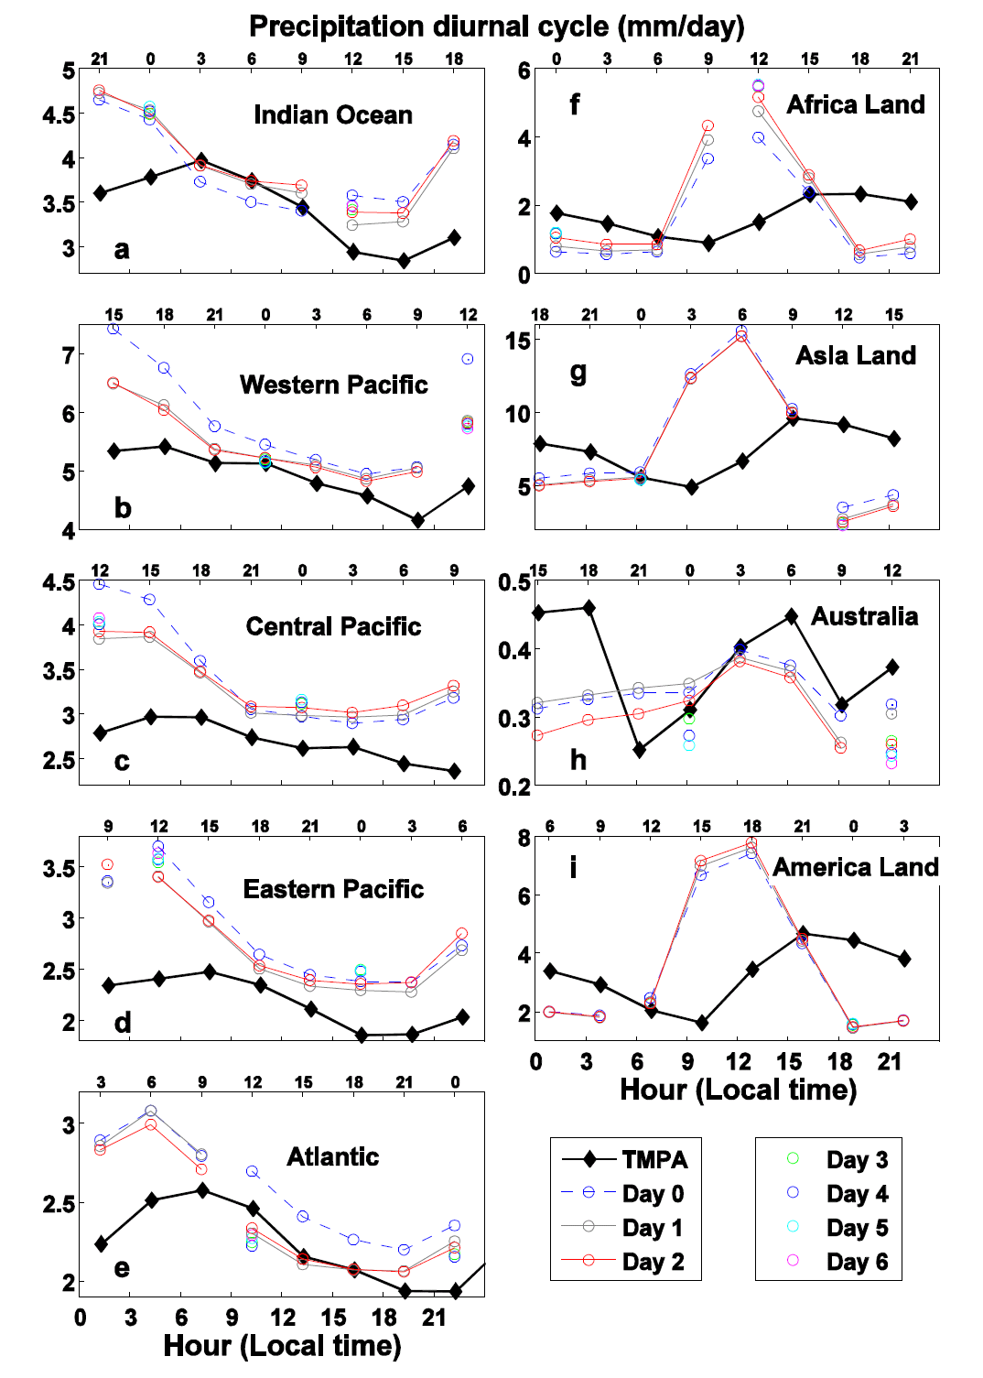
Diurnal cycle of precipitation
① Spin-up in P & water vapour in W. Pacific & Atlantic
② poor diurnal cycle over land
(i) timing
(ii) amplitude
①
②
①
Liu et al. (2013) JAMC

Slide 15
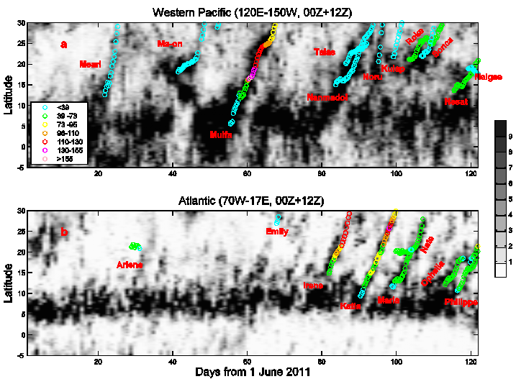
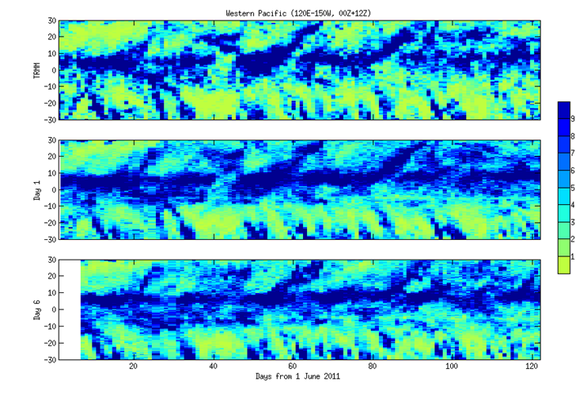
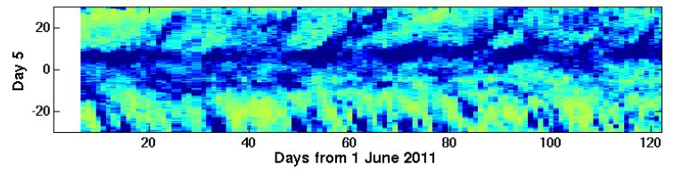
Tropical Cyclones and propagation of precipitation anomalies: NWP and TRMM
Liu et al. (2013) JAMC
Distinct propagation of precipitating systems northward from the West Pacific every 20-30 days: captured by NWP simulations
Western Pacific zonal mean Precipitation (mm/day):
NWP TRMM
Days since 1 Jun: 40 60 80 100 120
Notes:
Distinct propagation of precipitating systems northward from the West Pacific every 20-30 days: captured by NWP simulations

Slide 16
Project outcomes
Evaluation of blended observations (precip, water vapour)
  Liu & Allan (2012) JGR [LINK to Met Office partners]
Quantification of trends/hydrological sensitivity at global to largest regional scales (including extremes)
  Liu & Allan (2012) JGR; Liu et al. (2012) GRL; Allan et al. (2013) Surv Geophys in press; Liu & Allan (2013) ERL [LINK to Southampton/WP2]
  Process-based metrics (tropical wet/dry; land/ocean; dP/dT, dM_{F}/dT) [LINK to Edinburgh/WP4, WP5]
  Allan (2012) Clim. Dyn.; Allan et al. (2013) Surv. Geophys in press; Lavers et al. (2013) ERL; Liu & Allan (2013) ERL; Zahn & Allan (2013) WRR in press;
  Linking NWP forecast drift with climate model bias
    Liu et al. (2013) JAMC in press [LINK to Met Office partners]
Links to other NERC projects (HydEF, PREPARE)

Slide 17
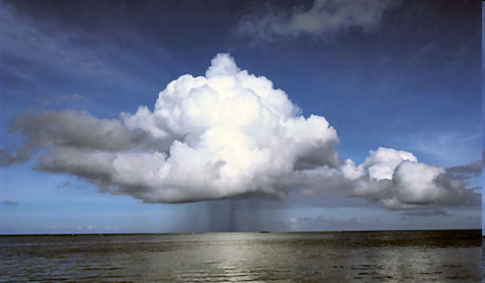
Science outcomes
  Global precipitation changes understood in terms of warming effect and atmospheric component of radiative forcing [Allan et al. 2013]
    increases with warming by ~3% per ºC of warming, offset by supressing effect from greenhouse gas forcing (energy balance constraint) [O’Gorman et al. 2012]
Robust increases in water vapour & transports with warming (~7%/K) [O’Gorman et al. 2012; Allan et al. 2013; Zahn & Allan 2013]
  wet get wetter, dry get drier [Allan 2012; Liu et al. 2012; Liu & Allan 2013]
  Erroneous precipitation variability & trends in reanalyses and some satellite datasets over the ocean [Liu & Allan 2012; Liu et al. 2012; Allan et al. 2013]
  AMIP simulations reproduce observed land P variability (land/ocean P anti-correlated → ENSO) [Liu et al. 2012; Liu and Allan 2013]
  Little agreement between AMIP and satellite observations of ΔP over ocean before 1996 [Liu et al. 2012]
  Amplification of precipitation extremes with climate warming, highest percentiles ~7%/K, less than variability [Liu and Allan 2012; Allan et al. 2013]
  Interannual variability is not a good proxy for climate change over land Tropics
Systematic water vapour and precipitation biases in climate models linked to NWP model drift [Liu et al. 2013]
Notes:
17
Projected Responses in Extreme Precipitation and Atmospheric Radiative Energy

Slide 18
WP3 Project Publications
Allan, R.P., C. Liu, M. Zahn, D. A. Lavers, E. Koukouvagias and A. Bodas-Salcedo (2013) Physically consistent responses of the global atmospheric hydrological cycle in models and observations, Surv. Geophys., doi:10.1007/s10712-012-9213-z
Liu, C.-L. and R. P. Allan, (2012) Multi-satellite observed responses of precipitation and its extremes to interannual climate variability, J. Geophys. Res. 117, D03101, doi:10.1029/2011JD016568
Liu, C. and R.P. Allan (2013) Observed and simulated precipitation responses in wet and dry regions 1850-2100, Environ. Res. Lett., 8, 034002, doi:10.1088/1748-9326/8/3/034002
Liu, C., R. P. Allan, and G. J. Huffman (2012) Co-variation of temperature and precipitation in CMIP5 models and satellite observations, Geophys. Res. Lett., 39, L13803, doi:10.1029/2012GL052093
Liu, C., R.P. Allan, M. Brooks, S. F. Milton (2013) Comparing tropical precipitation simulated by the Met Office NWP and climate models with satellite observations, J. Appl. Met. Clim, in press
Allan, R. P. (2011), Human influence on rainfall, Nature, 470, 344-34
Allan, R.P., (2012) Regime dependent changes in global precipitation, Climate Dynamics 39, 827-840 10.1007/s00382-011-1134-x
Allan R. P. (2012) The role of water vapour in Earth's energy flows, Surv. Geophys., 33, 557-564, doi: 10.1007/s10712-011-9157-8
O'Gorman, P. A., R. P. Allan, M. P. Byrne and M. Previdi (2012) Energetic constraints on precipitation under climate change, Surv. Geophys., 33, 585-608, doi: 10.1007/s10712-011-9159-6
Polson D., G.C. Hegerl, R. P. Allan and B. Balan Sarojini (2013) Have greenhouse gases intensified the contrast between wet and dry regions? Geophys. Res. Lett., 40, 4783-4787. doi:10.1002/grl.50923
Zahn, M. and R. P. Allan, (2013) Quantifying present and projected future atmospheric moisture transports onto land, Water Resources Research. in press, doi:10.1002/2012WR013209
Zahn, M. and R. P. Allan, (2013) Climate Warming related strengthening of the tropical hydrological cycle, J Climate. 26, p.562-574, doi: 10.1175/JCLI-D-12-00222.1
In Preparation:
Hegerl, G.C., E. Black, R.P. Allan and co-authors (2014) Quantifying changes in the global water cycle, Bull. Americ. Meteorol. Soc, submitted (again…)
Skliris, N., R. Marsh, S. A. Josey, S. A. Good, C. Liu, R. P. Allan (2014) Salinity changes in the World Ocean since 1950 in relation to changing surface freshwater fluxes submitted to Climate Dynamics, under review

Slide 20
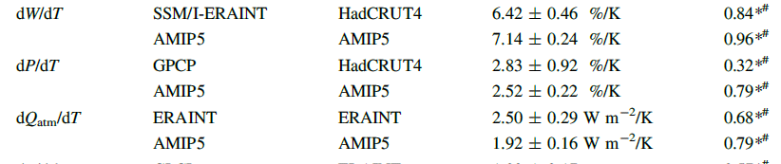
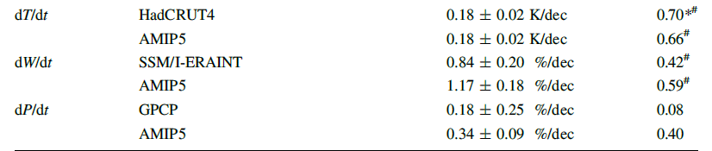
Trends 1988-2008 (W=atmos moisture, T=surface temperature, P=precip, t=time)
Allan et al. (2013) Surv. Geophys

Slide 21
Floating Tasks in WP3
Calculate energy and water budgets
P-E fields and links to salinity (ongoing collaboration with WP2)
heat flux feedbacks in the tropical central Pacific
fingerprints of terrestrial evaporation in observations and models (CEH)
Update the CRUTS3.0 precipitation dataset (UEA)

Slide 22
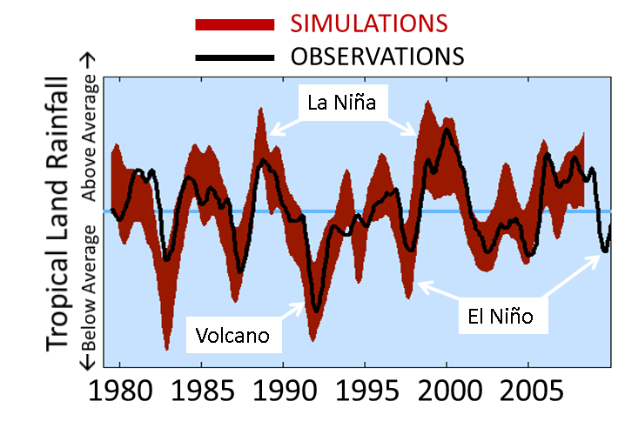
Climate model simulations capture variability in rainfall over land
AMIP5 simulations with observed sea surface temperature as boundary conditions can simulate GPCP observed rainfall variability over land.
Over oceans, the observing system appears questionable
Liu, Allan, Huffman (2012) GRL; Liu and Allan (2013) ERL
Notes:
Although AMIP5 simulations prescribe ocean surface temperatures, land temperature is free to evolve. This is important for two reasons: (1) if models can simulate changes in sea surface temperatures then they are likely to be able to capture the changes in rainfall over land (2) surface temperature over many land regions is driven by changes in rainfall rather than land temperature determining rainfall (more cloud and rain means less solar heating and more surface evaporative cooling leading to cooler surface temperatures)

