Slide 1
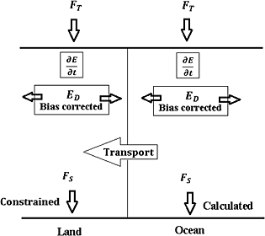
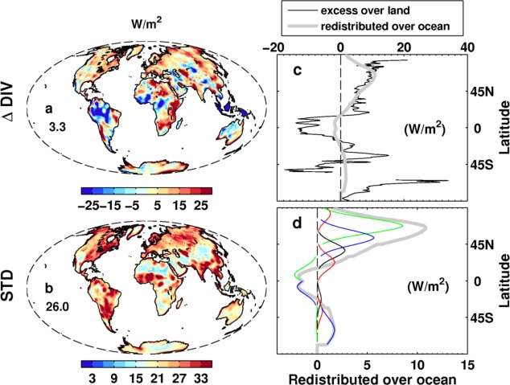
DEEP-C surface energy flux product (Richard Allan, Chunlei Liu, University of Reading)
CERES/ERBS
Combine satellite-based top of atmosphere radiation budget (Allan et al. 2014 GRL) with reanalysis energy transports (e.g. Berrisford et al. 2011) at each grid point.
Compute surface total energy flux as residual (e.g. Trenberth & Solomon 1994)
Method: Liu et al. (2015) JGR
reanalyses
Unrealistic energy flux over land – corrected using simple energy balance model (observed dTs, simulated heat capacity)
Redistribute adjusted energy flux over ocean (by hemisphere or latitude bands)

Slide 2
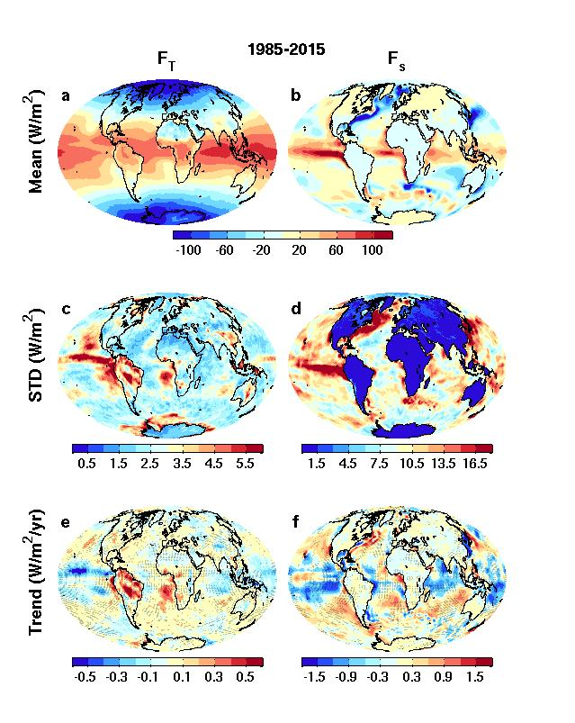
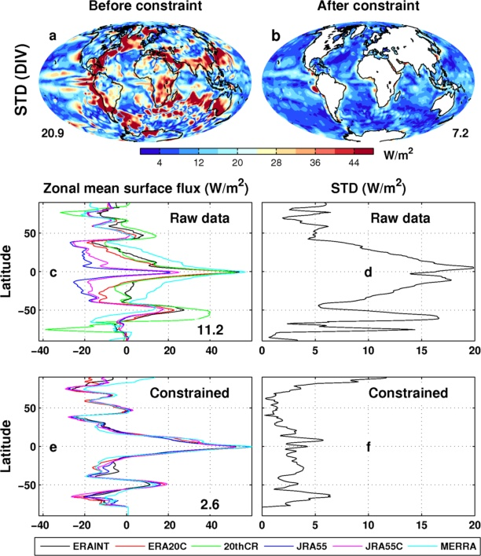
Net downward energy flux & trends top of atmosphere surface

Slide 3
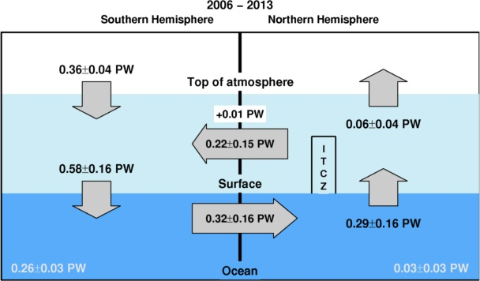
Future Plans
Evaluation of method/comparison with in situ observations
Regional changes in energy flux and links to hiatus & feedbacks on internal variability (SMURPHS project)
Investigation of southern ocean model bias in energy fluxes
Reconcile top of atmosphere radiation and 3D ocean heating distribution and associated mechanisms
Role of cloud and latent heat changes in E Pacific
Calculation of hemispheric energy imbalance and transports (petawatt, right) – implied ocean transports seem low
Updated from Loeb et al. (2015) Clim. Dyn. For 2006-2013 based on Liu et al. (2015) JGR

Slide 5


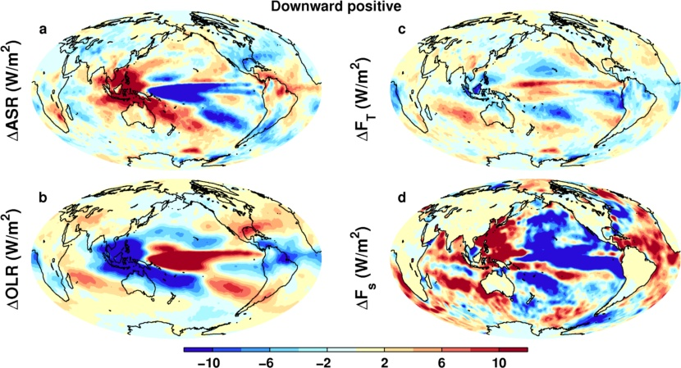
El Niño minus La Niña changes in energy fluxes
TOA solar
TOA net
Surface NET energy rad+turb
-
TOA LW DOWN
Plot by Chunlei Liu: 1985-2015 (Allan et al. (2014) GRL and Liu et al. (2015) JGR)
Notes:
Changes in top of atmosphere LW and SW consistent with shifts in cloud due to ENSO. These compensate in the NET TOA fluxes for high/deep cloud but a residual signal is evident over the Pacific ITCZ (stronger cloud greenhouse effect dominates more reflected sunlight), the Pacific stratocumulus zones (more absorbed sunlight AND more downward LW).
The surface energy flux looks quite different as there is a large heat flux out the east Pacific in El Nino and reduced horizontal transport by a weaker Walker circulation (presumably less negative energy flow from the cooler east to warmer west so therefore greater energy convergence in the warm pool).

