Slide 1
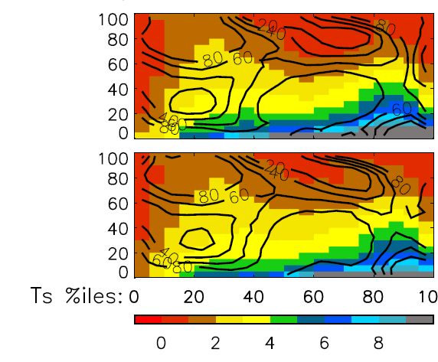
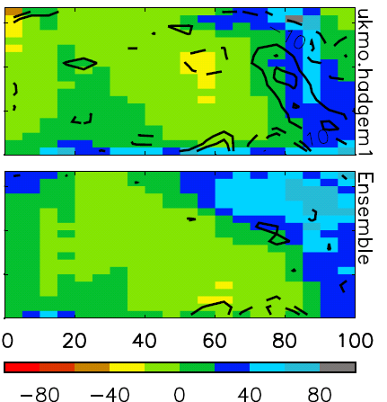
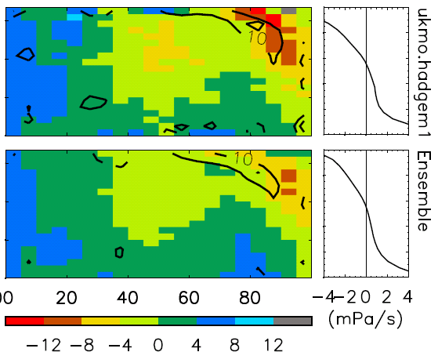
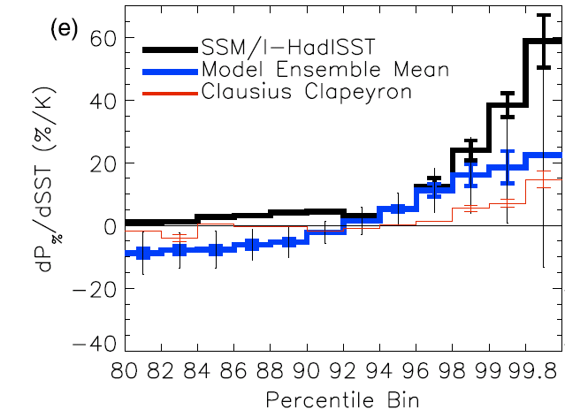
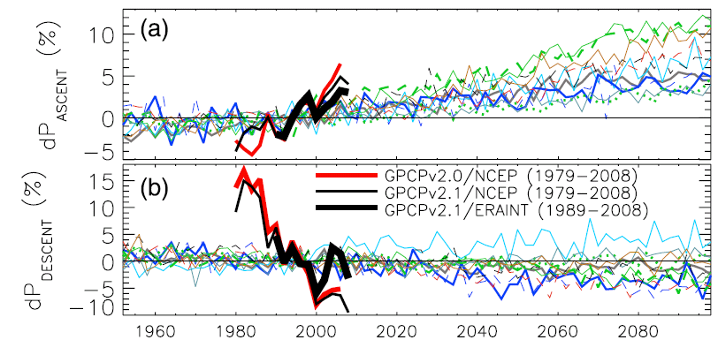
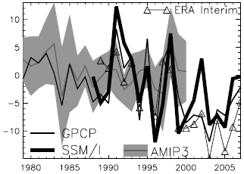
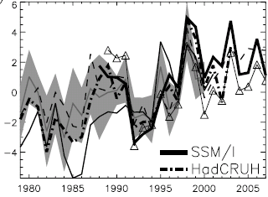
Current and future changes in global precipitation
Introduction
Changes in the atmospheric component of the global water cycle, including precipitation and its extremes, are of primary concern in planning and adapting to climate change. Climate models are our only tools for projecting future changes in climate. Here we assess future climate model projections in the context of current changes in precipitation using blended satellite observations.
The wet get wetter
Reanalysis vertical motion fields are used to define “wet” ascending and “dry” descending branches of the tropical circulation for use with satellite precipitation products. Mean precipitation is calculated separately for each region (Fig. 1; Allan et al. 2010) for models and GPCP/reanalyses
There are positive precipitation trends in the wet regions and negative trends in the dry regions
Observed trends appear stronger than model trends but are sensitive to the reanalysis vertical motion used
Tropical rainfall intensification
Daily precipitation was sorted by intensity. Bin boundaries were calculated and monthly anomalies in frequency in each bin computed. Linear regression with SST was applied to estimate precipitation response to warming (Fig. 2)
The most intense 1% of daily events explains 66% of the variability in the SSM/I monthly precipitation anomalies over the tropical ocean
The observed intensification of rainfall lies at the upper bounds of the model responses (vertical lines)
The range in model responses of the most intense tropical rainfall to warming is considerable
(a) P (mm/day); % area (b) Model–GPCP P (%) (c) 2080-99 – 1980-99 P (%/K); (d) ω
Vertical motion (ω) percentiles
ascent descent
Figure 4. Precipitation binned in percentiles of vertical motion (0-5% bin is strongest ascent) and temperature (95-100% bin is warmest) for the HadGEM1 model (top) and an ensemble of 10 CMIP3 models (bottom). (a) Mean precipitation and % area enclosed in each contour, (b) model – GPCP precipitation and model change in (c) precipitation (scaled by temperature change) and (d) vertical motion for 2080-99 minus 1980-99
Regional changes in north Atlantic
Regional changes in precipitation are dominated by dynamics
Trends in the north Atlantic region in summer are apparent with increases in column integrated water vapour yet an apparent decline in precipitation for SSM/I microwave data and ERA Interim (Fig. 3)
Models forced with observed SSTs simulate increases in moisture with warming (3.7 %/K), similar to ERA interim but lower than SSM/I & HadCRUH observations (>5 %/K)
Models do not capture an observed negative relationship between precipitation and surface temperature
Changes within dynamical regimes
Monthly precipitation is computed for percentile bins of vertical motion and temperature for models (Fig. 4a) and GPCP data.
Models overestimate precipitation over the warm, descending bins when compared to GPCP data (Fig. 4b)
Model precipitation responses over the 21st century (Fig. 4c):
increases in cold bins and warm, ascending bins (tropical wet regions)
less precipitation for warm, convectively suppressed tropical regions
Wet/dry precipitation responses (Fig. 1) are counteracted by reduced magnitudes of ascent and descent (Fig. 4d), linked to a weakened tropical circulation (Zelinka and Hartmann, 2010)
Figure 2. Linear fit between frequency of tropical ocean precipitation in high percentile bins of intensity (P%) and sea surface temperature (SST) for satellite observations (SSM/I), AMIP3 models and Clausius Clapeyron scaling (dP/dT=0.07P). See Allan et al. (2010) for further details.
Models
Figure 1. Changes in 2-year mean tropical precipitation anomaly , P (%), calculated separately for (a) ascending and (b) descending branches of the tropical circulation for CMIP3 models and GPCP blended observations. The ascent and decent regions are defined by NCEP or ERA Interim reanalyses
Figure 3. June-August anomaly in precipitation (top) and column integrated water vapour (bottom) over north Atlantic (30-60N, 10-70W).
References
Allan, R. P., B. J. Soden, V. O. John, W. Ingram and P. Good (2010) Current changes in tropical precipitation, Environ. Res. Lett., 5, doi:10.1088/1748-9326/5/2/025205
Allan, R. P. and I. I. Zveryaev (2010), Variability in the summer season hydrological cycle over the Atlantic-Europe region 1979-2007, Int. J. Climatol., in press.
Zelinka, M. D., and D. L. Hartmann (2010), Why is longwave cloud feedback positive?, J. Geophys. Res., 115, D16117, doi:10.1029/2010JD013817.
Rainfall responses: key constraints
Global precipitation rises due to enhanced radiative cooling
Intense rainfall in the wet regions of the tropics is constrained by enhanced moisture convergence determined by the Clausius Clapeyron equation (surface moisture increases at ~7%/K)
Enhanced moisture divergence in the dry subtropics explains a component of the projected drying in these regions
Interplay between energetics and thermodynamics, involving increased static stability, imply weakening of the atmospheric circulation in the tropics (Zelinka and Hartmann, 2010)
Trends were recalculated using the precipitation fields to define the wet and dry regions (30% wettest and 70% driest grid boxes):
Water Vapour (%) Precipitation (%)
Contact information
1 - Department of Meteorology, University of Reading, Whiteknights, RG6 6AL
Email: r.p.allan@reading.ac.uk Web: www.reading.ac.uk/~sgs02rpa
2 - RSMAS, University of Miami ; 3 - Met Office, Exeter ; 4 - P. P. Shirshov Institute, Moscow
Notes:
1

