Slide 1
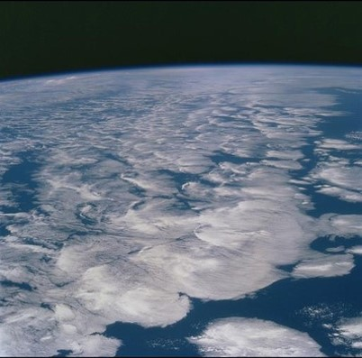


Earth’s ENERGY and water cycles: ongoing projects
Department of Meteorology
Richard Allan r.p.allan@reading.ac.uk @rpallanuk
Summary of current research projects and results
LIMITLESS B***** BLOODY **** G*VE FLIPPIN’ #*”%*& ETC

Slide 2
Current and recent projects
NERC CWC projects (PAGODA, HYDEF )
DEEP-C – Understanding changes in Earth’s energy balance in the context of current climate change and variability (NERC)
SINATRA – Work task on atmospheric precursors to intense summer rainfall (NERC FFIR programme)
DACCIWA – Clouds, Radiation & Aerosol over West Africa (EU)
3D Shortwave Radiative Kernels of Marine Boundary-layer Clouds (DoE)
NCEO – Cloud, Radiation & Precip studies & prep for Earthcare
TAMSAT – changes in Africa rainfall including PhD project
Simple model for precipitation (PhD project)

Slide 3
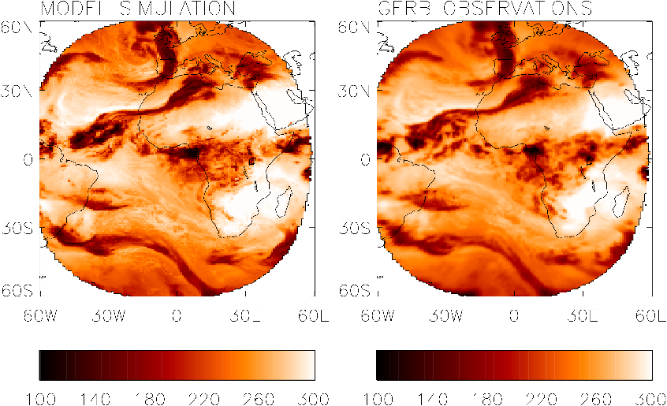
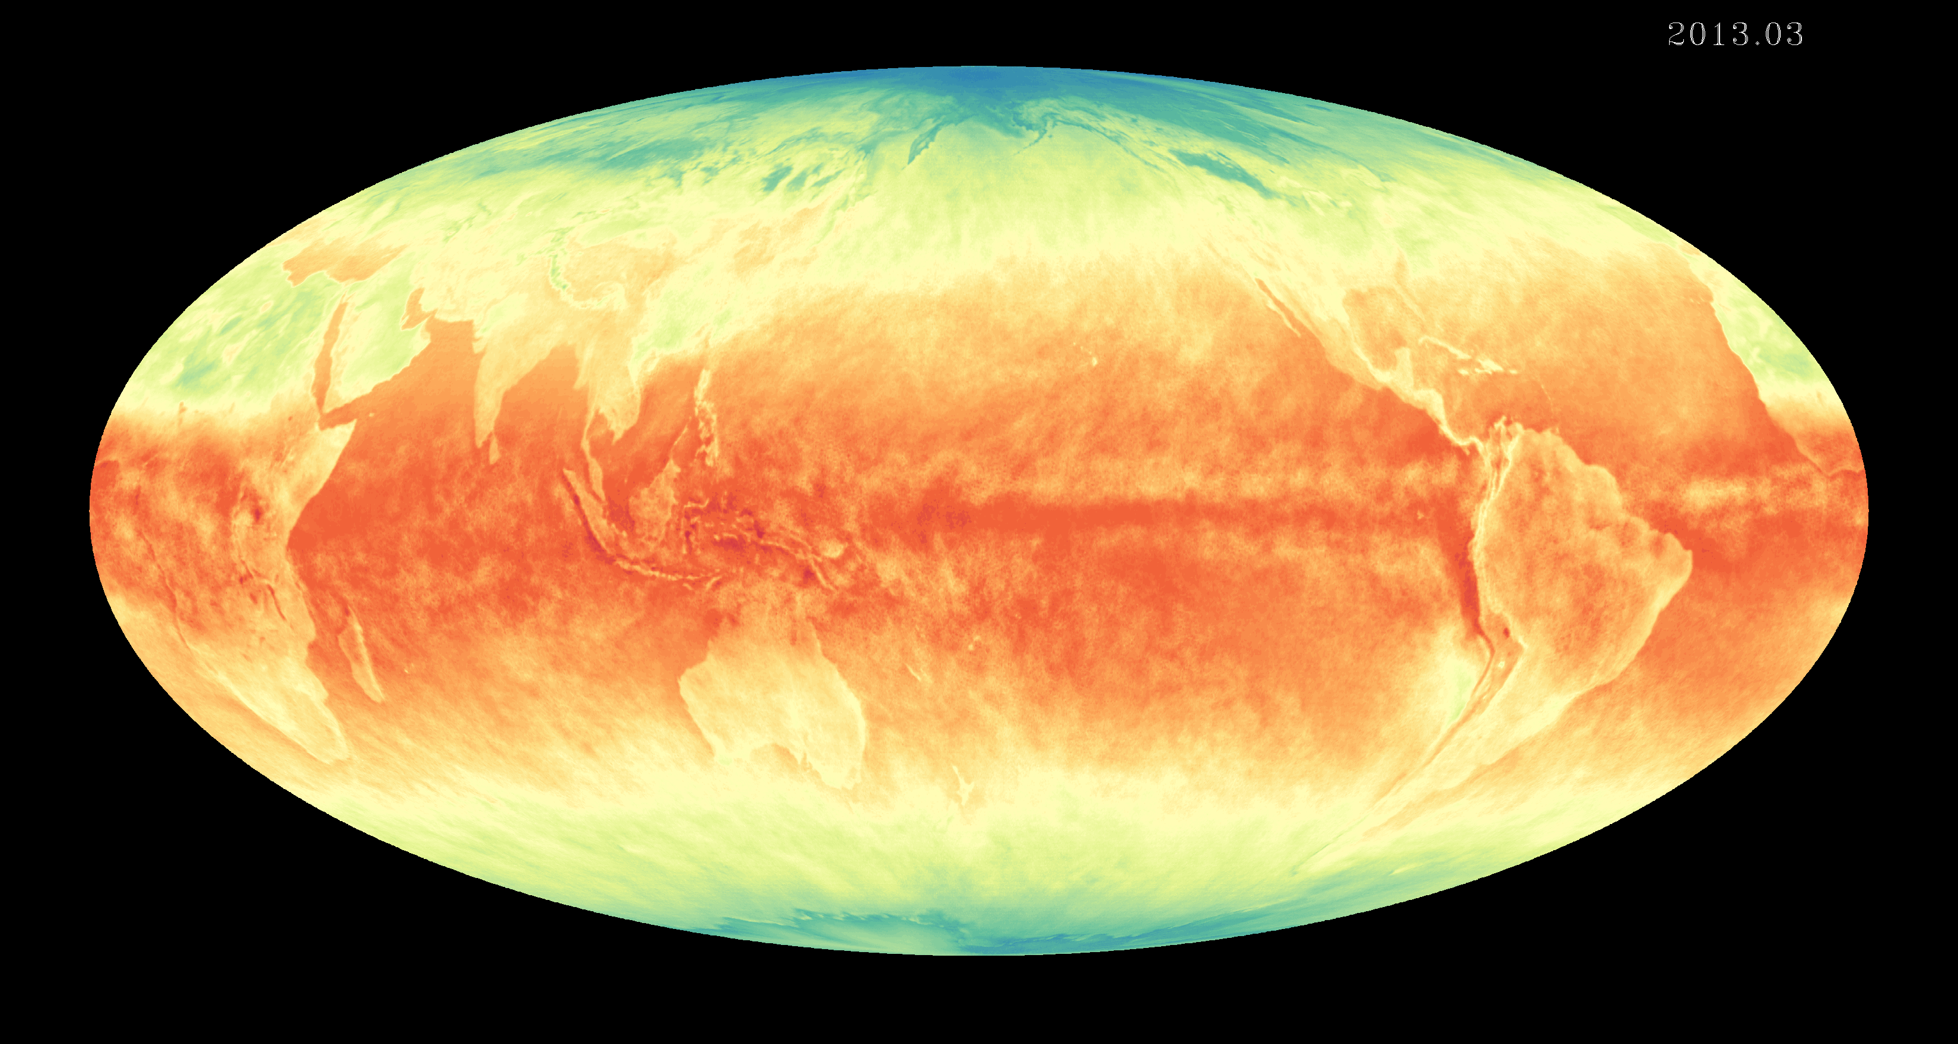
Earth’s radiative energy budget and climate
Earth’s radiative energy budget represents a nexus between radiative forcings, feedbacks & climate response
Powerful constraint upon hydrological cycle
Versatile diagnostic of the impact of clouds, aerosol, water vapour greenhouse effect and atmospheric circulation
CERES
T. Wong
Notes:
The Earth’s radiative energy balance represents a nexus between changes in radiative forcings (which set the trajectory of climate change) and climate response (the magnitude of which is determined by feedbacks which may amplify or diminish climate responses) but is also influenced by unforced variability internal to the climate system
GERB: 2011 -10-24_0600

Slide 4
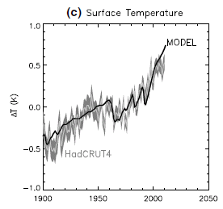
A Simple energy balance model of earth’s climate
Oceans dominate the heat capacity of climate system
Temperature change linked to radiative forcings (∆F) and response which depends on feedbacks Y.
Heat uptake by the deep ocean is important in the timescale and variability of climate change
Simple models are useful for interpreting climate change
ΔF–YΔT
ΔT
D
ΔT_{d}
e.g. Allan et al. (2014) Surv. Geophys

Slide 5
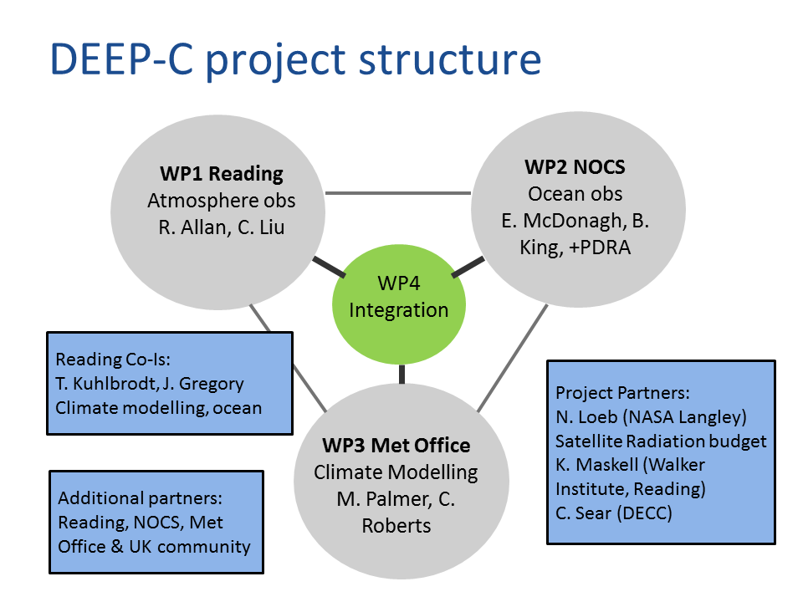
Diagnosing earth’s energy pathways in the climate system: DEEP-C
4-year NERC consortium (Reading/Met Office/NOC) tackling the questions:
What explains apparent slowing in global surface warming rate since around 2000
Where is excess energy due to rising greenhouse gas concentrations currently accumulating in the climate system?
~sgs02rpa/research/DEEP-C.html

Slide 6
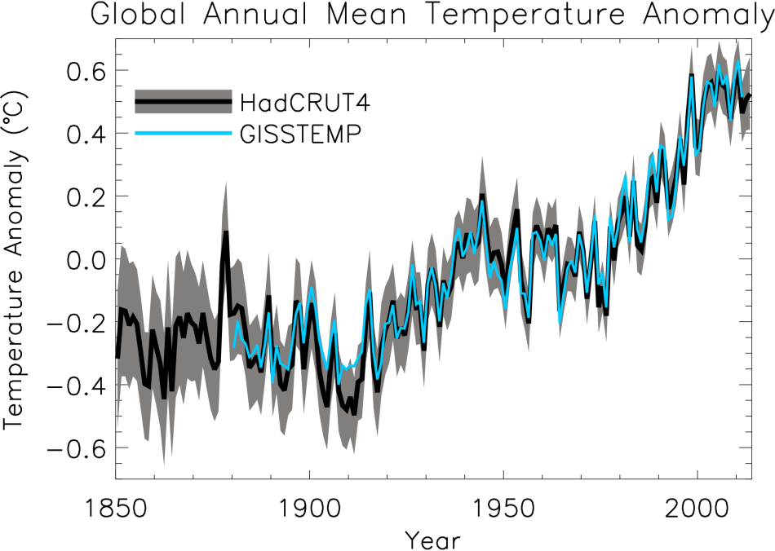
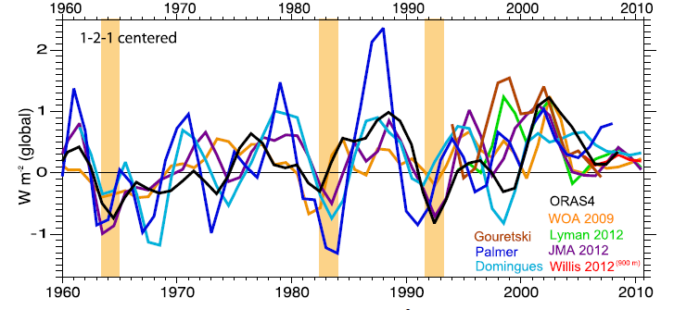
At what rate is Earth heating?
ºC Surface Temperature
Upper ocean (Wm⁻²)
Trenberth et al. (2014) J Clim

Slide 7
Unforced variability in
Earth’s eneRgy budget
Diverse range of unforced variability in CMIP5 pre-industrial control simulations
Left: variations in total energy content of Earth’s climate system across CMIP5 simulations
Palmer & McNeall (2014) ERL
Notes:
Future work?

Slide 8
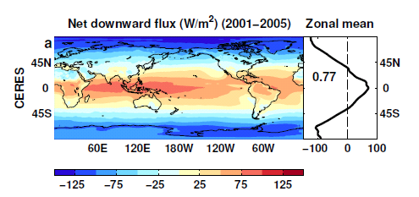
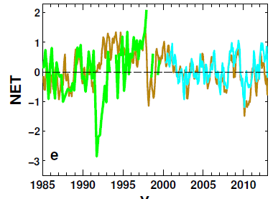
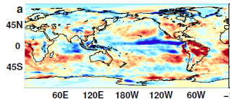
Reconstructing global radiative fluxes since 1985
ERBS/CERES variability
CERES monthly climatology
ERBS WFOV
CERES
ERA Interim
ERA Interim spatial anomalies
Combine CERES/ARGO accuracy, ERBS WFOV stability and reanalysis circulation patterns to reconstruct radiative fluxes

Slide 9
Net Imbalance Anomaly (Wm⁻²)
Earth continues to heat up
Imbalance: 0.23 0.00 0.78 0.63 0.63 (Wm⁻²)
0.34±0.67 Wm⁻²
0.62±0.43 Wm⁻²
La Niña
El Niño
Volcano
Allan et al. (2014) GRL

Slide 10
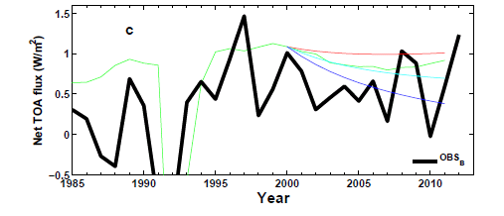
Understanding changes in net imbalance
+ve RF trend
AR5 RF
0 RF trend
-ve RF trend
N
N=ΔF–YΔT
ΔT
D
Analysis using simple energy balance model Allan et al. (2014) GRL supplementary
ΔT_{d}

Slide 11
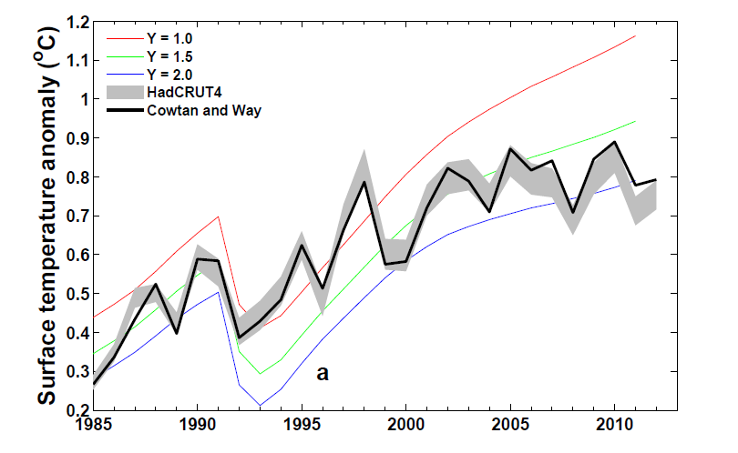
Implications for climate sensitivity?
?Can comparisons tell us about how sensitive climate is to radiative forcing Otto et al. (2013) Nature Geosci
Infilling data gaps influences surface
temperature trends (Cowtan & Way, 2013 QJRMS) and ocean heat content (Lyman & Johnson 2014 J. Clim.)
Allan et al. (2014) GRL supplementary

Slide 12
Discrepancy between radiation budget & ocean heating
Large ocean heating anomaly in 2002
Inconsistent with radiation budget observations and simulations
Changing observing system influence?
Slight drop in net flux 1999-2005?
Smith et al. (2015) GRL

Slide 13
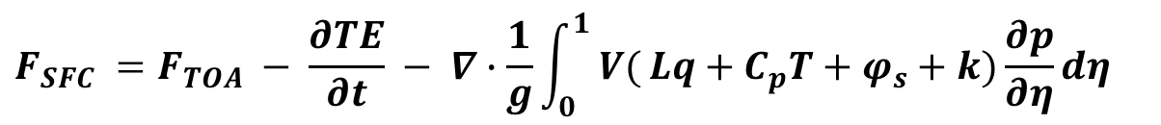
Where is the heat going?
New Estimates of surface energy flux
$$F_{SFC} =F_{TOA} − \frac{∂TE}{∂t} − ∇∙\frac{1}{g}\int_{0}^{1}{ V(}Lq+C_{p}T+φ_{s}+k)\frac{∂p}{∂η}dη$$
CERES/Argo Net Flux
Estimate horizontal energy flux
Surface Flux
Net surface downward energy flux (Wm⁻²)
Liu et al. (2015) in prep

Slide 14
Where is the heat going? changes in surface energy flux
Changes in energy fluxes 1986-2000 to 2001-2008
Surface energy flux dominated by atmospheric transports
Contrasting model pattern of change
Are reanalysis transports reliable?

Slide 15
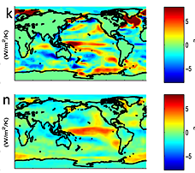
feedbacks on internal variability?
← Right: less heat flux out of east Pacific during warm phases?
Models may underestimate interdecadal variability
Are there positive heat flux feedbacks which amplify internal climate variability?
TOA flux (down) surface flux (up)
Brown et al. (2015) JGR

Slide 16
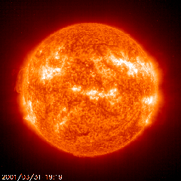
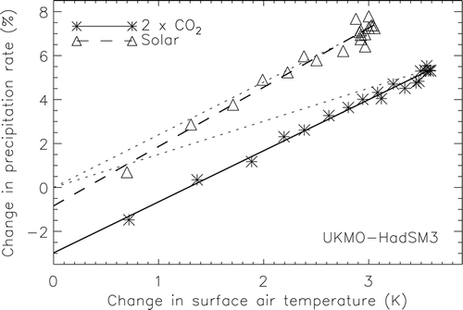
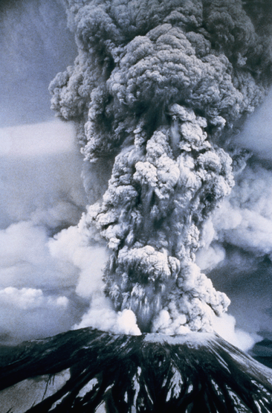
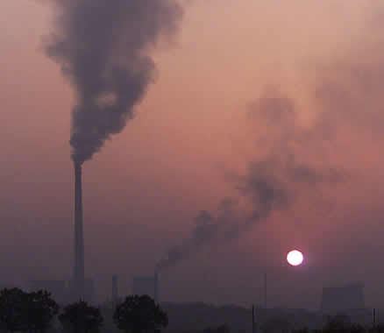
Earth’s Energy budget and precipitation response
LΔP ≈
kΔT – f_{F}ΔF
k
Andrews et al. (2009) J Climate
See also: Allen and Ingram (2002) Nature ; O’Gorman et al. (2012) Surv. Geophys ; Pendergrass & Hartmann (2012) GRL
Notes:
16

Slide 17
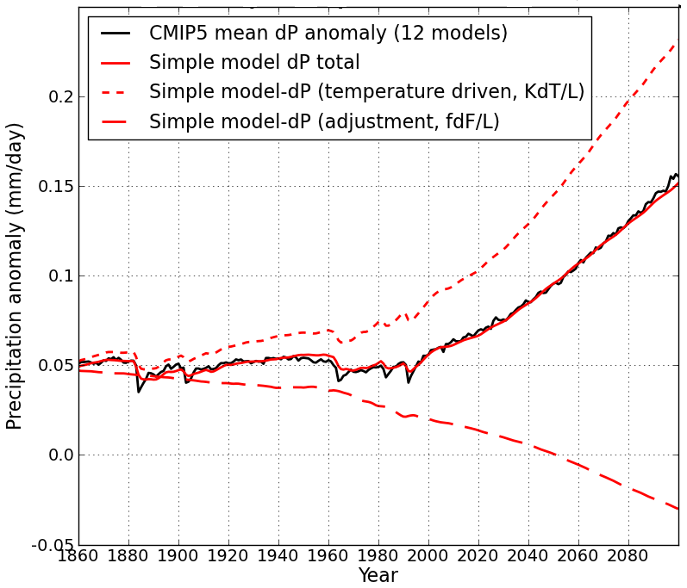
Simple model for global precipitation PhD project (Zahra Mousavi, Keith Shine)
Using simple model:
LΔP = kΔT – f_{F}ΔF
Precipitation change (mm/day)
N=ΔF–YΔT
CMIP5 historical/RCP8.5
ΔT
D
After Allan et al. (2014) Surv. Geophys and Thorpe and Andrews (2014) ERL
Notes:
17
There is huge uncertainty in global precipitation projections, relating both to climate sensitivity and mitigation pathways.
In PAGODA we are understanding the precipitation changes at the largest scales relating both to the warming (in response to radiative forcings) and and also the direct effect of the radiative forcings themselves on precipitation.

Slide 18
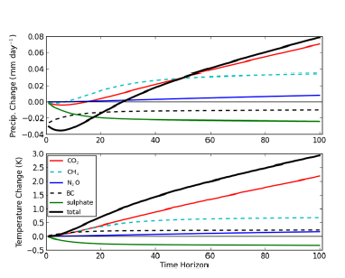
Metrics for global precipitation
Metrics linking emissions to precipitation response
Precipitation and temperature response to constant emissions after 2008
Shine et al. (2015) in prep:

Slide 19
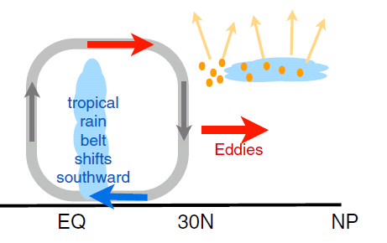
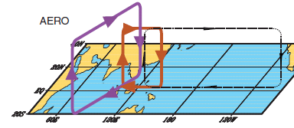
earth’s energy budget & regional changes in the water cycle
Regional precipitation changes sensitive to asymmetries in Earth’s energy budget
N. Hemisphere cooling: stronger heat transport into hemisphere
Reduced Sahel rainfall from:
Anthropogenic aerosol cooling 1950-1980s: Hwang et al. (2013) GRL →
Asymmetric volcanic forcing e.g. Haywood et al. (2013) Nature Climate
Enhanced energy transport
cooling
Sulphate aerosol effects on Asian monsoon e.g. Bollasina et al. 2011 Science (left)
Links to drought in Horn of Africa? Park et al. (2011) Clim Dyn
GHGs & Sahel rainfall recovery?
Dong & Sutton (2015) Nature Clim.

Slide 20
Observed Asymmetry in earth’s energy budget
Observed inter-hemispheric imbalance in Earth’s energy budget
Not explained by albedo: brighter NH surface but more clouds in SH (Stephens et al. 2015)
Imbalance explains position of ITCZ (Frierson et al. 2013)
Loeb et al. (2015) in review

Slide 21
Equatorial heat transport and model precipitation bias
Clear link between bias in cross-equatorial heat transport by atmosphere and inter-hemispheric precipitation asymmetry
Models
CERES/ERA Interim
Loeb et al. (2015) in review
More rain in NH →

Slide 22
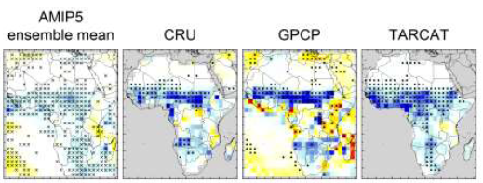
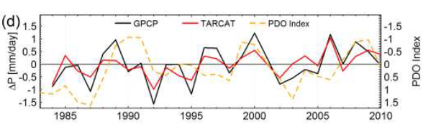
TAMSAT projects:
Recent trends in africa rainfall
Evaluating and understanding recent changes in Africa rainfall (Ross Maidment, Emily Black)
PhD project extending this work: changes in impact-relevant metrics for Africa (Caroline Dunning, Emily Black)
Maidment et al. (2015) submitted

Slide 23
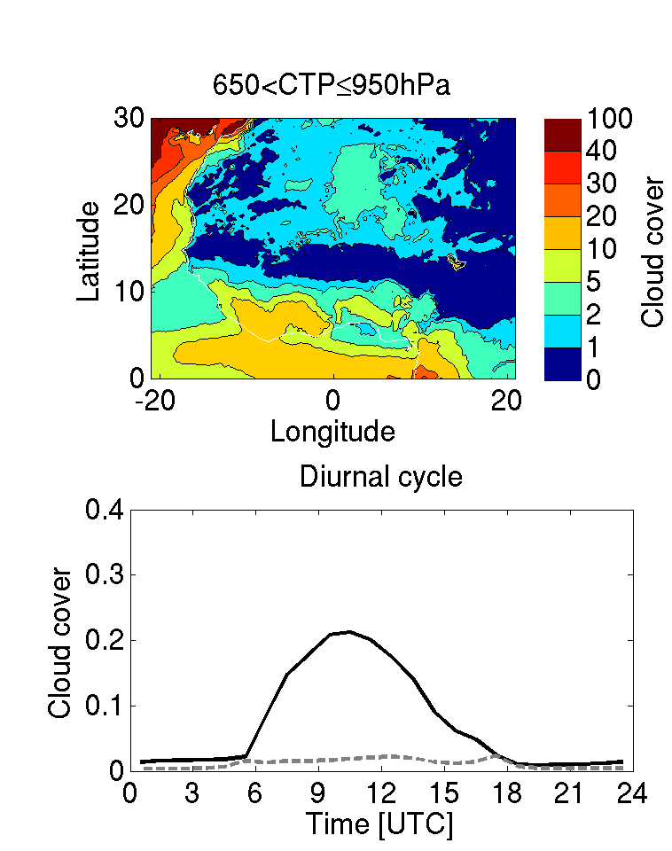
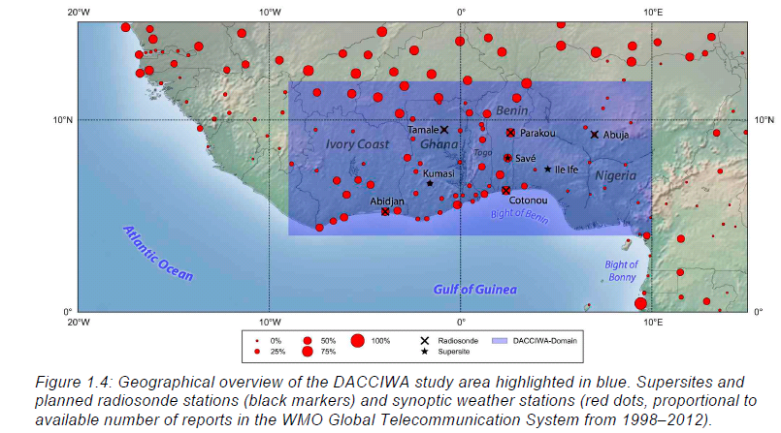
Dynamics-aerosol-chemistry-cloud interactions in West Africa (DACCIWA)
EU consortium lead by Peter Knipperts
Radiation Budget & Clouds: Christine Chiu, Thorwald Stein, Peter Hill

Slide 24
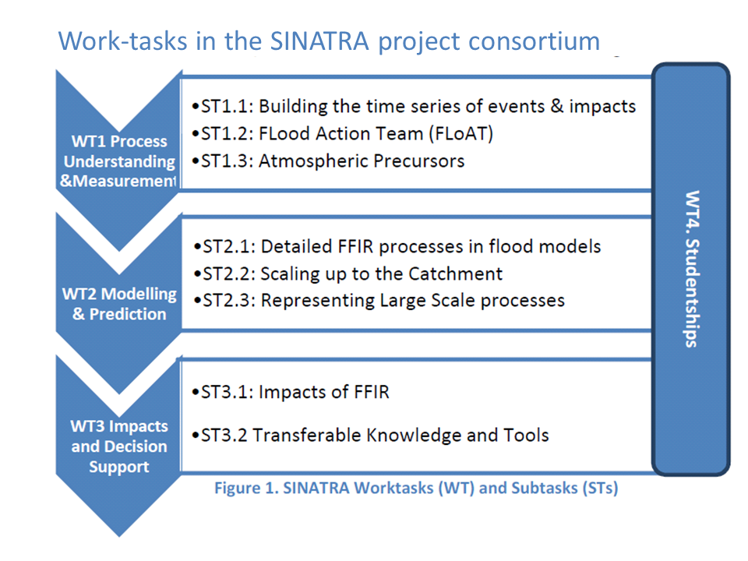
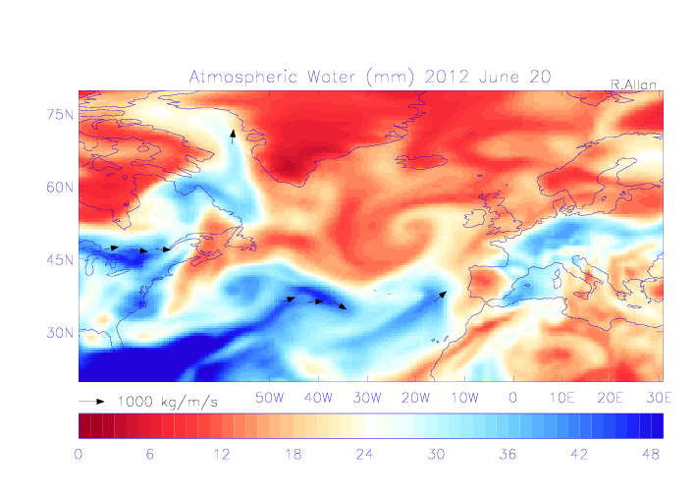
Susceptibility of catchments to
INTense RAinfall & flooding (SINATRA)
4-year NERC consortium
Work task 1.3 looking at precursors to summer flooding (Adrian Champion)
Initial work concentrating on moisture transport

Slide 25
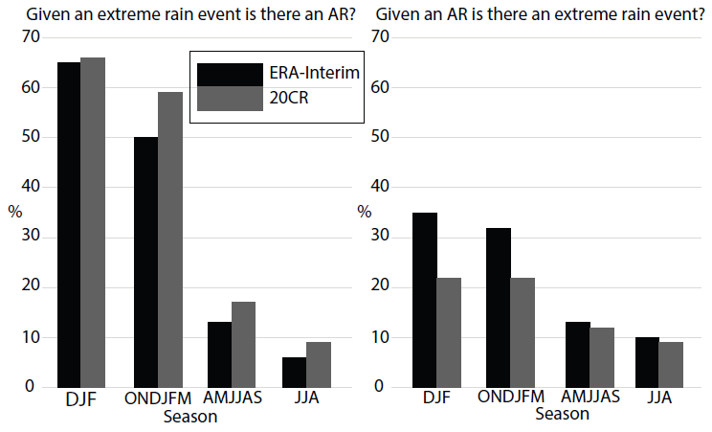
Atmospheric rivers don’t explain heavy summer rainfall events
Initially investigated influence of intense moisture transport events (Atmospheric Rivers or ARs)
Relatively few ARs associated with extreme rainfall
Very few extreme daily rainfall events in summer linked to ARs
Champion et al. submitted

Slide 26
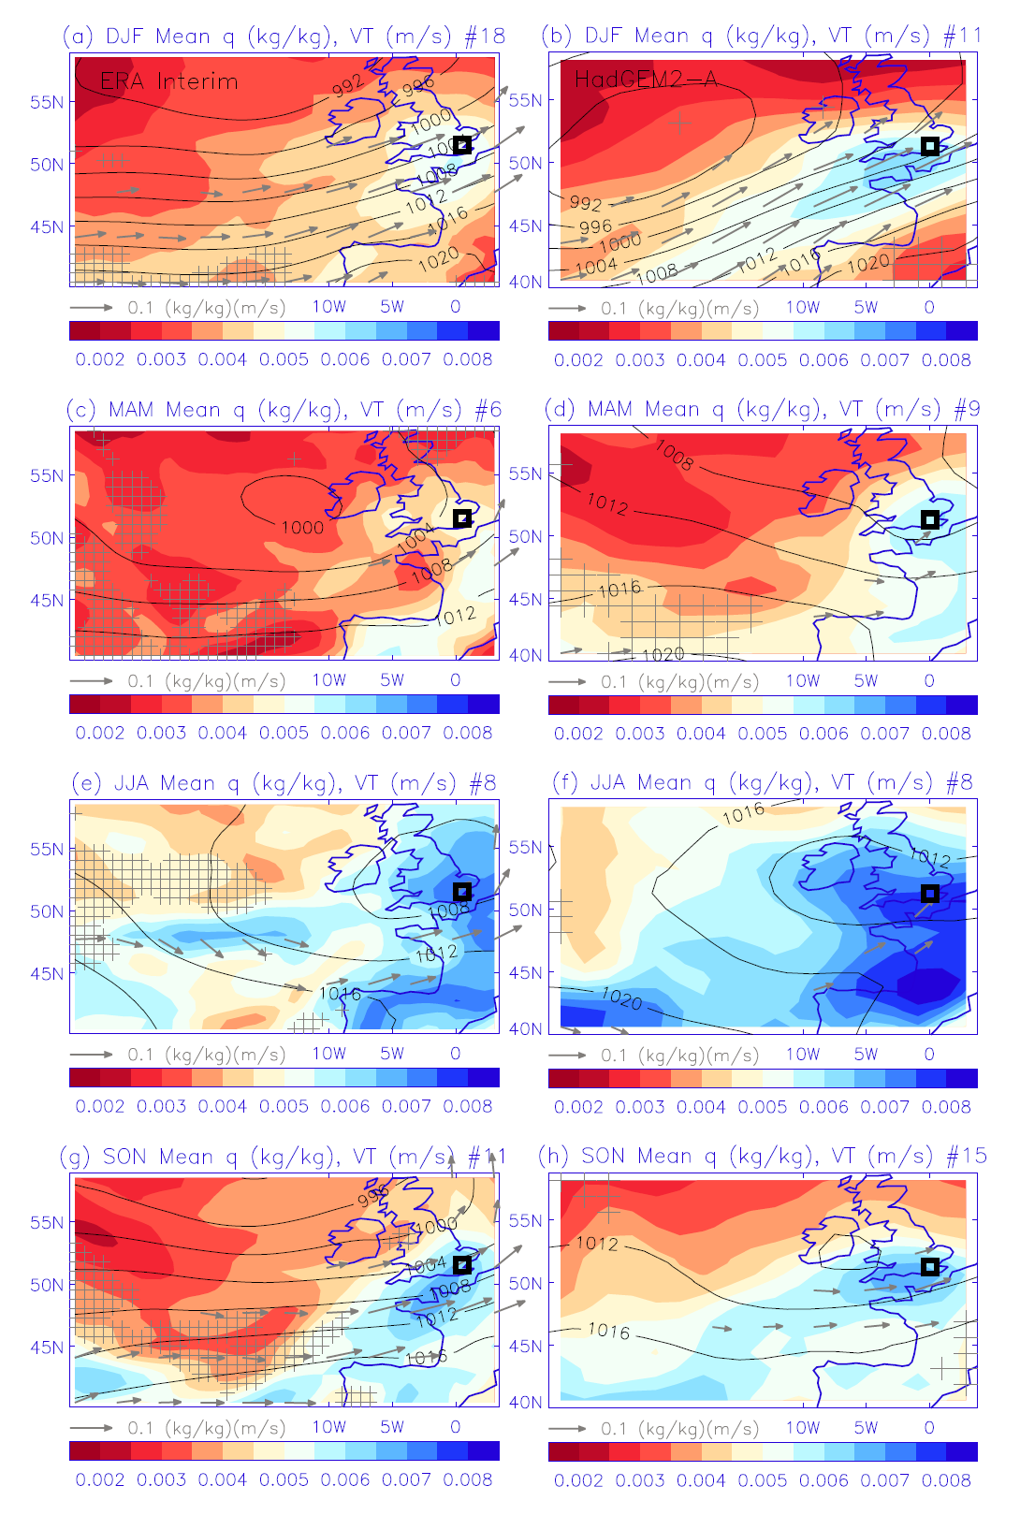
Moisture characteristics associated with heavy daily rainfall events
Initial evaluation of moisture characteristics associated with heavy daily rainfall
Dependence on region/season
Now moving to hourly data and CAPE-based diagnostics

Slide 27
conclusions
Earth’s energy imbalance
  Heating of Earth continues at rate of ~0.6 Wm⁻²
  Variability from radiative forcings & unforced ocean changes
  Where is the excess energy going in the oceans?
  Toward reconciled ocean heating and radiation budget changes
  Do feedbacks amplify/extend hiatus/surge events?
Energy budget constraint on precipitation responses
  Simple models for global precipitation
  Greenhouse gas & absorbing aerosol forcing supress global precipitation response to warming (“hydrological sensitivity”)
Inter-hemispheric heating, moisture budget & unforced variability affect regional responses and climate model biases
  Radiative forcing & unforced variability influence African rainfall trends
Local-scale precursors and characteristics crucial for impacts

Slide 29
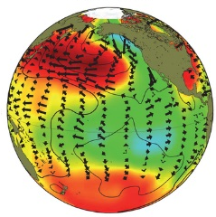
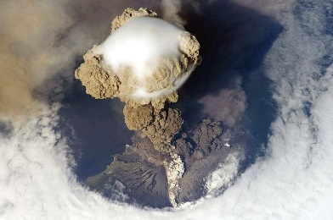
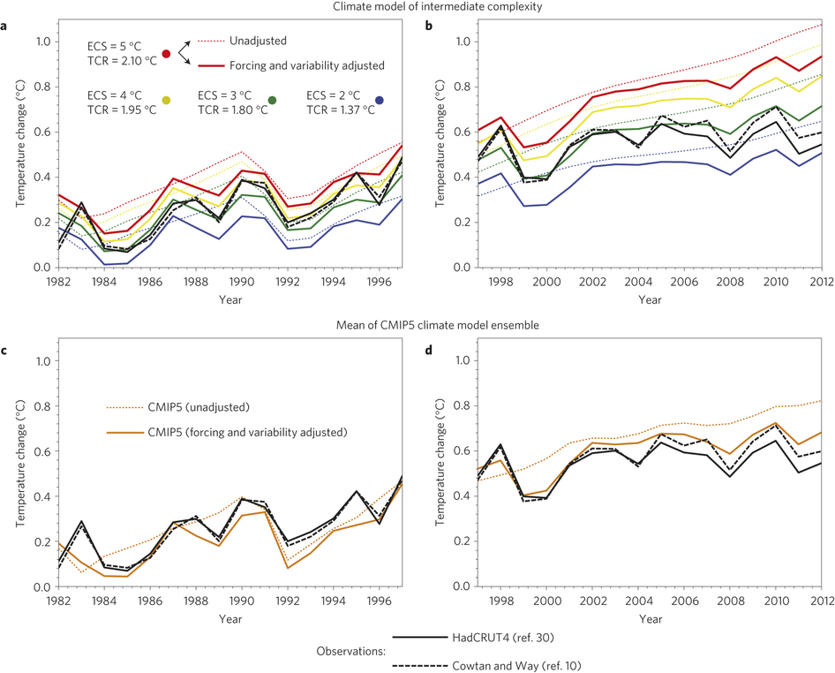
explaining the slowdown
Declining solar forcing (e.g. Hansen et al. 2013 PLOSONE) , more small volcanos (e.g. Ridley et al. 2014 GRL) & more La Niñas/cold NH land in winter vs late 1990s appear to explain:
  Slowing in surface warming (e.g. Foster & Rahmstorf 2012)
  Slower surface warming compared with coupled simulations (e.g. Risbey et al. 2014 ; Huber & Knutti 2014)
Simulations
Adjusted Simulations
Observations
Huber & Knutti 2014

Slide 30
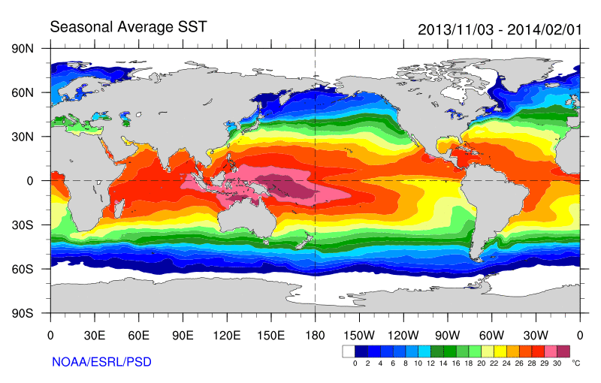
Role of Pacific Ocean Variability
Continued heating from rising greenhouse gas concentrations
Unusual weather patterns (Ding et al. 2014; Trenberth et al. 2014b)
Enhanced Walker Circulation
Ocean circulation strengthens atmospheric circulation
Heat flux to Indian ocean Lee etal 2015
Increased sea height
Warm
Upwelling,
Cool water
Remote link to Atlantic?
McGregor et al. (2014)
Increased precipitation
Decreased salinity
Strengthening trade winds
Equatorial Undercurrent
Enhanced mixing of heat below 100 metres depth by accelerating shallow overturning cells and equatorial undercurrent
See: Merrifield (2010) J. Clim.; Sohn et al. (2013) Clim. Dyn.; L’Heureux et al. (2013) Nature Clim. Change; Kosaka and Xie (2013) Nature; England et al. (2014) Nature Clim. Change; Watanabe et al. 2014 Nature Clim. Change; Balmaseda et al. (2013) GRL; Trenberth et al. (2014) J. Clim.

Slide 31
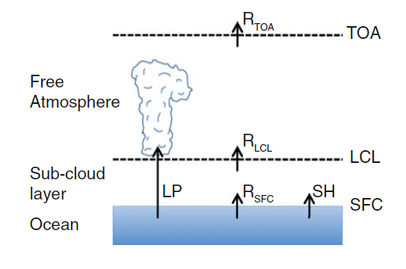
Radiative energy budget of the atmosphere
Adjustments in latent heating (precipitation, LΔP) balance change in radiative energy budget ΔR above LCL (lifting condensation level)
ΔR below LCL → adjustments in SH (sensible heat flux) important e.g. Ming et al. (2010) GRL
O’Gorman et al. (2012) Surv. Geophys
After Takahashi (2009) JAS.
See also Manabe & Wetherald (1975) JAS

Slide 32
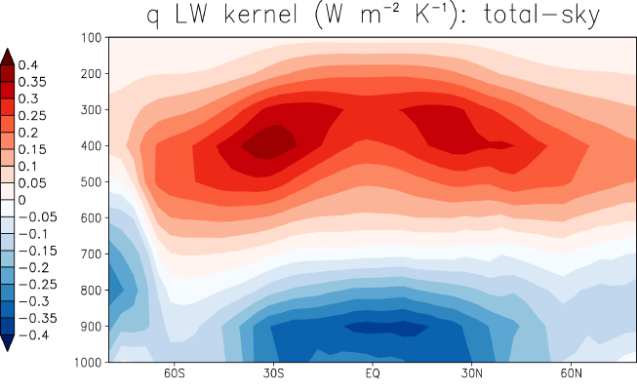
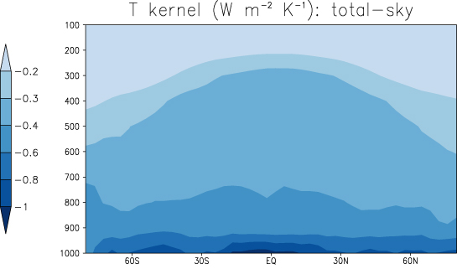
Radiative constraint on precipitation:
≈ 2 Wm⁻²K⁻¹
≈ 2-3%/K
Radiative kernals
Previdi (2010) ERL
O’Gorman et al. (2012) Surv. Geophys
Increased Precipitation

Slide 33
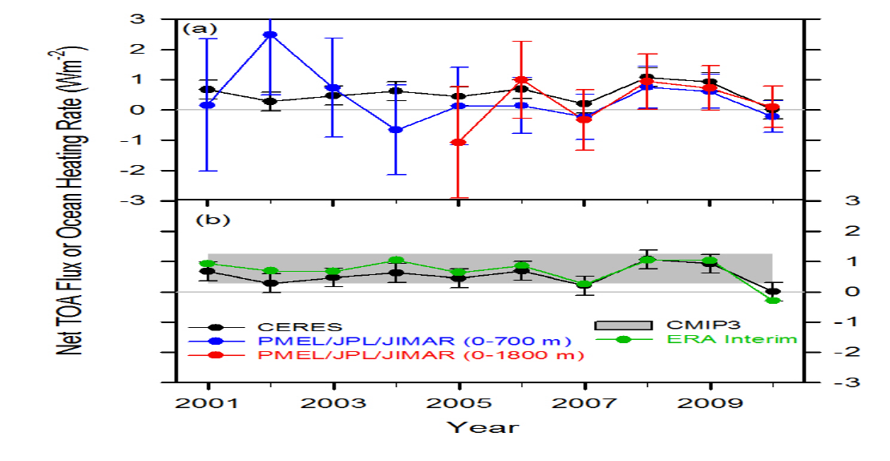
Combining Earth Radiation Budget and Ocean Heat Content data (2)
Replotted so that CERES and ERA Interim sample 6-months later than ARGO
Is there a lag in the system?
Where in ocean is energy accumulating?
Mechanism?
Notes:
Fi gure 3 (a) Global annual average net TOA flux from CERES observations and (b) ERA Interim reanalysis are anchored to an estimate of Earth’s heating rate for 2006–2010 ⁵ The Pacific Marine Environmental Laboratory/Jet Propulsion Laboratory/Joint Institute for Marine and Atmospheric Research (PMEL/JPL/JIMAR) ocean heating rate estimates⁴ use data from Argo and World Ocean Database 2009; uncertainties for upper ocean heating rates are given at one-standard error derived from sampling uncertainties. The gray bar in (b) corresponds to one standard deviation about the 2001–2010 average net TOA flux of 15 CMIP3 models.

Slide 34
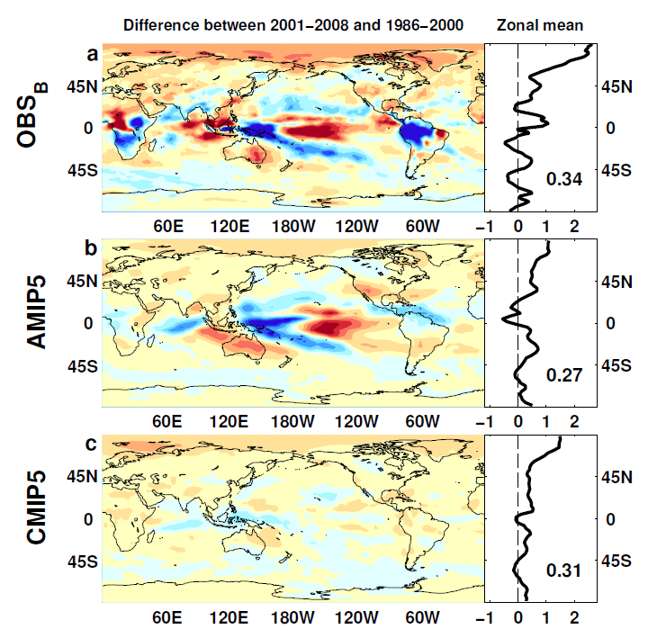

Outgoing Longwave Radiation
Wm⁻²

Slide 35
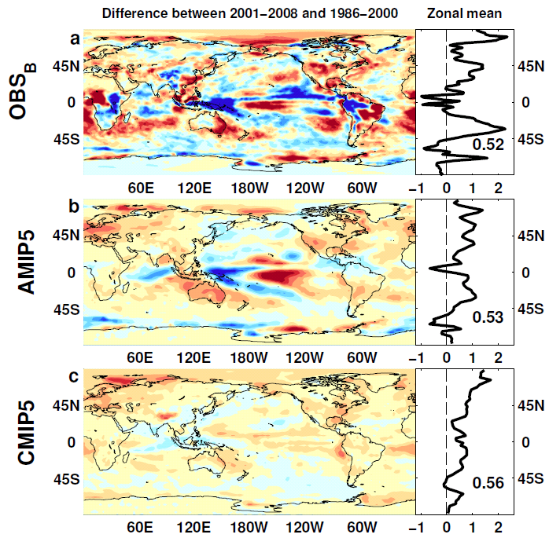
Absorbed Shortwave Radiation
Wm⁻²

Slide 36
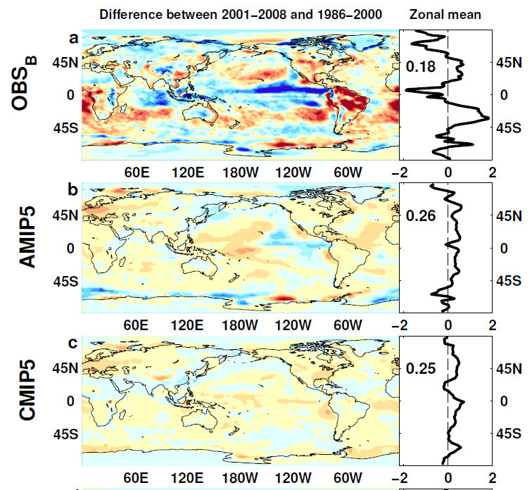

NET Radiation

Slide 37
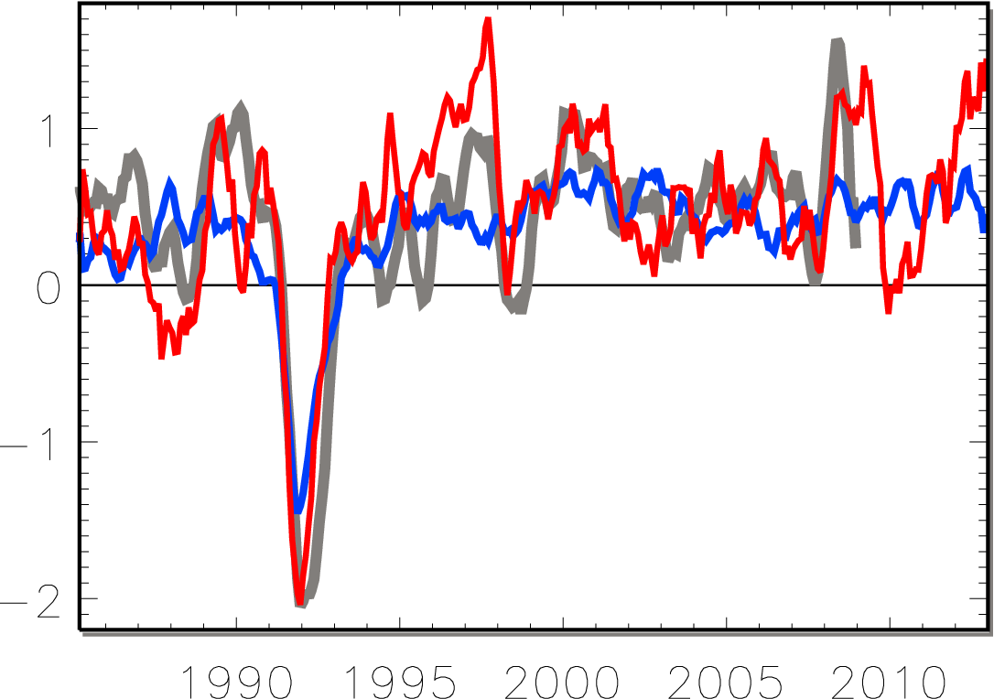
Earth continues to heat up
0.34±0.67 Wm⁻²
0.62±0.43 Wm⁻²
Allan et al. (2014) GRL
La Niña
Watts per square metre
heating cooling
El Niño
OBSERVATIONS
Volcano
CMIP5 SIMULATIONS
AMIP5 SIMULATIONS

Slide 38
lw & sw fluxes

