Slide 1



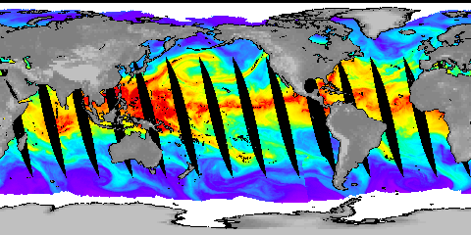
Current and future changes in precipitation and its extremes
Richard P. Allan, David Lavers, Chunlei Liu, Matthias Zahn
Department of Meteorology/NCAS, University of Reading
http://www.met.reading.ac.uk/~sgs02rpa r.p.allan@reading.ac.uk
Thanks to Brian Soden and Viju John
Notes:
Projected Responses in Extreme Precipitation and Atmospheric Radiative Energy
Energetics response
Wet/dry responses
Intense rainfall
Transient responses

Slide 2
Climate model projections
Precipitation Intensity
Increased Precipitation
More Intense Rainfall
More droughts
Wet regions get wetter, dry regions get drier?
Regional projections??
Dry Days
Precipitation Change (%)
IPCC WGI (2007)

Slide 3
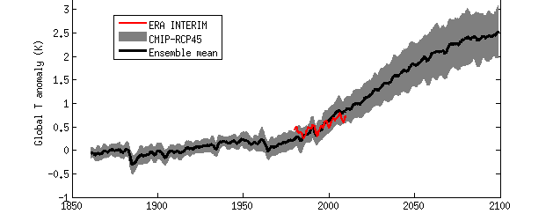

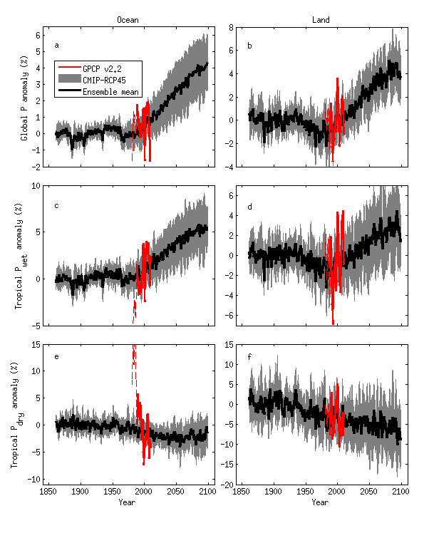

Projected precipitation response
Response ~2%/K
Precipitation (%) Temperature (K)
Ocean
Land

Slide 4
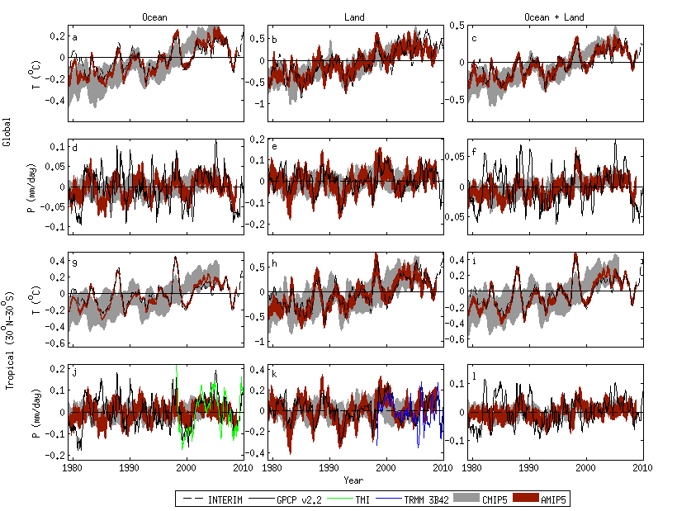
Current observed & simulated changes
Note realism of atmosphere-only AMIP model simulations
Oceans Land
Allan et al. (2010) ERL; Liu and Allan in prep…

Slide 5
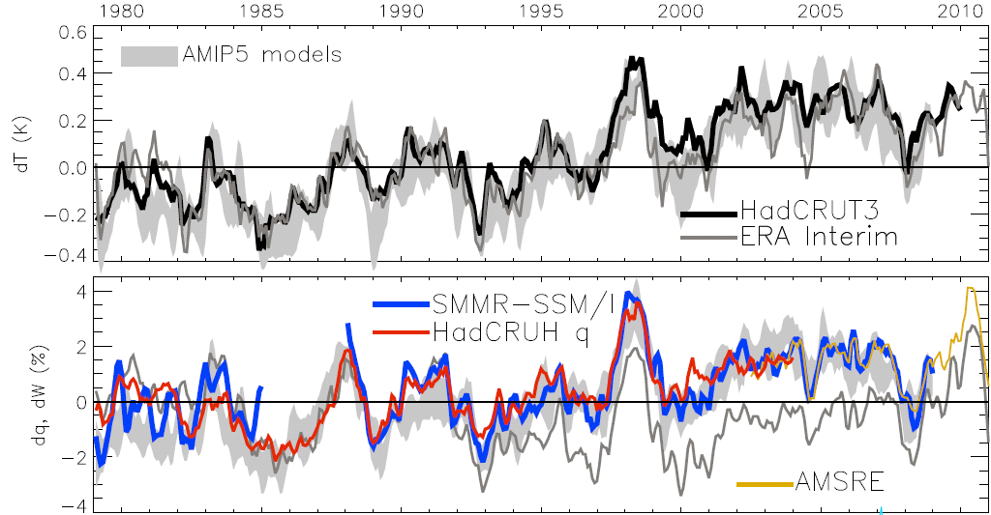
Global changes in water vapour
Water Vapour (%) Surface Tempertaure (K)
Updated from O’Gorman et al. (2012) Surv. Geophys; see also John et al. (2009) GRL
Notes:
The main point to note is that models and observations are consistent in showing increases in low level water vapour with warming. Reanalyses such as ERA Interim, which are widely used, are not constrained to balance their energy or water budgets.
For ocean-only satellite datasets I apply ERA Interim for poleward of 50 degrees latitude and for missing/land grid points.
Note that SSM/I F13 2003-2007 CWV = 24.7794 mm; AMSRE 2003-2007 CWV = 24.8850
5

Slide 6
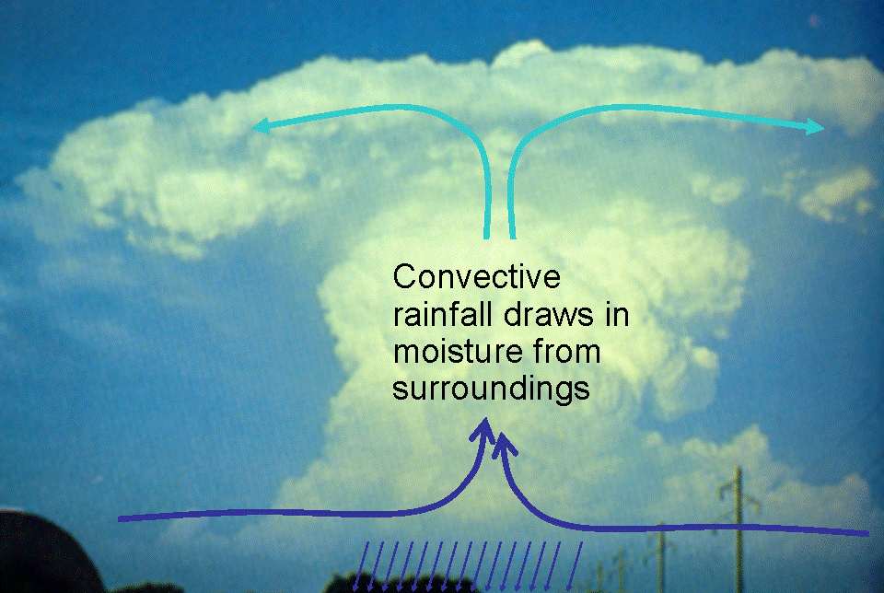
Extreme Precipitation
Large-scale rainfall events fuelled by moisture convergence
  e.g. Trenberth et al. (2003) BAMS. But see also Wilson and Toumi (2005) GRL
Intensification of rainfall (~7%/K?)
O’Gorman & Schneider (2009) PNAS; Gastineau and Soden (2009) GRL
Is there a positive latent heating feedback on hourly intensities?
Lenderink & van Meijgaard (2010) ERL; Haerter et (2010) GRL

Slide 7
Observed and Simulated responses in extreme daily Precipitation
Increase in intense rainfall with tropical ocean warming
SSM/I satellite observations at upper range of models
Allan et al. (2010) Environ. Res. Lett.; Liu and Allan (2012) JGR

Slide 8


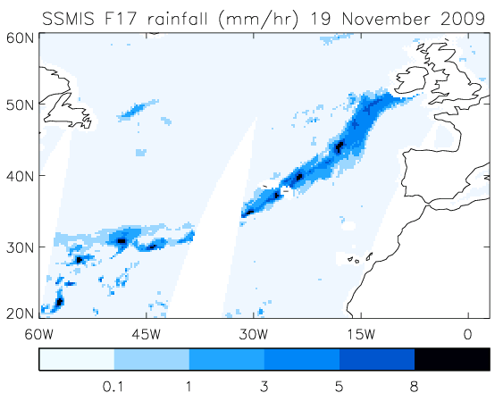
Extreme precipitation & mid-latitude flooding
Links UK winter flooding to moisture conveyor events
  e.g. Nov 2009 Cumbria floods
Lavers et al. (2011) Geophys. Res. Lett.

Slide 9
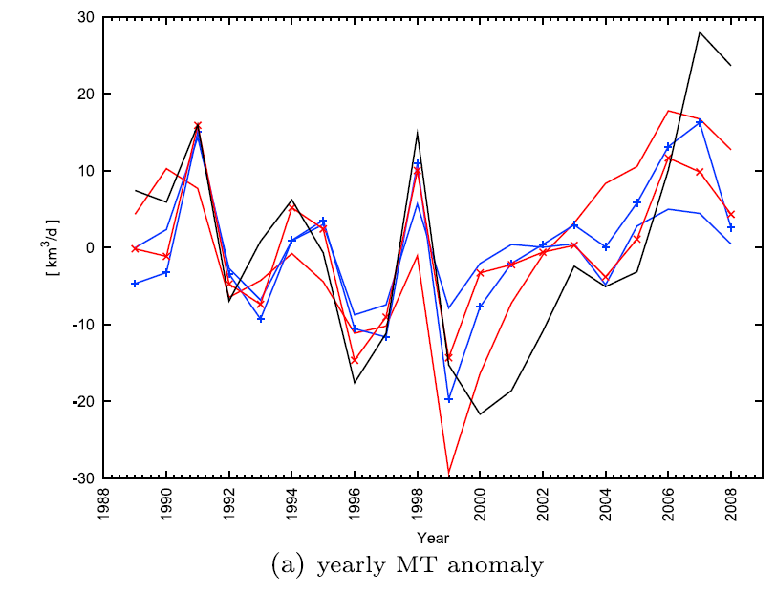
Enhanced tropical moisture transports
Instantaneous field
Moisture transport into tropical ascent region
Significant mid-level outflow
2000s: increases in inflow or drift in ERA Interim?
outflux
influx
Zahn and Allan (2011) JGR
PREPARE project
See poster A203 (CL2.10), Hall A Friday AM (Matthias Zahn)
Notes:
We are also interested in calculating observationally based water budgets including moisture transports and P-E and how this relates to ocean salinity observations.

Slide 10

Contrasting precipitation response expected
Heavy rain follows moisture (~7%/K)
Mean Precipitation linked to radiation balance (~3%/K)
Precipitation →
Light Precipitation (-?%/K)
Temperature →
e.g. Allen and Ingram (2002) Nature; Allan and Soden (2008) Science

Slide 11
Wet regions get wetter, dry regions get drier
Ocean Land
Pre 1988 GPCP ocean data does not contain microwave data
Tropical dry Tropical wet
Robust drying of dry tropical land
More at poster A204 Friday AM: (Liu & Allan)
Allan et al. (2010) ERL.; Liu and Allan in prep

Slide 12
Conclusions
Global rises in precipitation ~2%/K
  Relate to energetics (Allen and Ingram 2002)
  Regional projections a challenge
Robust increases in water vapour (~7%/K) →
Fuels comparable rise in precipitation intensity
  Possible positive feedbacks on hourly time-scales
Enhances moisture transport: wet get wetter, dry get drier
  Moisture feedbacks over land?
Aerosols
  Alter energetically driven global response (e.g. Andrews et al. 2010 ERL); implications for mitigation and geoengineering
  Associated changes in atmospheric circulation
See also posters Friday AM:
A203-4, Hall A (Zahn & Allan; Liu & Allan); Z96, HallZ (Williams et al.)
Notes:
12
Projected Responses in Extreme Precipitation and Atmospheric Radiative Energy

Slide 13
Extra slides

Slide 14
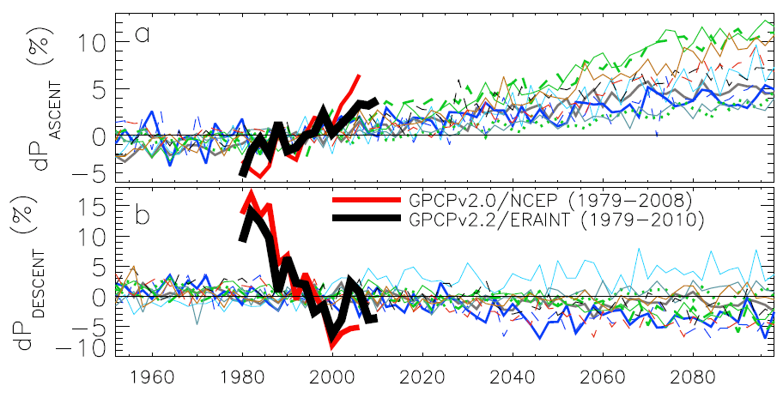
Contrasting precipitation response in wet and dry regions of the tropical circulation
wet
Observations
Models
Precipitation change (%)
dry
Sensitivity to reanalysis dataset used to define wet/dry regions
Updated from Allan et al. (2010) Environ. Res. Lett.
Notes:
Note that the wet getting wetter and dry getting drier signal in the tropics is robust in models. The recently updated GPCP observations (black) show a slightly larger trend in the wet region. The dry region trend is probably spurious before 1988 since microwave data began in 1987.

Slide 15
Increases in the frequency of the heaviest rainfall with warming: daily data from models and microwave satellite data (SSM/I)
Reduced frequency Increased frequency
Allan and Soden (2008) Science; Allan et al. (2010) Environ. Res. Lett.
Notes:
15
Daily data from AMIP climate model simulations (observed SST forcing) and microwave data from the F08/F11/F13 SSM/I series of satellite microwave measurements. The heaviest rainfall events are separated into bins ranging from heavy up to torrential events and the variation in the frequency of events in each bin is calculated (red=more frequent, blue=less frequent). The response of the heaviest rainfall events is consistent with models but the models appear to underestimate the response to warming and the details of the changes away from the heaviest rainfall regimes are not in agreement.

Slide 16
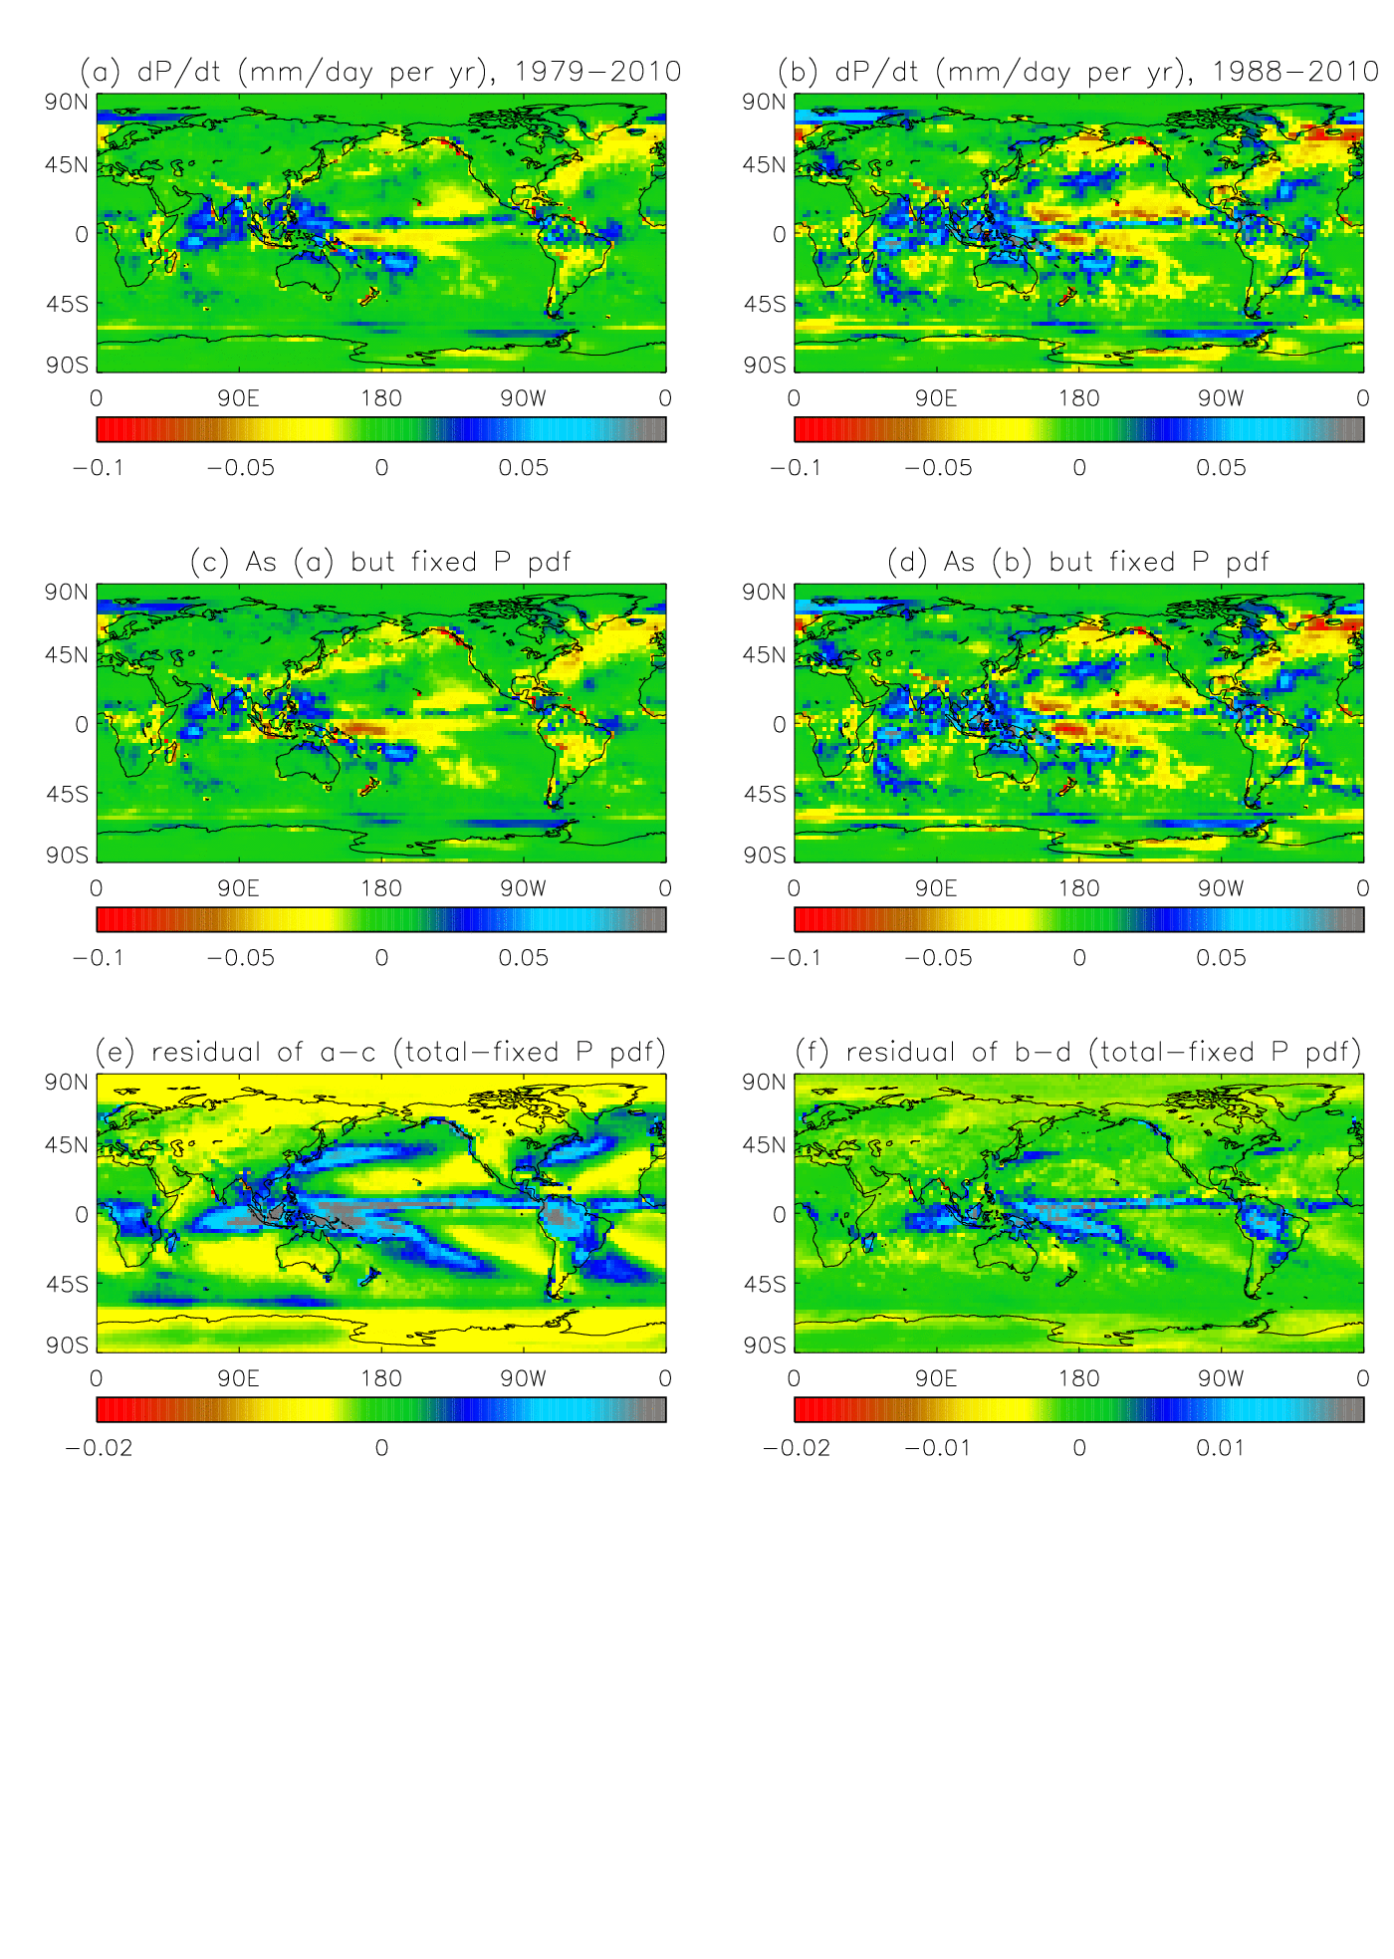
Separating dynamical thermodynamic trends
Top: fixed P intensity PDF
Bottom: residual (total trend minus fixed PDF)
We are currently applying this technique to CMIP5 models

Slide 17
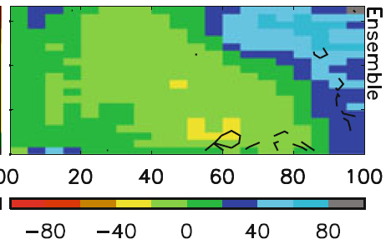
Precipitation bias and response binned by dynamical regime
Warmer surface temperature →
Model biases in warm, dry regime
Strong wet/dry fingerprint in model projections (below)
Stronger ascent →
Allan (2012) Clim. Dyn.
Stronger ascent →

