Slide 1
Water activities in the UK space and EO programmes
Richard Allan,
NCEO, University Reading
John Remedios
Director of NCEO
www.nceo.ac.uk
@NCEOscience
EO science for a changing planet

Slide 2
Brief insight into UK EO
UK Space Agency is responsible for:
  UK-supported EO missions mainly through European entities but also bilateral and public-supported commercial missions
  Joint academic-industrial programmes in EO technology
  The International Partnerships Programme (IPP) which is an ODA-based funding activity supporting also UK EO growth aspirations.
NERC/UKRI national capability programmes
  NCEO
  Other NERC Centres e.g. CEH
There is also funding of HEIs through grants etc.
Notes:
European entities are ESA, Eumetsat and Copernicus

Slide 3
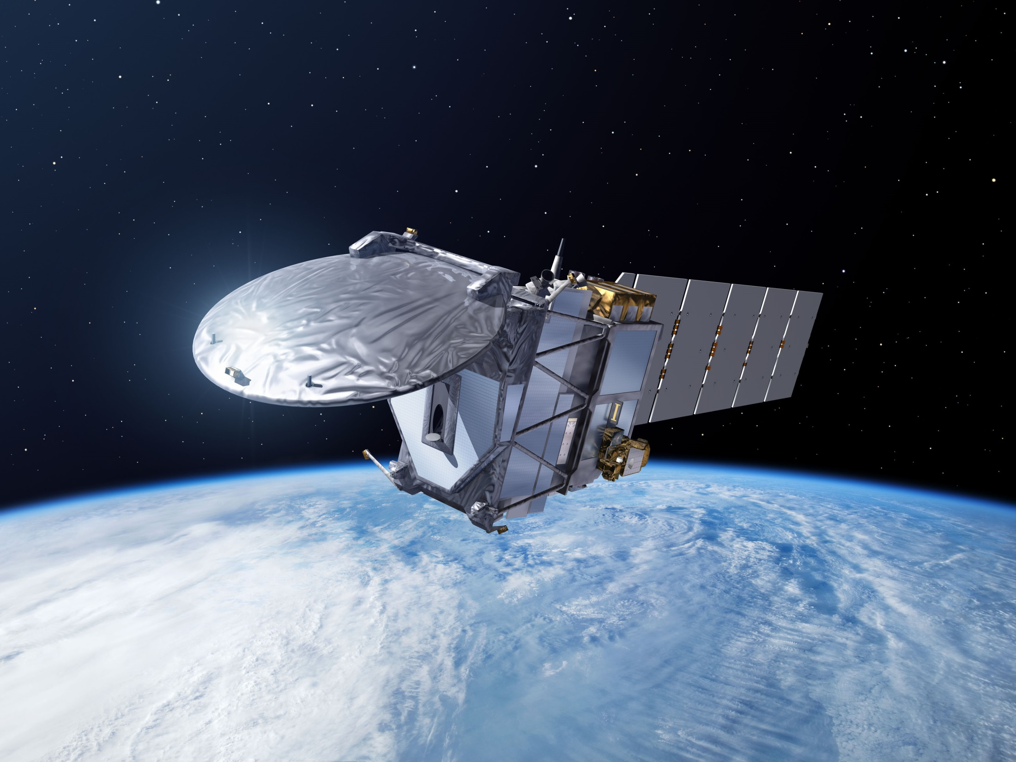
UK R&D ACCESS TO SPACE INFRASTRUCTURE
RESEARCH SATELLITES
ESA EOEP
50 million euros/year: Cryosat, Earthcare, Biomass
OPERATIONAL SATELLITES Copernicus Sentinels
80+ million euros per year
RESEARCH SATELLITES
Bilaterals, Science teams (CNES,NASA…)
Small millions of euros/year
Microcarb, SWOT
OPERATIONAL SATELITES
METOP 50 million euros/year

Slide 4

International Partnership Programme (IPP)
IPP: £152 million (approx £30 million p.a.)
  5 years
The aim of IPP is to address real issues faced by emerging economies, by running projects which deliver tangible and lasting impacts on the ground using satellite solutions
  Projects led by the best of the UK’s world class research and innovation sector
2 projects on Flooding
  EO enabled decision support for Flood & Drought Resilience (Airbus)
    Ethiopia - building resilience to water-related hazards
    Kenya - EO data for micro-insurance
  Drought and Flood Mitigation Service in Uganda (Rhea)

Slide 5
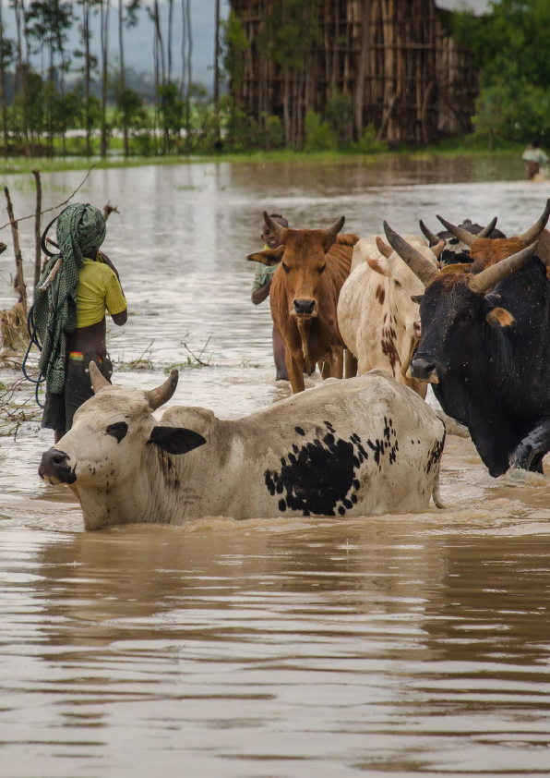




Earth Observation-enabled decision support for flood and drought resilience
Project Lead: Airbus
Project Location: Ethiopia & Kenya
In Kenya: Using EO data for the micro-insurance market and government Institutions.
In Ethiopia: Building an improved understanding of flood and drought hazards and risks to help build social and economic resilience to water-related hazards.
Supported by a flexible dashboard with tailored information to assist decision-making related to flood and drought.
International Partnership Programme
For more information contact: IPP@ukspaceagency.bis.gsi.gov.uk

Slide 6

Drought and Flood Mitigation Service (DFMS)
Project Lead: Rhea
Project Location: Uganda
Satellite and ground-based data, combined with drought and flood models, to help people respond to effects on agriculture.
Information distributed by national and local government, by commercial operators to farmers, and others, such as NGOs.
Through better forecasts, local people can improve their lives and better protect key assets such as livestock and crops.
International Partnership Programme
For more information contact: IPP@ukspaceagency.bis.gsi.gov.uk

Slide 7
UK water cycle activities in EO and climate
The UK is active in rainfall observing systems
  Climate records (SSMI(S)/GPCP, TRMM → GPM)
  MSG, TAMSAT for Africa (rainfall monitoring, building resilience)
  Envisat/Sentinel-3 and now Sentinel-2 (water quality)
  Sentinel-1 to Cosmo-Skymed/NovaSAR SAR (flooding)
  ESA CCI missions e.g. ASCAT active; AMSR-E passive, LST sensors, cf GlobTemperature (soil moisture/climate)
Climate change-related water cycle research is a major topic for UK EO science programmes
  Observations of water cycle change [NCEO]
  Evaluating climate models: dry spells (drought) [NCEO, CEH]
  Ice/snow changes [CPOM]

Slide 8
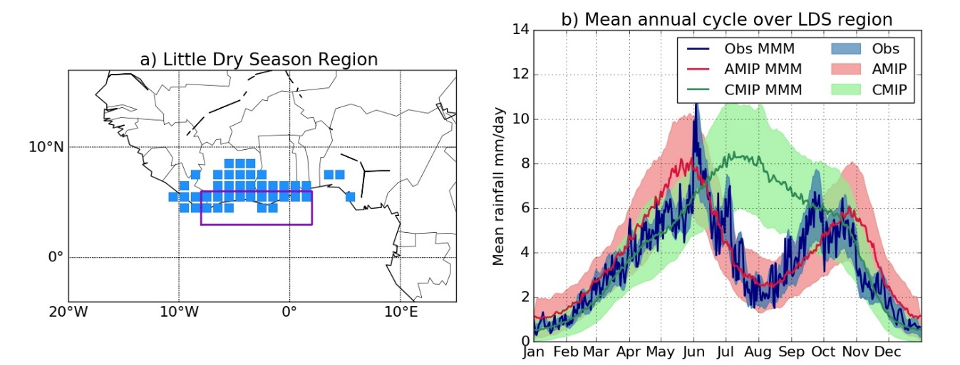
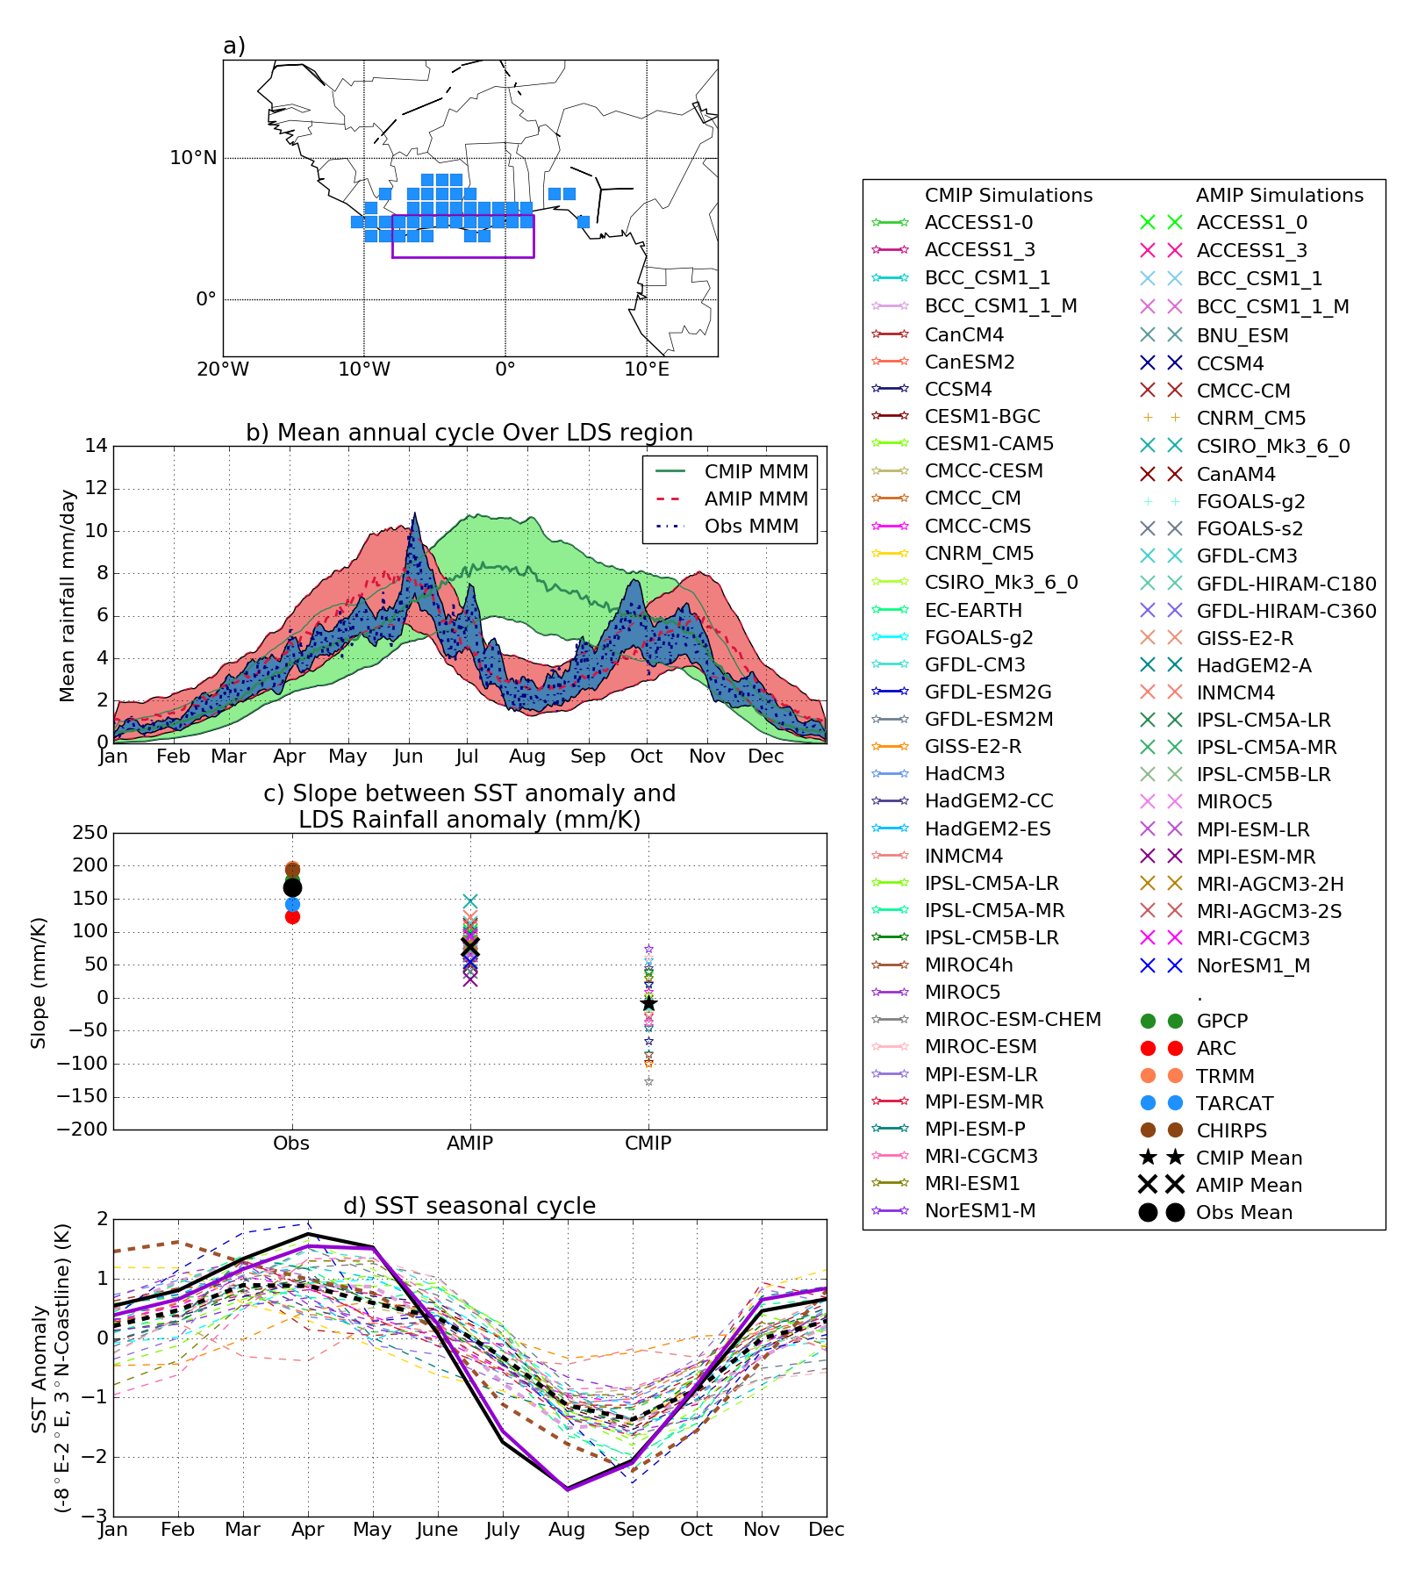
Rainfall monitoring for decision support, forecasting & climate
Dunning et al. 2017 ERL
Method to identify onset/cessation of wet season using daily data
Exploit www.tamsat.org daily rainfall to investigate impact of SST bias & deficient SST/rainfall relationship
Extending method to agricultural decision support & operational forecasting (Rainwatch/TAMSAT-ALERT)
SST seasonal cycle
CMIP5
OBS/AMIP

Slide 9
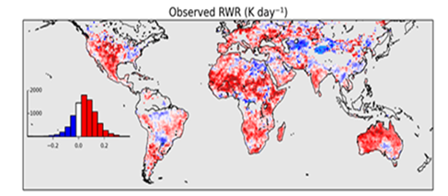
Relative warming rates
Relative warming rates observed during dry spells using satellite data
Used to verify climate models but can inform better dry spell characterisaton for droughts.

Slide 10
Improved land surface: Data Assimilation
Land surface behaviour in models is relatively sensitive to poorly observed parameters and to uncertain process dynamics.
Data assimilation potentially provides better constrained land surface model data as for weather forecasting, e.g.
  for convective-driven processes
  soil moisture representation
Advances in DA for land could improve both “nowcasting” and prediction skill.

Slide 11
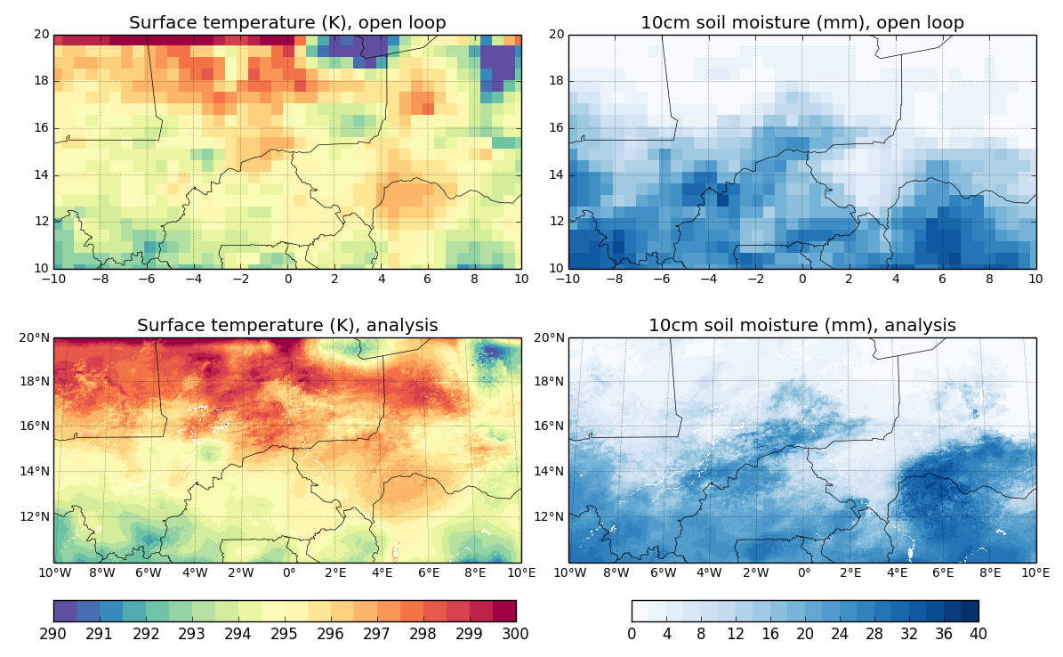
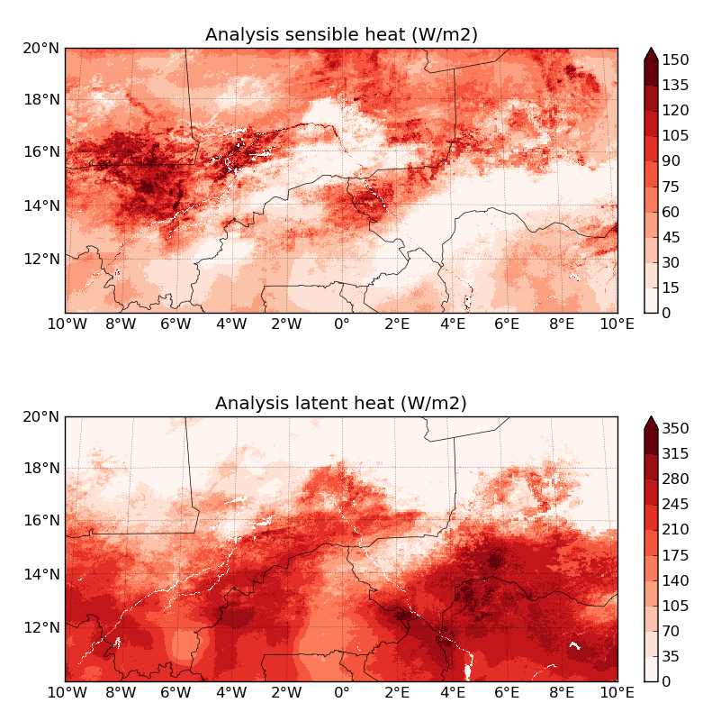
MoDEl DOWNscaling for SOIL MOISTURE
  In semi-arid Sahel LST surface SM and fluxes are closely linked
  Downscale JULES simulations from 0.5° to 3 km by assimilating SEVIRI LST
  Results provide initial/boundary conditions for atmospheric simulations
Notes:
This was work done for the AMMA-UK project
JULES simulations for 2006 are originally at 0.5°
We assimilated 15 minute, 3 km SEVIRI LST from SAF Land to constrain the (very uncertain) precipitation forcing so that JULES LST best matched the satellite obs over a 3-day window.
By adjusting the precipitation rather than (say) soil moisture itself, the simulations remain internally consistent with model dynamics.
The Univ of Leeds used the resulting fields of
Soil moisture to initialise fine-resolution atmospheric case studies with the UM
Surface fluxes to force a large-eddy simulation case study

Slide 12
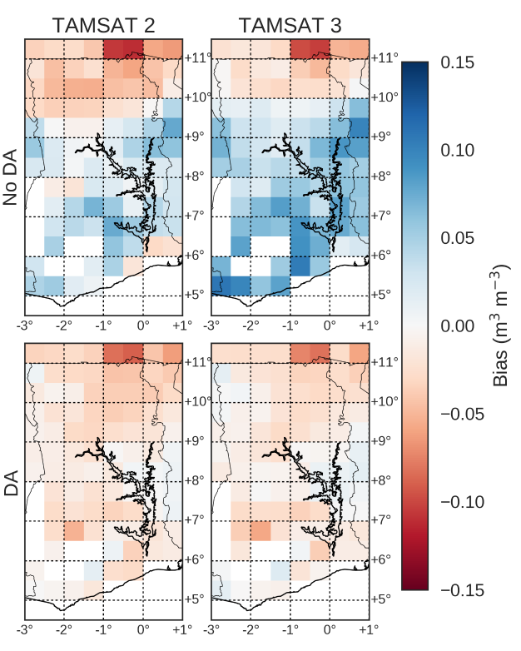
Rainfall/soil moisture role in JULES simulations using ESA CCI & TAMSAT
Default JULES
soil ancillaries
Pinnington, E., Quaife, T., and Black, E.: Using satellite observations of precipitation and soil moisture to constrain the water budget of a land surface model, Hydrol. Earth Syst. Sci. Discuss., https://doi.org/10.5194/hess-2017-705
New JULES
soil ancillaries
Pinnington et al. (2017) HESS - Ghana
- Getting precipitation right is crucial for the start of season wetting-up
- Representing soil moisture determines the end of season dry-down
Notes:
This is from our recent HESS paper. Region is Ghana. In essence we tested the relative information in TAMSAT data and ESA soil moisture data for constraining the soil moisture estimates from JULES (assessed using a hindcast experiment). The conclusion is basically that getting precipitation right is crucial for the start of season wetting-up, whereas getting the soil description right is crucial for the end of season dry-down. [Kind of obvious when you think about it, but nice to have it demonstrated in an experiment.]

Slide 13
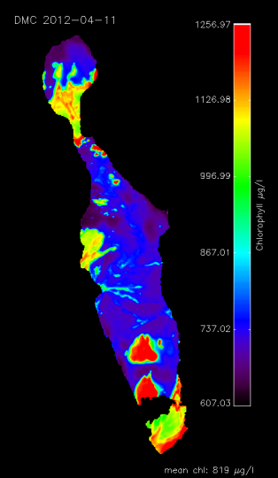
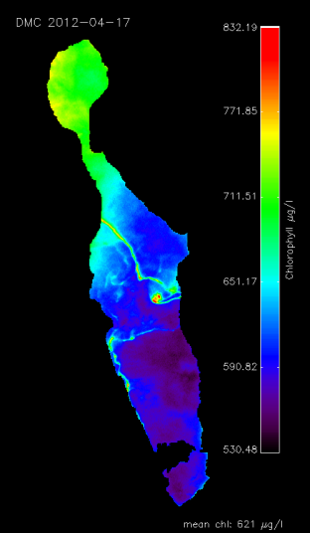
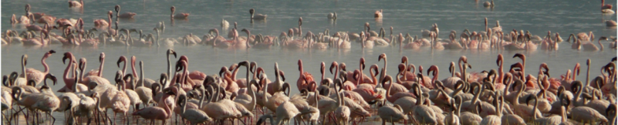
Water quality in lakes
Haze/cloud leads to overestimation of Chl-a
The UK has undertaken research on water quality in lakes which is now feeding into Copernicus services:
  PML
  Stirling University
  King’s College, London
E. Tebbs
KCL

Slide 14
Summary
UK Space Agency supports EO missions and is actively encouraging EO missions relevant to water cycle, e.g. flooding, soil moisture, clouds and convection, LST
It also supports EO applications and services
NERC provides UK research money to exploit EO missions for environmental science. Key interests are precipitation and flooding, climate and water cycle, data assimilation to improve land surface model skill
A foundation is the money NERC provides to support national capability in these areas, particularly at NCEO but also other NERC centres

Slide 16
Missions: UK water cycle interests
Precipitation: GPM/TRMM, MSG (convective)
Soil moisture/LST. Climate change based.
  ESA CCI missions e.g. ASCAT active; AMSR-E passive
  The constellation of LST sensors, cf GlobTemperature:
  http://data.globtemperature.info/
Water quality: Envisat/Sentinel-3 and now Sentinel-2

Slide 17
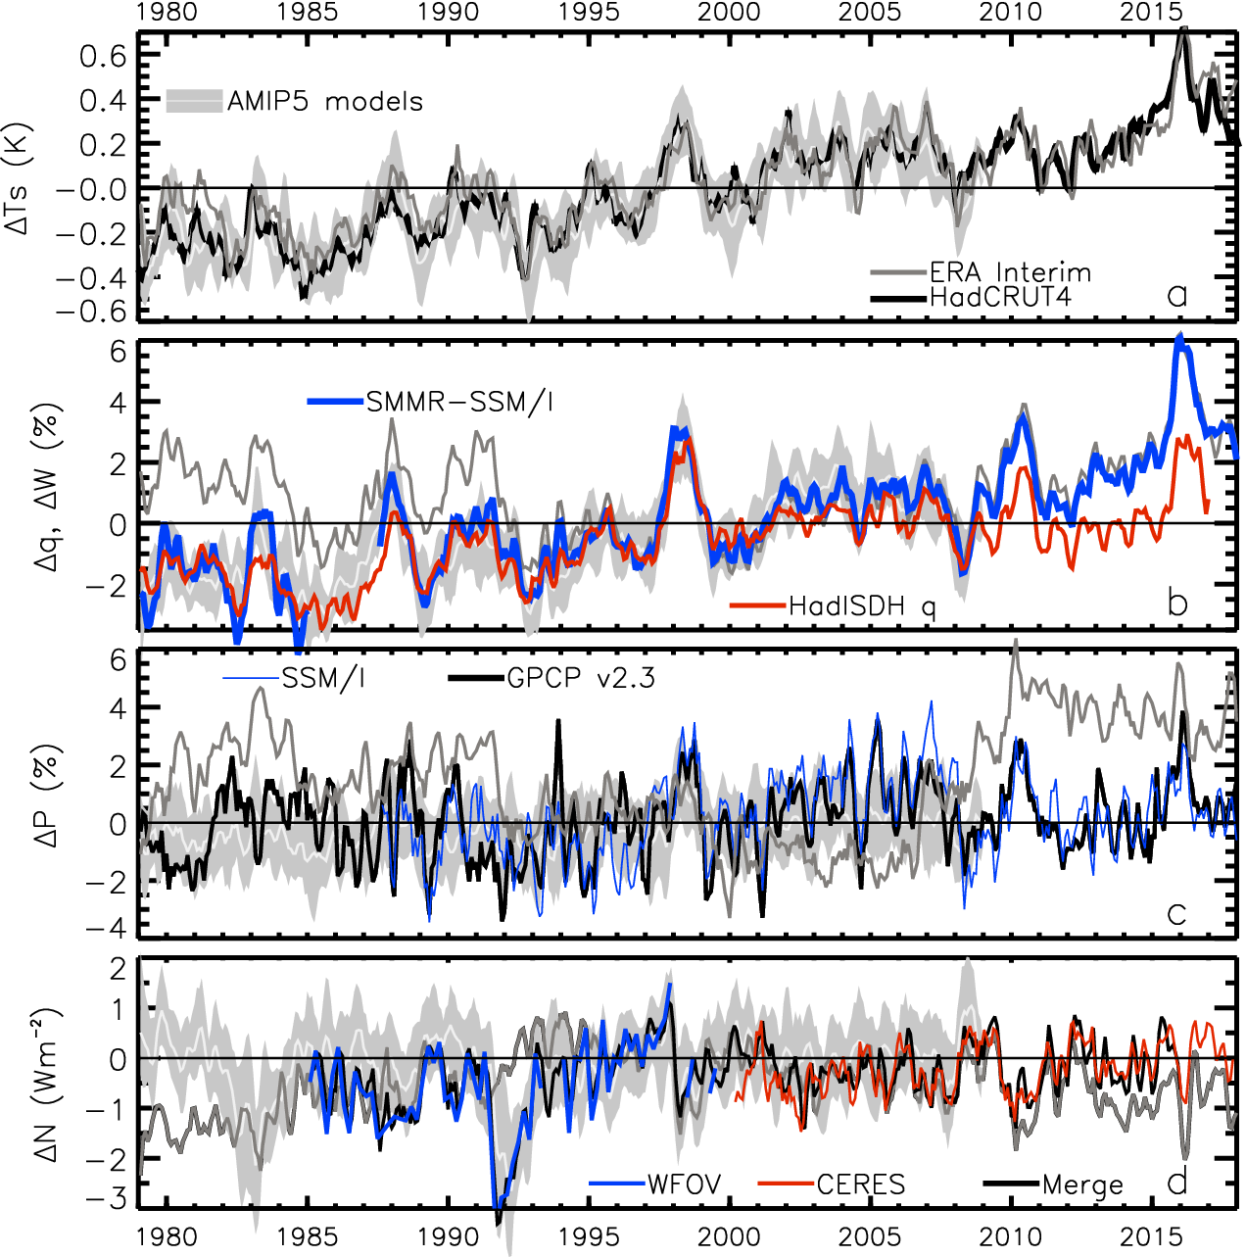
Climate monitoring
ERAINT
AMIP5
Water Vapour anomaly (%)
?
Precip anomaly (%)
Allan et al. (2014) Surv. Geophys

Slide 18
Precipitation extremes
Possible “emergent constraints” from water cycle variability on future projections
Evaluate model climate model projections
99th%
light
heavy
Allan et al. (2014) Surv. Geophys

Slide 19
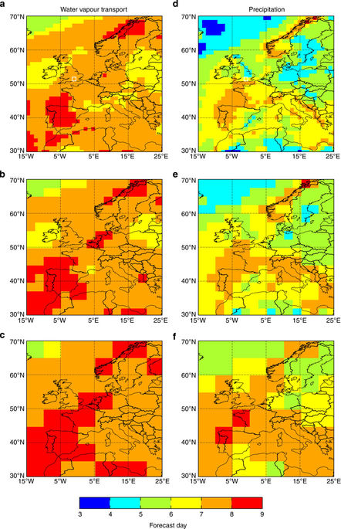
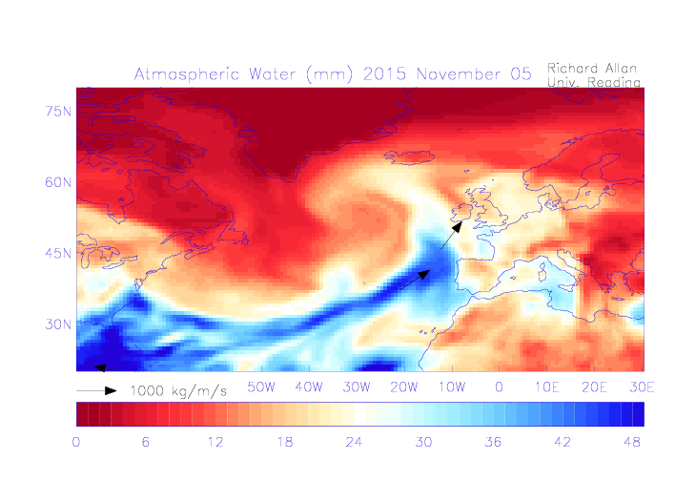
Moisture transport & Extreme Rainfall
Moisture transport linked with flooding e.g. Atmospheric Rivers
Promising applications in forecasting and climate prediction →
Satellite-based constraints on energy/moisture fluxes active research area (e.g. ECMWF/ Univ. Reading)
Energy transport metrics can also be explored (e.g. role in drought/heatwave).
Lavers et al. (2014) Nature Comms
Lavers et al. (2011) GRL; Lavers et al. (2013) ERL

Slide 20
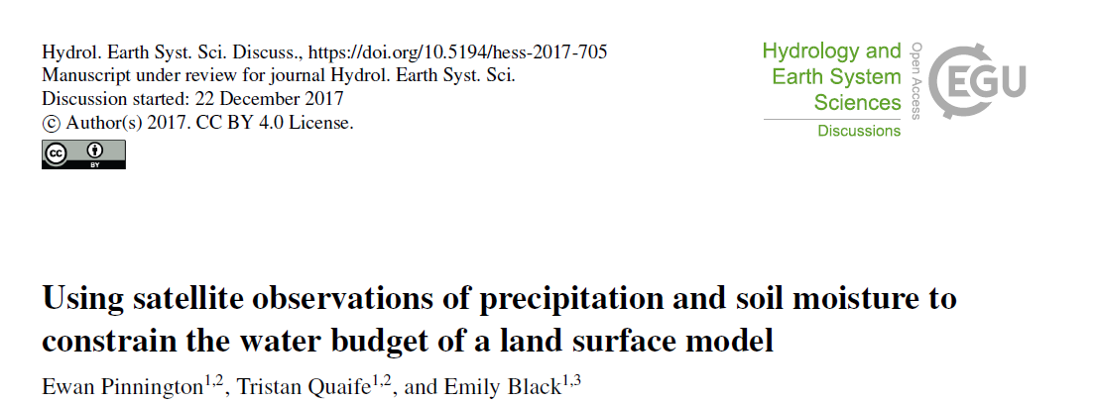
Key features:
  Standard variational DA (using non-gradient based descent)
  Compares TAMSAT v2 and v3
  Assimilates ESA CCI soil moisture data
  Target variables are JULES soil parameters

Slide 21

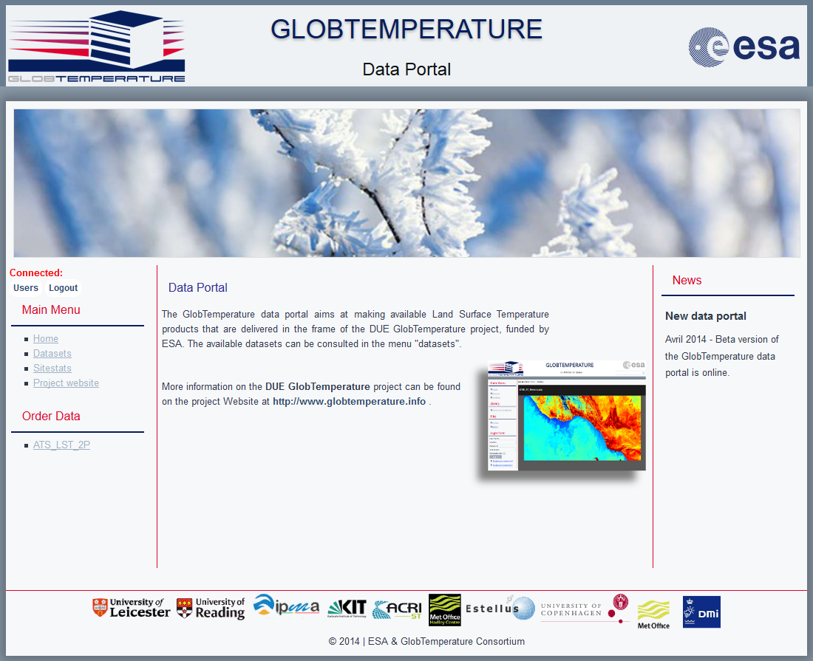
Data Portal for LST
http://data.globtemperature.info/

