Slide 1

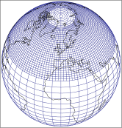
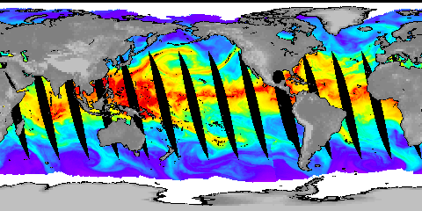




A Changing Character of Precipitation in a Warming World: Physical Drivers
Richard Allan
Department of Meteorology, University of Reading
www.met.reading.ac.uk/~sgs02rpa r.p.allan@reading.ac.uk @rpallanuk
Notes:
Projected Responses in Extreme Precipitation and Atmospheric Radiative Energy
Energetics response
Wet/dry responses
Intense rainfall
Transient responses

Slide 2
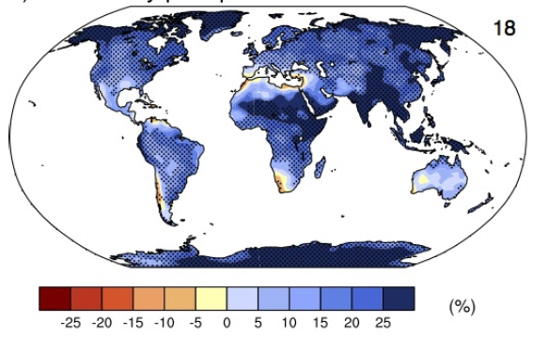
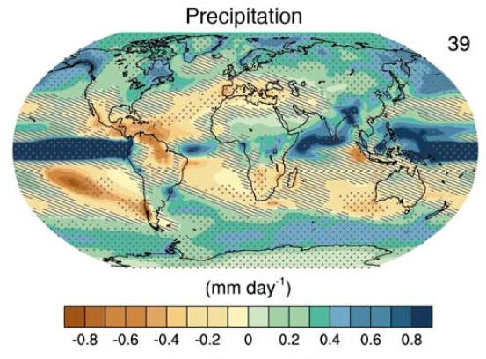
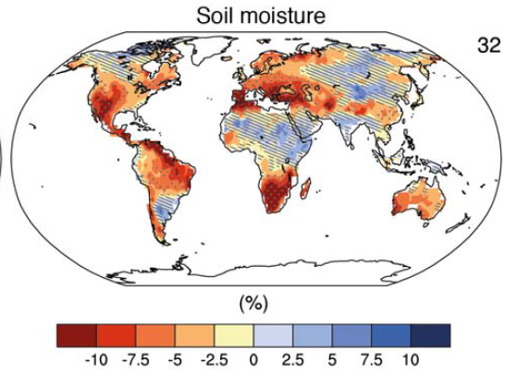
How will the water cycle change?
Precipitation intensity
Increased Precipitation
More Intense Rainfall
More droughts
Wet regions get wetter, dry regions get drier?
Regional projections??
IPCC WGI (2013)
Notes:
PRECIPITATION: [Tech Summ Fig. 2]
RCP8.5 ANN: Multi-model CMIP5 average mm/day change.
Hatching: multi-model mean change is small (<1SD of internal variability)
Stippling: multi-model mean change is big (>2SD of internal variability and 90% of models agree on sign)
P INTENSITY:
Percent change in annual maximum 5-day precipitation 2081-2100 relative to 1981-2000 for RCP8.5 CMIP5 ensemble.
Fig. 12.26, Chapter 12.
Stippling → significant change
SOIL MOISTURE: [Tech Summ, Fig. 2]
RCP8.5 ANN change in %, Upper 10cm
Hatching: multi-model mean change is small (<1SD of internal variability)
Stippling: multi-model mean change is big (>2SD of internal variability and 90% of models agree on sign)

Slide 3
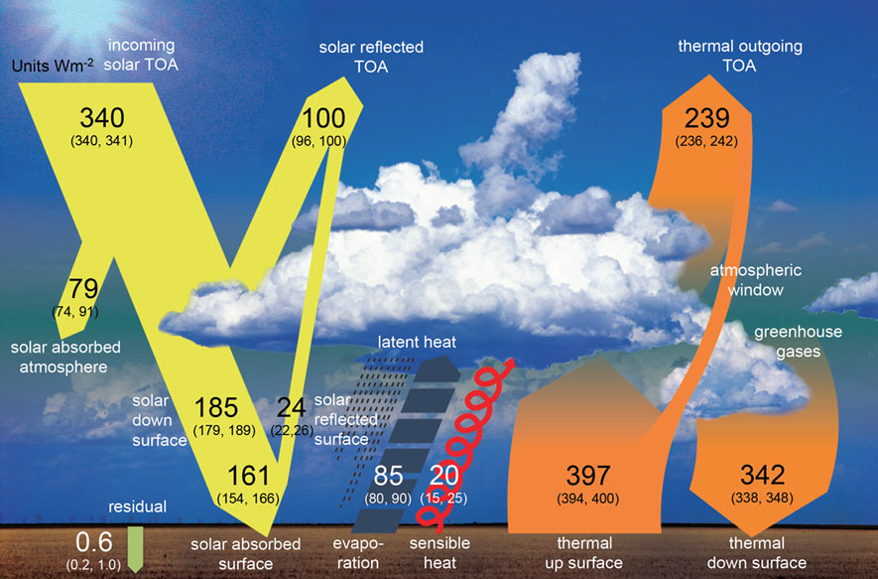
Physical Driver: Earth’s Energy Balance
Wild et al. (2012) Clim. Dynamics. See also: Trenberth et al. (2009) BAMS
Notes:
The incoming radiative energy from the sun is reflected back to space by clouds, the atmosphere and the surface. About half is absorbed by the Earth’s surface and a fifth by the atmosphere. The absorbed solar energy is balanced by thermal (or infrared/longwave) radiation that is emitted out to space. Most of the thermal energy emitted by the surface is absorbed by the atmosphere and clouds and emitted back to the surface (the greenhouse effect). Most of the Earth’s energy directly lost to space comes from the atmosphere. However, a large amount of energy is transferred from the surface to the atmosphere by thermals and evaporation as well as longwave thermal radiation.

Slide 4
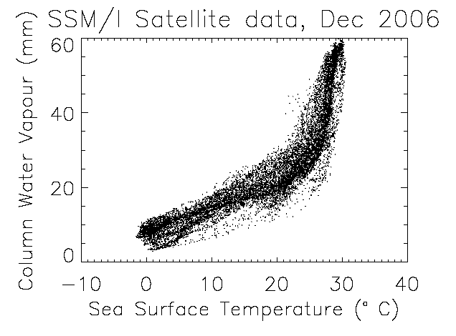
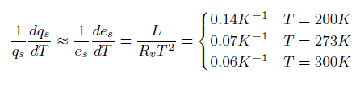
Physical Driver: water vapour
Physics: Clausius-Clapeyron
Low-level water vapour concentrations increase with atmospheric warming at about 6-7%/K
  Wentz and Shabel (2000) Nature; Raval and Ramanathan (1989) Nature

Slide 5
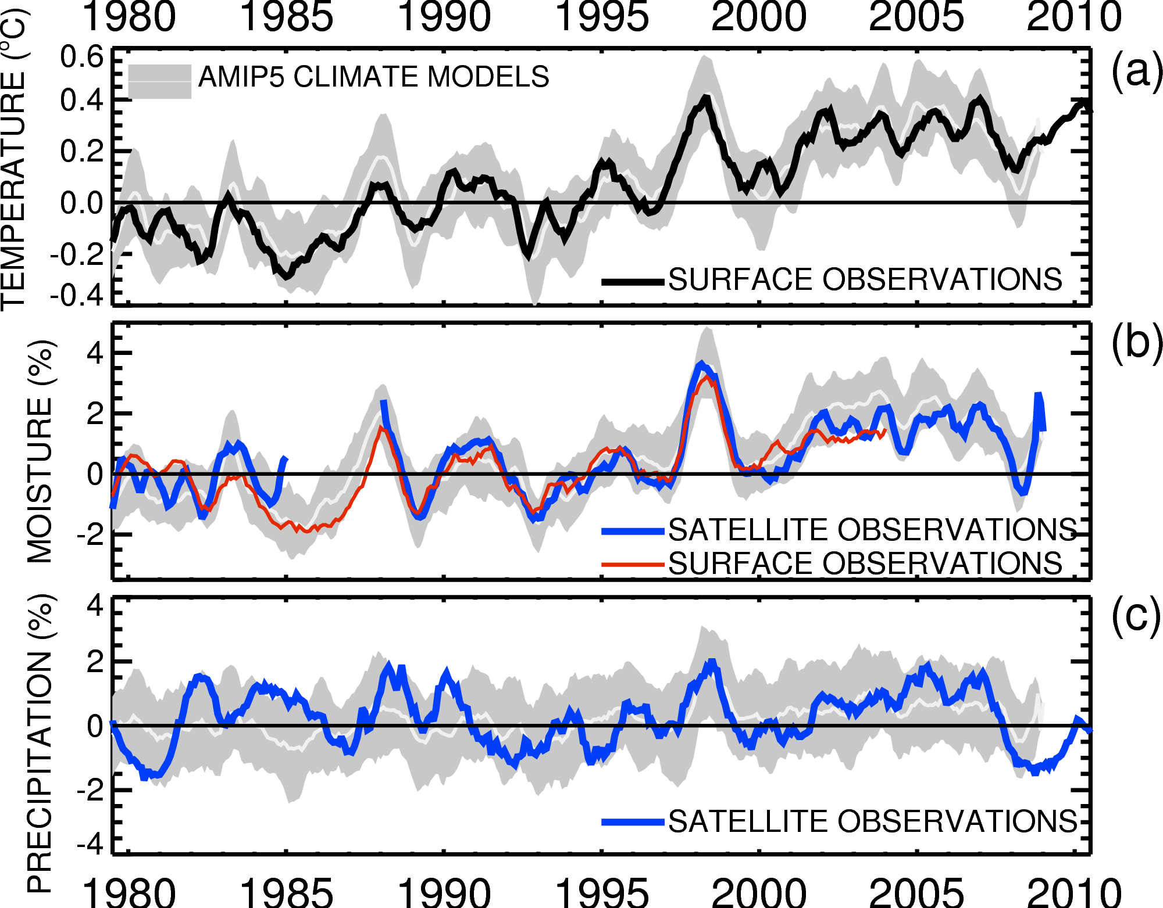

Globally, in the present-day climate, temperature, moisture and precipitation are strongly coupled
Allan et al. (2014) Surv. Geophys

Slide 6
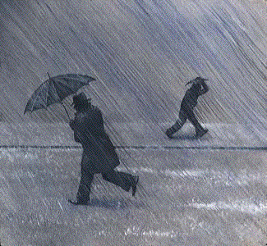
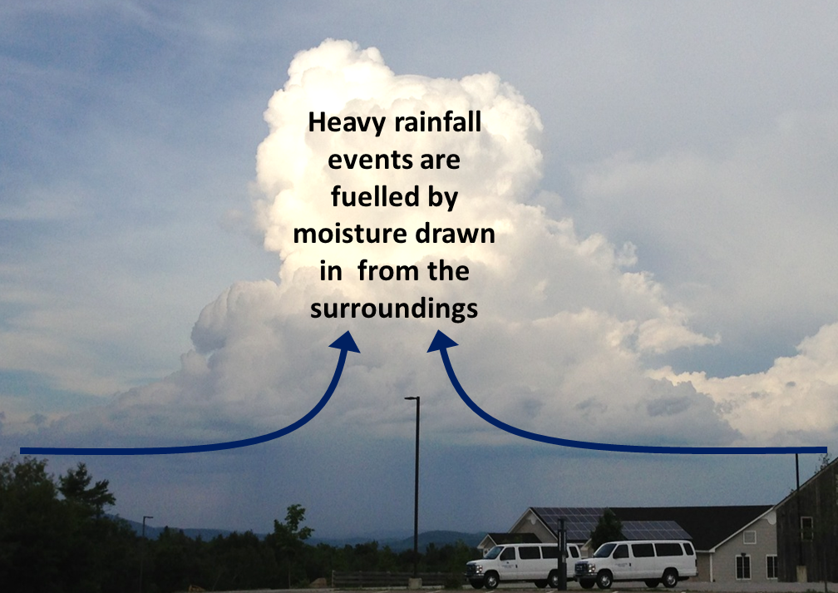
Extreme Precipitation
Large-scale rainfall events fuelled by moisture convergence
  e.g. Trenberth et al. (2003) BAMS
Intensification of rainfall with global warming 7%/K or more?
  e.g. Allan and Soden (2008) Science ; Kendon et al. (2014) Nature Climate

Slide 7
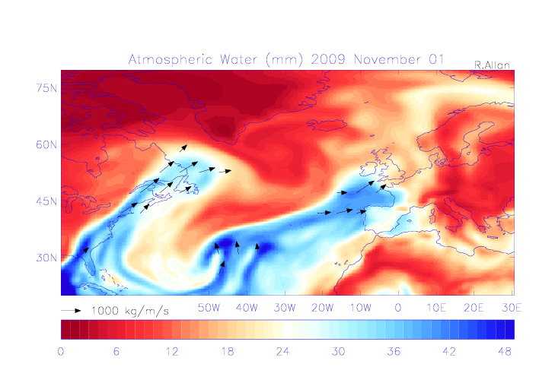
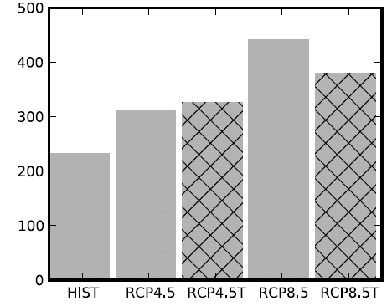
Water vapour and mid-latitude flooding
UK winter flooding linked to strong moisture transport events
  Cumbria November 2009 (Lavers et al. 2011 GRL)
  “Atmospheric Rivers” (ARs) in warm conveyor
  Lavers et al. (2013) ERL
Future increase in moisture explains most (but not all) of intensification of AR events
  Confident in the mechanisms and physics involved
Number of ARs
NorESM1-M

Slide 8

Contrasting precipitation response expected
Heavy rain follows moisture (~7%/K)
Mean Precipitation linked to energy balance (~2-3%/K)
Precipitation →
Light Precipitation (-?%/K)
Temperature →
e.g. Allen and Ingram (2002) Nature; Allan (2011) Nature

Slide 9
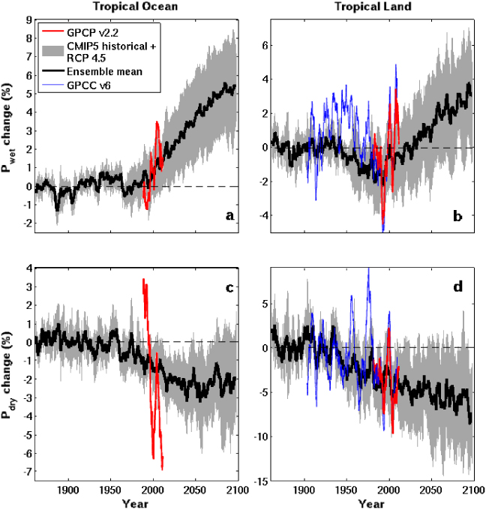
The Rich Get Richer…
Tropical Land
6
4
2
0
-2
-4
Simulations
Wet regions become wetter, already dry regions drier
Observations and detailed computer simulations (CMIP5)
But wet/dry regions move around e.g. Allan (2014) Nature Geosci.
Wet
Precipitation Change (%)
1900 1950 2000 2050 2100
5
0
-5
-10
Dry
Observations
1900 1950 2000 2050 2100
Liu & Allan (2013) Environmental Research Letters
Notes:
Note that the wet getting wetter and dry getting drier signal in the tropics is robust in models. The recently updated GPCP observations (black) show a slightly larger trend in the wet region. The dry region trend is probably spurious before 1988 since microwave data began in 1987.

Slide 10


Challenge: Regional projections
Shifts in atmospheric circulation are crucial to regional changes in water resources and risk yet this is the most challenging aspect of climate prediction
JJA DJF
How will position of jet streams & monsoons respond to warming?
Aerosol radiative forcing, internal variability and feedbacks involving land surface & ocean-atmosphere coupling all influence regional circulation & precipitation patterns

Slide 11
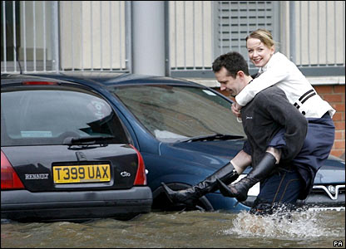
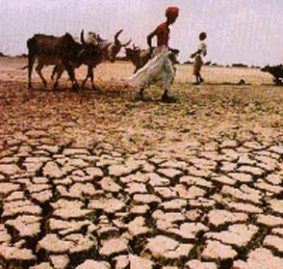
Conclusions
Global precipitation will rise with warming ~2%/K
  Constrained by energy budget of atmosphere and surface
Heavy rainfall becomes more intense
  Fuelled by increased water vapour (~7%/K)
Wet get wetter, dry get drier
  More flooding, more drought ?
  But wet and dry regions don’t stay still…
Regional projections are a challenge
  Sensitive to small changes in atmospheric circulation
Notes:
11
Projected Responses in Extreme Precipitation and Atmospheric Radiative Energy

Slide 12
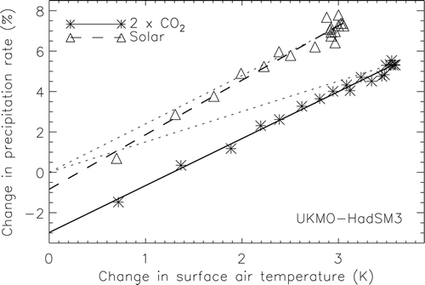
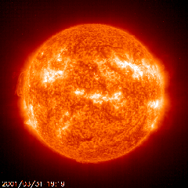
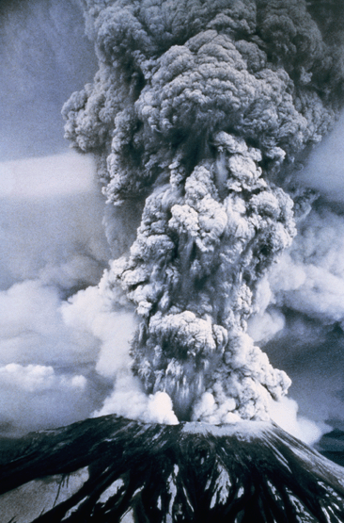
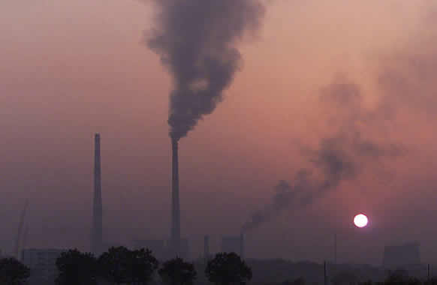
Improved understanding:
radiative forcing & global precipitation response
Andrews et al. (2009) J Climate
See also: Allen and Ingram (2002) Nature ; O’Gorman et al. (2012) Surv. Geophys ; Pendergrass & Hartmann (2012) GRL
Notes:
12

Slide 13
How will global precipitation respond to climate change?
Simulations:
RCP 8.5
Historical
RCP 4.5
Global Precipitation Change (%)
Observations
Allan et al. (2013) Surv. Geophys, see also Hawkins & Sutton (2010) Clim. Dyn
Notes:
13
There is huge uncertainty in global precipitation projections, relating both to climate sensitivity and mitigation pathways.

Slide 14


Water vapour and mid-latitude flooding
Linking UK winter flooding to Atmospheric Rivers
  e.g. Nov 2009 Cumbria floods
  NERC HydEF project
  See poster by David Lavers
Lavers et al. (2011) Geophys. Res. Lett.

Slide 15
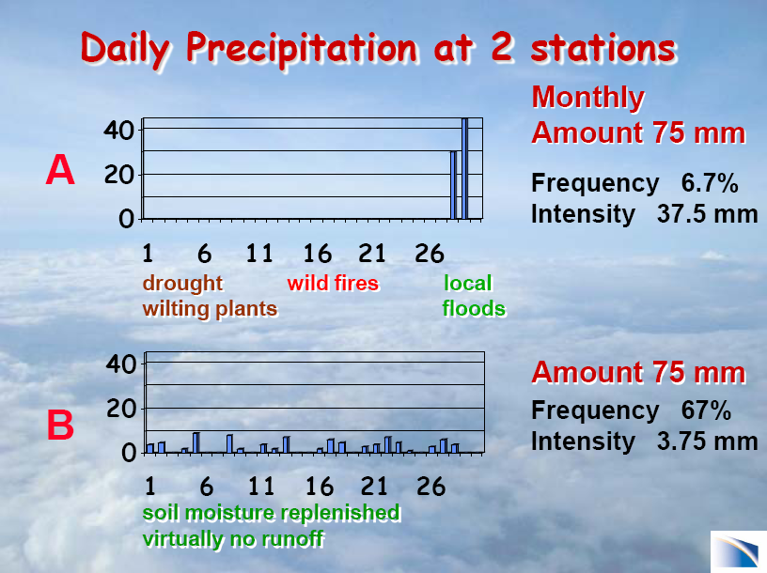
Courtesy of Dr Kevin Trenberth, Head of the Climate Analysis Section at the USA National Center for Atmospheric Research

Slide 16
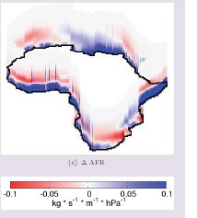
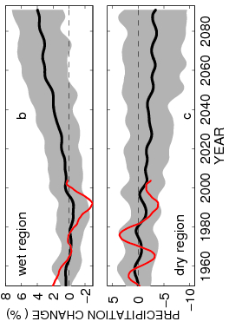

Contrasting precipitation response in wet and dry regions of the tropics
21C-20C
Tropical land
Simulations
Observations
NERC PREPARE project
See posters by Matthias Zahn and Chunlei Liu
Allan et al. (2010) Environ. Res. Lett., Zahn & Allan (2013) J Clim
Notes:
Note that the wet getting wetter and dry getting drier signal in the tropics is robust in models. The recently updated GPCP observations (black) show a slightly larger trend in the wet region. The dry region trend is probably spurious before 1988 since microwave data began in 1987.

Slide 17
CMIP5 simulations: Wettest tropical grid-points get wetter, driest drier
Ocean Land
Wet land: strong ENSO influence
GPCC GPCP
Pre 1988 GPCP observations over ocean don’t use microwave data
dry tropical region wet
Precipitation Change (%)
Tropical dry Tropical wet
Robust drying of dry tropical land
30% wettest gridpoints vs 70% driest each month
Liu and Allan (2013) ERL; see also: Chou et al. (2013) Nature Geosci; Chadwick et al. (2013) J Clim ; Allan (2012) Clim. Dyn.

Slide 18
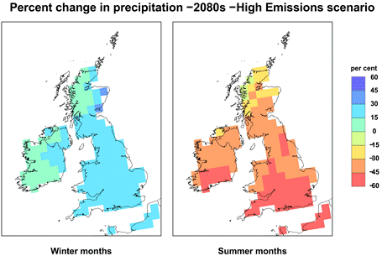
Robust predictions of regional changes in the water cycle: a great challenge
Shifts in circulation patterns are crucial to regional changes in water resources and risk yet predictability is often poor.
How will monsoons and jet stream positions respond to warming?
How will primary land-surface and ocean-atmosphere feedbacks affect the local response to global warming?

