Slide 1
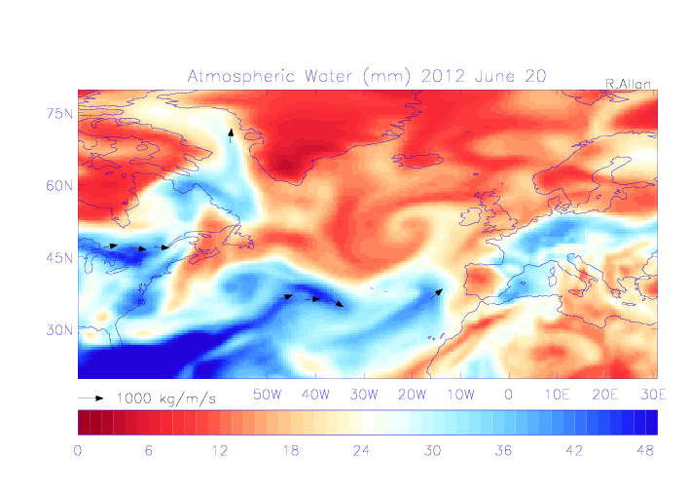
Atmospheric precursors
Evaluation of moisture characteristics associated with heavy daily rainfall
Dependence on region/season
Progressing to hourly rain gauge data and additional precursor diagnostics (e.g. wet bulb & dew point temperature)
q
(kg/ kg)
Allan et al. (2015) IJOC

Slide 2
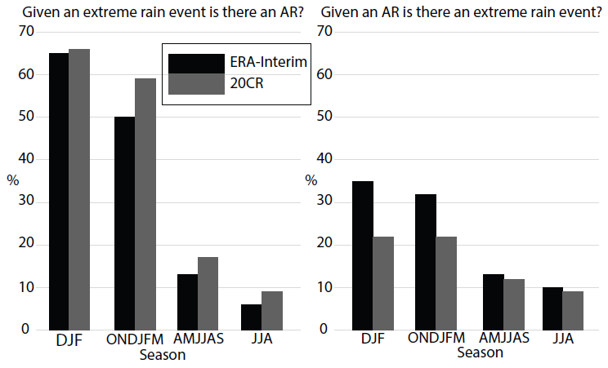
Atmospheric precursors
– plans for wp3
Compact KE work task
Work closely with EA & FFC inc. secondments
Potential for aiding flood forecasting
e.g. Lavers et al. 2014 Nature Comm.
Additional beneficiaries: climate research (e.g. Met Office/IPCC)
Champion et al. (2015) JGR
Extreme event?
Atmospheric precursor?

