Slide 1
Tracking Earth’s Energy since 2000
Richard Allan
University of Reading/NCAS climate
Collaborators:
Norman Loeb, Greg Johnson, John Lyman, Brian Soden
Notes:
This is the title slide, PowerPoint will automatically format the first slide with the title master, although this can be changed in the design palette.

Slide 2
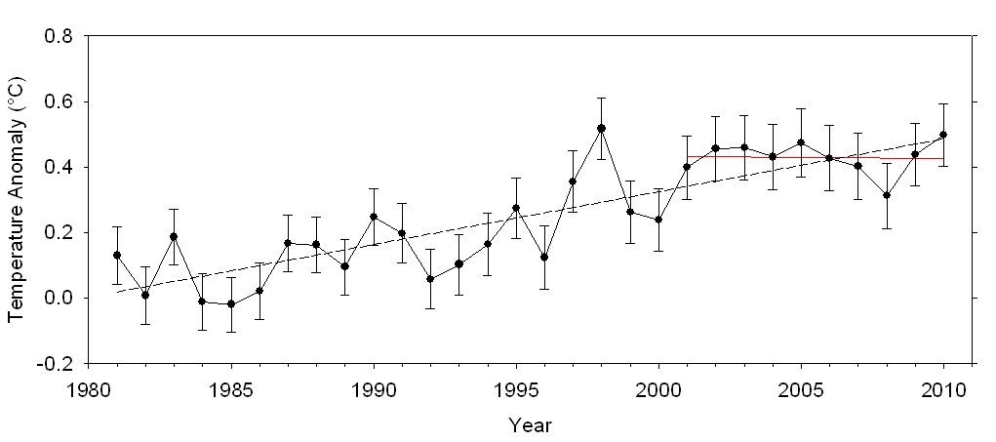
Lack of recent surface warming
Radiative forcing or energy redistribution?
Global annual average temperature anomalies from the 1961–1990 mean (black dots with 95% confidence limits) from the HadCRUT3 dataset .

Slide 3
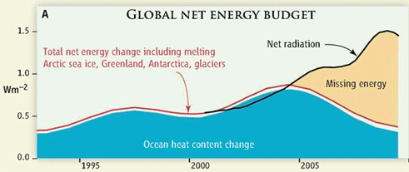
Missing energy?
Older ocean heat content analysis combined with inappropriate net radiation products appear to indicate “missing energy” in the climate system (Trenberth and Fasullo, 2010, Science)
Estimates of net radiation from satellite data and total net energy estimated primarily from ocean heat content data, do not appear to correspond (Trenberth & Fasullo 2010)

Slide 4
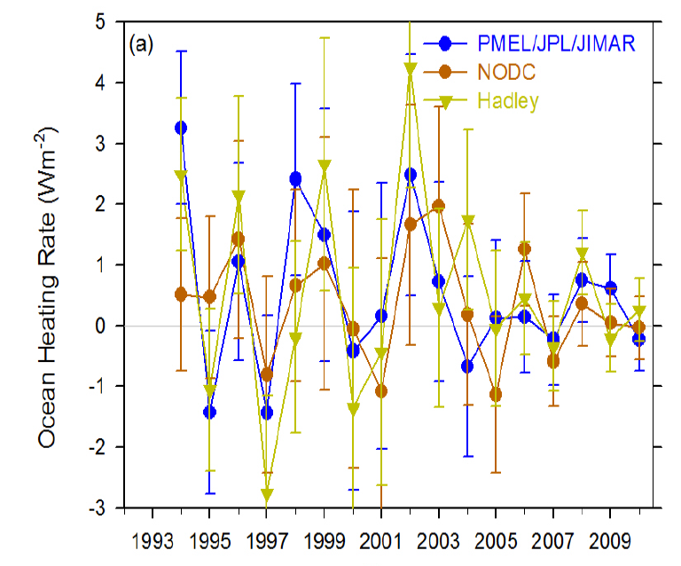
Ocean heat content data
Integrating trend in ocean heat content → energy flux
Accounting for considerable sampling/structural uncertainty there is no evidence for a robust decline in ocean heating since 2005

Slide 5
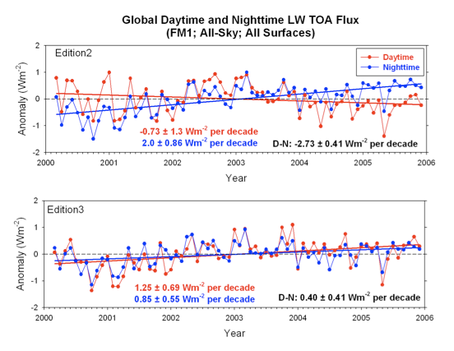
Earth Radiation Budget from satellite
CERES satellite data updated
Correction for daytime LW
Corrections also for SW

Slide 6
Earth Radiation Budget from satellite
Errors in satellite sensors and inappropriate use of satellite products explain rise in net radiative flux shown by Trenberth and Fasullo (2010)

Slide 7
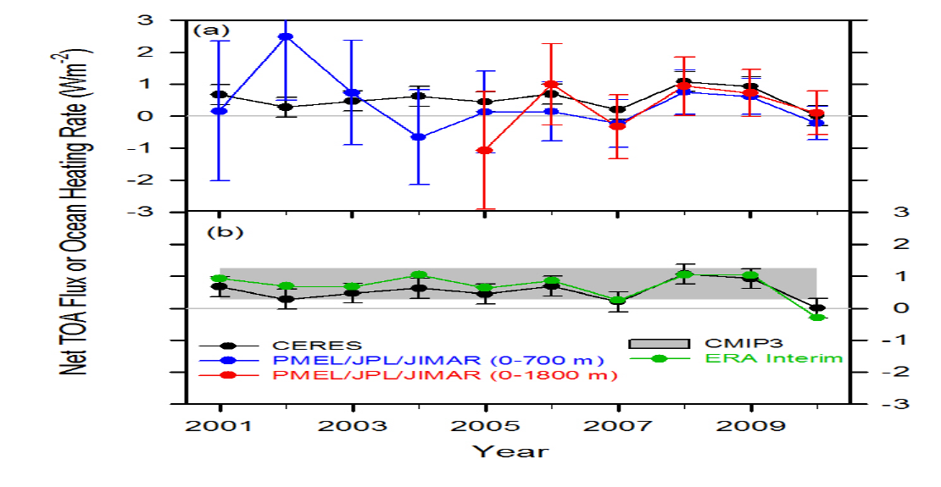
Combining Earth Radiation
Budget and Ocean Heat Content data
Tie 10-year CERES record to ARGO-estimated heating rate 2006-2010
Variability relating to ENSO reproduced by CERES, ARGO and ERA Interim since 2005
Estimate of decade long net energy imbalance of 0.54±0.43 Wm^{–2}.
Where has energy gone? Presumably heating up sub-surface ocean.
Notes:
Fi gure 3 (a) Global annual average net TOA flux from CERES observations and (b) ERA Interim reanalysis are anchored to an estimate of Earth’s heating rate for 2006–2010 ⁵ The Pacific Marine Environmental Laboratory/Jet Propulsion Laboratory/Joint Institute for Marine and Atmospheric Research (PMEL/JPL/JIMAR) ocean heating rate estimates⁴ use data from Argo and World Ocean Database 2009; uncertainties for upper ocean heating rates are given at one-standard error derived from sampling uncertainties. The gray bar in (b) corresponds to one standard deviation about the 2001–2010 average net TOA flux of 15 CMIP3 models.

Slide 8
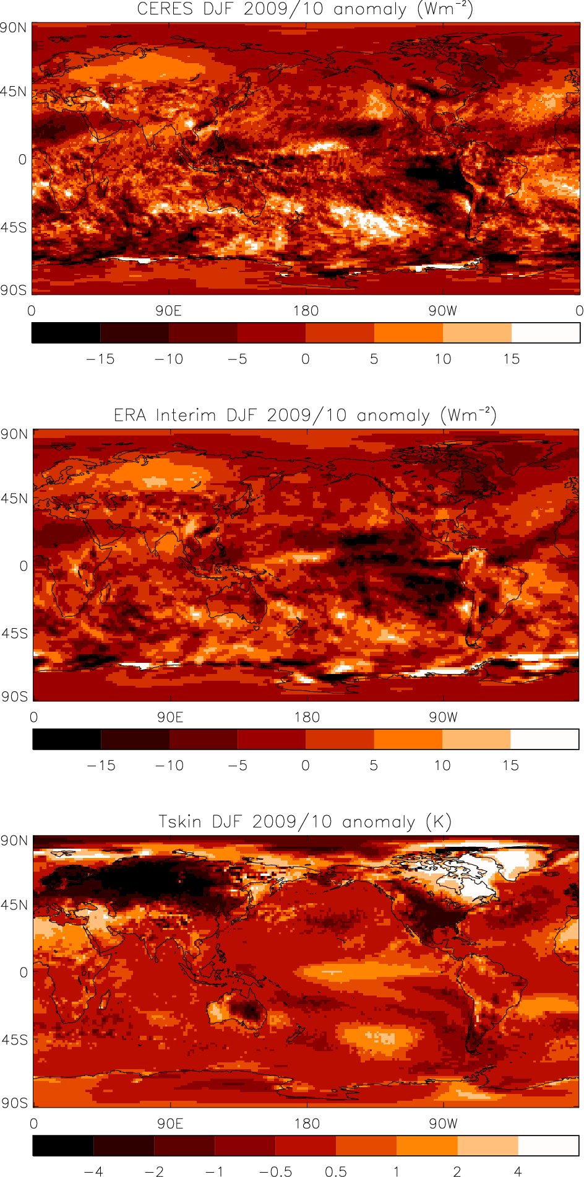
Spatial signatures
DJF 2009/10 – net radiation anomalies:
  CERES
  ERA Interim
El Niño and cold Eurasia/USA, warm Canada/Greenland
Energy transports by ocean and land crucial
Heating induced warming at 45ºS 120ºW
Notes:
Deseasonalised monthly anomalies of net radiation (60ºS-60ºN) from satellite data (ERBS WFOV; CERES) and reanalysis simulations (ERA Interim) updated from ref 6 to include CMIP5 climate model simulations (AMIP 5 simulations from CNRM, NorESM1, HadGEM2 and INMCM4 in grey and combined historical and RCP4.5 scenario coupled simulations from CNRM, CanESM, HadGEM2-ES and INMCM4 in blue shading).

Slide 9
Future work
Assess variability in net radiation since 1985
Evaluate model simulations of net energy
Understand drivers for redistribution of energy
Notes:
Deseasonalised monthly anomalies of net radiation (60ºS-60ºN) from satellite data (ERBS WFOV; CERES) and reanalysis simulations (ERA Interim) updated from ref 6 to include CMIP5 climate model simulations (AMIP 5 simulations from CNRM, NorESM1, HadGEM2 and INMCM4 in grey and combined historical and RCP4.5 scenario coupled simulations from CNRM, CanESM, HadGEM2-ES and INMCM4 in blue shading).

