Slide 1



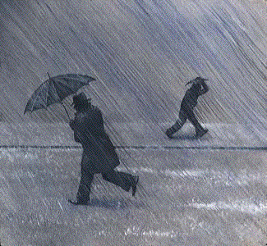
Sensitivity of precipitation extremes to ENSO variability
ENSO provides a test-bed for analysing sensitivity of precipitation extremes to temperature change
1 day average 5 day average
Change in Precipitation Intensity per ºC warming (%/day)
Increase of ~15% per ºC warming
10 mm/day
0 mm/day
20 mm/day
4 mm/day
Precipitation intensity percentile (%)
Liu & Allan (2012) JGR; see also O’Gorman (2012) Nature Geosci
Richard Allan, University of Reading

Slide 2
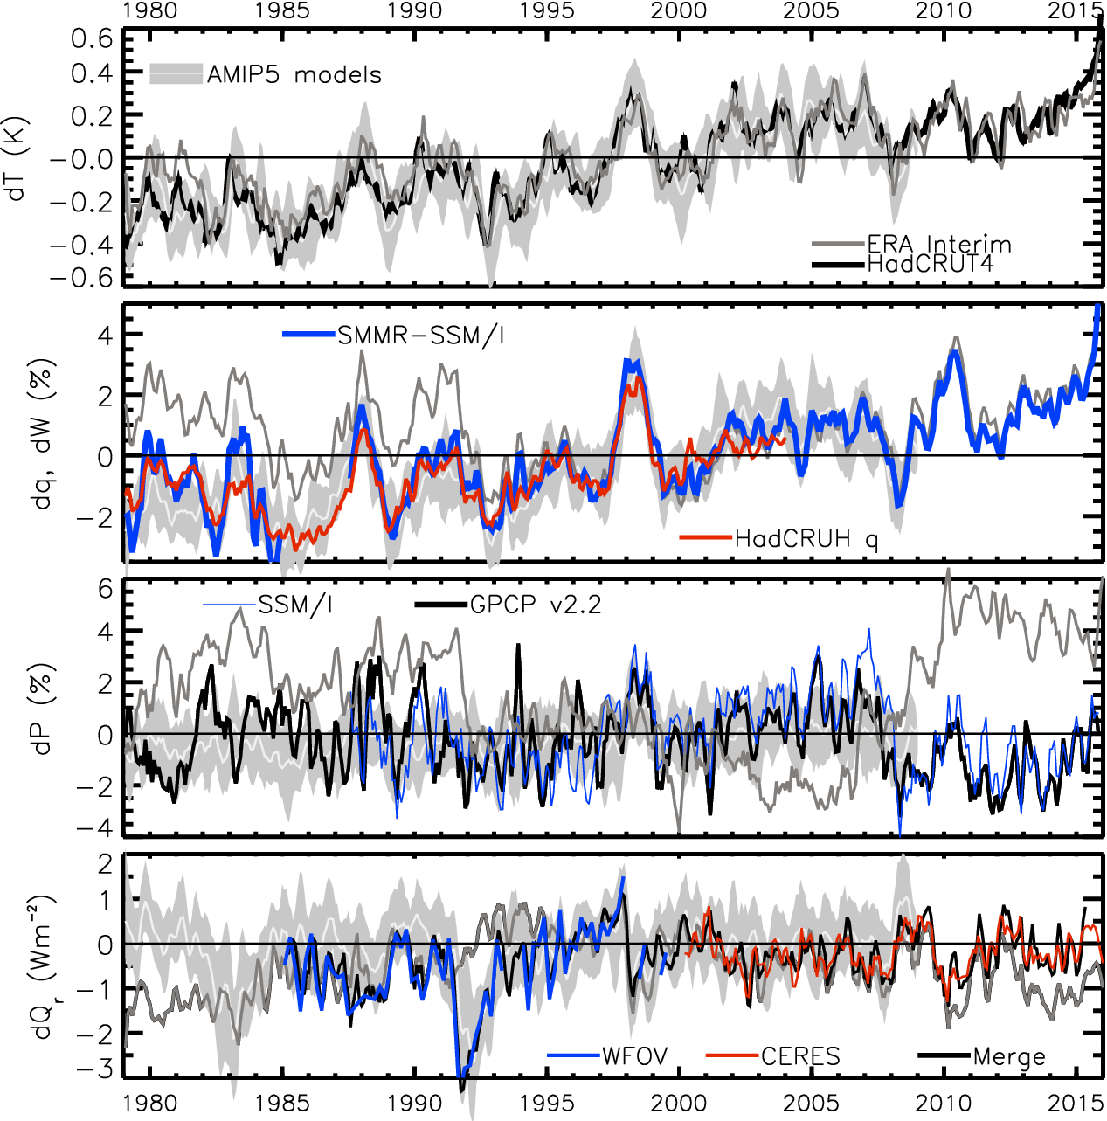
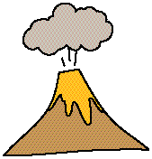
ENSO variability in global energy & water cycles
HEATING (Wm⁻²) PRECIP (%) MOISTURE (%) TEMPERATURE (K)
HEATING (Wm⁻²) PRECIPITATION (%) MOISTURE (%) TEMPERATURE (K)
Updated from Allan et al. (2014) Surveys of Geophys & Allan et al. (2014) GRL
2.8
1.8
0.8
-0.2
-1.2
-2.2
Earth’s energy imbalance (Wm⁻²)
Richard Allan, Reading

Slide 3
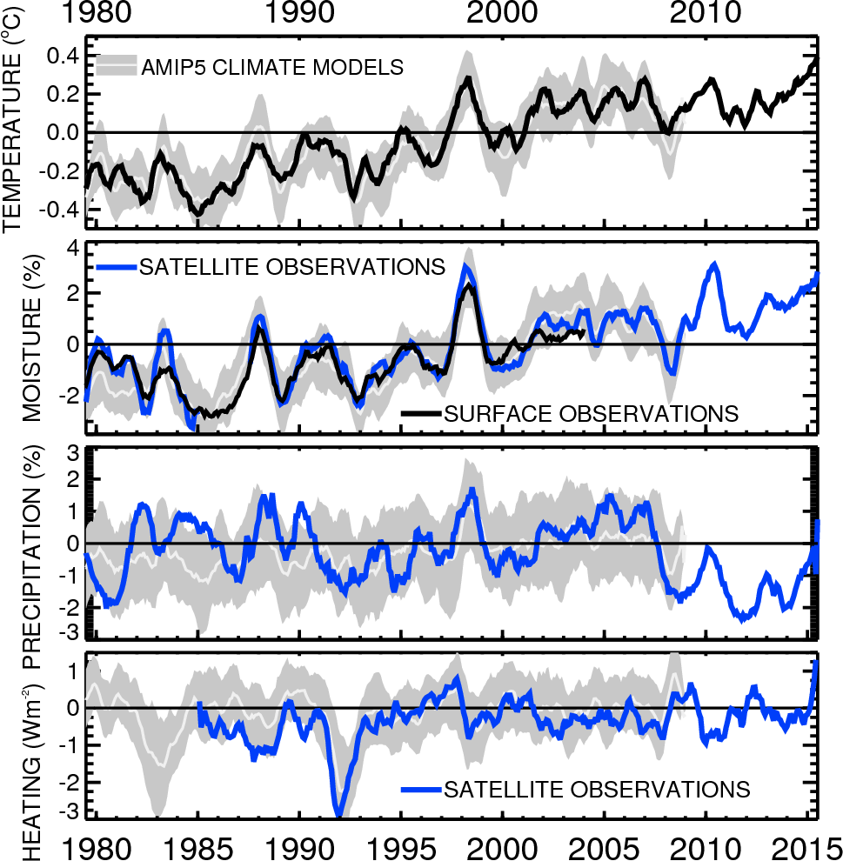
ENSO variability in global energy & water cycles
Updated from Allan et al. (2014) Surveys of Geophys & Allan et al. (2014) GRL
1.8
0.8
- 0.2
-1.2
-2.2
Earth’s energy imbalance (Wm⁻²)
Notes:
Or a simpler plot

Slide 4
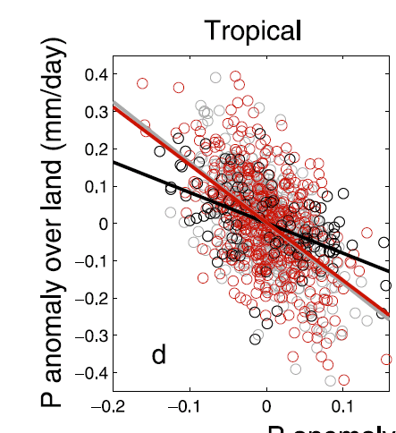
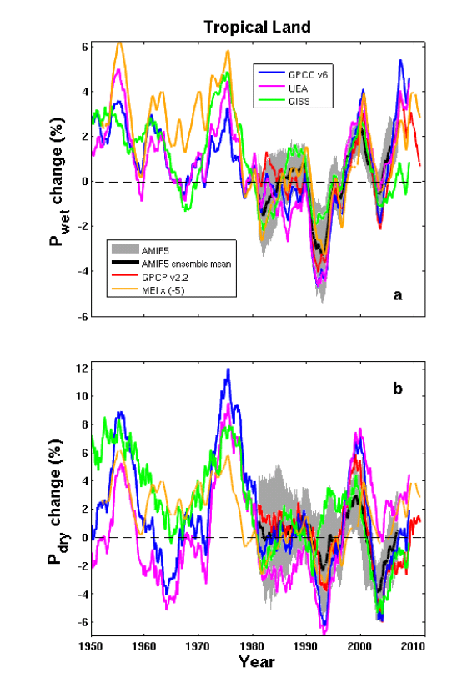
ENSO-related precipitation changes over tropical land
Interanual-decadal changes in continental rainfall dominated by: La Niña (more rain) & El Niño (less rain)
ENSO MEI
AMIP
CMIP
GPCP
P anomaly over ocean (mm/day)
Land and ocean rainfall anti-correlated on interannual/ ENSO time-scale (above)
GISS AMIP
volcano
Liu, Allan, Huffman (2012) GRL
Liu & Allan (2013) ERL

Slide 5
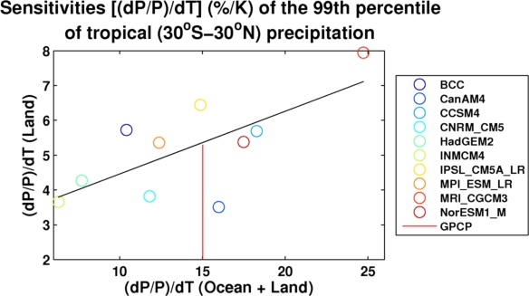
ENSO variability as an emergent constraint on precipitation extremes?
Sensitivity of tropical 5-day precipitation extremes to ENSO-related temperature variability (x-axis) plotted against future land response (y-axis)
Future response (RCP4.5)
GPCP
ENSO variability (AMIP)
Plot by Chunlei Liu, based on data from Allan et al. (2014) Surv. Geophys
See O’Gorman (2012) Nature Geosci

Slide 6
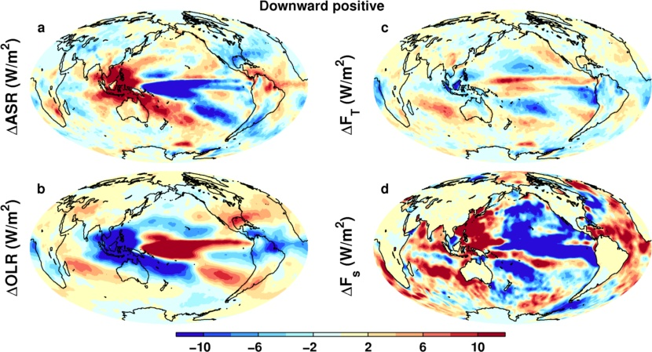
El Niño minus La Niña changes in energy fluxes
TOA solar
TOA net
Surface NET energy rad+turb
-
TOA LW DOWN
Plot by Chunlei Liu: 1985-2015 (Allan et al. (2014) GRL and Liu et al. (2015) JGR)
Notes:
Changes in top of atmosphere LW and SW consistent with shifts in cloud due to ENSO. These compensate in the NET TOA fluxes for high/deep cloud but a residual signal is evident over the Pacific ITCZ (stronger cloud greenhouse effect dominates more reflected sunlight), the Pacific stratocumulus zones (more absorbed sunlight AND more downward LW).
The surface energy flux looks quite different as there is a large heat flux out the east Pacific in El Nino and reduced horizontal transport by a weaker Walker circulation (presumably less negative energy flow from the cooler east to warmer west so therefore greater energy convergence in the warm pool).

Slide 8
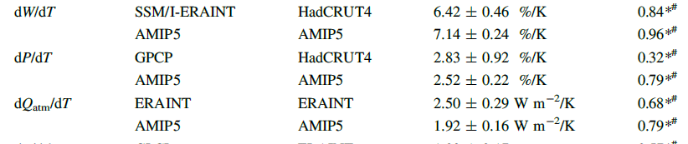
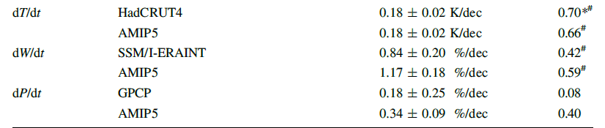
Trends 1988-2008 (W=atmos moisture, T=surface temperature, P=precip, t=time)
Allan et al. (2014) Surv. Geophys

Slide 9
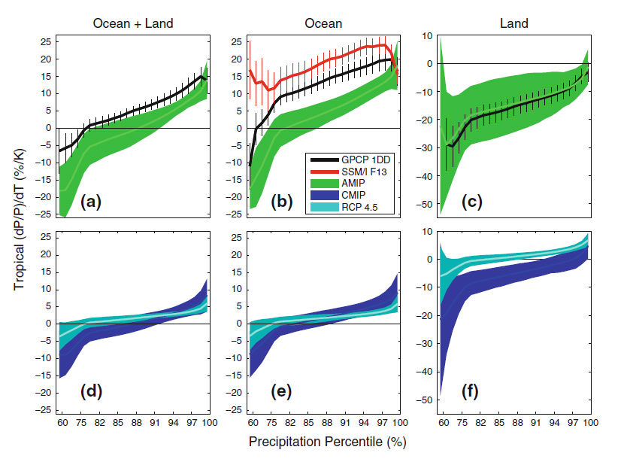
Using ENSO variability to evaluating sensitivity of precipitation extremes to warming
Observed/simulated 5-day mean response
① More positve dP/dT for heavier percentiles
② More positive observed sensitivity over ocean
③ Negative land dP/dT as more rain during cold La Nina
④ Interannual dP/dT not good direct proxy for climate change, especially over land
…but may be good global indicator of model diversity e.g. O’Gorman (2012)
②
①
③
dP/dT (%) Tropics
1998-2008
RCP4.5
2080-2099 minus 1985-2005
④
amip
amip
④
Historical 1985-2005
Allan et al. (2014) Surv. Geophys
Notes:
5-day means.
More positve dP/dT for heavier percentiles (obs and models)
Higher observed sensitivity than models over ocean, good agreement over land.
Mostly negative dP/dT for all percentiles (apart from heaviest) over land. Partly due to less rainfall over land in El Nino when warmer tropical T
Coupled models: similar picture over ocean. Smaller sensitivity for highest percentiles under climate change since global increases in P with warming are muted by increasing CO2 levels.

Slide 10
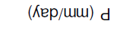
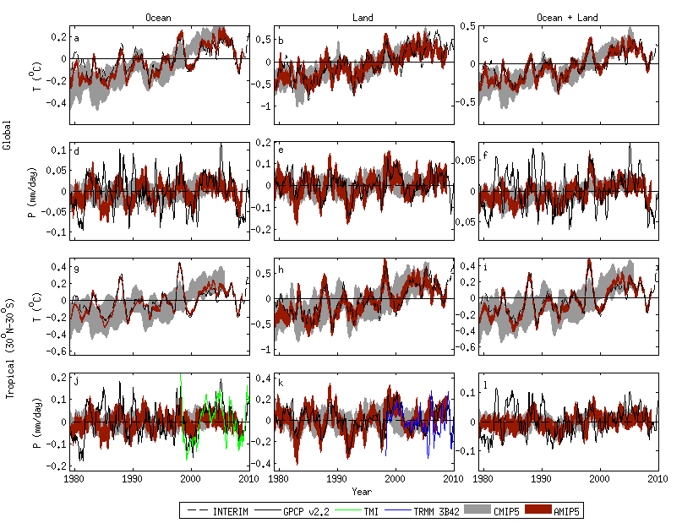

Tropical precipitation variability in satellite data and CMIP5 simulations
Note consistency between atmosphere-only AMIP model simulations over land and GPCP observations. This is not the case for the ocean, in particular before about 1996.
AMIP5 simulations with prescribed observed sea surface temperature can simulate GPCP observed rainfall variability over land.
Oceans Land
Tropical Land
La Niña
Volcano
El Niño
Liu, Allan, Huffman (2012) GRL

