Slide 1
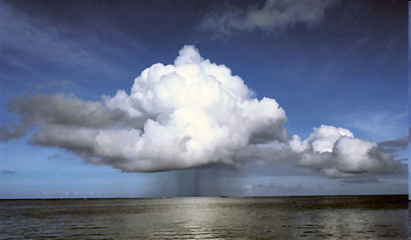
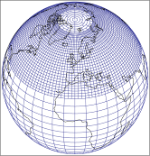
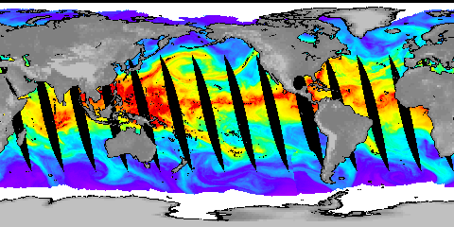




Climate change and meteorological drivers of widespread flooding in the UK
EA/Defra/NRW Research and Development (R&D) project board meeting, London, March 26 2015
Richard Allan Department of Meteorology, University of Reading
www.met.reading.ac.uk/~sgs02rpa r.p.allan@reading.ac.uk @rpallanuk
Notes:
Projected Responses in Extreme Precipitation and Atmospheric Radiative Energy
Energetics response
Wet/dry responses
Intense rainfall
Transient responses

Slide 2
Meteorological drivers of widespread flooding in the UK
Extreme seasonal rainfall e.g. winter 2013/14
  Jet stream position/strength/characteristics, blocking
  “Memory” in climate system e.g. remote sea surface temperature and ice coverage
  Repeated rainfall & coastal inundation events
Extreme weather events
  “Atmospheric rivers”, convergence lines, “Spanish Plume”, wind storms, snow melt
Impact of a warming climate
  Increasing atmospheric water vapour
  Changing characteristics of weather patterns

Slide 3
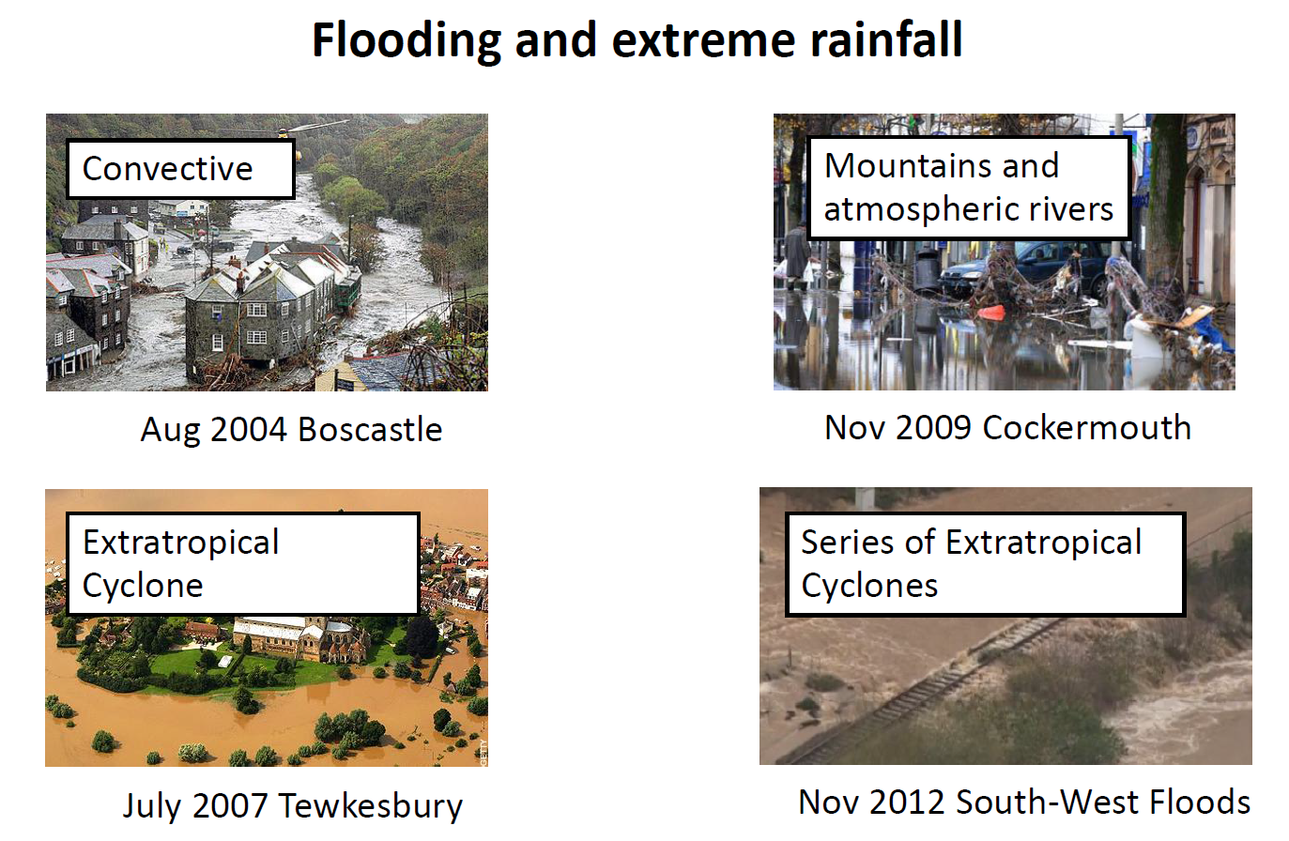

Slide courtesy of Len Shaffrey, University of Reading

Slide 4
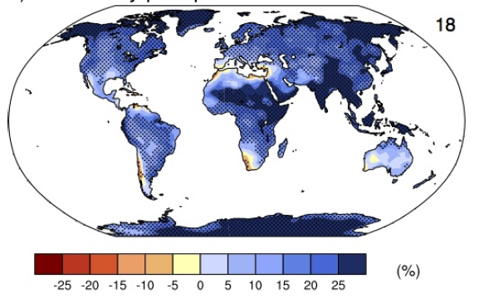
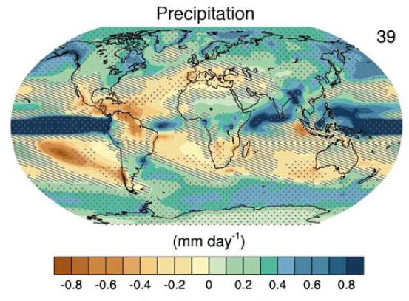
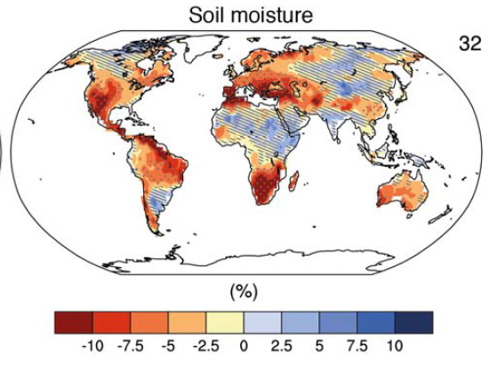
Global context: changing water cycle
Precipitation intensity
Increased Precipitation
More Intense Rainfall
More droughts
Wet regions get wetter, dry regions get drier?
Regional projections??
IPCC WGI (2013)
Notes:
PRECIPITATION: [Tech Summ Fig. 2]
RCP8.5 ANN: Multi-model CMIP5 average mm/day change.
Hatching: multi-model mean change is small (<1SD of internal variability)
Stippling: multi-model mean change is big (>2SD of internal variability and 90% of models agree on sign)
P INTENSITY:
Percent change in annual maximum 5-day precipitation 2081-2100 relative to 1981-2000 for RCP8.5 CMIP5 ensemble.
Fig. 12.26, Chapter 12.
Stippling → significant change
SOIL MOISTURE: [Tech Summ, Fig. 2]
RCP8.5 ANN change in %, Upper 10cm
Hatching: multi-model mean change is small (<1SD of internal variability)
Stippling: multi-model mean change is big (>2SD of internal variability and 90% of models agree on sign)

Slide 5


Challenge: Regional projections
Shifts in atmospheric circulation are crucial to regional changes in water resources and risk yet this is the most challenging aspect of climate prediction
JJA DJF
How will position of jet streams & monsoons respond to warming?
Regional heating/cooling effects from aerosol particle pollution and feedback loops involving the land and sea surface become important

Slide 6
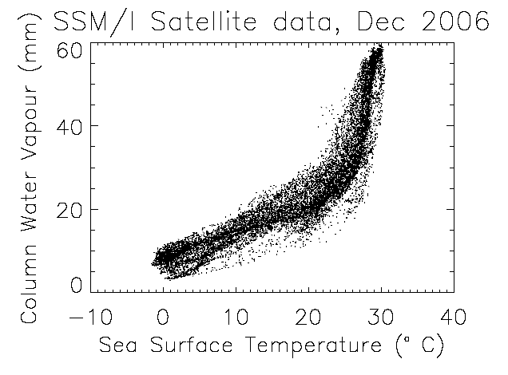
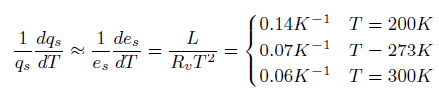
Physical Driver: water vapour
Physics: Clausius-Clapeyron
Low-level water vapour concentrations increase with atmospheric warming at about 6-7%/K
  Wentz and Shabel (2000) Nature; Raval and Ramanathan (1989) Nature

Slide 7
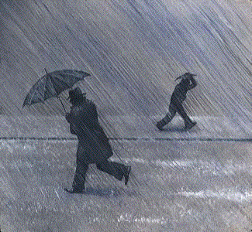
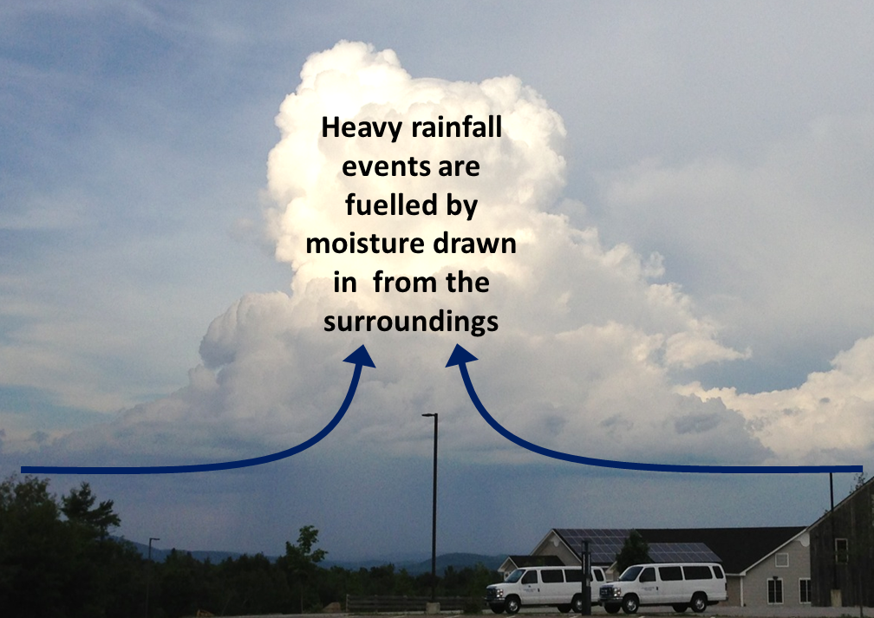
Extreme Precipitation
Large-scale rainfall events fuelled by moisture convergence
  e.g. Trenberth et al. (2003) BAMS
Intensification of rainfall with global warming 7%/K or more?
  e.g. Allan and Soden (2008) Science ; Kendon et al. (2014) Nature Climate

Slide 8
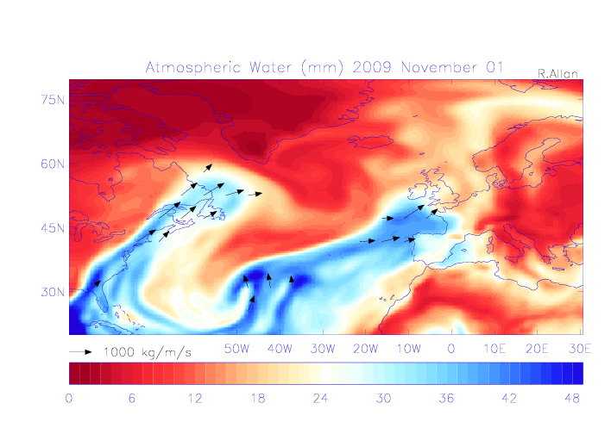
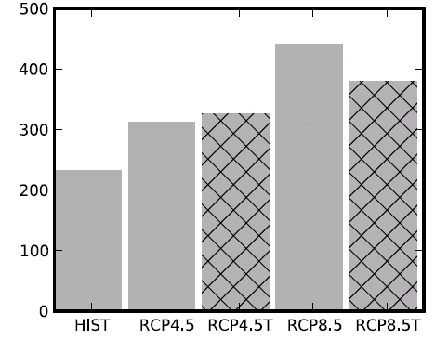
Water vapour and mid-latitude flooding
UK winter flooding linked to strong moisture transport events
  Cumbria November 2009 (Lavers et al. 2011 GRL)
  “Atmospheric Rivers” (ARs) in warm conveyor
  Lavers et al. (2013) ERL
Future increase in moisture explains most (but not all) of intensification of AR events
  Confident in the mechanisms and physics involved
Number of ARs
NorESM1-M

Slide 9
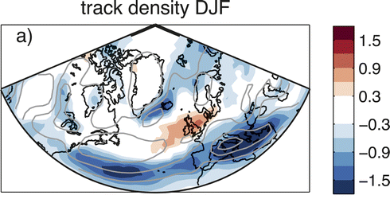
Projected changes in storms
Changes in storm frequency (2070-2100 minus 1980-2005) from climate model projections for a high-range emissions scenario.
Fewer storms over Mediterranean and Iceland.
UK: Little signal.
Robust signal: more extreme precipitation from all storms.
Zappa et al. 2013 J. Clim.
Notes:
Changes in number of cyclones per month per unit area

Slide 10
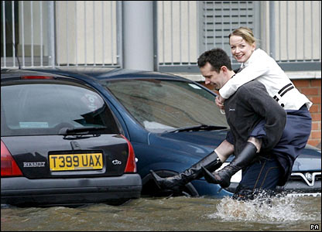
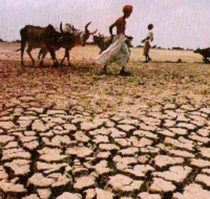
Conclusions
Global precipitation will rise with warming ~2%/K
  Constrained by energy budget of atmosphere and surface
Heavy rainfall becomes more intense
  Fuelled by increased water vapour & moisture convergence ~7%/K
Regional projections are a challenge
  Sensitive to small changes in atmospheric circulation
  When atmosphere conspires to generate heavy and/or prolonged rainfall, it will be more intense in a warmer environment
Sea level rise, due to warming oceans and melting land ice, will exacerbate coastal flooding
Snow melt events are likely to decrease in importance
Notes:
10
Projected Responses in Extreme Precipitation and Atmospheric Radiative Energy

Slide 11
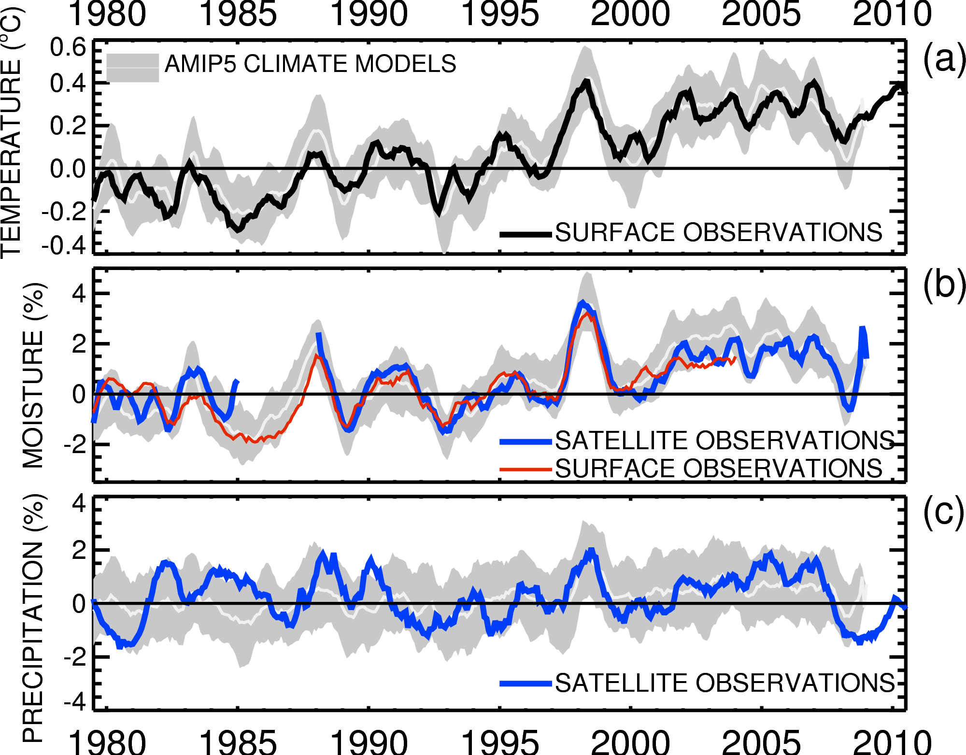

Globally, in the present-day climate, temperature, moisture and precipitation are strongly coupled
Allan et al. (2014) Surv. Geophys

