Slide 1
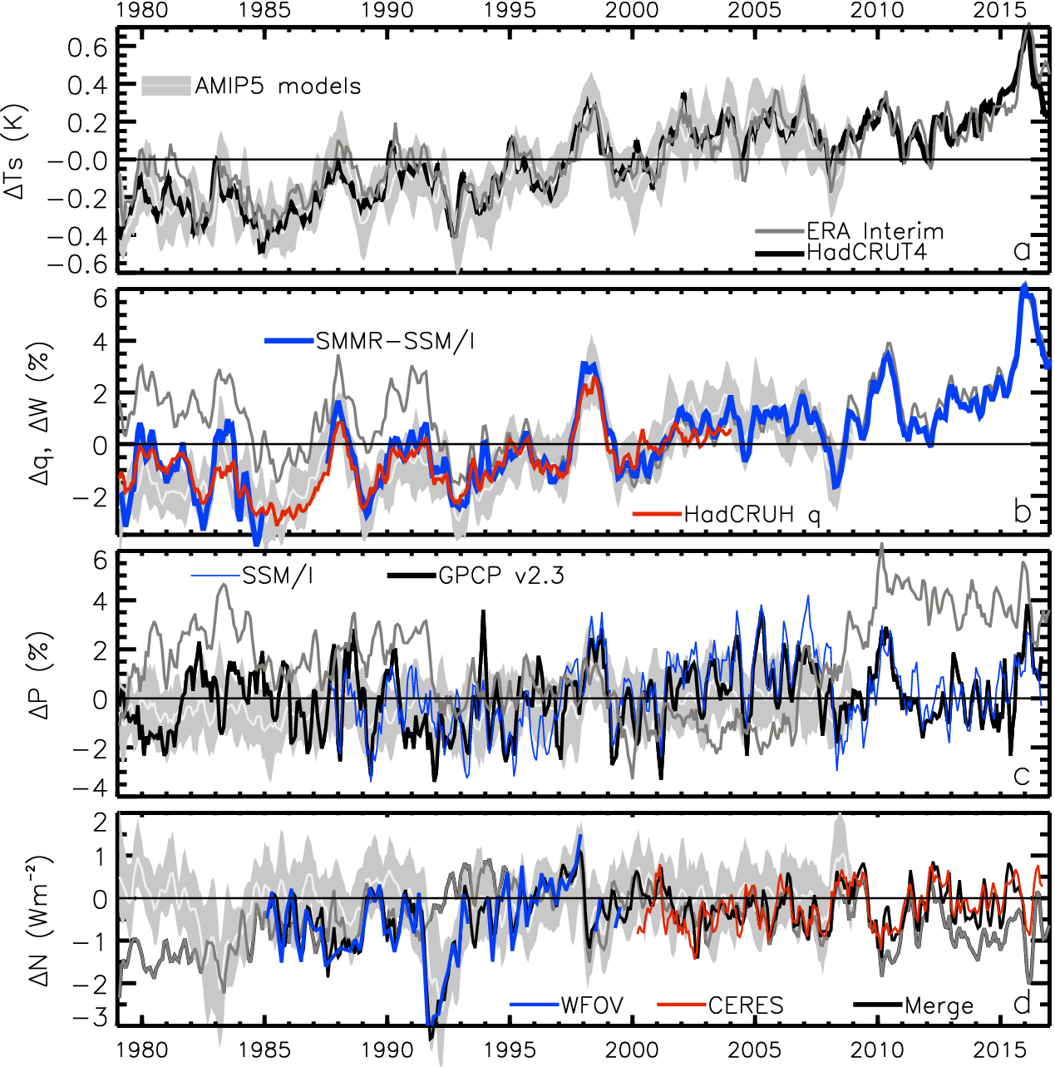
Earth’s global surface temperature & energy imbalance variability since the 1980s
TEMPERATURE anomaly (degC)
2.8
1.8
0.8
-0.2
-1.2
-2.2
ENERGY BUDGET anomaly (Wm⁻²)
Energy imbalance (Wm⁻²)
after Allan et al. 2014 (GRL)

Slide 2
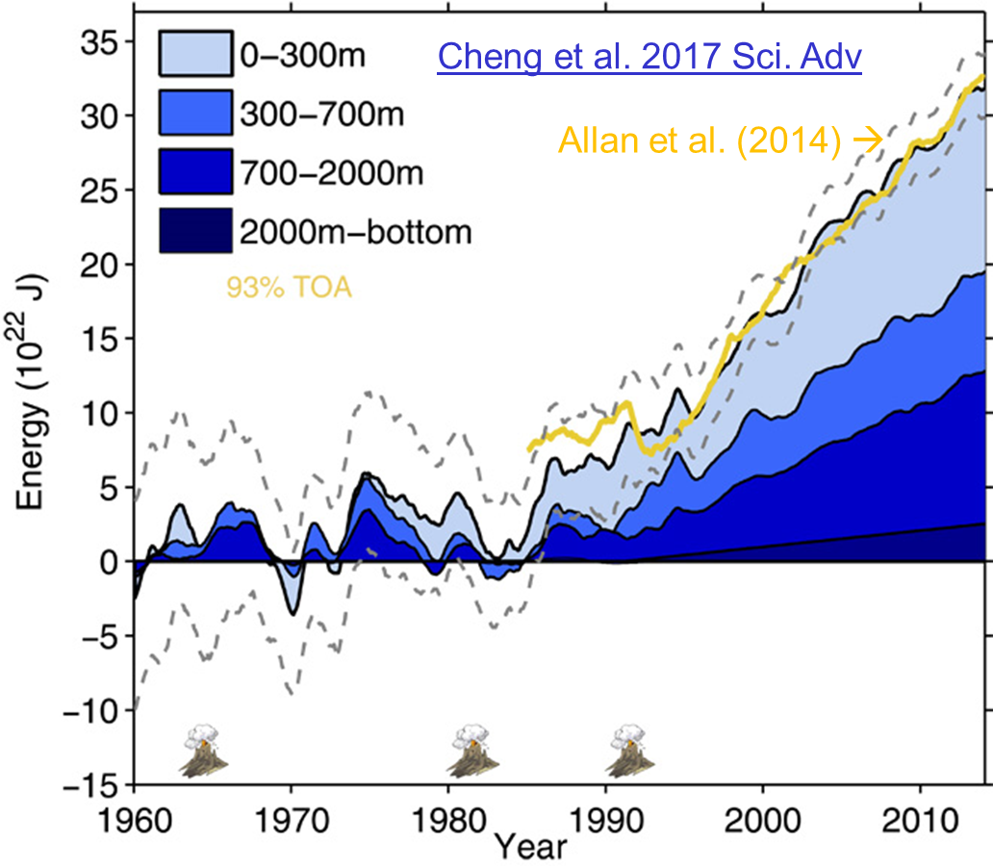
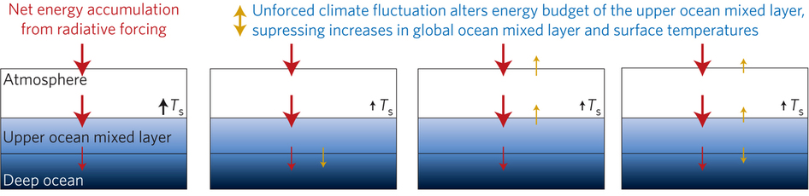
Role of energy imbalance in “hiatus” decades
Steady decadal ocean heating since 2000:
0.6-0.8 Wm⁻² (Johnson et al. 2016; Cheng et al. 2017)
Radiative forcing/internal variability influence TOA radiation (Palmer & McNeall 2014; Allan et al. 2014; Huber & Knutti 2014; Xie & Kosaka 2017)
Upper ocean heat budget explains surface temperature: hiatus events explained by < 0.1 Wm⁻² anomaly, Hedemann et al. 2017 NatureCC
Allan (2017) Nature Climate Change
Notes:
Improved and longer records of ocean heating and top of atmosphere radiation measurements have improved estimates of Earth’s energy imbalance and its changes over recent decades.
Simulations with prescribed observed SST and radiative forcing are able to capture variations in energy budget
Greater appreciation for the role of internal variability in influencing global energy budget and the link between energy imbalance and surface temperature via heat budget of upper ocean

Slide 3
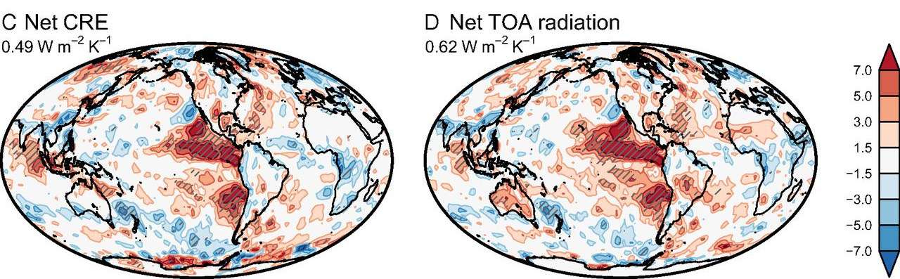
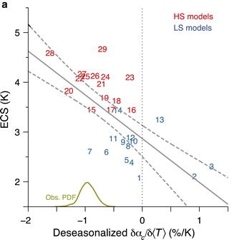
Climate sensitivity
Using observed interannual energy balance variability as proxy for low-cloud climate feedbacks
Above: Ceppi & Gregory, 2017 PNAS
Left: Brient and Schneider (2016) J. Clim.
Few tenths of %/K albedo or Wm⁻²K⁻¹ net radiation

Slide 4
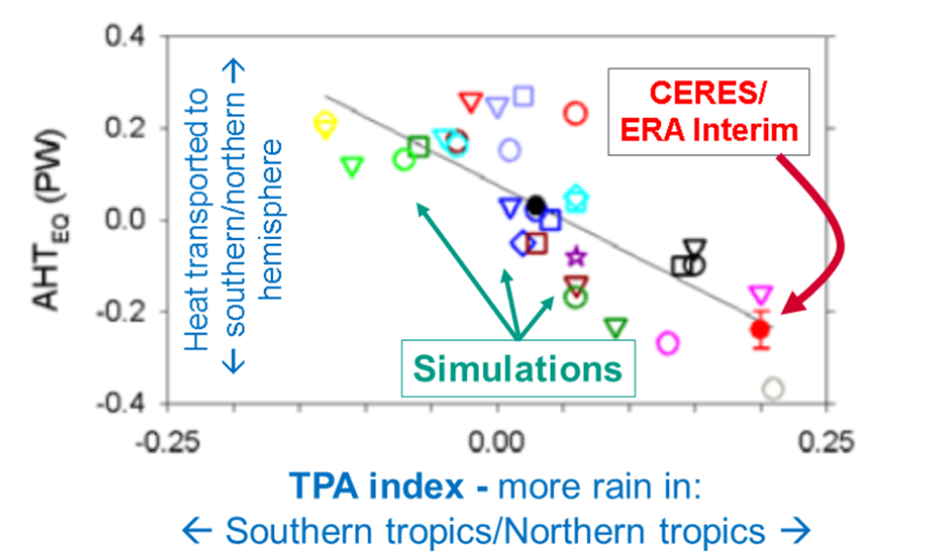
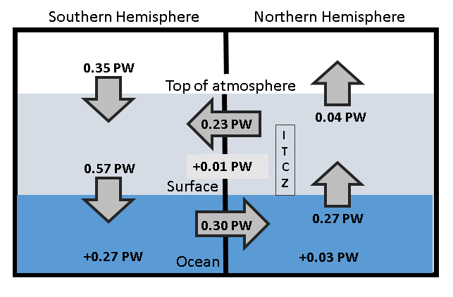
Inter-hemispheric energy imbalance/transport and precipitation biases in CMIP5 models
Cross-equatorial heat transport by atmosphere & hemispheric precipitation asymmetry linked
(Loeb et al. (2016) Clim. Dyn)
See also: Haywood et al. (2016) GRL; Hawcroft et al. (2016) Clim. Dyn.
Can infer cross equatorial heat flux from observed inter-hemispheric imbalance in Earth’s energy budget (Liu et al. 2017 JGR 2000-15 update of Loeb et al. (2016) Clim. Dyn using Roemmich et al. (2015) Nature Climate ocean heating)
Also ocean heat transports? Trenberth & Fasullo (2017)
Notes:
Combining top of atmosphere energy budget and reanalysis horizontal energy transports allows new estimates of global surface energy budget
This has enabled advances in observing/understanding inter-hemispheric energy imbalance/transports and precipitation and links to model biases
Many CMIP5 models contain gross errors in cross equatorial energy fluxes which coincide with incorrect depiction of hemispheric precipitation asymmetries offering a potential constraint on climate models

Slide 5
Science questions & requirements
Energy imbalance since 2000: 0.6-0.8 Wm⁻² (Loeb et al. 2012; Johnson et al. 2016); trend requirements of ~0.1 Wm⁻²/decade (Loeb et al. 2018)
Upper mixed ocean layer energy budget deviation within ~0.1 Wm⁻² required to attribute hiatus decades (e.g. Hedemann et al. 2017)
Distinct feedbacks on internal variability/forced change, few tenths of Wm⁻²K⁻¹ (Brown et al. 2016 J. Clim; Zhou et al. 2016)
  <0.5%CRF/decade (Wielicki et al. 2013)
Inter-hemispheric energy imbalance as constraint on heat transport simulated precipitation (Frierson et al. 2013; Loeb et al. 2016 Clim. Dyn; Stephens et al. 2016 CCCR Haywood et al. (2016) GRL)
  0.1 PW/hemisphere → 0.4 Wm⁻²
assimilation of energy balance data to constrain ocean heat content data: Storto et al. (2017) GRL
Sampling e.g. diurnal (CERES, Loeb et al. 2018); spatial (Gristey et al. 2017)
Richard Allan (University of Reading) r.p.allan@reading.ac.uk @rpallanuk
List of journal articles: www.met.reading.ac.uk/~sgs02rpa/research/DEEP-C.html#PAPERS

Slide 7
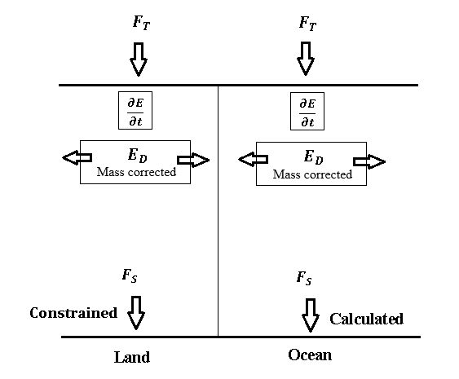
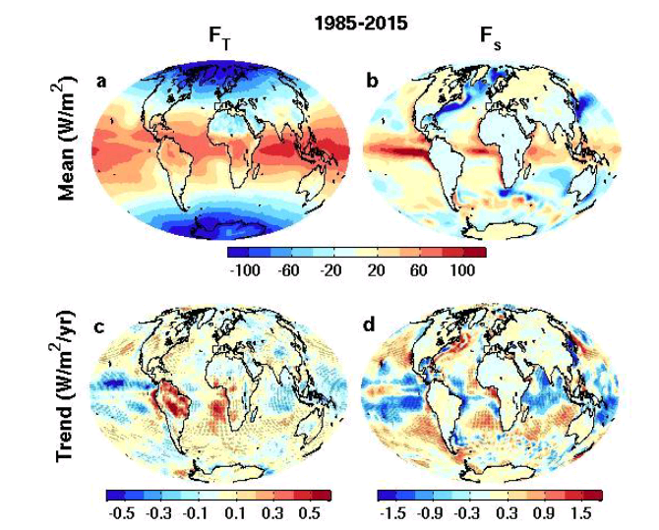

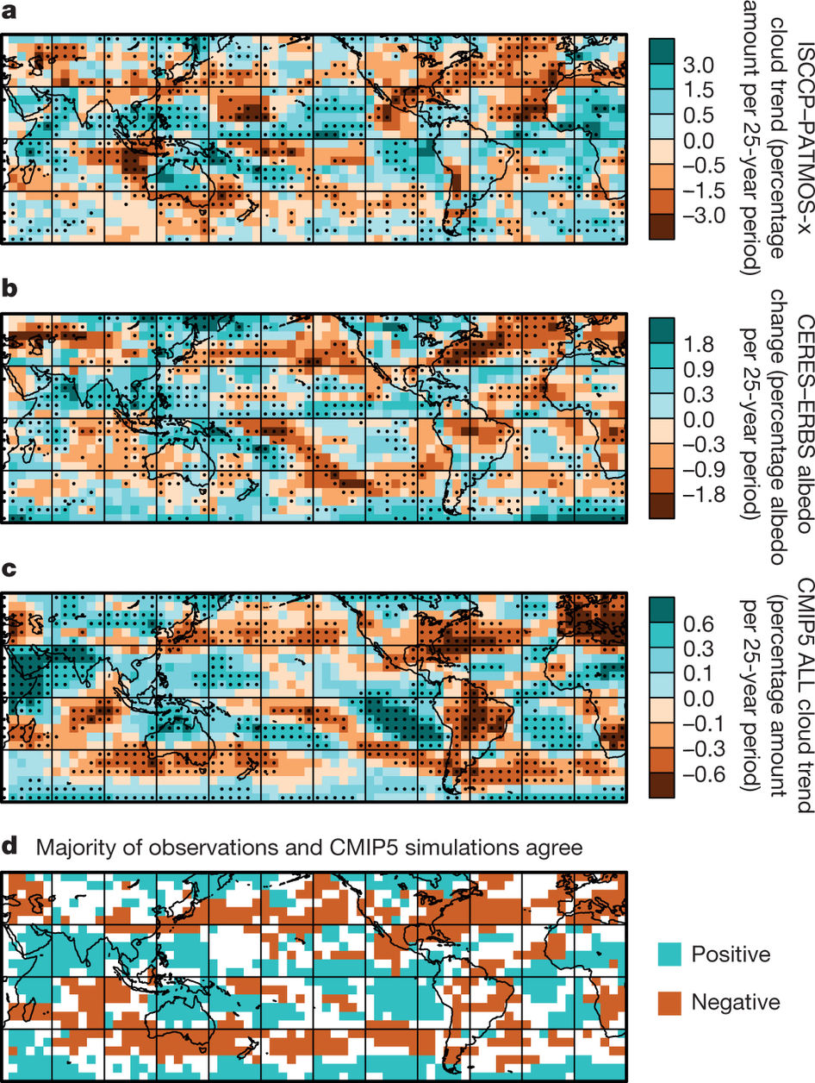
Deriving surface/TOA energy fluxes
ERBS CERES
reanalyses
top of atmosphere surface
Surface energy flux dataset combining TOA reconstruction with reanalysis energy transports: Liu et al. (2015) JGR
Liu et al. (2017) JGR
Data: http://dx.doi.org/10.17864/1947.111
Norris et al (2016) Nature
Links to cloudiness?

Slide 8
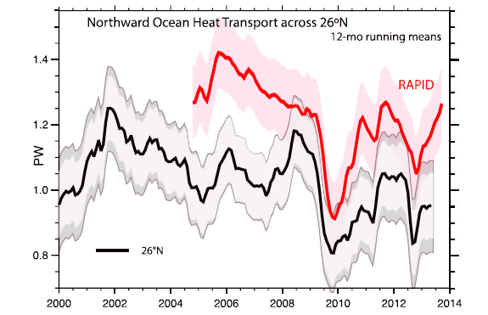
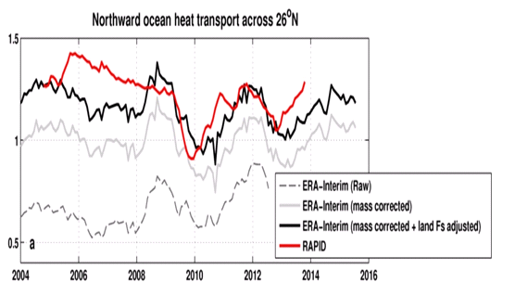
Energy balance constraint on N Atlantic heat transport?
Trenberth & Fasullo (2017) GRL
Compare indirect method with RAPID observations
Is TF2017 discrepancy due to lack of land F_{s} adjustment?
Ocean heating from ORAS4 (0-700m).
Better agreement after land Fs adjustment
2004-2013
RAPID 1.23 PW
TF2017 1.00 PW
Liu et al: 1.16 PW
large uncertainty

Slide 10
Global energy budget: advances/questions
More accurate multi-decadal global estimates of Earth’s energy budget and its variability (e.g. Cheng et al. 2017 Sci. Adv.; Allan et al. 2014 GRL)
  Better indicator of global climate change than surface temperature but gaps in observing deep ocean (e.g. Palmer 2017 CCCR)
  Link to observed cloudiness? e.g. Norris et al (2016) Nature
Link between energy imbalance and surface warming depends on energy budget of upper mixed ocean layer (Roberts et al. 2015 JGR; Hedemann et al. 2017 Nature Climate Change; Xie & Kosaka 2017 CCCR)
  Better appreciation of mechanisms of decadal global climate variability
Distinct feedbacks on internal variability/forced change (Brown et al. 2016 J. Clim; Xie et al. 2015 Nature Geosci; Zhou et al. (2016) Nature Geosci
  Obs. estimates of climate sensitivity (Richardson et al. (2016) Nature Climate)
  Spatial patterns of warming crucial (Gregory and Andrews (2016) GRL)
  What explains decreased heating of E Pacific and is it realistic?
Advances in observing/understanding inter-hemispheric energy imbalance/transport and links to CMIP5 precipitation biases (Frierson et al. 2013; Loeb et al. 2016 Clim. Dyn; Stephens et al. 2016 CCCR)
  Possible constraint on realism of climate models (Haywood et al. (2016) GRL)

Slide 11
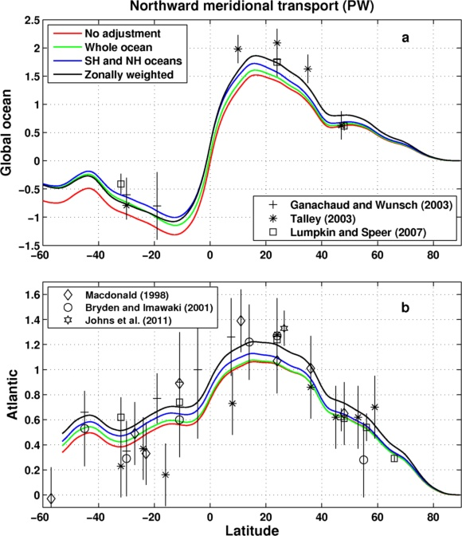
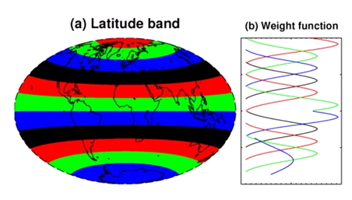
Comparison of Meridional Heat Transport
Inferred from F_{s} (Liu et al.) & ocean heating (Roemmich et al 2015) 2006-2013
Sensitivity of method to land flux correction
Zonal land correction
26ºN
Liu et al. (2017) submitted to JGR

Slide 12
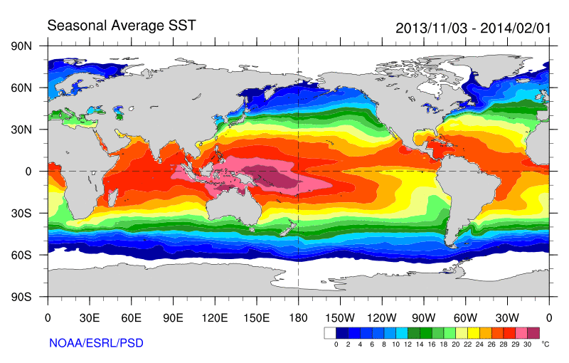
Role of Atlantic/Pacific Variability?
Radiative Forcing/Imbalance Johnson et al. (2016) ; Checa-Garcia et al. (2016) ; Huber & Knutti (2014) ;Santer et al. (2015) :
Continued heating from greenhouse gases
Aerosol forcing of circulation (Smith et al. 2016)
Unusual weather patterns (Ding et al. 2014; Trenberth et al. 2014b)
Pacific SST strengthens atmospheric circulation
Enhanced Walker Circulation
? Heat flux to Indian ocean Lee etal 2015
Increased sea height
Warm
Upwelling,
Cool water
Remote forcing from Atlantic:
Li et al. (2016) ;
McGregor et al. (2014)
Increased precipitation
Decreased salinity
Strengthening trade winds
Equatorial Undercurrent
Pacific dominates?
Mann et al. (2016) Kosaka & Xie (2013) England et al. (2014)
Enhanced mixing of heat below 100 metres depth by accelerating shallow overturning cells and equatorial undercurrent
See also: Merrifield (2010).; Sohn et al. (2013) .; L’Heureux et al. (2013) . Change; Watanabe et al. (2014) ; Balmaseda et al. (2013) ; Trenberth et al. (2014) .; Llovel et al. (2014) ;Durack et al. (2014) ; Nieves et al. (2015) ; Brown et al. (2015) JGR ; Somavilla et al. (2016) ; Liu et al. (2016)
Notes:
There is lots of new results focussing on the slower rates of surface warming and associated unusual climatic conditions at the beginning of the 21st century (see DEEP-C website: http://www.met.reading.ac.uk/~sgs02rpa/research/DEEP-C.html#PAPERS).

