Slide 1
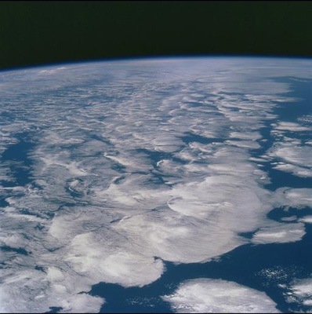




DEEP-C: Diagnosing Earth’s Energy Pathways in the Climate system
PIs: Richard Allan, Elaine McDonagh, Matt Palmer
University of Reading, National Oceanography Centre – Southampton, Met Office
Partners: Walker Institute, NASA Langley, DECC, NCAS, NCEO.
Notes:
This is the title slide, PowerPoint will automatically format the first slide with the title master, although this can be changed in the design palette.

Slide 2
Agenda
11:15am-1pm Project Intro (R. Allan) and workpackages¬¦¥ͫ΅︣ꜘ
WP1 - Observed Radiative Imbalance/Atmospheric Energy Transports
WP2 - Ocean Heat Content from Observations (E. McDonagh)
WP3 - Climate Model Simulations and Process Understanding (M. Palmer)
1-2pm Lunch
2-3:30pm Science talks – TBD (around 20 minutes each)
Ed Hawkins - Comparing global temperatures from CMIP5 simulations with recent observations
Doug Smith - Decadal predictions of the hiatus
Jonathan Gregory - inferring climate sensitivity from observations
...
3:30-4pm Discussion of Project Workplan/next steps
4pm coffee/tea, any other business
Meeting aims: (1) Meet team; (2) Initial results; (3) Discussion of Project Workplan and Direction

Slide 3
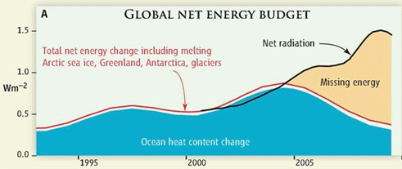

Motivation (1) Missing energy?
Trenberth and Fasullo (2010, Science) highlighted an apparent large discrepancy between net radiation and ocean heat content changes
H1 – “Missing Energy” in the climate system is explained by deficiencies in the observing system and can be resolved through improved combination and analysis of updated satellite and in situ measurements and modelling

Slide 4
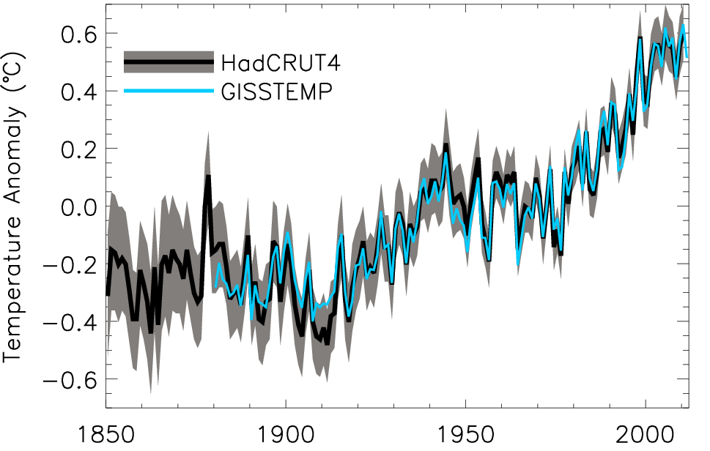
Motivation (2) What has caused the decline in rate of global surface warming?
H2 – The recent slow rates of surface warming (the so-called warming hiatus) are primarily due to an enhanced transport of heat to the deep ocean caused by natural variability in ocean circulation with changes in external forcing playing a secondary role.
Global annual average temperature anomalies relative to 1951–1980 mean (shading denotes lower and upper 95% uncertainty range for HadCRUT4)

Slide 5
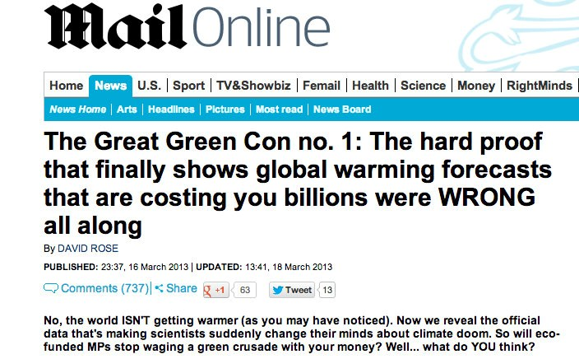
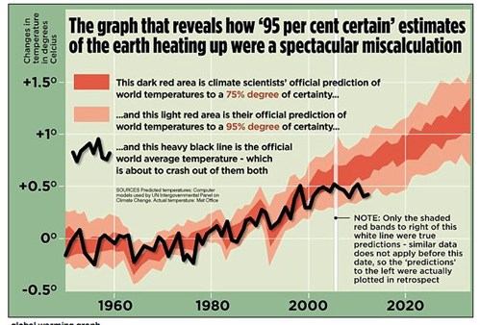
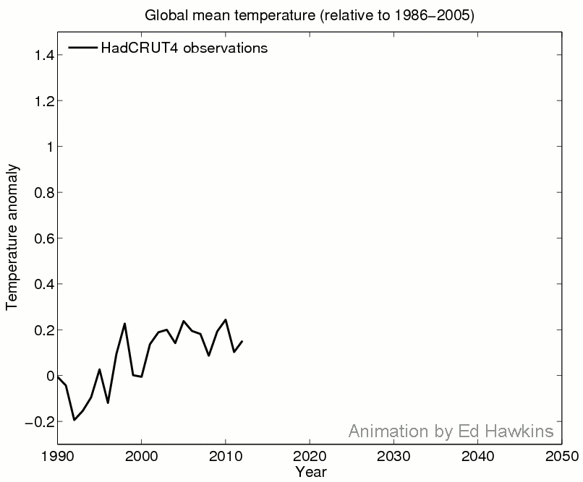

Public understanding of climate change
Ed Hawkins’ ClimateLabBook

Slide 6
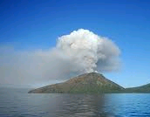
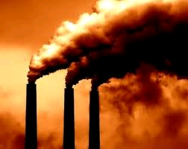
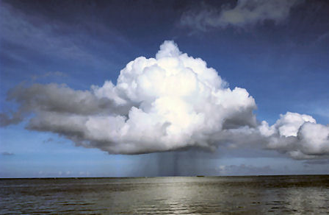
Radiative forcing or energy redistribution?
Radiative forcing?
  volcanic, solar, sulphate, stratospheric water vapour, Pinatubo overshoot
  Fyfe et al. (2013) GRL ; Murphy (2013) Nature Geosci ; Solomon et al. (2011) Science ; Kaufmann et al. (2011) PNAS ; Solomon et al. (2010) Science ; Murphy et al. (2009) JGR ; Solomon et al. (2011) Science ; Hansen et al. (2011) ACP .
Unforced variability?
  Cloud forcing/adjustment/feedbacks, El Niño, IPO/climate shift, ocean circulation
  Meehl et al. (2011) Nature Climate Change (NCC); Palmer et al. (2010) GRL ; Guemas et al. (2013) NCC ; Katsman & van Oldenborgh (2011) GRL ; Balmaseda et_al._(2013)_GRL ; Foster and Rahmstorf (2011) ERL ; Loeb et al. (2012) Nature Geosci.; Chikamoto et al.(2012) GRL

Slide 7
DEEP-C project structure
WP1 Reading
Atmosphere obs
R. Allan, C. Liu
WP2 NOCS
Ocean obs
E. McDonagh, B. King, +PDRA
WP4
Integration
Reading Co-Is:
T. Kuhlbrodt, J. Gregory
Climate modelling, ocean
Project Partners:
N. Loeb (NASA Langley) Satellite Radiation budget
K. Maskell (Walker Institute, Reading)
C. Sear (DECC)
WP3 Met Office
Climate Modelling
M. Palmer, C. Roberts
Additional partners:
Reading, NOCS, Met Office & UK community

Slide 8
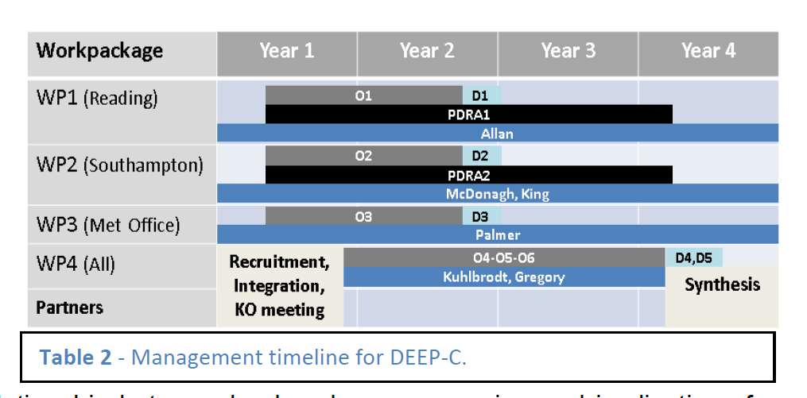
DEEP-C Work Plan
Start date: March 2013; Project Ends February 2017
Workpackage | Year 1 | Year 2 | Year 3 | Year 4
WP1 (Reading)
WP2 (Southampton)
WP3 (Met Office)
WP4 (All)
Partners
O1
D1
PDRA1
Allan
O2
D2
PDRA2
McDonagh, King
O3
D3
Palmer
Recruitment, Integration, KO meeting
O4-O5-O6
D4,D5
Kuhlbrodt, Gregory
Synthesis

Slide 9
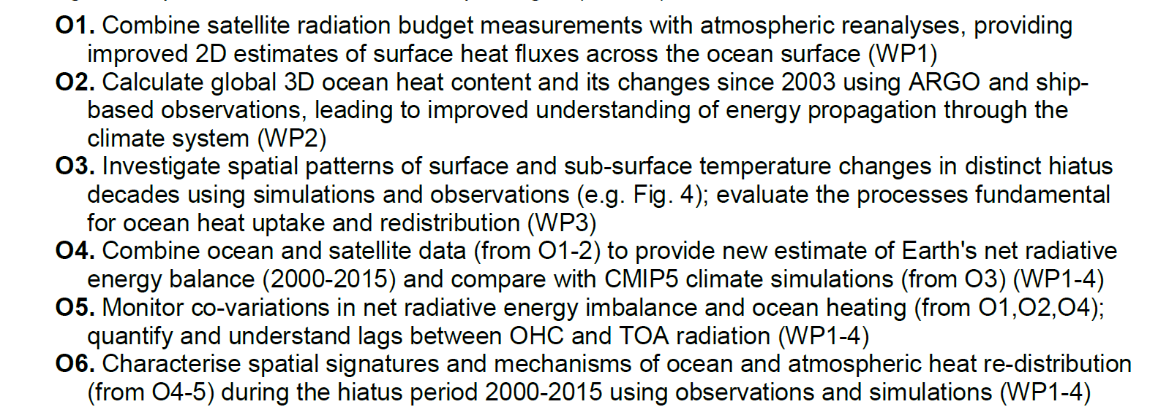
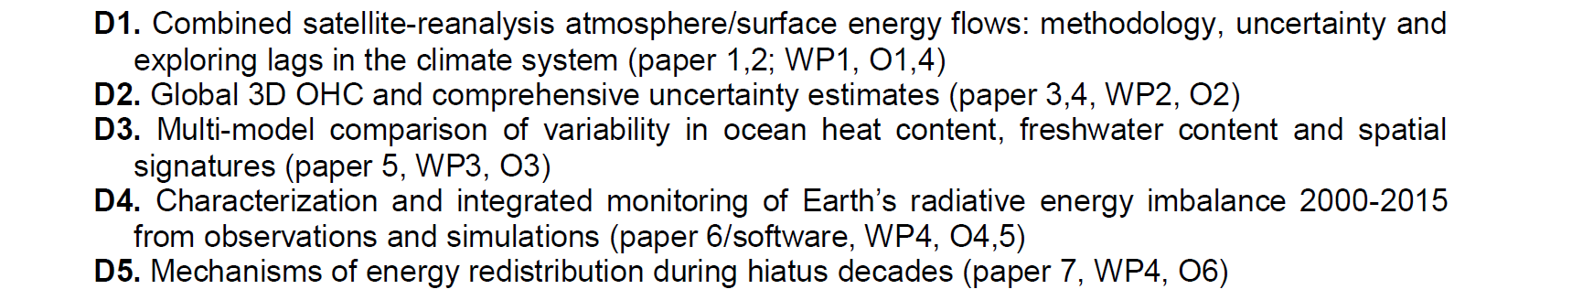
Objectives/Deliverables
Goal – to move beyond global means and towards understanding of 3D energy flows and mechanisms
Rooted in observations
Spatial structure of hiatus
Physical Mechanisms

Slide 10
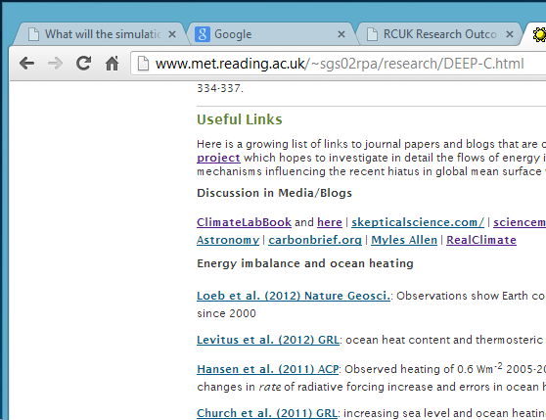
Integration/Dissemination
Project meetings (3 each at Reading, NOC-Southampton and Met Office)
Briefings to DECC
Website/twitter/outreach
Conference session/workshop
Review paper? …
Partners: please send/enter outputs (papers, talks, outreach) for NERC outcomes database www.rcuk.ac.uk/researchoutcomes

Slide 11
WP1 - Observed TOA Radiative Imbalance and Atmospheric Energy Transports
Richard P. Allan, Chunlei Liu
University of Reading, Department of Meteorology NCAS-Climate/NCEO
Links: Norman Loeb, Walker Institute, DECC, WP2-4
Notes:
This is the title slide, PowerPoint will automatically format the first slide with the title master, although this can be changed in the design palette.

Slide 12
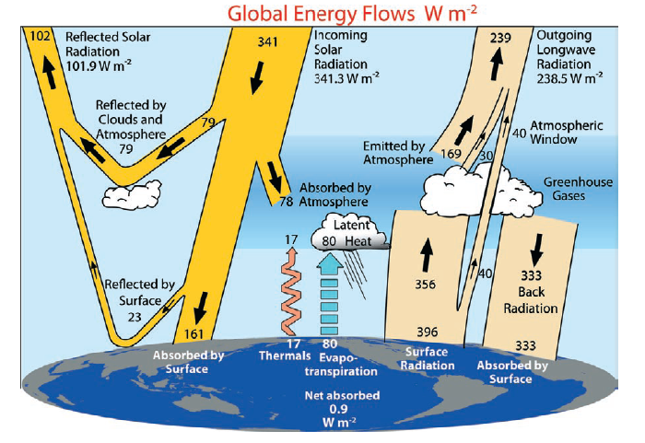
Updates to Earth’s Energy Budget
20
338-348
0.6
LH ~ 80-90
Trenberth et al. (2009) BAMS, but see update by Wild et al. (2012) Clim. Dynamics

Slide 13
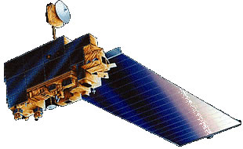
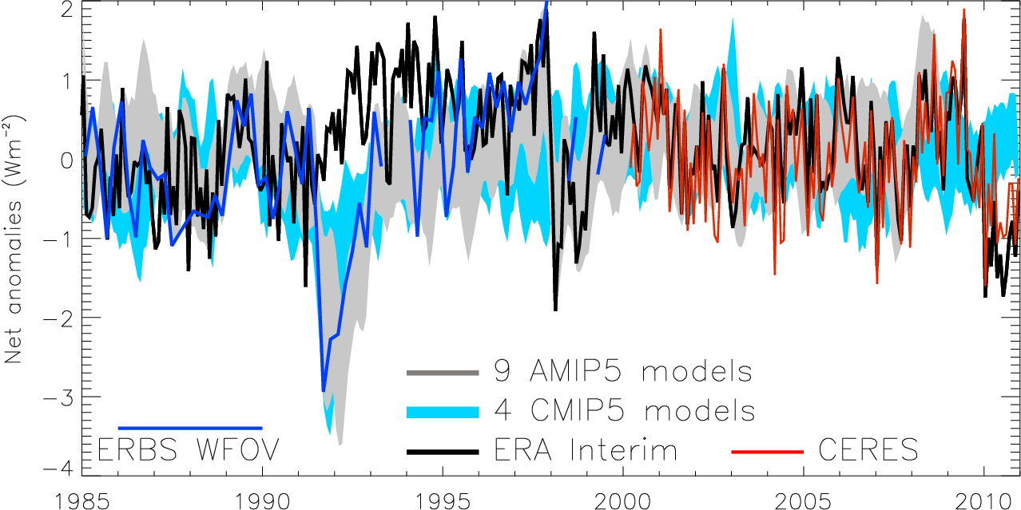
Variation in net radiation since 1985
60S-60N, after Allan (2011) Meteorol. Apps
Notes:
Deseasonalised monthly anomalies of net radiation (60ºS-60ºN) from satellite data (ERBS WFOV; CERES) and reanalysis simulations (ERA Interim) updated from ref 6 to include CMIP5 climate model simulations (AMIP 5 simulations from CNRM, NorESM1, HadGEM2 and INMCM4 in grey and combined historical and RCP4.5 scenario coupled simulations from CNRM, CanESM, HadGEM2-ES and INMCM4 in blue shading). CERES has been updated to EBAF2.6 and ERA Interim to 1985-2010.

Slide 14
Trends in net radiation
Errors in satellite sensors and inappropriate use of satellite products explain much of large rise in net radiative flux shown by Trenberth and Fasullo (2010)
global net radiation anomalies

Slide 15
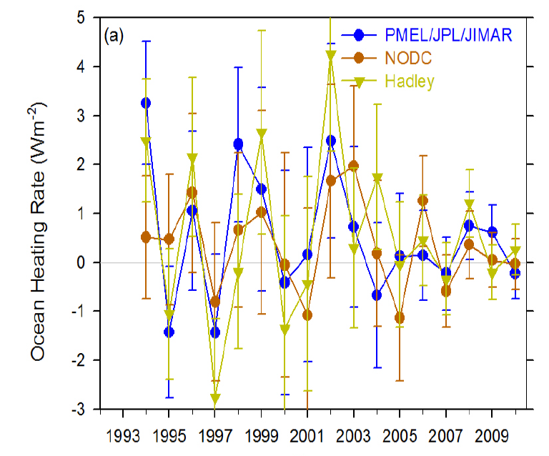
Ocean heat content data uncertainty
Accounting for considerable sampling/structural uncertainty we find no evidence for a robust decline in ocean heating rate since 2005 in Trenberth and Fasullo (2010)
Loeb et al. (2012) Nat. Geosci

Slide 16
Combining Earth Radiation Budget and Ocean Heat Content data
Tie 10-year CERES record with SORCE TSI and ARGO-estimated heating rate 2005-2010
Best estimates for additional storage terms
Variability relating to ENSO reproduced by CERES and ERA Interim
Estimate of decade long net energy imbalance of 0.50±0.43 Wm^{–2}
Loeb et al. (2012) Nat. Geosci. See also Hansen et al. (2011) ACP
Notes:
Fi gure 3 (a) Global annual average net TOA flux from CERES observations and (b) ERA Interim reanalysis are anchored to an estimate of Earth’s heating rate for 2006–2010 ⁵ The Pacific Marine Environmental Laboratory/Jet Propulsion Laboratory/Joint Institute for Marine and Atmospheric Research (PMEL/JPL/JIMAR) ocean heating rate estimates⁴ use data from Argo and World Ocean Database 2009; uncertainties for upper ocean heating rates are given at one-standard error derived from sampling uncertainties. The gray bar in (b) corresponds to one standard deviation about the 2001–2010 average net TOA flux of 15 CMIP3 models.

Slide 17
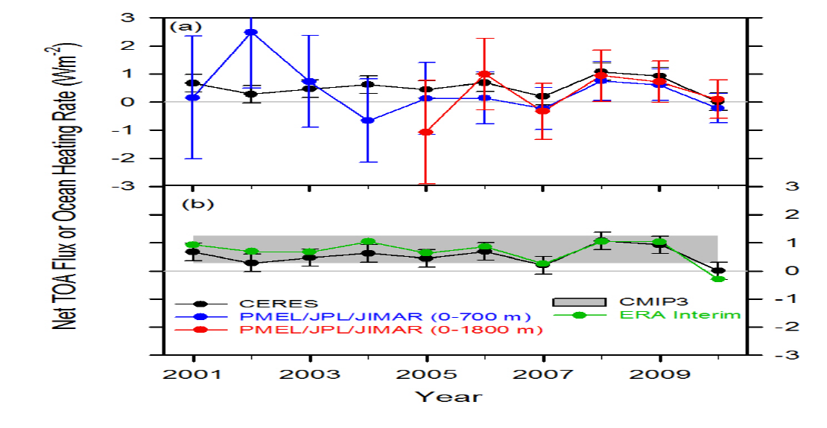
Combining Earth Radiation Budget and Ocean Heat Content data (2)
Replotted so that CERES and ERA Interim sample 6-months later than ARGO
Is there a lag in the system?
Where in ocean is energy accumulating?
Mechanism?
Notes:
Fi gure 3 (a) Global annual average net TOA flux from CERES observations and (b) ERA Interim reanalysis are anchored to an estimate of Earth’s heating rate for 2006–2010 ⁵ The Pacific Marine Environmental Laboratory/Jet Propulsion Laboratory/Joint Institute for Marine and Atmospheric Research (PMEL/JPL/JIMAR) ocean heating rate estimates⁴ use data from Argo and World Ocean Database 2009; uncertainties for upper ocean heating rates are given at one-standard error derived from sampling uncertainties. The gray bar in (b) corresponds to one standard deviation about the 2001–2010 average net TOA flux of 15 CMIP3 models.

Slide 18
Preliminary findings
Previously highlighted “missing energy” explained by ocean heat content uncertainty combined with inappropriate net radiation satellite products
Heating of Earth continues at rate of ~0.5 Wm⁻²
  Negative radiative forcing does not appear to contribute strongly
Implications/mechanisms?
  Energy continues to accumulate below the ocean surface
  Strengthening of Walker circulation, e.g. Merrifield (2011) J Clim?
  Implications for hydrological cycle, e.g. Simmons et al. (2010) JGR?

Slide 19
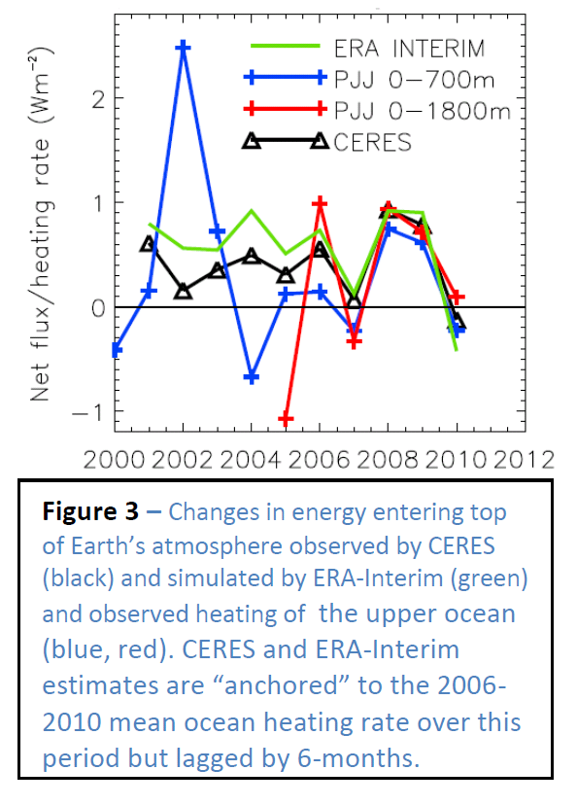
WP1 - Planned work
Analyse and update observed variability in TOA radiation balance
Investigate lags in climate system
Combine ERA Interim and CERES to provide new estimate of surface heating
Monitoring of changes in energy balance
Reconcile TOA radiation balance and ocean heating

Slide 20
Minor energy flux terms
Changes in atmospheric energy (ΔA) from ERA Interim (thin black)
Changes in energy required to melt Arctic ice (ΔI). I assumed that additional land ice melt and heating increased these changes by factor of 2.
Heating of the land surface (ΔL) from ERA Interim (brown)
I adjusted the sum so that the average equalled the 0.07+0.04 Wm⁻² minor heating terms assumed in Loeb et al. (thick black line) which included the deep ocean (ΔD) term.

Slide 21
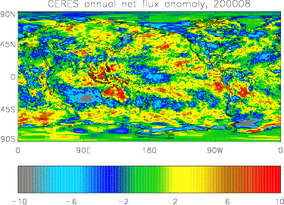
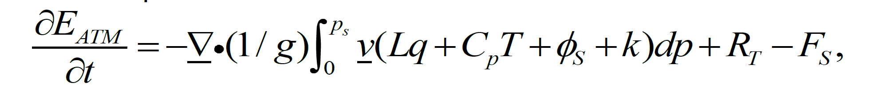
New estimates of surface fluxes
WP1 – improved 2D estimate of surface fluxes combining ERA Interim transports and CERES TOA radiation budget
e.g. Berrisford et al. (2011) QJRMS

Slide 22
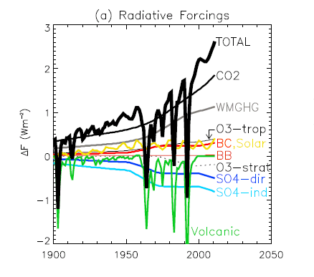
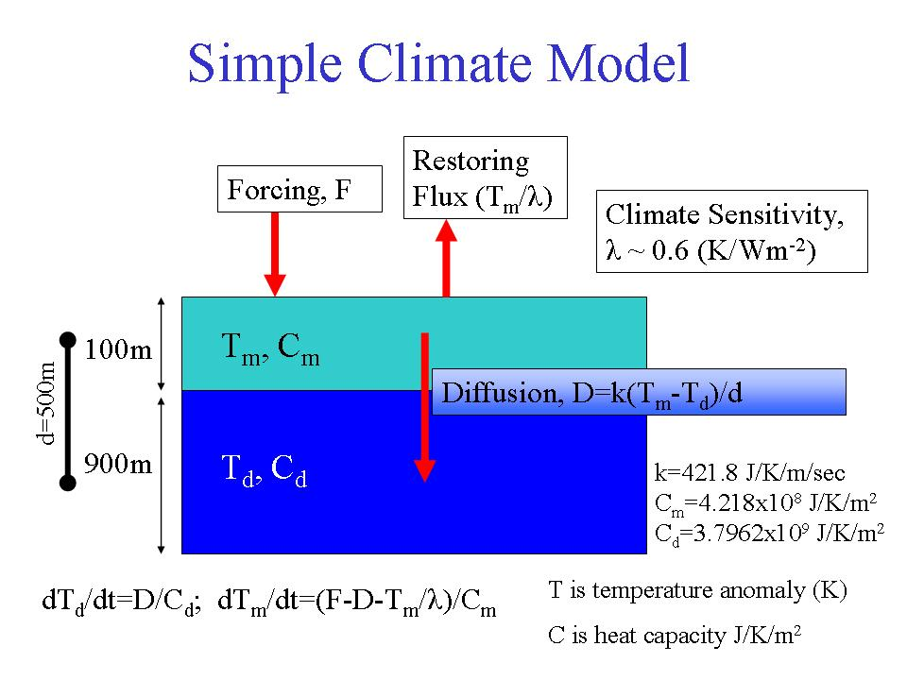
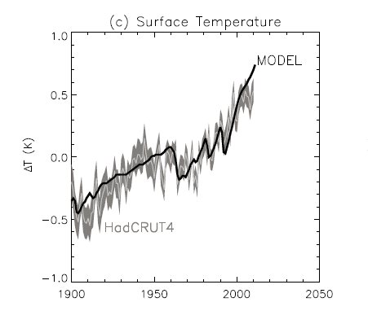
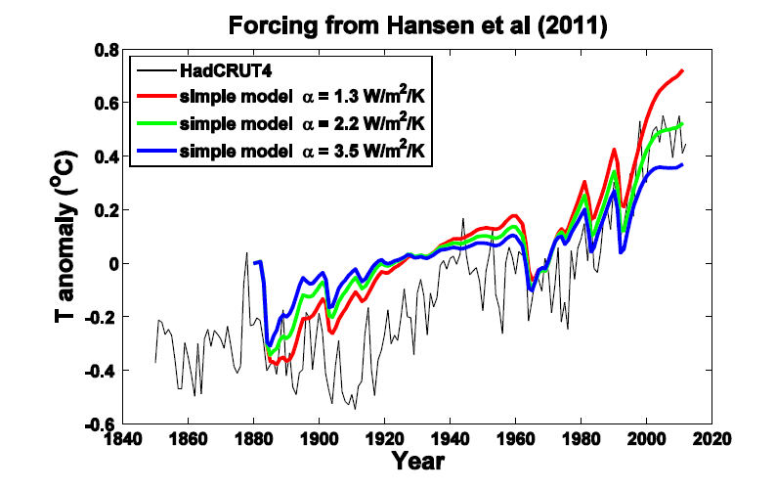
Chunlei Liu
Allan et al. (2013) Surv. Geophys.

Slide 23
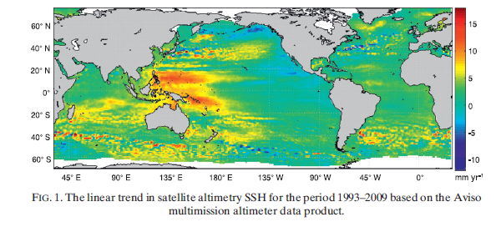
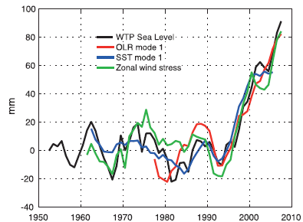
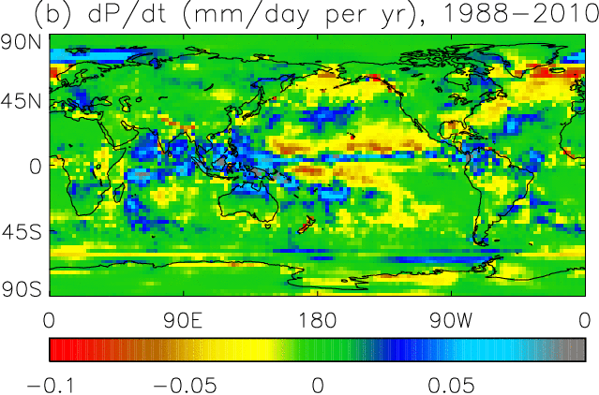
Links to ocean circulation & precip?
Wind-driven changes in sea surface height (Merrifield 2011)
http://journals.ametsoc.org/doi/abs/10.1175/2011JCLI3932.1
Has a stronger Walker circulation enhanced ocean mixing and precipitation changes 1990-2000s?
Sohn et al. (2013) Climate Dyn:
Chikamoto et al. (2012) GRL: Merrifield (2011) J Climate: a

Slide 24
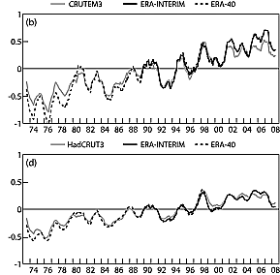
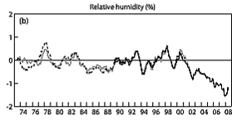
Implications for global water cycle?
Land T
global T
Stalling of ocean temperatures in 2000s
Continued warming of land
Reduced relative humidity over land?
Land RH
Simmons et al. (2010) JGR

Slide 25
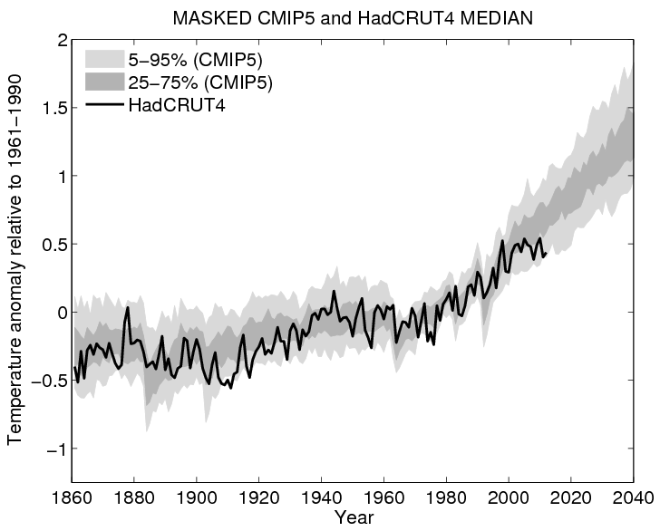
Plot by Ed Hawkins

