Slide 1
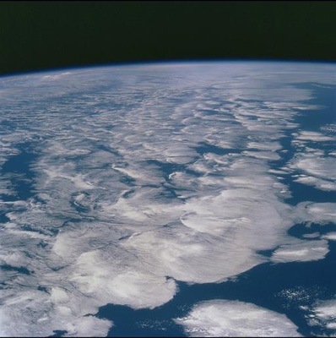

WP1 highlights - Observed TOA imbalance
& atmospheric energy transports
Richard Allan - University of Reading
DEEP-C wrap-up meeting, Met Office, 31 March 2017

Slide 2
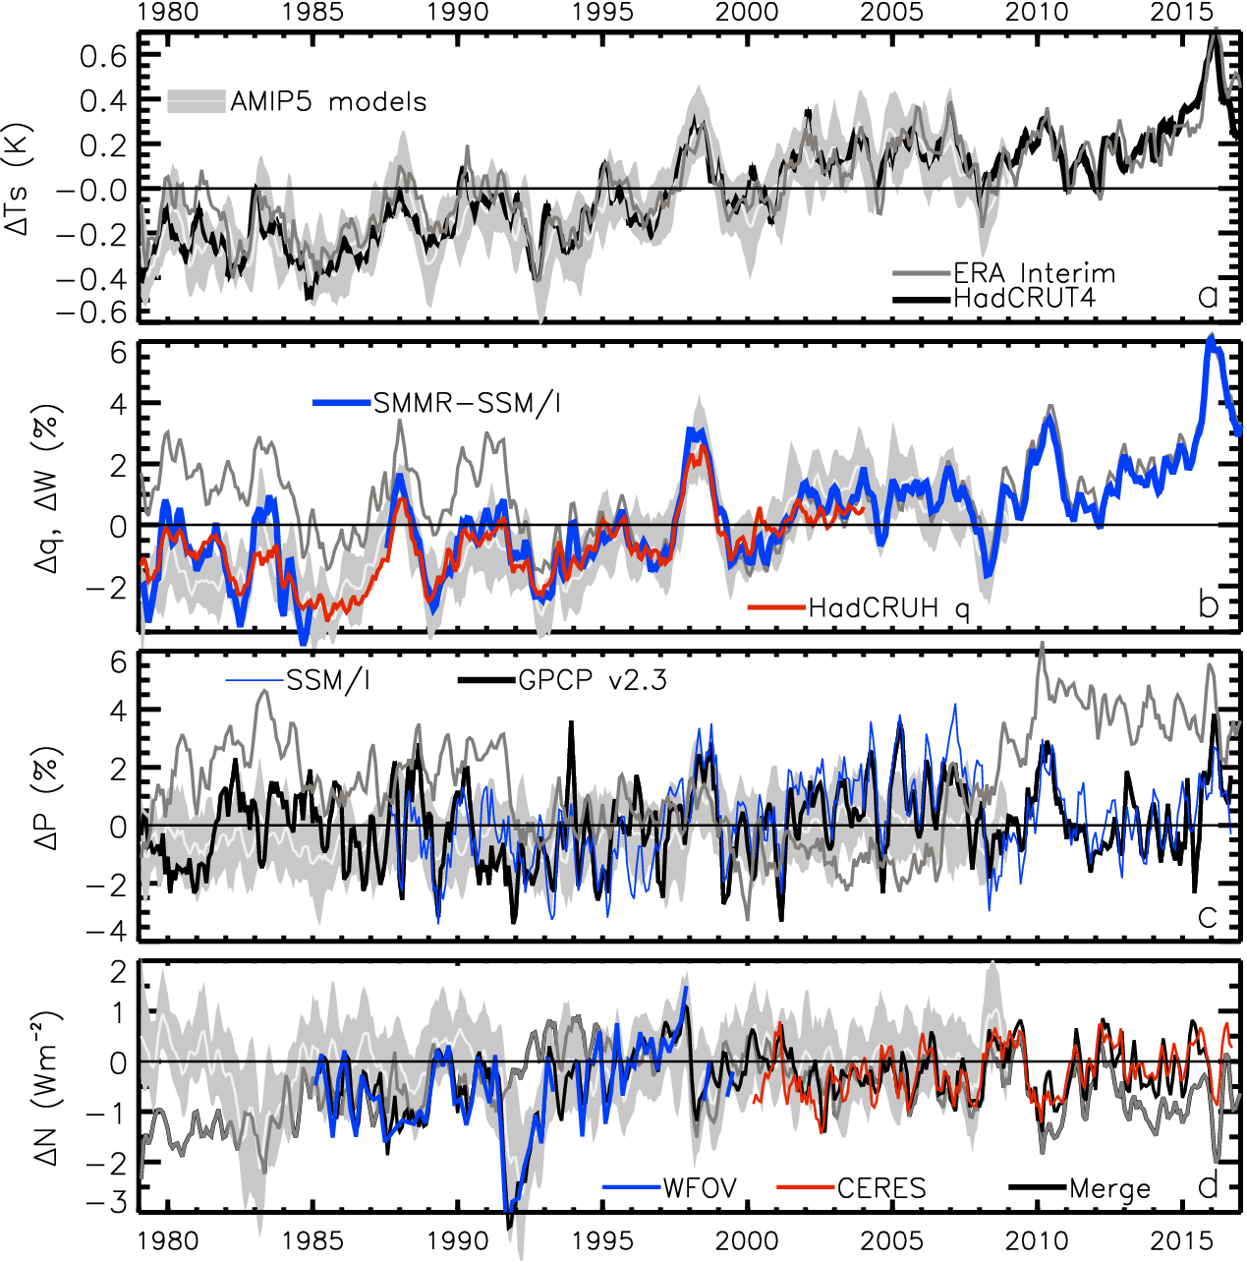
Changes in
Temperature, moisture, precipitation
& net radiation through surge
& slowdown
surge
slowdown
HEATING (Wm⁻²) PRECIP (%) MOISTURE (%) TEMPERATURE (K)
Update from:
Allan et al. (2014) Surv. Geophys &
Allan et al. (2014) GRL
2.8
1.8
0.8
-0.2
-1.2
-2.2
Earth’s energy imbalance (Wm⁻²)

Slide 3
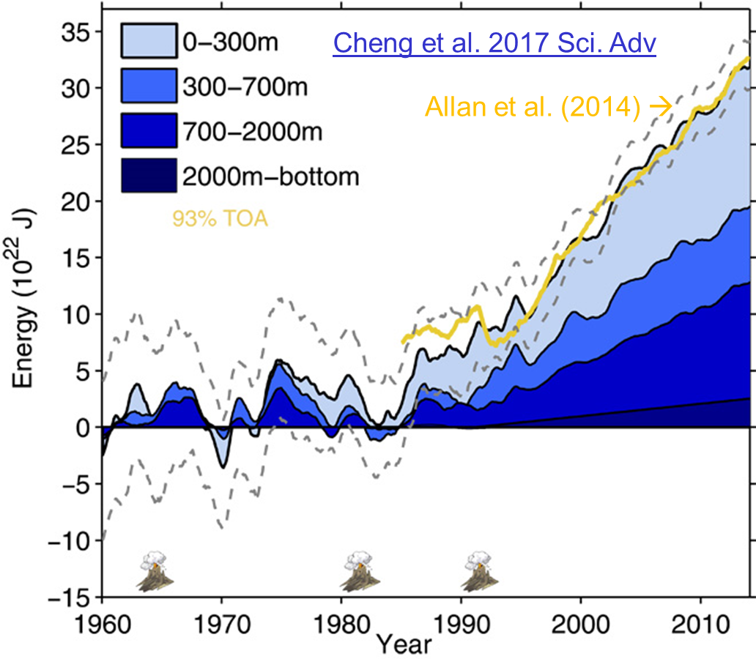
Top of atmosphere radiation dataset
Allan et al. (2014) GRL
1985-present dataset (NetCDF)
Steady heating of planet despite temporary surface warming slowdown
Increase in net imbalance: late 1980s ~ 0.2 Wm⁻²; 2000s ~ 0.6 Wm⁻²
  Confirmed recently by updated ocean data (above, Cheng et al. 2017 Sci. Adv)
  Slight drop in net imbalance late 1990s-2000s may have influenced slowdown (e.g. Smith et al. 2015 GRL)
  Distinct energy budget/temperature relations for internal variability: Xie et al. (2015) Nature Geosci
  Well cited (43), dataset used (e.g. Cheng et al., Xie et al., Williams et al., Hyder et al. & Roberts et al. see talks) & disseminated via media/social media/blogs

Slide 4
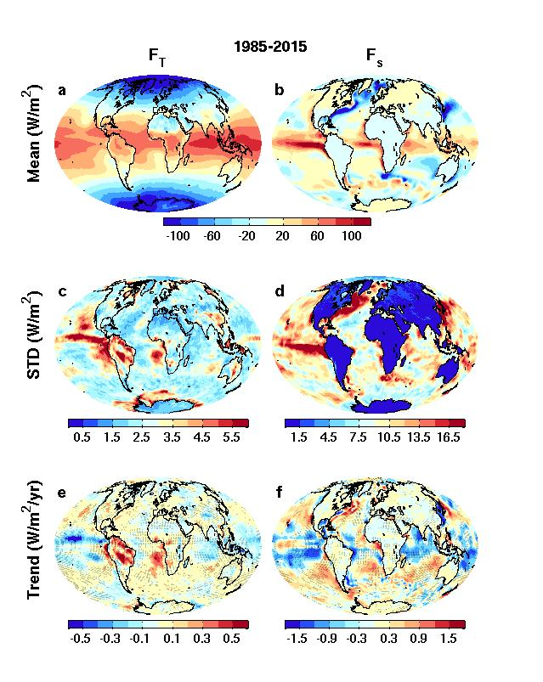
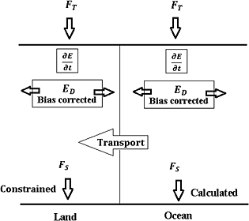
Net downward energy flux/trends top of atmosphere surface
CERES/ERBS/ERAINT
reanalyses
JULES/ERAINT
Surface energy flux dataset combining TOA reconstruction with reanalysis energy transports: Liu et al. (2015) JGR
More in Chunlei’s talk

Slide 5
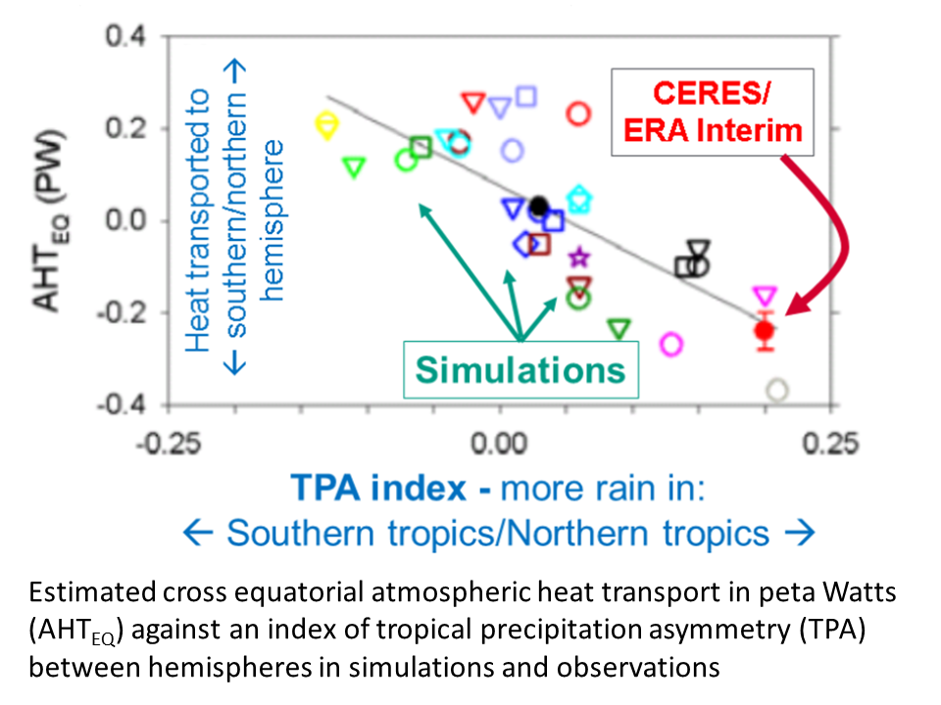
Cross-Equatorial heat transport linked to model precipitation bias
Clear link between bias in cross-equatorial heat transport by atmosphere and inter-hemispheric precipitation asymmetry
Loeb et al. (2016) Clim. Dyn
Also: Haywood et al. (2016) GRL
Hawcroft et al. (2016) Clim. Dyn.

Slide 6
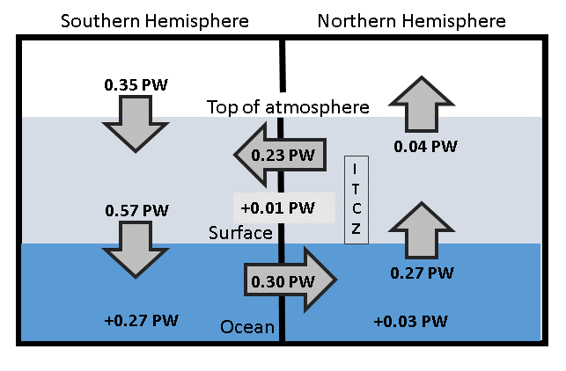
Updated observed energy budget asymmetry
Updated from Loeb et al. (2016) for 2000-2015 based on Liu et al. (2015) JGR (Liu et al. 2017 JGR in review)
Observed inter-hemispheric imbalance in Earth’s energy budget
Use asymmetric ocean heating observed by Roemmich et al. (2015) Nature Climate and Purkey & Johnson (2010)
Derive implied ocean heat transport: smaller that Loeb et al. (2015) and Frierson et al. 2013 (0.44 PW) – unrealistically so?

Slide 7
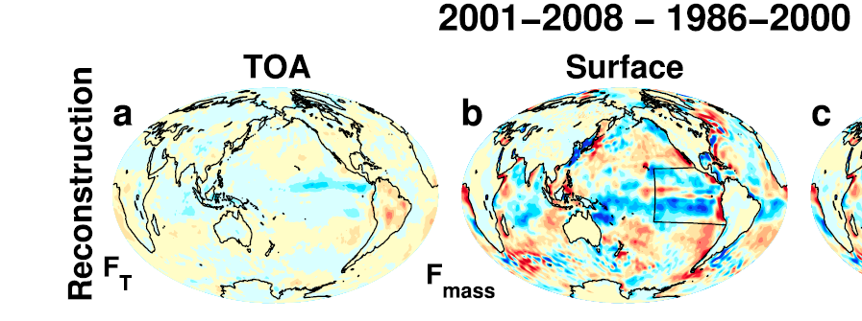
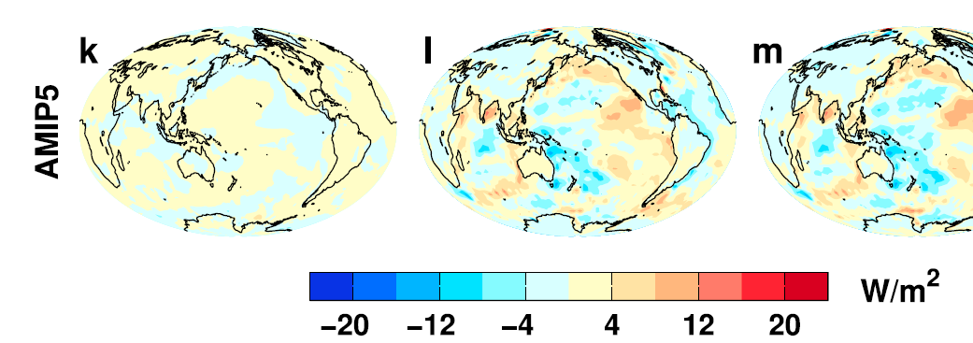
Surface energy flux changes: discrepancy between models/reconstruction
Changes in energy fluxes 1986-2000 to 2001-2008
Surface energy flux dominated by atmospheric transports
Contrasting model pattern of change, realistic? e.g. He & Soden (2016) J. Clim
Are reanalysis transports reliable?
Liu et al. (2015) JGR

Slide 8
Dissemination Activities
Activities listed on researchfish, including:
Media: BBC Breakfast (COP), BBC Radio 4 (comment on Nieves et al.), Science Media Centre (briefings & comments), BBC news/Independent /Sky/Telegraph/Voice of Russia, etc (e.g. IPCC & comments on papers)
Blogs: NASA sensing our planet, Climate Lab Book, Weather@Reading, Carbon Brief, Conversation, NCAS and NCEO highlights
Outreach: U3A, RMetS, local interest groups, schools, twitter
Workshops: CLIVAR, decision analysis workshop, GEWEX, CERES/GERB
Datasets: DEEP-C TOA and surface energy flux; NOC ocean heat content
Special Issues: Current Climate Change Reports Energy Budget Section
Website: resource for journal papers -
http://www.met.reading.ac.uk/~sgs02rpa/research/DEEP-C.html#PAPERS

Slide 9
Recent Literature (from DEEP-C website)
Cheng et al. (2017) Sci. Adv.: 200 billion kilowatt heating of Earth since 1960 mostly after 1980, affecting deeper ocean since 1990s, variation close to Allan et al. (2014)
Johnson and Birnbaum (2017) GRL: building El Nino increases ocean heat uptake (1ºC warming in Nino3.4 over a year increases Earth's energy uptake by 0.2 Wm⁻²)
Johnson et al. (2016) Nature Climate Change: improved estimate of Earth's energy imbalance of +0.6 to +0.8 Wm⁻² due to better ocean sampling
Burgman et al. (2017) GRL: shortwave low cloud feedbacks in E. Pacific explain much of SST/circulation variability of last 16 years
Dong & McPhaden (2017) ERL: radiative forcing dominates decadal temperature trends apart from during extreme phases of internal variability
Desbruyères, et al. (2017) J Clim.: global heat uptake of 0.62-0.80 Wm⁻², 90% above 2000-m depth, large part in S. Ocean.
Trenberth and Fasullo (2017) GRL: satellite/reanalysis-based 26ºN heat transports 1PW close to RAPID in situ but without negative trend
Hu & Sprintall (2017) GRL: Strengthened Indonesian throughflow 2004-2014 from increased precipitation & freshening
Roberts et al. (2017) JGR-Oceans: Non-Ekman ocean heat transport processes dominate mixed layer ocean heat content in equatorial oceans & regions of strong ocean currents/eddy activity & force atmospheric response.
Llovel & Terray (2016): ocean heat uptake peaks ~40ºS; rapid upper ocean warming linked to poleward shift of mean wind stress curl enhances Ekman pumping 45-60ºS
Richardson et al. (2016) Nature Climate: reconciling obs-based/simulated TCS through consistent sampling of surface temperature (TCR~1.7ºC at 2xCO₂)
Medhaug and Drange (2016) Clim. Dyn.: Decadal-scale upper 700m ocean heat anomalies of ~7.5 x 10²¹ J comparable to that needed to maintain global warming.
Kosaka and Xie (2016) Nature Geosci.: model simulations of global warming "staircase" used to remove internal variability from observational record
Sevellec et al. (2016) GRL: hiatus of the early 21st Century was extremely unlikely
Mann et al. (2016) GRL: N. Pacific played critical role in the slowdown but was not predictable; minor contribution from N. Atlantic exhibits some predictability
Bellamo et al. (2016) GRL& Brown et al. (2016) GRL: basin-scale Atlantic Multidecadal Oscillation amplified by cloud feedback
Checa-Garcia et al. (2016) ERL: CFC decline + less growth in methane & low-level ozone pollution contributed to slower surface warming
Takahashi and Watanabe (2016) & Smith et al. (2016) Nature Climate: Aerosol forcing linked to hiatus through influence on Pacific trade winds/ocean circulation
http://www.met.reading.ac.uk/~sgs02rpa/research/DEEP-C.html#PAPERS

Slide 10

WP1 - Primary Outputs
Allan, R. P., C. Liu, N. G. Loeb, M. D. Palmer, M. Roberts, D. Smith and P.-L. Vidale (2014) Changes in global net radiative imbalance 1985-2012, Geophysical Research Letters, 41,10.1002/2014GL060962. DATASET
Liu, C. Allan, R. P., P. Berrisford , M. Mayer , P. Hyder, N. Loeb , D. Smith , P.-L. Vidale, J. Edwards (2015) Combining satellite observations and reanalysis energy transports to estimate global net surface energy fluxes 1985-2012, J. Geophysical Research, doi: 10.1002/2015JD023264 Datasets: http://dx.doi.org/10.17864/1947.111
Loeb, N. G., H. Wang, A. Cheng, S. Kato, J. T. Fasullo, K.-M. Xu and R. P. Allan (2015) Observational Constraints on Atmospheric and Oceanic Cross-Equatorial Heat Transports: Revisiting the Precipitation Asymmetry Problem in Climate Models, Climate Dynamics, 10.1007/s00382-015-2766-z
Smith, D., R. P. Allan, A. C. Coward, R. Eade, P. Hyder, C. Liu, N. G. Loeb, M. D. Palmer, M. Roberts, & A. A. Scaif (2015) Earth's energy imbalance since 1960 in observations and CMIP5 models, GRL, 10.1002/2014GL062669,
In prep:
Liu et al. (2017) Evaluation of satellite and reanalysis-based global net surface energy flux and uncertainty estimates, JGR in review
Schmidt et al. (2017) Current and near-future volcanic forcing of global climate change, in prep.
Chris Roberts’ Nature Climate paper →

Slide 11
Discussion slides

Slide 12
Future collaboration: for discussion
Academic partnership on energy budget and climate change
Highlight topic (e.g. interhemispheric heating and monsoon)?
Future work:
  SMURPHS: feedbacks on internal variability, role of LHF/SW radiation
  ACSIS: meridional heat transports
  CONCEPT-HEAT etc…
Future funding opportunities?
...

Slide 13
Proposed Academic Partnership:
Energy balance and climate change
The Earths energy balance represents a nexus between radiative forcings, feedbacks and response in climate which are further entwined with complex unforced decadal fluctuations. It is intimately linked with the global water cycle and sea level rise through ocean heat uptake so therefore is a diagnostic of key interest to policymakers through informing ongoing monitoring, understanding and projection of climate change.
The University of Reading has considerable strength in this area and would be in a good position to work with the Met Office to develop the underpinning science needed to provide timely information to government, providing expertise in observing and simulating past and current changes in Earth's energy budget to advance understanding of:
the effect of climate feedbacks and ocean heat uptake on unforced decadal variability and climate response to radiative forcing, including sea level rise due to thermal expansion,
links between the global energy and water cycles,
characteristics of energy transport within the climate system.

Slide 14

Final WP1 outputs/conclusions
  Finalised energy flux dataset version and uncertainty estimates (Liu et al.)
  Cross equatorial heat transport (NERC highlight topic?)
  Heat flux bias in southern ocean (Pat et al.)
  Basin-scale changes in heat flux (Damien et al.) & heat flux/transport contributions to heat content (Chris et al.)
  TOA radiation/volcanic response (Schmidt et al. 2017 in prep)
  SMURPHS work
    spatial signatures/morphology,
    links to water cycle,
    Understanding Pacific discrepancy in heat flux changes
    quantify/understand lags between OHC and TOA radiation
    mechanisms for feedbacks on internal variability

Slide 15
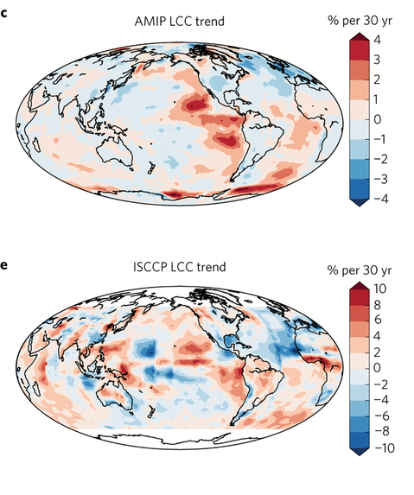
Feedbacks on internal climate variability
Low Cloud Cover trend 1980s-2005 Surface energy flux change ~1986-2008
OBSERVATIONS AMIP MODELS
Zhou et al. (2016) Nature Geosci
Liu et al. (2015) JGR

Slide 16
See also Trenberth & Fasullo (2017) GRL: satellite/reanalysis-based 26ºN heat transports 1PW close to RAPID in situ but without negative trend

Slide 17
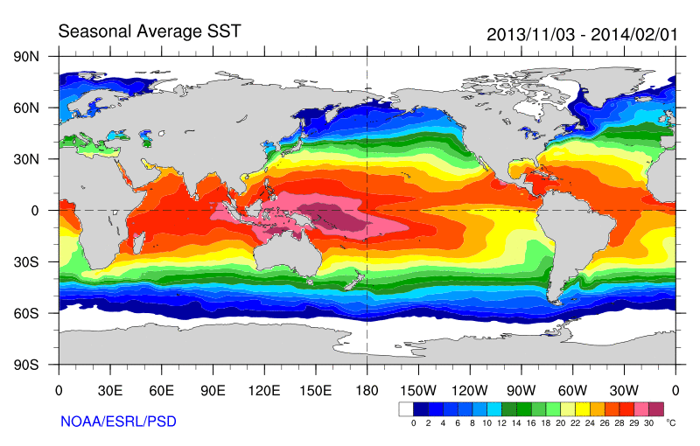
Role of Atlantic/Pacific Variability?
Radiative Forcing/Imbalance Johnson et al. (2016) ; Checa-Garcia et al. (2016) ; Huber & Knutti (2014) ;Santer et al. (2015) :
Continued heating from greenhouse gases
Aerosol forcing of circulation (Smith et al. 2016)
Unusual weather patterns (Ding et al. 2014; Trenberth et al. 2014b)
Pacific SST strengthens atmospheric circulation
Enhanced Walker Circulation
? Heat flux to Indian ocean Lee etal 2015
Increased sea height
Warm
Upwelling,
Cool water
Remote forcing from Atlantic:
Li et al. (2016) ;
McGregor et al. (2014)
Increased precipitation
Decreased salinity
Strengthening trade winds
Equatorial Undercurrent
Pacific dominates?
Mann et al. (2016) Kosaka & Xie (2013) England et al. (2014)
Enhanced mixing of heat below 100 metres depth by accelerating shallow overturning cells and equatorial undercurrent
See also: Merrifield (2010).; Sohn et al. (2013) .; L’Heureux et al. (2013) . Change; Watanabe et al. (2014) ; Balmaseda et al. (2013) ; Trenberth et al. (2014) .; Llovel et al. (2014) ;Durack et al. (2014) ; Nieves et al. (2015) ; Brown et al. (2015) JGR ; Somavilla et al. (2016) ; Liu et al. (2016)

Slide 18
Cartoon of a warming slowdown
Net energy accumulation from radiative forcing
Unforced climate fluctuation alters energy budget of the upper ocean mixed layer supressing increases in global mixed layer and surface temperature
atmosphere
↑T_{s}
↑T_{s}
↑T_{s}
↑T_{s}
Ocean mixed layer
Deep ocean
Energy accumulation from rising greenhouse gas concentrations leads to surface warming, ↑Ts
Ocean hiatus: increased heat flux into the deep ocean reduces heating of upper mixed layer
Top of atmosphere hiatus: less heat flux into the ocean surface less mixed layer heating
Combined hiatus: reduced heat flux into ocean surface, larger heat flux to deep ocean
e.g. Roberts et al. (2017) JGR; Xie & Kosaka (2017) Curr. Clim. Change Rep.; Hedemann et al. (2017) Nature Climate Change (in press)

Slide 19
SPARE SLIDES

Slide 20
Conclusions / PLAns
Top of atmosphere/surface heat flux product delivered
  Further work required to determine uncertainties
Characterising changes in Earth’s energy imbalance
  Variability from radiative forcings & internal variability
  Manifest as positive imbalance in Southern Hemisphere
    Ocean energy transport to North offset by atmos. energy trans. to South
    Links to model precipitation biases
    Decadal changes in energy imbalance? [idea → NERC]
  Toward reconciled ocean heating/radiation budget changes
  Where in oceans is energy going (regional/vertical structure)?
  What are time-scales/lags associated with net imbalance?
Do feedbacks amplify/extend hiatus/surge events?
  New SMURPHS project
  Toward an observational constraint on climate sensitivity?
Links to WP2-4

Slide 21
WP1 Dissemination Activities
Jan 2016: Energy and water cycle seminar, Reading; El Nino comments (WSJ)
Nov 2015: Paris COP BBC Breakfast, etc; U3A talk; NASA sensing our planet
Sep/Oct 2015: NCEO meeting Southampton; CliVar workshop; outreach talks
July 2015: Commented on Nieves et al on BBC Radio 4 Today program; Talks/posters at IUGG Prague & Common Future Climate conf.
June 2015: Comments on Karl et al. paper (Carbon Brief/SMC/Reuters); Seminars at Imperial College & NCAS
April 2015: Presentation at Decision Analysis for Policy Support workshop
Feb 2015: Comment on detection of greenhouse gas radiative effect
Jan 2015: Smith et al. (2015) GRL dissemination work & U3A outreach
October 2014: Conversation article on Durack/Llovel papers; BBC2 Jeremy Vine show; CERES/GERB/ScaRaB meeting talk
August 2014: Allan et al. (2014) NCAS highlight, Nature Climate Change highlight ; Climate Lab Book , Carbon Brief , Met Department & Conversation blogs; Telegraph ; Eddington Astronomical Society talk
July 2014: DEEP-C talks at GEWEX and AMS conferences
April 2014 – Royal Society “Hiatus” discussion meeting; EGU talk
Feb 2014 - "Where has the warming gone?" RMetS local group ; Comment on England et al. (see also Guardian article).
Aug/Sep2013 - Comment on recent Nature paper by Kosaka and Xie (see also BBC and Independent articles); Voice of Russia; IPCC Sky/BBC/etc
July 2013 - Science Media Centre briefing on “slowdown”
May 2013: Carbon Brief article on DEEP-C temperature obs.
April 2013 - Meeting with DECC partners in London
Also: twitter, Walker Institute, media interaction http://www.met.reading.ac.uk/~sgs02rpa/research/DEEP-C.html

Slide 22
DEEP-C Introduction
Diagnosing Earth’s Energy Pathways in the Climate system
  WP1 Radiative imbalance & transports (Allan, et al. Reading)
  WP2 Ocean heat content & observations (McDonagh et al., NOC)
  WP3 Simulations/process understanding (Palmer et al., Met Office)
  WP4 Synthesis (All)
Original aims to explain and understand:
  “missing” energy in the climate system
  Slower rates of surface warming in early 2000s
Methods: combine satellite data, reanalyses and ocean measurements with modelling
See: http://www.met.reading.ac.uk/~sgs02rpa/research/DEEP-C.html

Slide 23
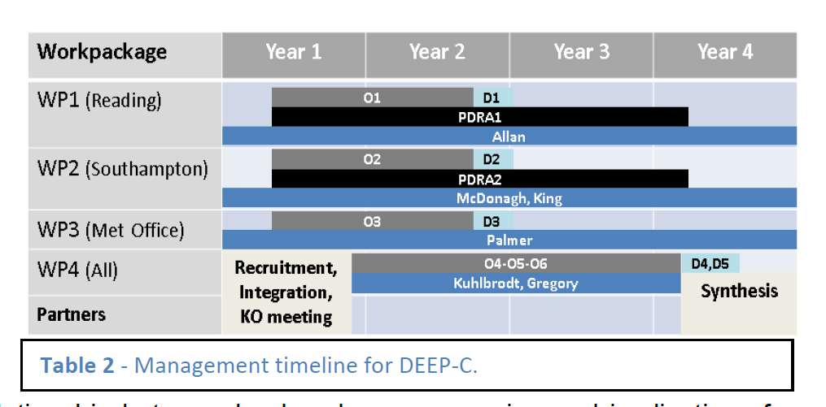
DEEP-C Work Plan
Start date: March 2013; Project Ends February 2017
Workpackage | Year 1 | Year 2 | Year 3 | Year 4
WP1 (Reading)
WP2 (Southampton)
WP3 (Met Office)
WP4 (All)
Partners
O1
D1
PDRA1
Allan
O2
D2
PDRA2
McDonagh, King
O3
D3
Palmer
Recruitment, Integration, KO meeting
O4-O5-O6
D4,D5
Kuhlbrodt, Gregory
Synthesis

Slide 24
Project Objectives
O1. Combine satellite radiation budget measurements with atmospheric reanalyses, providing improved 2D estimates of surface heat fluxes across the ocean surface (WP1)
O2. Calculate global 3D ocean heat content and its changes since 2003 using ARGO and ship-based observations, leading to improved understanding of energy propagation through the climate system (WP2)
O3. Investigate spatial patterns of surface and sub-surface temperature changes in distinct hiatus decades using simulations and observations (e.g. Fig. 4); evaluate the processes fundamental for ocean heat uptake and redistribution (WP3)
O4. Combine ocean and satellite data (from O1-2) to provide new estimate of Earth's net radiative energy balance (2000-2015) and compare with CMIP5 climate simulations (from O3) (WP1-4)
O5. Monitor co-variations in net radiative energy imbalance and ocean heating (from O1,O2,O4); quantify and understand lags between OHC and TOA radiation (WP1-4)
O6. Characterise spatial signatures and mechanisms of ocean and atmospheric heat re-distribution (from O4-5) during the hiatus period 2000-2015 using observations and simulations (WP1-4)

Slide 25
Primary Outputs
Allan, R. P., C. Liu, N. G. Loeb, M. D. Palmer, M. Roberts, D. Smith and P.-L. Vidale (2014) Changes in global net radiative imbalance 1985-2012, Geophysical Research Letters, 41,10.1002/2014GL060962.
Cheng, L., K. E. Trenberth, M. D. Palmer, J. Zhu and J. P. Abraham (2016) Observed and simulated full-depth ocean heat-content changes for 1970-2005, Ocean Science, 12, doi:10.5194/os-12-925-2016
Desbruyères, D. G., S. Purkey, G. J. Johnson, E. L. McDonagh and B. A. King (2016), Deep and Abyssal Ocean Warming from 35 years of Repeat Hydrography, GRL, in press, DOI: doi: 10.1002/2016GL070413
Desbruyères, D. G., E. L. McDonagh, B. A. King, F. K. Garry, A. T. Blaker, B. Moat and H. Mercier (2014) Full-depth temperature trends in the NE Atlantic through the early 21st century, GRL, doi:10.1002/2014GL061844
Liu, C. Allan, R. P., P. Berrisford , M. Mayer , P. Hyder, N. Loeb , D. Smith , P.-L. Vidale, J. Edwards (2015) Combining satellite observations and reanalysis energy transports to estimate global net surface energy fluxes 1985-2012, J. Geophysical Research, doi: 10.1002/2015JD023264
Loeb, N. G., H. Wang, A. Cheng, S. Kato, J. T. Fasullo, K.-M. Xu and R. P. Allan (2015) Observational Constraints on Atmospheric and Oceanic Cross-Equatorial Heat Transports: Revisiting the Precipitation Asymmetry Problem in Climate Models, Climate Dynamics, 10.1007/s00382-015-2766-z
Palmer, M.D. and D.J. McNeall (2014) Internal variability of Earth's energy budget simulated by CMIP5 climate models, Environ. Res. Lett. 9, 034016, doi:10.1088/1748-9326/9/3/034016
Palmer, M.D., C. D. Roberts, et al. (2015) Ocean heat content variability and change in an ensemble of ocean reanalyses, Climate Dynamics, doi: 10.1007/s00382-015-2801-0
Roberts, C.D., M.D. Palmer, D. McNeall and M. Collins (2014) Quantifying the likelihood of a continued hiatus in global warming, Nature Climate Change doi:10.1038/nclimate2531
Roberts, M. J. and co-authors inc. P Hyder (2016) Impact of ocean resolution on coupled air-sea fluxes and large-scale climate, GRL, doi:10.1002/2016GL070559
Smith, D., R. P. Allan, A. C. Coward, R. Eade, P. Hyder, C. Liu, N. G. Loeb, M. D. Palmer, M. Roberts, & A. A. Scaif (2015) Earth's energy imbalance since 1960 in observations and CMIP5 models, GRL, 10.1002/2014GL062669,
von Schuckmann, K. et al. inc. M. D. Palmer (2016) An imperative to monitor Earth's energy imbalance, Nature Climate Change doi: 10.1038/nclimate2876

