Slide 1
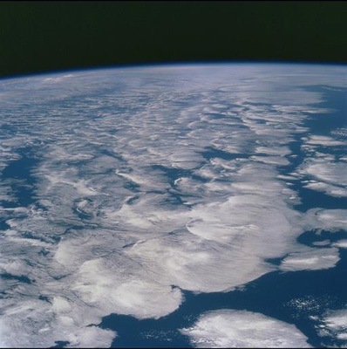

DEEP-C 8th project meeting:
Introduction
Richard Allan - University of Reading
DEEP-C project meeting, University of Reading, 10 October 2016

Slide 2
Agenda
11:20-11:40 Evaluation of satellite and reanalysis-based global net surface energy flux - Chunlei Liu
11:40-12:00 Deep and abyssal ocean warming from 35 years of repeat hydrography - Damien Desbruyeres
12:00-12:20 Did hydrography sampling capture global and regional deep ocean heat content trends accurately between 1990-2010? - Freya Gary
12:20-12:40 Surface flux and ocean heat transport convergence contributions to seasonal and interannual variations of ocean heat content - Chris Roberts*
12:40-13:20 LUNCH
13:30-13:50 Rationalising the impact of ocean mixing parameterisations on simulations of ocean heat uptake - Remi Tailleux, INSPECT project
13:50-14:00 ESA SST Climate Change Initiative project/dataset - Claire MacIntosh*
14:00-14:10 Plans for synthetic profiling and sea level - Lesley Allison
14:10-14:30 Southern Ocean heat flux errors - Pat Hyder
14:30-14:40 Impact of choice of climatology on results from OI mapping of float data - Brian King
14:40-15:30 Discussion/Wrap up & TEA
* Affected by puking toddlers

Slide 3
DEEP-C Introduction
Diagnosing Earth’s Energy Pathways in the Climate system
  WP1 Radiative imbalance & transports (Allan, et al. Reading)
  WP2 Ocean heat content & observations (McDonagh et al., NOC)
  WP3 Simulations/process understanding (Palmer et al., Met Office)
  WP4 Synthesis (All)
Original aims to explain and understand:
  “missing” energy in the climate system
  Slower rates of surface warming in early 2000s
Methods: combine satellite data, reanalyses and ocean measurements with modelling
See: http://www.met.reading.ac.uk/~sgs02rpa/research/DEEP-C.html

Slide 4
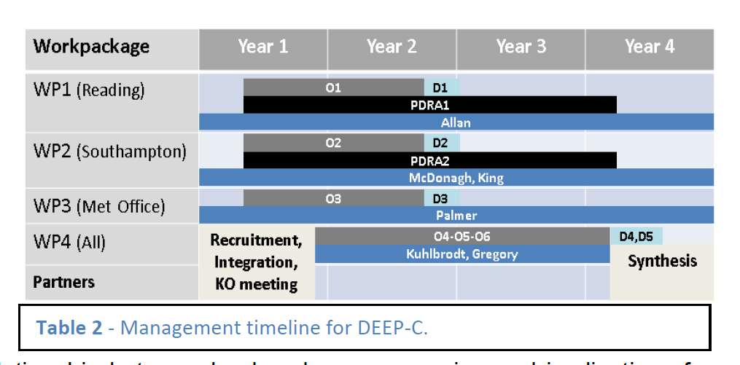
DEEP-C Work Plan
Start date: March 2013; Project Ends February 2017
Workpackage | Year 1 | Year 2 | Year 3 | Year 4
WP1 (Reading)
WP2 (Southampton)
WP3 (Met Office)
WP4 (All)
Partners
O1
D1
PDRA1
Allan
O2
D2
PDRA2
McDonagh, King
O3
D3
Palmer
Recruitment, Integration, KO meeting
O4-O5-O6
D4,D5
Kuhlbrodt, Gregory
Synthesis

Slide 5
Project Objectives
O1. Combine satellite radiation budget measurements with atmospheric reanalyses, providing improved 2D estimates of surface heat fluxes across the ocean surface (WP1)
O2. Calculate global 3D ocean heat content and its changes since 2003 using ARGO and ship-based observations, leading to improved understanding of energy propagation through the climate system (WP2)
O3. Investigate spatial patterns of surface and sub-surface temperature changes in distinct hiatus decades using simulations and observations (e.g. Fig. 4); evaluate the processes fundamental for ocean heat uptake and redistribution (WP3)
O4. Combine ocean and satellite data (from O1-2) to provide new estimate of Earth's net radiative energy balance (2000-2015) and compare with CMIP5 climate simulations (from O3) (WP1-4)
O5. Monitor co-variations in net radiative energy imbalance and ocean heating (from O1,O2,O4); quantify and understand lags between OHC and TOA radiation (WP1-4)
O6. Characterise spatial signatures and mechanisms of ocean and atmospheric heat re-distribution (from O4-5) during the hiatus period 2000-2015 using observations and simulations (WP1-4)

Slide 6
Primary Outputs
Allan, R. P., C. Liu, N. G. Loeb, M. D. Palmer, M. Roberts, D. Smith and P.-L. Vidale (2014) Changes in global net radiative imbalance 1985-2012, Geophysical Research Letters, 41,10.1002/2014GL060962.
Cheng, L., K. E. Trenberth, M. D. Palmer, J. Zhu and J. P. Abraham (2016) Observed and simulated full-depth ocean heat-content changes for 1970-2005, Ocean Science, 12, doi:10.5194/os-12-925-2016
Desbruyères, D. G., S. Purkey, G. J. Johnson, E. L. McDonagh and B. A. King (2016), Deep and Abyssal Ocean Warming from 35 years of Repeat Hydrography, GRL, in press, DOI: doi: 10.1002/2016GL070413
Desbruyères, D. G., E. L. McDonagh, B. A. King, F. K. Garry, A. T. Blaker, B. Moat and H. Mercier (2014) Full-depth temperature trends in the NE Atlantic through the early 21st century, GRL, doi:10.1002/2014GL061844
Liu, C. Allan, R. P., P. Berrisford , M. Mayer , P. Hyder, N. Loeb , D. Smith , P.-L. Vidale, J. Edwards (2015) Combining satellite observations and reanalysis energy transports to estimate global net surface energy fluxes 1985-2012, J. Geophysical Research, doi: 10.1002/2015JD023264
Loeb, N. G., H. Wang, A. Cheng, S. Kato, J. T. Fasullo, K.-M. Xu and R. P. Allan (2015) Observational Constraints on Atmospheric and Oceanic Cross-Equatorial Heat Transports: Revisiting the Precipitation Asymmetry Problem in Climate Models, Climate Dynamics, 10.1007/s00382-015-2766-z
Palmer, M.D. and D.J. McNeall (2014) Internal variability of Earth's energy budget simulated by CMIP5 climate models, Environ. Res. Lett. 9, 034016, doi:10.1088/1748-9326/9/3/034016
Palmer, M.D., C. D. Roberts, et al. (2015) Ocean heat content variability and change in an ensemble of ocean reanalyses, Climate Dynamics, doi: 10.1007/s00382-015-2801-0
Roberts, C.D., M.D. Palmer, D. McNeall and M. Collins (2014) Quantifying the likelihood of a continued hiatus in global warming, Nature Climate Change doi:10.1038/nclimate2531
Roberts, M. J. and co-authors inc. P Hyder (2016) Impact of ocean resolution on coupled air-sea fluxes and large-scale climate, GRL, doi:10.1002/2016GL070559
Smith, D., R. P. Allan, A. C. Coward, R. Eade, P. Hyder, C. Liu, N. G. Loeb, M. D. Palmer, M. Roberts, & A. A. Scaif (2015) Earth's energy imbalance since 1960 in observations and CMIP5 models, GRL, 10.1002/2014GL062669,
von Schuckmann, K. et al. inc. M. D. Palmer (2016) An imperative to monitor Earth's energy imbalance, Nature Climate Change doi: 10.1038/nclimate2876

Slide 7
Some Dissemination Activities
Media: BBC Breakfast (COP), BBC Radio 4 (comment on Nieves et al.), Science Media Centre (briefings & comments), BBC news/Independent/Sky/Telegraph/ Voice of Russia, etc (e.g. IPCC & comments on England et al and Kosaka and Xie)
Blogs: NASA sensing our planet, Climate Lab Book, Weather@Reading, Carbon Brief, Conversation, NCAS and NCEO highlights
Workshops: CLIVAR, decision analysis workshop, GEWEX, CERES/ScaRaB/GERB
Outreach: U3A, RMetS, local interest groups, schools, twitter
Datasets: DEEP-C TOA and surface energy flux; NOC ocean heat content

Slide 8
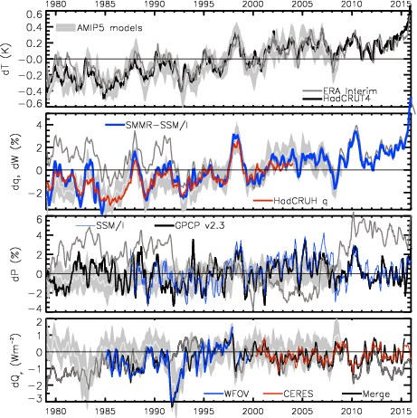
Changes in
Temperature, moisture, precipitation
& net radiation through a surge and slowdown
surge
slowdown
HEATING (Wm⁻²) PRECIP (%) MOISTURE (%) TEMPERATURE (K)
Update from Allan et al. (2014) Surv. Geophys & Allan et al. (2014) GRL
2.8
1.8
0.8
-0.2
-1.2
-2.2
Earth’s energy imbalance (Wm⁻²)

Slide 9
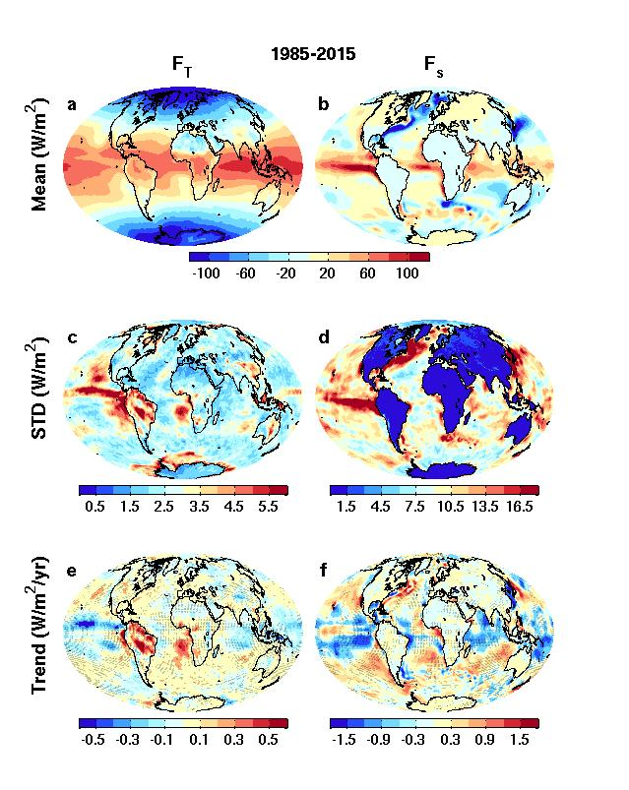
Net downward energy flux & trends top of atmosphere surface

Slide 10
Recent Literature
Johnson et al. (2016) Nature Climate Change: improved estimate of Earth's energy imbalance of +0.6 to +0.8 Wm⁻² due to better ocean sampling
Richardson et al. (2016) Nature Climate: reconciling obs-based/simulated TCS through consistent sampling of surface temperature (TCR~1.7ºC at 2xCO₂)
Medhaug and Drange (2016) Clim. Dyn.: Decadal-scale upper 700m ocean heat anomalies of ~7.5 x 10²¹ J comparable to that needed to maintain global warming.
Kosaka and Xie (2016) Nature Geosci.: model simulations of global warming "staircase" used to remove internal variability from observational record
Sevellec et al. (2016) GRL: hiatus of the early 21st Century was extremely unlikely
Mann et al. (2016) GRL: N. Pacific played critical role in the slowdown but was not predictable; minor contribution from N. Atlantic exhibits some predictability
Bellamo et al. (2016) GRL& Brown et al. (2016) GRL: basin-scale Atlantic Multidecadal Oscillation amplified by cloud feedback
Checa-Garcia et al. (2016) ERL: CFC decline + less growth in methane & low-level ozone pollution contributed to slower surface warming
Takahashi and Watanabe (2016) & Smith et al. (2016) Nature Climate: Aerosol forcing linked to hiatus through influence on Pacific trade winds/ocean circulation
http://www.met.reading.ac.uk/~sgs02rpa/research/DEEP-C.html#PAPERS

Slide 11
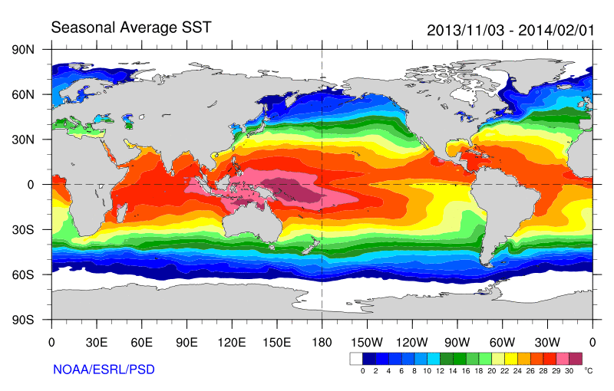
Role of Atlantic/Pacific Variability?
Radiative Forcing/Imbalance Johnson et al. (2016) ; Checa-Garcia et al. (2016) ; Huber & Knutti (2014) ;Santer et al. (2015) :
Continued heating from greenhouse gases
Aerosol forcing of circulation (Smith et al. 2016)
Unusual weather patterns (Ding et al. 2014; Trenberth et al. 2014b)
Pacific SST strengthens atmospheric circulation
Enhanced Walker Circulation
? Heat flux to Indian ocean Lee etal 2015
Increased sea height
Warm
Upwelling,
Cool water
Remote forcing from Atlantic:
Li et al. (2016) ;
McGregor et al. (2014)
Increased precipitation
Decreased salinity
Strengthening trade winds
Equatorial Undercurrent
Pacific dominates?
Mann et al. (2016) Kosaka & Xie (2013) England et al. (2014)
Enhanced mixing of heat below 100 metres depth by accelerating shallow overturning cells and equatorial undercurrent
See also: Merrifield (2010).; Sohn et al. (2013) .; L’Heureux et al. (2013) . Change; Watanabe et al. (2014) ; Balmaseda et al. (2013) ; Trenberth et al. (2014) .; Llovel et al. (2014) ;Durack et al. (2014) ; Nieves et al. (2015) ; Brown et al. (2015) JGR ; Somavilla et al. (2016) ; Liu et al. (2016)

Slide 12

Final WP1 outputs/conclusions
  Finalised energy flux dataset version and uncertainty estimates (Liu et al.)
  Cross equatorial heat transport (NERC highlight topic?)
  Heat flux bias in southern ocean (Pat et al.)
  Basin-scale changes in heat flux (Damien et al.) & heat flux/transport contributions to heat content (Chris et al.)
  SMURPHS work
    spatial signatures/morphology,
    links to water cycle,
    Understanding Pacific discrepancy in heat flux changes
    quantify/understand lags between OHC and TOA radiation
    mechanisms for feedbacks on internal variability)

Slide 13
Spare slides

Slide 14
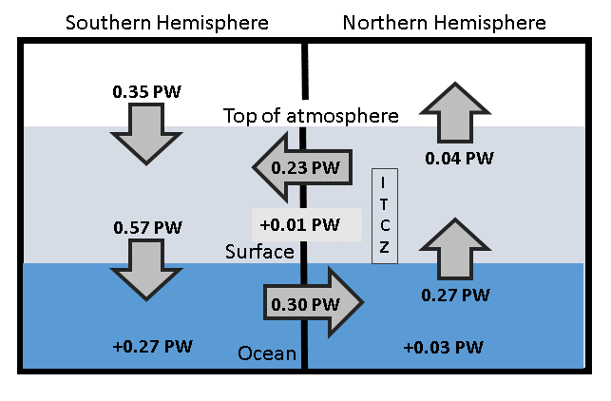
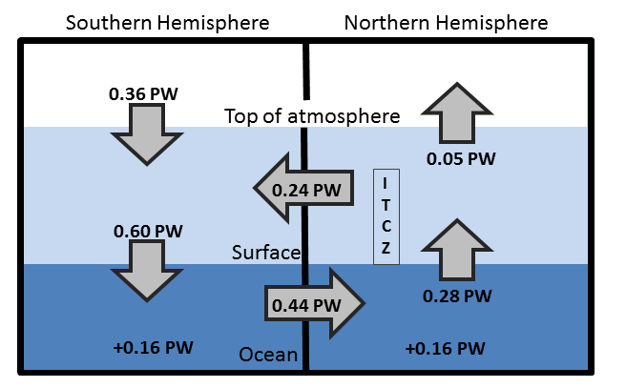
Updated observed energy budget asymmetry
Updated from Loeb et al. (2015) Clim. Dyn. For 2000-2015 based on Liu et al. (2015) JGR
Observed inter-hemispheric imbalance in Earth’s energy budget
Use asymmetric ocean heating observed by Roemmich et al. (2015) Nature Climate and Purkey & Johnson (2010)
Derive implied ocean heat transport: smaller that Loeb et al. (2015) and Frierson et al. 2013 (0.44 PW) – unrealistically so?

Slide 15
Future work
  Which ocean basins are taking up 0.6 Wm⁻² energy imbalance?
  Can we observationally constrain climate sensitivity & feedbacks on internal variability?
  How do changes in cloud/circulation amplify slowdowns/surges? e.g. Brown et al. (2015) JGR ; Radel et al. (2016) Nature Geosci. ; Li et al. (2016) Nature Climate
  Decadal changes in interhemispheric imbalance, ITCZ and global atmospheric/ocean circulation (highlight topic?)
  How has the “hiatus” affected the water cycle?

Slide 16
Net Imbalance Anomaly (Wm⁻²)
Changes in imbalance in models & observations
Imbalance: 0.23 0.00 0.78 0.63 0.63 (Wm⁻²)
0.34±0.67 Wm⁻²
0.62±0.43 Wm⁻²
La Niña
El Niño
Volcano
Allan et al. (2014) GRL

Slide 17
Energy imbalance-implied temperature changes

Slide 18
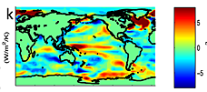
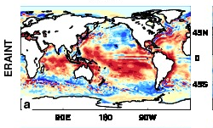
feedbacks on internal variability?
← less heat flux out of east Pacific during warm phases?
Models may underestimate interdecadal variability
Are there positive heat flux feedbacks which amplify internal climate variability?
New project: SMURPHS
surface flux (up)
Brown et al. (2015) JGR
ERAINT latent heat flux trend 1988-2008

Slide 19
Conclusions / PLAns
Top of atmosphere/surface heat flux product delivered
  Further work required to determine uncertainties
Characterising changes in Earth’s energy imbalance
  Variability from radiative forcings & internal variability
  Manifest as positive imbalance in Southern Hemisphere
    Ocean energy transport to North offset by atmos. energy trans. to South
    Links to model precipitation biases
    Decadal changes in energy imbalance? [idea → NERC]
  Toward reconciled ocean heating/radiation budget changes
  Where in oceans is energy going (regional/vertical structure)?
  What are time-scales/lags associated with net imbalance?
Do feedbacks amplify/extend hiatus/surge events?
  New SMURPHS project
  Toward an observational constraint on climate sensitivity?
Links to WP2-4

Slide 20
Discussion
Activities to combine work packages?
  Joint publications
  Intercomparison of ocean heating/imbalance data
  Assess uncertainty in surface flux product
  Lags in system/feedbacks on decadal variability
  Estimated imbalance + regional/vertical structure
  Heating by ocean basin and surface fluxes
Big issue questions to aim for?
Future funding opportunities?
Next meeting
  Dates…
  Should we arrange a larger 2-day workshop?

Slide 21
WP1 Dissemination Activities
Jan 2016: Energy and water cycle seminar, Reading; El Nino comments (WSJ)
Nov 2015: Paris COP BBC Breakfast, etc; U3A talk; NASA sensing our planet
Sep/Oct 2015: NCEO meeting Southampton; CliVar workshop; outreach talks
July 2015: Commented on Nieves et al on BBC Radio 4 Today program; Talks/posters at IUGG Prague & Common Future Climate conf.
June 2015: Comments on Karl et al. paper (Carbon Brief/SMC/Reuters); Seminars at Imperial College & NCAS
April 2015: Presentation at Decision Analysis for Policy Support workshop
Feb 2015: Comment on detection of greenhouse gas radiative effect
Jan 2015: Smith et al. (2015) GRL dissemination work & U3A outreach
October 2014: Conversation article on Durack/Llovel papers; BBC2 Jeremy Vine show; CERES/GERB/ScaRaB meeting talk
August 2014: Allan et al. (2014) NCAS highlight, Nature Climate Change highlight ; Climate Lab Book , Carbon Brief , Met Department & Conversation blogs; Telegraph ; Eddington Astronomical Society talk
July 2014: DEEP-C talks at GEWEX and AMS conferences
April 2014 – Royal Society “Hiatus” discussion meeting; EGU talk
Feb 2014 - "Where has the warming gone?" RMetS local group ; Comment on England et al. (see also Guardian article).
Aug/Sep2013 - Comment on recent Nature paper by Kosaka and Xie (see also BBC and Independent articles); Voice of Russia; IPCC Sky/BBC/etc
July 2013 - Science Media Centre briefing on “slowdown”
May 2013: Carbon Brief article on DEEP-C temperature obs.
April 2013 - Meeting with DECC partners in London
Also: twitter, Walker Institute, media interaction http://www.met.reading.ac.uk/~sgs02rpa/research/DEEP-C.html

