Slide 1
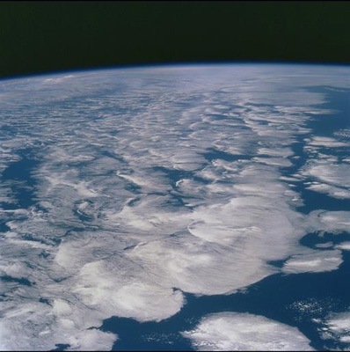

DEEP-C:
Introduction & WP1 update
Richard Allan, Chunlei Liu - University of Reading
Thanks to: Norman Loeb, Matt Palmer, Doug Smith
DEEP-C Meeting, University of Reading, 9th June 2015

Slide 2
DEEP-C project meeting, 9th June 2015 University of Reading
11:00 Coffee
11:30 Introduction and summary of recent literature (Richard Allan)
12:00 Independent estimate of surface energy fluxes based upon satellite data and reanalysis atmospheric transports (Chunlei Liu)
12:20 Assessing and applying new DEEP-C net heat flux product (Pat Hyder)
13:00 Lunch
13:40 Temperature trends form Argo and Hydrography Data (Elaine McDonagh)
14:00 Report on Deep Argo workshop, CSIRO, Hobart, May 2015 (Brian King)
14:20 Deep Argo float deployment critical in Southern Ocean to resolve (Freya Garry)
15:00 (1) Pseudo profiles from climate and ocean models to evaluate ocean heat content mapping methods (2) Intercomparison of ocean heat content in ocean reanalysis“ (Matt Palmer)
15:30 Plans for collaborative work (WP4)
16:00 Tea and final discussions.

Slide 3
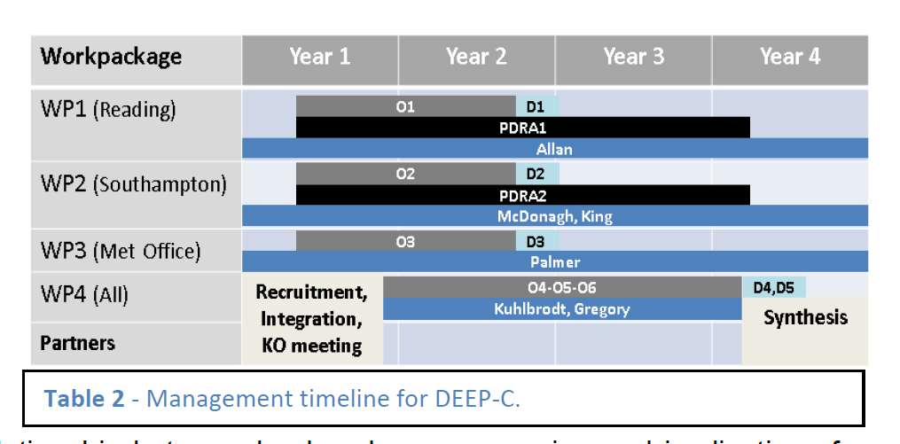
DEEP-C Work Plan
Start date: March 2013; Project Ends February 2017
Workpackage | Year 1 | Year 2 | Year 3 | Year 4
WP1 (Reading)
WP2 (Southampton)
WP3 (Met Office)
WP4 (All)
Partners
O1
D1
PDRA1
Allan
O2
D2
PDRA2
McDonagh, King
O3
D3
Palmer
Recruitment, Integration, KO meeting
O4-O5-O6
D4,D5
Kuhlbrodt, Gregory
Synthesis

Slide 4
Project Objectives
O1. Combine satellite radiation budget measurements with atmospheric reanalyses, providing improved 2D estimates of surface heat fluxes across the ocean surface (WP1)
O2. Calculate global 3D ocean heat content and its changes since 2003 using ARGO and ship-based observations, leading to improved understanding of energy propagation through the climate system (WP2)
O3. Investigate spatial patterns of surface and sub-surface temperature changes in distinct hiatus decades using simulations and observations (e.g. Fig. 4); evaluate the processes fundamental for ocean heat uptake and redistribution (WP3)
O4. Combine ocean and satellite data (from O1-2) to provide new estimate of Earth's net radiative energy balance (2000-2015) and compare with CMIP5 climate simulations (from O3) (WP1-4)
O5. Monitor co-variations in net radiative energy imbalance and ocean heating (from O1,O2,O4); quantify and understand lags between OHC and TOA radiation (WP1-4)
O6. Characterise spatial signatures and mechanisms of ocean and atmospheric heat re-distribution (from O4-5) during the hiatus period 2000-2015 using observations and simulations (WP1-4)

Slide 5
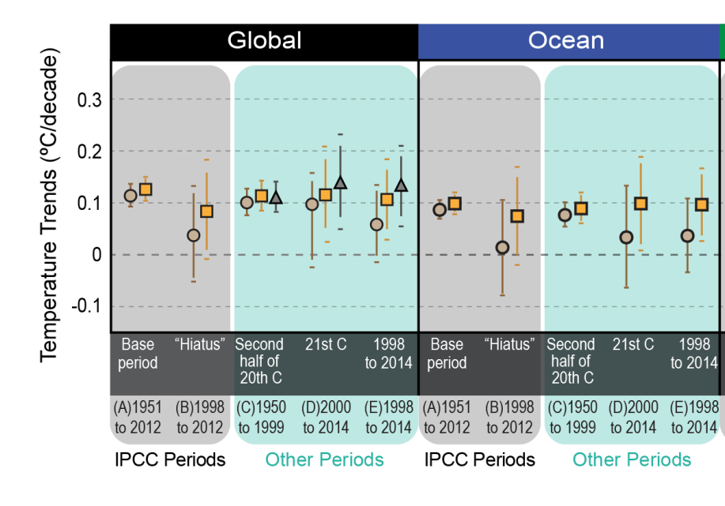
Some recent updates to the literature: No “hiatus”? Karl et al. (2015) Science
Doesn’t explain slower warming compared to:
1980s/90s
coupled models
Climatically unusual conditions in 2000s

Slide 6
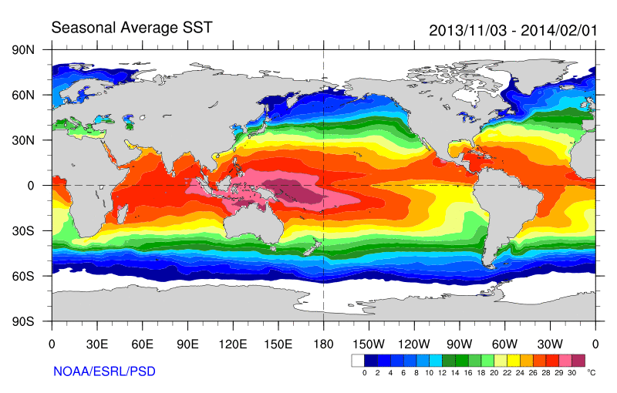
Role of Pacific Ocean Variability?
Continued heating from rising greenhouse gas concentrations
Unusual weather patterns (Ding et al. 2014; Trenberth et al. 2014b)
Enhanced Walker Circulation
Ocean circulation strengthens atmospheric circulation
? Heat flux to Indian ocean Lee etal 2015
Increased sea height
Warm
Upwelling,
Cool water
Remote link to Atlantic?
McGregor et al. (2014)
Increased precipitation
Decreased salinity
Strengthening trade winds
Equatorial Undercurrent
Enhanced mixing of heat below 100 metres depth by accelerating shallow overturning cells and equatorial undercurrent
See: Merrifield (2010) J. Clim.; Sohn et al. (2013) Clim. Dyn.; L’Heureux et al. (2013) Nature Clim. Change; Kosaka and Xie (2013) Nature; England et al. (2014) Nature Clim. Change; Watanabe et al. 2014 Nature Clim. Change; Balmaseda et al. (2013) GRL; Trenberth et al. (2014) J. Clim.

Slide 7
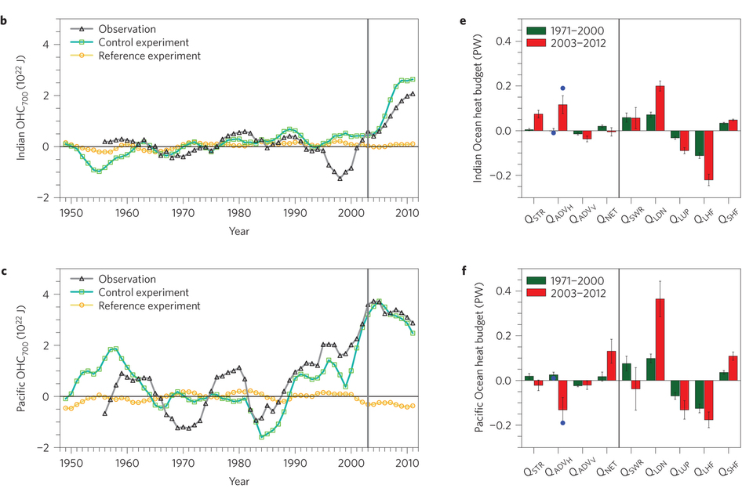
Increased heat flow from Pacific to Indian Ocean?
Lee et al. (2015) Nature Geosci

Slide 8
WP1 - Planned work
Analyse and update observed variability in TOA radiation balance (Allan et al. 2014: delivered)
Combine reanalyses/satellite data to provide independent estimates of surface flux (in revision: C. Liu et al.)
  - Wider use of flux products by Pat Hyder et al. (Met Office)
Other topics:
  Inter-hemispheric heating asymmetry and water cycle
  Investigate lags in climate system (preliminary work)
  Evaluation of ERA CLIM radiation budget?
Monitoring of changes in energy balance (ongoing)
Reconcile TOA radiation balance and ocean heating (WP4)

Slide 9
WP1 Objectives/Deliverables
O1. Combine satellite radiation budget measurements with atmospheric reanalyses, providing improved 2D estimates of surface heat fluxes across the ocean surface (WP1)
D1. Combined satellite-reanalysis atmosphere/surface energy flows: methodology, uncertainty and exploring lags in the climate system (paper 1,2; WP1, O1,4)
O5. Monitor co-variations in net radiative energy imbalance and ocean heating (from O1,O2,O4); quantify and understand lags between OHC and TOA radiation (WP1-4)
O6. Characterise spatial signatures/mechanisms of ocean and atmospheric heat re-distribution (from O4-5) during the hiatus period 2000-2015 using observations and simulations (WP1-4)

Slide 10
Net Imbalance Anomaly (Wm⁻²)
Changes in imbalance in models & observations
Imbalance: 0.23 0.00 0.78 0.63 0.63 (Wm⁻²)
0.34±0.67 Wm⁻²
0.62±0.43 Wm⁻²
La Niña
El Niño
Volcano
Allan et al. (2014) GRL

Slide 11
Discrepancy between radiation budget & ocean heating
Large ocean heating anomaly in 2002
Inconsistent with radiation budget observations and simulations
Changing observing system influence?
Slight drop in net flux 1999-2005?
Smith et al. (2015) GRL

Slide 12
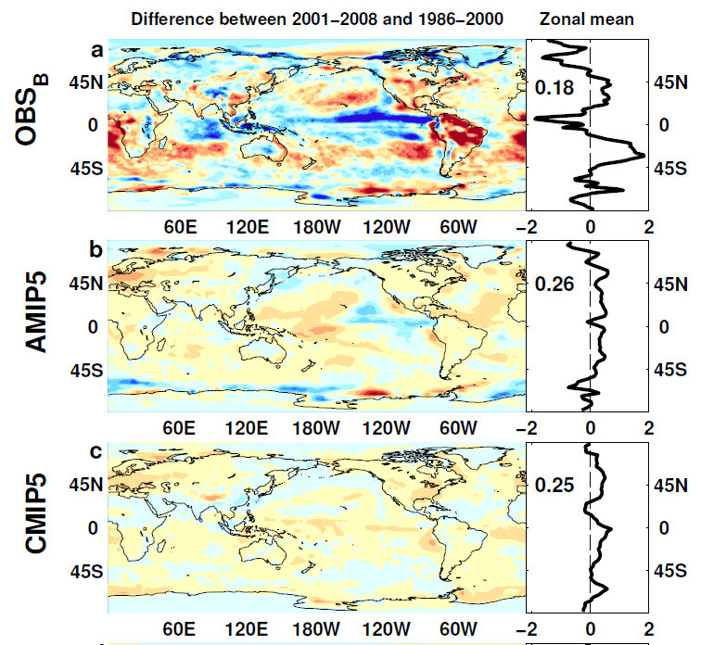

NET TOA Radiation
Allan et al. (2014)

Slide 13
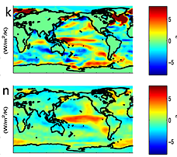
feedbacks on internal variability?
← top: less heat flux out of east Pacific during warm phases?
Models may underestimate interdecadal variability
Are there positive heat flux feedbacks which amplify internal climate variability?
TOA flux (down) surface flux (up)
Brown et al. (2015) JGR

Slide 14
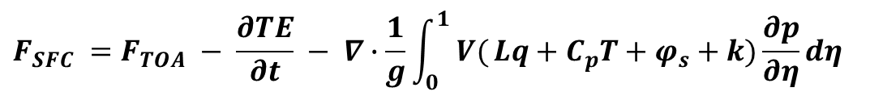
Current work: estimates of Surface Flux (Chunlei Liu)
CERES/Argo Net Flux
Estimate horizontal energy flux
Surface Flux
$$F_{SFC} =F_{TOA} − \frac{∂TE}{∂t} − ∇∙\frac{1}{g}\int_{0}^{1}{ V(}Lq+C_{p}T+φ_{s}+k)\frac{∂p}{∂η}dη$$

Slide 15

Observed Asymmetry in earth’s energy budget
Observed inter-hemispheric imbalance in Earth’s energy budget
Not explained by albedo: brighter NH surface but more clouds in SH (Stephens et al. 2015)
Imbalance explains position of ITCZ (Frierson et al. 2013)
Loeb et al. (2015) submitted

Slide 16
Equatorial heat transport and model precipitation bias
Clear link between bias in cross-equatorial heat transport by atmosphere and inter-hemispheric precipitation asymmetry
Models
CERES/ERA Interim
Loeb et al. (2015) in review
More rain in NH →

Slide 17
Conclusions
Heating of Earth continues at rate of ~0.6 Wm⁻²
Current variability in TOA radiation (1985-2013)
  Net flux higher in 1995-1999 than 2000-2012 period
  Radiative forcing alone can’t explain surface warming slowdown: internal variability important
  Pacific signal in ΔT/ΔN; atmos. transports dominate surface
Plans:
  Development of surface flux estimate (finalising)
  Evaluate with other datasets; basin-scale flux changes
  Work with WP2 (surface fluxes) and WP3 (simulations & intercomparisons) and comparison with surface fluxes products (Met Office)

Slide 18
WP1 Dissemination Activities
Late 2015 - DEEP-C workshop?? TBD
November 2015: Megha Tropique workshop, Paris
September 2015: NCEO meeting Southampton; CliVar workshop Exeter
July 2015: Talks/posters at IUGG Prague & Common Future Climate conf.
June 2015: Comments on Karl et al. paper (Carbon Brief/SMC/Reuters); Seminars at Imperial College & NCAS
April 2015: Presentation at Decision Analysis for Policy Support workshop
February 2015: Comment on detection of greenhouse gas radiative effect
January 2015: Smith et al. (2015) GRL dissemination work & U3A outreach
October 2014: Conversation article on Durack/Llovel papers; BBC2 Jeremy Vine show; CERES/GERB/ScaRaB Science team meeting talk
August 2014: Allan et al. (2014) NCAS highlight, Nature Climate Change highlight ; Climate Lab Book , Carbon Brief , Met Department & Conversation blogs; Telegraph ; Eddington Astronomical Society talk
July 2014: DEEP-C talks at GEWEX and AMS conferences
April 2014 – Royal Society “Hiatus” discussion meeting; EGU talk
Feb 2014 - "Where has the warming gone?" talk to RMetS local group ; Comment on England et al. (see also Guardian article).
Aug/Sep2013 - Comment on recent Nature paper by Kosaka and Xie (see also BBC and Independent articles); Voice of Russia; IPCC Sky/BBC/etc
July 2013 - Science Media Centre briefing on “slowdown”
May 2013: Carbon Brief article on DEEP-C temperature obs.
April 2013 - Meeting with DECC partners in London
Also: twitter, Walker Institute, media interaction
http://www.met.reading.ac.uk/~sgs02rpa/research/DEEP-C.html

Slide 19
Discussion
Activities to combine work packages?
  Joint publications
  Intercomparison of ocean heating/imbalance data
  Assess uncertainty in surface flux product
  Lags in system/feedbacks on decadal variability
  Estimated imbalance + regional/vertical structure
  Heating by ocean basin and surface fluxes
Big issue questions to aim for?
Future funding opportunities?
Next meeting
  Dates…
  Should we arrange a larger 2-day workshop?

Slide 20
Project Objectives
O1. Combine satellite radiation budget measurements with atmospheric reanalyses, providing improved 2D estimates of surface heat fluxes across the ocean surface (WP1)
O2. Calculate global 3D ocean heat content and its changes since 2003 using ARGO and ship-based observations, leading to improved understanding of energy propagation through the climate system (WP2)
O3. Investigate spatial patterns of surface and sub-surface temperature changes in distinct hiatus decades using simulations and observations (e.g. Fig. 4); evaluate the processes fundamental for ocean heat uptake and redistribution (WP3)
O4. Combine ocean and satellite data (from O1-2) to provide new estimate of Earth's net radiative energy balance (2000-2015) and compare with CMIP5 climate simulations (from O3) (WP1-4)
O5. Monitor co-variations in net radiative energy imbalance and ocean heating (from O1,O2,O4); quantify and understand lags between OHC and TOA radiation (WP1-4)
O6. Characterise spatial signatures and mechanisms of ocean and atmospheric heat re-distribution (from O4-5) during the hiatus period 2000-2015 using observations and simulations (WP1-4)

Slide 21
Possible Future work
Can we reconcile ocean heating and top of atmosphere imbalance?
Time-scales and lags associated with net imbalance (Harries & Futyan 2006 GRL)
Observational constraint on radiative feedbacks & climate sensitivity
What controls decadal variability: “hiatus” and “surge” events?
Feedbacks associated with unforced variability
  Cloud and latent heat fluxes in the Pacific e.g. Brown et al. 2014 GRL
Do patterned radiative forcings force distinct feedback responses?
To what extent does inter-hemispheric imbalance control rainfall patterns? e.g. Hwang et al. (2012) GRL

Slide 22
Spare slides

Slide 23
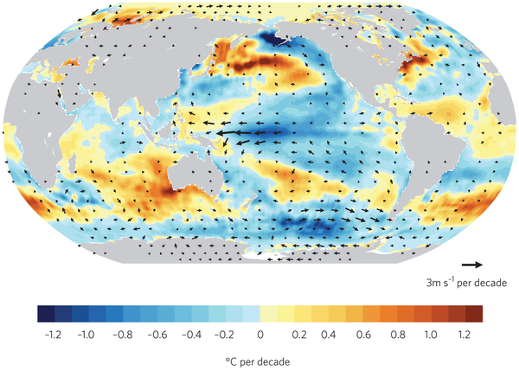
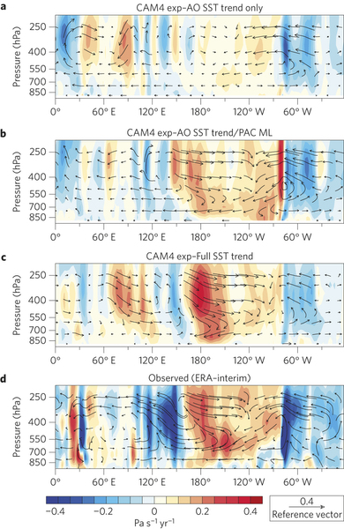
Mechanisms of ocean variability
Pacific Decadal Variability Pattern
Is Atlantic driving Pacific changes?
Atlantic circulation salinity feedback? (Chen & Tung 2014)
(Kosaka 2014)
Model simulates stronger Pacific trades when apply Atlantic SSTs + Pacific SST allowed to respond →
McGregor et al. (2014)

Slide 24
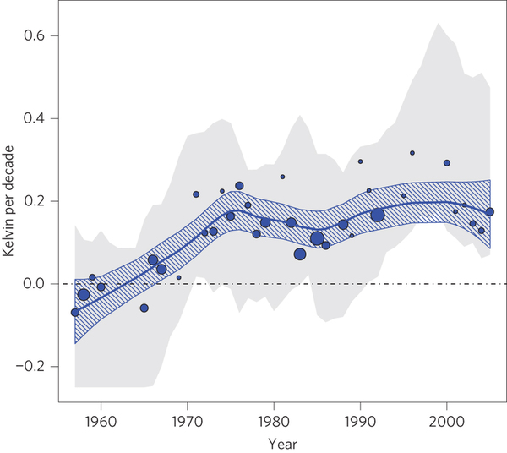
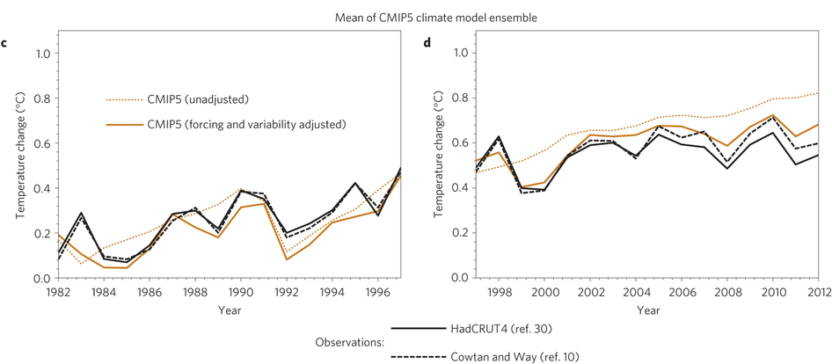
Better agreement accounting for ENSO & natural forcings
Risbey et al. (2014) Nature Climate Change →
← Huber & Knutti (2014) Nature Geosci

Slide 25
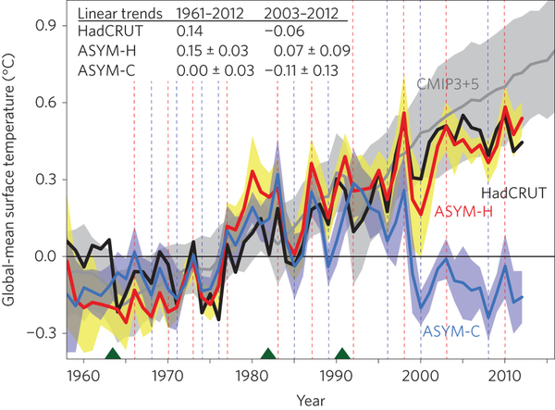
Role of Pacific Trade Winds
Watanabe et al. (2014) Nature Climate Change:
Prescribe observed changes in Pacific trade winds
Estimate Internal variability contributes ~+0.11-0.13ºC in 1980s/90s and -0.11ºC in 2000s
Is it all internal or is there a forced component?

Slide 26
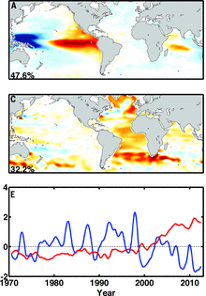
Role of the Atlantic ?
Chen & Tung (2014) Science → propose mechanism involving deeper AMOC circulation and salinty feedbacks
McGregor et al. (2014) Nature Clim.
Model simulated strengthened Pacific trades when forced by Atlantic SST and Pacific SST is allowed to respond

Slide 27
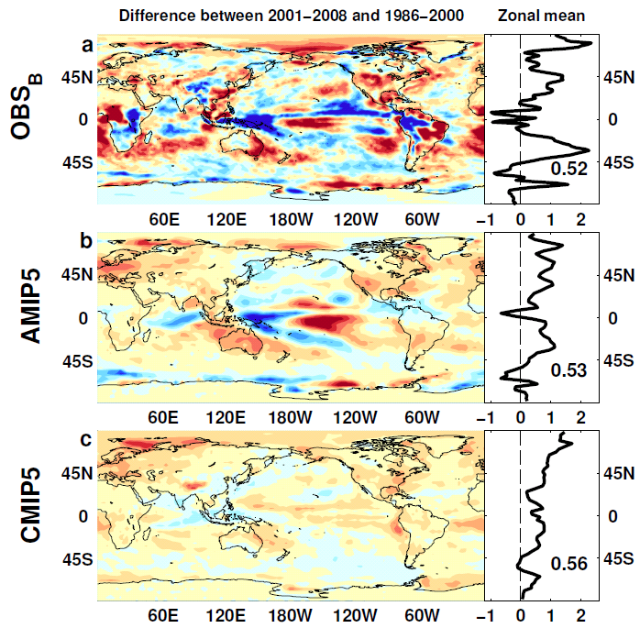

Absorbed Shortwave Radiation
Wm⁻²

Slide 28
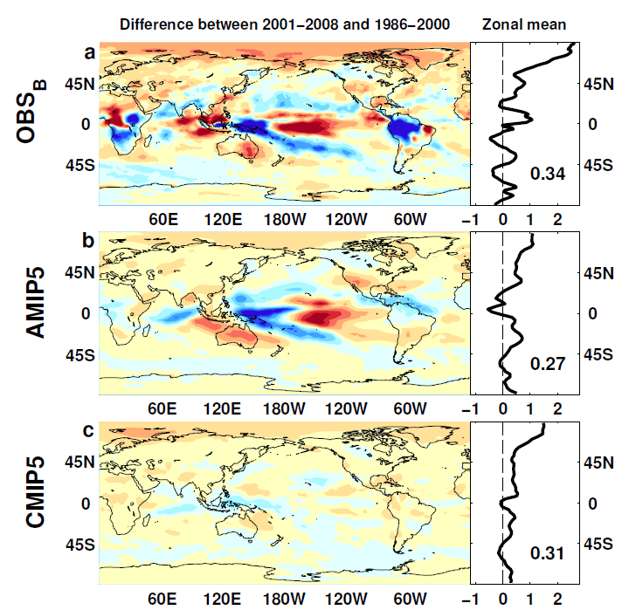
Outgoing Longwave Radiation
Wm⁻²

Slide 29
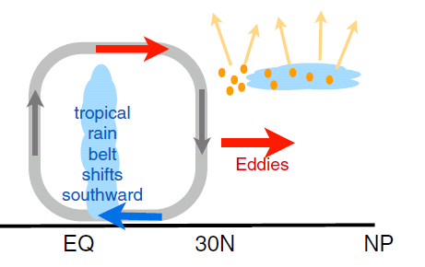
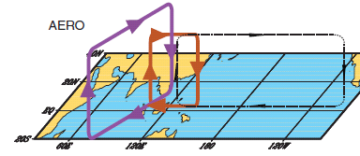
earth’s energy budget & regional changes in the water cycle
Regional precipitation changes sensitive to asymmetries in Earth’s energy budget
N. Hemisphere cooling: stronger heat transport into hemisphere
Reduced Sahel rainfall from:
Anthropogenic aerosol cooling 1950-1980s: Hwang et al. (2013) GRL →
Asymmetric volcanic forcing e.g. Haywood et al. (2013) Nature Climate
Enhanced energy transport
cooling
Sulphate aerosol effects on Asian monsoon e.g. Bollasina et al. 2011 Science (left)
Links to drought in Horn of Africa? Park et al. (2011) Clim Dyn
GHGs & Sahel rainfall recovery?
Dong & Sutton (2015) Nature Clim.

Slide 30
Loeb et al. (2015) submitted
CERES/ ERA Interim
Heat transported to
← southern/northern → hemisphere
Simulations
TPA index - more rain in:
← Southern tropics/Northern tropics →

