Slide 1
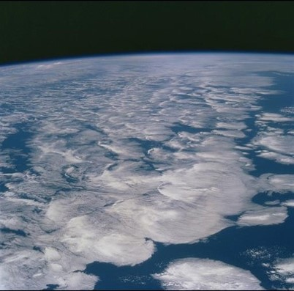
The role of CMIP in climate research for policy support
Department of Meteorology
Examples focusing on the changing water cycle and global warming hiatus
Richard Allan

Slide 2
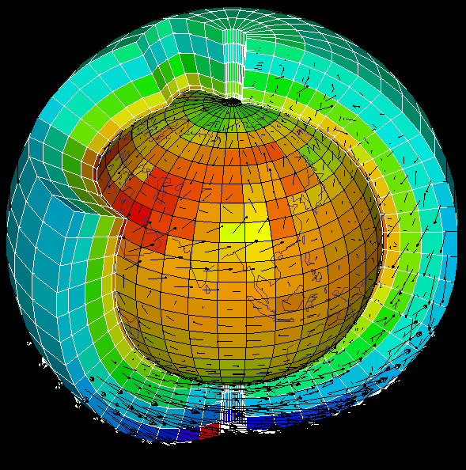
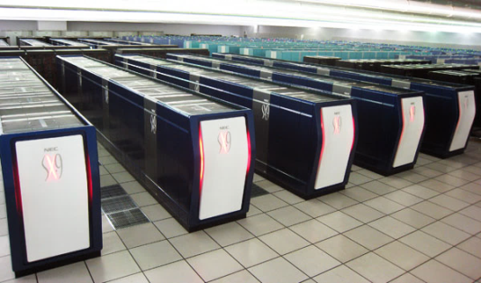
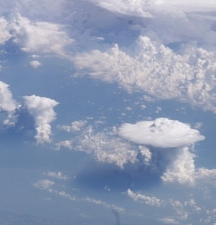
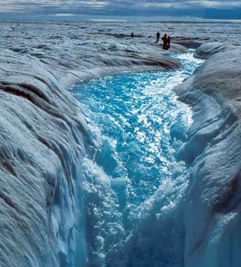
CMIP: THE Coupled Model
Inter-comparison PROJECT
CMIP provides a framework for coordinated climate change experiments using comprehensive global simulations
CMIP provides a multi-model context for:
Assessing the mechanisms responsible for model differences in poorly understood feedbacks associated with the carbon cycle and with clouds
Examining climate predictability and exploring the ability of models to predict climate on decadal time scales, and, more generally
Determining why similarly forced models produce a range of responses

Slide 3
CMIP5: THE Coupled Model
Inter-comparison PROJECT #5
CMIP5 promotes standard set of model simulations in order to:
  evaluate how realistic the models are in simulating the recent past
  provide projections of future climate change on two time scales, near term (out to about 2035) and long term (out to 2100 and beyond)
  understand some of the factors responsible for differences in model projections, including quantifying some key feedbacks such as those involving clouds and the carbon cycle

Slide 4
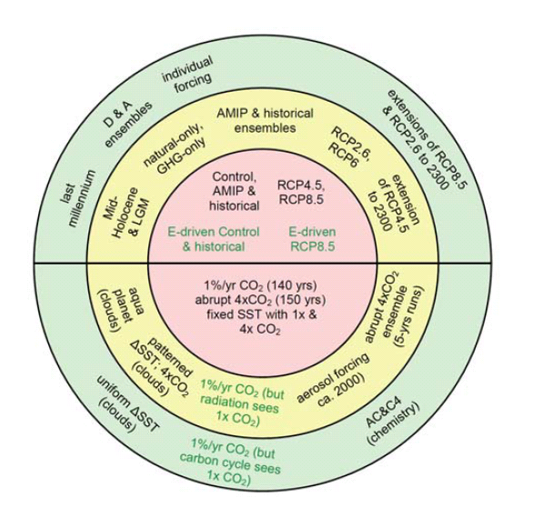
EXPERIMENTS…
Coupled Model Intercomparison Project Phase 5: CMIP5
AMIP: Atmosphere-only; realistic past sea surface temperature/sea ice & radiative forcings 1979-2008
Historical: fully coupled, realistic radiative forcing 1850-2005
RCPs: fully coupled projections >2005 driven by representative concentration pathway scenarios
Many other flavours & idealised experiments (e.g. 1%/yr CO₂)
IPCC (2013) Fig. 9.1 (see also Table 9.1)

Slide 5
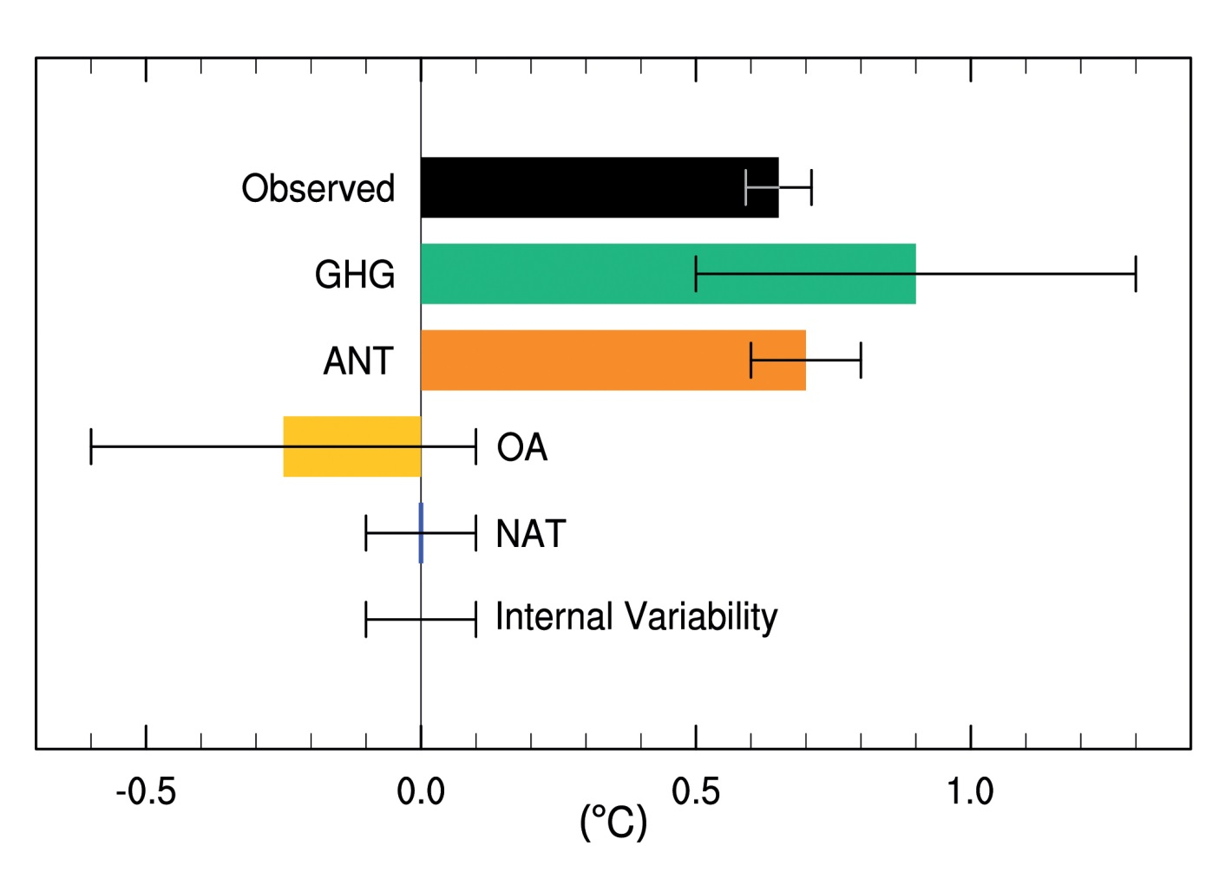
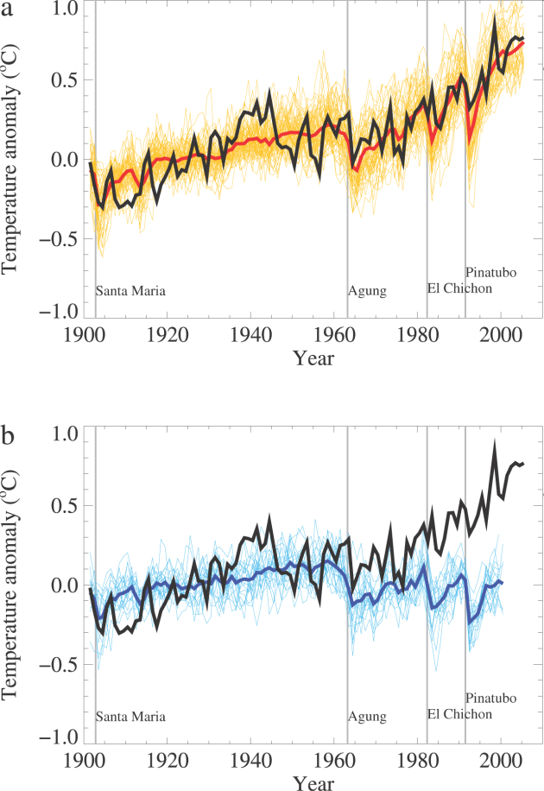
DETECTION & attribution
IPCC (2013) WG1 Fig. 10.5 (see also IPCC updates for schools)

Slide 6
1.0
0.8
0.6
0.4
0.2
0.0
IPCC: Future PROJECTIONS
High emissions
Low emissions
(m)
IPCC (2013) WG1 Summary for Policy Makers
Notes:
Increase of global mean surface temperatures for 2081–2100 relative to 1986–2005 is projected to likely be in the ranges 0.3°C to 1.7°C for the lowest emissions scenario (RCP2.6) and 2.6°C to 4.8°C for the highest emissions scenario (RCP8.5). The Arctic region will warm more rapidly than the global mean, and mean warming over land will be larger than over the ocean.
Global mean sea level rise is projected to range from 0.52 to 0.98 m by 2100 for RCP8.5, with a rate during 2081 to 2100 of 8 to 16 mm per year. Further uptake of carbon by the ocean will increase ocean acidification.
Heavy rainfall is expected to become more intense with wet regions generally seeing more rainfall and dry sub-tropical regions or seasons less.
For further details, see the IPCC (2014) WG1 Summary For Policy Makers, Section E.

Slide 7
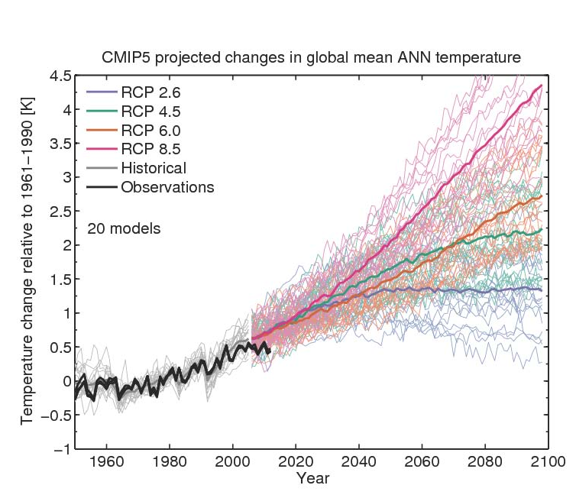
UNCERTAINTY ranges
Climate sensitivity and socioeconomic scenario
Climate sensitivity
From Ed Hawkins: see Climate Lab Book

Slide 8
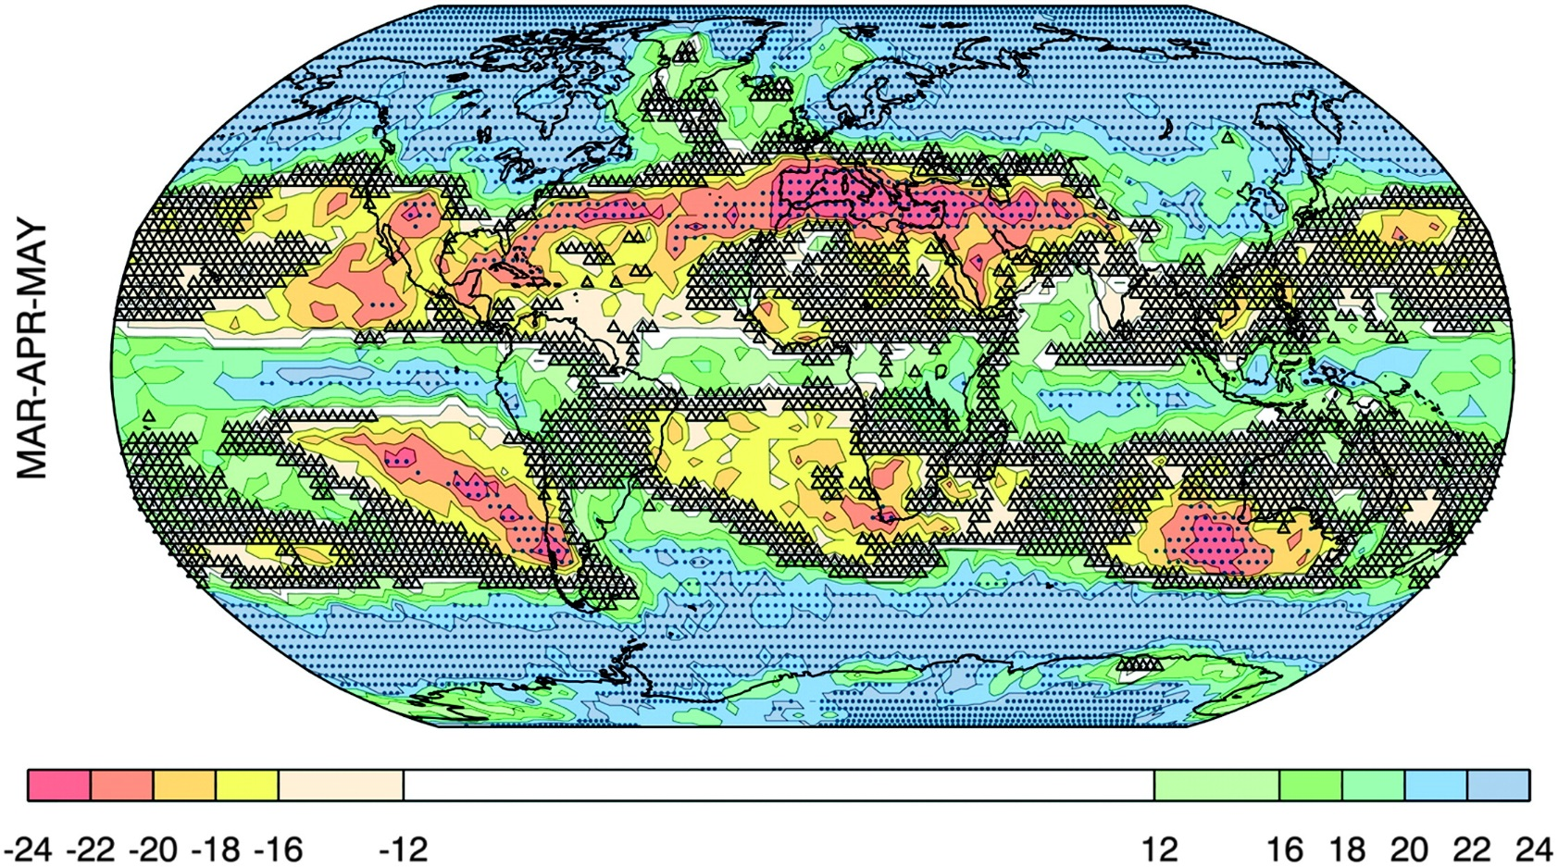
Changing PRECIPITATION:
WHERE IS BIG/SMALL CHANGE ROBUST?
Change > σ_{models}
Small change vs. variability
Number of models that agree on sign of change
Power, et al. (2012) J. Climate
Notes:
The degree of consensus on the sign of the projected change (colored shading), the areas where the MMEM change exceeds the intermodel standard deviation (dots), and regions where the projected change is very likely small relative to variability (small triangles). In virtually all cases triangles only appear where the degree of consensus is very low or absent—for MAM only.

Slide 9

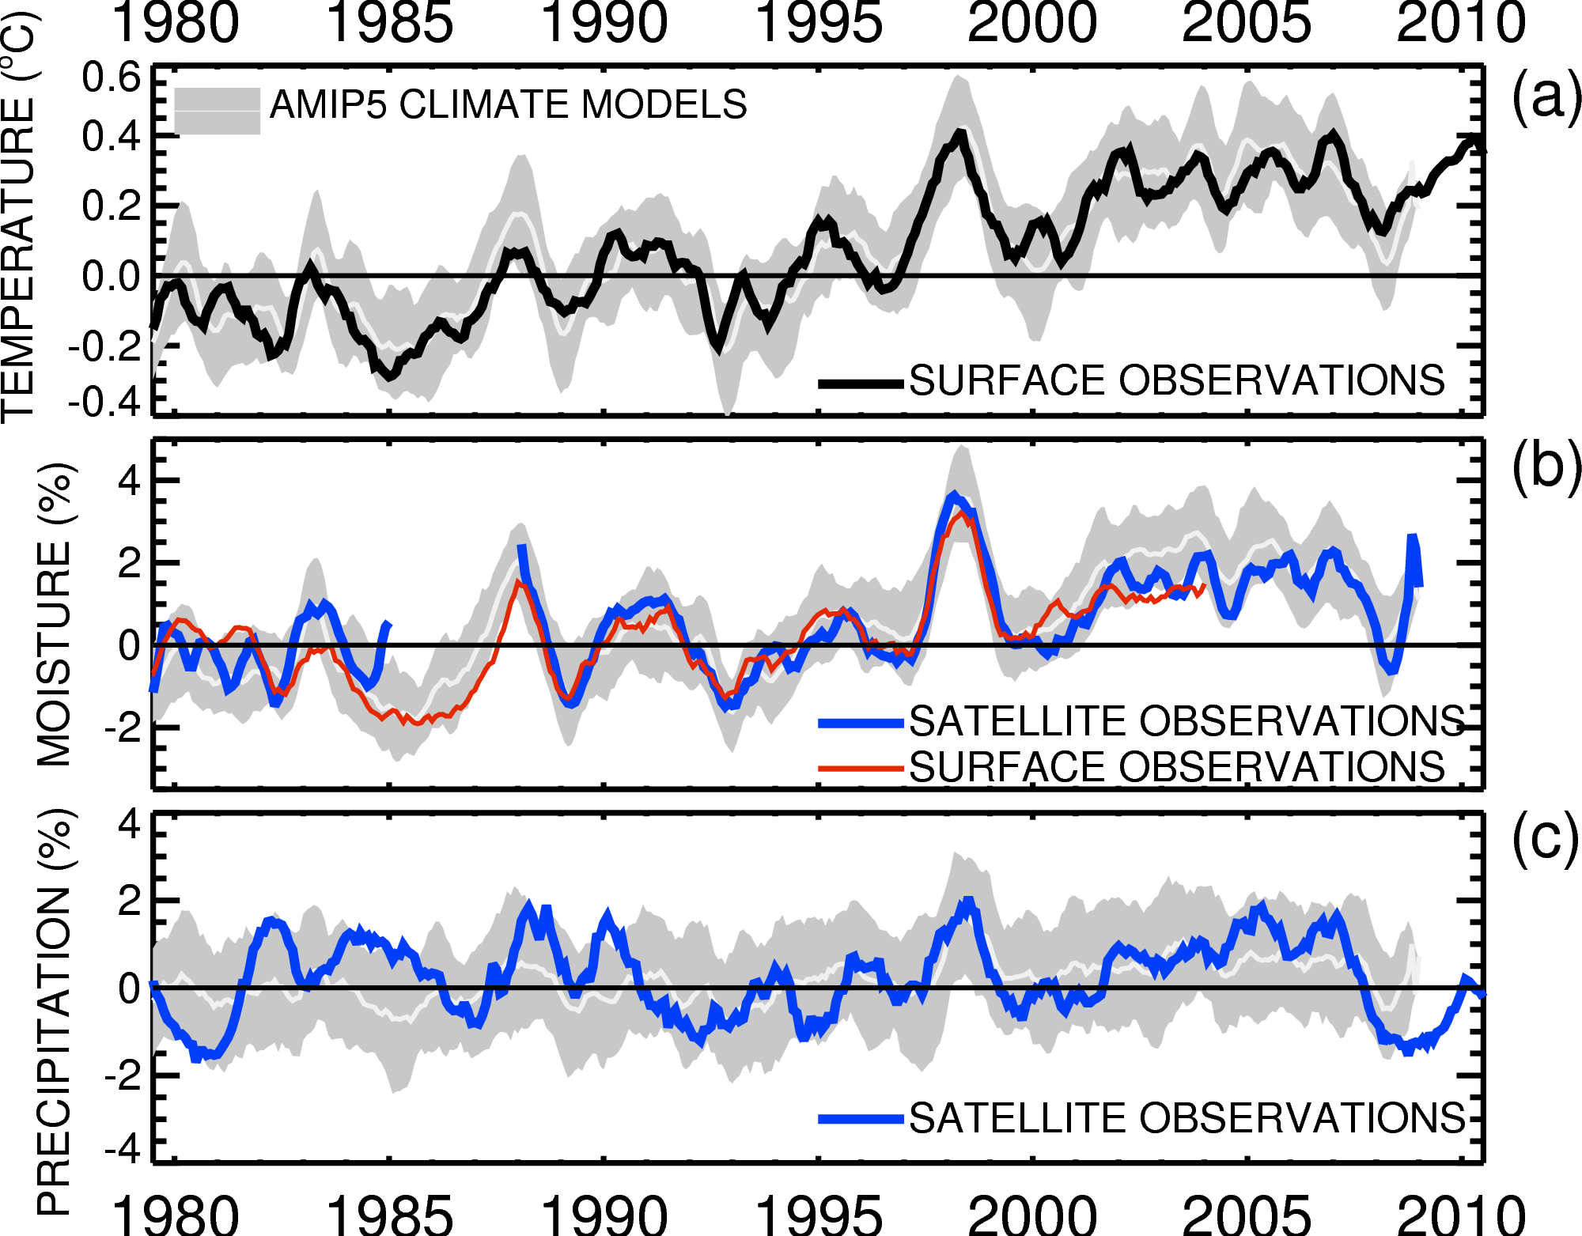

Current changes in THE global water cycle
Co-variation: dW/dTs ~ 7%/ºC
~1%/decade trend
Adapted from: Allan et al. (2014) Surv. Geophys

Slide 10
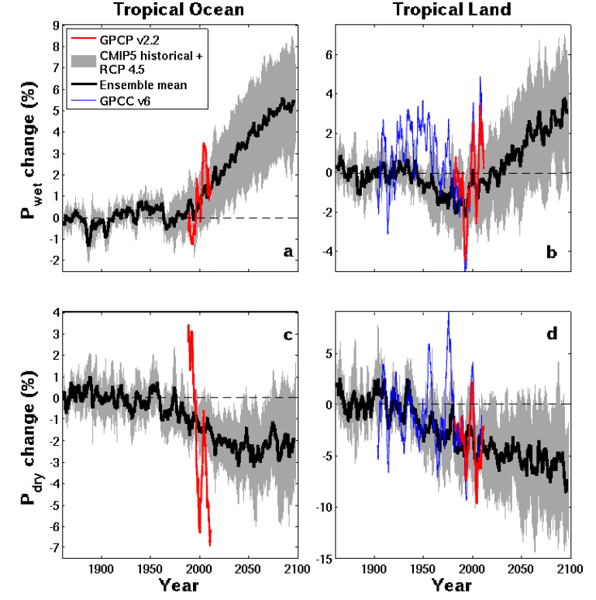

CONTRASTING TRENDS IN
TROPICAL PRECIPITATION
Discrepancy: wet tropical land
Ocean Land
Historical/RCP4.5
GPCC GPCP
simulations
Pre 1988 GPCP observations over ocean don’t use microwave data
dry tropical region wet
Precipitation Change (%)
Tropical dry Tropical wet
1900 1950 2000 2050 2100
1900 1950 2000 2050 2100
Robust drying of dry tropical land
30% wettest gridpoints vs 70% driest each month
Liu and Allan (2013) ERL See also Chadwick et al. (2013) J Clim; Greve et al. (2014) Nature Geosci.

Slide 11
EVALUATING response of
extreme Precipitation
Increase in intense rainfall with tropical ocean warming
SSM/I satellite observations at upper range of models
Allan et al. (2010) ERL; Allan and Soden (2008) Science

Slide 12
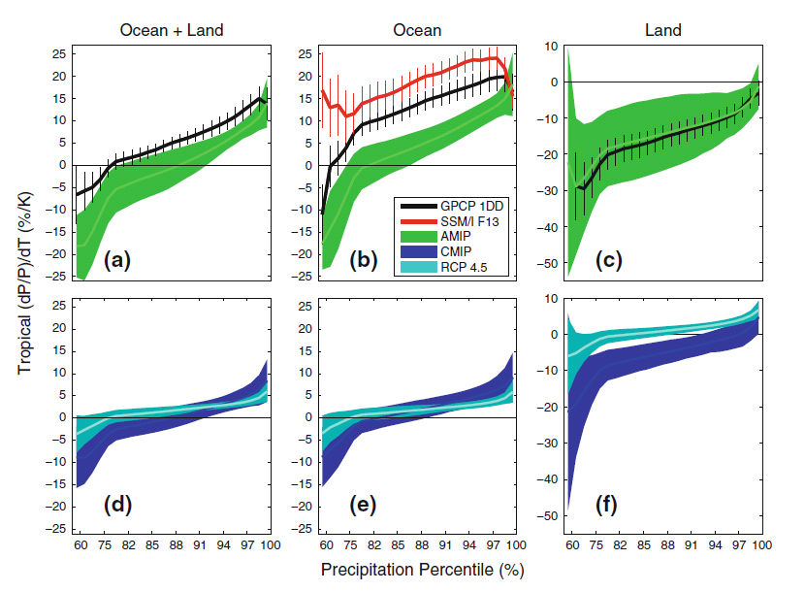
Changing precipitation extremes
Allan et al. (2014) Surv. Geophys
②
dP/dT (%) Tropics
①
③
1998-2008
5-day means (observations and simulations)
① More positve dP/dT for heavier percentiles (observations & models)
② Observations have more positive sensitivity over the ocean
③ Mostly negative dP/dT for all percentiles over land due to less rainfall over land during El Niño when warmer tropical mean Temperatures
Notes:
5-day means.
More positve dP/dT for heavier percentiles (obs and models)
Higher observed sensitivity than models over ocean, good agreement over land.
Mostly negative dP/dT for all percentiles (apart from heaviest) over land. Partly due to less rainfall over land in El Nino when warmer tropical T
Coupled models: similar picture over ocean. Smaller sensitivity for highest percentiles under climate change since global increases in P with warming are muted by increasing CO2 levels.

Slide 13
Changing precipitation extremes
Allan et al. (2014) Surv. Geophys
①
RCP4.5
2080-2099 minus 1985-2005
amip
amip
dP/dT (%) Tropics
③
Historical 1985-2005
②
① Smaller dP/dT sensitivity for coupled simulations (historical vs amip)
② Smaller dP/dT sensitivity under climate change (historical vs rcp4.5) as dP/dT supressed by direct atmospheric heating from rising greenhouse gases
③ More positive dP/dT over land under climate change (rcp4.5 vs historical) as Temperature rises un-related to ENSO for climate change response
CONCLUSIONS: a. Amplification of precipitation extremes with climate warming
b. Interannual variability is not a good proxy for climate change over land
Notes:
5-day means.
More positve dP/dT for heavier percentiles (obs and models)
Higher observed sensitivity than models over ocean, good agreement over land.
Mostly negative dP/dT for all percentiles (apart from heaviest) over land. Partly due to less rainfall over land in El Nino when warmer tropical T
Coupled models: similar picture over ocean. Smaller sensitivity for highest percentiles under climate change since global increases in P with warming are muted by increasing CO2 levels.

Slide 14
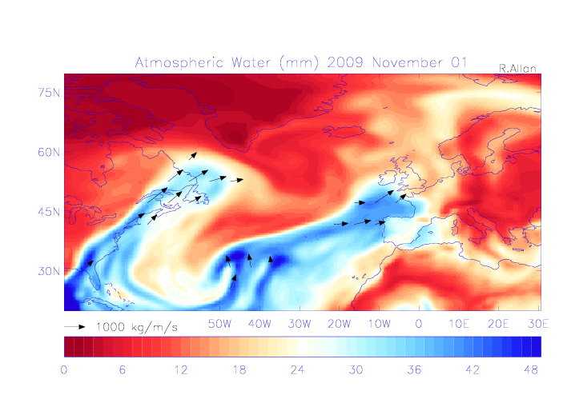
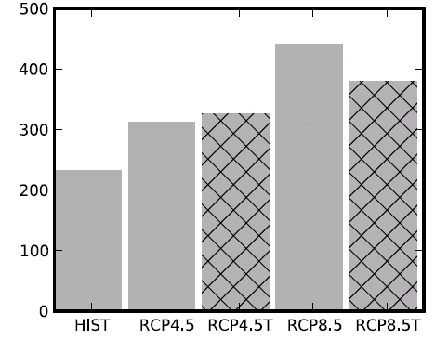
Water vapour and mid-latitude flooding
UK winter flooding linked to strong moisture transport events
  Cumbria November 2009 (Lavers et al. 2011 GRL)
  “Atmospheric Rivers” (ARs) in warm conveyor
  Lavers et al. (2013) ERL
Future increase in moisture explains most (but not all) of intensification of AR events
  Confident in the mechanisms and physics involved
Number of ARs
NorESM1-M

Slide 15
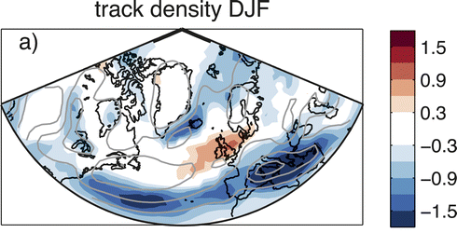
Projected changes in storms
Fewer storms over Mediterranean and Iceland.
UK: Little signal.
Robust signal: more extreme precipitation from all storms.
Zappa et al. 2013 J. Clim.
Changes in storm frequency (2070-2100 minus 1980-2005) from CMIP5 high-range emissions scenario.
Notes:
Changes in number of cyclones per month per unit area

Slide 16
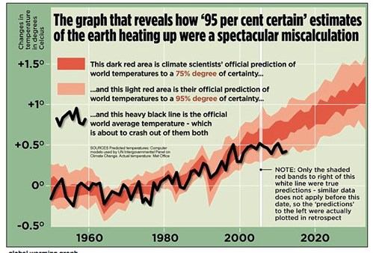
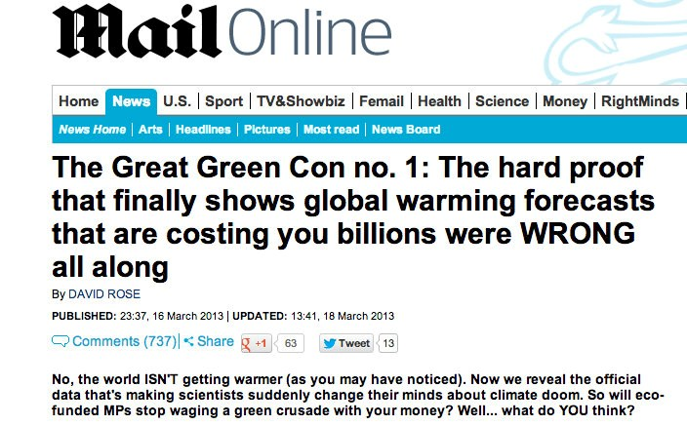
Has global warming stopped?
Mail on Sunday 16th March 2013

Slide 17
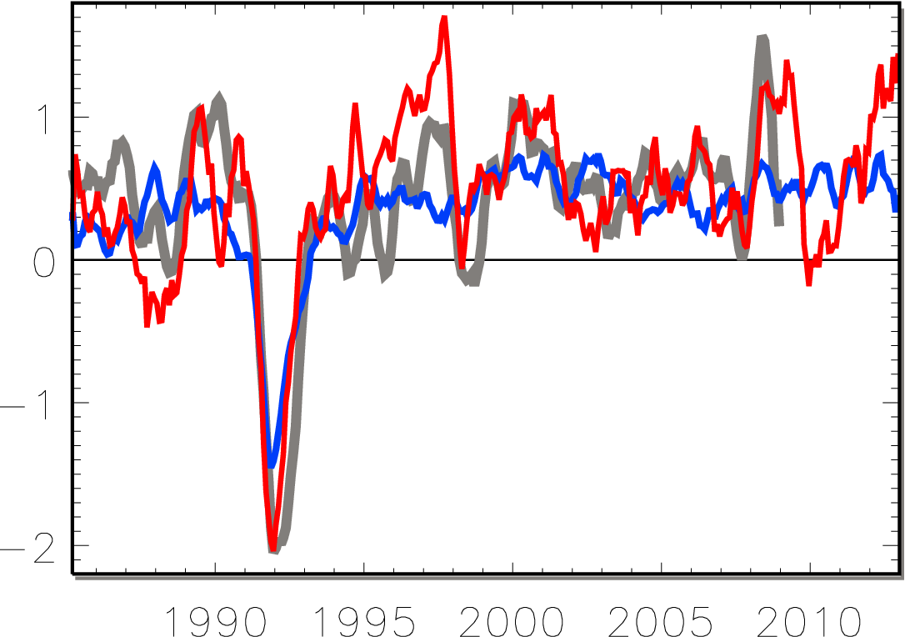
Earth continues to heat up
0.34±0.67 Wm⁻²
0.62±0.43 Wm⁻²
Allan et al. (2014) GRL
La Niña
Watts per square metre
heating cooling
El Niño
OBSERVATIONS
Volcano
CMIP5 SIMULATIONS
AMIP5 SIMULATIONS

Slide 18
Unforced variability in
Earth’s eneRgy budget
Diverse range of unforced variability in CMIP5 pre-industrial control simulations
Left: variations in total energy content of Earth’s climate system across CMIP5 simulations
Palmer & McNeall (2014) ERL

Slide 19
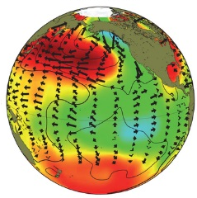
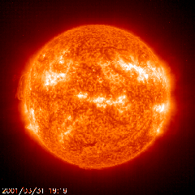
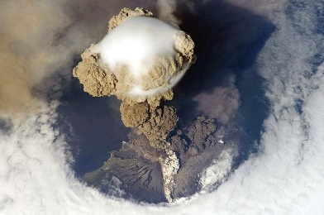
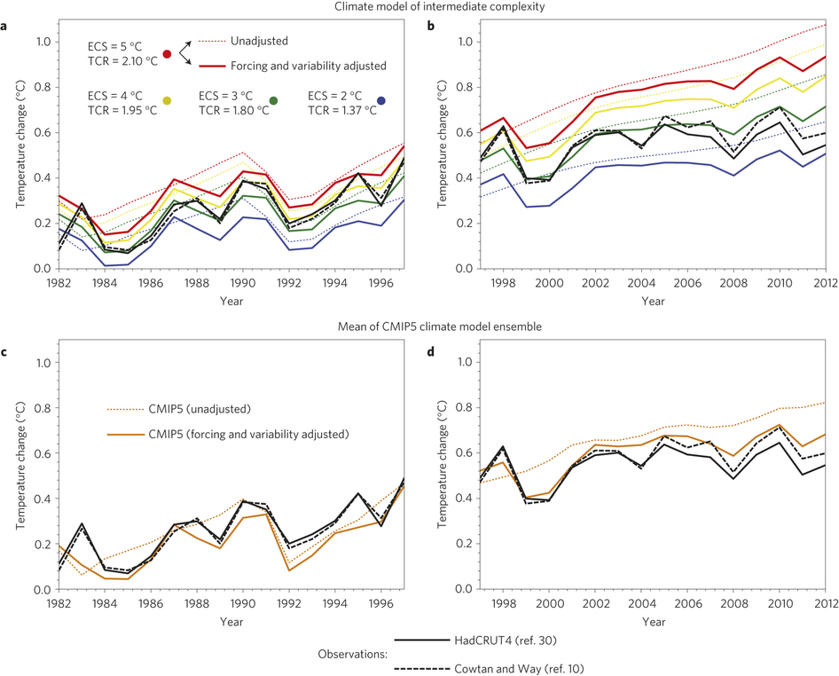
What explains the hiatus?
Declining solar forcing (e.g. Hansen et al. 2013 PLOSONE) , more small volcanos (e.g. Ridley et al. 2014 GRL) & more La Niñas/cold NH land in winter vs late 1990s appear to explain:
  Slowing in surface warming (e.g. Foster & Rahmstorf 2012)
  Slower surface warming compared with coupled simulations (e.g. Risbey et al. 2014 ; Huber & Knutti 2014)
Simulations
Adjusted Simulations
Observations
Huber & Knutti 2014

Slide 20
PAtHWAYS to POLICYMAKERS
IPCC
  Literature; Contributing and Lead authors
DECC/EA – face to face meetings/web-based info
Media
  Press briefings/media events (e.g. Science Media Centre)
  Planned or reactionary interaction
Public Engagement
  Stakeholder meetings (CWC program; Walker Institute Flooding conference)
  Schools events, local interest groups?

Slide 21
conclusions
The CMIP5 database offers a huge resource to support policy advice through climate research
  e.g. changing water cycle, global warming “hiatus”
Combining with a robust physical basis and verifying with observations is a vital step in providing useful advice
The IPCC is vital in collating, distilling and driving research that is policy relevant
Clearly the analysis of comprehensive climate models is only one component of providing sound policy-relevant advice

Slide 23
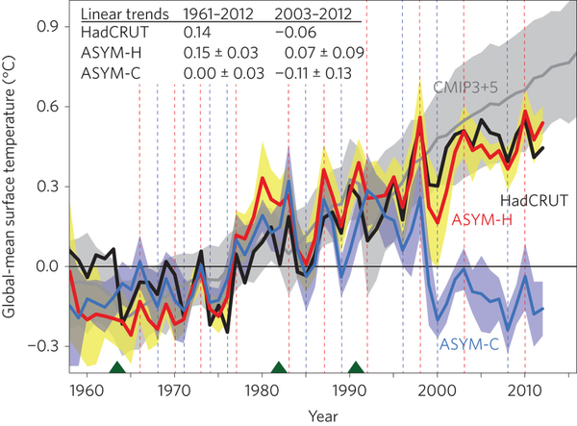
Role of Pacific Trade
Winds IN HIATUS
Watanabe et al. (2014) Nature Climate Change:
Prescribe observed changes in Pacific trade winds
Estimate Internal variability contributes ~+0.11-0.13ºC in 1980s/90s and -0.11ºC in 2000s
Is it all internal or is there a forced component?

Slide 24
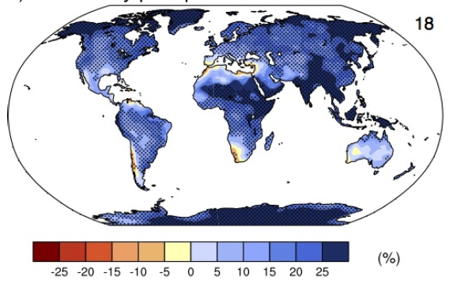
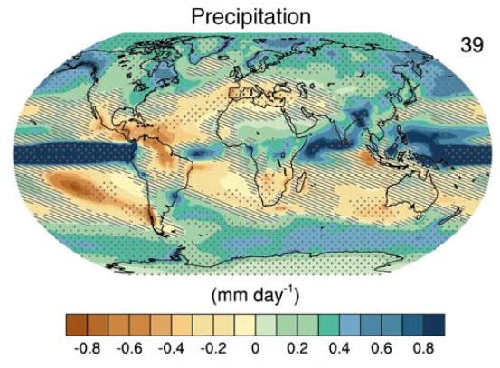
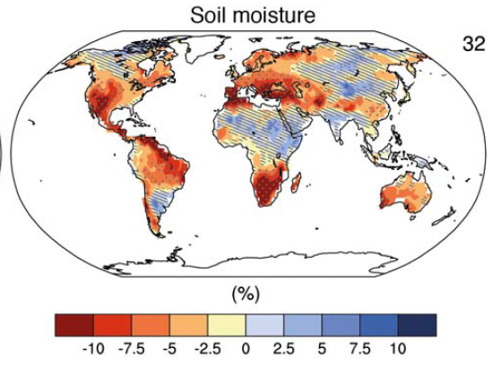
Global context: changing water cycle
Precipitation intensity
Increased Precipitation
More Intense Rainfall
More droughts
Wet regions get wetter, dry regions get drier?
Regional projections??
IPCC WGI (2013)
Notes:
PRECIPITATION: [Tech Summ Fig. 2]
RCP8.5 ANN: Multi-model CMIP5 average mm/day change.
Hatching: multi-model mean change is small (<1SD of internal variability)
Stippling: multi-model mean change is big (>2SD of internal variability and 90% of models agree on sign)
P INTENSITY:
Percent change in annual maximum 5-day precipitation 2081-2100 relative to 1981-2000 for RCP8.5 CMIP5 ensemble.
Fig. 12.26, Chapter 12.
Stippling → significant change
SOIL MOISTURE: [Tech Summ, Fig. 2]
RCP8.5 ANN change in %, Upper 10cm
Hatching: multi-model mean change is small (<1SD of internal variability)
Stippling: multi-model mean change is big (>2SD of internal variability and 90% of models agree on sign)

Slide 25
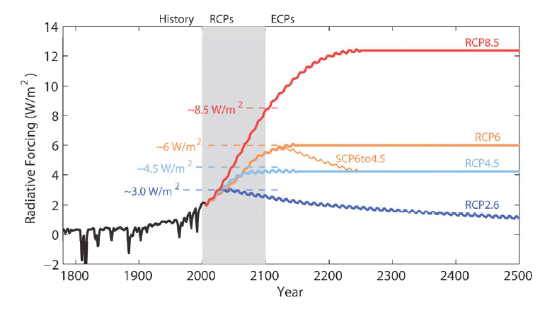
4. Experiments with Climate Models
IPCC (2013) Chapter 1 Box 1.1
Historical and Future scenarios
Notes:
See also IPCC (2013) Figure 1.15

Slide 26
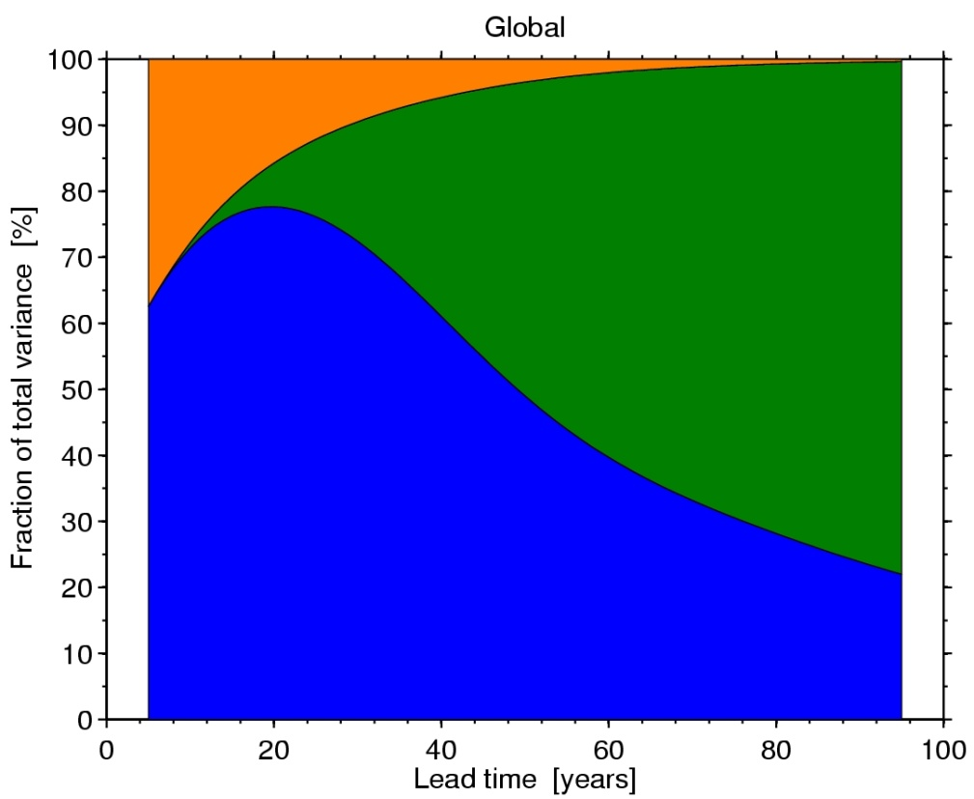
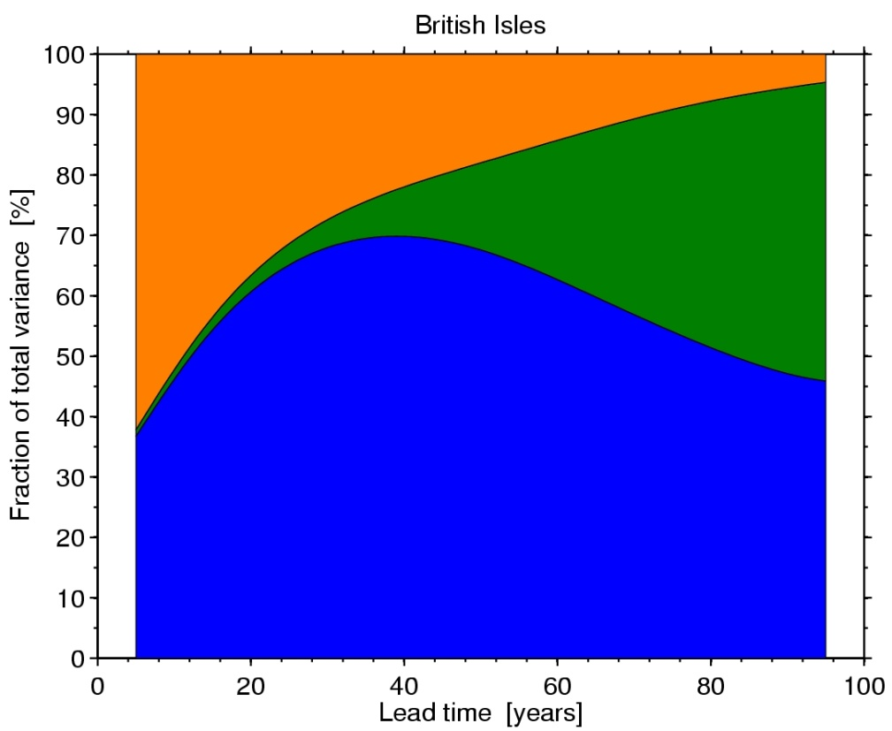
Predictability of Climate:
Surface air temperature
INTERNAL VARIABILITY
SCENARIO UNCERTAINTY
MODEL UNCERTAINTY
Global, decadal mean
British Isles, decadal mean
Ed Hawkins, NCAS Climate; see IPCC (2013) Fig. 11.8 & FAQ 1.1
Notes:
Uncertainty in decadal predictions is dominated by model uncertainty and internal variability on regional scales as well as on global scales.

Slide 27
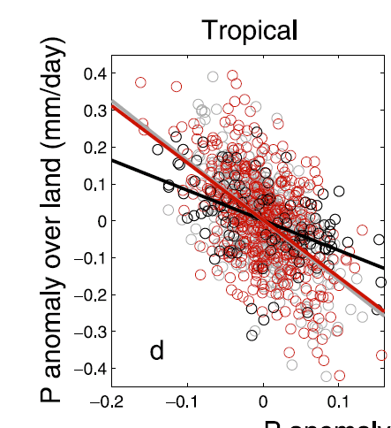
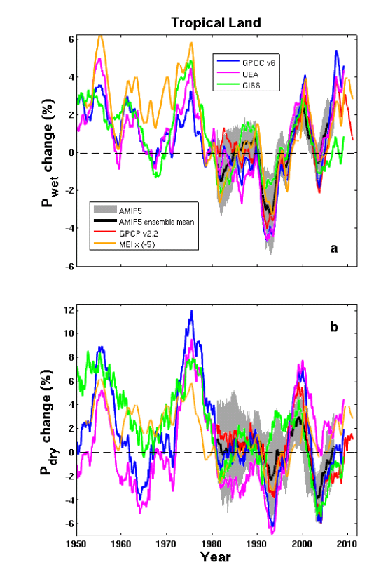
Interannual changes in precipitation over land
Interannual-decadal changes in continental rainfall dominated by: La Niña (more rain) & El Niño (less rain)
P anomaly over ocean (mm/day)
Land and ocean rainfall anti-correlated on interannual time-scale (above)
GISS AMIP
volcano
Liu, Allan, Huffman (2012) GRL
Liu & Allan (2013) ERL

Slide 28
Net Imbalance Anomaly (Wm⁻²)
Earth continues to heat up
Imbalance: 0.23 0.00 0.78 0.63 0.63 (Wm⁻²)
0.34±0.67 Wm⁻²
0.62±0.43 Wm⁻²
La Niña
El Niño
Volcano
Allan et al. (2014) GRL

