Slide 1
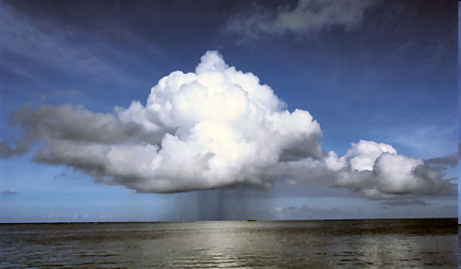
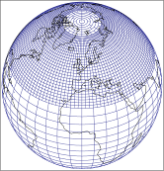
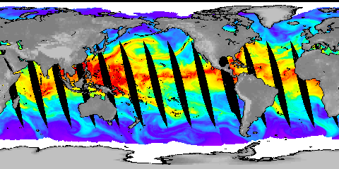


Evaluating changes in global precipitation and Earth’s radiation budget
Richard P. Allan @rpallanuk www.met.reading.ac.uk/~sgs02rpa
Thanks to Chunlei Liu and Norman Loeb (NASA Langley)
Work from PAGODA, PREPARE and DEEP-C NERC projects
Notes:
Projected Responses in Extreme Precipitation and Atmospheric Radiative Energy
Energetics response
Wet/dry responses
Intense rainfall
Transient responses

Slide 2
Motivations
Fundamental question:
  How much will the world warm this century, how will the global water cycle respond and what are the implications for society?
More specific questions:
  How and why are precipitation patterns changing?
  Why has global surface warming slowed?
Notes:
2
Intro stuff – current understanding of the nature and importance of the problem: the water cycle is changing and vulnerability is inevitable…
Model projections/intro
Water vapour
Intense rainfall events
Evaporation
Soil Moisture
Precipitation and extremes
Anticipated large-scale responses
Toward regional responses
Unanswered questions

Slide 3
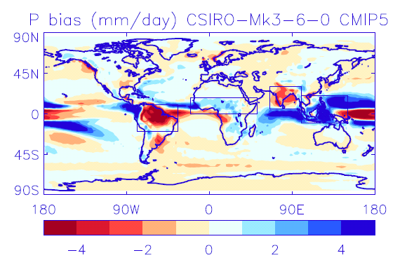
Precipitation bias & response
Positional errors?
Process errors?
Disagreement in sign of precipitation change

Slide 4
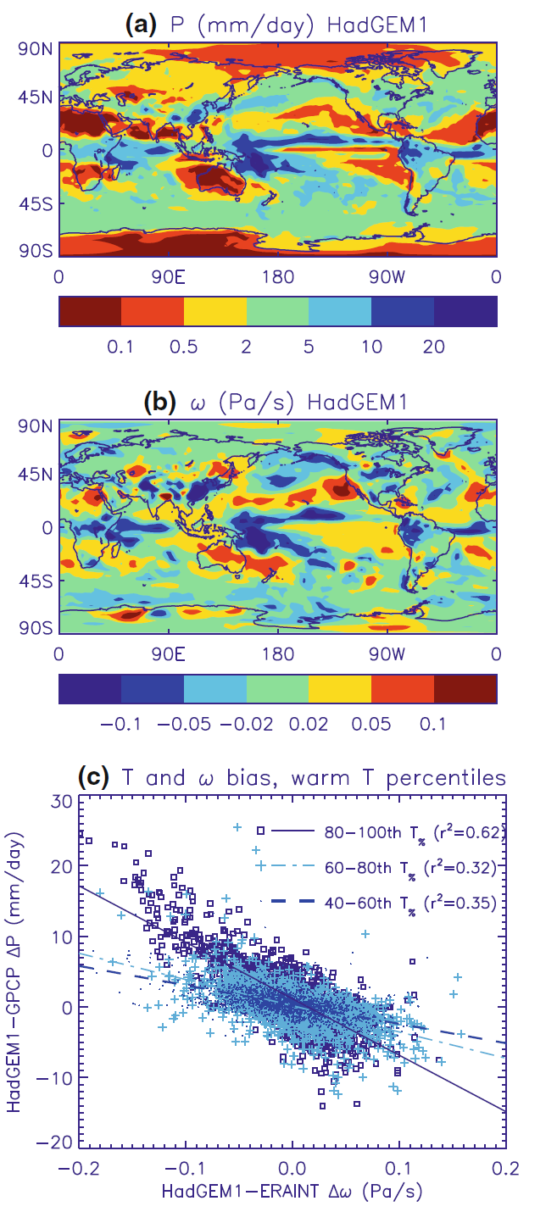
It’s the dynamics, stupid!
Most tropical precipitation where air is rising…
  500 hPa vertical motion commonly used diagnostic
  Strong association between model bias in precipitation and vertical motion (below)
  Thermodynamics also crucial

Slide 5
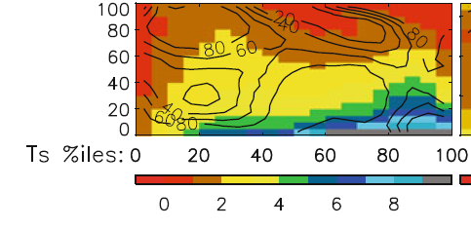
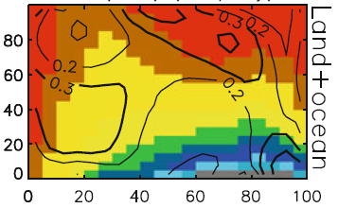
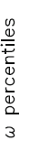

Precipitation composites
Subtropical, dry
Model ensemble mean GPCP observations
←Stronger ascent
Precipitation (mm/day)
Extra-tropical
Tropical moist
Composite precipitation by percentiles of vertical motion (strong decent to strong ascent) and temperature
Contour values enclose % of total area (left) or show percentage contribution of each composite box to total area (right)

Slide 6
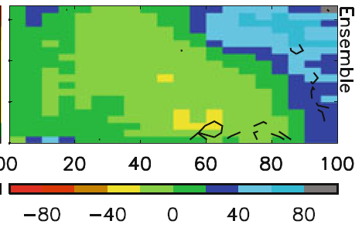
Precipitation bias and response by dynamical regime
Warmer surface temperature →
Model biases in warm, dry regime
Strong wet/dry fingerprint in model projections (below)
←Stronger ascent
←Stronger ascent
Allan (2012) Clim. Dyn.
Also: Liu & Allan (2013) ERL; Allan et al. (2014) Surv. Geophs.

Slide 7
Conclusions (1)
Method for consistently comparing model and observations using dynamical regimes
Large precipitation biases in subtropical dry regimes
Clear wet/dry tropical signal of climate change
Reduced Walker circulation offsets but does not cancel this thermodynamical signal
Sampling daily or sub-daily data required for better representing regimes and extremes

Slide 8
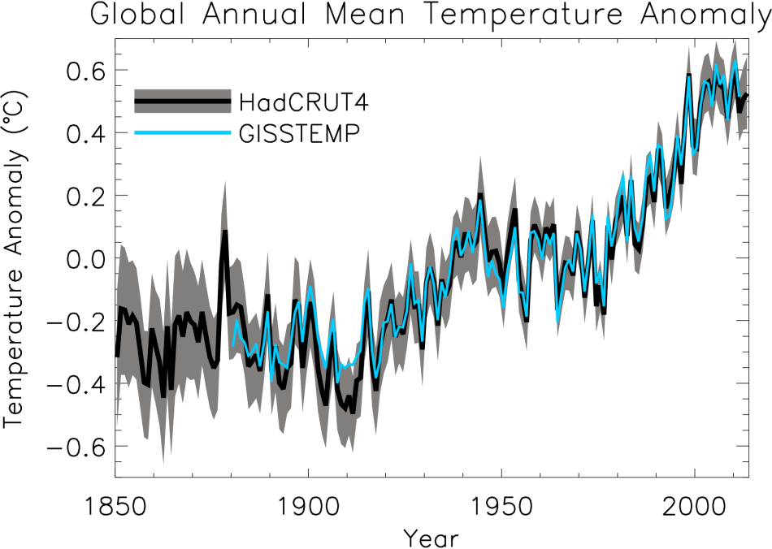
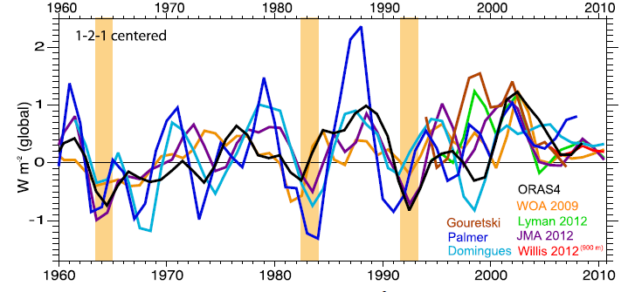
At what rate is Earth heating?
ºC Surface Temperature
Upper ocean (Wm⁻²)
Trenberth et al. (2014) J Clim

Slide 9
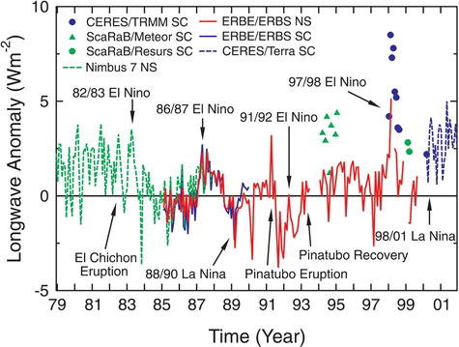
Earth Radiation Budget Satellite Data
20°N to 20°S
Wong et al. (2006) J Clim; Wielicki et al. (2002) Science

Slide 10
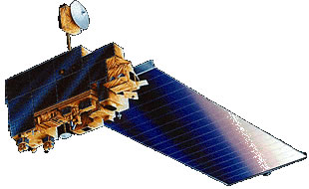
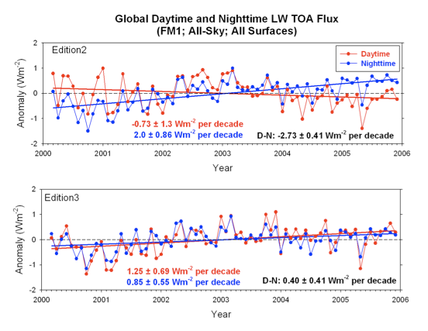
Updated CERES satellite data
Sampling, radiance to flux conversion, calibration contribute uncertainty
Correction for degradation of shortwave filter
Correction also improves physical consistency of trends in daytime longwave
We used version CERES_EBAF-TOA_Ed2.6r; currently v2.8

Slide 11
Combined CERES/Argo data
Incoming Solar: SORCE Level 3 V10
Reflected Shortwave/Outgoing Longwave from EBAF
  (v2.6r → v2.8 → V3…)
Added errors in quadrature to give ± 0.43 Wm⁻²
  Argo 0-2000m dOHCA/dt = 0.47 ± 0.38 Wm⁻² (2005-2010)
  >2000m ~ 0.07 ± 0.05 Wm⁻²
  Heating/melting ice, heating land/atmos ~ 0.04 ± 0.02 Wm⁻²
  CERES standard error ± 0.2 Wm⁻²
Jan 2001-Dec 2010: 0.50 ± 0.43 Wm⁻² (EBAF V2.6r)
  Changes in heating rate within uncertainty of ocean observations
  Loeb et al. (2012) Nature Geosci.
What about before 2000 (e.g. Wielicki et al. 2002 Science)?

Slide 12
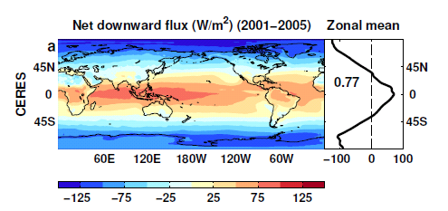
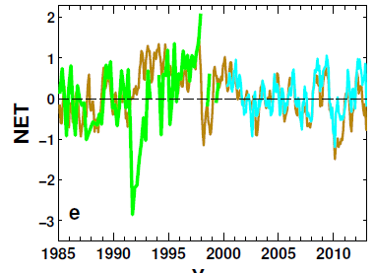
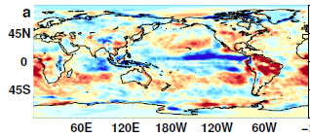
Reconstructing global radiative fluxes prior to 2000
ERBS/CERES variability
CERES monthly climatology
ERBS WFOV
CERES
ERA Interim
ERA Interim spatial anomalies
Combine CERES/ARGO accuracy, ERBS WFOV stability and reanalysis circulation patterns to reconstruct radiative fluxes

Slide 13
Use reanalyses or models to bridge gaps in record (1993 and 1999/2000)
Outgoing Longwave Radiation Anomalies (Wm⁻²)
ERA Interim trends suspect. Use model…
UPSCALE simulations (obs. SST, sea ice & realistic radiative forcings) “OBS”
Net less sensitive to method than OLR/ASR

Slide 14
Net Imbalance Anomaly (Wm⁻²)
Changes in imbalance in models & observations
Imbalance: 0.23 0.00 0.78 0.63 0.63 (Wm⁻²)
0.34±0.67 Wm⁻²
0.62±0.43 Wm⁻²
La Niña
El Niño
Volcano
Allan et al. (2014) GRL

Slide 15
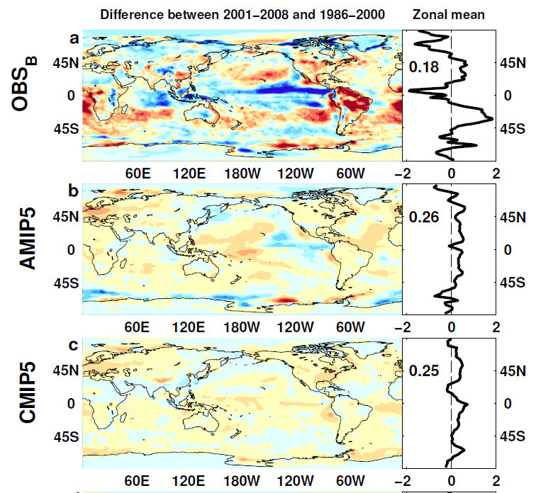

NET Radiation

Slide 16
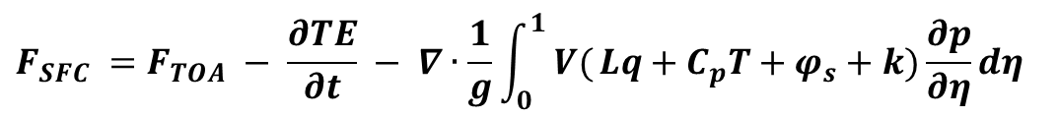
Future work: Estimates of Surface Flux
CERES/Argo Net Flux
Estimate horizontal energy flux
Surface Flux
$$F_{SFC} =F_{TOA} − \frac{∂TE}{∂t} − ∇∙\frac{1}{g}\int_{0}^{1}{ V(}Lq+C_{p}T+φ_{s}+k)\frac{∂p}{∂η}dη$$

Slide 17
Conclusions
Heating of Earth continues at rate of ~0.6 Wm⁻²
Current variability in TOA radiation (1985-2013)
Net radiative flux imbalance fairly stable
  Requires anchoring to ARGO ocean heating rate + minor terms
  Influence of Pinatubo and ENSO
  ~0.3 Wm⁻² higher in 1995-1999 than 2000-2013 period
Distinct East Pacific signal in ΔT and ΔN
Radiative forcing alone can’t explain surface warming slowdown: internal variability important
Next steps: combining with reanalyses energy transports to estimate surface fluxes

Slide 19

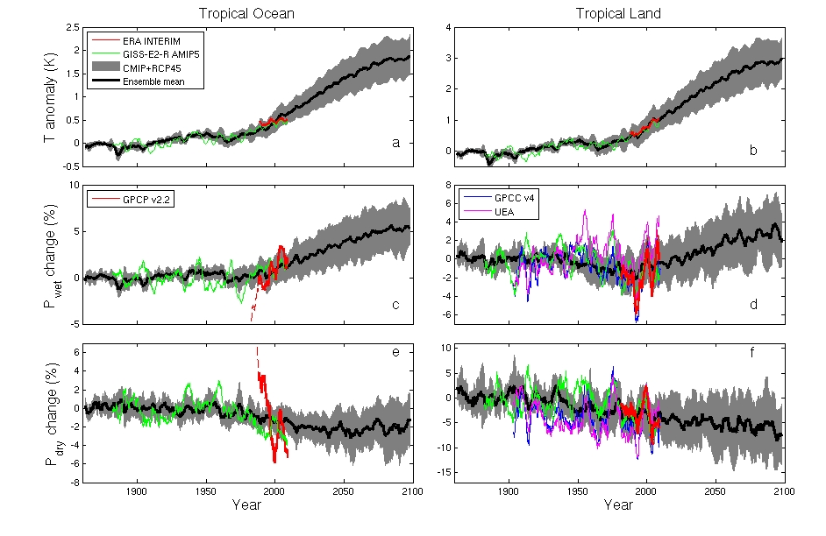
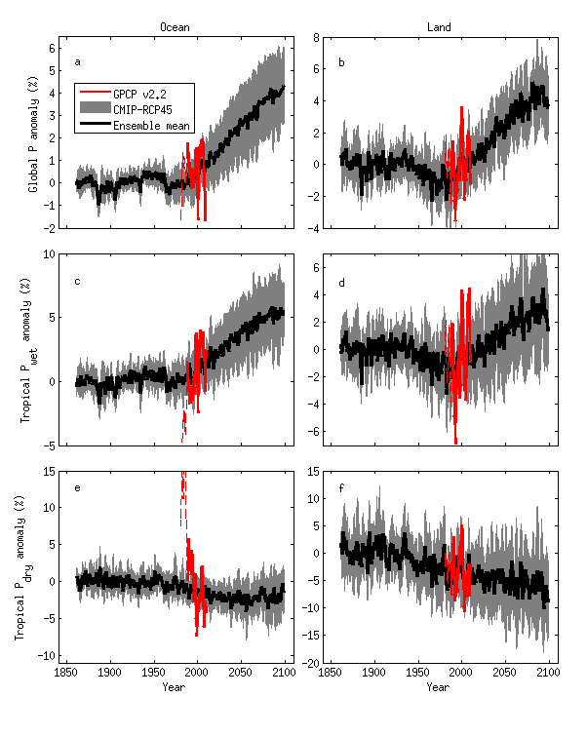

CMIP5 simulations: Wet regions get wetter, dry regions get drier
Ocean Land
Pre 1988 GPCP ocean data does not contain microwave data
Tropical dry Tropical wet
Robust drying of dry tropical land
30% wettest gridpoints vs 70% driest each month
Liu and Allan in prep; see also Allan et al. (2010) ERL.

Slide 20
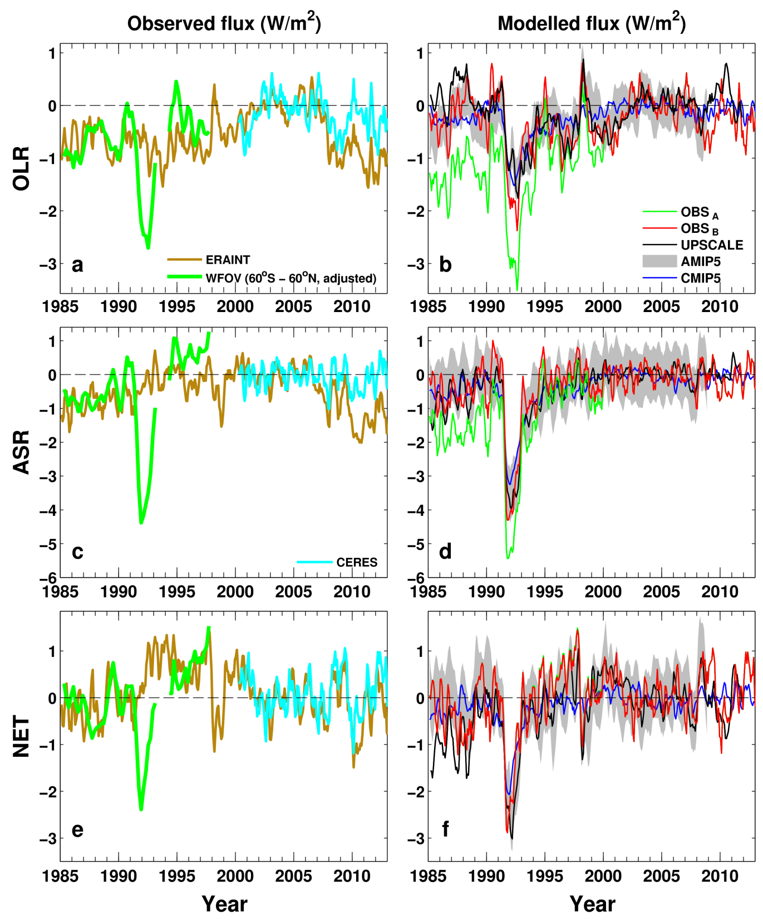
Changes in top of atmosphere radiative fluxes since 1985
Net Imbalance Anomaly (Wm⁻²)
Absorbed Solar (Wm⁻²) Outgoing Longwave
Chunlei Liu
Research in DEEP-C project at Reading…

