Slide 1
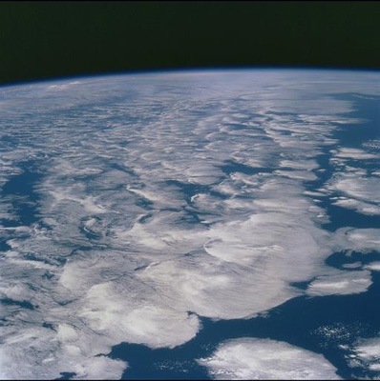




Additional CLIVAR meeting slides
Richard P. Allan – University of Reading
Notes:
This is the title slide, PowerPoint will automatically format the first slide with the title master, although this can be changed in the design palette.

Slide 2
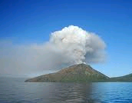
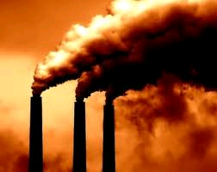
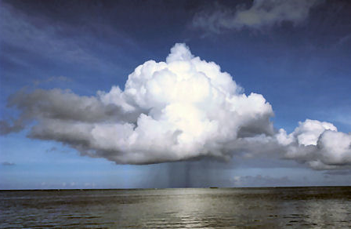
Radiative forcing or energy redistribution?
See also links to papers on DEEP-C website: www.met.reading.ac.uk/~sgs02rpa/research/DEEP-C.html
Radiative forcing?
  volcanic, solar, sulphate, stratospheric water vapour, Pinatubo overshoot
  Fyfe et al. (2013) GRL ; Murphy (2013) Nature Geosci ; Solomon et al. (2011) Science ; Kaufmann et al. (2011) PNAS ; Solomon et al. (2010) Science ; Murphy et al. (2009) JGR ; Solomon et al. (2011) Science ; Hansen et al. (2011) ACP .
Unforced variability?
  Cloud forcing/adjustment/feedbacks, El Niño, IPO/climate shift, ocean circulation
  Meehl et al. (2011) NCC; Meehl et al. (2013) J Clim; Watanabe et al. (2013) GRL; Palmer et al. (2010) GRL ; Guemas et al. (2013) NCC ; Katsman & van Oldenborgh (2011) GRL ; Balmaseda et_al._(2013)_GRL ; Foster and Rahmstorf (2011) ERL ; Loeb et al. (2012) Nature Geosci.; Chikamoto et al.(2012) GRL

Slide 3
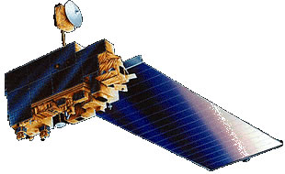
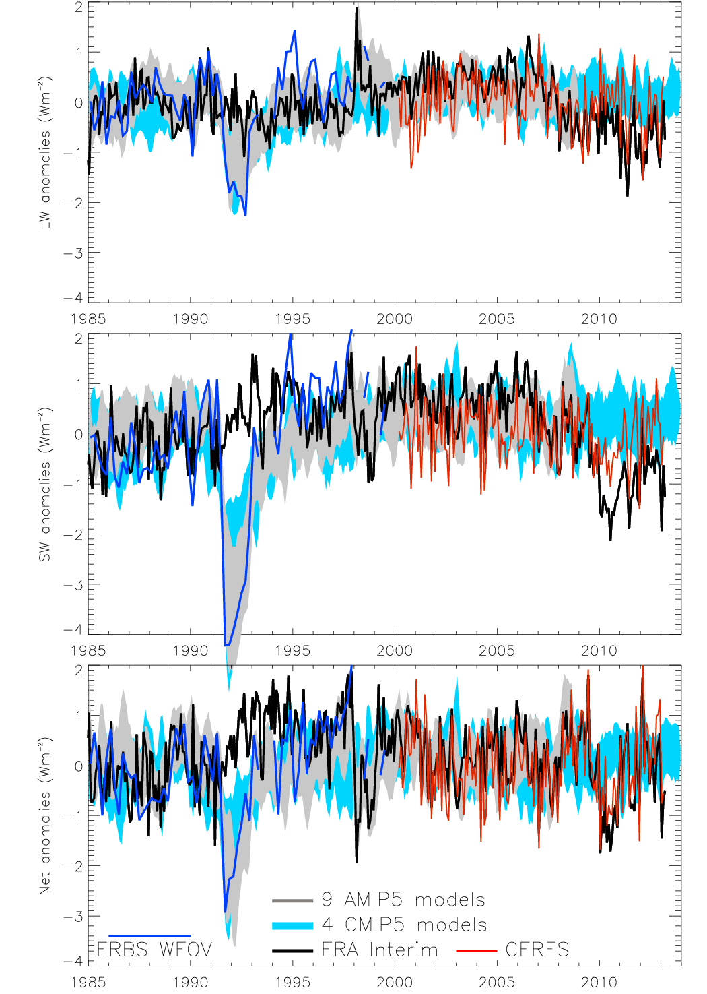
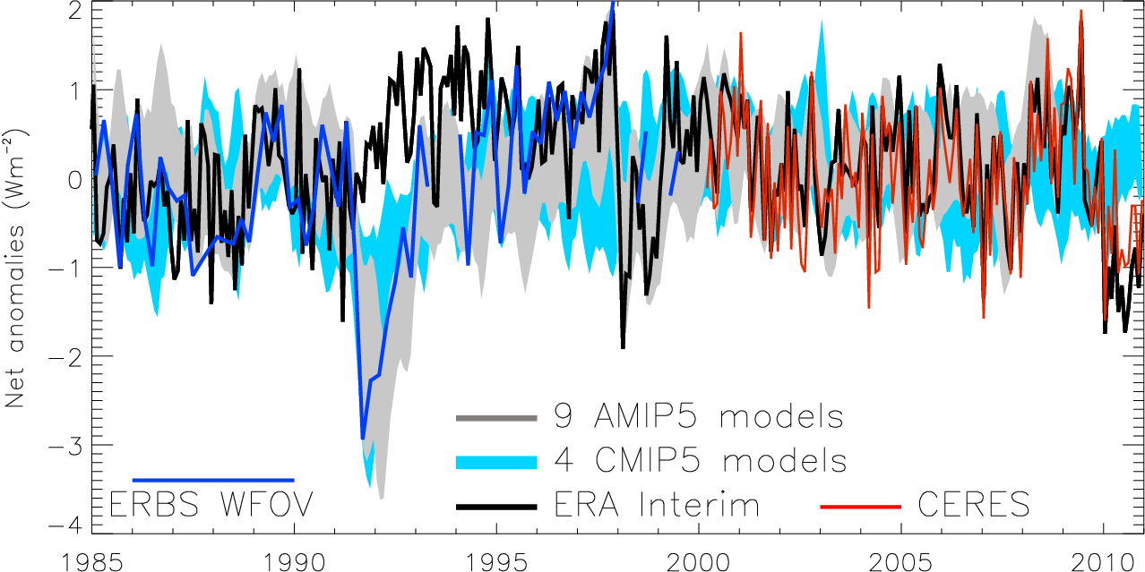
Variation in net radiation since 1985
Combining satellite data with reanalyses and models
60S-60N, after Allan (2011) Meteorol. Apps
See also Loeb et al. (2012); Wong et al. (2006)
Notes:
Deseasonalised monthly anomalies of net radiation (60ºS-60ºN) from satellite data (ERBS WFOV; CERES) and reanalysis simulations (ERA Interim) updated from Allan (2011) to include CMIP5 climate model simulations (AMIP 5 simulations from CNRM, NorESM1, HadGEM2 and INMCM4 in grey and combined historical and RCP4.5 scenario coupled simulations from CNRM, CanESM, HadGEM2-ES and INMCM4 in blue shading). CERES has been updated to EBAF2.7 and ERA Interim to 1985-2013.
Comments:
Monthly fluctuations in net flux capturred by CERES and ERA Interim.
The 1999-2000 gap in satellite data is a problem for the long term record.
Pinatubo, the 1997/98 El Nino and 2009/10 El Nino were significant in removing energy from the system
AMIP simulations are able to capture this variability adequately.

Slide 4

Additional thoughts & perspectives (Richard Allan)
Previously highlighted “missing energy” explained by ocean heat content uncertainty combined with inappropriate net radiation satellite products
Heating of Earth continues ~0.6 Wm⁻²; Negative radiative forcing does not appear to contribute strongly e.g._Hansen et al. (2011) ACP; Loeb et al. (2012) Nat Geosci
  Energy continues to accumulate below the ocean surface-below 300m/700m/tropics? Balmaseda et_al._(2013)_GRL; Guemas et al. (2013) Nature Climate Change
  MECHANISMS: where is the energy going and what process?
  Links to Interdecadal Pacific Oscillation… but what is this? e.g. Meehl et al. (2013) J Clim
  Links to recent Strengthening of Walker circulation? e.g. Merrifield (2011) J Clim; Sohn et al. (2011) Clim Dyn; L’Heureux et al. (2013) NCC; Chikamoto et al. (2012) GRL
  Implications for hydrological cycle: bigger land/sea temperature contrast, reduced relative humidity over land? Simmons et al. (2010) JGR; Cao et al. (2012) ERL
Can we extend satellite record back to 1985 by combining with reanalyses/models?
Can we improve estimates of surface flux variability by combining satellite data with reanalysis transports? e.g. Berrisford et al. (2011) QJRMS
Do minor energy storage terms contribute significantly to time-evolving heating rate?
Atmospheric reanalyses cannot simulate trends due to a changing observing system. Can we trust ocean reanalyses?

Slide 5
Extra slides

Slide 6
Variation in SW radiation since 1985
60S-60N, after Allan (2011) Meteorol. Apps
See also Loeb et al. (2012); Wong et al. (2006)
Notes:
Deseasonalised monthly anomalies of net radiation (60ºS-60ºN) from satellite data (ERBS WFOV; CERES) and reanalysis simulations (ERA Interim) updated from ref 6 to include CMIP5 climate model simulations (AMIP 5 simulations from CNRM, NorESM1, HadGEM2 and INMCM4 in grey and combined historical and RCP4.5 scenario coupled simulations from CNRM, CanESM, HadGEM2-ES and INMCM4 in blue shading). CERES has been updated to EBAF2.6 and ERA Interim to 1985-2010.

Slide 7
Variation in LW radiation since 1985
60S-60N, after Allan (2011) Meteorol. Apps
See also Loeb et al. (2012); Wong et al. (2006)
Notes:
Deseasonalised monthly anomalies of net radiation (60ºS-60ºN) from satellite data (ERBS WFOV; CERES) and reanalysis simulations (ERA Interim) updated from ref 6 to include CMIP5 climate model simulations (AMIP 5 simulations from CNRM, NorESM1, HadGEM2 and INMCM4 in grey and combined historical and RCP4.5 scenario coupled simulations from CNRM, CanESM, HadGEM2-ES and INMCM4 in blue shading). CERES has been updated to EBAF2.6 and ERA Interim to 1985-2010.

Slide 8
Are minor energy flux terms important in time evolution of heating rate?
Changes in atmospheric energy (ΔA) from ERA Interim (thin black)
Changes in energy required to melt Arctic ice (ΔI). I assumed that additional land ice melt and heating increased these changes by factor of 2.
Heating of the land surface (ΔL) from ERA Interim (brown)
I adjusted the sum so that the average equalled the 0.07+0.04 Wm⁻² minor heating terms assumed in Loeb et al. (thick black line) which included the deep ocean (ΔD) term.

Slide 9
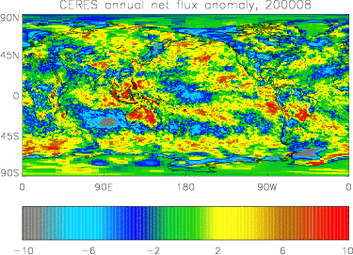
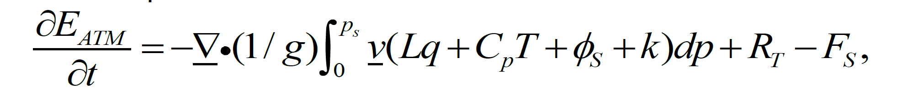
Improved estimates of surface fluxes?
Can we improve 2D estimate of surface fluxes by combining ERA Interim transports and CERES TOA fluxes?
e.g. Berrisford et al. (2011) QJRMS

Slide 10
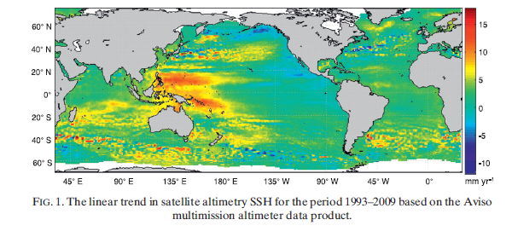
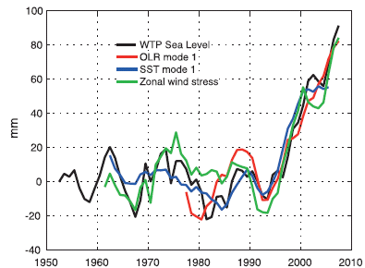
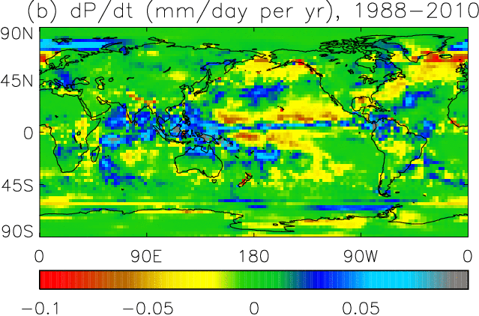
Links to recent changes in atmospheric circulation & precipitation?
Wind-driven changes in sea surface height Merrifield 2011 J Clim
Is stronger Walker circulation connected with enhanced ocean mixing and changes in precipitation 1990-2000s?
Sohn et al. (2013) Climate Dyn:
  Chikamoto et al. (2012) GRL: Merrifield (2011) J Climate: L’Heureux et al. (2013) NCC

Slide 11
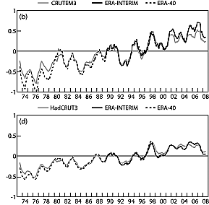
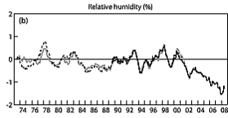
Implications for global water cycle?
Land T
global T
Stalling of ocean surface temperatures in 2000s
Continued warming of land
Changes in land-sea temperature contrast?
Reduced relative humidity over land?
Land RH
Simmons et al. (2010) JGR →
See also Cao et al. (2012) ERL

Slide 12
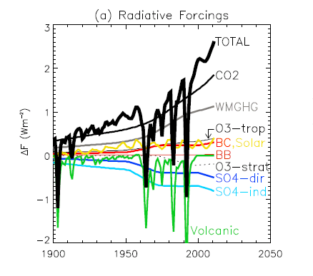
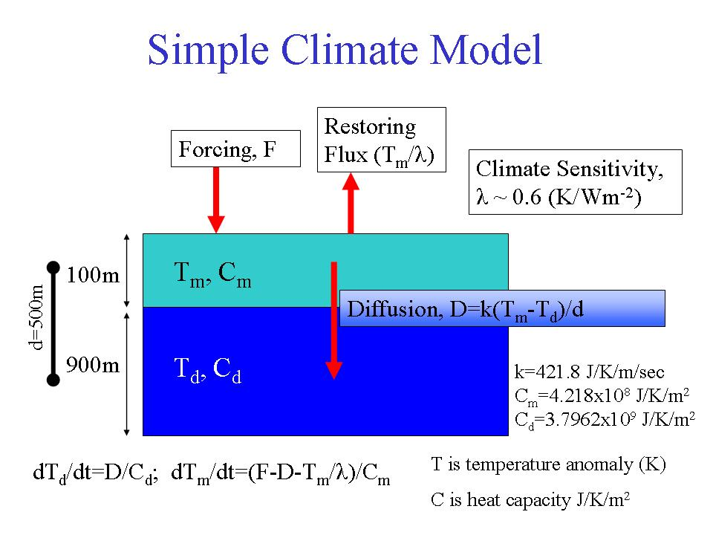
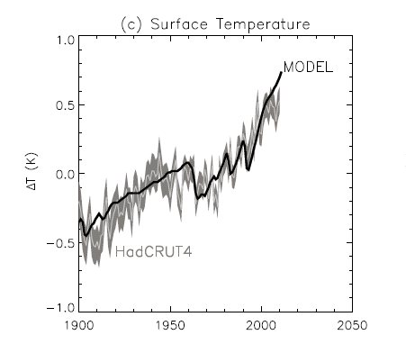
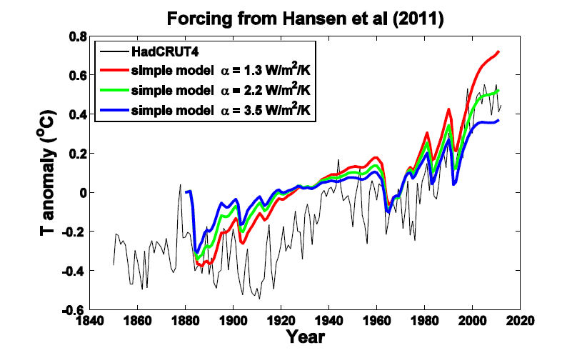
Energy balance model
Chunlei Liu
Allan et al. (2013) Surv. Geophys.

Slide 13
Some slides introducing NERC DEEP-C project

Slide 14
DEEP-C project structure
WP1 Reading
Atmosphere obs
R. Allan, C. Liu
WP2 NOCS
Ocean obs
E. McDonagh, B. King, +PDRA
WP4
Integration
Reading Co-Is:
T. Kuhlbrodt, J. Gregory
Climate modelling, ocean
Project Partners:
N. Loeb (NASA Langley) Satellite Radiation budget
K. Maskell (Walker Institute, Reading)
C. Sear (DECC)
WP3 Met Office
Climate Modelling
M. Palmer, C. Roberts
Additional partners:
Reading, NOCS, Met Office & UK community
PROJECT WEBSITE: http://www.met.reading.ac.uk/~sgs02rpa/research/DEEP-C.html

Slide 15
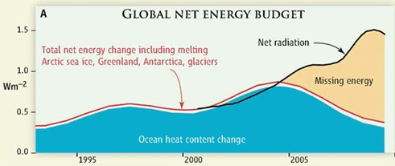

Motivation (1) Missing energy?
Trenberth and Fasullo (2010, Science) highlighted an apparent large discrepancy between net radiation and ocean heat content changes
H1 – “Missing Energy” in the climate system is explained by deficiencies in the observing system and can be resolved through improved combination and analysis of updated satellite and in situ measurements and modelling

Slide 16
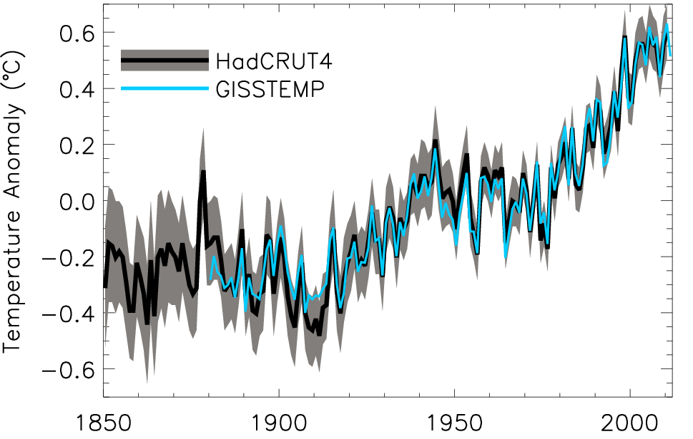
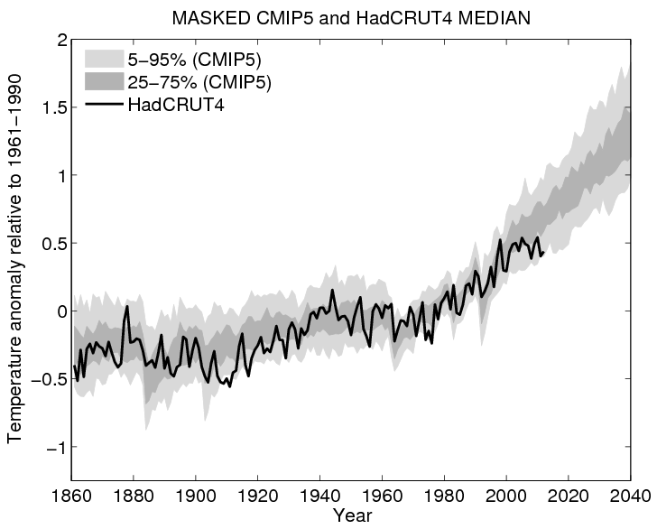
Motivation (2) What has caused the decline in rate of global surface warming?
Plot by Ed Hawkins
H2 – The recent slow rates of surface warming (the so-called warming hiatus) are primarily due to an enhanced transport of heat to the deep ocean caused by natural variability in ocean circulation with changes in external forcing playing a secondary role.
Global annual average temperature anomalies relative to 1951–1980 mean (shading denotes lower and upper 95% uncertainty range for HadCRUT4)

Slide 17
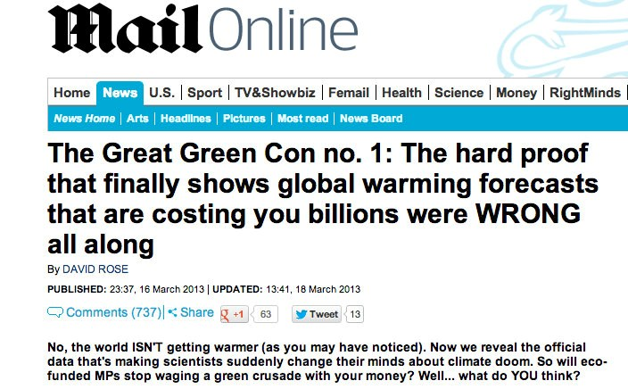
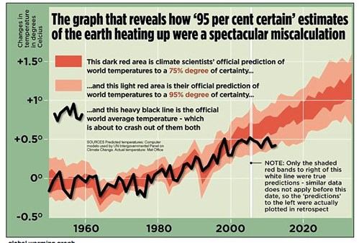
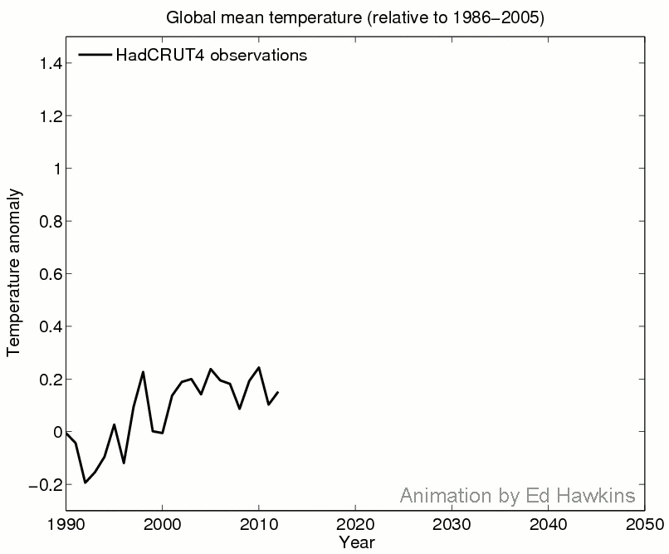

Public understanding of climate change
Ed Hawkins’ ClimateLabBook

