Slide 1
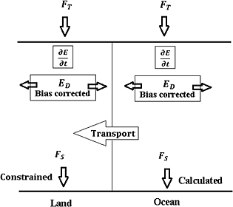
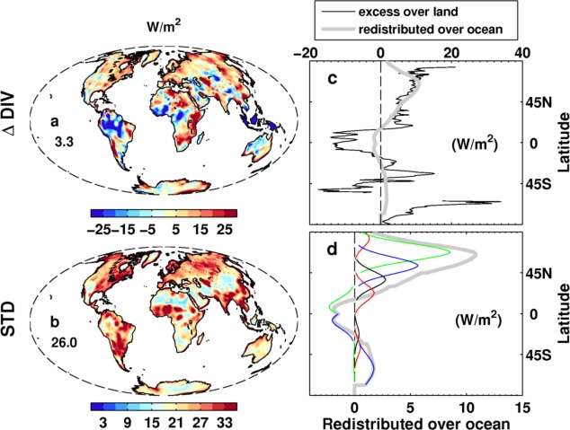
DEEP-C surface energy flux product (Richard Allan, Chunlei Liu, University of Reading)
CERES/ERBS
Combine satellite-based top of atmosphere radiation budget (Allan et al. 2014 GRL) with reanalysis energy transports (e.g. Berrisford et al. 2011) at each grid point.
Compute surface total energy flux as residual (e.g. Trenberth & Solomon 1994)
Method: Liu et al. (2015) JGR
reanalyses
Unrealistic energy flux over land – corrected using simple energy balance model (observed dTs, simulated heat capacity)
Redistribute adjusted energy flux over ocean (by hemisphere or latitude bands)

Slide 2
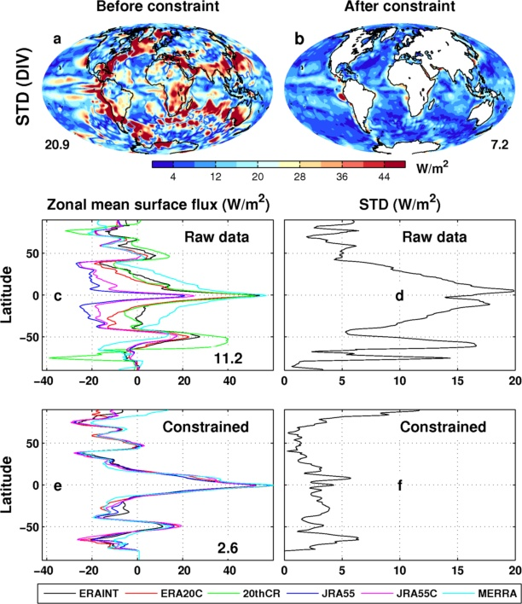
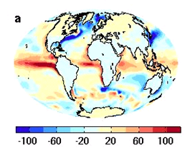
Evaluation of surface fluxes
Above: Surface flux climatology (Wm⁻²)
Right: Evaluation of reanalyses surface fluxes (top) & constrained reanalyses using Liu et al. (2015) method below→

Slide 3
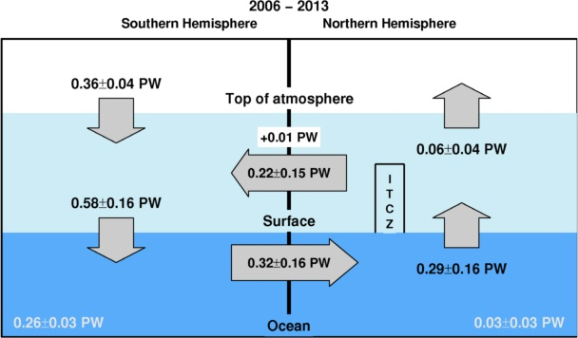
Future Plans
Evaluation of method/comparison with in situ observations
Regional changes in energy flux and links to hiatus & feedbacks on internal variability (SMURPHS project)
Investigation of southern ocean model bias in energy fluxes
Reconcile top of atmosphere radiation and 3D ocean heating distribution and associated mechanisms
Role of cloud and latent heat changes
Calculation of hemispheric energy imbalance & transports (Petawatt, right) – implied ocean transports seem low

