Slide 1
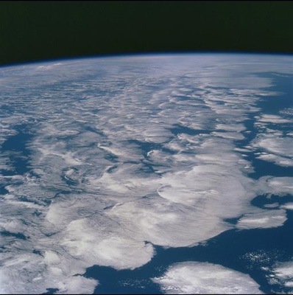
Heating of Earth's climate continues in the 2000s based upon satellite data and ocean observations
Richard P. Allan¹, N. Loeb², J. Lyman³, G. Johnson³
¹University of Reading (Department of Meteorology/NCAS Climate),
²NASA Langley, ³NOAA/PMEL
Also thanks to Brian Soden, Graeme Stephens and CERES group
Notes:
This is the title slide, PowerPoint will automatically format the first slide with the title master, although this can be changed in the design palette.

Slide 2
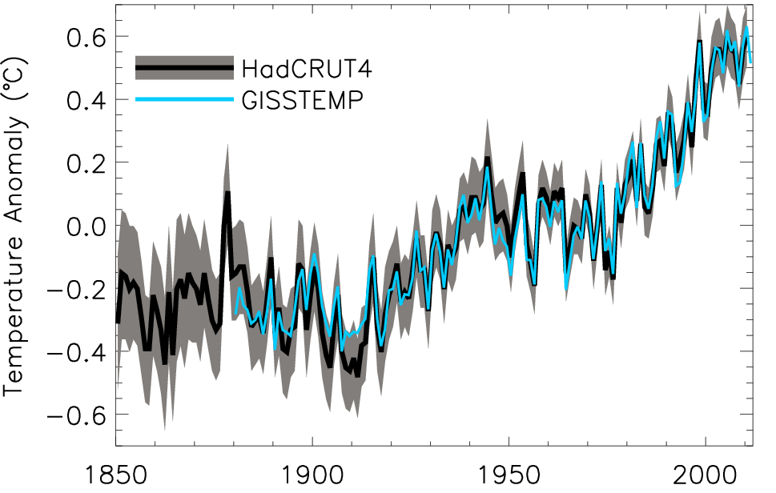
Decline in rate of surface warming?
Global annual average temperature anomalies relative to 1951–1980 mean (shading denotes lower and upper 95% uncertainty range for HadCRUT4)

Slide 3
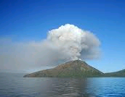
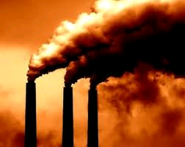
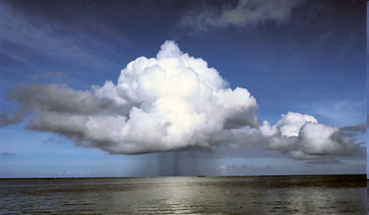
Radiative forcing or energy redistribution?
Small, persistent volcanic forcing?
  e.g. Solomon et al. (2011) Science
Sulphur emissions?
  e.g. Kaufmann et al. (2011) PNAS
Stratospheric water vapour?
  e.g. Solomon et al. (2010) Science
Cloud forcing/feedbacks & El Nino?
Ocean circulation e.g. Modelling studies:
  Meehl et al. (2011) Nature Climate Change , Palmer et al. (2010) GRL , Katsman and van Oldenborgh (2011) GRL

Slide 4
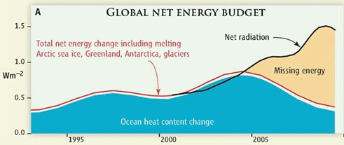
Missing energy?
Trenberth and Fasullo (2010, Science) highlighted an apparent large discrepancy between net radiation and ocean heat content changes
We undertook a reanalysis of the satellite and ocean record over the period 2000-2010…

Slide 5
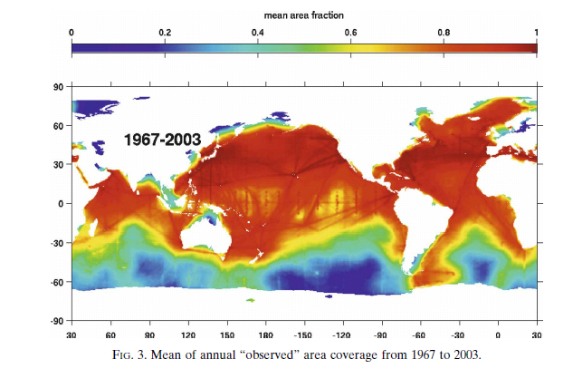
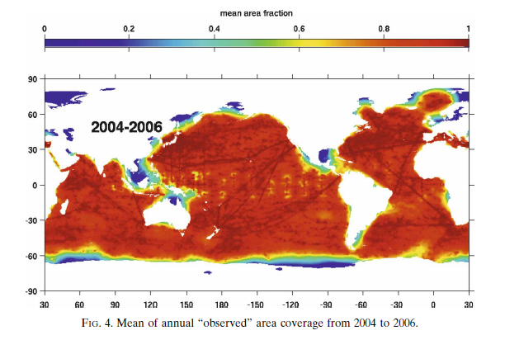
Ocean Heat Content data
Use weighted integral to account for changes in data coverage
Ensures transition to ARGO era does not introduce spurious variability
Integrate ocean heat content trend over time and divide by Earth’s surface area → Wm⁻²
Lyman & Johnson (2008) J Clim

Slide 6
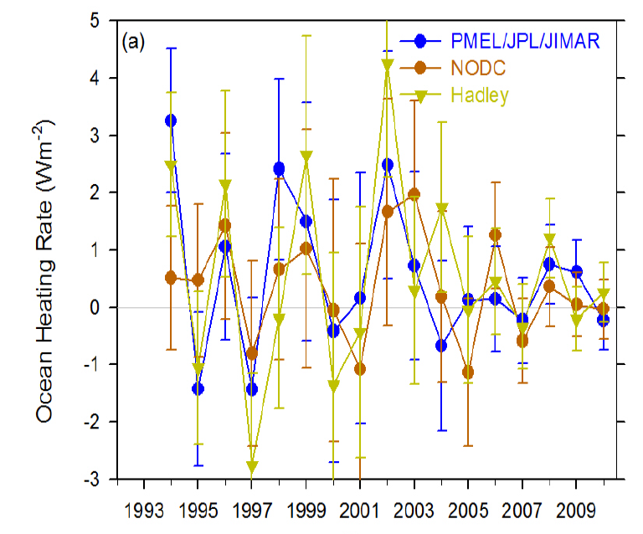
Ocean heat content data uncertainty
Accounting for considerable sampling/structural uncertainty we find no evidence for a robust decline in ocean heating rate since 2005
Loeb et al. (2012) Nat. Geosci.

Slide 7
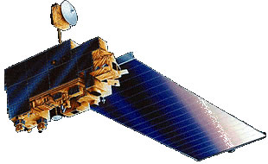
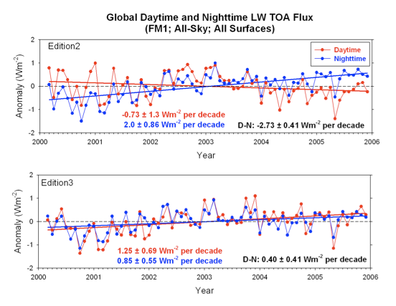
Updated CERES satellite data
Global Earth Radiation Balance
Correction for degradation of shortwave filter
Correction also improves physical consistency of trends in daytime longwave
We use version CERES_EBAF-TOA_Ed2.6r

Slide 8
Trends in net radiation
Errors in satellite sensors and inappropriate use of satellite products explain much of large rise in net radiative flux shown by Trenberth and Fasullo (2010)
global net radiation anomalies

Slide 9
Combining Earth Radiation Budget and Ocean Heat Content data
Tie 10-year CERES record with SORCE TSI and ARGO-estimated heating rate 2005-2010
Best estimates for additional storage terms
Variability relating to ENSO reproduced by CERES and ERA Interim
Estimate of decade long net energy imbalance of 0.54±0.43 Wm^{–2}
Loeb et al. (2012) Nat. Geosci.
Notes:
Fi gure 3 (a) Global annual average net TOA flux from CERES observations and (b) ERA Interim reanalysis are anchored to an estimate of Earth’s heating rate for 2006–2010 ⁵ The Pacific Marine Environmental Laboratory/Jet Propulsion Laboratory/Joint Institute for Marine and Atmospheric Research (PMEL/JPL/JIMAR) ocean heating rate estimates⁴ use data from Argo and World Ocean Database 2009; uncertainties for upper ocean heating rates are given at one-standard error derived from sampling uncertainties. The gray bar in (b) corresponds to one standard deviation about the 2001–2010 average net TOA flux of 15 CMIP3 models.

Slide 10
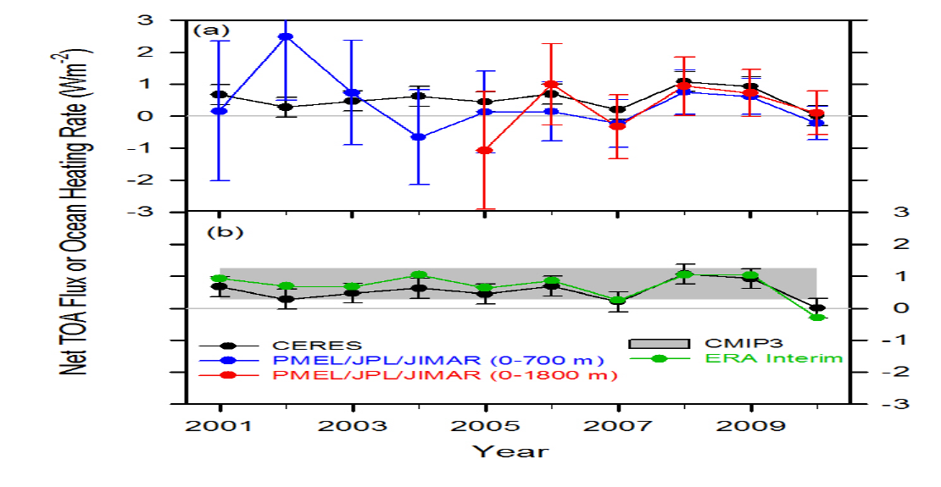
Combining Earth Radiation
Budget and Ocean Heat Content data
Replotted so that CERES and ERA Interim sample 6-months later than ARGO
Is there a lag in the system?
Where in ocean is energy accumulating?
Mechanism?
Notes:
Fi gure 3 (a) Global annual average net TOA flux from CERES observations and (b) ERA Interim reanalysis are anchored to an estimate of Earth’s heating rate for 2006–2010 ⁵ The Pacific Marine Environmental Laboratory/Jet Propulsion Laboratory/Joint Institute for Marine and Atmospheric Research (PMEL/JPL/JIMAR) ocean heating rate estimates⁴ use data from Argo and World Ocean Database 2009; uncertainties for upper ocean heating rates are given at one-standard error derived from sampling uncertainties. The gray bar in (b) corresponds to one standard deviation about the 2001–2010 average net TOA flux of 15 CMIP3 models.

Slide 11
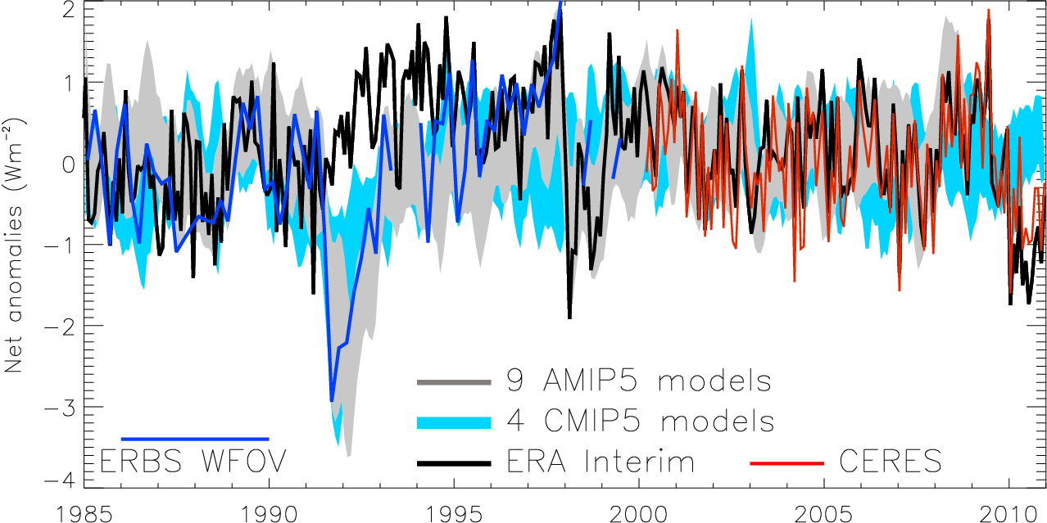
Variation in net radiation since 1985
60S-60N, after Allan (2011) Meteorol. Apps
Notes:
Deseasonalised monthly anomalies of net radiation (60ºS-60ºN) from satellite data (ERBS WFOV; CERES) and reanalysis simulations (ERA Interim) updated from ref 6 to include CMIP5 climate model simulations (AMIP 5 simulations from CNRM, NorESM1, HadGEM2 and INMCM4 in grey and combined historical and RCP4.5 scenario coupled simulations from CNRM, CanESM, HadGEM2-ES and INMCM4 in blue shading). CERES has been updated to EBAF2.6 and ERA Interim to 1985-2010.

Slide 12
Conclusions and Future work
Previously highlighted “missing energy” explained by ocean heat content uncertainty combined with inappropriate net radiation satellite products
Heating of Earth continues (~0.5 Wm⁻²)
  Negative radiative forcing does not appear to strongly contribute
Implications:
  Energy continues to accumulate below the ocean surface
  Strengthening of Walker circulation, e.g. Merrifield (2011) J Clim?
  See also poster A203 (CL2.10), Hall A Friday AM (Matthias Zahn)
  Implications for hydrological cycle, e.g. Simmons et al. (2010) JGR?
  See also poster A204 (CL2.10), Hall A Friday AM (Chunlei Liu)

