Slide 1
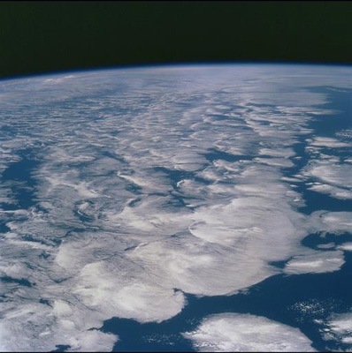

Earth's Radiation Budget & Current
Changes in the Global Water Cycle
Richard P. Allan, Chunlei Liu (University of Reading/NCAS Climate); Norman Loeb (NASA Langley); Matt Palmer (Met Office)
r.p.allan@reading.ac.uk @rpallanuk
AMS 14th Conference on Atmospheric Radiation
Tony Slingo Symposium 8th July 2014

Slide 2

Tony would have enjoyed & enriched the exciting, developing science linking Earth’s radiative energy budget, the global water cycle and climate change

Slide 3
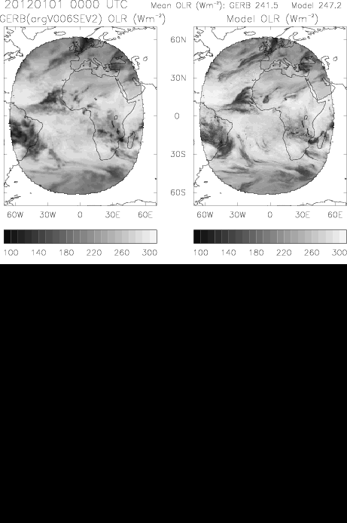
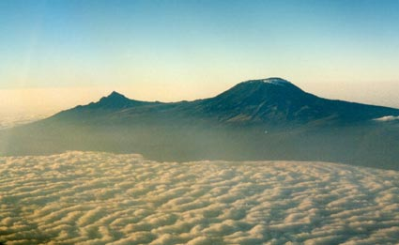
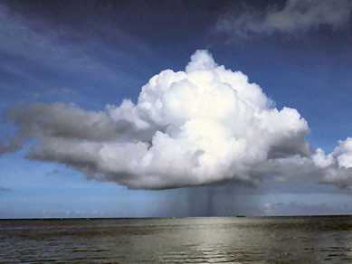
Earth’s Energy budget: a key variable…
Evaluation of weather and climate model processes
Radiative forcing/feedbacks and ocean heat uptake
Coupling of global energy and water cycle
N=ΔF–ΔT/λ
ΔT
D
Allan et al. (2007) QJRMS
Notes:
Sophisticated computer models have been developed by thousands of scientists over periods of decades that approximate the important components of the Earth’s environment. These models are used to forecast weather evolution and predict how changes in natural and man-made influences on the environment alter future climate.
The animation (click on “OLR Animation”) showed that weather forecast models are good at representing the large weather systems at middle latitudes but are not so good at resolving the convective processes in the tropics which are acting at smaller spatial scales than can easily be resolved in global models.

Slide 4

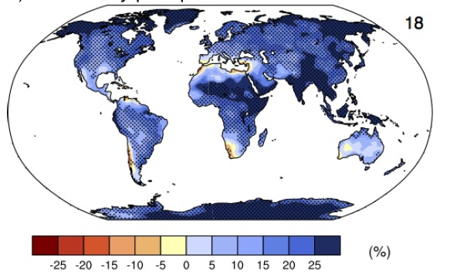
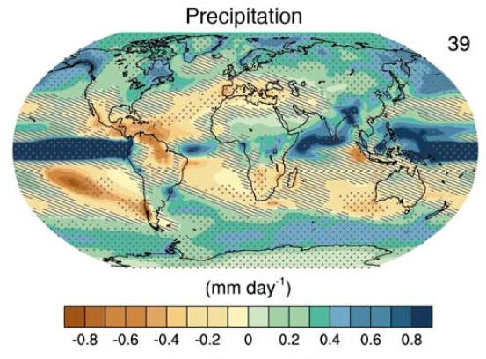
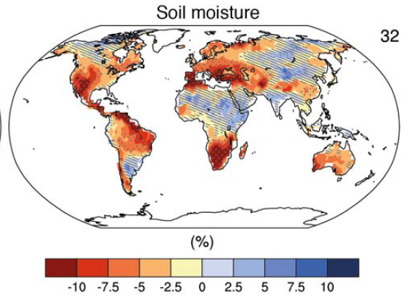
How will the water cycle change?
Precipitation intensity
Increased Precipitation
More Intense Rainfall
More droughts
Wet regions get wetter, dry regions get drier?
Regional projections??
e.g. Liu & Allan (2013) ERL
IPCC WGI (2013)
Notes:
PRECIPITATION: [Tech Summ Fig. 2]
RCP8.5 ANN: Multi-model CMIP5 average mm/day change.
Hatching: multi-model mean change is small (<1SD of internal variability)
Stippling: multi-model mean change is big (>2SD of internal variability and 90% of models agree on sign)
P INTENSITY:
Percent change in annual maximum 5-day precipitation 2081-2100 relative to 1981-2000 for RCP8.5 CMIP5 ensemble.
Fig. 12.26, Chapter 12.
Stippling → significant change
SOIL MOISTURE: [Tech Summ, Fig. 2]
RCP8.5 ANN change in %, Upper 10cm
Hatching: multi-model mean change is small (<1SD of internal variability)
Stippling: multi-model mean change is big (>2SD of internal variability and 90% of models agree on sign)

Slide 5
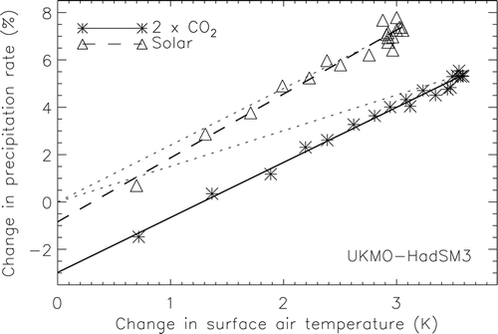
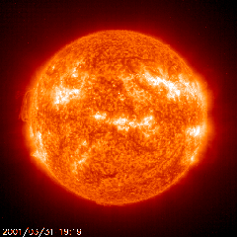
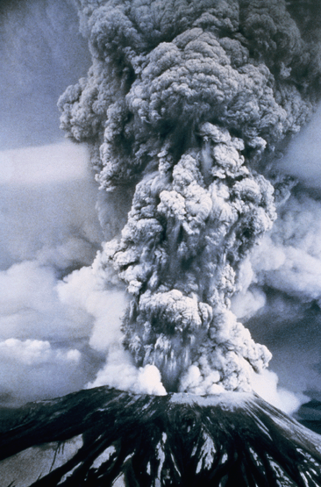
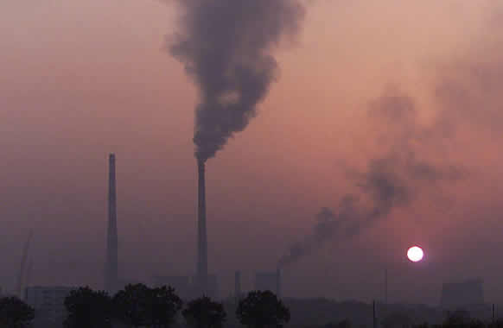
Improved understanding:
radiative forcing & global precipitation response
Andrews et al. (2009) J Climate
See also: Allen and Ingram (2002) Nature ; O’Gorman et al. (2012) Surv. Geophys ; Pendergrass & Hartmann (2012) GRL
Notes:
5

Slide 6
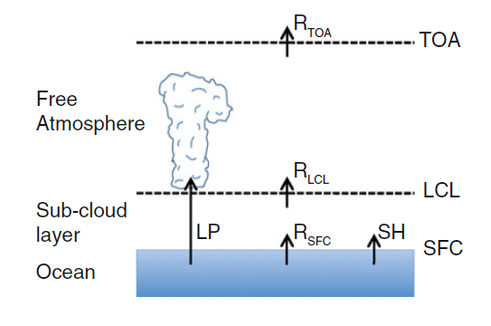
Radiative energy budget of the atmosphere and hydrological response
Adjustments in latent heating LP (precipitation) balance change in radiative energy budget ΔR above LCL (lifting condensation level)
ΔR below LCL → adjustments in SH (sensible heat flux) important e.g. Ming et al. (2010) GRL
O’Gorman et al. (2012) Surv. Geophys
After Takahashi (2009) JAS.
See also Manabe & Wetherald (1975) JAS

Slide 7
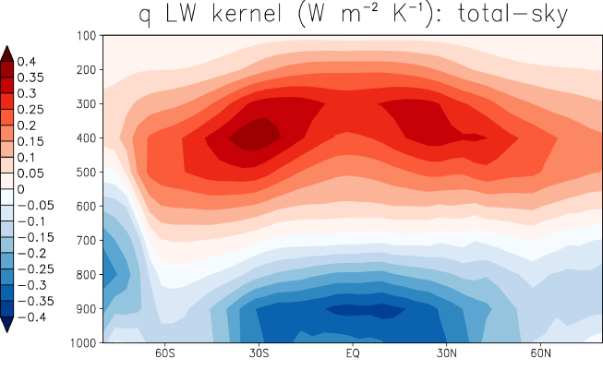
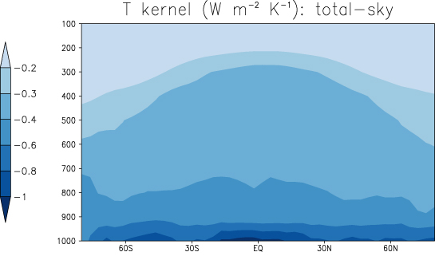
Radiative constraint on precipitation:
≈ 2 Wm⁻²K⁻¹
≈ 2-3%/K
Radiative kernals
Previdi (2010) ERL
O’Gorman et al. (2012) Surv. Geophys
Increased Precipitation

Slide 8
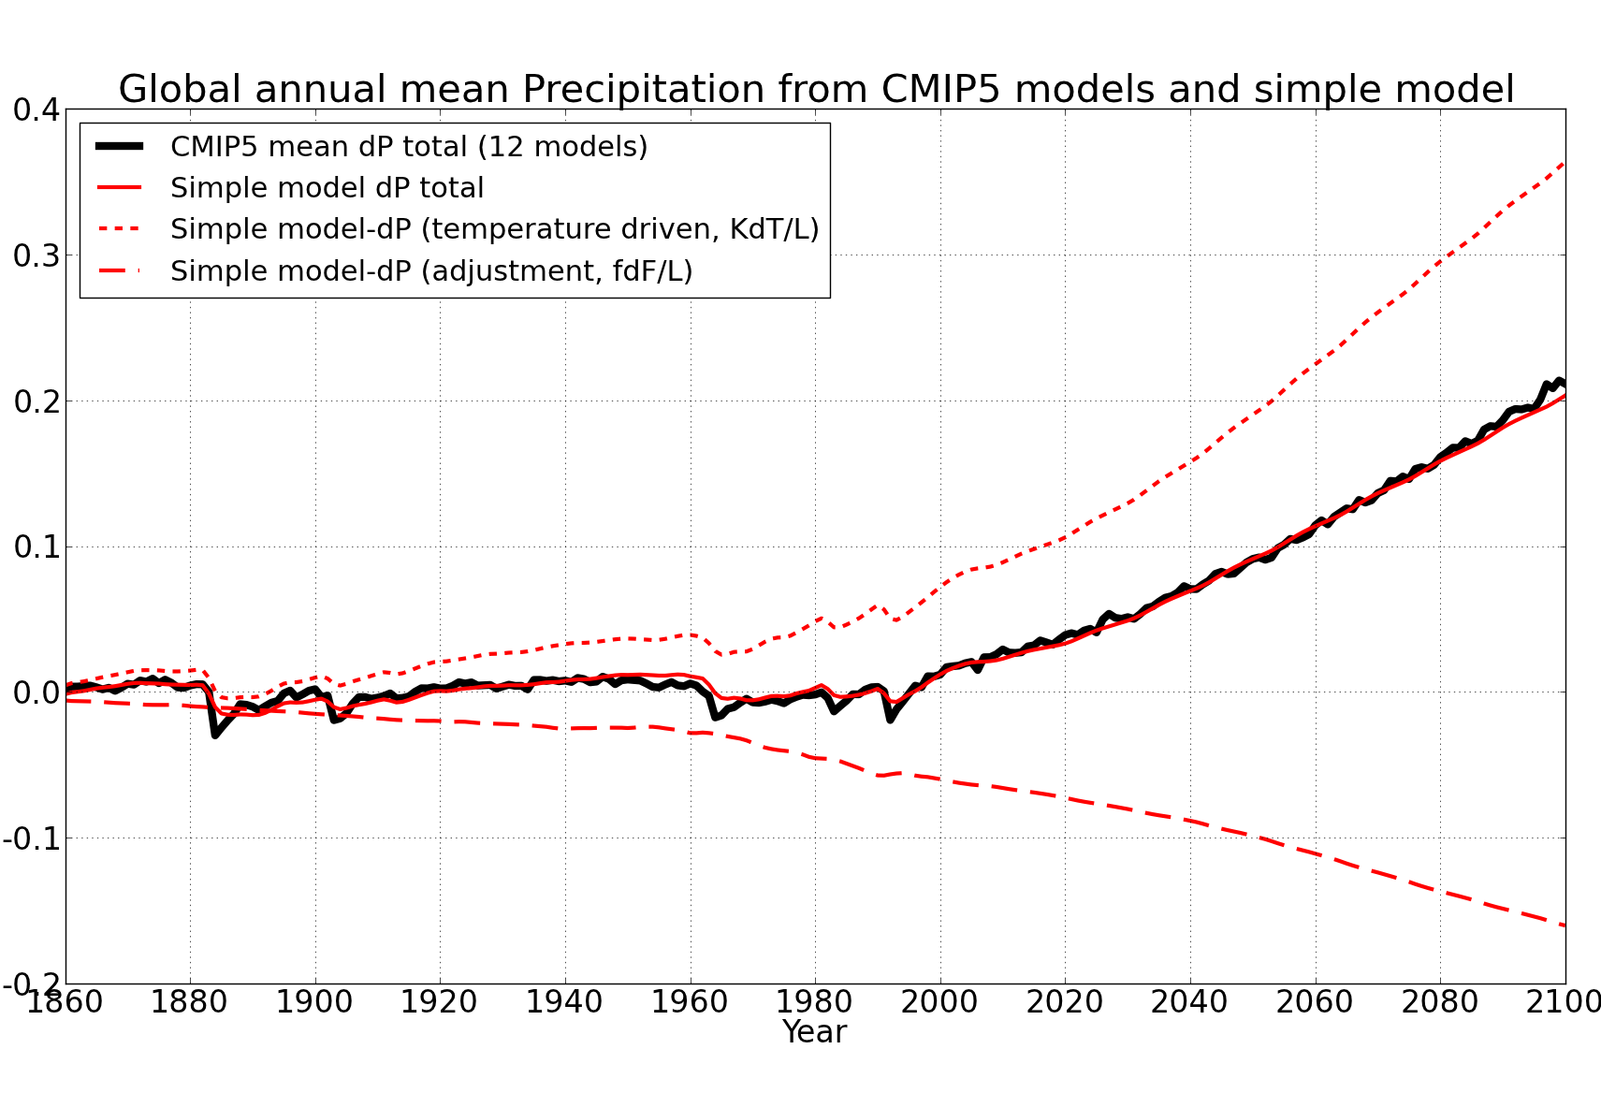
Simple model for global precipitation
N=ΔF–ΔT/λ
Using simple model: LΔP = kΔT – f_{F}ΔF
ΔT
D
Precipitation change (mm/day)
CMIP5 historical/RCP8.5
Zahra Mousavi (PhD project)
After Allan et al. (2013) Surv. Geophys and Thorpe and Andrews (2014) ERL
See also Andrews et al. (2010) ; Allen and Ingram (2002) ; Stephens and Ellis (2008)
Notes:
8
There is huge uncertainty in global precipitation projections, relating both to climate sensitivity and mitigation pathways.
In PAGODA we are understanding the precipitation changes at the largest scales relating both to the warming (in response to radiative forcings) and and also the direct effect of the radiative forcings themselves on precipitation.

Slide 9
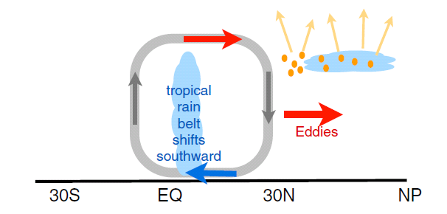
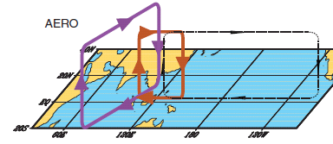
Interhemispheric heating and the water cycle
N Hemisphere Aerosol cooling 1950-1980s
Induces southward movement of ITCZ
Reduced Sahel rainfall →
Recovery after 1980s e.g. Wild 2012 BAMS
+Asymmetric volcanic forcing e.g. Haywood et al. (2013) Nature Climate
Enhanced energy transport
cooling
Hwang et al. (2013) GRL
Sulphate aerosol effects on Asian monsoon e.g. Bollasina et al. 2011 Science
Links to drought in Horn of Africa? Park et al. (2011) Clim Dyn

Slide 10
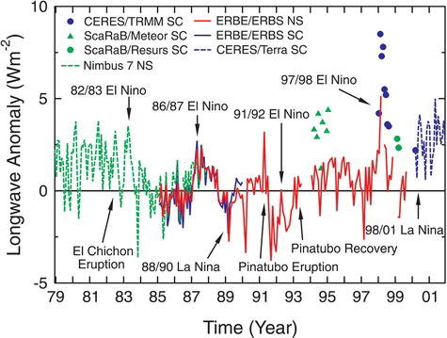
Changes in Earth’s radiative energy balance
20°N to 20°S
Wong et al. (2006) J Clim; Wielicki et al. (2002) Science

Slide 11
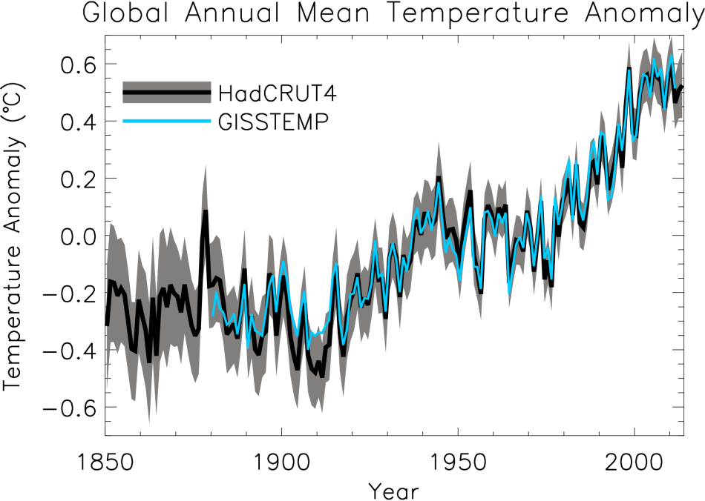
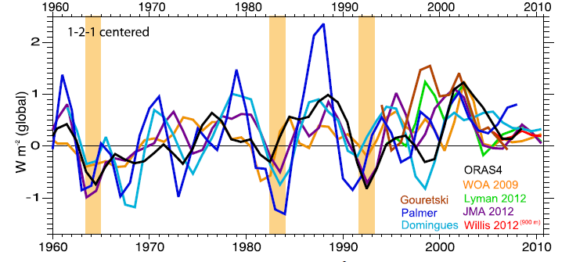
Estimating Earth’s rate of heating
ºC Surface Temperature
Upper ocean (Wm⁻²)
Trenberth et al. (2014) J Clim

Slide 12
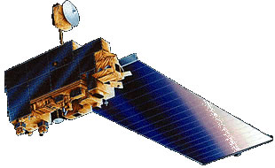
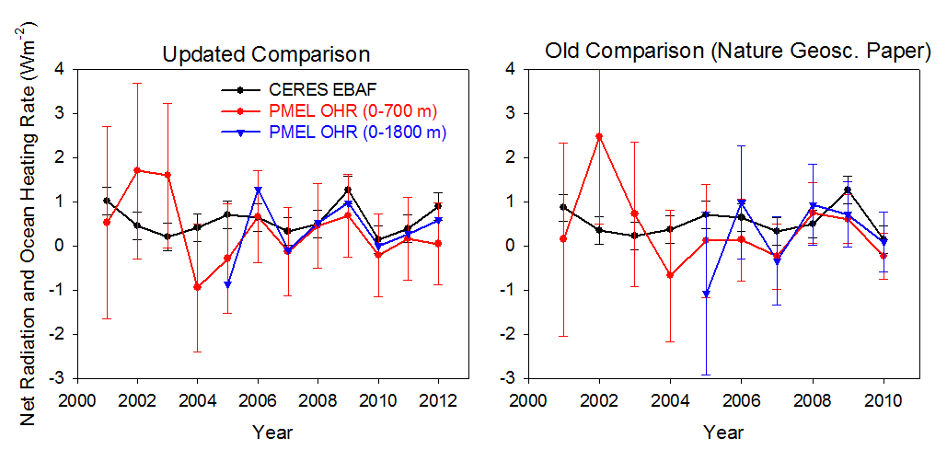
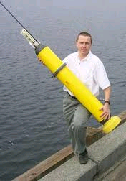
Combining Earth Radiation Budget data and Ocean Heat Content measurements
Tie 14-year CERES record with SORCE TSI and Argo-estimated heating rate 2005-10 & minor additional storage terms
Variability relating to ENSO reproduced by CERES and ERA Interim
What about before 2000?
Loeb et al. (2012) Nat. Geosci.
unpublished
Loeb et al. (2012) Nat. Geosci. See also Hansen et al. (2011) ACP; Stephens et al. (2012) Nat Geosci.; Wild et al. (2013) Clim. Dyn.
Notes:
Fi gure 3 (a) Global annual average net TOA flux from CERES observations and (b) ERA Interim reanalysis are anchored to an estimate of Earth’s heating rate for 2005–2010 ⁵ The Pacific Marine Environmental Laboratory/Jet Propulsion Laboratory/Joint Institute for Marine and Atmospheric Research (PMEL/JPL/JIMAR) ocean heating rate estimates⁴ use data from Argo and World Ocean Database 2009; uncertainties for upper ocean heating rates are given at one-standard error derived from sampling uncertainties. The gray bar in (b) corresponds to one standard deviation about the 2001–2010 average net TOA flux of 15 CMIP3 models.

Slide 13
Net Imbalance Anomaly (Wm⁻²)
Changes in imbalance in models & observations
Imbalance: 0.23 0.00 0.78 0.63 0.63 (Wm⁻²)
0.62 Wm⁻²
La Niña
El Niño
Volcano
Allan et al. (2014) in prep

Slide 14
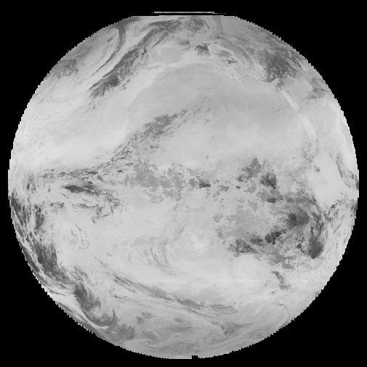
Conclusions
Heating of Earth continues at rate of ~0.6 Wm⁻²
  Variability from radiative forcings & ocean changes
Radiative transfer & Thermodynamics explain increased global precipitation with warming ≈ 2%/K
  Radiative forcings also affect water cycle responses
  Greenhouse gas & absorbing aerosol forcing supress global precipitation response to warming
Inter-hemispheric heating, moisture budget & unforced variability dictate regional responses
How has the “hiatus” affected water cycle?
How do changes in cloud/circulation fit in?
Where is energy going? NERC DEEP-C project…

Slide 16
Combined CERES/Argo data
Incoming Solar: SORCE Level 3 V10
Reflected Shortwave/Outgoing Longwave from EBAF
  (v2.6r → v2.8 → V3…)
Added errors in quadrature to give ± 0.43 Wm⁻²
  Argo 0-2000m dOHCA/dt = 0.47 ± 0.38 Wm⁻² (2005-2010)
  >2000m ~ 0.07 ± 0.05 Wm⁻²
  Heating/melting ice, heating land/atmos ~ 0.04 ± 0.02 Wm⁻²
  CERES standard error ± 0.2 Wm⁻²
Jan 2001-Dec 2010: 0.50 ± 0.43 Wm⁻² (EBAF V2.6r)
March 2000 – February 2013: 0.60 ± 0.43 Wm⁻² (EBAF V2.8)
CERES scanner data: cloud mask → clear-sky fluxes; not possible for ERBS wide-field of view

Slide 17


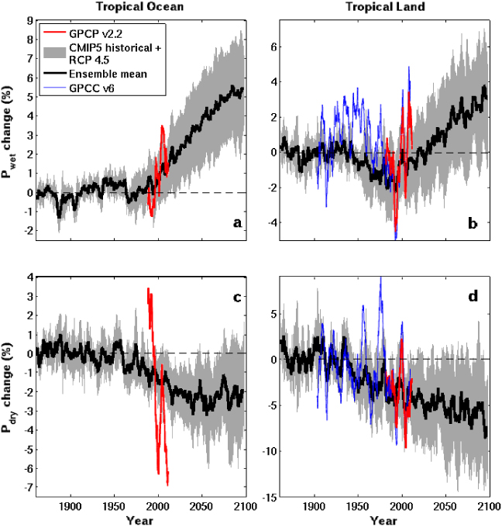

Energy and moisture budget: wettest tropical grid-points becoming wetter, driest grid-points drier
Ocean Land
Wet land: strong ENSO influence
GPCC GPCP
Pre 1988 GPCP observations over ocean don’t use microwave data
dry tropical region wet
Precipitation Change (%)
Tropical dry Tropical wet
Robust drying of dry tropical land
Liu & Allan (2013) ERL
30% wettest gridpoints vs 70% driest each month
See also: Chou et al. (2013) Nature Geosci; Chadwick et al. (2013) J Clim ; Allan (2012) Clim. Dyn.

Slide 18
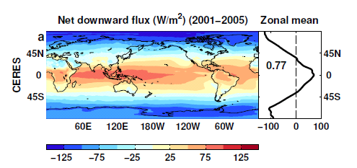
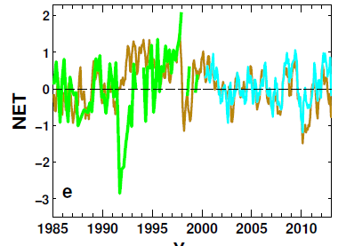
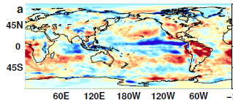
Reconstructing global radiative fluxes prior to 2000
ERBS/CERES variability
CERES monthly climatology
ERBS WFOV
CERES
ERA Interim
ERA Interim spatial anomalies
Combine CERES/ARGO accuracy, ERBS WFOV stability and reanalysis circulation patterns to reconstruct radiative fluxes

Slide 19
Use reanalyses or models to bridge gaps in record (1993 and 1999/2000)
Outgoing Longwave Radiation Anomalies (Wm⁻²)
ERA Interim trends suspect. Use model…
UPSCALE simulations (obs. SST, sea ice & realistic radiative forcings) “OBS”
Net less sensitive to method than OLR/ASR

Slide 20
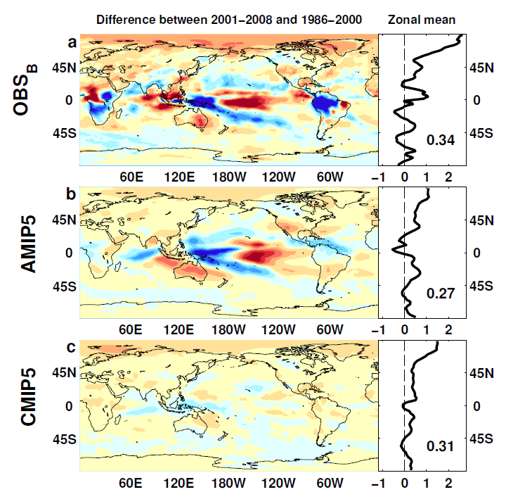

Outgoing Longwave Radiation
Wm⁻²

Slide 21
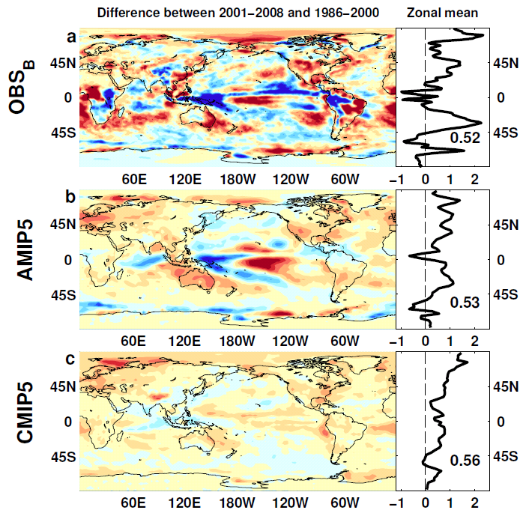
Absorbed Shortwave Radiation
Wm⁻²

Slide 22
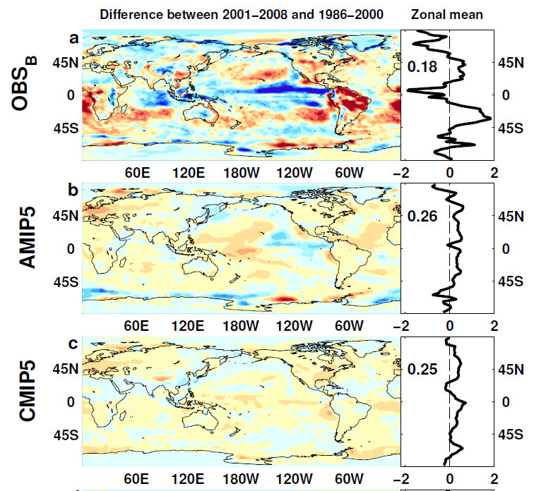

NET Radiation

Slide 23
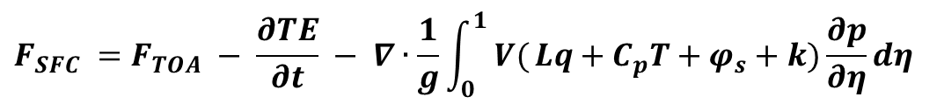
Estimates of Surface Flux
CERES/Argo Net Flux
Estimate horizontal energy flux
Surface Flux
$$F_{SFC} =F_{TOA} − \frac{∂TE}{∂t} − ∇∙\frac{1}{g}\int_{0}^{1}{ V(}Lq+C_{p}T+φ_{s}+k)\frac{∂p}{∂η}dη$$

Slide 24
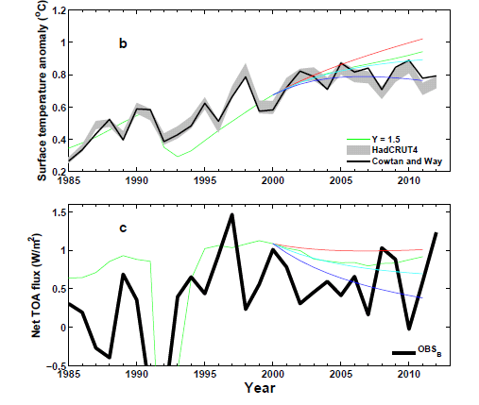
Analysis using simple energy balance model
+ve RF trend
0 RF trend
-ve RF trend
ΔT
N=ΔF–YΔT
Use AR5 RF
ΔT
D
N
ΔT_{d}

Slide 25
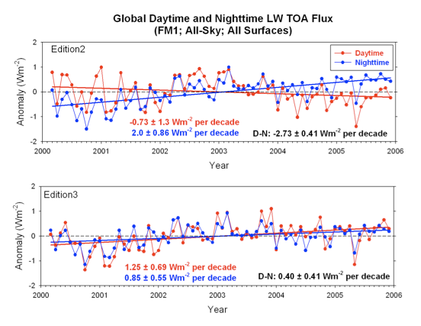
Updated CERES satellite data
Issues with sampling, radiance to flux conversion, calibration, etc
Correction for degradation of shortwave filter
Correction also improves physical consistency of trends in daytime longwave
We used version CERES_EBAF-TOA_Ed2.6r; currently v2.8

Slide 26
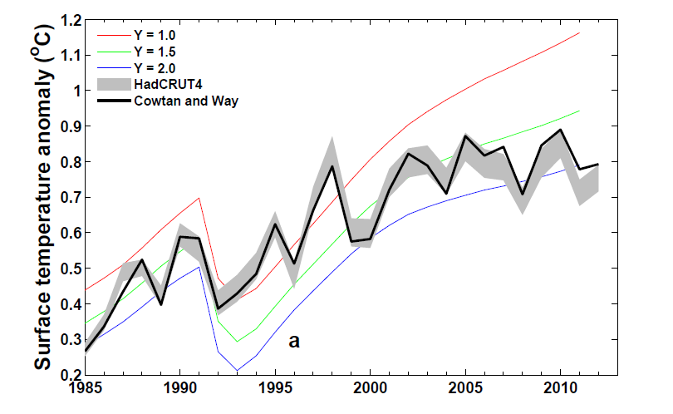
Is the temperature record wrong or are computer models inaccurate?
Can comparisons tell us about how sensitive climate is to radiative forcing? e.g. Otto et al. (2013) Nature Geosci
Spatial infilling of data gaps influences trends in surface temperature (Cowtan & Way, 2013 QJRMS) and ocean heat content (Lyman & Johnson 2014 J. Clim.)
Graph by Chunlei Liu

Slide 27
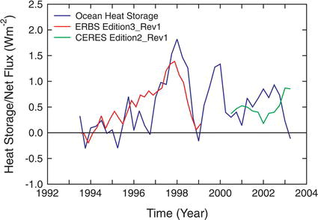
Wong et al. (2006) J Clim

Slide 28
Simple model for global precipitation
Using simple model: ΔP = kΔT – fΔF
Observations
Simulations:
Simulations:
RCP 8.5
Historical
RCP 4.5
Global mean Precipitation change (%)
From Thorpe & Andrews. Also Zahra Mousavi (PhD student)
Allan et al. (2013) Surv. Geophys
See also Andrews et al. (2010) ; Allen and Ingram (2002) Stephens and Ellis (2008)
Notes:
28
There is huge uncertainty in global precipitation projections, relating both to climate sensitivity and mitigation pathways.
In PAGODA we are understanding the precipitation changes at the largest scales relating both to the warming (in response to radiative forcings) and and also the direct effect of the radiative forcings themselves on precipitation.

