Slide 1


Influence of climate variability and
volcanic forcing on Earth's energy balance
Richard Allan
Andy Sayer meeting, July 19th 2017

Slide 2

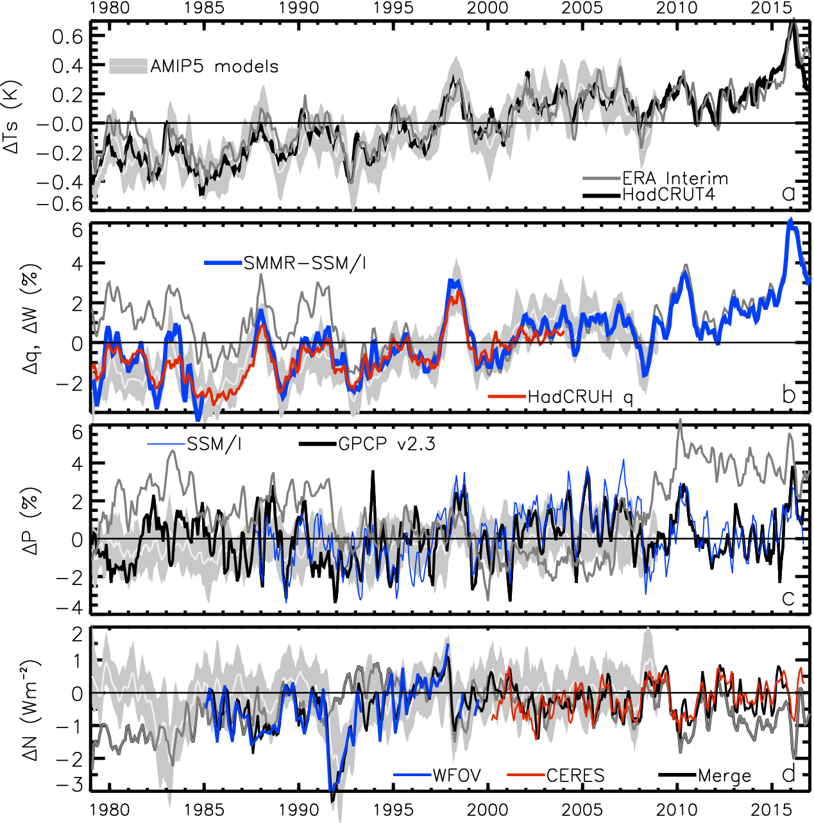
Variation in Earth’s global energy imbalance since the 1980s
TEMPERATURE anomaly (degC)
2.8
1.8
0.8
-0.2
-1.2
-2.2
ENERGY BUDGET anomaly (Wm⁻²)
Energy imbalance (Wm⁻²)
Allan et al. 2014 GRL

Slide 3
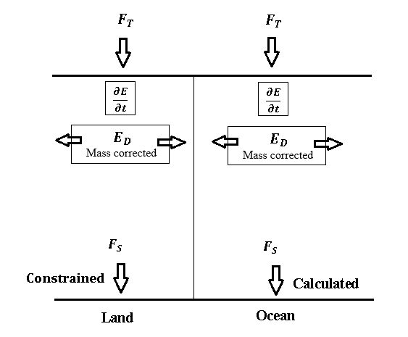
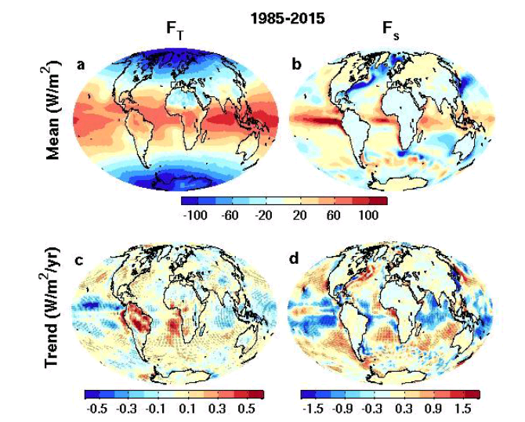

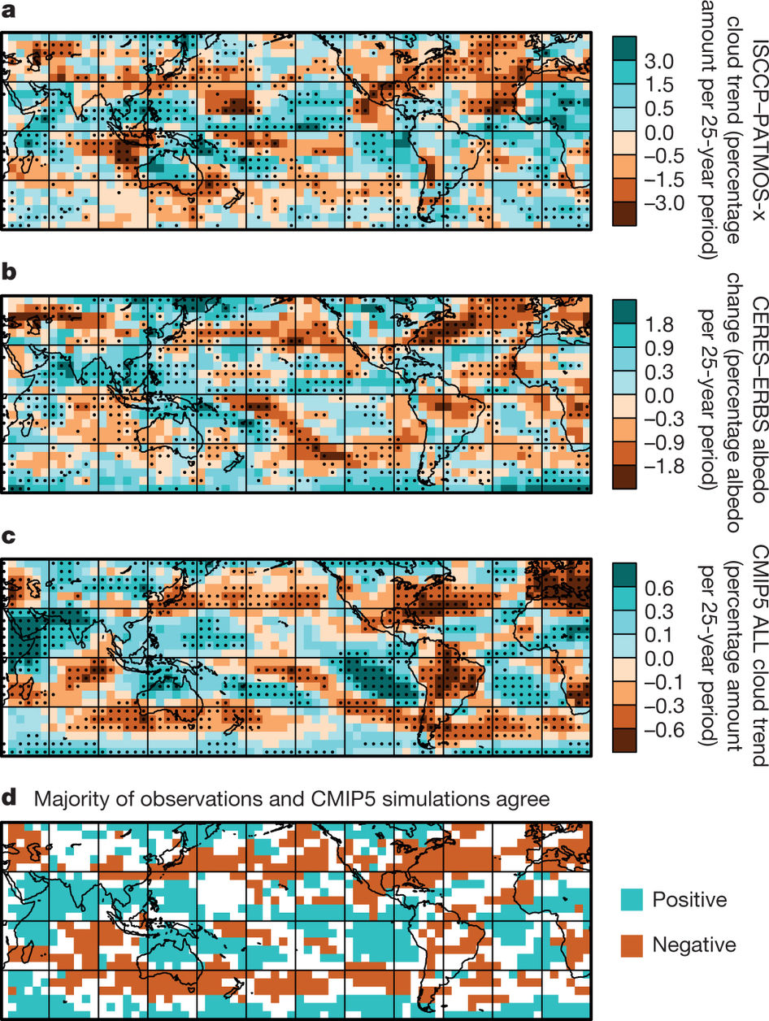
Surface/TOA energy fluxes & trends
ERBS CERES
reanalyses
top of atmosphere surface
Surface energy flux dataset combining TOA reconstruction with reanalysis energy transports: Liu et al. (2015) JGR
Liu et al. (2017) JGR Data: http://dx.doi.org/10.17864/1947.111
Norris et al (2016) Nature
Changes in cloudiness

Slide 4
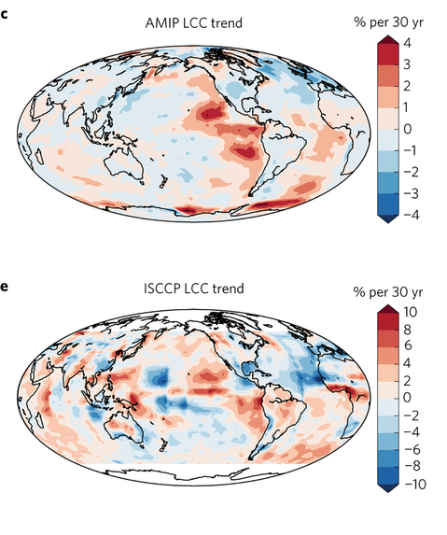
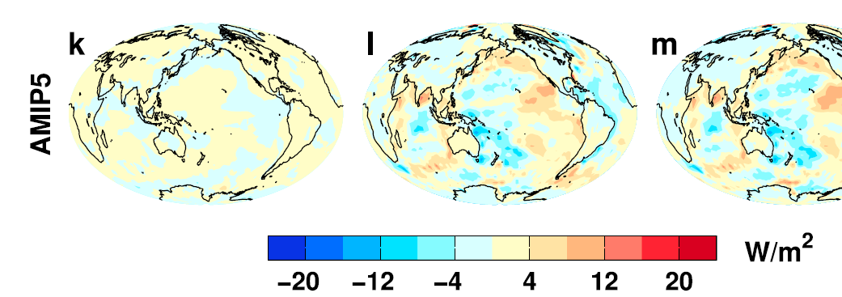
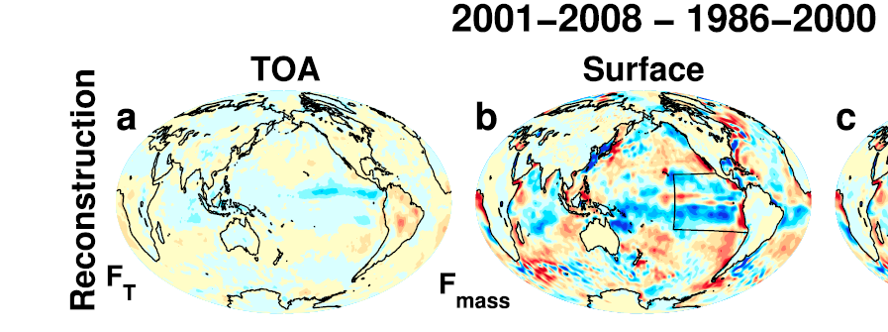
Do cloud feedbacks in E. Pacific amplify decadal internal variability?
Low Cloud Cover trend 1980s-2000s Surface energy flux change
Distinct feedbacks on internal variability & forced change e.g. Brown et al. 2016 J. Clim; Xie et al. 2015 Nature Geosci; England et al. (2014) Nature Clim
Spatial patterns of warming crucial for feedbacks & climate sensitivity e.g. He & Soden (2016) J. Clim; Richardson et al. (2016) Nature Clim Change; Gregory & Andrews (2016) GRL
OBSERVATIONS AMIP MODELS
Zhou et al. (2016) Nature Geosci
Liu et al. (2015) JGR
What explains decreased heating of E Pacific; is it realistic?
Notes:
Combining decadal observations of cloud, radiation and energy transports is leading to advances in understanding regional to global feedbacks
There is emerging evidence of contrasting energy budget responses/feedbacks acting on internal and forced variability
The spatial pattern of warming is crucial in determining global feedback responses; accounting for this may help in determining climate sensitivity from observations

Slide 5
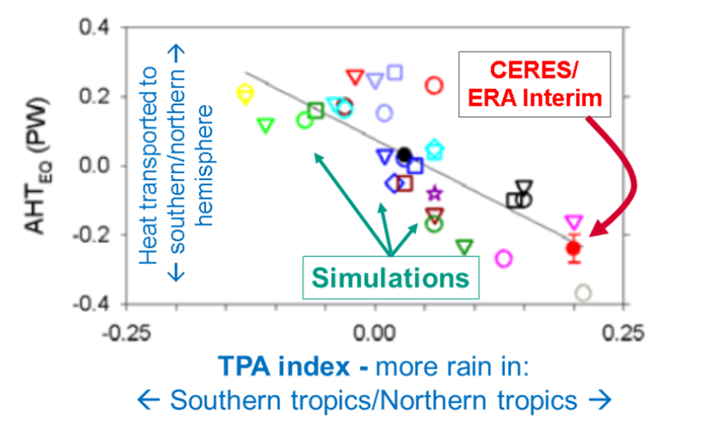
Cross-hemispheric energy transport & precipitation biases
Left: New observational estimates of inter-hemispheric energy budget (peta watts):
Liu et al. (2017) JGR
- see also Stephens et al. 2016 CCCR
Right: Model precipitation biases linked to cross-equatorial heat transport:
Loeb et al. (2016) Clim. Dyn
Notes:
Combining top of atmosphere energy buget and reanalysis horizontal energy transports allows new estimates of global surface energy budget
This has enabled advances in observing/understanding inter-hemispheric energy imbalance/transports and precipitation and links to model biases
Many CMIP5 models contain gross errors in cross equatorial energy fluxes which coincide with incorrect depiction of hemispheric precipitation asymmetries offering a potential constraint on climate models

Slide 6
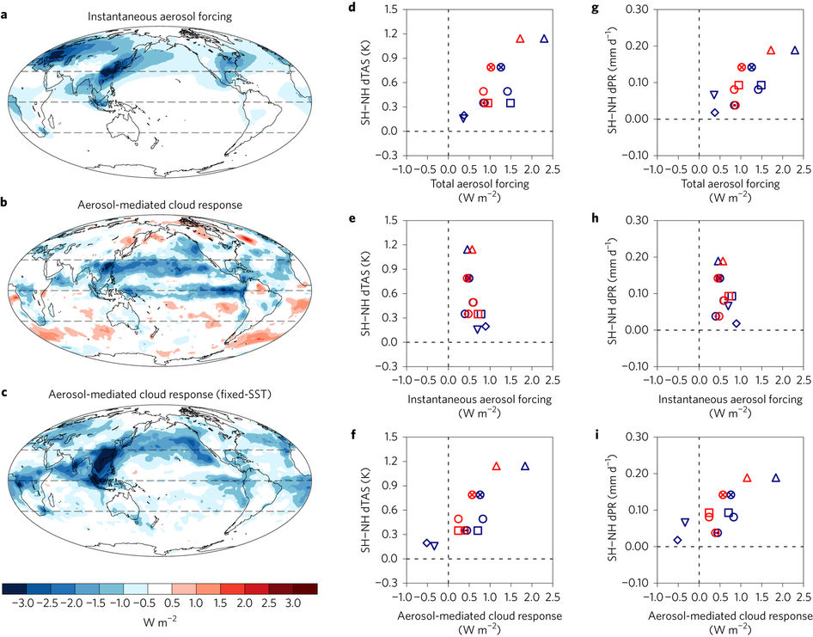

Aerosol-cloud forcing drives hemispheric climate response in simulations
Chung & Soden (2017) Nature Geosci
To test aspects of anthropogenic aerosol-cloud interactions we use comparable SO₂ emissions from massive fissure eruption of Holuhraun, Iceland.

Slide 7
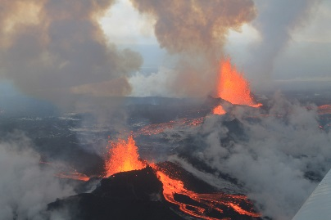
Diverse simulated cloud response to volcanic aerosol emissions
Malavelle et al. (2017) Nature

Slide 8
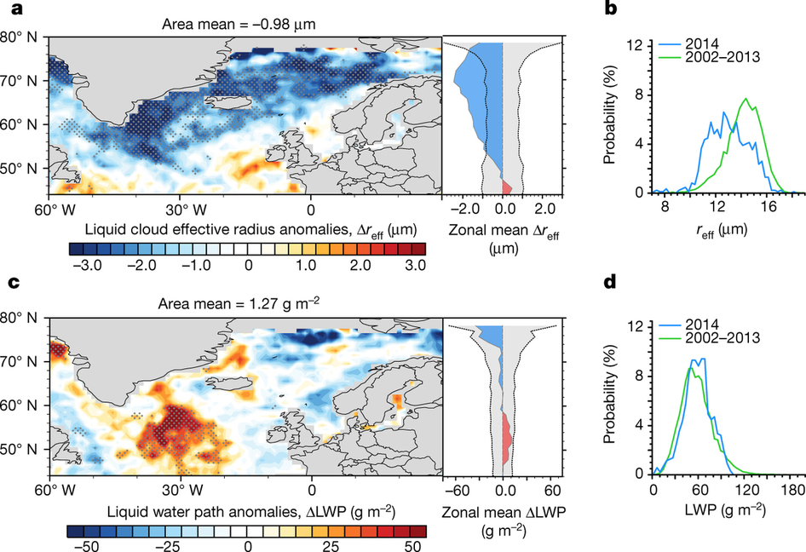
Volcanic aerosol haze causes noticeable expected decrease in cloud drop size
MODIS-Aqua Observations
Cloud water Droplet size
Malavelle et al. (2017) Nature
Further indirect effects of aerosol haze on cloud water undetectable

Slide 9
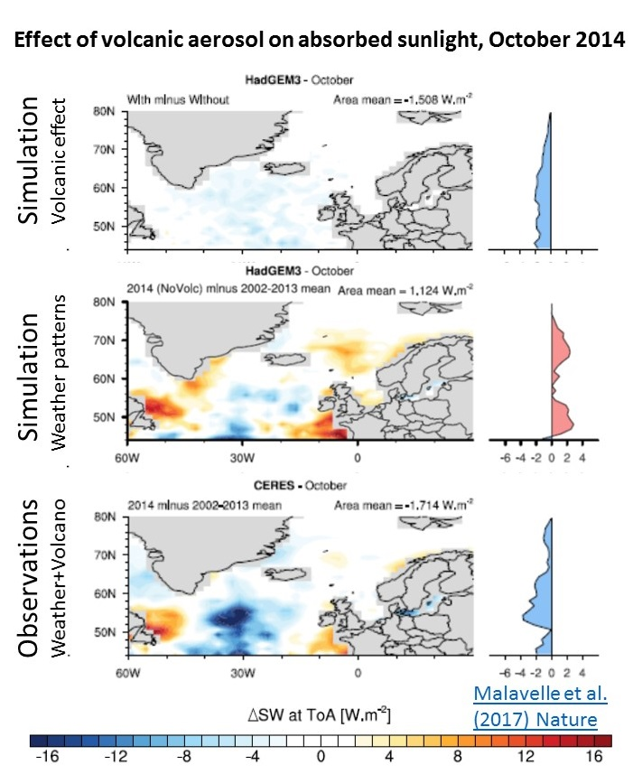
TOA irradiance
Influence of cloud/aerosol interaction on TOA shortwave undetectable above weather noise
Can swath level measurements show signal?
Malavelle et al. (2017) Nature

Slide 10
Conclusions
Extended Top of atmosphere radiation dataset (Allan et al. 2014 GRL)
  Earth’s energy imbalance relatively stable (~0.7 Wm⁻²), increased since 1980s?
New method for deriving surface energy flux (Liu et al. 2017 JGR)
  How do clouds and surface fluxes determine decadal climate variability?
  Link between hemispheric energy balance and climate
Observed constraint on aerosol-cloud interactions (Malavelle et al. 2017 Nature)
  Use volcano to mimic aerosol pollution haze
  Decrease in cloud droplet size detectable
  Further indirect effects on cloud and the radiation budget not distinguishable from weather noise

Slide 12
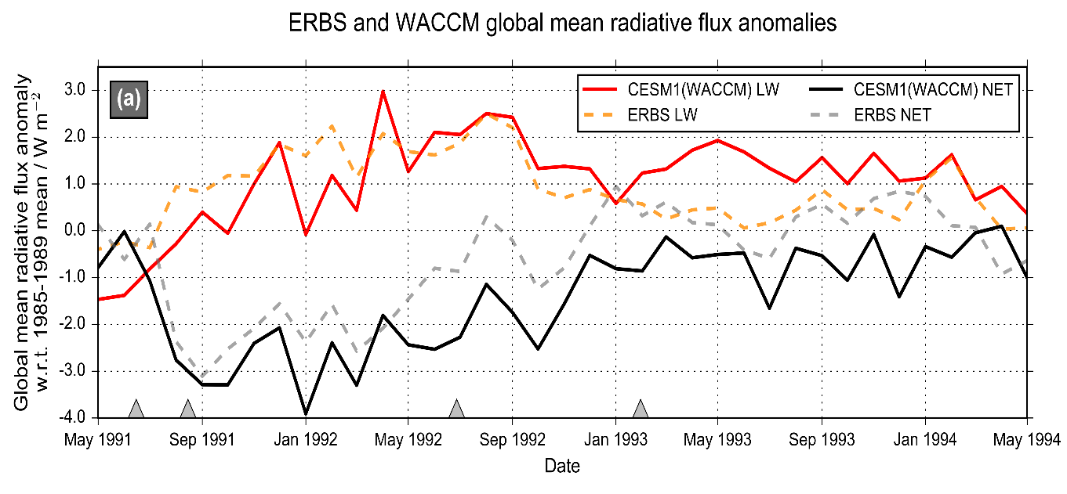
Advancing understanding of volcanic aerosol effects on climate
Malavelle et al. (2017) Nature
MODIS-Aqua Observations
Cloud water Droplet size
Volcanic aerosol haze brightens low altitude clouds, cooling climate
Further indirect effects in cloud water found to be negligible
Results will help to improve climate change projections
New assessment of direct volcanic influence on climate combining nudged models & observations
Schmidt et al. (2017) in prep

Slide 13
Summary
More accurate multi-decadal global estimates of Earth’s energy budget and its variability (e.g. Cheng et al. 2017 Sci. Adv.; Allan et al. 2014 GRL)
  Better indicator of global climate change than surface temperature but gaps in observing deep ocean (e.g. Palmer 2017 CCCR)
  Link to observed cloudiness? e.g. Norris et al (2016) Nature
Link between energy imbalance and surface warming depends on energy budget of upper mixed ocean layer (Roberts et al. 2015 JGR; Hedemann et al. 2017 Nature Climate Change; Xie & Kosaka 2017 CCCR)
  Better appreciation of mechanisms of decadal global climate variability
Distinct feedbacks on internal variability/forced change (Brown et al. 2016 J. Clim; Xie et al. 2015 Nature Geosci; Zhou et al. (2016) Nature Geosci
  Obs. estimates of climate sensitivity (Richardson et al. (2016) Nature Climate)
  Spatial patterns of warming crucial (Gregory and Andrews (2016) GRL)
  What explains decreased heating of E Pacific and is it realistic?
Advances in observing/understanding inter-hemispheric energy imbalance/transport and links to CMIP5 precipitation biases (Frierson et al. 2013; Loeb et al. 2016 Clim. Dyn; Stephens et al. 2016 CCCR)
  Possible constraint on realism of climate models (Haywood et al. (2016) GRL)

Slide 14
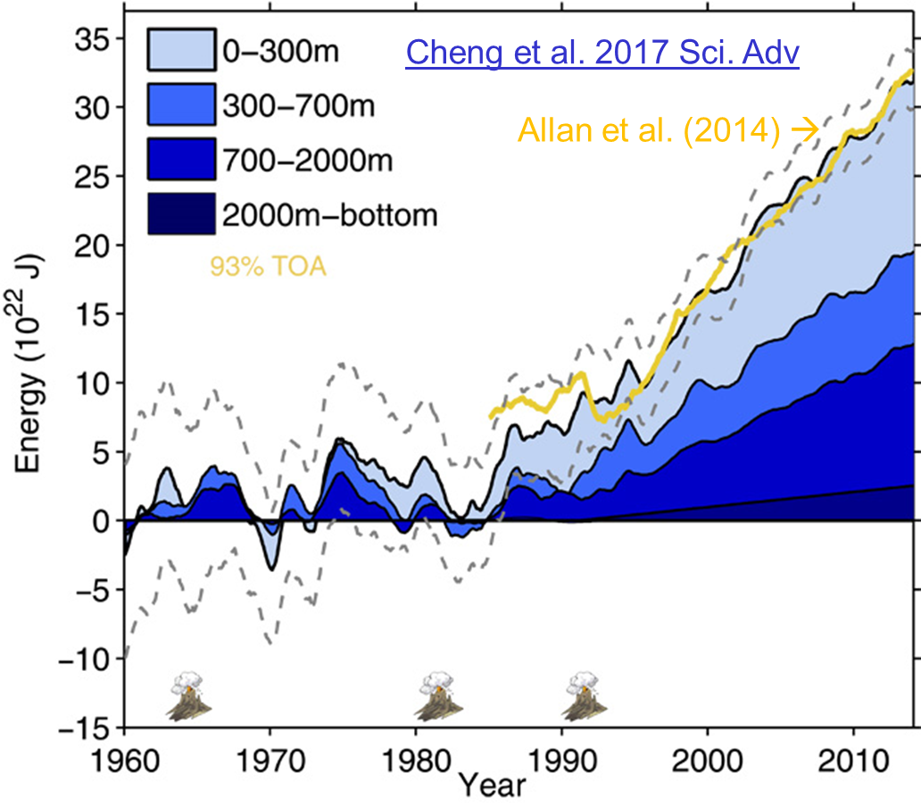
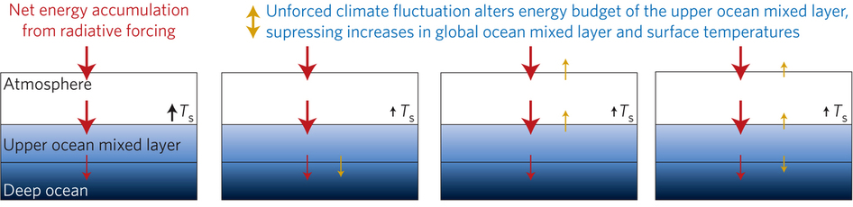
Improved global energy imbalance estimates
More accurate global imbalance from ocean and satellite observations: Cheng et al. 2017:
Steady decadal ocean heating since 2000: 0.6-0.8 Wm⁻² (Johnson et al. 2016)
Radiative forcing/internal variability influence TOA radiation (Palmer/ McNeall 2014; Allan et al. 2014; Huber/Knutti 2014; Xie/Kosaka 2017)
Upper ocean heat budget explains surface temperature: Hedemann et al. 2017 NatureCC
Allan (2017) Nature Climate Change
Notes:
Improved and longer records of ocean heating and top of atmosphere radiation measurements have improved estimates of Earth’s energy imbalance and its changes over recent decades.
Simulations with prescribed observed SST and radiative forcing are able to capture variations in energy budget
Greater appreciation for the role of internal variability in influencing global energy budget and the link between energy imbalance and surface temperature via heat budget of upper ocean

